Slide 1

Pavement Maintenance and Microsurfacing
Board of Aldermen Discussion Session
January 26, 2010

Slide 2
Pavement Maintenance Program
Asphalt Streets (entire subdivision)
  Year 0-Asphalt Surface Installed
  Year 7-Microsurfacing
  Year 14-Microsurfacing
  Year 20-Mill and Asphalt Overlay
  Cracksealing every 2 years (east/west)

Slide 3
Pavement Maintenance Program
Concrete Streets and Alleys
  Surface treatment on Carondelet Plaza in 2012
  Replacement of Alleys every 25-30 years
  Cracksealing every 2 years (east/west)

Slide 4
Annual Pavement Evaluation
Performed in January each year
Each street/alley evaluated
Alley replacement prioritized based upon condition and budget
Streets follow predictable decline and improvement due to our program

Slide 5
Pavement Condition Index
5: “Like New” condition
4: Minor reflective cracks
3: More extensive cracking, microsurfacing starting to deteriorate
2: Significant cracking. Significant deterioration of microsurfacing, leaving up to 50% exposed asphalt. Asphalt may be raveling.
1: Significant cracking, potholes forming. Nearly all microsurfacing gone. In dire need of rehabilitation.

Slide 6
Pavement Condition Index
Scorecard goal: 85% of streets (by area) score 3 or better
  2007: 83%
  2008: 90%
  2009: 72%
  2010: 88% PROJECTED

Slide 7
Deterioration of Pavement

Slide 8
Reactive Pavement Strategy
Reconstruct

Slide 9
Reactive Pavement Strategy
Reconstruct

Slide 10
Proactive Maintenance Strategy
Years 0-7
Microsurface

Slide 11
Proactive Maintenance Strategy
Years 7-14
Microsurface
Microsurface

Slide 12
Proactive Maintenance Strategy
Years 14-20
Microsurface
Microsurface
Mill & Overlay

Slide 13
Proactive Maintenance Strategy
Years 20+
Microsurface
Microsurface
Mill & Overlay

Slide 14
Proactive vs. Reactive

Slide 15
Benefits of a Proactive Program
Pavement maintained at higher level
Significant cost savings
Entire subdivisions treated at same time
Establishment of sequence
More predictable budget
Environmentally friendly

Slide 16
Microsurfacing
Thin layer, approximately ¼” thick
  Residential: 1 coat
  Arterial: 2 coats
Asphalt emulsion
Water
Aggregate (granite and/or slag)
Portland Cement
Polymer Binder

Slide 17
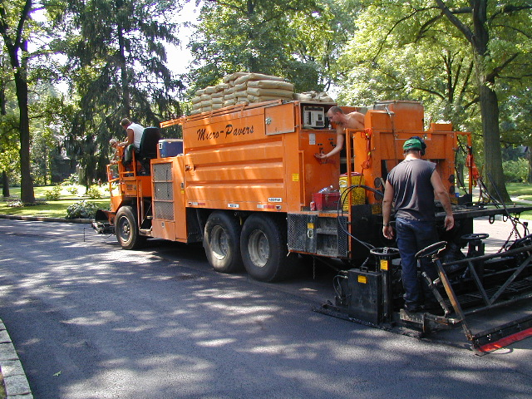
Microsurfacing

Slide 18
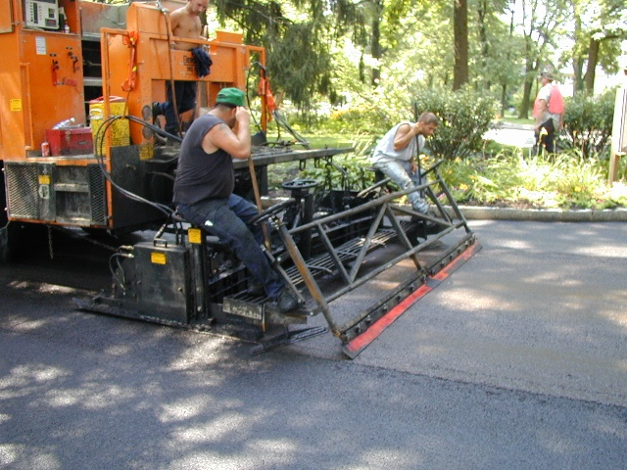
Microsurfacing

Slide 19
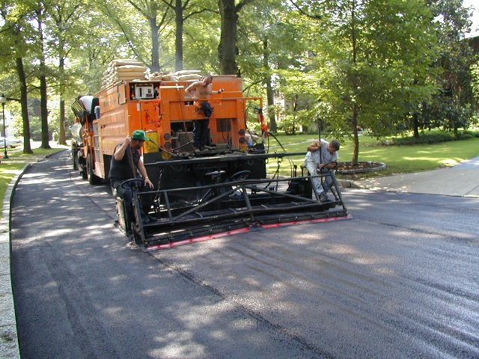
Microsurfacing

Slide 20
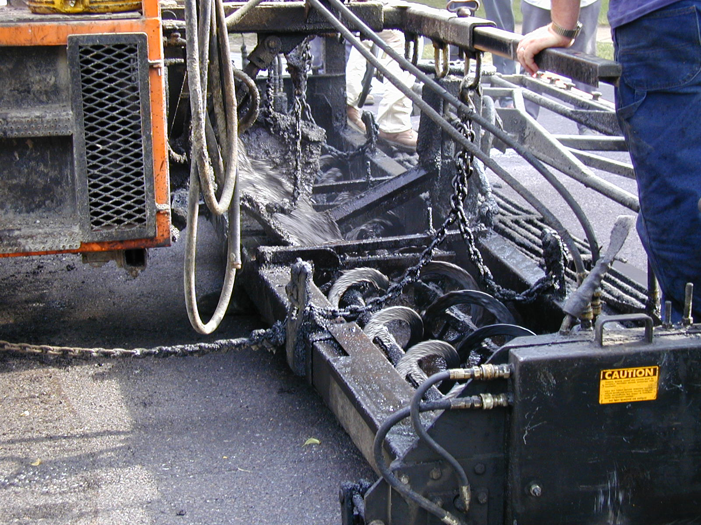
Microsurfacing

Slide 21
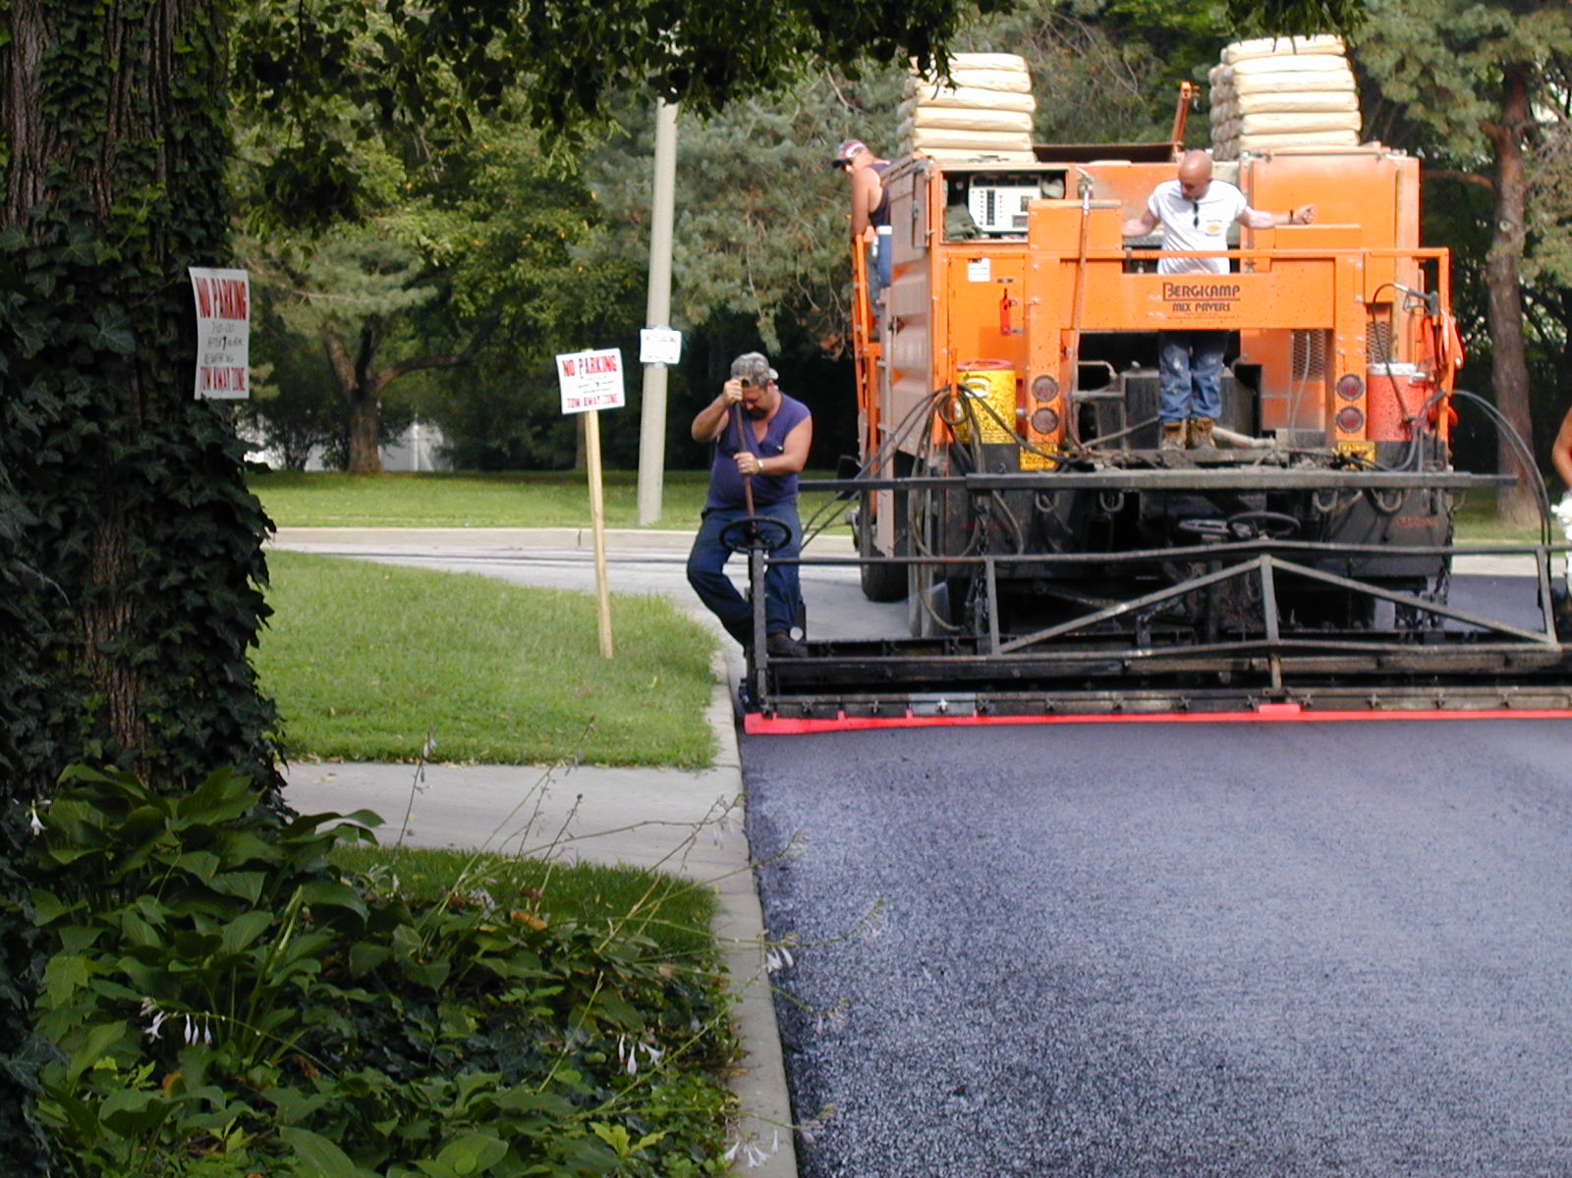
Microsurfacing

Slide 22
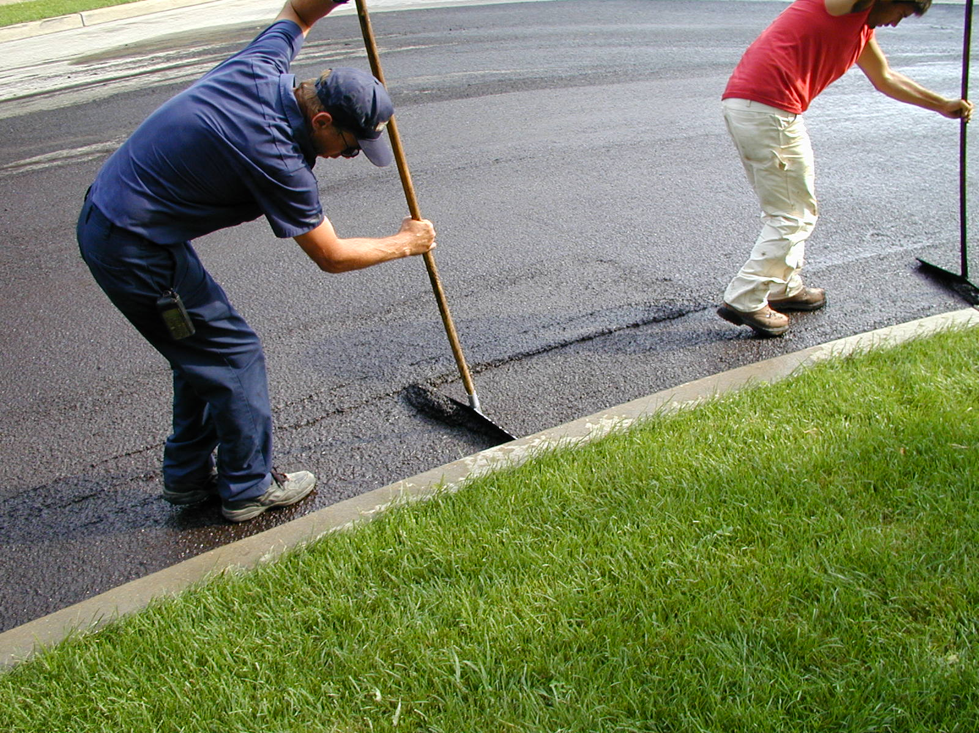
Microsurfacing

Slide 23
2010 Microsurfacing Project
Residential
  1 coat (medium-duty treatment)
  Clayshire, Country Club Estates, Hillcrest
  Wednesdays, Thursdays, and Fridays
Central Business District
  2 coats (heavy-duty treatment)
  Saturdays and Sundays

Slide 24
Project Schedule-June 2010
SUNDAY | MONDAY | TUESDAY | WEDNESDAY | THURSDAY | FRIDAY | SATURDAY
 |  | 1 | 2 | 3 | 4 | 5
6 | 7 | 8 | 9 | 10 | 11 | 12
13 | 14 | 15 | 16 | 17 | 18 | 19
20 | 21 | 22 | 23 | 24 | 25 | 26
27 | 28 | 29 | 30
RESIDENTIAL
CBD
CBD
Notes:
24

Slide 25
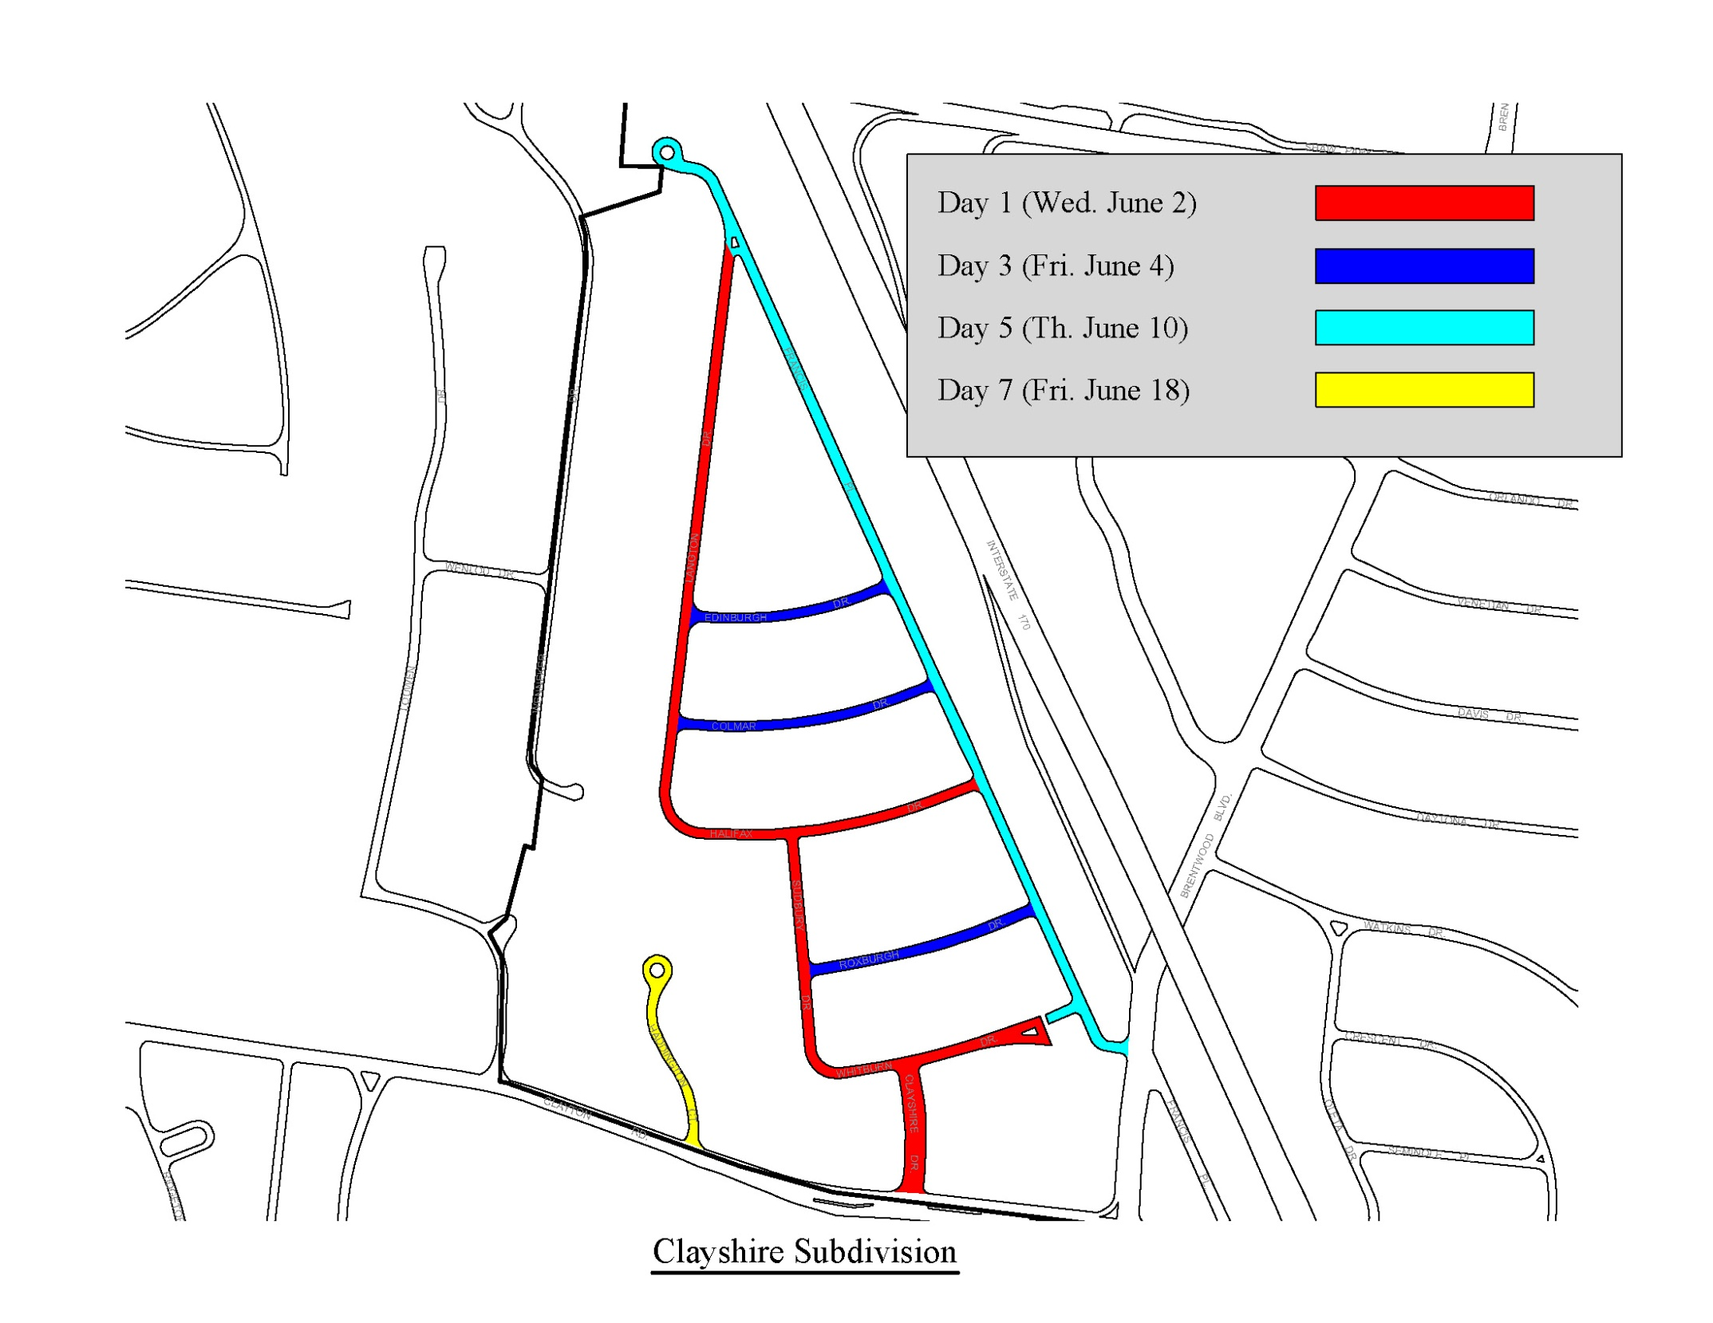

Slide 26
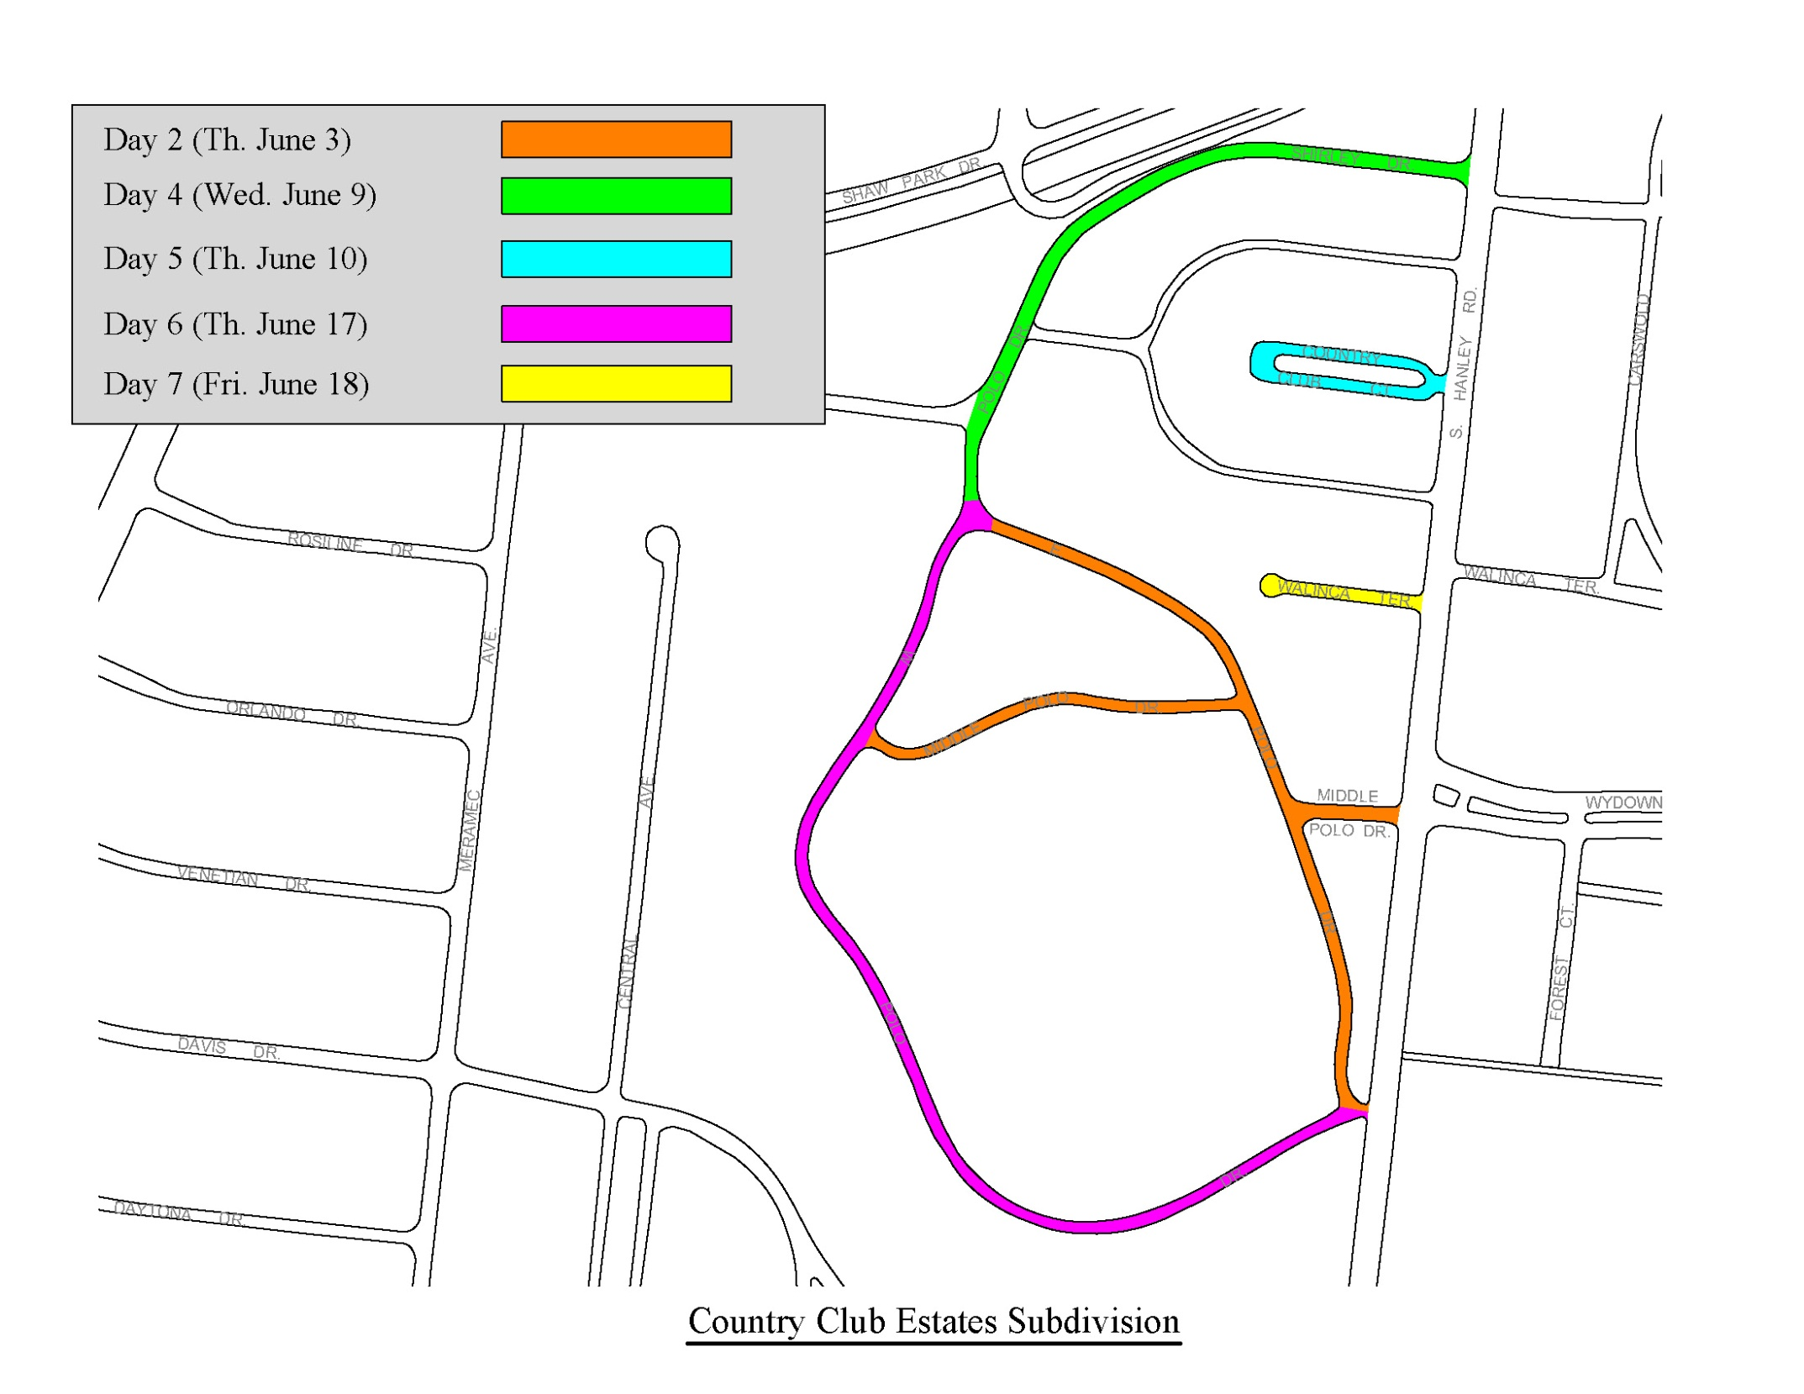

Slide 27
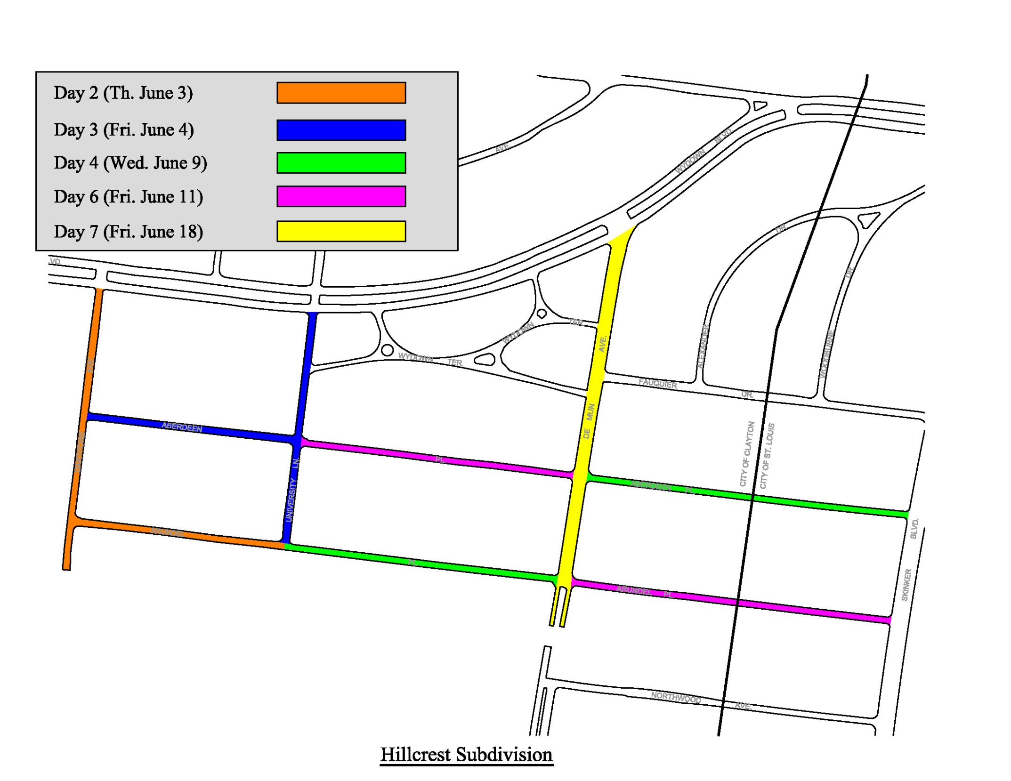

Slide 28
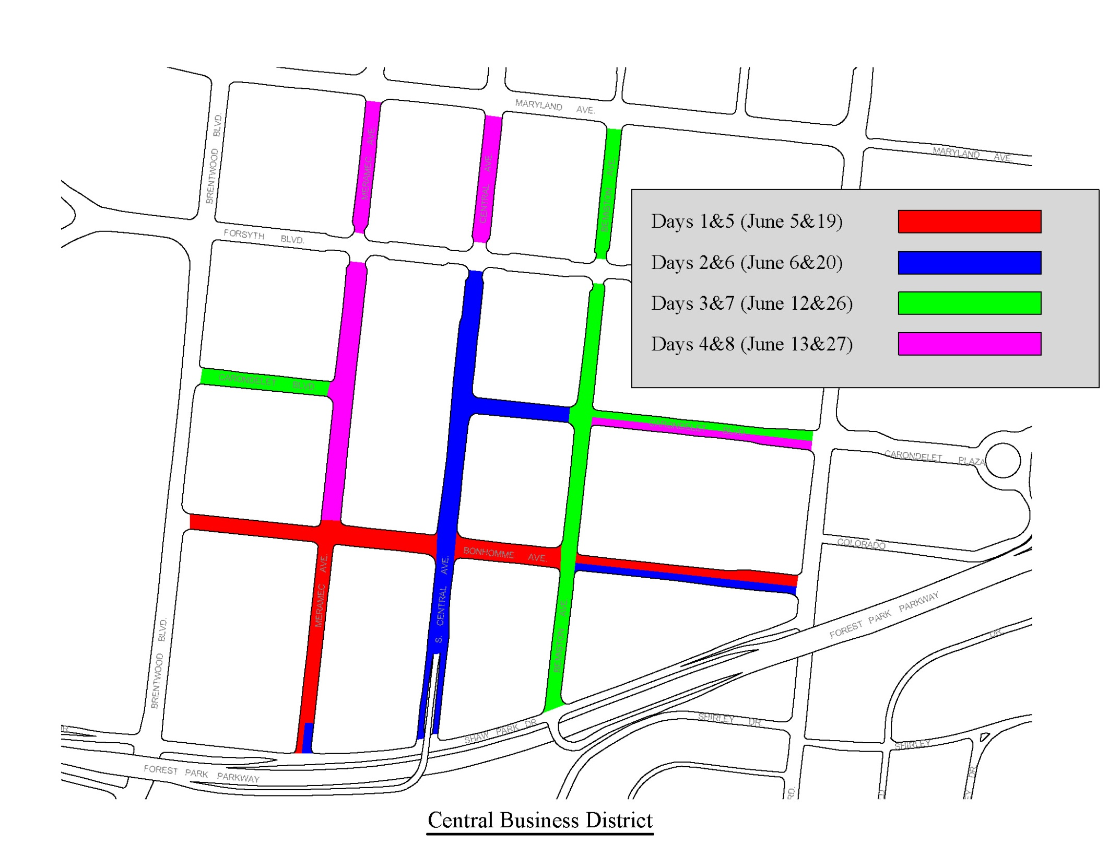
2010 Microsurfacing Project

Slide 29
Project Communications
Chamber of Commerce
Mailings
City Website
CityViews
Electronic Message Panels
Metro (bus re-routing at Transit Center)
No Parking Signage
Construction Signage

Slide 30
Questions
Steve Meyer
Civil Engineer
290-8547
smeyer@ci.clayton.mo.us

