Slide 1
Empowering Local Actors: Leveraging Data for Equitable Housing & Workforce Equity
Temilola Afolabi,
Program Manager - Data for Equity
Center for Open Data Enterprise (CODE)

Slide 2
Overview
Open Data for Equity Program
Background of historical housing & workforce policies driving unequal outcomes
Overview of Esri StoryMaps tool
Present day issues driving inequity
Data-driven opportunities & data sources
Case studies & models

Slide 3
The Opportunity
Fair Housing
Wealth creation & intergenerational income mobility
Labor market success
Access to credit
Workforce Opportunity
Equitable and inclusive workforce system
Access to quality education and better jobs
Economic opportunities

Slide 4
CODE Open Data for Equity Program
Aim:
  Evaluate the landscape of racial equity data
  Improve data access & usability for local actors
  Provide guidance on data use to improve equitable outcomes
Aligned with presidential priorities
Priority Areas: Workforce Opportunity, Fair Housing, Criminal Justice/Policing, Healthcare, & Environmental Justice

Slide 5
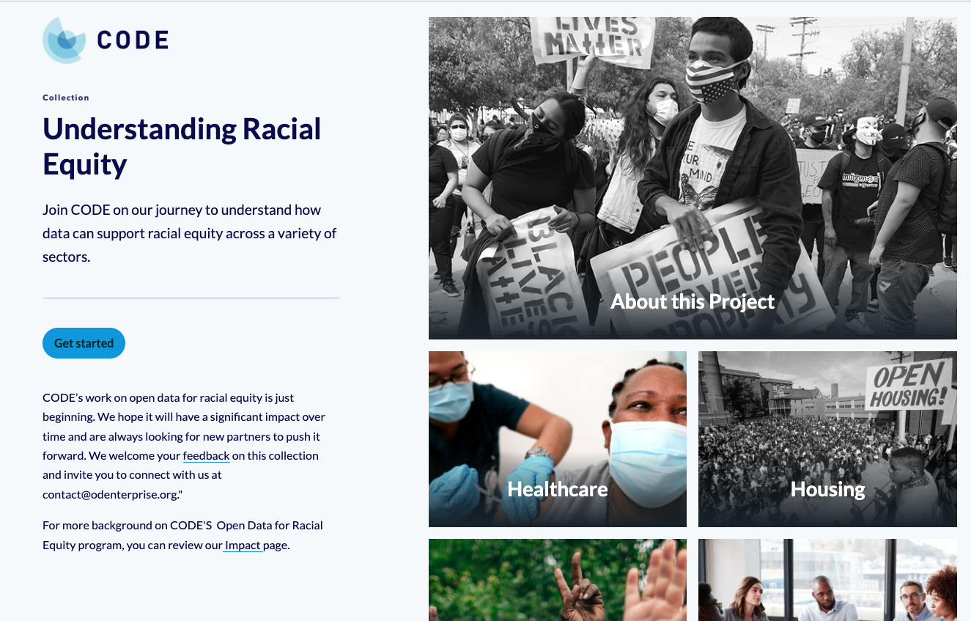

From Data to Communities: Mapping Racial Equity
Explores and visualizes how open data can be applied to improve equity in the 5 priority areas
The website provides: data sources, interactive maps, dashboards, use cases, & case studies for local & Federal actors
Developed using Esri StoryMaps
Scan to access StoryMaps

Slide 6
Understanding Inequality in Fair Housing and Workforce

Slide 7
Background — Segregationist housing policies
Guaranteed mortgages to White American but not their Black counterparts ¹
Segregated public housing ²
Selective FHA financing of mass production builders who refused to sell homes to Black residents ³
Redlining by HOLC ⁴
Steering — the use of words or actions to influence prospective consumers
Walker, R. A. (2019, May 24). Was the New Deal racist? Living New Deal.
Gross, T. (2017, May 3). A 'Forgotten history' of how the U.S. government segregated America. NPR.
Gotham, K. F. (2000). Racialization and the state: The housing Act of 1934 and the creation of the federal housing administration. Sociological Perspectives, 43(2), 291-317.
Aaronson, D., Faber, J., Hartley, D., Mazumder, B., & Sharkey, P. (2021). The long-run effects of the 1930s HOLC “Redlining” maps on place-based measures of economic opportunity and socioeconomic success. Regional Science and Urban Economics, 86.

Slide 8
Background — Historical discriminatory workforce policies
Exclusionary labor practices
1913 - President Wilson authorizes racial discrimination in Federal departments ²
1920s - American Federation of Labor upholds racial & ethnic discrimination in unions ¹
1936 - Southern states bar participation of predominantly Black agricultural & domestic workers from social security act ³
Segregated educational and training programs
¹Lehr, D. (2021, May 4). The racist legacy of Woodrow Wilson. The Atlantic.
²Moreno, P. (2010). Unions and Discrimination. Cato Journal, 30(1), 72-74.
³DeWitt, L. (2010). The decision to exclude agricultural and domestic workers from the 1935 Social Security Act, 70(4). Social Security Administration Office of Retirement and Disability Policy.

Slide 9
Present Day Impacts on Fair Housing
Creation of American “ghettos” due to redlining and New Deal policies
Mortgage lending discrimination against BIPOC & inability to qualify for loans
Black homeownership the lowest among all races in U.S. & lack of affordability by BIPOC
Negative effects on wellbeing and environmental health
Poorer socioeconomic outcomes for people of color in U.S.

Slide 10
Federal Housing Mandates
Equal Credit Opportunity Act — Department of Justice
  Prohibits discrimination on the basis of race, color, religion, national origin, sex, marital status, age, receipt of public assistance
Community Reinvestment Act — Federal Reserve Board, the Federal Deposit Insurance Corporation, & the Office of the Comptroller of the Currency
  Requires federal banking regulators to encourage financial institutions to help meet the credit needs of the communities in which they do business,
Fair Housing Act — Department of Housing and Urban Development
  Prohibits discrimination for those renting or buying a home, getting a mortgage, seeking housing assistance, or engaging in other housing-related activities

Slide 11
Data-Driven Opportunities for Housing Equity

Slide 12
Opportunity: Combat discriminatory housing practices
Segregation indices using local & demographic data
Averaging hyperlocal demographics to reveal segregation at larger geographic levels
Dissimilarity and Isolation indices — tool to measure demographics & analyze segregation across geographic areas
Audience: Local housing authorities, state and local government

Slide 13
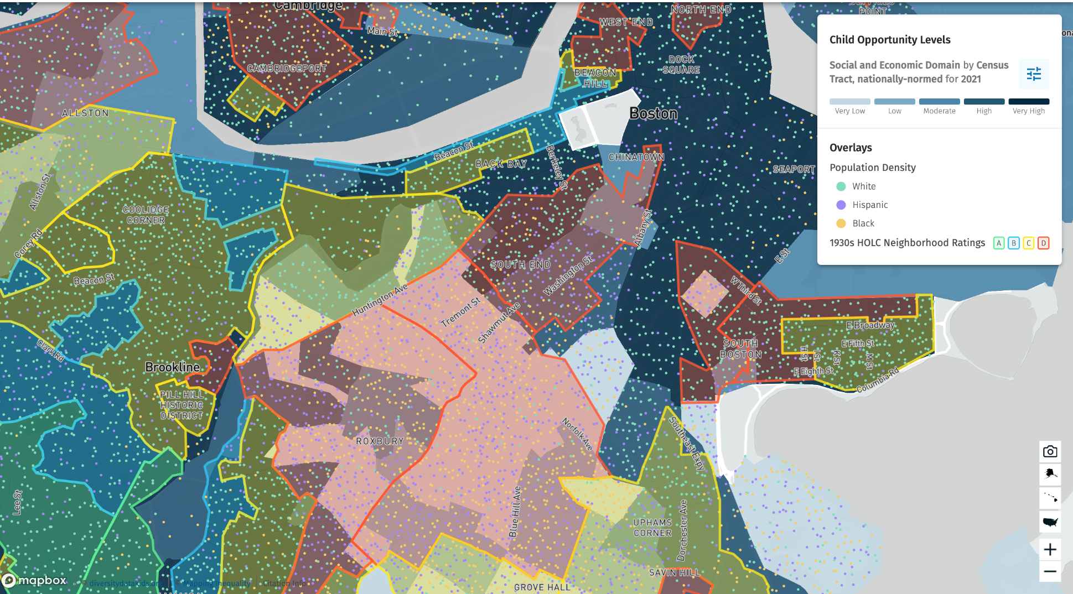
Data sources & resources
Sample Data Sources
National Equity Atlas —provides a diversity index for the nation, states, regions, & cities
PolicyMap —provides demographic data at neighborhood and ZIP level
DiversityData.org—provides dissimilarity, isolation, and exposure indices for full population & child population by metro area
DiversityData.org — Child Opportunity Index

Slide 14
Opportunity: Systemically combat mortgage lending discrimination
Use Fair Housing Act guidance on key data types to understand an area's fair housing
Engage communities in identifying barriers & developing targeted solutions for fair housing
State and local agencies should use HUD guidance to adhere to AFFH obligation & receive funds
Leverage HUD data to identify patterns, causes, & impacts of housing discrimination
Use HMDA data on homeownership & lending disparities by demographics to reveal patterns of discrimination
Audience: State and local government agencies, local housing authorities

Slide 15
Data sources & resources
Sample Data Sources
Home Mortgage Disclosure Act — data on disposition of home purchase & refinanced mortgage applications, by race, gender, & income; county and state level
American Community Survey — data on mortgages by race, at state county, and place level
State/Local Tax Assessors (i.e., Maryland State Department of Assessments & Taxation)—provides data on housing prices.

Slide 16
Case Study: EquiLoans, Seattle WA
In 2020, Seattle developed "EquiLoans," a program targeting mortgage lending discrimination using data-driven strategies. The initiative analyzed loan application outcomes, loan denial rates, & interest rate differentials across demographic groups to identify disparities. Leveraging partnerships with local financial institutions and housing advocates, EquiLoans implemented targeted interventions including fair lending training, community outreach, and a dedicated fair housing hotline. These efforts resulted in tangible reductions in discriminatory practices and increased mortgage approvals for marginalized groups.

Slide 17
Opportunity: Improve Home ownership & affordability
Assess state of fair housing & opportunity to develop targeted interventions
Analyze housing costs alongside household income levels
Develop and use indicators to measure housing affordability
Disaggregate cost burden data across demographic groups to assess fair housing & opportunity
Audience: Policymakers, state & local governments
Notes:
Talk about ability to improve socioeconomic outcomes as well

Slide 18
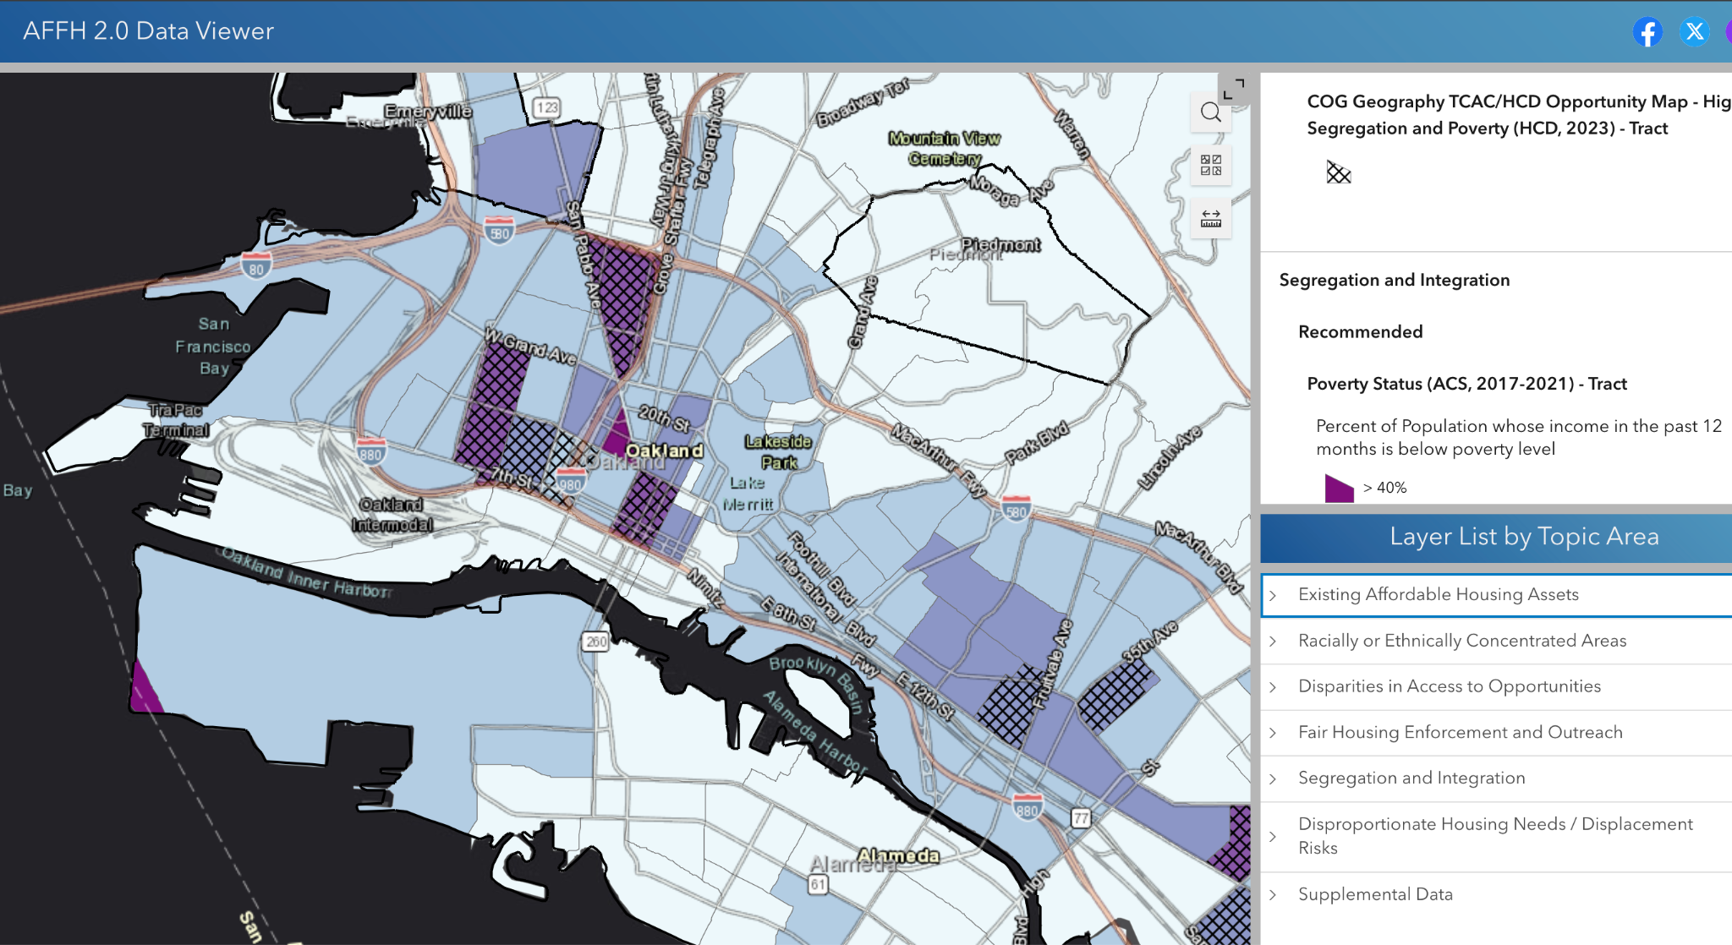
Data sources & resources
American Community Survey
The Comprehensive Housing Affordability Strategy
HUD Affirmatively Furthering Fair Housing — data on housing affordability at the census-tract level by race/ethnicity & national origin.
Urban Institute Guidebook — guidance on measuring housing affordability using granular housing cost & market trend indicators
  “Using Data to Assess Fair Housing and Improve Access to Opportunity”
HUD Affirmatively Furthering Fair Housing Tool 2.0

Slide 19
Case Study: New Haven, CN “I’M HOME” initiative
By examining mortgage lending patterns, housing affordability metrics, & demographic trends, the City of New Haven identified critical areas for intervention. Through collaboration w/ community stakeholders, policymakers crafted targeted solutions such as rental assistance and zero-interest forgivable loans to increase access to affordable housing & promote homeownership among marginalized communities.

Slide 20
Opportunity: Improve housing for well-being & environmental health
Analyze public health surveillance data alongside community design decisions to improve public health Improve community design decision using Health Impact Assessments
Educate local decision makers on the health/wellness implications associated w/ community design
Conduct research to identify the links between a localities health outcomes and community design structure
Audience: State & local public health agencies, community planners, state academic institutions, policymakers

Slide 21
Data sources & resources
Interdepartmental Health Equity Collaborative, HHS Office of Minority Health, CDC
  Healthy People 2030 Health Disparities Data - nationally representative data at granular geographic levels
  Minority Health Social Vulnerability Index — identify communities that may need support before, during, & after disasters; focus on minority racial, ethnic, language groups, & medical vulnerability
PLACES: Local Data for Better Health — provides small area estimates for chronic disease risk factors, health outcomes, health status, & clinical preventive service use
  Counties, places, census tracts, & ZIP Code Tabulation Areas across the U.S.

Slide 22
Use Case: CDC Health Impact Assessment (HIA) - Oregon
In 2022, the CDC funded a HIA in Oregon for a proposed affordable housing project. The assessment focused on the project's potential health effects, such as stable housing, access to healthcare, & neighborhood safety.
Through community engagement & analysis, the HIA found that the housing initiative could reduce homelessness & improve well-being by providing stable homes and proximity to healthcare. This information guided policymakers to prioritize health equity, leading to the successful implementation of the project with a focus on residents' health and quality of life.

Slide 23
Additional data sources & resources
Vulnerable Populations Footprint Tool— creates maps and reports that identify geographic areas w/ high poverty rates & low education levels.
U.S. Census Social Vulnerability Index —uses 15 U.S. census variables to help local officials identify communities that may need support before, during, or after disasters.
National Environmental Public Health Tracking Network — Maps, tables, & charts with data about environmental indicators.

Slide 24
Data-Driven Opportunities for Workforce Equity

Slide 25
Present Day Impacts on Workforce Opportunity
Unconscious bias in recruitment process and discriminative job requirements
Access to education and training to qualify for good jobs
Ineffective communication of employee skills and learning records
Equitable data within federal sources

Slide 26
Opportunity: Reduce bias in recruitment process & job requirements
Employ emerging technologies to identify unconscious bias in job requirements (e.g., machine learning algorithms)
Leverage diverse open source recruitment platforms (e.g., Jopwell)
Partner w/ leaders of minority communities and minority serving institutions to improve hiring practices

Slide 27
Data sources & resources
Exploring Equal Employment Opportunity Data Map, Department of Labor— Earnings by Sex and Race
Jopwell — job recruitment platform w/ talent pool of racially and ethnically diverse candidates.
Black Wealth Data Center — provide and make relevant data available to experts and policymakers address racial wealth disparities.

Slide 28
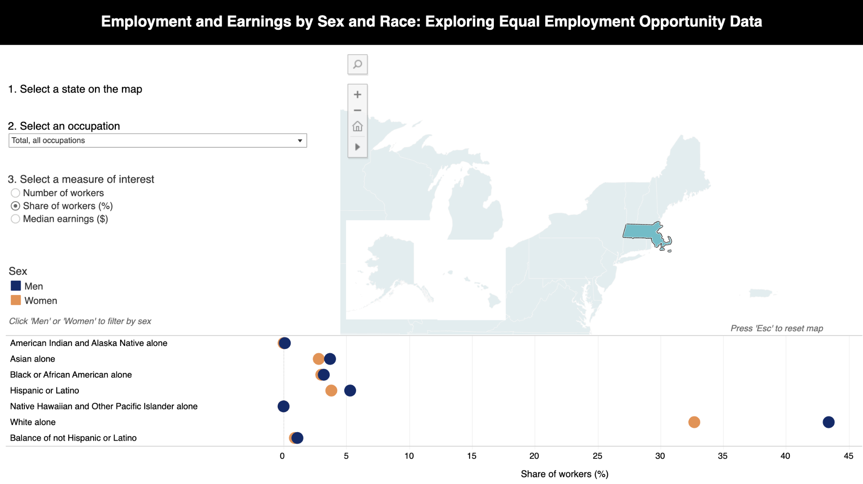
Equal Employment Opportunity Data Map, U.S. DoL, Women’s Bureau

Slide 29
Opportunity: Improve access to education & quality job training
Coordinate b/w high school & state college systems to align coursework w/ admissions requirements
Provide advanced courses in under-resourced schools in low-income neighborhoods
Develop statewide transition intervention programs
Invest substantially into skills and workforce training
Improve reporting of student-level information to state higher education agencies
Invest in data collection on public workforce training programs
Audience: Government, businesses, educators, & trainers

Slide 30
Data sources & resources
Data on post-secondary programs
Program completion & graduation data
Evidence of the competencies mastered
Credential earned
Student demographics
Credential attainment data
Technical education data from community colleges
Apprenticeships & work-based learning on job sites
Job training at community organizations
Resources: U.S. Chamber of Commerce Foundation T3 Innovation Network. Promotes open access to structured data on skills, jobs, job openings, and related industry data.
Future of Data in K-12 Education initiative: three-phase, multiyear effort exploring the effectiveness of data and assessments in America’s K-12 public schools.

Slide 31
Case Study: Quality Postsecondary Credentials of Value, Louisiana (LA)
The LA Board of Regents adopted a standard definition for quality non-degree credentials in 2020 to support its Master Plan for Higher Education. Proprietary & licensed institutions—institutions that are licensed by the Board of Regents and adhere to rules & regulations of state Proprietary School Advisory Commissions—must ensure their programs lead to successful equitable outcomes like better wages and attainment of good quality jobs. The requirements for a credential to be considered are:
Provision of valid, reliable & transparent evidence of competencies mastered, & conferment by a business, industry, and/or State of LA entity
Alignment to in-demand occupations as defined by the LA Workforce Commission based on job demand, projected job growth & earnings
Attainment of an occupation with a 20% wage premium over a high school diploma in LA
Provision of evidence for employment & wage outcomes
Above criteria attainment as a standalone credential, independent of other credentials

Slide 32
Opportunity: Improve communication of employee skills
Invest in the development of structured skill and competency data
Employ learning algorithms to better match applicants’ skills to employers’ needs
Invest in the development and use of Learning and Employment Records (LERs)
Audience: Federal & local government, job-seekers, employers

Slide 33
Data sources & resources
The Occupational Information Network (O*NET) — nation’s primary source of occupational information — U.S. Department of Labor
Learning and Employment Records — digital records of an individual’s skills, credentials, diplomas, and employment history

Slide 34
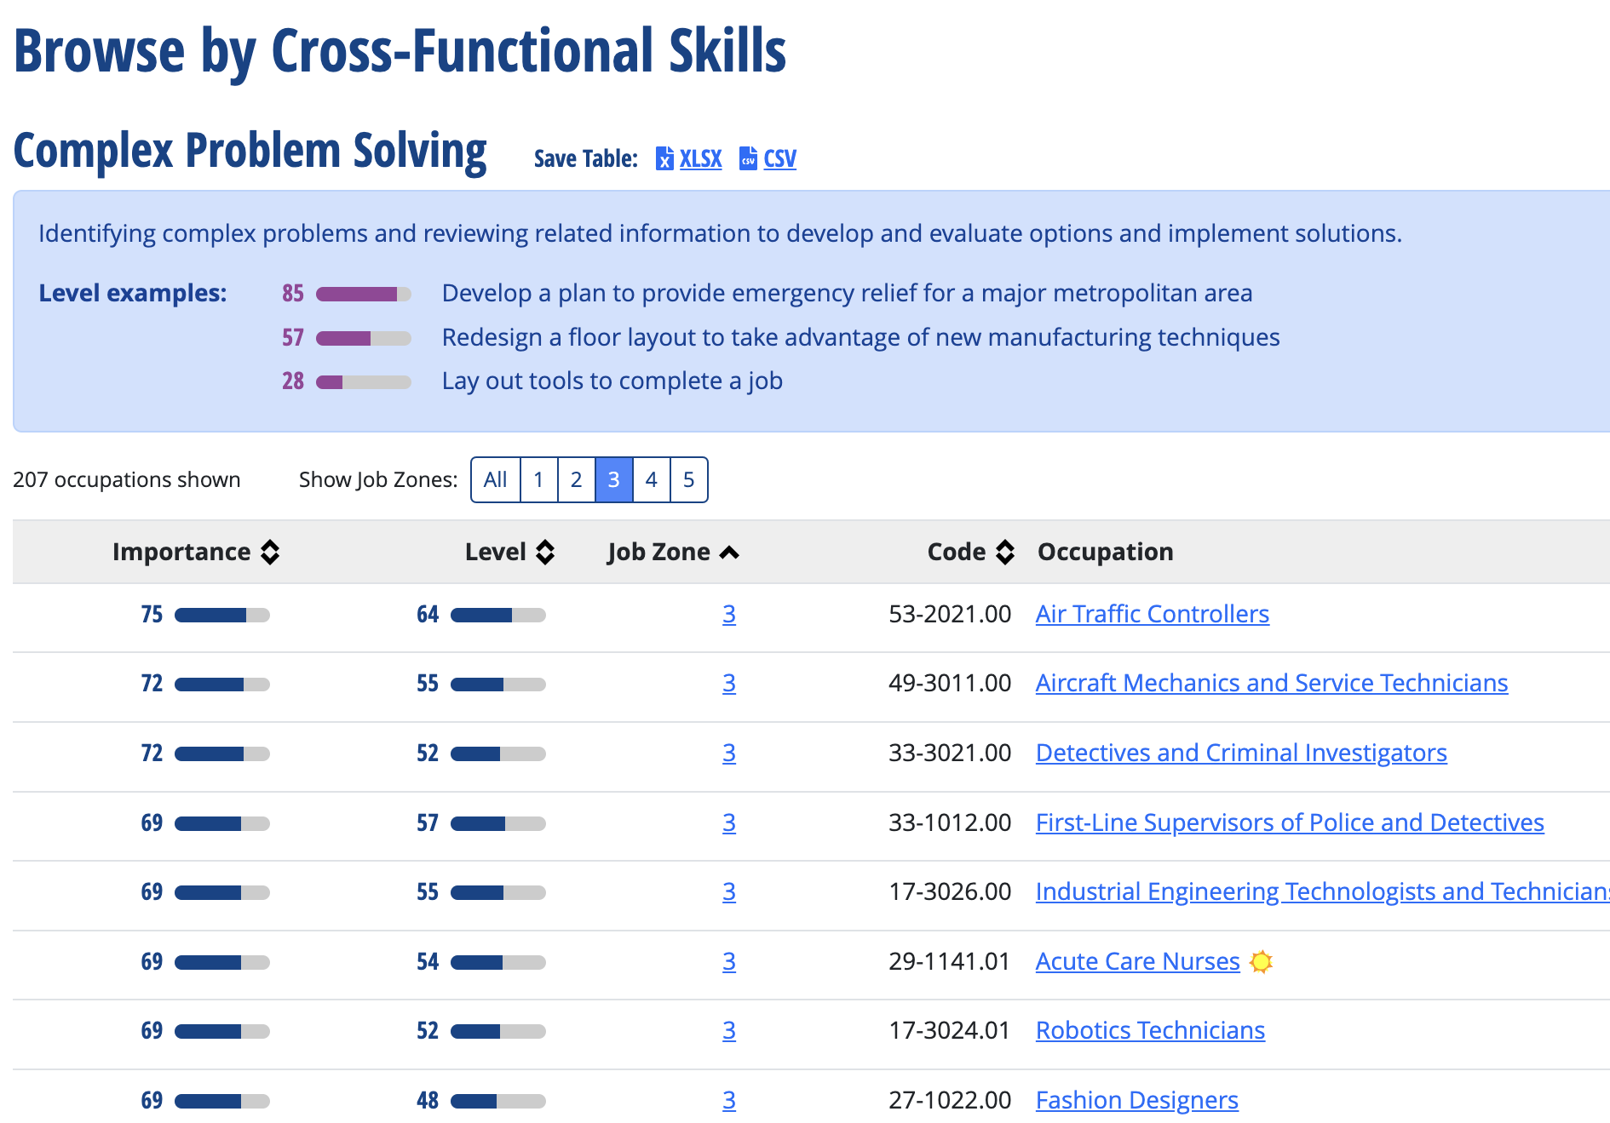
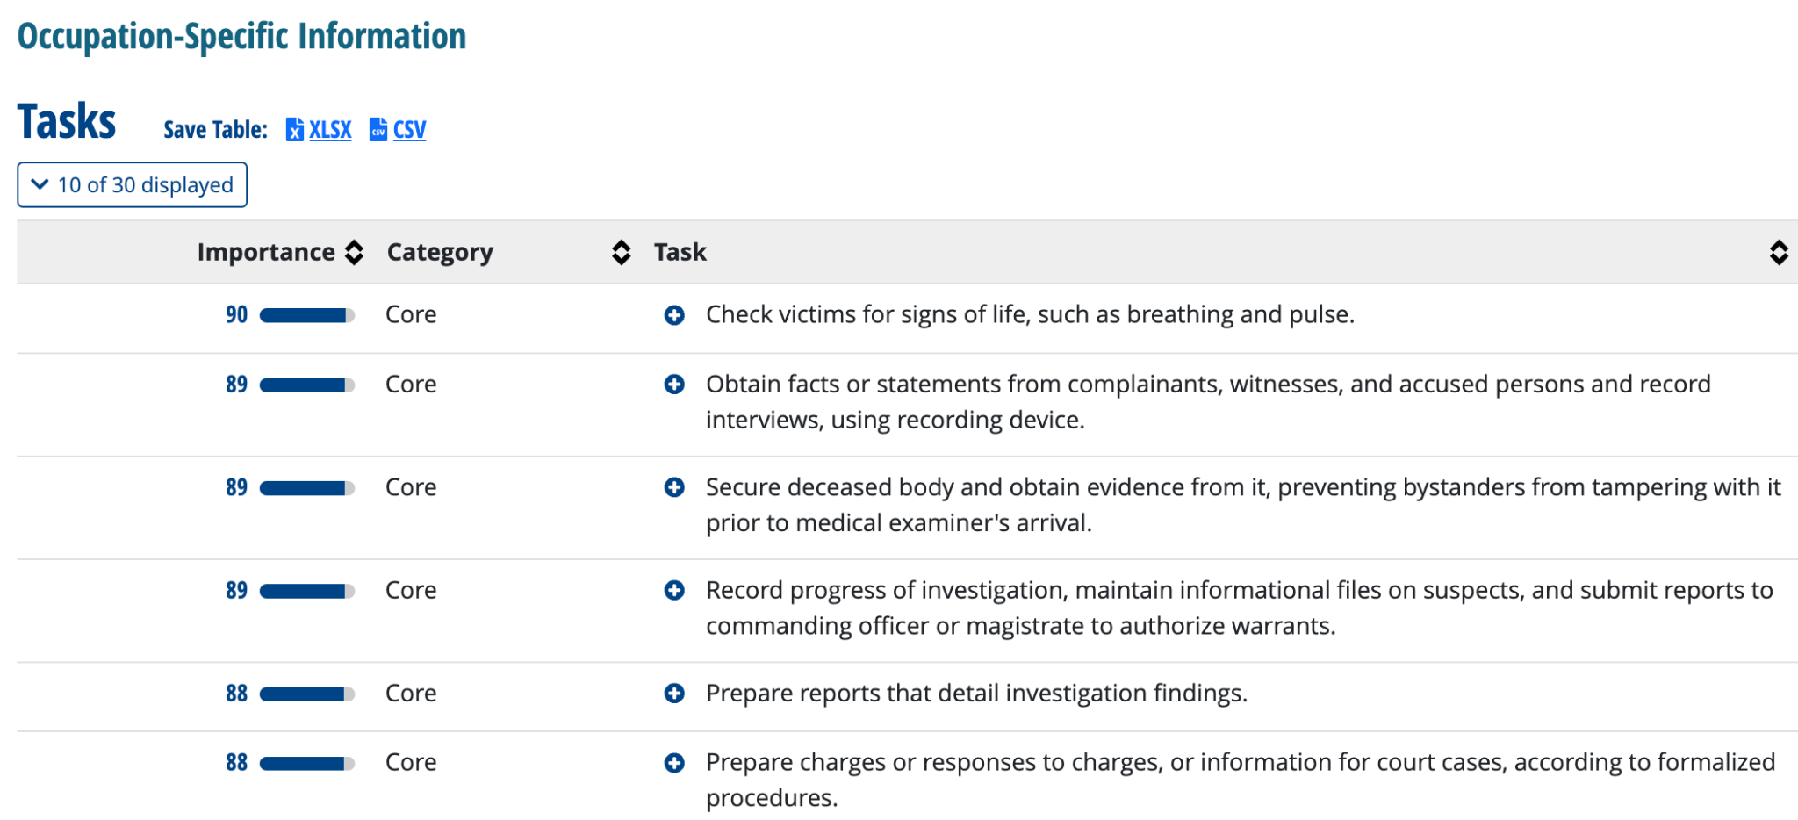
O*Net, Department of Labor

Slide 35
Acknowledgements
Temilola Afolabi, Program Manager — Data for Equity, Center for Open Data Enterprise
Temilola@odenterprise.org
The Urban Institute

