Slide 1
Generative Artificial Intelligence and Storytelling: How to Effectively Use the Tools for Authentic Human Connection
David Sewell McCann, Trainer, Consultant and Storyteller

Slide 2
This Workshop
1. Map the Workshop with some AI and Storytelling Quotes.
2. Align our Expectations with Deliverables.
3. Common Understanding of Storytelling.
4. Prompting Exercise.
5. Story Listening Skill
6. Open Response and Restorative Dialogue Skills
7. Fulfill the Alignment.

Slide 3
  "If we do it right, we might be able to evolve a form of work that taps into our uniquely human capabilities and restores our humanity. The ultimate paradox is that this technology may become a powerful catalyst that we need to reclaim our humanity.”
      John Hagel of Beyond Our Edge, Management Consultant

Slide 4
"As more and more artificial intelligence is entering into the world, more and more emotional intelligence must enter into leadership.”
  Amit Ray, AI Scientist, Author of Compassionate Artificial Intelligence

Slide 5
"Hot take: Many believe prompt engineering is a skill one must learn to be competitive in the future. The reality is that prompting AI systems is no different than being an effective communicator with other humans."
    Logan Kilpatrick of OpenAI via a post on X (Twitter)

Slide 6
"The human species thinks in metaphors and learns through stories.”
    Mary Catherine Bateson, author and anthropologist

Slide 7
  "Those who tell the stories
      rule the world.”
              Hopi American Indian Proverb

Slide 8
“If the world is made of stories, then the most powerful people in the world are the storytellers.”
    David Sewell McCann

Slide 9
Aligning our time together
What are your expectations?
How do those align with the plan?
Lets try something.

Slide 10

Use this QR code to tell me your expectations
“Give me feedback”
Please record a 1 minute video of you telling me what you would like to learn in this skill building session

Slide 11
What is Storytelling?
Storytelling is the interactive art of using words and actions to reveal the elements and images of a story while encouraging the listener's imagination.
- National Storytelling Network Website

Slide 12
What is Storytelling?
Words: the content of the story. The crafted information.
This is the specialty of Artificial Intelligence.
Actions: the telling of the story. Nonverbal communication including presence, facial expression, gesture, and vocality.
Interactive: the back and forth between the teller and listener. Also the relationship between a person and AI.

Slide 13
Containing your Storytelling
Who is this for?
Why are you engaging? To what aim?
When is this happening and for how long?

Slide 14
Choose Something You Wish to Story
Please write down a project you know is good, but needs a better story.

Slide 15
Choose Something You Wish to Story
Please write down a project you know is good, but needs a better story.
Take some time to develop a prompt. How can you get what you want from AI?

Slide 16
Choose Something You Wish to Story
Please write down a project you know is good, but needs a better story.
Take some time to develop a prompt. How can you get what you want from AI?
Now let’s “contain” some interactive storytelling.

Slide 17
Choose Something You Wish to Story
The Container is the Who, Why, and When.
  Who: Partner with someone near you that doesn’t know your project.
  Why: Describe your project and the state of your prompt.
  How Long: You have one minute to present. Just you.
  Switch: Take the same amount of time.

Slide 18
Choose Something You Wish to Story
The Container is the Who, Why, and When.
  Who: Partner with someone near you that doesn’t know your project.
  Why: Describe your project and the state of your prompt.
  How Long: You have one minute to present. Just you.
  Switch: Take the same amount of time.
Both of you take another minute to improve your prompt.

Slide 19
Discuss and Compare!
Try to avoid problem solving or giving advice. This is not the exercise.
Instead, focus on:
  What happened when you described the process to someone?
  What was it like to have that time constraint?
  What did you notice in the way they were listening?
  Did it ultimately help you in revising your prompt?

Slide 20
The value of talking
The value of listening
We hear our ideas out loud.
We feel connected to another person.
We experience something real.
We don’t need to solve it.
We react authentically.
Our nonverbal response to their ideas gives them value.

Slide 21
Story Listening
There is more than one way to listen.
  Narrow, when listening for content.
  Wide, when allowing your attention wander.
  Dense, when noticing how you feel while listening.
  Emergent, when you get a signal that something new and potentially important has just occurred.

Slide 22
Try Narrow Listening
You are listening for something specific.
  Write down something you want to know about your partner.
  Your partner will speak for 2 minutes talking about themself.
  Feel successful or unsuccessful when you hear what you want to hear.

Slide 23
Try Wide Listening
Pay attention to everything.
  Intend to be helpful to your partner.
  Allow everything to be interesting. Sights, sounds, thoughts.
  They will talk for 2 minutes about a project they are working on. Allow yourself to be “distracted”.
  Notice where your attention goes.

Slide 24
Try Dense Listening
Focus your attention inwardly. Your body and feelings.
  Intend to learn something about yourself.
  Your body notices more than your conscious mind.
  Be aware of how your body feels while they talk.
  They will talk for 1 minutes about work/life balance.
  Notice how this affects your body and feelings.

Slide 25
Try Emergent Listening
Emergent happens any time - you only need to notice.
  Set the intention to learn something important.
  Listen to them talk about their project - 2 minutes long.
  Wait for a signal: hair stands, temperature or energy change.
  As soon as you get it, interrupt them and say what it was.
  The two of you can explore potential reasons why.

Slide 26
Story Listening
Open Response
Consciously choose which of the four and change.
Expect a signal.
Keep gathering information and interrupt if you get a signal.
Respond to more than just the content. Widen and deepen.
Tell them how and where you got distracted or in your head.
Take the signals seriously.

Slide 27
Restorative Dialogue:
Is to “talk through” something with someone else.
This dialogue uses Story Listening and Open Response with a common aim toward a specific intention.
Contain, then dialogue, then reflect.
    (works with AI too)

Slide 28
Prepare for Restorative Dialogue
Form a partnership or small group.
Clearly “contain” the dialogue.
  Who is a part of the dialogue?
  Why you are having this dialogue—what question you are addressing?
  How long you will have this dialogue? (5 minutes)

Slide 29
Engage in Restorative Dialogue
One person begin to talk.
The other person uses Story Listening and Open Response.
  Prioritize Wide, Dense and Emergent Listening.
  Notice where your attention goes.
  Respond with reflections on your attention, sensations in your body, or interrupt when you get a signal.
Keep going back and forth using both tools for 5 minutes.

Slide 30
Using Restorative Dialogue for Alignment
Some of your expectations have not been met.
We will use Restorative Dialogue to clarify what those are.
Then I will respond with appropriate content, practices and tools.

Slide 31
What we did today
How to contain an interaction (storytelling).
Introduction to Story Listening
  Narrow, Wide, Dense, Emergent
How to use Open Response and Restorative Dialogue
The connection between these storytelling skills and working with Generative AI tools.

Slide 32
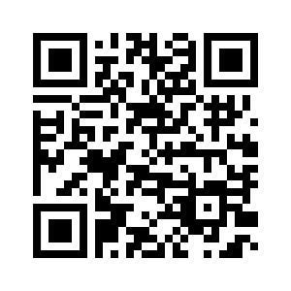
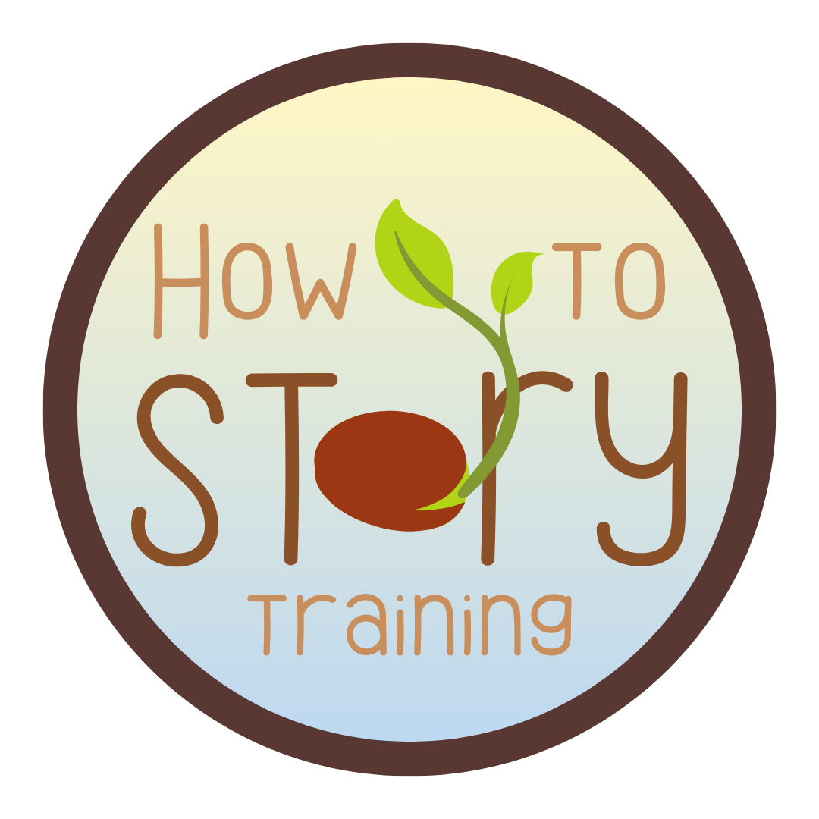
How to Reach Me
(802)355-0958
david@davidsewellmccann.com

