Slide 1
Human Intelligence vs. Artificial Intelligence: The Connection
Noel Bernal
County Manager, ICMA-CM

Slide 2
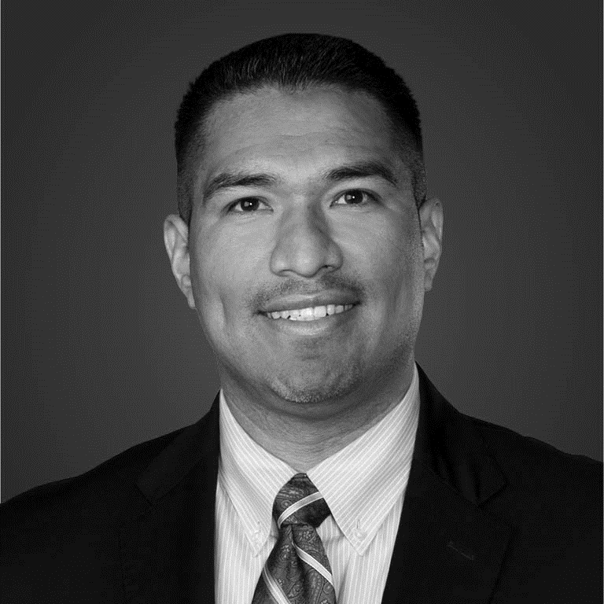
Noel Bernal County Manager

Slide 3
Background & Context
525,000 Population, Operating Budget of $841 million, and 2700 Employees
10 cities and towns
1200 sq. miles of rural, urban, and suburban
High-Growth, currently 5th largest County in Colorado
Next to Denver International Airport (DIA), 3rd busiest airport in the world

Slide 4
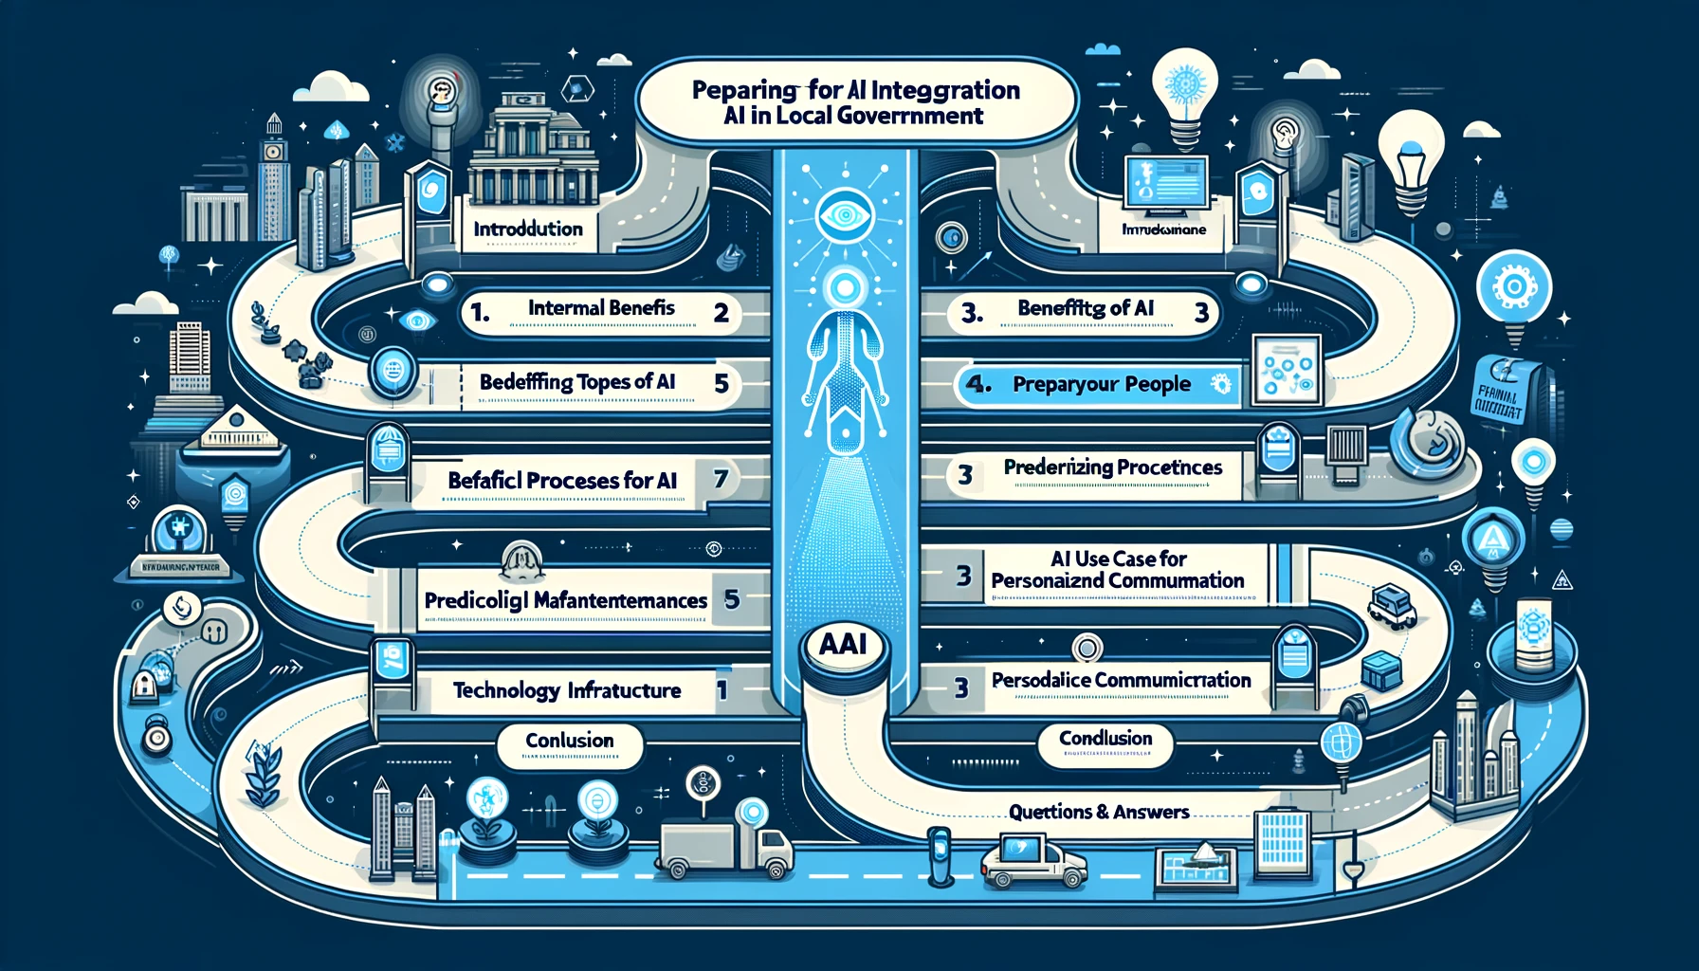
Embracing AI
In Local Government
Adams County Colorado
Process Considerations
Value of AI Internally
Technology Considerations
Value of AI for Constituents
USE CASE #1: AITSM
USE CASE #2: AIops
Prepare Your Organization for AI
People Considerations
USE CASE #3: AIPMO
Questions?

Slide 5
Adams County is the most innovative and inclusive
county in America for all families and businesses.
"To empower county agencies with innovative, value-focused IT solutions and responsive support, enabling them to adapt to evolving needs and effectively deliver essential services that create lasting value for the community."
OUR WHY
Adams County [DIGITAL] SERVICES GROUP

Slide 6
[DIGITAL] SERVICES GROUP

Slide 7
VALUE AI Value Internally
[DIGITAL] SERVICES GROUP

Slide 8
Value of AI Internally
Decision Effectiveness
Faster decision making
Break down complexities
Predictive models
Operational Excellence
Avoid outages
Resolve incidents faster
End “Alert Fatigue”
Resource Management
“Practice to the Level of The License”
Drive Automation
Improved Efficiency

Slide 9
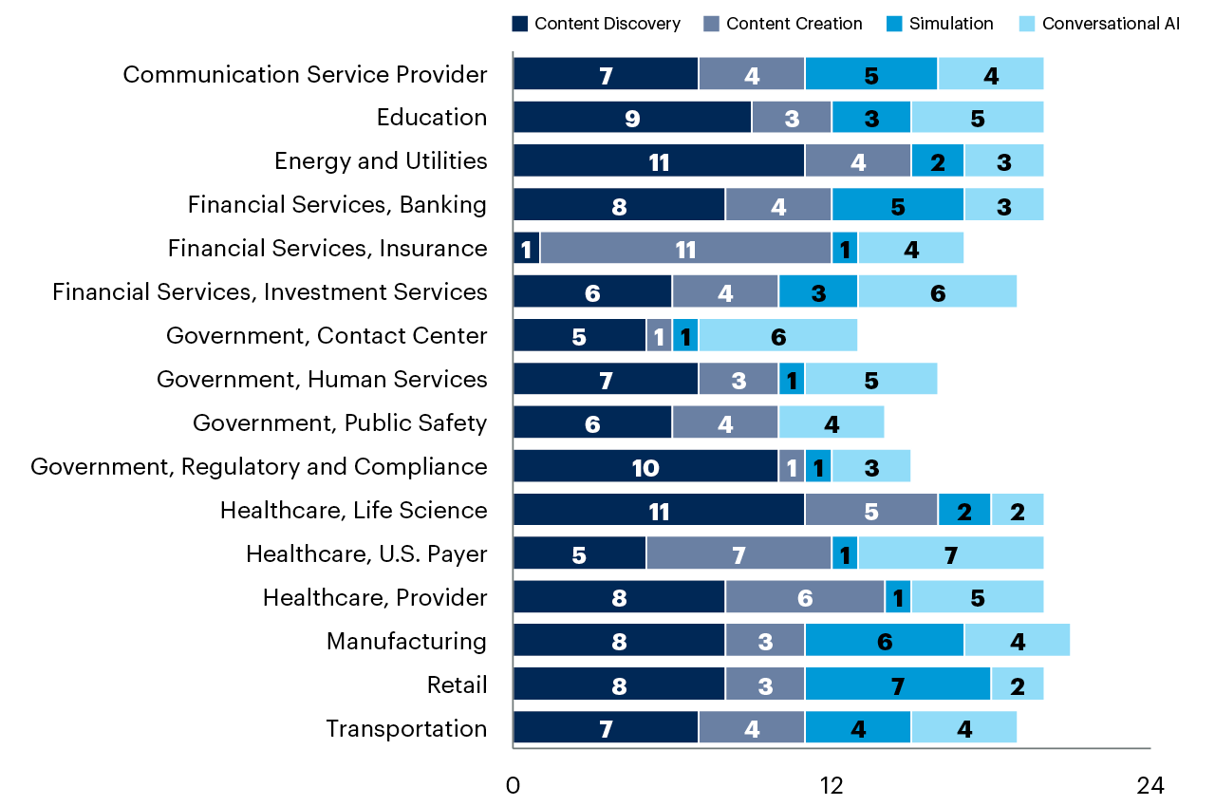
GenAI Use Cases by Industry & Capability

Slide 10
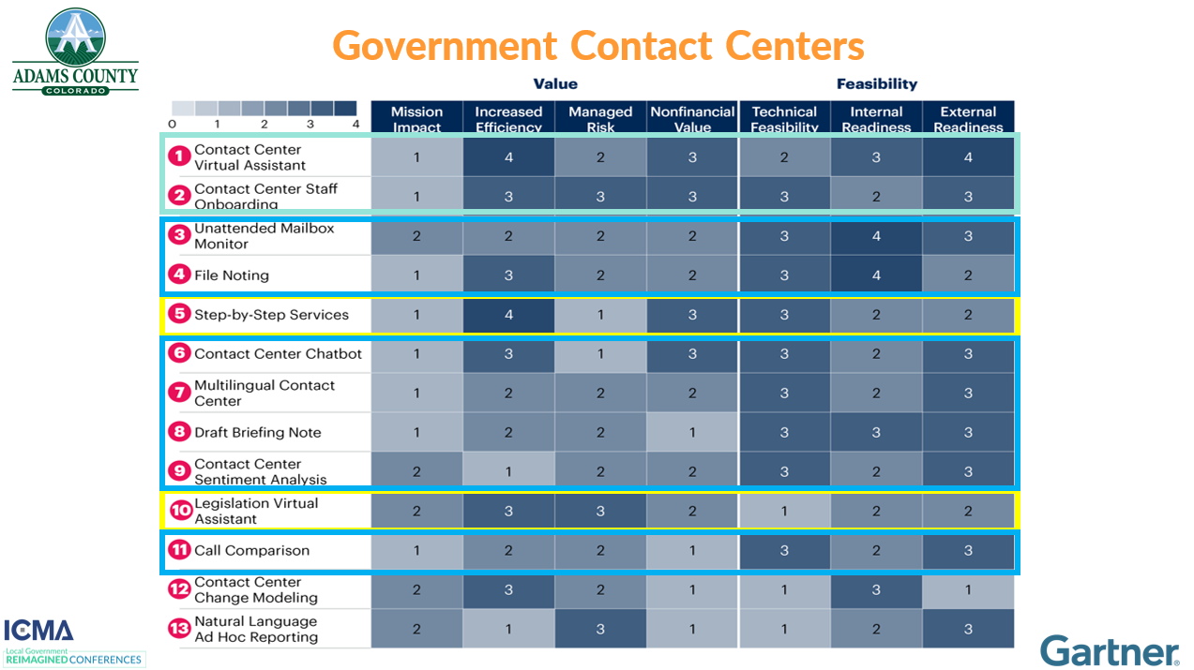

Slide 11
[DIGITAL] SERVICES GROUP

Slide 12
VALUE AI Value for Constituents
[DIGITAL] SERVICES GROUP

Slide 13
Value of AI for Constituents
Enhanced Services
24/7 Services
Improved deflection
1st contact resolution
Predictive Models
Predictive policing
Traffic management
Resource management
Communications
Personalized
Automated
Real-Time

Slide 14
[DIGITAL] SERVICES GROUP

Slide 15
Roadmap: Prepare for AI
STRATEGY
STRATEGY
INVEST
GOVERN
01
01
02
03
03
04
04
05
05
06
06
ASSESS
ENGAGE
PILOT

Slide 16
Roadmap: Prepare for AI
01
STRATEGY
03
01
02
ASSESS
ENGAGE
AI Assessment
Data Quality
Infrastructure
Skillsets
AI Strategy
*Minimum Viable Strategy
Align with priorities
Resource plan
Technical uplift
Stakeholder Engagement
Present Strategy
Identify outcomes
Build trust & support

Slide 17
Roadmap: Prepare for AI
Create Minimum Viable Strategy
03
Use Strategy Reviews to Evolve and Update the Strategy
01
STRATEGY
01
1
CONTEXT SCANNING
Understand the
02
CONTEXT
ASSESS
ENGAGE
2
Strategy Review
Strategy Review
Strategy Review
Set The
AI Assessment
Data Quality
Infrastructure
Skillsets
AI Strategy
*Minimum Viable Strategy
Align with priorities
Resource plan
Technical uplift
Stakeholder Engagement
Present Strategy
Identify outcomes
Build trust & support
DIRECTION
3
Define the
EXECUTION SCANNING
ACTIONS

Slide 18
Roadmap: Prepare for AI
05
INVEST
GOVERN
06
04
PILOT
AI Training
Educate staff
Data science
AI ethics
Fail Fast
Internal IT
Internal Customers
Constituents
Maintain Trust
Policies & frameworks
Data privacy
Algorithmic transparency

Slide 19
Prepare Your People
Upscale Culture
Foster creativity
Collaboration
Innovation labs
Upskill/Reskill
Data analytics
Machine learning
Equip employees to succeed
Resistance
Open workshops
Responsible practices
Bias mitigation & privacy

Slide 20
Prepare Your Processes
Process Audit
Repetitive/Time consuming
Prioritize processes
Start with highest impact
Redesign
Map workflow with AI
Ensure AI is the right tool
Validate integration
Measure
Develop KPI’s
Transparency
Continuous improvement

Slide 21
Prepare Your Technology
Data Management
Policies & guidelines
Data collection & storage
Data quality & management
Scalable Resources
Cloud platforms (pr/pu)
Staffing is a resource
Resiliency
Appropriate Tools
Get help
SaaS options vs. build
Focus on outcomes

Slide 22
[DIGITAL] SERVICES GROUP

Slide 23
Use Cases Start Small Fail Fast
[DIGITAL] SERVICES GROUP

Slide 24
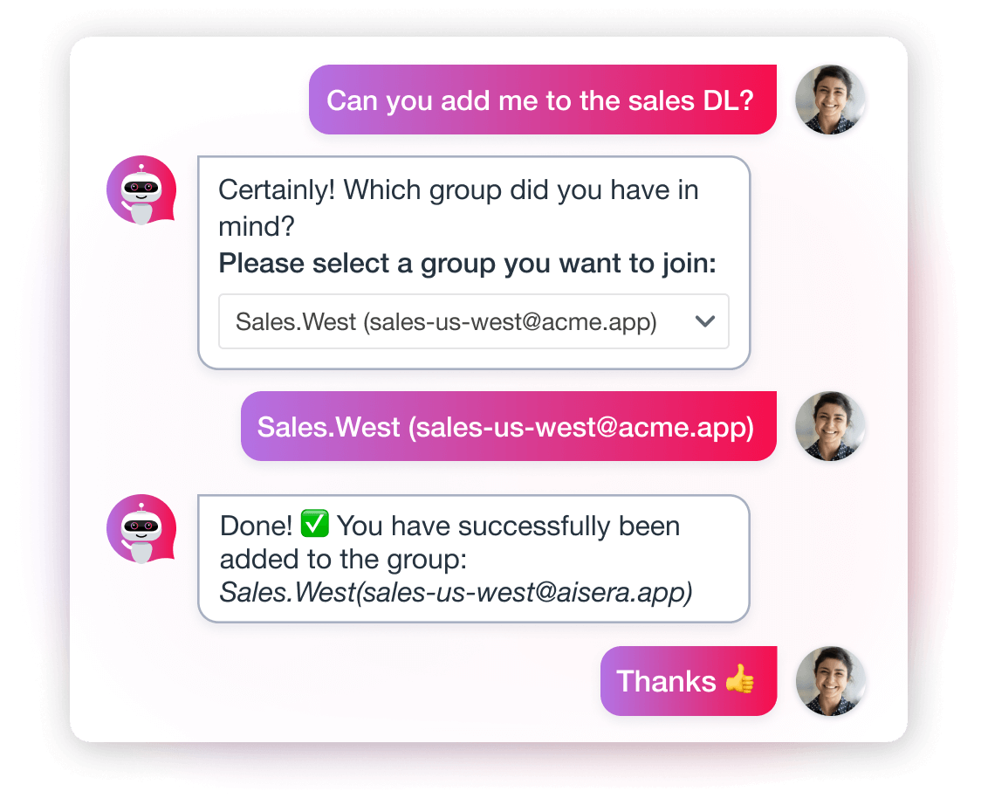
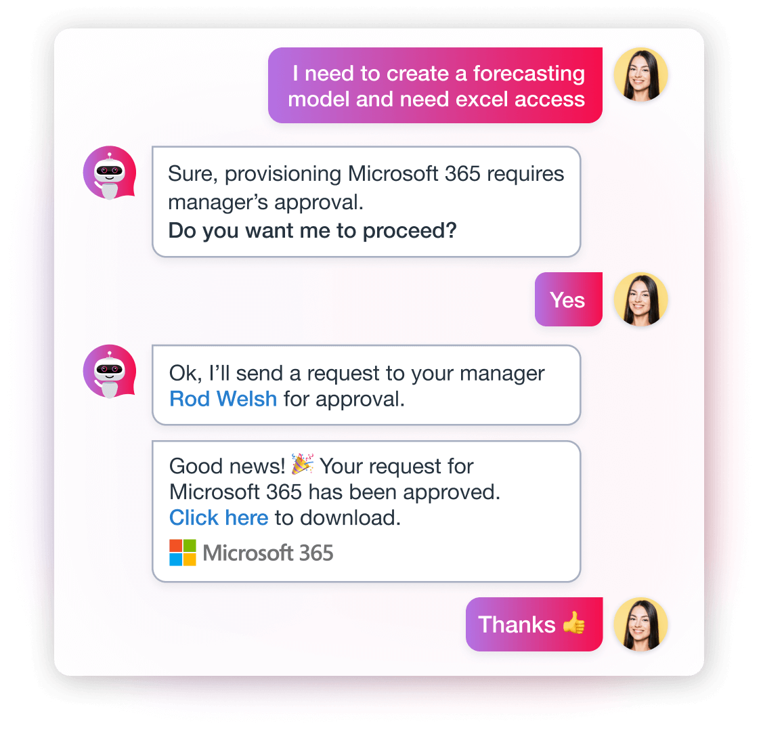
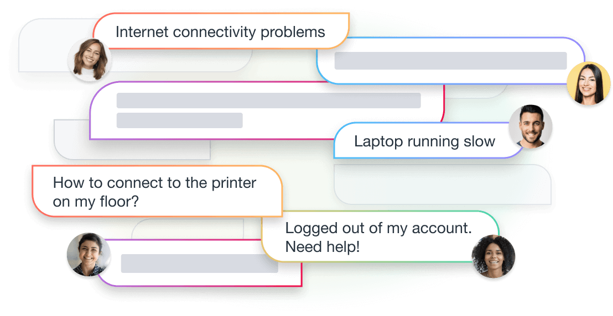
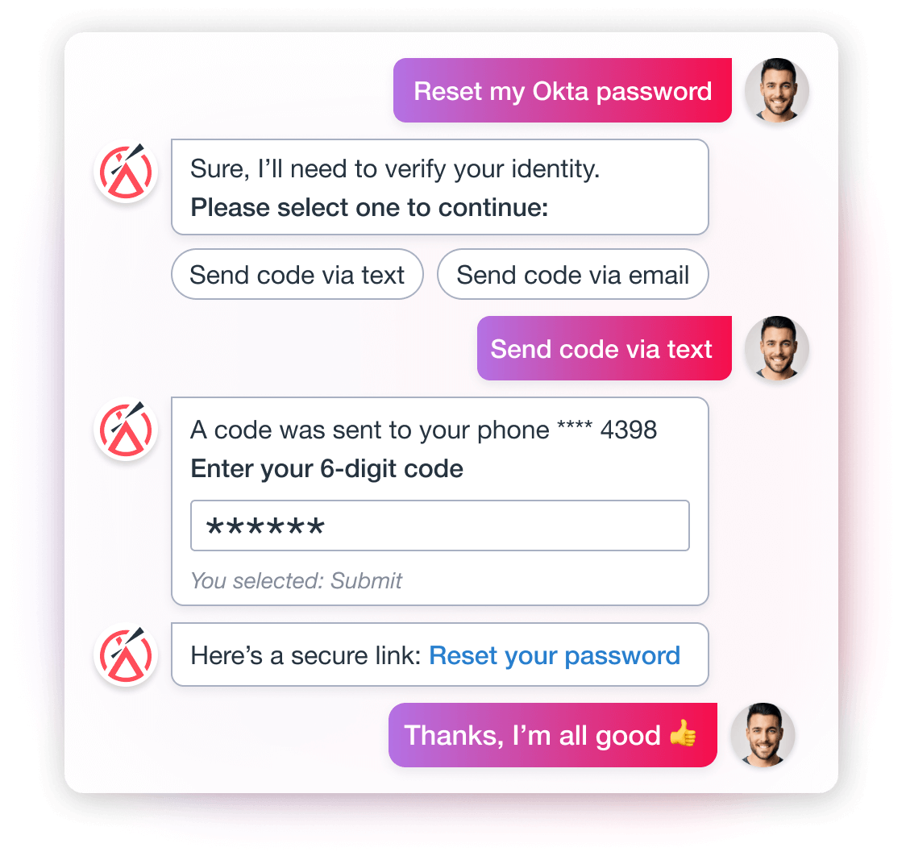
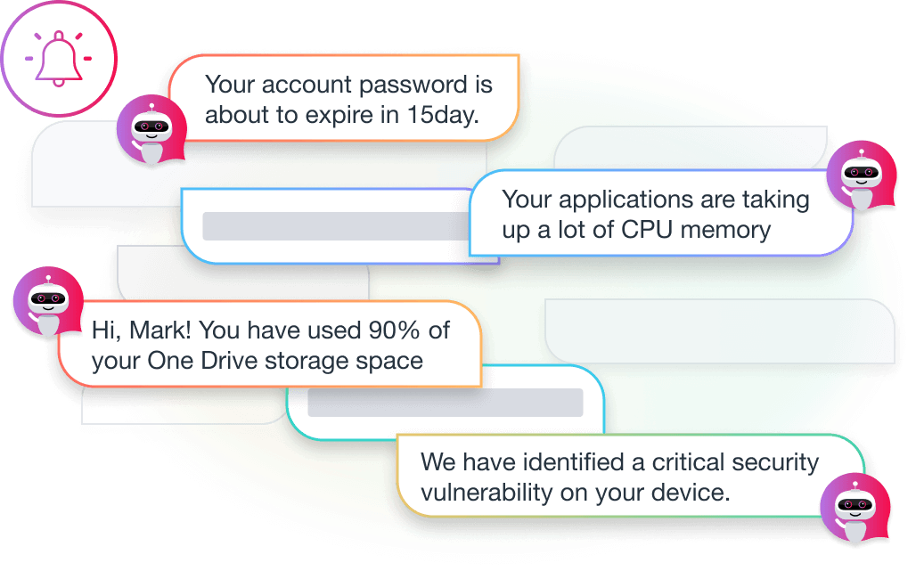
AITSM: AI Service Management
Ticket triage & issue resolution
Repetitive task automation
Software Approvals & Provisioning
Repetitive task automation
abcdef
Troubleshooting Assistance
Recommended Actions
Resolve Issues BEFORE ticket
Self-Service
Password Resets
Account Unlocks
Proactive Measures
Org announcements
Scheduled Maintenance
Outages
Relevant Updates

Slide 25
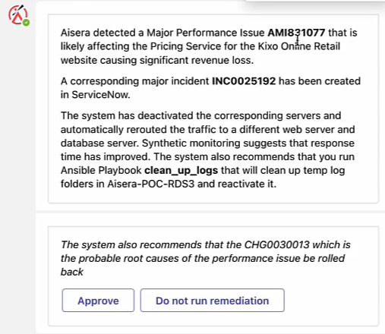
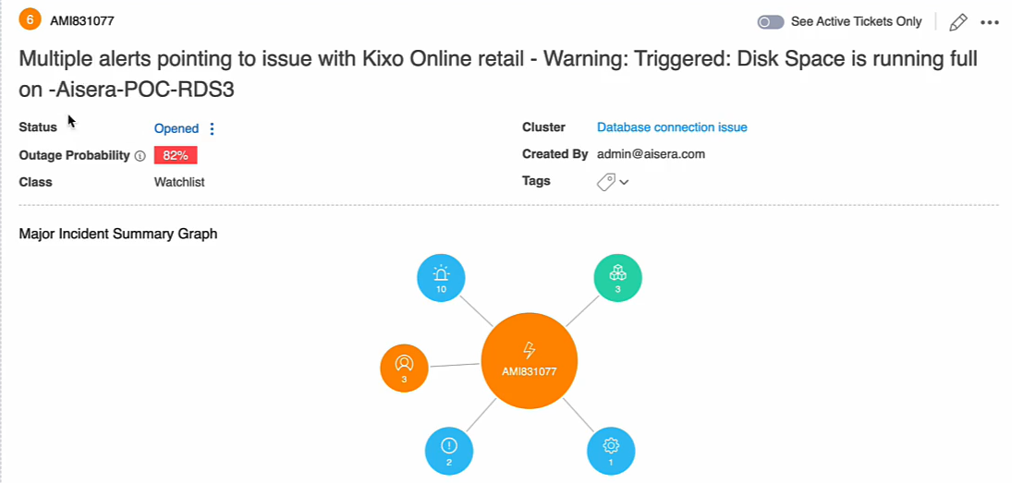
Alops: AI Operations
AI Engine Consumes Data
Merlin
Adams County Portal
AI Engine Analyzes Data
ENTR47356
ADAMS-SRV-W2078
admin@adamscounty.gov
ADAMS-SRV-W2078
AI Engine Takes Action
ENTR47356

Slide 26
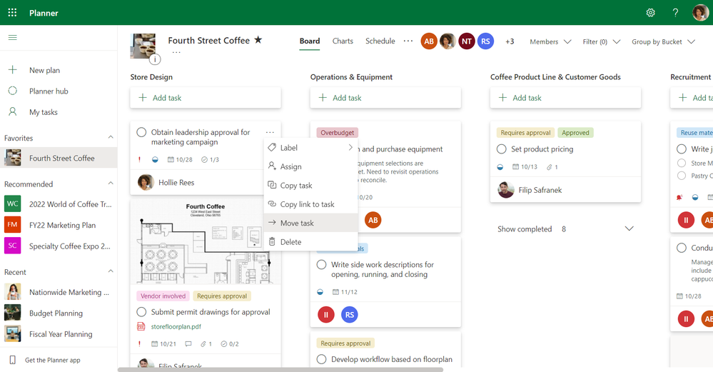
AIPMO: AI in Project Management
Task plan generation
Risk Assessments
Project Status Reports
Task follow-ups
Resource Projections
Resource Planning

Slide 27
[DIGITAL] SERVICES GROUP

Slide 28
ChatGPT
Embracing AI
In Local Government
INTRODUCTION
Adams County Colorado
Process Considerations
Value of AI Internally
Technology Considerations
Value of AI for Constituents
USE CASE #1: AITSM
USE CASE #2: AIops
Prepare Your Organization for AI
People Considerations
USE CASE #3: AIPMO
Questions?

Slide 29
Human Intelligence vs. Artificial Intelligence: The Connection
Speaker Name, Title, Credits
QUESTIONS?
[DIGITAL] SERVICES GROUP

