Slide 1
Human Intelligence vs. Artificial Intelligence: The Connection
Dr. Peter Pirnejad
City Manager – Town of Los Altos Hills & Cal-ICMA President Elect

Slide 2
What is Artificial Intelligence?

Slide 3
A machine that imitates human behavior.
Source: Merrian-Webster
Notes:
AI has no emotions or independent thought, yet.

Slide 4
AI is data, code, and mathematics.

Slide 5
Today, we use Artificial Narrow Intelligence (ANI).
It’s good at performing specific tasks.

Slide 6
Popular Uses Of AI Include:
Spam Management
Recommendation Engines
Chatbots
Fraud Detection
Facial Recognition
Virtual Assistants

Slide 7
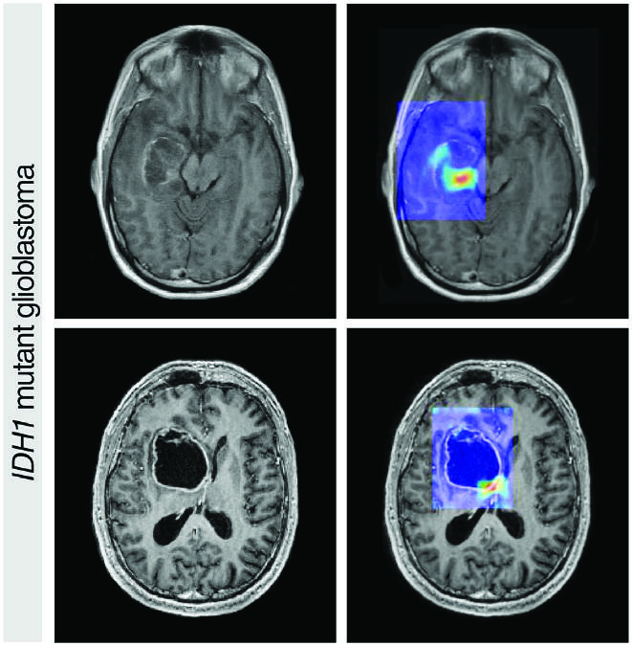
AI Is Helping To Detect Cancer Earlier

Slide 8
What Is Driving AI Innovation?
Big Data
Market Interest
High Performance Computing
Better Software
Massive Investment

Slide 9
What is Generative AI?

Slide 10
Simply, it is software that creates new content based on a variety of inputs.

Slide 11
This New Content Is Remarkable And Includes Text, Pictures, Video, and Audio.

Slide 14
Popular Uses Of Gen AI in Government
Creating Content
Analytics
Customer Service
Summarizing
Research
And Much More

Slide 15
Multipurpose Gen AI Tools

Slide 16
ChatGPT
Google Gemini
Microsoft CoPilot

Slide 17
Notes:
Free ChatGPT: Latest version 4o supports: Faster response, will include the LLM from the premium version, analyze data and charts, upload files to analyze, significant visual features enabling users to discuss what ChatGPT sees, support for 50 languages, and a new feature that can memorize what’s important to user.
Issues: Potential challenges with privacy and copyright, misinformation, hallucinations, and bias.

Slide 18
Notes:
Google Astra: A universal AI agent that is helpful in everyday life. Building on Google Gemini models, Project Astra explores the future of AI assistants that can process multimodal information, understand the context you're in, and respond naturally in conversation.
Issues: Potential challenges with privacy and copyright, misinformation, hallucinations, and bias.

Slide 19
Notes:
Microsoft Copilot for Microsoft 365 combines the power of large language models (LLMs) with your organization’s data – all in the flow of work – to turn your words into one of the most powerful productivity tools on the planet. It works alongside popular Microsoft 365 apps such as Word, Excel, PowerPoint, Outlook, Teams, and more. Copilot for Microsoft 365 provides real-time intelligent assistance, enabling users to enhance their creativity, productivity, and skills.

Slide 20
Government Focused AI Tools

Slide 21
Public Safety - Police
Software to help eliminate crime and keep communities safe. Their holistic public safety platform is comprehensive and intelligent – that means you have the actionable evidence you need to solve, deter and reduce crime across neighborhoods, schools, businesses and entire cities.
www.flocksafety.com

Slide 22
Public Safety - Fire
Rain’s technology is built to help fire agencies more rapidly suppress wildfires during the earliest stages of ignition. By adapting existing military and civil autonomous aircraft with the intelligence to perceive, understand, and suppress wildfires, Rain enables numerous aircraft to be prepositioned in remote locations resulting in accelerated response time.
www.rain.aero

Slide 23
Public Safety - Enforcement
AI-powered cameras perceive, map, and understand their environment, and collaborate to deliver state-of-the-art traffic enforcement and real-time insights.
www.hayden.ai
Notes:
Market Leader. Hayden AI is the largest provider of mobile automated bus lane and bus stop enforcement systems in the US.
Hayden AI has developed an autonomous perception system using mobile sensors and traffic data to generate real-time digital twins of cities. The company analyzes a city’s existing transportation fleet to simulate traffic scenarios and provide actionable insights — helping improve traffic flow and safety. The goal is to take humans out of the loop and automate traffic enforcement, allowing municipalities and police departments to focus on more important work.

Slide 24
Community Engagement
Organizations nationwide use Polco for strategic planning, budgeting, and empowering resident voices. They make civil, verified community engagement online possible and accessible.
Polly, an AI analyst for government can help make data-informed decisions easily and efficiently.
info.polco.us

Slide 25
Community Engagement
Citibot's advanced Generative AI fuels government communication in text messaging, web chat, and interactive alerts. Their products enable communications in 71 languages and ensure seamless and inclusive interactions for elevated operational efficiency and exceptional customer service.
www.citibot.io

Slide 26
Community Engagement
AI-Powered Sensemaking analyzes large volumes of government data. With automatic data analysis and meticulously generated reports, it assists with focusing on more inclusive and efficient public decision-making.
www.citizenlab.co/sensemaking
Notes:
Uses AI to analyze large volumes of citizen input data to gauge sentiment and make insights more powerful

Slide 27
Community Engagement
The software streamlines the process of transforming public data into actionable insights for businesses and communities. They develop innovative tools that enable deeper connections between residents, businesses, and the communities they serve and inhabit.
www.myhamlet.com

Slide 28
City Clerk – Legislative Process
A suite of legislative research, drafting, and workflow tools that assist local governments in streamlining their day-to-day legislative processes.
www.legislaide.com

Slide 29
Training – AI Education
One of the leading providers of AI Training. Uses AI-powered features to auto-generate course content — such as overall course structure, readings, assignments, and glossaries
www.coursera.org

Slide 30
Transportation – Detection System
Video and hybrid (video and radar) detection systems are equipped with Iteris' PedTrax and SmartCycle algorithms for detection and differentiation between pedestrians, bicycles and vehicles.
www.iteris.com

Slide 31
Transportation – Autononous Vehicles
Zoox will provide autonomous mobility-as-a-service in dense urban environments. They will handle the driving, charging, maintenance, and upgrades for its fleet of vehicles. The rider will simply pay for the service.
zoox.com

Slide 32
Admin: Analytics
Chat with files and get expert-level insights in seconds. Julius is an aggregate of different Large Language Models, including OpenAI's GPT-4 and Anthropic's Claude, which they’ve equipped to write Python code and use tools. As a result, Julius can complete a variety of computational and analytical tasks.
julius.ai

Slide 33
Admin: Note Taking
Connect a Google or Microsoft calendar and schedule OtterPilot to auto-join Zoom, Microsoft Teams, or Google Meet to take and share meeting notes.
otter.ai

Slide 34
Getting Started

Slide 35
Education
Soft entry
Hands-on
Policy
Engage stakeholders
Less is more
Pilots
Experiment
Evaluate
Pivot
Deploy
Monitor
Review
Budget
Train

Slide 36
Risks And Challenges
Ethical AI
Privacy
Copyright
Bias
Hallucinations
Lack of Skills
Notes:
Ethical AI is artificial intelligence that adheres to well-defined ethical guidelines regarding fundamental values, including such things as individual rights, privacy, non-discrimination, and non-manipulation. Ethical AI places fundamental importance on ethical considerations in determining legitimate and illegitimate uses of AI. Organizations that apply ethical AI have clearly stated policies and well-defined review processes to ensure adherence to these guidelines.

Slide 37
AI Has The Potential To Bring Significant New Capabilities To City Staff And Community.

Slide 38
Questions

