Slide 1
Embracing AI in the Finance Office
Leveraging the technology to help you leave the office on time

Slide 2

Today’s Speakers
Stuart M. Langer, CPA, MBA, is a seasoned executive with extensive experience in product strategy and management, financial applications, and professional services. As the Senior Vice-President of Product Strategy at OpenGov, he currently leads the overall product strategy, ensuring effective collaboration across various teams.
Stuart has been an early adopter of both generative and machine learning based AI tools for years, including leading the effort to bring AI to private sector ERP products, being a patent applicant for "Continuous Anomaly Detection Using Machine Learning”, and led the development and release of Sage Intelligent Time.
In addition to being a builder of financial solutions, he has also been an auditor, contract CFO and consultant in both public and private sector having worked with hundreds of organizations to deploy and optimize financial and operational systems and processes.
Stuart holds an MBA with a concentration in Accounting from Georgia State University's J. Mack Robinson School of Business and is a Certified Public Accountant in Georgia since 1986. Additionally, he has been an Adjunct Professor of Accounting at Oglethorpe University, Atlanta GA.
Drafted by
Chat GPT
Stuart Langer, CPA
SVP Product Strategy for OpenGov Financials

Slide 3
Agenda
Introduction
What is AI? Generative AI vs Machine Learning
How You Can Use AI in the Finance Office
Not all AI is Created Equal
Prompt Best Practices for Getting the Best Results
Excel Macro Creation Using Generative AI
Q&A

Slide 4
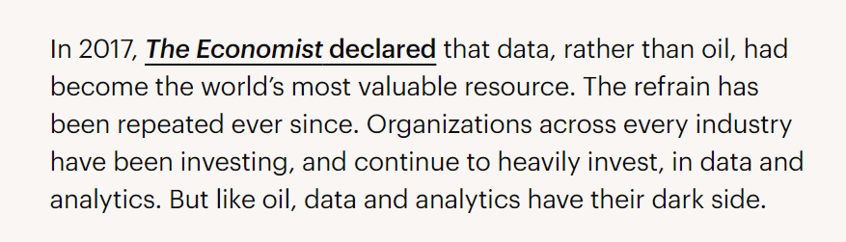
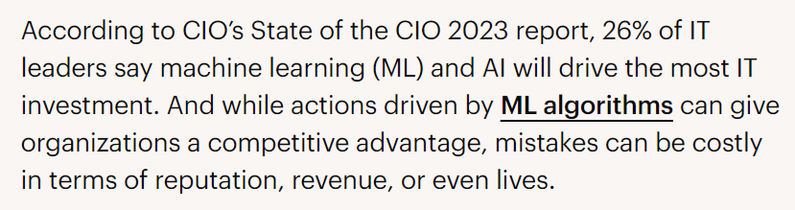

Slide 5
Poll #1

Slide 6
Poll #1: How much is your organization currently using AI?
Not much
Individuals are using it but the use isn’t organized or part of a larger plan
Departments are using it but the use is just for a few very specific purposes
Departments are using it in an organized, strategic manner
Our entire organization is using it in an organized, strategic manner

Slide 7

The Dos and Don’ts of Using AI in the Public Sector
AI has the potential to revolutionize the way the public sector operates, serves its missions, and supports its citizens.
Karen Dahut, CEO of Google Public Sector
Notes:
Talk over poll results
Goals of the webinar:
Demystify the use of AI in the public sector so that you walk away feeling ready to get your feet wet.
Also, dispel fear.
Get your feet wet, share best practices, what others in public sector are currently doing, and what we’re doing at OpenGov to bring AI to local government.
Consider briefly including:
What is generative AI?
Generative AI models lets you use natural human language to generate writing, images, videos, data analysis, and a lot more.
Tools include OpenAI’s ChatGPT and Google’s Bard.
I’ll be doing a short demo so if you’ve never used ChatGPT, you’ll get to see what it looks like here in a moment.

Slide 8
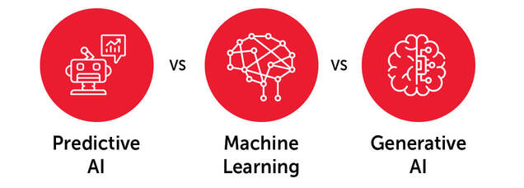
What is Generative AI

Slide 9
What is Generative AI
Predictive AI
Machine Learning
Generative AI
The use of machine learning to identify patterns in past events and make predictions about future events. It does not use human judgment, which leads to far less error and often outperforms data scientists.
A subset of AI that enables machines or systems to learn and improve from experience. Instead of explicit programming, ML uses algorithms to analyze large amounts of data, learn from insights, and make informed decisions.
A specialized branch of ML that focuses on creating new data, such as images, text, or even music, based on patterns and knowledge learned from existing information

Slide 10






How You Can Use Gen AI in the Finance Office?
Copywriting
Brainstorming & ideation
Data analysis
Productivity hacks
As a search engine
Generating Excel Macros
Notes:
This list isn’t exhaustive
Although writing is often discussed, I’ve personally found ChatGPT to be better at outlining and ideation than the actual writing, though maybe it will get there one day
For me, ideation literally means helping me come up with ideas
List
Copywriting
Brainstorming and ideation
Data analysis - like outlier analysis
Productivity hacks (setting reminders, generating To Do lists, planning)
As a search engine (but beware—AI can hallucinate!)
Generating Excel Macros

Slide 11
Sample Use Cases - External
Budget vs Actual Variance analysis
RFP building for repetitive projects
Budget initiative narratives for public consumption
Assist with creating visualizations of complex financial data for external use
Comparative analytics of provided data (i.e. compare to benchmarks)
Support self-service FOIA requests
Chatbots for constituent Q&A
How much raw / semi- raw data do you make available externally that others will run through AI?

Slide 12
Sample Use Cases - Internal
Email responses
Research technical topics
Draft checklists (audit prep, month-end close, purchasing compliance)
Financial analysis - Excel tools (formulas, pivot tables, macros)
Presentation preparation - developing graphs/visualizations
Generative AI - today - is best used in the initial phases of drafting and organizing work

Slide 13


Not All AI is Created Equal
Data Hallucinations
Privacy Concerns
Certain generative AI systems like ChatGPT can generate information that seems plausible, but is not based on real data.
If you’re using a free AI account, all the data you provide belongs to the company that made the tool you’re using.
Fun article
Notes:
To get started, let’s talk about what to avoid when using a tool like ChatGPT in the public sector—or in general
The two biggest concerns are privacy and data hallucinations
On the privacy front, make sure you never enter private data into a tool like ChatGPT
On the data hallucination topic, just be forewarned that generative AI tools can make up information. The best practice, given this, is to input the information you want the tool to analyze, so you know the original data was good. That or double check its information somewhere else.
This article is great for AI fails:
https://www.cio.com/article/190888/5-famous-analytics-and-ai-disasters.html
Three I like best for your talk track
1. Zillow (Nov '21) cut workforce by 25% because of a data error, which was miscalculated by the ML algorithm.
2. iTutorRecruiting (Aug '23) used an AI-powered recruiting tool, but the tool automatically rejected candidates who were 55 years old+.
3. Lawyer ('23) used ChatGPT to research precedent court cases in a suit. ChatGPT hallucinated cases, and the suit got thrown out

Slide 14
AI Created for the Public Sector
Keep Your Data Safe
Be Able to Verify Results
Opt in to Faster Workflows
Pick systems that don’t add your data to public models
Be able to document the sources of your outputs so that you can verify important outputs
Use AI when you want, but don’t be forced into using it if you don’t want to

Slide 15
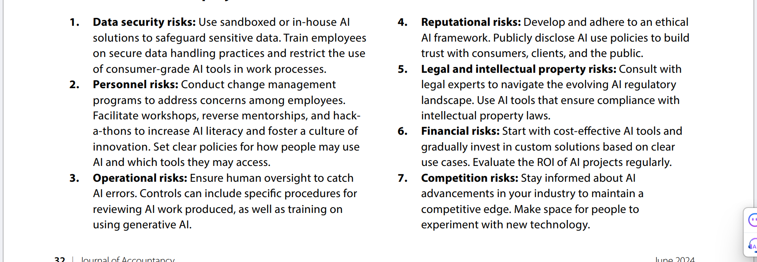
Checklist for AI Projects

Slide 16
Prompt Best Practices for Getting the Best Results
Use the RELIC formula to guide your prompt writing.
R — Role
E — Exclusion
L — Length
I — Inspiration
C — Context
You are an assistant city manager with over 20 years of experience . . .
Do not include . . .
Keep your writing between 300 and 400 words . . .
Use this article as a reference for style, tone, and voice: [LINK] (or [PASTE TEXT] if not using GPT4 with Bing).
You work for the City of Bard and you’ve been tasked with creating a plan for a multicultural day . . .
Notes:
Let’s make this more concrete—here is a great formula to use for writing a prompt for ChatGPT (or any other generative AI tool)
You don’t have to use all of these inputs
I’ve found just using Role, Length, and Context can usually produce great results
Let’s do a quick demo in ChatGPT
Drop link to https://opengov.com/article/ai-for-government/ in the chat

Slide 17
Prompt Creation Tips
Add structure and specificity
Provide context
Ask for multiple variations
Try multiple revisions
Ask for explanations and citations
Use Gen AI as an editor
Use alternative input formats
Save what works
Experiment with advanced techniques
Keep exploring and learning
“Gen AI for Accountants: 10 Prompt Writing Tips” - JoA - April 2024

Slide 18
Poll #2

Slide 19
Poll #2: How would you describe your feelings about the use of AI in the public sector?
Worried
Excited
Cautiously optimistic
This is the end of humanity as we know it
A mix of all of these
Notes:
Findings from the last time we did this poll
31% of public servants are excited about AI in the public sector.
Only 4% of public servants are worried about AI in the public sector.
23% of public servants have mixed feelings about AI in the public sector (both excited and worried)

Slide 20
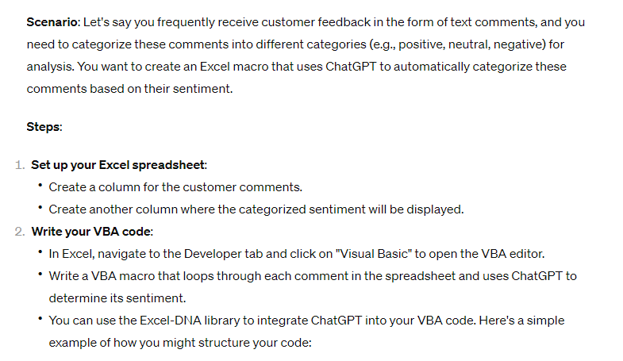
Excel Macro Creation

Slide 21
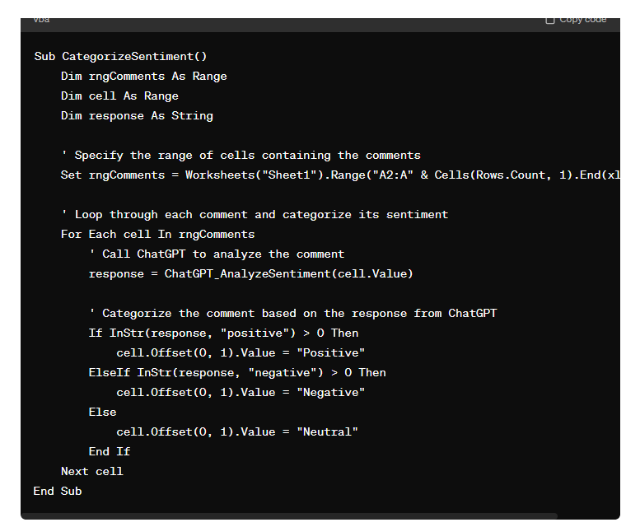
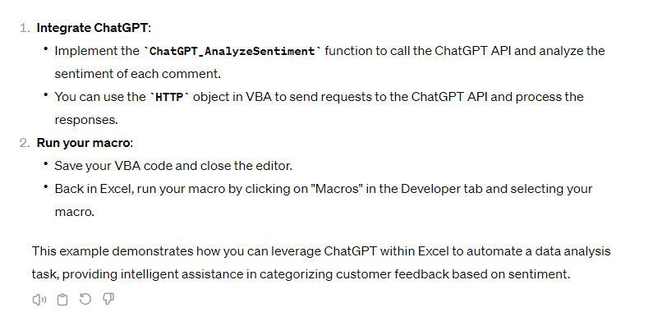
Generated Code
JOA Article and video (AICPA)

Slide 22
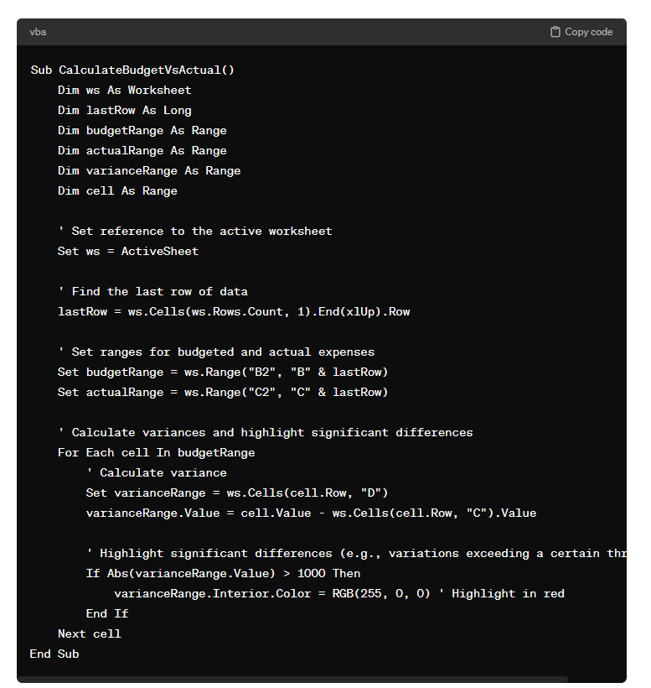
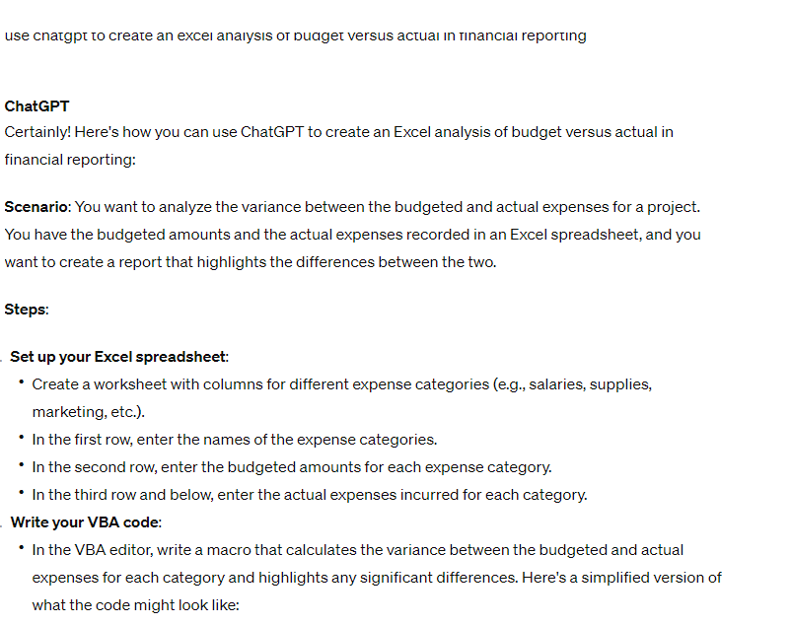
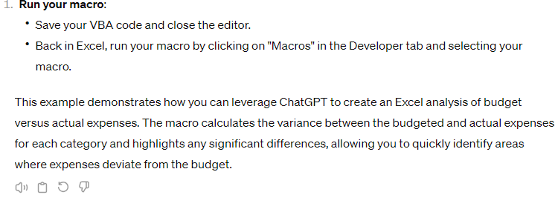
Excel Macro - Sample2

Slide 23
Poll #3

Slide 24
Poll #3: Does your organization have an AI policy in place?
Yes
No
We’re currently developing one
We don’t plan to make one
We have put the use of AI on hold while we create one
Notes:
The last time we asked this poll question, we found only 7% of respondents had a policy in place, but 30% were currently developing one.
What should be included in your AI policy:
Human accountability
Define who may use genAI
Require prior approval
Limit tasks
Require reviews
Mandate reporting
Have an AI point of contact

Slide 25


Looking Forward
“I don’t foresee a future where we’re building our own tools that leverage AI. Instead, I imagine that vendors will be our primary avenue for incorporating AI into our work.”
Confidential, Do not share
Notes:
When you think about the future of AI in the public sector, do you think we’ll see local government building its own tools or leaning on private partners?
Why? What will these partnerships look like? And how will local governments be able to vet companies for responsible use of AI?

Slide 26
What’s Next for AI at OpenGov

Slide 27
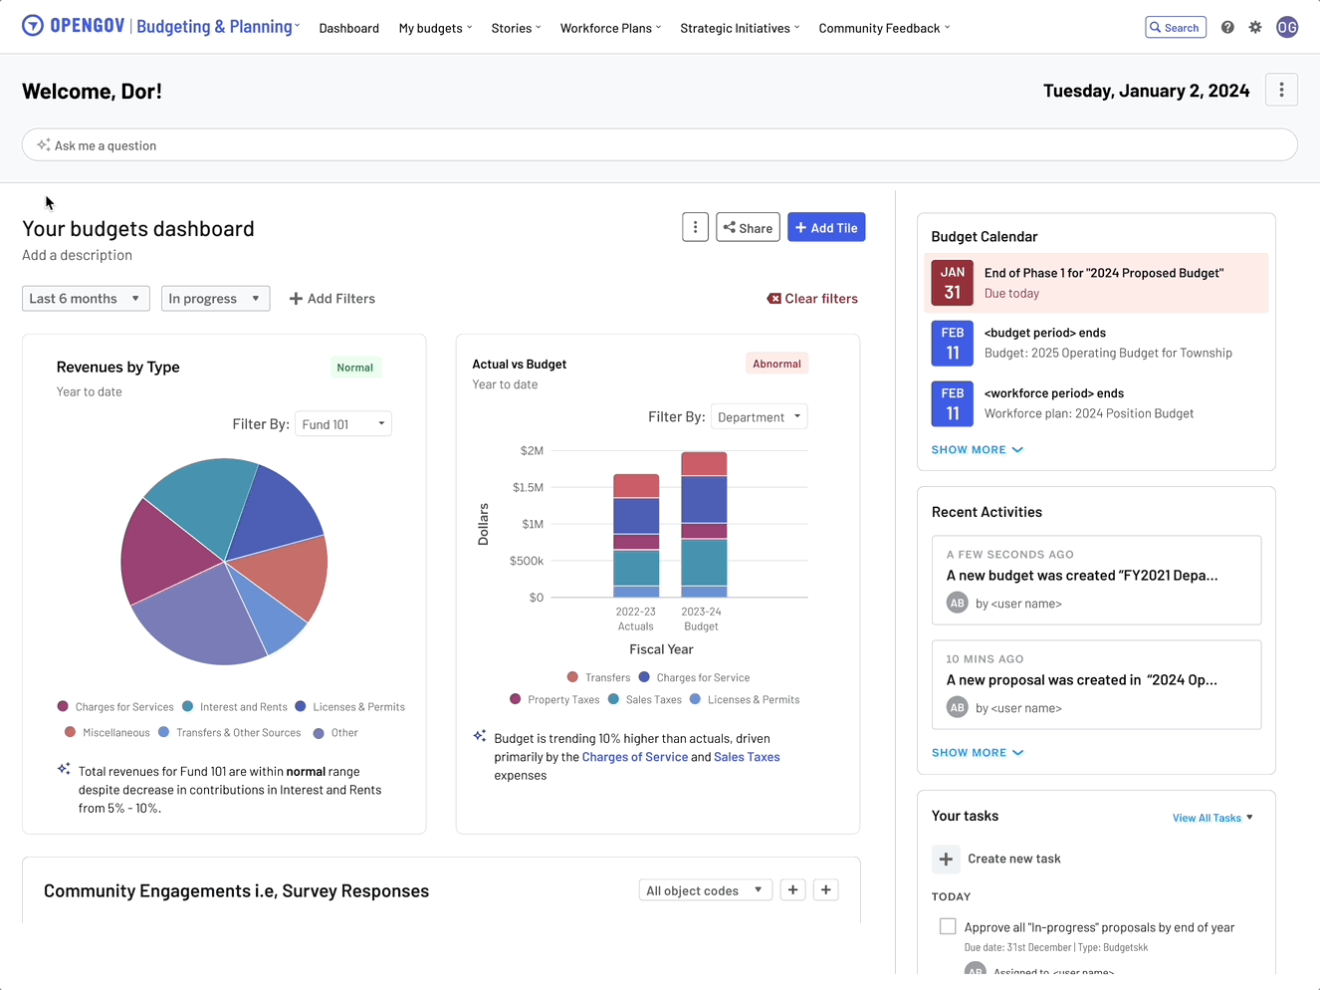
OpenGov Cloud: Simplified Help and Search Access
Introduce advanced search and help capabilities across all suites.
Search: AI-assisted search to help users find what they need quickly
Integrated resource center, chat, and support brings help to users right from the suites.
Notes:
Get what you need faster and easier
OpenGov is using AI to make your work easier, and part of that is a powerful search feature that pulls information specifically from your data to get your users what whey need
Integrating our resource center into the product will also help

Slide 28
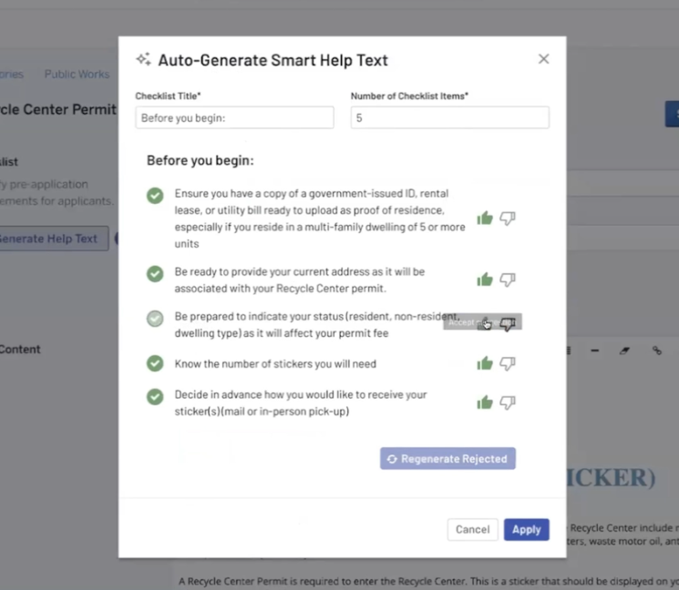
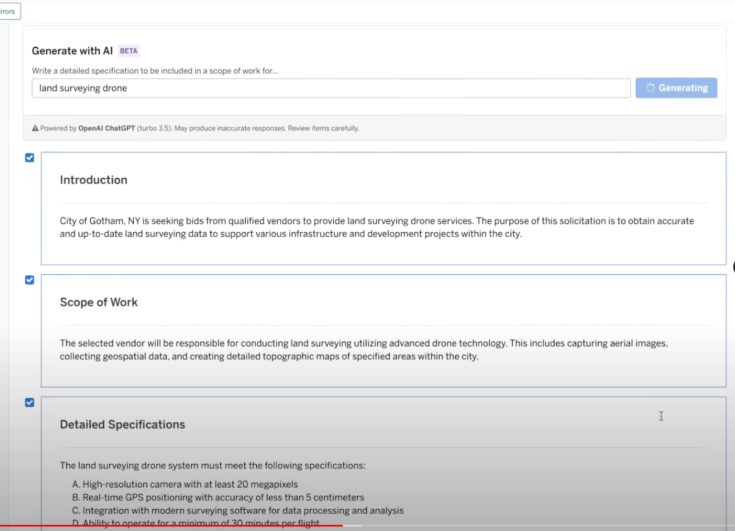
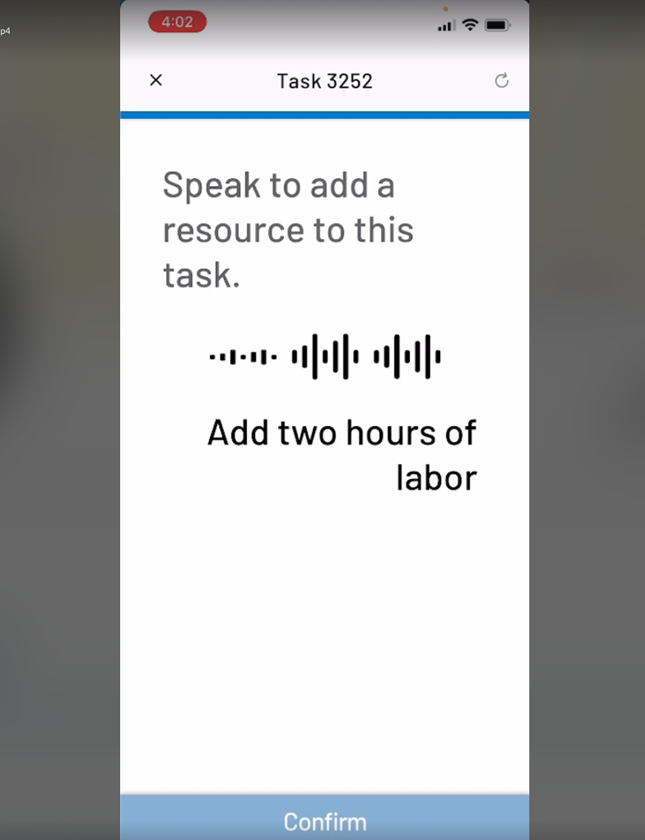
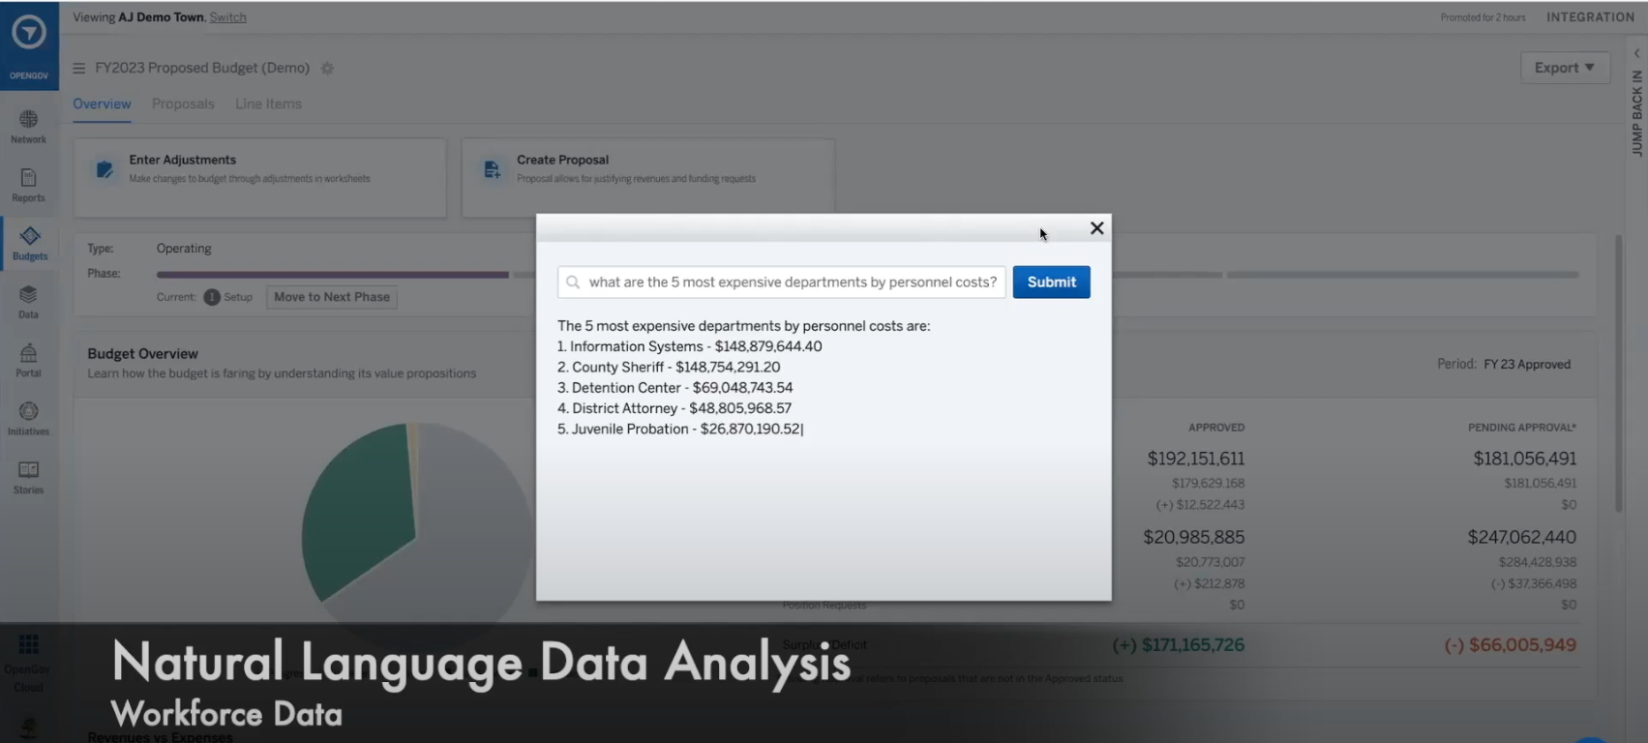
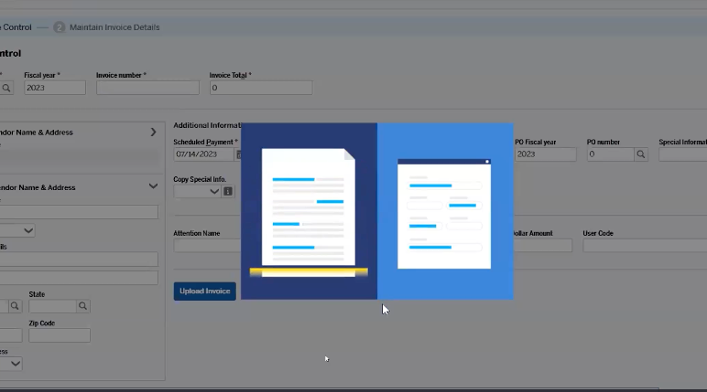
AI Product Evolution
Early Prototypes currently enroute to shipping product
Permitting & EAM
Budgeting & Planning
Financials
Procurement
Dynamic applicant guide (PLC)
Field Worker voice assistant (EAM)
Asset and Task search and navigation (EAM)
NLP search and filters (EAM)
Global Search and Intelligent Assistant
Auto generation of stories and budget books
Auto-Narratives from tables, charts and graphs
Synthesis of Community Feedback.
Smartscan for Invoice Entry and Validation (H1)
Application Navigation (H1)
NLP for Flexible Inquiries (H1)
Automatic categorization of goods and services
Automated supplier discovery
Auto Generation of Purchasing Specifications and Statements of Work

Slide 29
Questions?

