Slide 1
Navigating the Intersection:
Understanding Cybersecurity Risks in the Age of AI
Chad Spitters

Slide 2
What is AI? What is Generative AI?
The dictionary definition of AI is the capability of computers or programs to operate in ways believed to mimic human thought processes, such as reasoning and learning.
Generative AI
  A type of AI that can create new content and ideas, including conversations, stories, images, videos, and music from artifacts with similar characteristics.
  Powered by large machine learning (ML) models that are pretrained on vast amounts of unlabeled data, fine-tuned, and adapted to a wide range of applications.

Slide 3
Is Generative AI “learning”? Can it “understand”?
The terms we use to describe Gen AI are implicitly human terms such as learn, teach, and understand.
We need to remember that when using any of the Gen AI tools, we are using a computer application.
What are some other computer programs, and why is this important to understand?

Slide 4
How do we use ChatGPT? What can it do?
Cleaning up and formatting large amounts of data. Pasting or uploading a large set of data and asking to change it to what you want.
Explain complex documents by summarizing main points or explaining a topic we don’t understand.
Write computer code or help find the problem in code.
Make images, create stories, write papers, do homework, create videos, mimic voices and sounds, sort through image.
Every day there is something new!
The possibilities seem endless.

Slide 5
Vulnerabilities and Patches
Keeping in mind that this an application running in the cloud, does it need to be patched?
Consider this:
  How often do we see patches for our phones and computers?
  How long have the iPhone and Windows been around?
Gen AI does not patch or update itself. We are relying on those running the application to update and patch.
Why do we care about this?

Slide 6
Gen AI exploits on unpatched systems
ShadowRay:
First Known Attack Campaign Targeting AI Workloads Actively Exploited In The Wild
Attack targeted the computer framework Gen AI was built on.
The attacks have been active for at least seven months.
The Result
  Tampering of AI models – “Changing the code as it were”
  Compromise of network credentials, allowing access to internal networks and databases.
    Platforms including OpenAI, Hugging Face, Stripe, and Azure.
    Among the compromised sensitive information are AI production workloads, which allow the attackers to control or tamper with models during the training phase and, from there, corrupt the models’ integrity.
What can we do about this?

Slide 7
Are these AI programs biased?
Biased is defined as “Tending to show favor towards or against one group of people or one opinion for personal reasons; making unfair judgments.”
AI bias, also known as machine learning bias or algorithm bias, refers to AI systems that produce biased results reflecting and perpetuating human biases within a society. These biases can stem from historical and current social inequalities.
One main area of bias is Training Data Bias
  AI systems learn from training data, so assessing datasets for potential bias is crucial.
  Over- or underrepresentation of certain groups in the training data can lead to biased outcomes.
Is anyone going to let us look at what the AI is trained on?

Slide 8
Bias examples
Online advertising
Independent research at Carnegie Mellon University in Pittsburgh revealed that Google’s online advertising system displayed high-paying positions to males more often than to women.
Applicant tracking systems
Amazon stopped using a hiring algorithm after finding it favored applicants based on words like “executed” or “captured,” which were more commonly found on men’s resumes.
Image generation
Academic research found that when the generative AI art generation application Midjourney was asked to create images of people in specialized professions, it showed both younger and older people, but the older people were always men, reinforcing gendered bias of the role of women in the workplace.
Healthcare
Computer-aided diagnosis (CAD) systems have been found to return lower accuracy results for black patients than white patients.

Slide 9
What can we do about bias in AI?
Human touch—Processes like the “human-in-the-loop” system offer options or make recommendations that humans then review before a decision is made to provide another layer of quality assurance.
Where does the model come from, and who trained it?
The larger companies are more likely to act and correct the bias or, better yet, identify it up front before going to market.

Slide 10
How many AI websites are there?
As of January 2024, there are approximately 62,000 AI companies in the world. The large majority of these are start-ups.
These tools are being rushed to market very quickly. As with any high-tech hype cycle, people deploy systems, put out applications, and create new experiences to meet the needs of the business and the market, and often will neglect security.
How is this causing problems?
  June 2023 -Microsoft AI researchers accidentally exposed tens of terabytes of sensitive data, including private keys and passwords. The data included 38 terabytes of sensitive information, including the personal backups of two Microsoft employees’ personal computers. The data also contained other sensitive personal data, including passwords to Microsoft services, secret keys and more than 30,000 internal Microsoft Teams messages from hundreds of Microsoft employees.
“However, as data scientists and engineers race to bring new AI solutions to production, the massive amounts of data they handle require additional security checks and safeguards. With many development teams needing to manipulate massive amounts of data, share it with their peers or collaborate on public open-source projects, cases like Microsoft’s are increasingly hard to monitor and avoid.” - Wiz co-founder and CTO Ami Luttwak

Slide 11
Is this a hallucination?
A hallucination occurs when the AI produces outputs that are nonsensical or altogether inaccurate.
In essence, the AI “hallucinates” its response similarly to how humans might see shapes in clouds or faces on the moon.

Slide 12
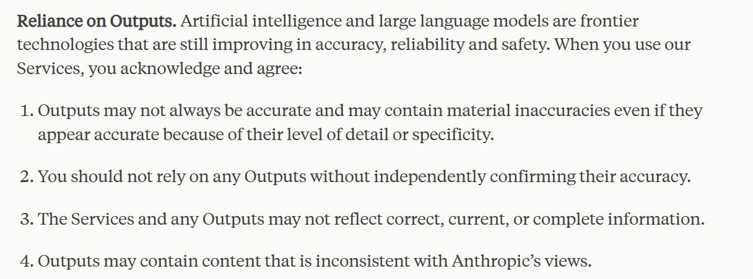

Real World Hallucinations
As of January, there have been at least 14 cases of lawyers filing briefs or appeals with false case cites in which they used ChatGPT or another AI to write or look up cases. AI hallucinated the cases it referenced.
- Anthropic’s Consumer Terms of Service - Consumer Terms of Service \ Anthropic
- ChatGPT - https://chat.openai.com
ChatGPT can make mistakes. Consider checking important information.

Slide 13
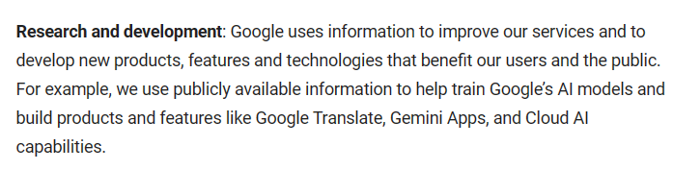
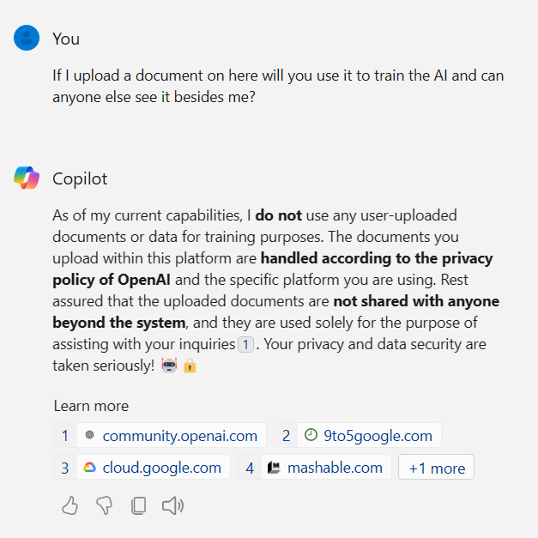
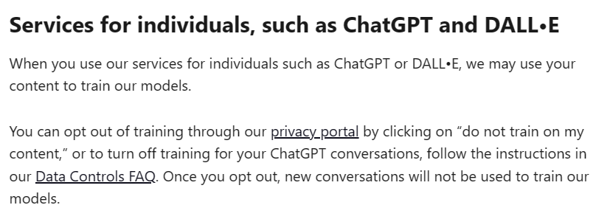
Data Leakage
What happens to your questions, answers, and documents you create or upload?

Slide 14
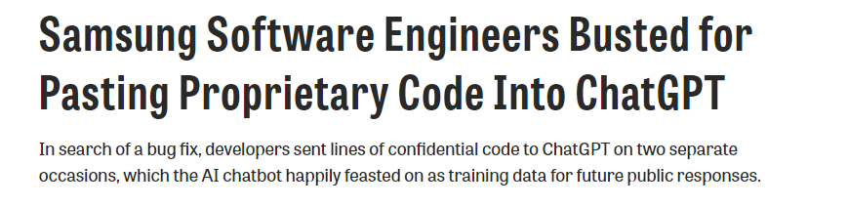
How do we protect ourselves against Data Leakage?

Slide 15
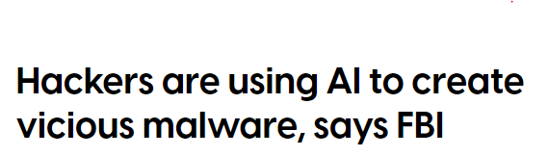
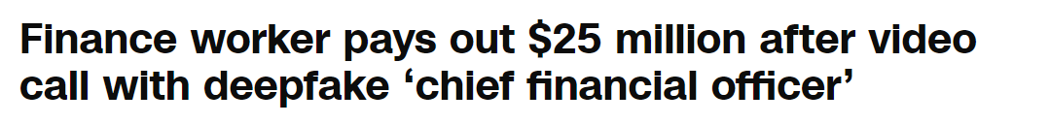
Are bad guys using AI?

Slide 16
What should we do about AI?
We need to make sure everything AI tells us is reviewed by a human.
Do not upload any documents to the Chat AI interfaces without knowing how the documents are used after upload.
For every new AI tool or website, we need to understand how long they have been around.
Be wary of unusual phone calls or video conferences that we did not expect.
Remind ourselves that AI is still in its early stages and is a computer program.

