Slide 1
Tech-Savvy Governance: Mastering Data in the Digital Era
Kiersten Farmer, Data Scientist, City of Henderson

Slide 3
Learning Objectives
Agenda
Data Privacy
Data Security
Data Compliance
Data Strategy
Gain foundational knowledge in data security, privacy, and compliance, tailored for municipal contexts.
Explore strategic applications of technology to enhance municipal operations and service delivery.
Develop a keen understanding of managing and leveraging data for visionary decision-making.

Slide 4
AI is YOUR Toddler

Slide 5
Tell me…
If you could have one data-related superpower to improve your municipality, what would it be?

Slide 6
Foundational Knowledge: Data Privacy

Slide 7
Foundational Knowledge: Data Privacy

Slide 8
Data Privacy Fundamentals
Purpose Limitation
Data Minimization
Accountability
Personal data must be collected for specified, explicit, and legitimate purposes, and not further processed in a manner that is incompatible with those purposes.
Personal data must be adequate, relevant, and limited to what is necessary in relation to the purposes for which they are processed.
The data controller must be responsible for, and be able to demonstrate compliance with, the principles of data protection.
Integrity and Confidentiality
Accuracy and Storage Limitation
Personal data must be processed in a manner that ensures appropriate security, including protection against unauthorized or unlawful processing and against accidental loss, destruction, or damage.
Personal data must be accurate and kept up-to-date. Data must not be kept for longer than is necessary for the purposes for which the personal data are processed.

Slide 9
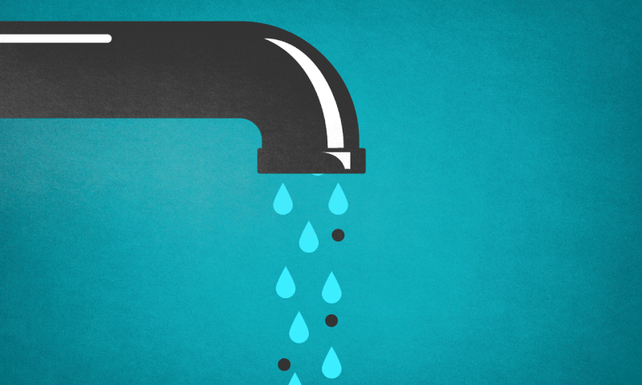
Imagine…
Lawfulness = Legal Basis Ex. Municipal Mandate
Fairness & Transparency = What & Why
Ex. Water Usage To Plan Infrastructure Upgrades
Purpose Limitation = Restrict Data
Ex. Parks Pool Newsletter
Data Minimization = Necessary Data
Ex. Social Security Numbers
Accuracy = Correct and Timely
Ex. Daily Meter Readings
Storage Limitation = Delete The Data Ex. Records Retention Policy
Integrity And Confidentiality = Securing Data & Training Staff
Ex. Encrypted Access Protocols
Accountability = Demonstrate Principles Followed
Ex. Audit Trail Documentation

Slide 10
Privacy in the Municipal Context
Public Right to Information vs. Individual Privacy
Data Management Across Systems and Departments
Balancing the public's right to information with individual privacy concerns in data-driven cities.
Ensuring seamless and secure data sharing and integration across various municipal systems and departments.
Protecting Vulnerable Populations
Building Public Trust Through Privacy-Protective Practices
Safeguarding the privacy and security of sensitive data belonging to vulnerable groups, such as minors, the elderly, and marginalized communities.
Implementing transparent, privacy-preserving data governance policies to foster public trust in smart city initiatives.

Slide 11
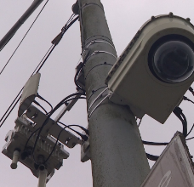
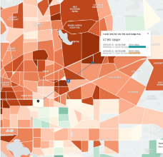
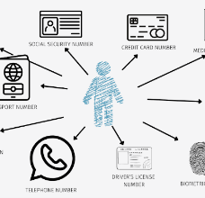
Privacy Pitfalls - Cautionary Tales
Seattle Surveillance Cameras
Backlash and City Ordinance
Proactive Privacy Planning And Impact Assessments
Transparency And Public Engagement Around Data Initiatives
Risks Of Re-identification And The Limitations Of Anonymization
Criticality Of Strong Data Governance And Sharing Protocols
Uber Trip Data
Data Anonymization Limits

Slide 12
Operationalizing Privacy
Conduct Data Inventory and Mapping
Perform Privacy Impact Assessments (PIAs)
Develop and Implement Privacy Policies
Provide Privacy Training
Establish Data Governance Structures
Foster a Culture of Privacy
Document what personal data is collected, where it's stored, how it's used, and who has access to it.
Evaluate the privacy risks of data systems, programs, and initiatives, and mitigation strategies.
Establish clear rules for data collection, use, access, sharing, and retention.
Educate staff on privacy principles and policies. Implement role-based training for those handling sensitive data.
Create cross-functional teams to oversee data practices and review and update policies and procedures.
Emphasize privacy as a core value and responsibility and encourage proactive identification and remediation of privacy risks.

Slide 13
Privacy in Action - Building a Privacy Program
Scenario: Your city is launching a new initiative to collect and analyze citizen energy usage data to inform sustainability programs. How would you build privacy into this initiative?

Slide 14
Privacy in Action - Building a Privacy Program
How will you notify residents and obtain consent for data collection?
What data will you collect, and what will you exclude?
How will you use and share the data? What safeguards will you put in place?
How will you protect and secure the data?
How long will you retain the data, and how will you dispose of it?
How will you communicate about the program and engage the public?
Scenario: Your city is launching a new initiative to collect and analyze citizen energy usage data to inform sustainability programs. How would you build privacy into this initiative?

Slide 15
Foundational Knowledge: Data Security

Slide 16
Foundational Knowledge: Data Security

Slide 17
Data Security Fundamentals
Confidentiality
Integrity
Availability

Slide 18
The Municipal Threat Landscape
Natural Disasters
Cyber Attacks
Infrastructure Failures
Civil Unrest
Earthquakes, floods, and other natural disasters like COVID can disrupt municipal services and infrastructure.
Ransomware, data breaches, and other cyber threats can compromise municipal networks and systems.
Aging or inadequate infrastructure such as water, power, and transportation systems can fail and impact public services.
Protests, riots, and other forms of civil unrest can strain municipal resources and disrupt operations.

Slide 19
Key Threats
Ransomware
Phishing
Atlanta (2018): Ransomware attack shut down city services, cost $17M
Baltimore (2019): Ransomware attack froze city systems, cost $18M
New Orleans (2019): Phishing attack led to declaration of state of emergency
Insider Breach
Former employee stole personal data of 65K Boston residents.
SMART Cities Vulnerabilities
Unsecured IoT devices and sensors can pose a threat.
Legacy Systems
Outdated technology with unpatched vulnerabilities

Slide 20
Anatomy of a Data Breach
March 2019
March-April 2019
March-April 2019
City computers infected with RobbinHood ransomware
City refused to pay; systems remained down for weeks
Workarounds: Crews sent to physically shut off water for overdue accounts
March-April 2019
March 2019
March 2019 - Present
Services disrupted: Online payments, email, real estate transactions, water billing
Attackers demanded 13 Bitcoin (~$100K) to unlock data
Recovery lasted months; cost estimated at $18M

Slide 21
Elements of a Strong Municipal Cybersecurity Program
Governance
Risk Management
Access Management
Data Protection
Network Security
Endpoint Security
Application Security
Incident Response
Disaster Recovery
Training and Awareness

Slide 22
Cybersecurity in Action - Incident Response Exercise
Scenario: Your city's public utility has been hit with ransomware. Customer data has been encrypted, the online payment portal is down, and the attacker is demanding a $500K ransom. What do you do?

Slide 23
Foundational Knowledge: Data Compliance

Slide 24
Foundational Knowledge: Data Compliance

Slide 25
The Regulatory Landscape
Freedom of Information Act (FOIA) and state open records laws
These laws require government agencies to disclose public records upon request, with some exceptions, ensuring transparency and accountability in municipal data management.
Health Insurance Portability and Accountability Act (HIPAA)
HIPAA sets standards for the protection of sensitive patient health information, impacting the handling of medical data by municipal entities.
FBI Criminal Justice Information Services (CJIS) Security Policy
This policy establishes security requirements for the access, transmission, and storage of criminal justice information by government agencies, including municipalities.
Payment Card Industry Data Security Standard (PCI DSS)
PCI DSS provides a set of requirements for ensuring the secure handling of payment card data, affecting municipalities that process credit/debit card payments.
Family Educational Rights and Privacy Act (FERPA)
FERPA protects the privacy of student educational records, which municipalities may handle for public schools and other educational programs.
General Data Protection Regulation (GDPR) for international data
GDPR is a comprehensive data privacy law that impacts the handling of personal data, including for municipalities with international data processing activities.

Slide 26
Compliance Program Maturity Model
1
Level 1 - Ad Hoc
- No formal policies or procedures - Reactive approach to compliance - Limited awareness and training
2
Level 2 - Developing
- Basic policies in place - Some compliance responsibilities assigned - Compliance considered in new projects
3
Level 3 - Defined
- Comprehensive policies and procedures - Dedicated compliance team - Regular compliance assessments
4
Level 4 - Managed
- Compliance integrated into all operations - Extensive training and awareness - Compliance metrics tracked and reported
5
Level 5 - Optimized
- Compliance as a core value - Proactive improvement of compliance posture - Compliance enabling business objectives

Slide 27
Operationalizing Compliance
Respond and Improve
Assign Compliance Responsibilities
Conduct a Data Inventory
Develop incident response plans to address compliance failures. Continuously review and improve policies and procedures based on lessons learned.
Designate a Chief Compliance Officer and establish a cross-functional compliance committee
Map the flow of data across the organization to identify all regulated data and the applicable compliance requirements for handling that data.
1
7
2
Monitor and Audit
6
3
Develop Policies and Procedures
Regularly assess the organization's compliance posture through internal and external audits. Identify areas for improvement.
5
4
Translate legal requirements into operational policies that can be consistently applied across the organization. Develop standard operating procedures for handling data in compliance with those policies.
Train and Raise Awareness
Implement Technical Controls
Train all staff on compliance policies and procedures, with targeted training for roles that handle sensitive data.
Configure systems to enforce compliance policies, such as access controls and logging. Implement compliance-supporting tools like consent management systems.

Slide 28
Compliance in Action - Data Sharing Agreement
Scenario: Your city's health department wants to share COVID-19 case data with the county to support contact tracing efforts. Draft a data sharing agreement that ensures compliance with relevant regulations.

Slide 29
Data Strategy: Leveraging Data for Decision-making

Slide 30
Leveraging Data for Decision-making

Slide 31
From Compliance to Strategy
Reactive Compliance
Proactive Protection
Ethical Data Practices
Data governance is seen as a necessary evil, with the focus on meeting the bare minimum legal requirements.
Data governance is viewed as a risk management practice, with the goal of preventing data breaches and violations.
Data governance is considered a moral imperative, emphasizing transparency, fairness, and social responsibility in data practices.
Data as an Asset
Data-Driven Transformation
Data governance is recognized as a value-creation opportunity, using data to drive insights and innovation.
Data governance is a strategic enabler, with data woven into all decisions and operations.

Slide 32
The Building Blocks of a Data Strategy
Vision
Principles
Priorities
Initiatives
Governance Framework
Enablers

Slide 33
The Data Strategy Process
Assess
Evaluate the current state of data practices, identify strengths, gaps, and opportunities to improve data management and utilization.
Engage
Consult stakeholders across the city to gather input on priorities and needs, ensuring the data strategy aligns with the organization's goals and requirements.
Define
Articulate a clear vision and principles for the data strategy, set priorities, and identify key initiatives to drive data-driven decision-making.
Plan
Develop a governance framework to oversee the data strategy, and identify the necessary enablers and resources required to successfully implement the initiatives.
Act
Execute the identified initiatives, measure progress, and track the impact of the data strategy to ensure it delivers the desired outcomes.
Evaluate & Iterate
Assess the outcomes and lessons learned from the data strategy implementation, and refine the strategy based on new insights and evolving needs.

Slide 34
Data Strategy in Action - Making the Case
Scenario: You've been tasked with making the case for investing in a citywide data strategy to senior leadership. Prepare an elevator pitch that outlines the key benefits and requirements.

Slide 35
Conclusion

Slide 36
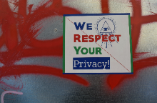
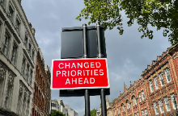
Key Takeaways
Data as a Strategic Asset
Privacy, Security, and Compliance
Effective Data Governance
Aligning Data with City Priorities
Continuous Improvement

Slide 37
A Call to Action
Assess Current Data Practices
Engage Stakeholders
Develop A Roadmap
One Concrete Action
Stay Engaged And Keep Learning

Slide 38
Questions

Slide 39
Thank You Linkedin.com/in/kiersten-farmer/

