Slide 1
We’ve Got Performance Measures, Now What?
NAVIGATING THE WHAT WORKS CITIES CERTIFICATION AS A <50K COMMUNITY
Wally Bobkiewicz, City Administrator, Issaquah, WA
Dale Markey-Crimp, Assistant to the City Administrator, Issaquah, WA
Elise Allari, Associate, What Works Cities Certification Team

Slide 2

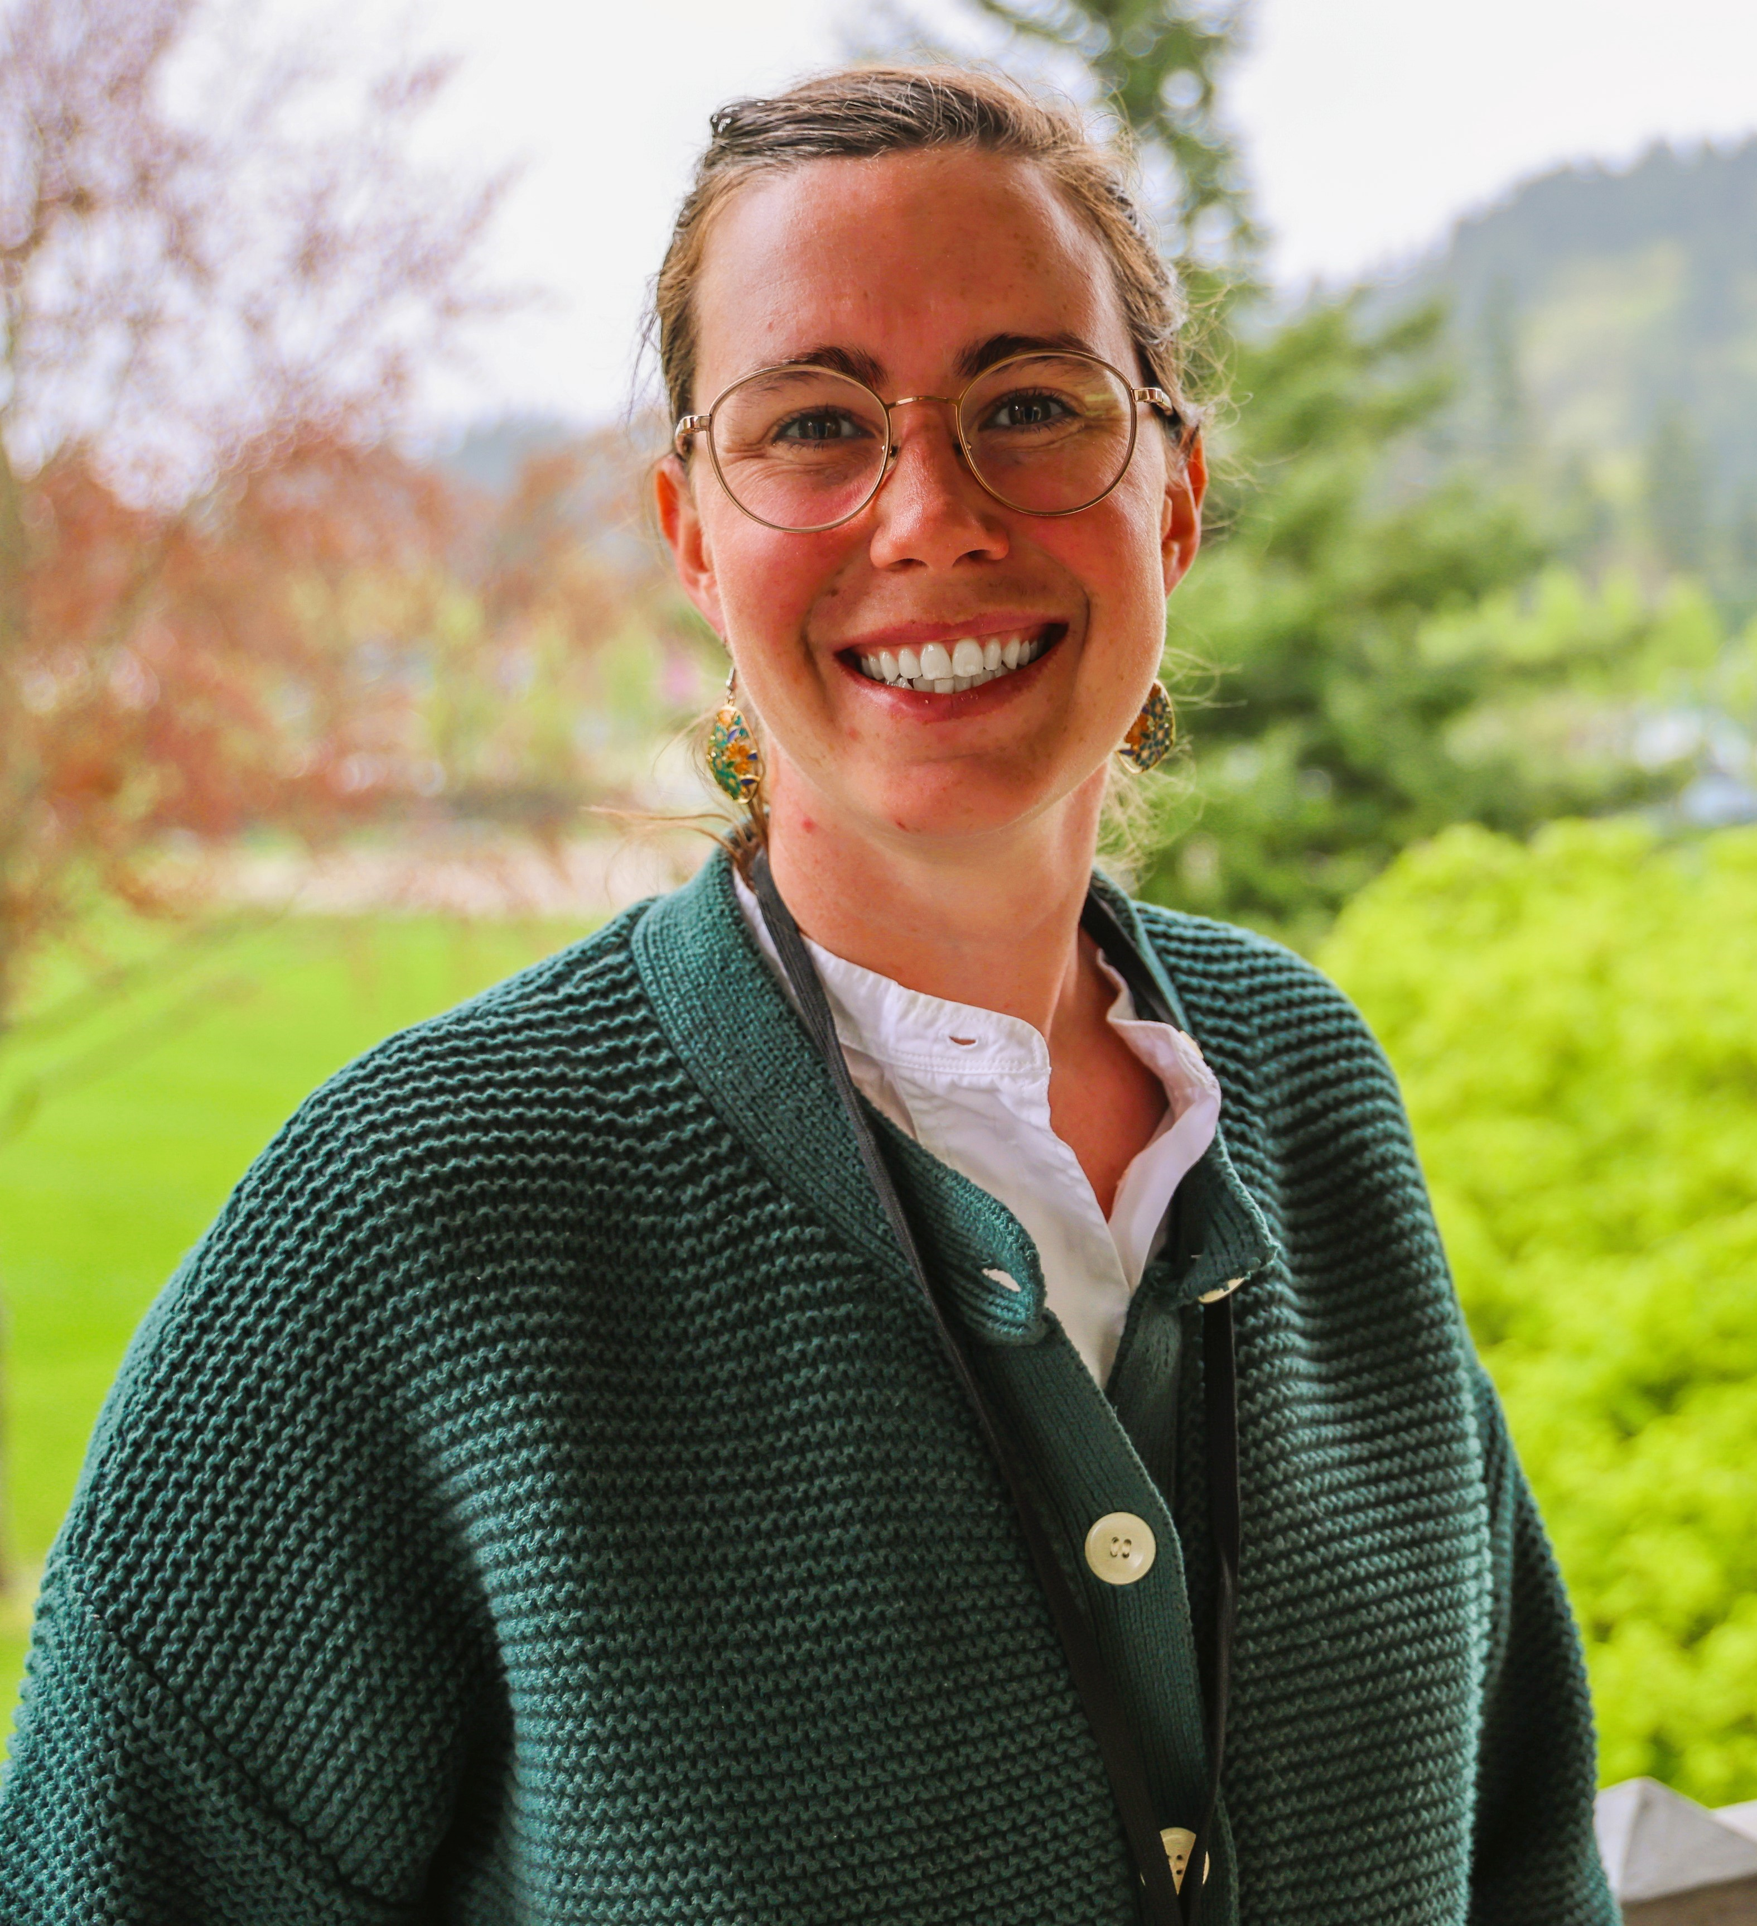
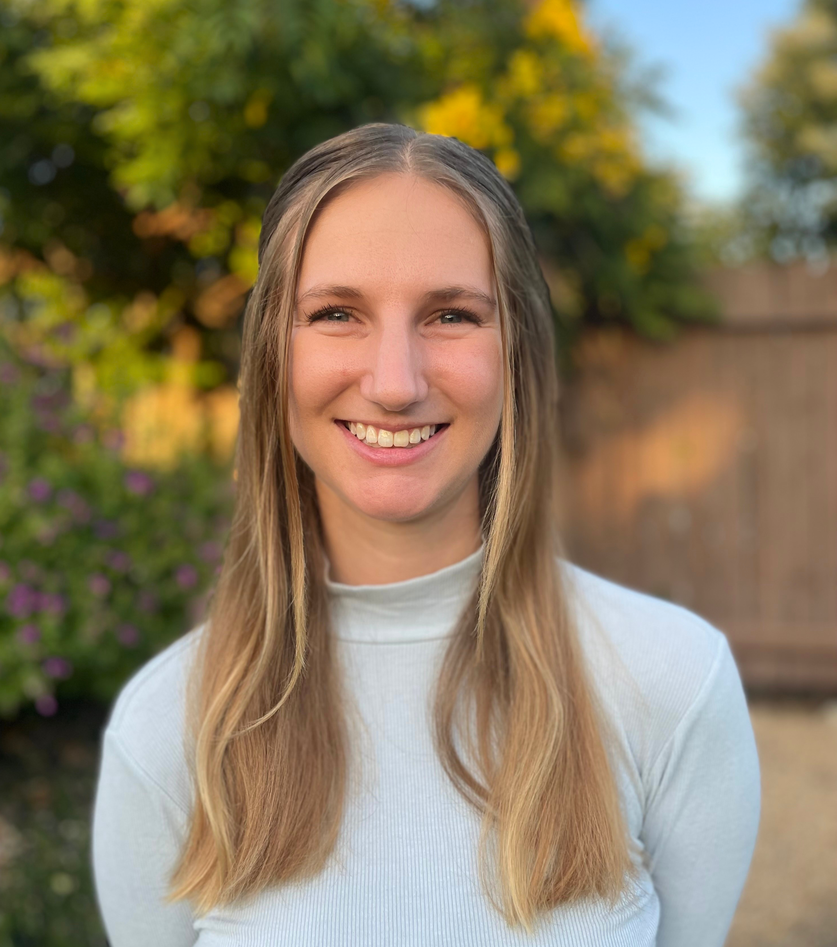
Wally Bobkiewicz
City Administrator
City of Issaquah, WA
Dale Markey-Crimp
Assistant to the City Administrator
City of Issaquah, WA
Elise Allari
Associate
What Works Cities

Slide 3
Think and Sketch
Take 5 minutes to draw a map of the world from memory.

Slide 4
…and SHARE!
How did you think about your map/create it?
What inputs did you use to help you make these decisions?
What’s different about your maps?
Is there anything that is similar? If so, why do you think that is?

Slide 5
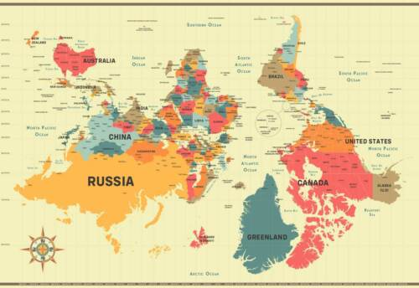
Maps are Stories are Data
Show me your story!

Slide 6
5 Key Steps of Working with Data
Abstraction
Collection
Coding/Analysis
Visualizing/Annotating
User Testing

Slide 7

City of Issaquah, WA
Population: ~40,000, 12 sq. miles
Org size: 280 FTE across 10+ departments
Strong Mayor, 7-member City Council
Notes:
Wally

Slide 8

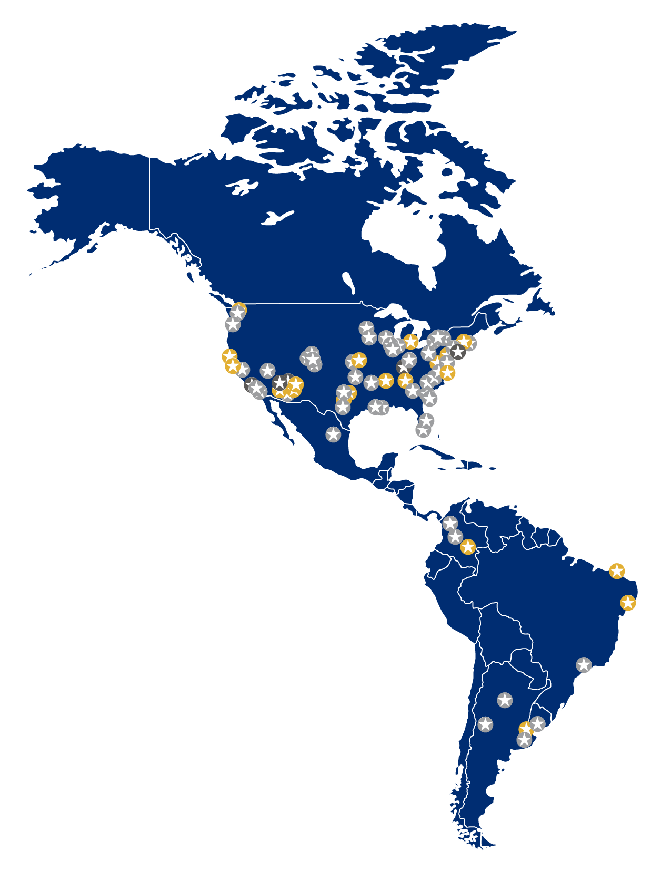
What Works Cities Certification
What Works Cities Certification, founded by Bloomberg Philanthropies and led by Results for America, helps local governments use data and evidence at scale, to tackle their most pressing challenges and improve residents’ lives.

Slide 9
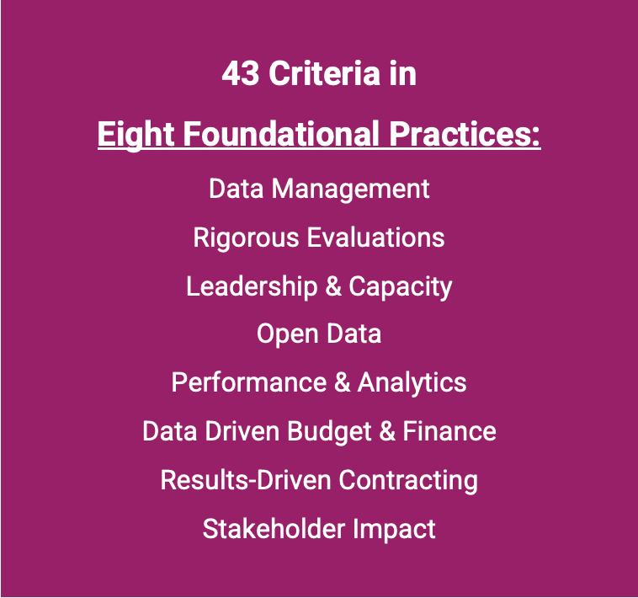
What Works Cities Certification
What Works Cities Certification, founded by Bloomberg Philanthropies and led by Results for America, helps local governments use data and evidence at scale, to tackle their most pressing challenges and improve residents’ lives.

Slide 10
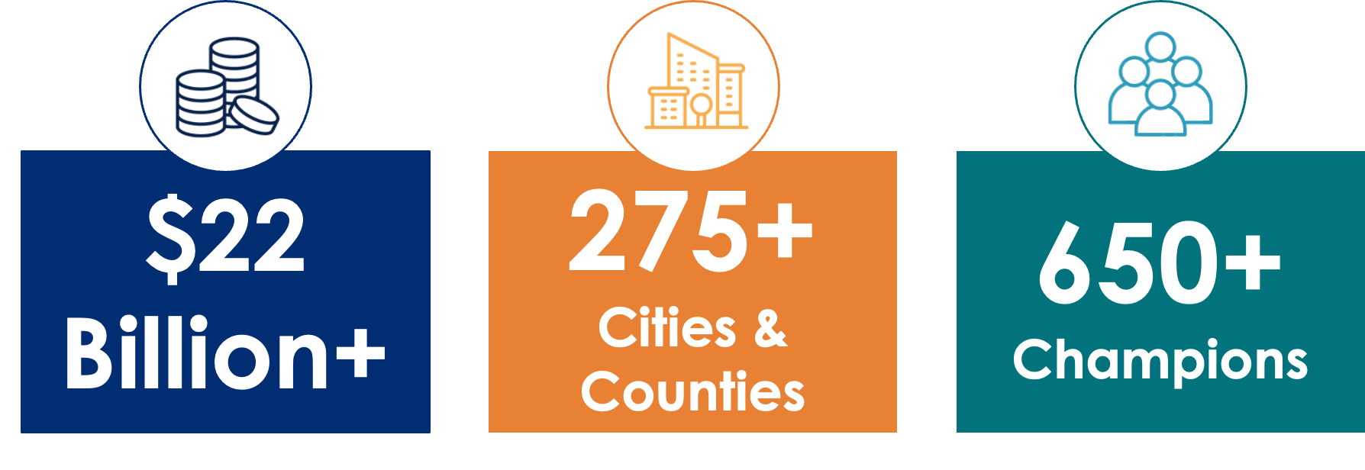
Results for America
Shifting Government Dollars.
Creating Local Solutions.
Growing the Data Movement.

Slide 11
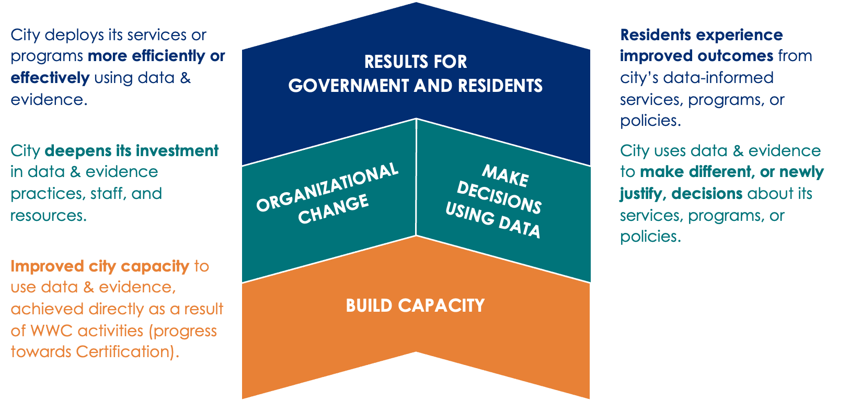
A Pathway to Getting Results

Slide 12


Cities’ Certification Journey
The What Works Cities Process

Slide 13
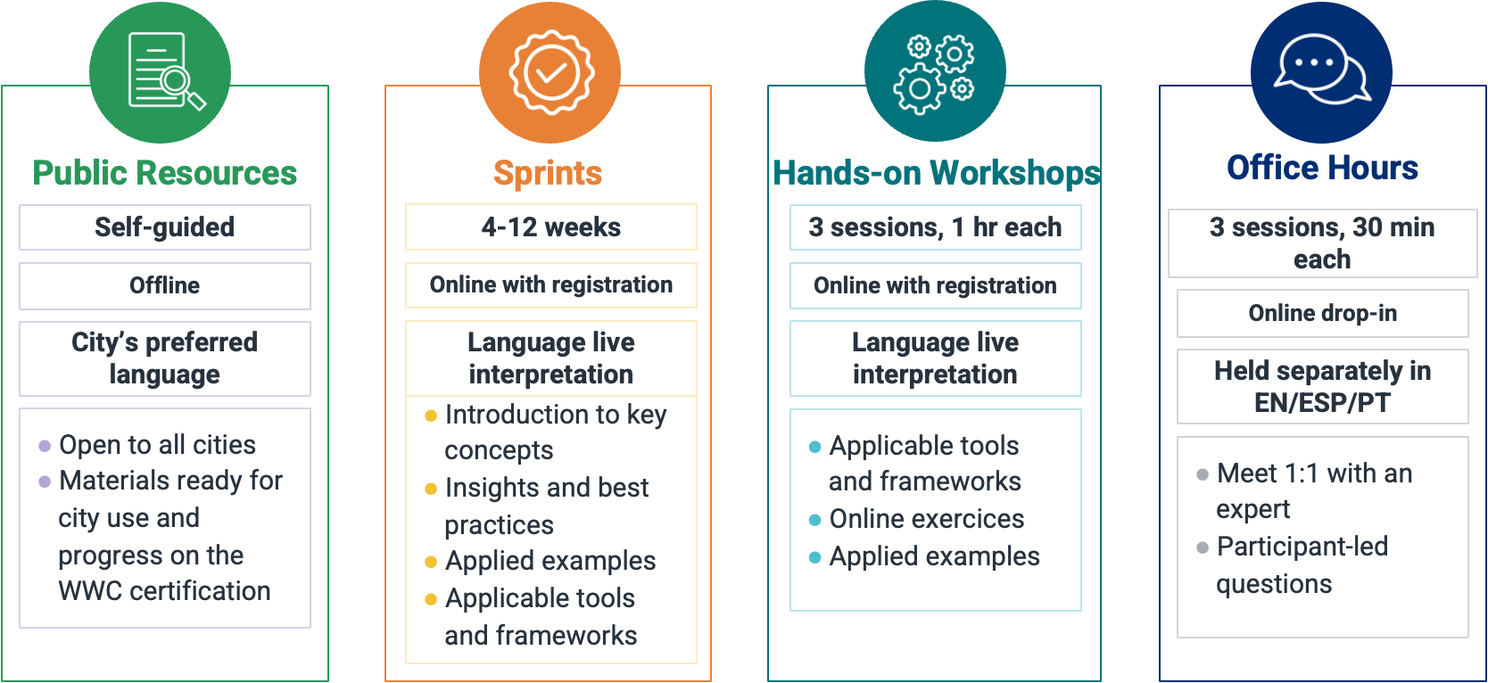
Support with Technical Assistance

Slide 14
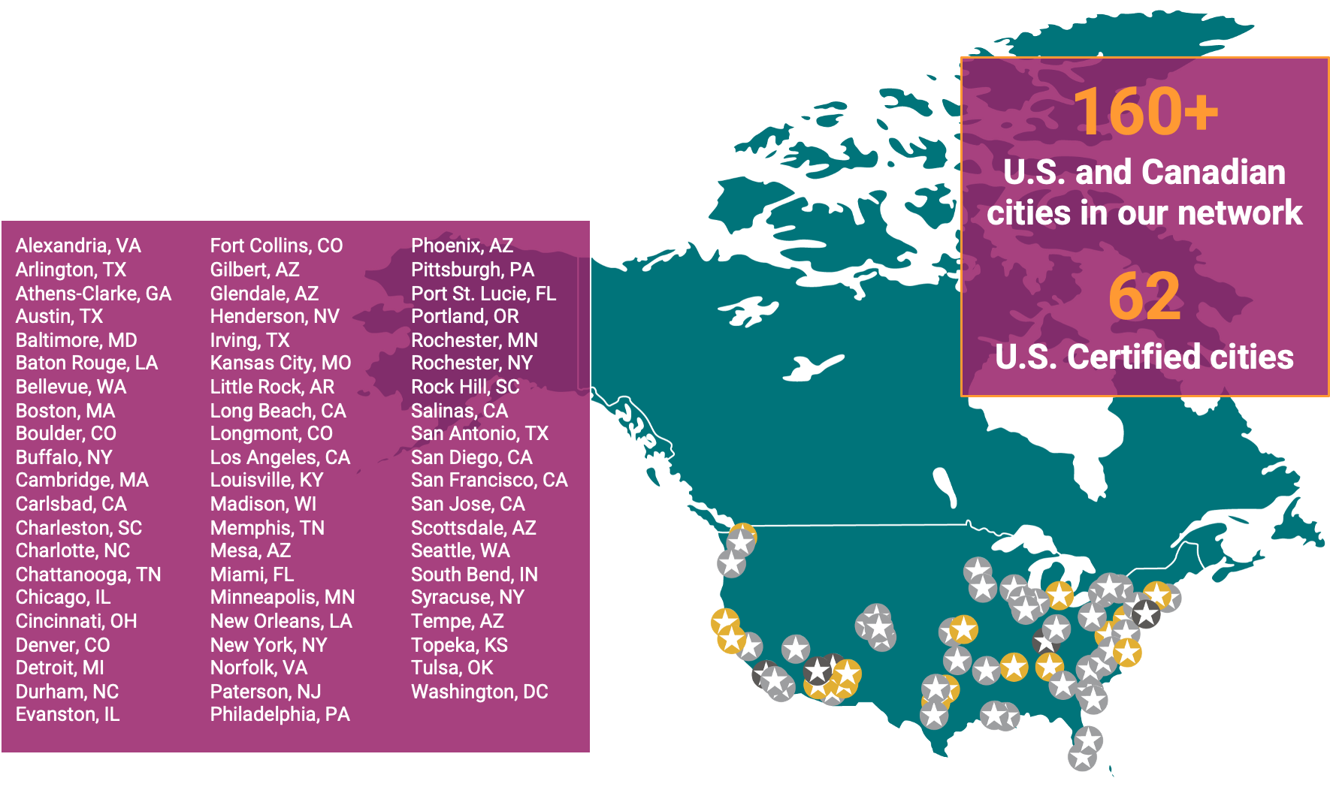
What Works Cities Certification Community

Slide 15
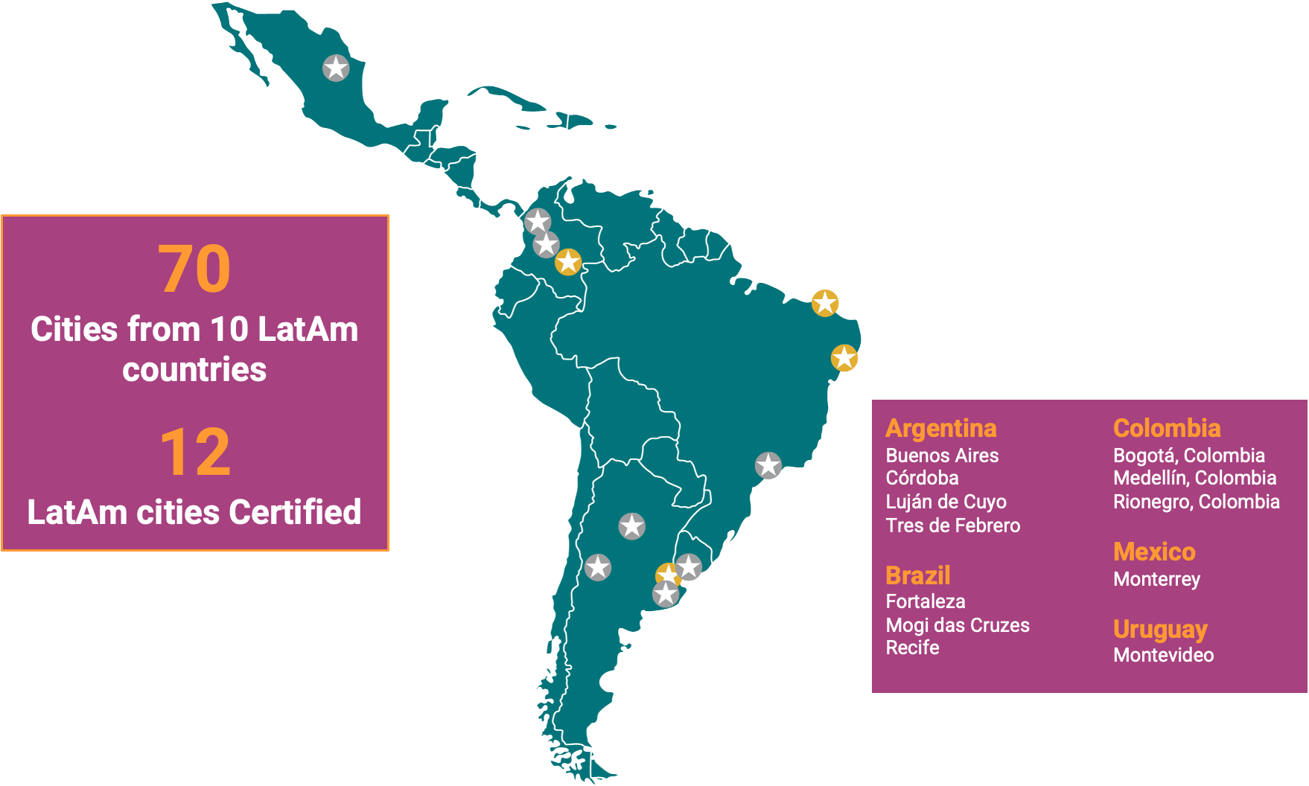
What Works Cities Certification Community

Slide 16
Okay, but how?

Slide 17

Overarching Approach
Assess agency data maturity.
Identify, understand, and nurture bright spots.
Establish relationships, high expectations, and a culture of consistency.
Develop and evolve the program to meet the diverse needs.

Slide 18
Overarching Approach
2019
Adoption of Our Issaquah Strategic Plan
Some success measures by goal area
2020
Development and adoption of Performance Measurement Plan
2021
Begin performance measurement data gathering
First What Works Cities submission
- Focus on Performance & Analytics

Slide 19
Overarching Approach
2022
Lessons Learned
Data Management
Leadership and Capacity development
Results-Driven Contracting
Data-Driven Budget and Finance
Change management approach:
Incremental and embedded in processes
Focus on addressing pain points
Build on what we’re already doing.

Slide 20
Overarching Approach
2023
Lessons Learned
Build the bench:
Department and division champions
Embed within other change management efforts (data & equity)
Build on what we’re already doing with a clear theory of progression.
Data Management, Part 2
Leadership and Capacity (focus)
Rigorous Evaluations
Open Data and Community Impact
Performance Analytics

Slide 21
Progress
2021
2022
2023
1
7
26

Slide 22
Okay, but what about my agency?

Slide 23
What Works Cities Certification Core Criteria
Data Management
Leadership & Capacity
Performance & Analytics
DM1 : Implementing Data Strategy and Governance
Your local government maintains a documented list of data strategy and governance responsibilities and meets at least quarterly to carry out those responsibilities.
LC1 : Executive Commitment to Data-Informed Government
Your mayor and/or chief executive consistently communicates and demonstrates to staff that governing with data and evidence is an organizational expectation.
PA1 : Selecting and Using Performance Metrics for Strategic Goals and Priorities
Your local government identifies strategic goals, aligns a diverse set of measures with those goals, and uses data to evaluate progress toward them.

Slide 24
Self-Assessment, Learn, Plan
Self-identify your jurisdiction’s strengths, interests, and opportunities
Gather in breakouts to:
  Learn more about an approach or strategy aligned to that criterion
  Brainstorm an approach to building skill, capacity, or success in that area based on your self-assessment

Slide 25
Self-Assessment
We do this already!
We’d like to do this, but we’re not doing it yet
WOAH, I don’t even know how to start doing that!
(and I might be a bit intimidated by it…)

Slide 26
Self-Assessment
15 minutes to rotate through the criteria, sticker accordingly.
Then, you’ll head to the criteria area you’re most interested in digging into more deeply.

Slide 27
Self-Assessment
Consider:
  Where were your strengths?
  Where are your opportunities?
  Where are your fears/far future possibilities?
  How are they similar to or different from the larger group? Why do you think that is?

Slide 28
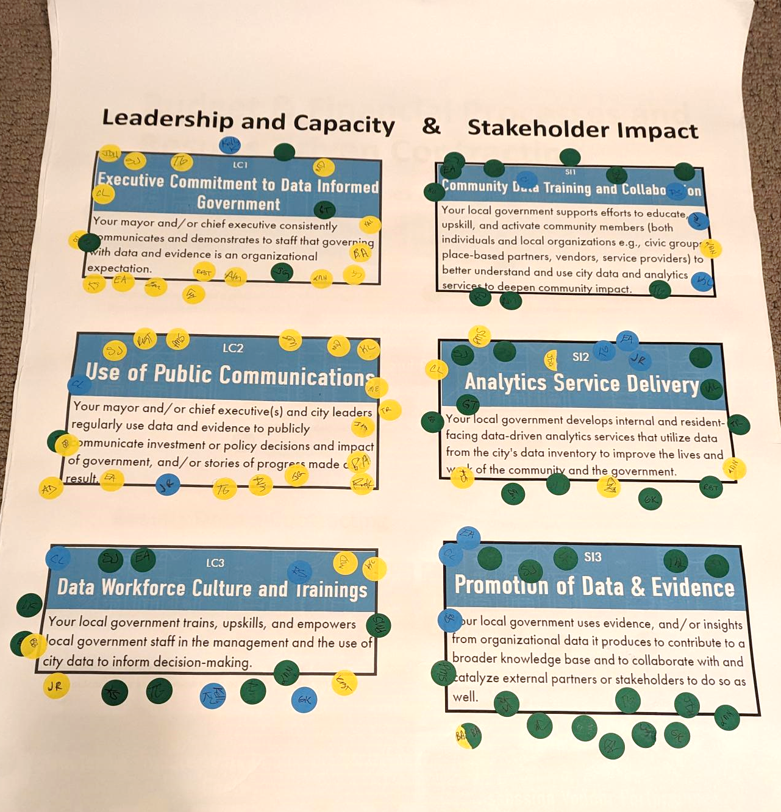
Issaquah’s Self-Assessment
What we learned:
Adaptation of rigorously evaluated programs
Promotion of data and evidence with partners
Data literacy and skills
Communicating with data
Program evaluation

Slide 29
Overarching Approach
Our 2023 initiatives
Data-Driven Decision-Making Team: Establishing a cross-departmental data-driven decision-making team.
Data Quah: Data analytics program aligned to our strategic plan—a guiding document that dictates decision-making across the organization from legislators to department directors.
#DataTuesdays: Focusing on boosting our practice of using data in public communications.

Slide 30
Okay, but then what?

Slide 31
Criteria Group Breakouts
Data Management
Leadership & Capacity
Performance & Analytics
DM1 : Implementing Data Strategy and Governance
LC1 : Executive Commitment to Data-Informed Government
PA1 : Selecting and Using Performance Metrics for Strategic Goals and Priorities
Share interests, opportunities, barriers
Explore resources and share ideas
What are your next steps or commitments coming out of today?

Slide 32
What’s next?

