Slide 1
What’s Next in Payment Tech: Exploring Possibilities for Forward-Looking Governments
Morgan Jines, Vice President, Payments
Tyler Technologies

Slide 2

Morgan Jines
Vice President, Payments & Sales
Tyler Technologies

Slide 3
Learning Objectives
Develop a deeper understanding of how payments and disbursement expansion trends will continue to shape the landscape of payment digitization.
Discover how data and analytics empower governments to understand payer behaviors and make strategic decisions that drive resident adoption.
Explore the role risk and payment security protections play in mitigating data breaches, reducing fraud, and protecting government reputations.

Slide 4
Trends Reshaping Payment Digitization

Slide 5


Which area of impact most concerns Government Agencies & Departments?
Data Privacy & Cybersecurity
Data Privacy & Authentication
Use of New Technology
Alternative Payment Methods
Real-Time Payments
Local Regulatory Pressures
Know Your Customer (KYC)
Anti-Money Laundering (AML)
Open Banking
Mergers & Acquisitions
Notes:
*Ask an open question to the audience by show of hands
*All these areas significantly contribute to the rise in digital payment adoption and delivery of new solutions to the market
*Offer examples:
-Data Privacy & Security: PCI-DSS and PCI-Validated P2PE and PCI 4.0
-NACHA: Account Validation Services Mandate to validate the payer has a real bank account and funds to pay their bill
-Alternative Payment Methods: BNPL, Digital Wallets, Crypto
-Mergers & Acquisitions: FIS & WorldPay, CapitalOne buying Discover for $35 billion

Slide 6



The Evolution of Payment Digitization
42%
86%
believe traditional payment providers will collaborate with FinTechs and Technology providers as a main source of innovation
increase in global cashless payment volumes since 2019
Generative AI could increase banking productivity by 2.8 to 4.7 percent, equivalent to
Modernization of banks’ technology stacks can reduce operating costs by 20-30% and halve time to market for new products
$200-340 billion
Digital wallet-based transactions grew globally by 7% in 2020, with the prediction that digital wallets will account for more than ½ of e-commerce payments in 2024
43%
of all payments in the U.S. and Canada are expected to be cashless by 2025
Notes:
*Payments 2025 and Beyond | PwC
*Do we want to include a timeline graphic of the entry of payment acceptance methods, where Apply Pay was introduced, then Text-to-Pay, and other Digital Wallets? The 2023 McKinsey Global Payments Report | McKinsey

Slide 7




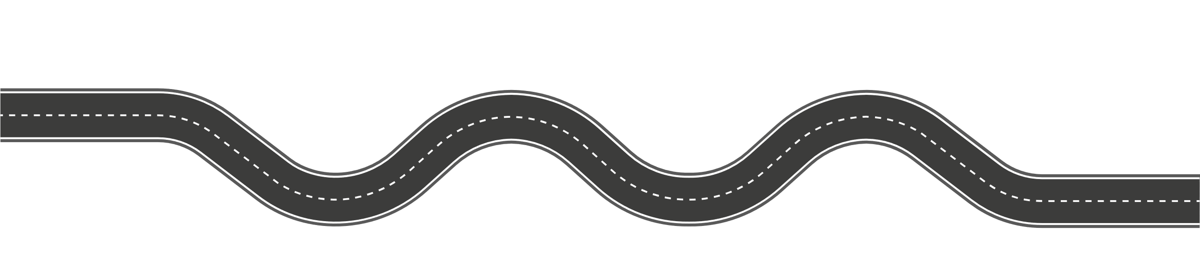











The Road to Digital Payment Acceptance
1994
2009
First online credit card transaction
Bitcoin and Venmo created
2014
2017
1997
Apple Pay
introduced
The Clearing House launches RTP (Real-Time Payment) Network
Text pay is
introduced
1995
2015
First contactless payment made
1998
Samsung Pay
introduced
PayPal founded
2011
Google Wallet
released

Slide 8

Driving the Shift to Digitized Payments
New Cashless & Mobile Technologies
Constituent Demographics & Demand
Inclusive Economy & Financial Transparency
Increased Security Awareness
Improved Cash Flow Management
Battle of the Payment Rails
Providing Greater Access to Underbanked Communities
Notes:
*Consumers Drive Demand for Real-Time Payments (pymnts.com)
*What Do Digital Payments Do For An Economy? - Payments Leadership Council
*Introduction of Digital Wallets, BNPL, Crypto, Apple Pay, Google Pay, creating simple and quick access to purchases, delivering instant authorization and satisfaction
*Constituents demand simplicity, convenience, and often setup recurring payments through a mobile-app for paying their monthly subscriptions, utility bills, or one-time driver’s license renewals
*55% of millennials and 68% of GenZ expect real-time payments
*Digital payments tools that help people better track and manage their finances help consumers stay in control of their money and make the decisions about when to spend, save, or invest. These innovative new options are key to expanded financial inclusion within the payments ecosystem
*Digital payments backed by ID and Authentication create safer transactions and connections from banking entities to the acquiring bank to the payment processor, reducing Fraud and Data Breaches
*Digital payments removes the cash flow issues associated with late payments and slow processing times for cash and checks, which 38% of small business owners in the U.S. and Canada experience
*Digital wallets will loop to adopt open-loop technologies and seek interoperability to benefit from ongoing globalization of payment rails

Slide 9
Developing a Holistic Payment Fraud Strategy

Slide 10


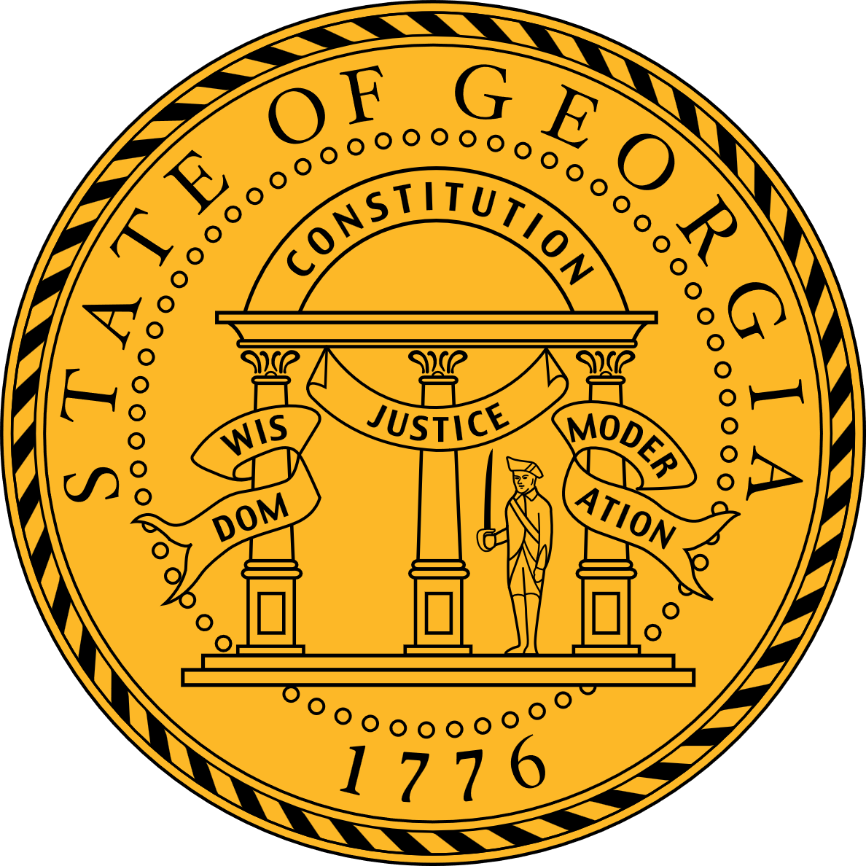


Impact From Government Data
Breaches Over the Past 10 Years
3.5 Million Records
3.6 Million Records
6.2 Million Records
21.5 Million Records
191 Million Records
Texas Comptroller’s Office
South Carolina Department of Revenue
Georgia Secretary of State Office
U.S. Office of Personnel Management
U.S. Voter Database
Notes:
*Ask an open question to the audience to name any major government data breaches from the past 10 years
*Top 10 Biggest Government Data Breaches of All Time in the U.S. (digitalguardian.com)
*Data breaches are impacting every layer of government, from local, to state, and federal, including exposure to PII, SSN, and voting affiliations, costing over $20 billion dollars

Slide 11
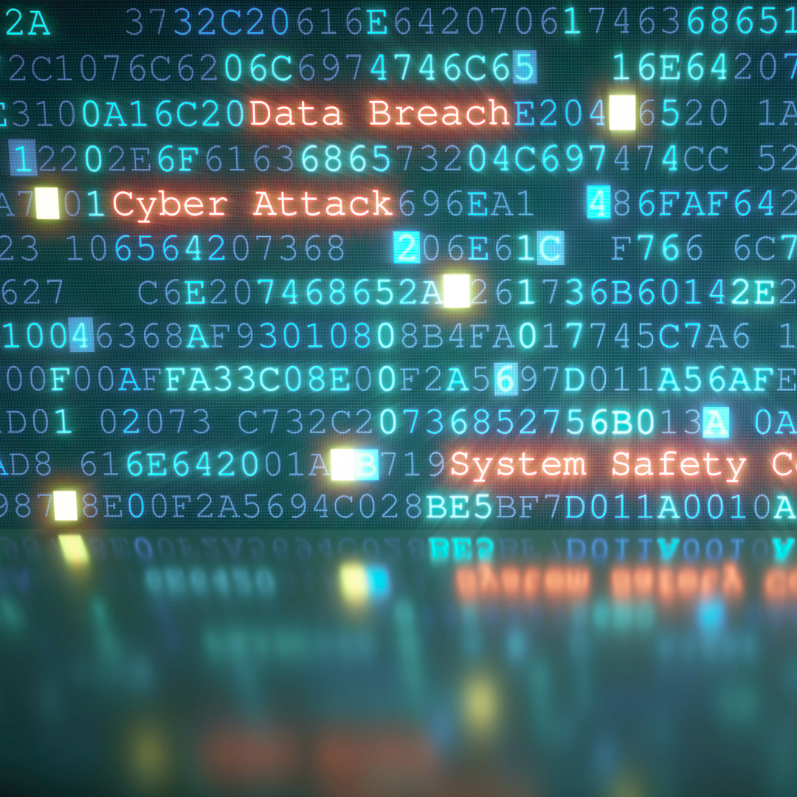
The Rise of Data Breaches in Government
Data vulnerabilities are on the rise in the public sector.
$26 billion
The cost of data breaches to local, state, and federal governments over the past decade
93%
175 million
records of personal identification information (PII) affected in 822 individual incidents nationwide
$10.5 trillion
The expected cost of cybercrime by 2025
Organizations that expect to increase cybersecurity spending in the next three years
35%
of CISOs believe AI will alleviate security skill gaps and talent shortages
Notes:
*Data breaches, led by USPS, OPM, cost governments $26 billion (federaltimes.com)
*Cybersecurity Trends & Statistics For 2023; What You Need To Know (forbes.com)

Slide 12


Source of Threats for Cybercrime
Open-Source Vulnerabilities
Advanced Phishing Technologies
Ransomware
Fraud & Identity Theft
Global Economic Headwinds
Lack of Investment & Preparation
Notes:
*Most Common Cyber Security Threats In 2024 – Forbes Advisor
*Open-Source Vulnerabilities: Antiquated code and open API exposure with security / firewall settings
*Advanced Phishing Technologies: Email access
*Ransomware: Paying to access your data and at the top of the list for a threat and final step in the process. Most recently, The Colonial Pipeline and $5M ransom to regain access to data was an example. In 2019, the City of Baltimore was forced to stop processing all payments in and out
*Fraud & Identity Theft
*Global Economic Headwinds
*Lack of Investment & Preparation

Slide 13



Defining an Offensive Approach to Fraud & Security in Government
Address Verification Services (AVS)
CVV, CVV2, CID, CVC Validation
Maximum Transaction Limits
Validation of a CAPTCHA
Real-Time Payment Authorization
NACHA Account Validation Services
Notes:
*Explain the core solutions all payment offerings and software technologies should offer with AVS, CVV, Validation of a CAPTCHA, Real-Time Payment Authorization, and NACHA Account Validation Services
*Explain some of these protect fraud against Card Present, E-Commerce, and ACH transaction types
*AVS: By collecting information about the billing address for the card, a Payment Gateway can validate through the credit card processing networks that the person paying knows the correct billing address for the card
*CVV: A Payment Gateway can process these codes at the time of payment which reduces the risk that someone without physical access to the card is making the payment
*Maximum Transaction Limits: For each service processing payments, a maximum limit on the payment amount can be configured. This minimizes the impact of fraudulent payments if they do occur and provides the ability to tailor it to the expectations of each service
*Validation of a CAPTCHA: CAPTCHA stands for “Completely Automated Public Turing test to tell Computers and Humans Apart.“ A Payment Gateway checkout process incorporates CAPTCHA technologies to prevent automated robots from brute force guessing payment information.
*Real-Time Payment Authorization: A Payment Gateway connects to the card acquirer to verify that the card has sufficient funds to make the payment and locks these funds for a period to ensure the funds can be captured during processing of the payment. Declined transactions store a decline reason code
*NACHA Account Validation Services: NACHA approved service provider to perform required account verification checks on applicable ACH transactions
*Fraud Scoring: A fully managed service that automates the creation of machine learning that identify potential fraud for common activities such as new account creations, online payments, and guest checkouts
*3DS: 3D Secure authentication is a security protocol that works to help prevent online credit and debit card fraud. This extra verification measure is designed to provide security for buyers and businesses at checkout
*PCI-Validated P2PE: P2PE device solution that reduces the complexity of payment solutions, while complying with PCI DSS, delivering POS via swipe / dip / tap and key entry as well as a PC, contactless, PIN-based, or Pre-Paid Gift Card
*Network Tokenization: This service provided by the card networks exchanges a Primary Account Number (PAN) with a token that automatically applies changes to cards that are stored in a Wallet API, creating increased security and increased authorization rates
*Account Updater: Monitor card networks to automatically apply changes to stored cards for recurring payments, such as the issuance of a new expiration date when the constituent is assigned a new date once their card expires or when a new card is issued and a constituent reports a lost card
*PCI 4.0 ASV Scanning:

Slide 14
Defining an Offensive Approach to Fraud & Security in Government
Fraud Scoring & AWS
3D Secure
PCI-Validated Point-to-Point Encryption
Network Tokenization
Account Updater
ASV Scanning & PCI 4.0
Notes:
*Explain the core solutions all payment offerings and software technologies should offer with AVS, CVV, Validation of a CAPTCHA, Real-Time Payment Authorization, and NACHA Account Validation Services
*Explain some of these protect fraud against Card Present, E-Commerce, and ACH transaction types
*AVS: By collecting information about the billing address for the card, a Payment Gateway can validate through the credit card processing networks that the person paying knows the correct billing address for the card
*CVV: A Payment Gateway can process these codes at the time of payment which reduces the risk that someone without physical access to the card is making the payment
*Maximum Transaction Limits: For each service processing payments, a maximum limit on the payment amount can be configured. This minimizes the impact of fraudulent payments if they do occur and provides the ability to tailor it to the expectations of each service
*Validation of a CAPTCHA: CAPTCHA stands for “Completely Automated Public Turing test to tell Computers and Humans Apart.“ A Payment Gateway checkout process incorporates CAPTCHA technologies to prevent automated robots from brute force guessing payment information.
*Real-Time Payment Authorization: A Payment Gateway connects to the card acquirer to verify that the card has sufficient funds to make the payment and locks these funds for a period to ensure the funds can be captured during processing of the payment. Declined transactions store a decline reason code
*NACHA Account Validation Services: NACHA approved service provider to perform required account verification checks on applicable ACH transactions
*Fraud Scoring: A fully managed service that automates the creation of machine learning that identify potential fraud for common activities such as new account creations, online payments, and guest checkouts
*3DS: 3D Secure authentication is a security protocol that works to help prevent online credit and debit card fraud. This extra verification measure is designed to provide security for buyers and businesses at checkout
*PCI-Validated P2PE: P2PE device solution that reduces the complexity of payment solutions, while complying with PCI DSS, delivering POS via swipe / dip / tap and key entry as well as a PC, contactless, PIN-based, or Pre-Paid Gift Card
*Network Tokenization: This service provided by the card networks exchanges a Primary Account Number (PAN) with a token that automatically applies changes to cards that are stored in a Wallet API, creating increased security and increased authorization rates
*Account Updater: Monitor card networks to automatically apply changes to stored cards for recurring payments, such as the issuance of a new expiration date when the constituent is assigned a new date once their card expires or when a new card is issued and a constituent reports a lost card
*PCI 4.0 ASV Scanning:

Slide 15
Data & Analytics Empower Government Decision-Making

Slide 16







The Value in Learning Constituents Paying
Behaviors & Modernizing Government
Drives payer
adoption
Increases operational efficiencies
Improves constituent satisfaction
Reduces and prevents fraud
Machine-learning algorithms
Ensures industry regulation adherence
Facilitates real-time decision-making
Notes:
*Drives Payer Adoption: A majority of U.S. citizens said they like the option of online services at every rung of government, with 55% preferring it for state services and 50% wanting it for local government. The digital citizen: US survey of how people perceive government digital services (deloitte.com)
*Lowers Operational Expenses: “If you can put online processes like e-payment in place, your staff can be more efficient. The data is more up to date, payments get posted faster and, of course, the accuracy is better versus manual data entry of any type.” Government Digital Transformation: E-Payments and E-Procurement | StateTech Magazine
*Improves Constituent Satisfaction: Demographics are demanding simple ways to complete a payment, with a rising demand for mobile app payments
*Reduces & Prevents Potential Fraud: Identifying patterns in payer behaviors to determine when they pay, how they pay, average ticket sizes, etc.
*Ensures Industry Regulation Adherence: NACHA mandate and validating funds within a bank accounting when a Constituent is paying by ACH / eCheck
*Facilitates Real-Time Decision-Making: Example of declining a transaction if it made above a typical transaction amount or approving a recurring transaction with a card setup on auto-pay

Slide 17
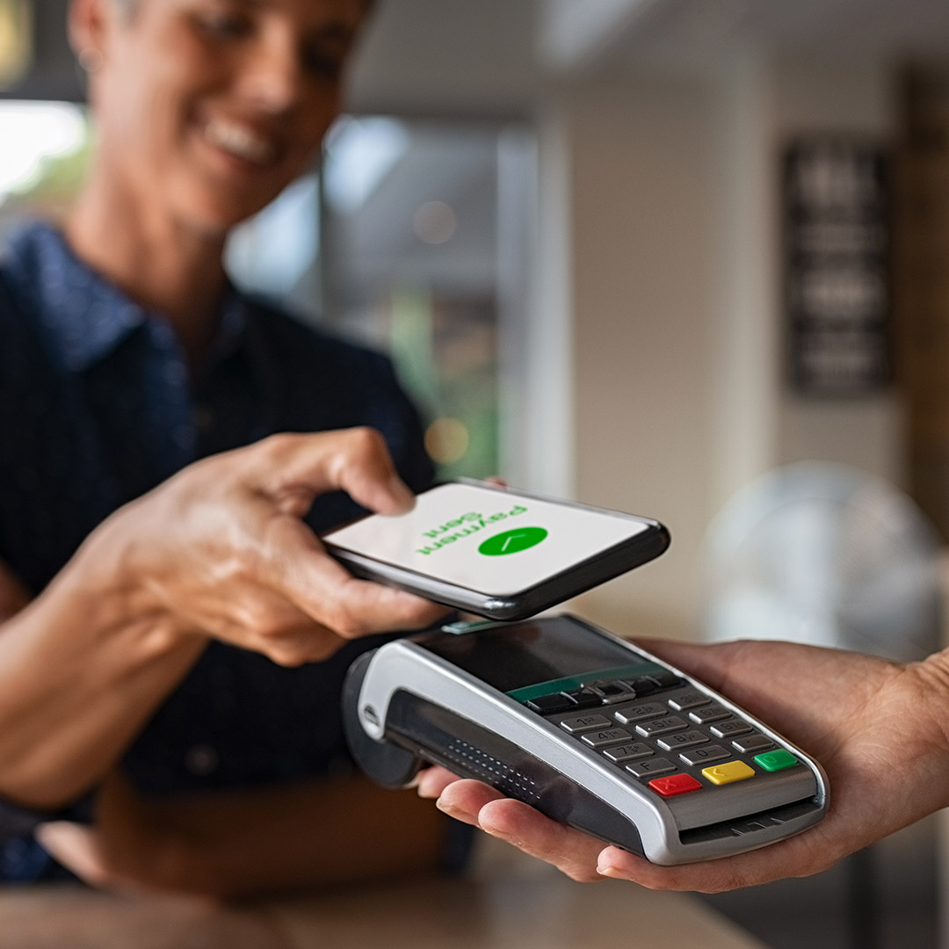
Delivering a Safe, Simple & Unified Payment Experience to Constituents
Understand current payments inventory, product offerings, and payment players involved across the enterprise
Determine priorities for payment solutions with a focus on data and analytics, fraud and security, and simple and safe constituent experiences
Engage key internal stakeholders to develop an evaluation and plan for payments that supports the enterprise and all agencies, departments, and services involved
Evaluate payment vendors and solutions that are specific to government and can scale across levels to best serve all mission-critical areas
Choose a strategic partner that delivers a holistic approach to payments and can address every point of interaction within the payment lifecycle with security and innovation at the forefront
Notes:
*Governments often use multiple department-level payment solutions to provide digital transactions for residents and businesses
*Standalone solutions create uneven payment experiences among different departments in the same government agency, causing frustration and bottlenecks
*Unified payment solutions deliver a consistent user experience across government, providing wider payment options and streamlined internal processes
*Leveraging our White Paper to glean points for the Unified Payment Experience story, so that we can reference our own client in the presentation

Slide 18

Q&A
Notes:
*Governments often use multiple department-level payment solutions to provide digital transactions for residents and businesses
*Standalone solutions create uneven payment experiences among different departments in the same government agency, causing frustration and bottlenecks
*Unified payment solutions deliver a consistent user experience across government, providing wider payment options and streamlined internal processes
*Leveraging our White Paper to glean points for the Unified Payment Experience story, so that we can reference our own client in the presentation

Slide 19

Let’s talk payments!
Morgan Jines
Vice President, Payments & Sales
morgan.jines@tylertech.com

