Slide 1
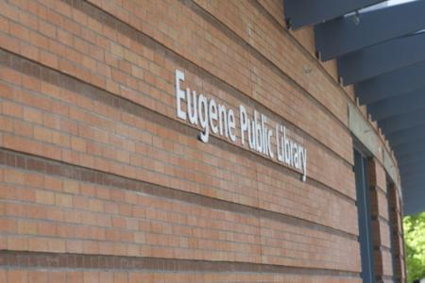
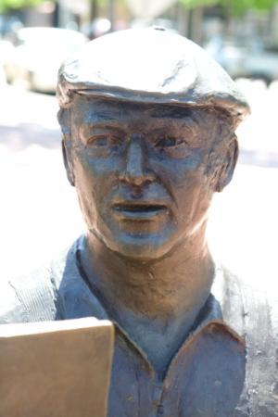
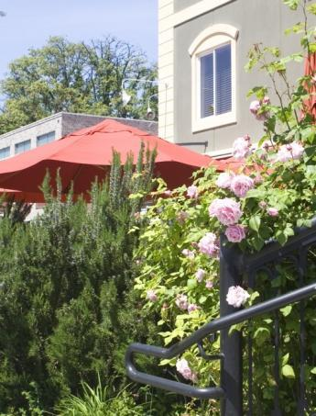
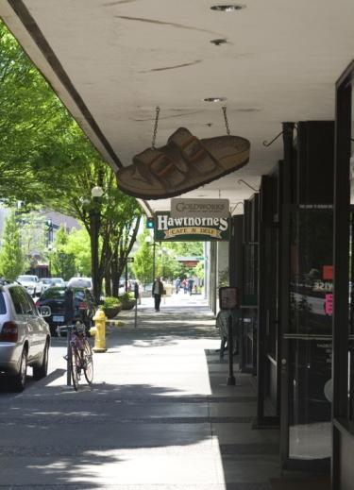
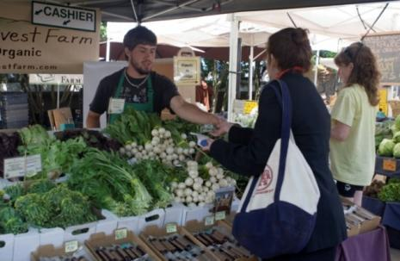
Eugene Counts

Slide 2
Eugene Counts connects council goals to the concrete results community members most want, finding common aspirations from diverse perspectives

Slide 3
Where we have been and where we are headed

Slide 4
community
workshop
surveys
social
networking
focus groups
panel
event
discussions
drop-ins
integrated
outreach
qualitative analysis
methods

Slide 5
accessible
effective and
fair, stable
safe
sustainable
and thriving
accountable
and adequate
community
development
culture and
municipal
financial
recreation
government
resources
top-ranked
top-ranked
top-ranked
top-ranked
top-ranked
results
results
results
results
results
3-5
3-5
3-5
3-5
3-5
outcomes
outcomes
outcomes
outcomes
outcomes
measures
measures
measures
measures
measures

Slide 6
Accountability for results by tracking and transparently reporting progress toward the highest-priority outcomes

Slide 7
Who we heard from

Slide 8
Results represent 1,000 respondents who participated in Eugene Counts from August to November

Slide 9
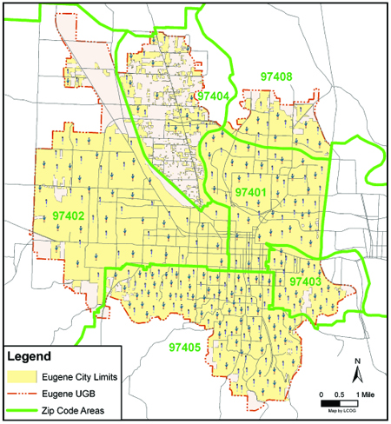
Geographic distribution of online survey responses

Slide 10
+ targeted and event-based outreach

Slide 11
Uses and limitations of the findings

Slide 12
Not in itself a priority-setting exercise
Use to help inform your priority setting

Slide 13
Results identified are spontaneous mentions, rather than a list of pre-determined outcomes tested against each other
Thus, this does not precisely measure the importance of one outcome against another

Slide 14
Vivid snapshot of what was foremost on minds of community members at the time

Slide 15
Other useful sources of information to help guide your goal-setting

Slide 16
What we heard about the
concrete results
participants sought from each of the five council goals

Slide 17
Downtown
Safe Community | Sustainable Development | Accessible and Thriving Culture and Recreation | Effective, Accountable Municipal Government | Fair, Stable and Adequate Financial Resources
feel safe walking | more jobs | accessible to all incomes | more responsive | fund public safety
visible police presence | infill/compact development | already great | greater transparency | new revenue sources
decreased crime | thriving downtown | support local arts | serve all equally | fund infrastructure
decreased property crime | help small or local businesses | variety of programming | better public engagement | prioritize spending
offenders kept locked up | more mass transit | cater to broader tastes | more effective communication | everyone pays fair share
safer downtown | good bike/ped infrastructure | more parks | make and stick to decisions | greater transparency
all treated equitably | preserve natural resources | thriving downtown | produce results | fund education
fewer visible homeless | efficient and green energy use | bike-ped friendly | get things done | economic development
homeless treated kindly | more green building | more/better communication | cooperation within and between governments | progressive taxes
positive activities | cleaner air and water | support education | more civil discourse | clear financial information
more public safety funding | reduce, reuse, recycle | culturally diverse activities | sound finances | live within means
decreased violent crime | strong green industry | more funding | able to prioritize | more jobs
more social services | support alt modes | more green spaces | clearly accountable | basic services
alternative transportation modes | thriving local food production | geographically dispersed recreation and arts resources | provide public safety | no subsidies
less panhandling | mixed-use development | economic development | economic development | social services
people getting to know and looking out for each other | incentives for compact or green development and businesses | public safety | honest and trustworthy
fast response | social justice | this is a waste of money | well-maintained infrastructure
less drug use | less regulation | more arts venues | wise use of tax dollars
more street lighting | balance between environmental and economic issues | focus on youth | thriving downtown
downtown development | preserve green space |  | police oversight
safety from police | long-term, visionary planning
traffic safety | collaborative planning and development
community policing | no automobiles
police/community relations
crime prevention
fewer young people behaving badly
pedestrian traffic
drug and alcohol treatment

Slide 18
Public safety
Safe Community | Sustainable Development | Accessible and Thriving Culture and Recreation | Effective, Accountable Municipal Government | Fair, Stable and Adequate Financial Resources
feel safe walking | more jobs | accessible to all incomes | more responsive | fund public safety
visible police presence | infill/compact development | already great | greater transparency | new revenue sources
decreased crime | thriving downtown | support local arts | serve all equally | fund infrastructure
decreased property crime | help small or local businesses | variety of programming | better public engagement | prioritize spending
offenders kept locked up | more mass transit | cater to broader tastes | more effective communication | everyone pays fair share
safer downtown | good bike/ped infrastructure | more parks | make and stick to decisions | greater transparency
all treated equitably | preserve natural resources | thriving downtown | produce results | fund education
fewer visible homeless | efficient and green energy use | bike-ped friendly | get things done | economic development
homeless treated kindly | more green building | more/better communication | cooperation within and between governments | progressive taxes
positive activities | cleaner air and water | support education | more civil discourse | clear financial information
more public safety funding | reduce, reuse, recycle | culturally diverse activities | sound finances | live within means
decreased violent crime | strong green industry | more funding | able to prioritize | more jobs
more social services | support alt modes | more green spaces | clearly accountable | basic services
alternative transportation modes | thriving local food production | geographically dispersed recreation and arts resources | provide public safety | no subsidies
less panhandling | mixed-use development | economic development | economic development | social services
people getting to know and looking out for each other | incentives for compact or green development and businesses | public safety | honest and trustworthy
fast response | social justice | this is a waste of money | well-maintained infrastructure
less drug use | less regulation | more arts venues | wise use of tax dollars
more street lighting | balance between environmental and economic issues | focus on youth | thriving downtown
downtown development | preserve green space |  | police oversight
safety from police | long-term, visionary planning
traffic safety | collaborative planning and development
community policing | no automobiles
police/community relations
crime prevention
fewer young people behaving badly
pedestrian traffic
drug and alcohol treatment

Slide 19
Jobs and economic development
Safe Community | Sustainable Development | Accessible and Thriving Culture and Recreation | Effective, Accountable Municipal Government | Fair, Stable and Adequate Financial Resources
feel safe walking | more jobs | accessible to all incomes | more responsive | fund public safety
visible police presence | infill/compact development | already great | greater transparency | new revenue sources
decreased crime | thriving downtown | support local arts | serve all equally | fund infrastructure
decreased property crime | help small or local businesses | variety of programming | better public engagement | prioritize spending
offenders kept locked up | more mass transit | cater to broader tastes | more effective communication | everyone pays fair share
safer downtown | good bike/ped infrastructure | more parks | make and stick to decisions | greater transparency
all treated equitably | preserve natural resources | thriving downtown | produce results | fund education
fewer visible homeless | efficient and green energy use | bike-ped friendly | get things done | economic development
homeless treated kindly | more green building | more/better communication | cooperation within and between governments | progressive taxes
positive activities | cleaner air and water | support education | more civil discourse | clear financial information
more public safety funding | reduce, reuse, recycle | culturally diverse activities | sound finances | live within means
decreased violent crime | strong green industry | more funding | able to prioritize | more jobs
more social services | support alt modes | more green spaces | clearly accountable | basic services
alternative transportation modes | thriving local food production | geographically dispersed recreation and arts resources | provide public safety | no subsidies
less panhandling | mixed-use development | economic development | economic development | social services
people getting to know and looking out for each other | incentives for compact or green development and businesses | public safety | honest and trustworthy
fast response | social justice | this is a waste of money | well-maintained infrastructure
less drug use | less regulation | more arts venues | wise use of tax dollars
more street lighting | balance between environmental and economic issues | focus on youth | thriving downtown
downtown development | preserve green space |  | police oversight
safety from police | long-term, visionary planning
traffic safety | collaborative planning and development
community policing | no automobiles
police/community relations
crime prevention
fewer young people behaving badly
pedestrian traffic
drug and alcohol treatment

Slide 20
Communication
Safe Community | Sustainable Development | Accessible and Thriving Culture and Recreation | Effective, Accountable Municipal Government | Fair, Stable and Adequate Financial Resources
feel safe walking | more jobs | accessible to all incomes | more responsive | fund public safety
visible police presence | infill/compact development | already great | greater transparency | new revenue sources
decreased crime | thriving downtown | support local arts | serve all equally | fund infrastructure
decreased property crime | help small or local businesses | variety of programming | better public engagement | prioritize spending
offenders kept locked up | more mass transit | cater to broader tastes | more effective communication | everyone pays fair share
safer downtown | good bike/ped infrastructure | more parks | make and stick to decisions | greater transparency
all treated equitably | preserve natural resources | thriving downtown | produce results | fund education
fewer visible homeless | efficient and green energy use | bike-ped friendly | get things done | economic development
homeless treated kindly | more green building | more/better communication | cooperation within and between governments | progressive taxes
positive activities | cleaner air and water | support education | more civil discourse | clear financial information
more public safety funding | reduce, reuse, recycle | culturally diverse activities | sound finances | live within means
decreased violent crime | strong green industry | more funding | able to prioritize | more jobs
more social services | support alt modes | more green spaces | clearly accountable | basic services
alternative transportation modes | thriving local food production | geographically dispersed recreation and arts resources | provide public safety | no subsidies
less panhandling | mixed-use development | economic development | economic development | social services
people getting to know and looking out for each other | incentives for compact or green development and businesses | public safety | honest and trustworthy
fast response | social justice | this is a waste of money | well-maintained infrastructure
less drug use | less regulation | more arts venues | wise use of tax dollars
more street lighting | balance between environmental and economic issues | focus on youth | thriving downtown
downtown development | preserve green space |  | police oversight
safety from police | long-term, visionary planning
traffic safety | collaborative planning and development
community policing | no automobiles
police/community relations
crime prevention
fewer young people behaving badly
pedestrian traffic
drug and alcohol treatment

Slide 21
Alternative transportation modes
Safe Community | Sustainable Development | Accessible and Thriving Culture and Recreation | Effective, Accountable Municipal Government | Fair, Stable and Adequate Financial Resources
feel safe walking | more jobs | accessible to all incomes | more responsive | fund public safety
visible police presence | infill/compact development | already great | greater transparency | new revenue sources
decreased crime | thriving downtown | support local arts | serve all equally | fund infrastructure
decreased property crime | help small or local businesses | variety of programming | better public engagement | prioritize spending
offenders kept locked up | more mass transit | cater to broader tastes | more effective communication | everyone pays fair share
safer downtown | good bike/ped infrastructure | more parks | make and stick to decisions | greater transparency
all treated equitably | preserve natural resources | thriving downtown | produce results | fund education
fewer visible homeless | efficient and green energy use | bike/ped friendly | get things done | economic development
homeless treated kindly | more green building | more/better communication | cooperation within and between governments | progressive taxes
positive activities | cleaner air and water | support education | more civil discourse | clear financial information
more public safety funding | reduce, reuse, recycle | culturally diverse activities | sound finances | live within means
decreased violent crime | strong green industry | more funding | able to prioritize | more jobs
more social services | support alt modes | more green spaces | clearly accountable | basic services
alternative transportation modes | thriving local food production | geographically dispersed recreation and arts resources | provide public safety | no subsidies
less panhandling | mixed-use development | economic development | economic development | social services
people getting to know and looking out for each other | incentives for compact or green development and businesses | public safety | honest and trustworthy
fast response | social justice | this is a waste of money | well-maintained infrastructure
less drug use | less regulation | more arts venues | wise use of tax dollars
more street lighting | balance between environmental and economic issues | focus on youth | thriving downtown
downtown development | preserve green space |  | police oversight
safety from police | long-term, visionary planning
traffic safety | collaborative planning and development
community policing | no automobiles
police/community relations
crime prevention
fewer young people behaving badly
pedestrian traffic
drug and alcohol treatment

Slide 22
annotated sample goal:
Blissful Community
desired results or outcomes spontaneously mentioned by respondents
more sunny days in winter
year-round
local blueberries
decreased crankiness
more accessible chocolate
24%
17%
16%
15%
distinct but related ideas are tied together vertically
% of people responding to the question who mentioned this outcome
8%
year-round
local broccoli
# of individual respondents to this question
(n=450)

Slide 23
annotated sample goal:
Blissful Community
data can sometime create more questions than answers
more Duck football games
fewer Duck football games
world peace
more roses
less fighting
14%
14%
13%
10%
8%
percentages do not add up to 100% because individual respondents offered multiple responses to the question, and all were counted
(n=450)

Slide 24
Safe Community
A community where all people are safe, valued and welcome.

Slide 25
Safe Community
people feel safe walking
visible police presence
decreased crime
offenders kept locked up
26%
24%
17%
15%
16%
8%
decreased property crime
decreased violent crime
(n=516)

Slide 26
Safe Community
safer downtown
all treated equitably
fewer visible homeless
homeless treated kindly
positive activities
more public safety funding
10%
10%
9%
9%
8%
8%
7%
7%
6%
less panhandling
more social services
downtown development
(n=516)

Slide 27
People feel safe walking
“People aren't afraid to walk alone downtown.”
“It's ok to walk alone. You don't feel like you always have to be with someone.”
“You aren't afraid to visit all parts of the city.”

Slide 28
Visible police presence
“Police officers who interact with both the goodies and the baddies.”
“More observable police presence in community gathering spots.”
“More police and volunteer vehicle patrols.”
“More walking and biking police all over the downtown, less use of tasers.”

Slide 29
Decreased crime (esp. property crime)
“Property crime is reduced to a rare occurrence.”
“Reduction in property damage, theft, assault, rape and other violent crime.”
“You aren't worried that your house and car will be broken into.”
“Fewer meth-related burglaries.”

Slide 30
Offenders kept locked up
“People who commit crimes suffer the consequences.”
“Keep criminals in jail rather than the current "catch and release" system.”
“Keep criminals behind bars for duration of their sentence.
“Dangerous individuals would not be released from custody to offend again.”

Slide 31
Sustainable Development
A community that meets its present environmental, economic and social needs without compromising the ability of future generations to meet their own needs.

Slide 32
Sustainable Development
more jobs
infill/compact development
thriving downtown
help small or local businesses
more mass transit
17%
15%
15%
15%
12%
8%
7%
support alt modes
mixed-use development
(n=458)

Slide 33
Sustainable Development
efficient and green energy use
thriving local food production
good bike/ped infrastructure
preserve natural resources
more green building
cleaner air and water
strong green industry
11%
11%
11%
10%
10%
9%
8%
9%
7%
reduce, reuse, recycle
incentives for green business and development
(n=458)

Slide 34
More jobs
“Build our economy around green jobs.”
“Become a competitive job market again.”
“Economic development that results in long term job growth.”
“Jobs that pay a sustainable salary.”
“Attract new business by making it easy to locate here and do business.”

Slide 35
Infill/compact development
“Incentives for urban infill.”
“Stop urban sprawl and bring a major retail store to downtown Eugene.”
“Build the city up rather than out.”
“More downtown housing options.”
“No development in the outer areas until the core of Eugene is rebuilt.”

Slide 36
Thriving downtown
“Big attractive stores will bring people who will also discover the smaller local retailers.”
“Less resistance to changing downtown.”
“More positive activity downtown: restaurants, shops and entertainment.”
“Do something, anything, to promote downtown.”

Slide 37
Help small or local businesses
“More thriving small local businesses, especially in the core of the city.”
“More people patronizing local businesses.”
“Small businesses encouraged and supported with as many incentives and breaks as the huge employers.”
“More investment in small businesses that are home-grown.”

Slide 38
Accessible and Thriving Culture and Recreation
A community where arts and outdoors are integral to our social and economic well-being and are available to all.

Slide 39
Accessible and Thriving Culture and Recreation
accessible to all incomes
already great
support local arts
27%
variety of programming
cater to broad tastes
22%
17%
11%
11%
(n=384)

Slide 40
Accessible and Thriving Culture and Recreation
more parks
culturally diverse activities
thriving downtown
bike/ped friendly
more/better
communication
support education
more funding
more green spaces
10%
9%
9%
8%
8%
7%
7%
7%
(n=384)

Slide 41
Accessible to all incomes
“Cultural and recreational offerings that cost little to nothing as well as more expensive.”
“More businesses and individuals would help sponsor these events.”
“More free cultural events; the symphony playing at Cuthbert this summer was super.”
“Scholarship opportunities.”
“Variety of price points.”

Slide 42
Already great
“Honestly, our community meets this goal. It is why I moved and live here.”
“Our park and trail system is the best around. Keep it alive!”
“It is a great strength of Eugene and needs to be cultivated and preserved.”
“Eugene is already an arts Mecca. We need to better promote what we already have.”
“This our strong suit.”

Slide 43
Support local arts
“The City should take the lead on communicating about the rich cultural resources in our community.”
“Resources to small arts groups including a facility for artists to create in.”
“Support local music like in Austin.”
“More support for local groups like the Eugene Concert Choir, Eugene Ballet, Mozart Players, Eugene Symphony.”

Slide 44
Variety of programming, tastes
“Activities and programs that meet the cultural needs of the entire community and not just those of the dominant culture.”
“Various types of recreation for differing interests throughout the community.”
“Wide variety of cultural events appealing to a wide cross-section of the population.”

Slide 45
Effective, Accountable
Municipal Government
A government that works openly, collaboratively, and fairly with the community to achieve measurable and positive outcomes and provide effective, efficient services.

Slide 46
Effective, Accountable Municipal Government
more responsive
greater transparency
serve all equally
better public engagement
more effective communication
make and stick to decisions
20%
14%
13%
12%
12%
11%
6%
honest and trustworthy
(n=364)

Slide 47
Effective, Accountable Municipal Government
cooperation within and between governments
provide public safety
produce results
get things done
more civil discourse
sound
finances
able to prioritize
clearly
accountable
10%
10%
10%
9%
8%
7%
7%
7%
6%
economic development
(n=364)

Slide 48
More responsive
“Government that helps citizens accomplish what they want, not dictate what they should want.”
“It is open to public opinion and it values decision-making and action over endless process.”
“Councilors that listen to us and each other.”
“Really listening to public input—not just paying lip-service.”

Slide 49
Greater transparency
“Transparency of council, city manager, police department decisions or actions/inactions.”
“Decisive and able to articulate what led to the decision.”
“Transparency on processes and how expenditures happen.”
“Ability to acknowledge when a mistake or error was made.”

Slide 50
Serve all equally
“Represent the interests of all reasonable individuals, not just those with monetary clout.”
“No catering to special interests.”
“More benefits to north and west Eugene such as parks, library branches.”
“Go to underserved populations and get their input on the decision-making process.”

Slide 51
Better public engagement
“Wider participation in government—not just the same old people making all the decisions.”
“Attempts like this to get broad public opinion.”
“Go out into the community. Don't expect us to come downtown to a meeting.”
“Blogs.
Town halls on Facebook.”
“Closer relationship between government and its people.”

Slide 52
More effective communication
“Leadership speaking publicly about what the City is up to.”
“More communication about what positive things the City does.”
“Better, easier-to-navigate city website.”
“Goals that are clear. Plans to reach these goals. Benchmarks that are public.”

Slide 53
Fair, Stable and Adequate Financial Resources
A government whose ongoing financial resources are based on a fair and equitable system of revenues and are adequate to maintain and deliver municipal services.

Slide 54
Fair, Stable and Adequate Financial Resources
prioritize spending
new revenue sources
everyone pays fair share
greater transparency
economic development
progressive taxes
live within means
10%
11%
8%
8%
7%
6%
6%
12%
fund
public safety
10%
fund infrastructure
6%
clear financial
information
7%
fund education
(n=311)

Slide 55
Prioritize spending
“Find the expenditures that are necessary and don't cut corners on those.”
“Focus on priorities.”
“Sustain the core governmental responsibilities as they are defined by the elected officials.”
“Highest values in community receive full funding.”

Slide 56
New revenue sources
“A sales tax would provide some stability to financial resources.”
“Seek out new revenue streams.”
“Link taxes to outcomes, issues on the ballot. We're able to accomplish virtually anything if the community is willing to pay for it.”
“Revenue sources that aren't prone to fickle markets.”

Slide 57
Everyone pays fair share
“A wide tax base with everyone paying their fair share of taxes.”
“Industry pays its fair share.”
“A revenue system that is progressive.”
“Fewer tax breaks for large out of state corporations.”

Slide 58
Greater transparency
“Confidence that money voted for new initiatives was being spent on those projects.”
“The budget needs to be really clear and understandable.”
“We want to see how our dollars are spent and that they are handled effectively.”
“Educational campaign to help citizens understand trade-offs.”

Slide 59
you are here
January 8 goal session
January 23 goal session
Spring ‘10
Summer ’10
Council views, discusses Eugene Counts results
Councilors review community survey, other information to aid goal-setting
Chosen outcomes help inform exec manager work on proposed budget
FY11 budget process
Online dashboard launches
Council selects 3-5 outcomes per goal
Outcomes help inform staff work on budget
Outcomes guide staff work on measures for each outcome

Slide 60
Eugene Counts next step: select as a group 3-5 outcomes per goal (15-25 total).

Slide 61
More Information:
terrie.e.monroe@ci.eugene.or.us
Terrie Monroe at 682-5412

