Slide 1
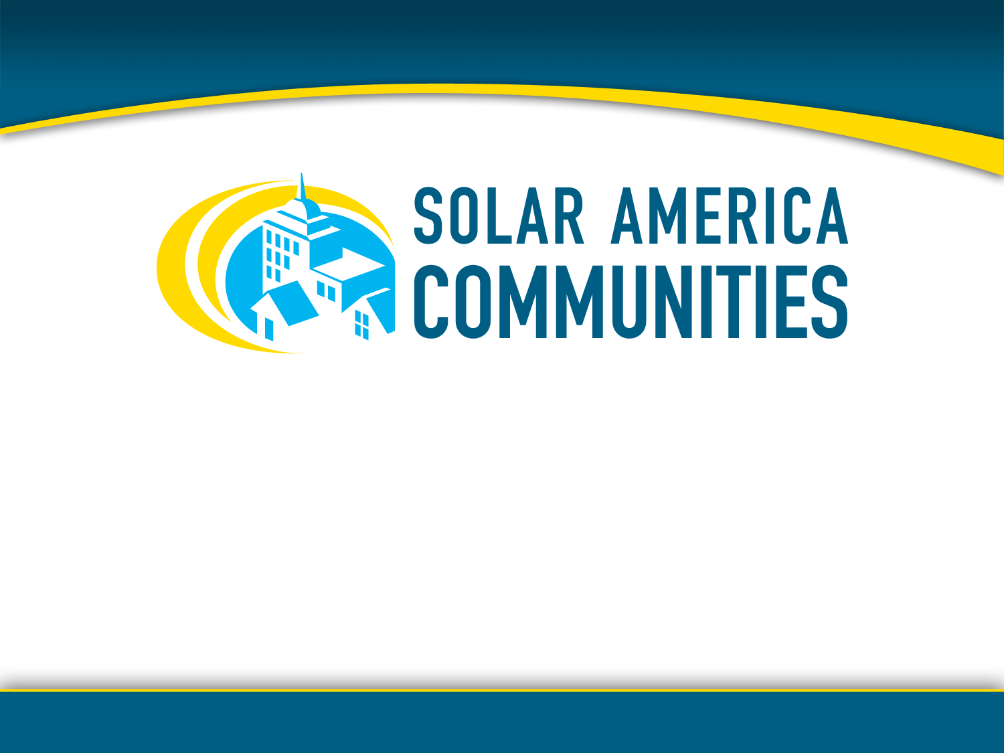
Planning for Solar Energy
American Planning Association
National Planning Conference
Boston, MA April 9, 2011
Notes:
Good morning everyone – Thank you for joining us on a beautiful Saturday morning in Boston. I’m Lisa Milligan and I represent ICLEI Local Governments for Sustainability, and I am your convener for today’s workshop. I am joined by three people who will be your trainers today: Colleen Kettles of Florida Solar Energy Research and Education Foundation, Suzanne Rynne of the American Planning Association, and Chad Laurent of Meister Consultants Group.
Our workshop today is Planning for Solar Energy, and we are going to walk you through how you can integrate solar in your community’s planning efforts.

Slide 2

"I'd put my money on the sun and solar energy. What a source of power! I hope we don't have to wait till oil and coal run out before we tackle that."
- Thomas Edison
Notes:
We can thank Thomas Edison for inventing the phonograph, movie camera, and the first long-lasting practical electric light bulb. He was a prolific inventor – holding over 1,000 US patents in his name – he was also a visionary. Edison very clearly saw the benefits of the sun and solar energy to power our lives.
He was one of the first, but slowly others have come to realize the potential of the sun and developed innovative ways to harness it.
I commend all of you for being here today – your attendance demonstrates that you too have a vision to better enable solar to help your communities continue to progress towards sustainability.

Slide 3

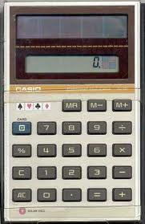
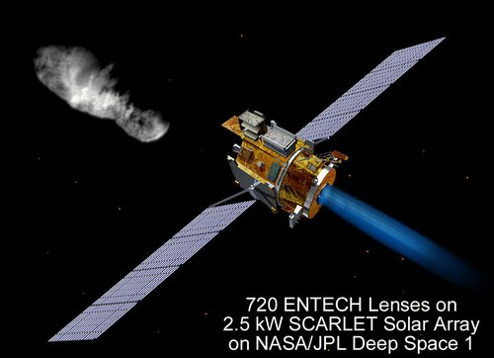
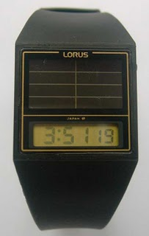
Satellite Photos: NREL
Calculator: Casio
Watch: Lorus
Notes:
In the early 1800’s, a trace mineral, selenium, was found to have photovoltaic - or electrical current producing – properties.
Much later, in the early 1950’s, three Americans working on small transistors found that if transistors are built in a certain way using silicon, the result would be a photovoltaic cell.
Beginning in the late 1950s, photovoltaics were used to power U.S. space satellites. The success of photovoltaics in space generated commercial applications for photovoltaic technology.
The simplest photovoltaic systems power many of the small calculators and wrist watches used everyday.

Slide 4
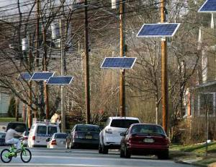
NIMBY – Would Edison would agree?!
"I don’t think our neighborhoods should become power generating stations," he said. "They have a negative effect on property values, a negative effect on quality of life. You can’t miss them. It’s not just my back yard," [one resident] said. "I don’t want them in Ridgewood’s back yard. I don’t want them in Edison’s back yard. I don’t want them in anybody’s front yard. They just don’t belong in anybody’s residential neighborhood.“
  - “North Jersey towns object to solar panels”, Sunday, March 27, 2011 ; www.NorthJersey.com
Notes:
That’s not to say that fully using solar in our communities is easy. It is not uncommon in some communities to see demonstrated opposition to installing solar.
Here is just one example – a very recent one – in northern New Jersey, coincidentally in Edison. In this particular case – at least according to articles in the media – reportedly residents were caught off-guard when one day they returned from work in the evening to find these solar panels installed along their residential street. One might conclude from reading the article that the residents of this street had not engaged in the decision making process for increasing the use of solar technologies in their community.
As planners, you have no doubt know that the more we can engage residents and other community members in our efforts, the more accepting they can be to lasting change. This is a great example of how important it is to engage the community in any permanent changes – including solar installations – that will impact them.

Slide 5

… and yet the Solar Market is responding… Among Top Solar Trends for 2011
Global PV demand likely to grow well in 2011
U.S. installed PV capacity could double from 2010
U.S. predicted to be 3rd largest in total installed capacity
Expansion of utility-scale systems in the U.S.
Strong expansion of solar development in U.S. states
25% increase in number of Americans employed in solar industry in 2011
Your community has the opportunity to capitalize on these trends.
Notes:
Mainstream news providers like USA Today, NY Times and Reuters are constantly reporting on how the US solar market is rising, more financing opportunities are becoming available, utilities are going solar, solar manufacturing is expanding, etc. There is so much buzz and excitement surrounding solar energy because it has the ability to touch all aspects of our lives – markets, architecture, research and development, economic development, jobs. There is no better time than right now to start engaging in solar.
Most all of the major market research firms have concluded that the global PV demand will increase in 2011. These estimates range anywhere from 12.7 GW and upwards to 20 GW. Installed PV capacity growth in the US will be continue to be solid, backed by federal grants from the federal government that will be valid until the end of 2011. Fueled by the expansion of utility scale projects, the US is projected to possibly rank 3rd in total installed capacity by the end of 2011. This expansion will also be seen in states not traditionally considered strong solar developers, such as Florida, Illinois, Nevada, New Mexico, North Carolina, Ohio, and Texas. Last year, 93,000 Americans were employed in the solar industry - this is twice the number employed in the industry in 2009.
And so, too, your community has an opportunity to capitalize on these trends.

Slide 6
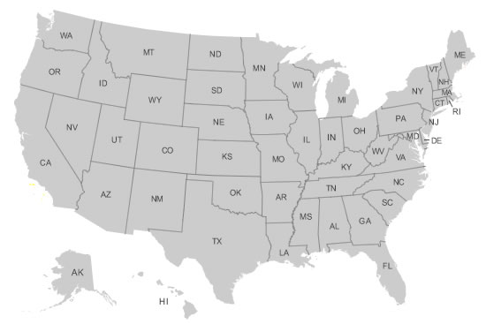
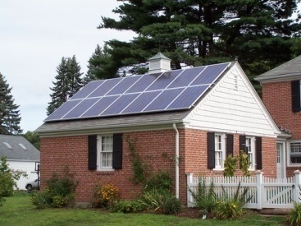
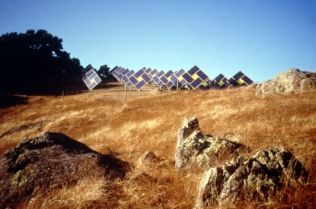
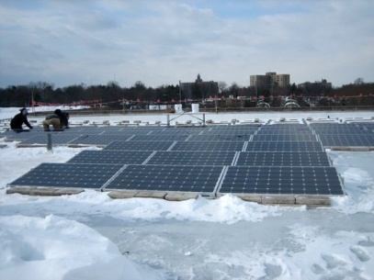
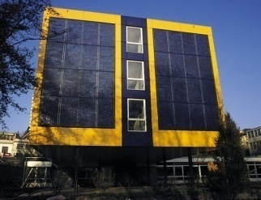
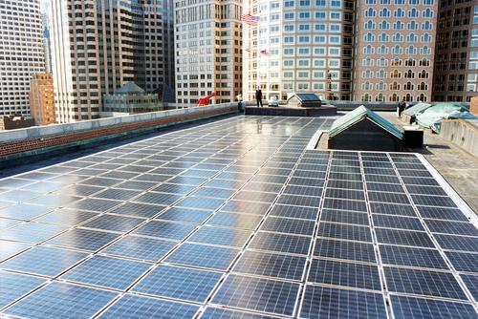
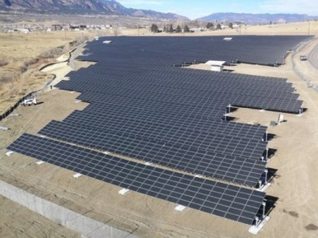
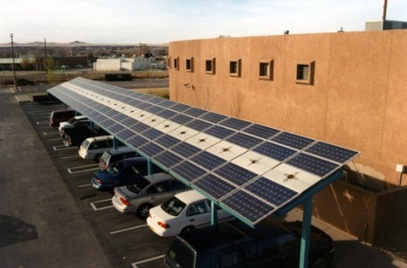
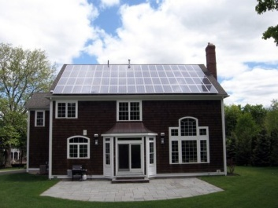
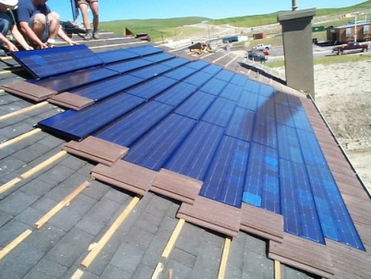
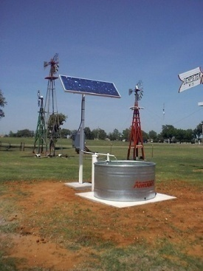
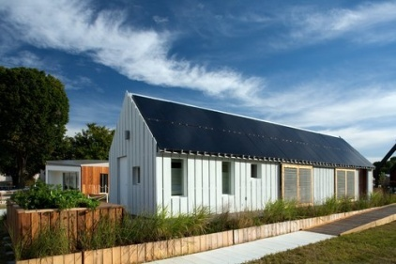
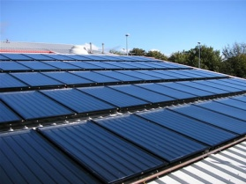
Notes:
Communities across the country have taken advantage of and capitalized on these trends – communities not only in the sunbelt but also all over the country – including Alaska!
There are solar energy systems on firehouses, on your neighbor’s roof, on schools, on landfills, on big-box stores - solar is pumping water out of wells, solar is being used as a shade structure, solar is being incorporated into building design, solar is everywhere.

Slide 7
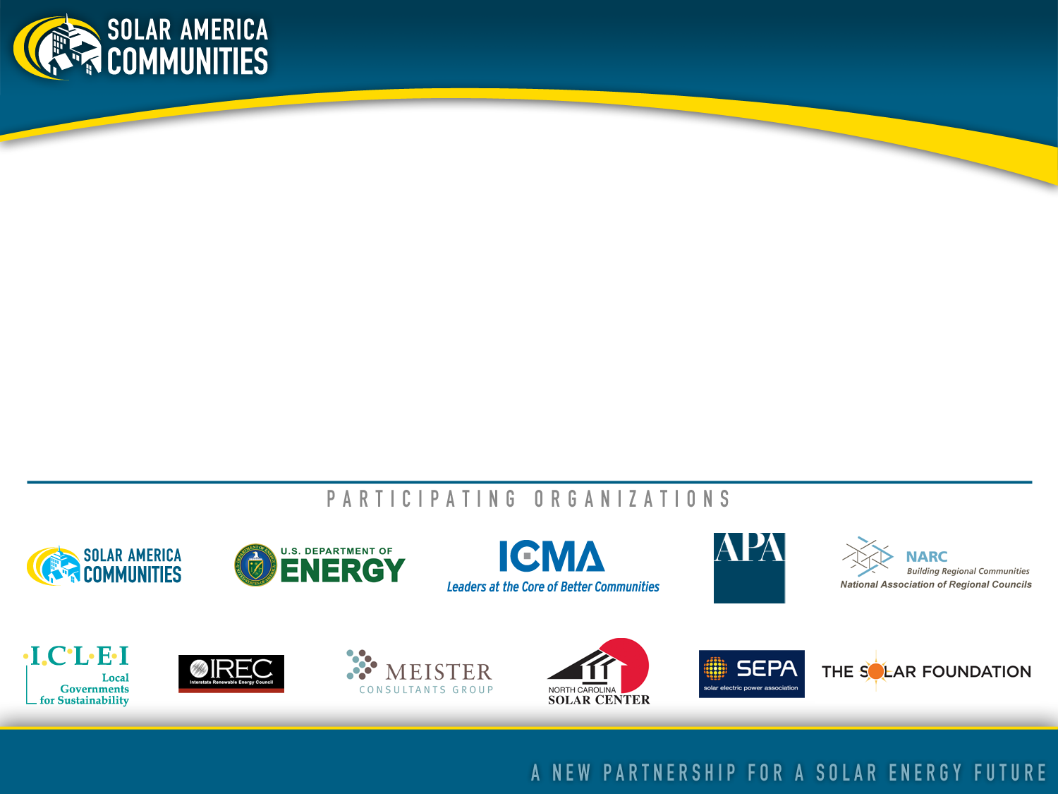
About Solar America Communities
Solar America Communities is a U.S. Department of Energy (DOE) program designed to increase the use and integration of solar energy in communities across the United States. The International City-County Management Association (ICMA) and ICLEI-Local Governments for Sustainability were competitively selected by DOE to conduct outreach to local governments across the United States, enabling them to replicate successful solar practices and quickly expand local adoption of solar energy. For more information visit www.solaramericacommunities.energy.gov.
Notes:
This is why we are bringing you today’s program. Colleen, Suzanne, Chad and I are part of the Solar America Communities program – which is a five year Department of Energy program designed to increase the use and integration of solar energy in communities across the US.
Led by two organizations – ICLEI Local Governments for Sustainability (the organization I represent) and ICMA (also known as the International City/County Management Association) – several organizations and subject matter experts in the solar industry are all working together to bring solar best practices to communities nationwide.

Slide 8

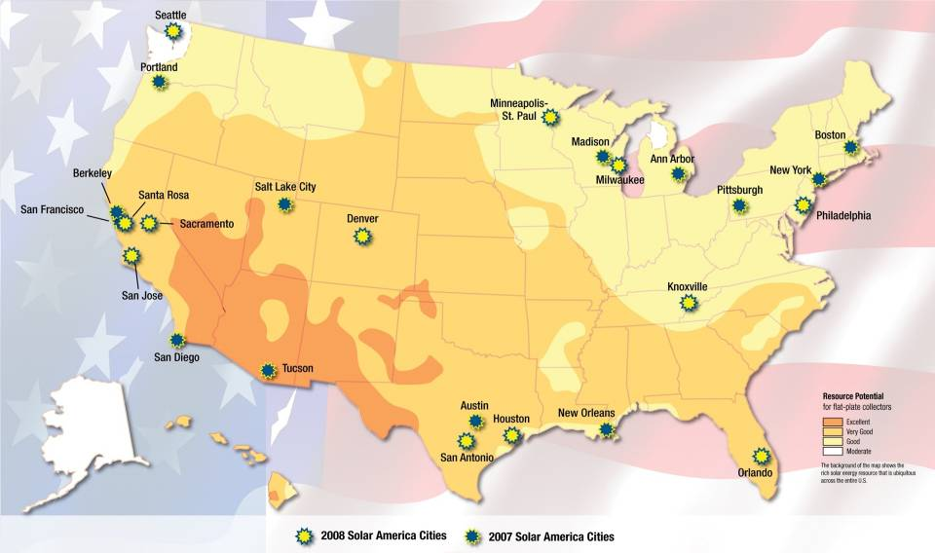
Notes:
Just to give you a little background, the Solar America Communities program was inspired by the highly successful Solar America Cities program where the Department of Energy competitively selected 25 US cities in diverse regions throughout the country as Solar America Cities. This program began in 2007 and is still in operation.
The map shows where the 25 Solar America Cities are located. Are any of you from one of these 25 cities?
Based on the success of its partnerships with these cities, DOE decided to expand the program to conduct outreach to many more local governments throughout the country to share the lessons learned and best practices from the partner cities. As the Solar America Cities program evolved to include this new outreach effort , the program has been renamed Solar America Communities to reflect DOE’s commitment to supporting solar initiatives in all types of local jurisdictions, including cities and counties.

Slide 9
Workshops
Half- to full-day training events for local government, community and business stakeholders focused on strategies for bringing more solar PV to their communities
Training modules developed by ICLEI Team with input from all project partners
Workshops held in conjunction with:
National, state, regional conferences and other large events
Regional councils (COGS) in targeted areas around the country
Notes:
A primary activity of the Solar America Communities Outreach Partnership is a series of workshops that target local government officials, community members, and local business stakeholders about proven approaches for bringing increased solar PV to their communities. The organizational and individual members of the ICLEI and ICMA teams lend their subject-matter expertise to develop the content and deliver the workshops at selected conferences held around the country where local solar stakeholders are gathering. During 2011, we will be delivering workshops such as this one at the different events; if you are interested in our schedule, please see me at a break or after today’s workshop.

Slide 10
As a result of your active participation in this workshop, you should be able to:
Define common solar terminology
Counter common arguments against going solar
Start working to make your community become more “solar-friendly”
Identify where to go for more “go solar” information
objectives
Notes:
We have designed this workshop so that when you leave for lunch, you will be able to do the following:
Define common solar terminology and technologies
Counter common arguments against going solar, including the many benefits that going solar offers
Start working with your municipality and community to create incentives for going solar
Identify where to go for more “go solar” information

Slide 11
agenda
Introductions
Overview: Solar Technologies; Planning for Solar
Dispelling the Myths and Communicating the Benefits of Going Solar
How and Where to Consider Solar in the Planning Process
Incorporating Solar into Codes and Ordinances
Other Actions Local Governments Can Take to Go Solar
Also featuring the solar stories of Boston and San Francisco
Notes:
Right after all this housekeeping – we will do a brief activity to start to get to know each other.
Then we will go over solar technology basics and introduce the model for planning for solar
We will explore the many myths associated with solar energy and seek to dispel them, as well as identify real barriers to going solar and how local communities can create incentives to overcome them
After a brief break we will discuss how and were we can integrate solar in local planning efforts.
Throughout the workshop we will be weaving in case studies, best practices and practical advice – with special emphasis on local planning. In particular, today we are fortunate to be able to hear from the cities of Boston and San Francisco about their solar stories.
At the conclusion of the workshop, we will also ask you to complete the workshop evaluation form so that we can learn how to improve these programs in the future.

Slide 12
On Your Radar…
Today’s workshop presentation & notes will be posted here:
www.SolarAmericaCommunities.Energy.Gov/Resources
AT THE CONFERENCE:
  Solar America Communities in the Exhibit Hall, Booth #218
  Planning for Solar Energy Facilitated Discussion/Listening Session on Sunday, 2:30-3:45 in Room 301
Notes:
The slides and notes from today’s workshop will be posted on DOE’s Solar America Communities website.
I would also like to point out that during the APA conference there are a couple of additional opportunities to learn more about what you can do to move your community towards going solar:
The Solar America Communities booth will be in the Exhibit Hall
A separate session called Planning for Solar Energy will take place tomorrow at 2:30 in Room 301. This session will be a discussion (rather than a series of technical presentations) designed to gather information from you and other local planners about what you need to help your community go solar.

Slide 13
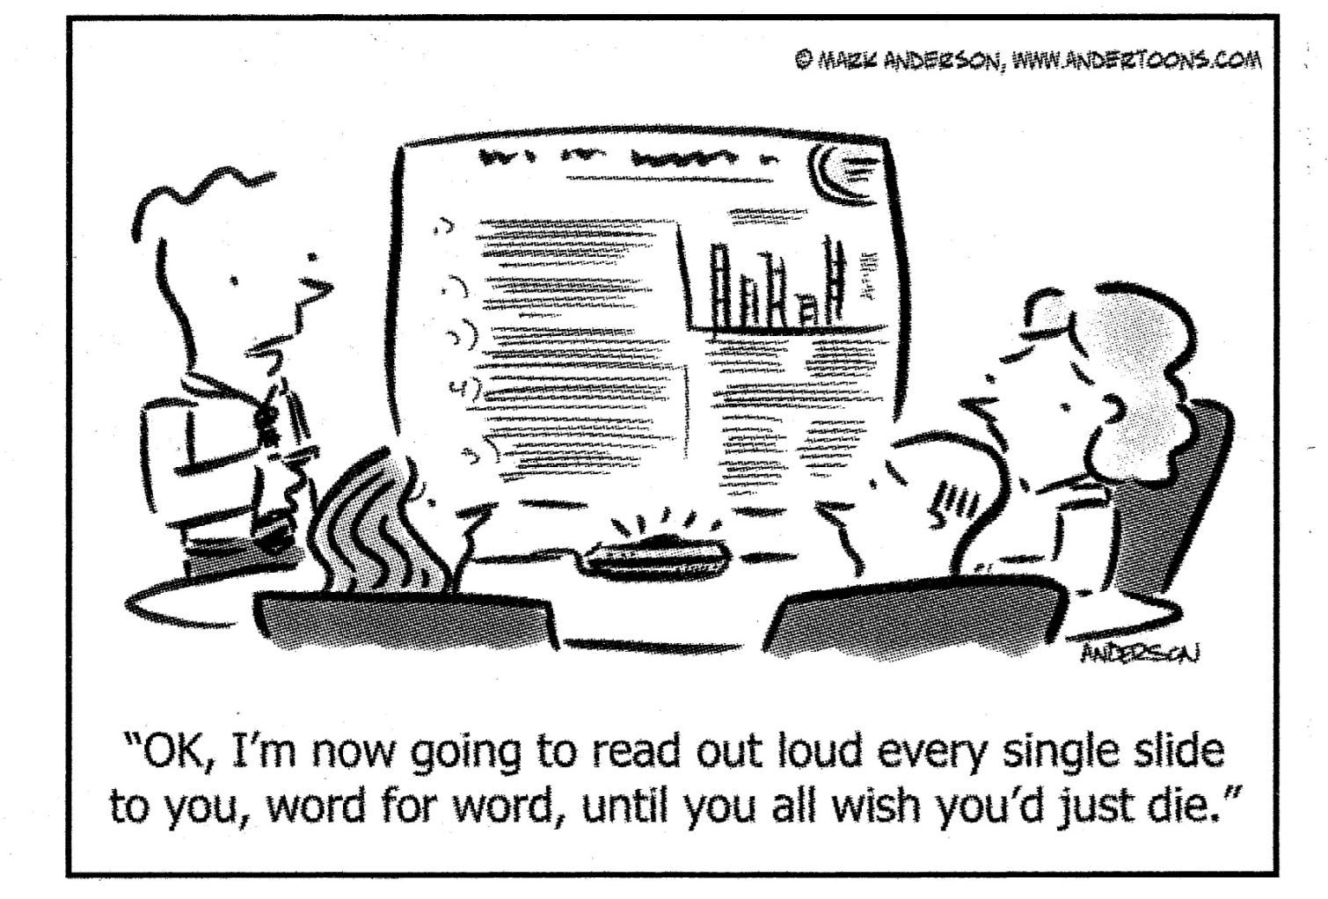
Working Together Today…
Notes:
In our minds, workshops are not lectures in which one person talks to an audience using a Powerpoint deck loaded with slide after slide containing bullet lists of heavy content, with the hope that maybe some bits of information will be retained. Rather, workshops are gatherings during which participants are just that: Participants… actively engaged in the delivery of the content. So while we have some great trainers here who can lend their subject-matter expertise to our discussion about bringing solar into local planning efforts, we have built in activities and discussion points throughout this agenda so we can learn from each other. Each person in this room brings a unique perspective to what it takes to bring solar to communities, and we all want to hear from you. So every 10-15 slides we will pause and discuss what we’re learning together, and at times engage in an activity to expand our learning.
With this in mind:
Because we view workshops as dialogue, clarifying questions are welcome during the presentation. At the same time, we have a lot of content to cover, so if more time on any particular question is desired, we will defer continued discussion to an offline conversation.
Respect diverse viewpoints - we intend to foster a safe learning environment where there is mutual respect for everyone
Please turn off or set to “silent” your cell phone

Slide 14
Introductions
In pairs, interview each other (5 minutes each)
Introduce your partner to your table group (10 minutes total)
What is your name?
Where do you live?
For what agency/organization do you work?
Why did you choose to enroll in today’s workshop?
What is the biggest challenge you believe you face in making your community more solar-friendly?
Notes:
In order to work well together, we need to get to know each other. So to begin our time together today, let’s spend a few minutes talking with each other about why we are at this workshop and what we expect to get out of it.
After we finish going through this brief set of instructions, please pair up with the person sitting next to or nearest to you, and spend 5 minutes interviewing each other. At the end of that 5 minutes, please introduce your partner to your table group.

Slide 15
Overview
- Solar Technologies -
- Planning for Solar -
Notes:
First let’s take a look at the different solar technologies that are in use today, and then we’ll go over in depth how you can plan to incorporate these technologies into your communities.

Slide 16
What is “Solar Energy?”
Energy from the sun that is converted into thermal or electrical energy
Notes:
Solar energy is really a simple concept. It is energy that is derived from either sun’s light or the sun’s heat. These are two very distinct processes that result in the production of either thermal energy or electrical energy. It is also possible to use both the sun’s light and heat together as you will see in later in this presentation.

Slide 17
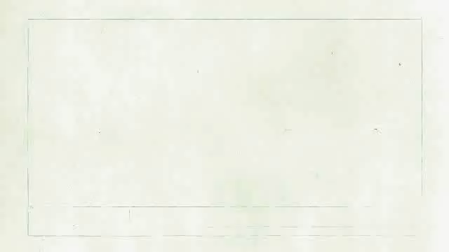
DOE Video: www.youtube.com/watch?v=0elhIcPVtKE
Notes:
Most people understand the thermal energy transfer from the sun to the earth’s surface, but the light can also be captured through the photovoltaic effect as shown in this video
17

Slide 18
Three Common Solar Technologies
photovoltaic
concentrating solar power
solar heating & cooling/ solar hot water (“solar thermal”)
PV
CSP
SHC/
SHW
Notes:
The three prevalent solar technologies that have been developed to convert the sun’s resources into usable energy are photovoltaics, concentrating solar power, and solar heating & cooling/solar hot water (commonly referred to as ‘solar thermal’).
Photovoltaics use the sun’s light to create direct current electricity.
Concentrating solar power uses the sun’s light to create thermal energy. CSP is also sometimes called CST or concentrating solar thermal. It also creates electricity.
Solar thermal applications take the sun’s heat and transfer it directly to air or fluids for a variety of purposes.
We’ll explore these three technologies in just a little more detail.

Slide 19
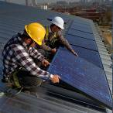
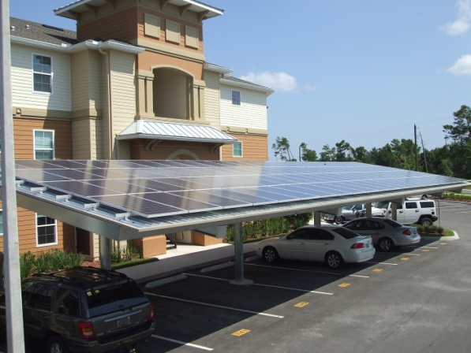
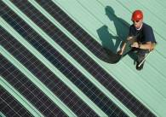
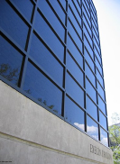
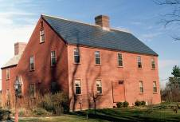

Photovoltaic (PV) Solar Energy
Directly generates electricity from sunlight
Different types you might come across
Building Integrated PV (BIPV), another type
Source: NREL
Crystalline silicon
Thin-film
Source:
www.ecofriend.org
Shingles
Skylights
Architectural glass and granite like materials
Photo Source: NREL http://www.nrel.gov/data/pix/
Notes:
Building-integrated photovoltaics (BIPV) are PV materials that are used to replace conventional building materials in parts of the building envelope such as the roof, skylights, or facades. They are increasingly being incorporated into the construction of new buildings as a principal or ancillary source of electrical power, although existing buildings may be retrofitted with BIPV modules as well.
The advantage of integrated photovoltaics over more common non-integrated systems is that the initial cost can be offset by reducing the amount spent on building materials and labor that would normally be used to construct the part of the building that the BIPV modules replace. These advantages make BIPV one of the fastest growing segments of the photovoltaic industry.

Slide 20
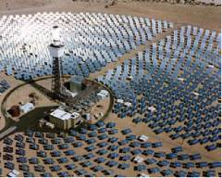
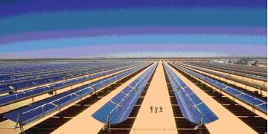
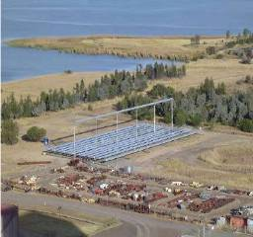
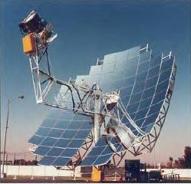
Concentrating Solar Power (CSP)
Central Receiver or Power Tower
Parabolic trough
Compact linear Fresnel reflector
Parabolic – dish engine
Source EPRI and NREL
Notes:
Concentrated solar power (CSP) are systems that use lenses or mirrors to concentrate a large area of sunlight, or solar thermal energy, onto a small area. Electrical power is produced when the concentrated light is converted to heat which drives a heat engine (usually a steam turbine) connected to an electrical power generator. CSP works best where there is lots of direct sunlight, typically in the desert southwest region of the U.S.
CSP should not be confused with photovoltaics, where solar power is directly converted to electricity without the use of steam turbines. The concentration of sunlight onto photovoltaic surfaces, similar to CSP, is known as concentrated photovoltaics (CPV).

Slide 21
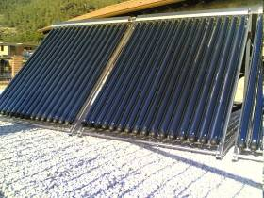
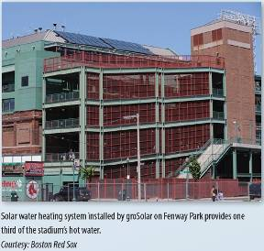
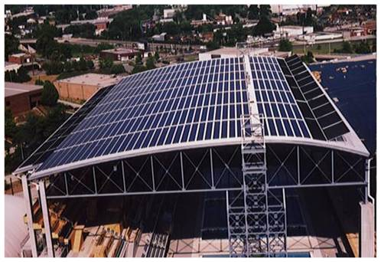
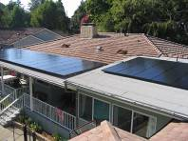
Solar Heating & Cooling/
Solar Hot Water (SHC/SHW)
Solar energy used to heat water or other medium
Applications
Solar pool heating
Domestic hot water use
Process hot water
Space heating
Solar assisted cooling
Notes:
Solar thermal applications known as solar heating and cooling and solar hot water are use the sun’s energy for the direct transfer of heat to fluids or air for residential, business and industrial uses. Solar pool heating uses low temperature solar collectors to heat swimming pool water and is probably the most cost effective solar application of this type. Domestic hot water applications on homes and businesses are also very cost effective and have been around for centuries! Process hot water, space heating and solar assisted cooling are more advanced solar technologies and incorporate higher temperature collectors and combine them with other mechanical equipment for the desired end use.

Slide 22
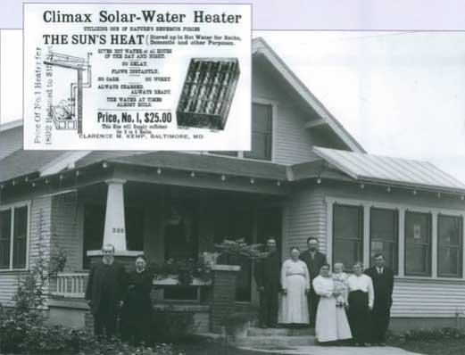
Notes:
… and solar thermal has been around for many, many years!!! This is an example of the early solar water heating systems in use throughout the south, incorporating the “thermo siphon” effect, where the collector installed on the roof’s overhang heats the water which then rises and is stored in a tank that is located in the roof’s attic, often enclosed in a false chimney. These systems were common until the war lead to copper shortages and cheap electricity came along.

Slide 23
Project processing
Costs relative to grid
Variability
Public awareness
Aesthetics – HOA
Requires persistent load
Lack of consumer education
Shortage of skilled workers
Challenges
of solar technologies
Modularity
Mitigates fuel price volatility
Low environmental impact, no GHGs
Supports grid infrastructure
Economic development potential
Can act independently from the grid
Strengths
of solar technologies
Notes:
Common challenges of these solar technologies include:
Time and difficulty of processing projects due to code barriers
Cost of solar technologies relative to the cost of conventional electricity and gas
The variability of the resource given that it depends on sunlight
The lack of public awareness of the attributes of solar
Aesthetic objections and community association deed restrictions
The need for a persistent load to justify the expense and the conversion from traditional energy sources
The lack of consumer education programs, and
A shortage of skilled and trained workers to sell, design and install the systems.
The strengths of these technologies include
Their modularity, in that they can be sited virtually anywhere the resource is present
They can mitigate the volatility of fuel prices, since the energy from the sun is free
Solar has a low carbon foot print
The utility interconnected distributed generation using solar energy supports the grid’s infrastructure
The labor intensive nature of solar applications presents opportunities for economic development and green job creation
Solar technologies are operable without relying upon the grid
23

Slide 24

Every hour, enough solar energy strikes Earth to power human activities for over a year.
U.S. Department of Energy
Solar Energy Technologies Program

Slide 25
Planning for Solar
Visioning and long-range goal setting
Plan making
Regulations and incentives
Development work
Public investment
comprehensive
sub-area
functional
infrastructure
community facilities
review and approval of projects
Notes:
Now that you have a better understanding of the different types of solar energy and some of the typical applications of this resource, we are going to explore the different ways that communities can plan for the introduction of solar energy at the local level. This will include a review and discussion of your vision and goal setting process; making plans at various levels; developing appropriate regulations and incentives; oversight of solar developments; and investing in solar on behalf of your constituents both on community facilities and within the community’s infrastructure (buildings, municipal utilities, traffic and parking lights, etc.).

Slide 26
In pairs or threes, answer the following questions:
REVIEW
How much solar energy reaches the Earth?
PV and CSP produce what kind of power?
Why does CSP work best in the US southwest?
Name and explain 2 strengths and 2 challenges of solar energy.
Notes:
How much solar energy reaches the Earth? Every hour, enough solar energy strikes Earth to power human activities for over a year.
PV and CSP produce what kind of power? Electricity.
Why does CSP work best in the US southwest? Combination of 2 reasons: it requires lots of direct sunlight (not diffused through humid air), and it needs lots of open space.
Name and explain 2 strengths and 2 challenges of solar energy.
Strengths:
Modularity, Mitigates fuel price volatility, Low environmental impact, no GHGs
Supports grid infrastructure, as well as it can act independently from the grid, Economic development potential – promotes local growth in jobs and revenue
Challenges:
Project processing, Costs relative to grid, Variability, Public awareness, Aesthetics – HOA, Requires persistent load, Lack of consumer education, Shortage of skilled workers

Slide 27

Dispelling the Myths and Communicating the Benefits of Going Solar
Notes:
I imagine that through the course of your work and even in your daily personal life amongst family and friends, you come across naysayers to solar – these are people who you care about (whether for personal or professional reasons or both), and I also imagine you would want to help them understand – and eventually embrace – the idea that solar offers real and positive opportunities for their community.
So in this section we present look at the many benefits that solar offers to local communities. We hope that you can use this evidence-based information to present the positive attributes about solar when you return to the communities where you live and work.

Slide 28
Why Isn’t Solar More Widely Adopted?

Slide 29

Solar Myths
Solar takes more energy to produce than it produces!
Solar will cause our grid to overload; blackouts will occur!
Solar is too expensive!
Solar technology is immature and inefficient!
Solar is only for tree-huggers!
Solar doesn’t work in the north (or in the south!)

Slide 30

Part of your role as a local solar champion is dispelling these myths.
Notes:
In the following section, we offer scientific evidence to bust the various myths that exist about solar. You will no doubt find yourself among naysayers and others who you want to engage in discussions about bringing more solar to your community.
We hope you find this series of data and talking points as a useful tool for busting solar myths.

Slide 31
Myth:
Solar doesn’t work in the north (or in the south!)

Slide 32
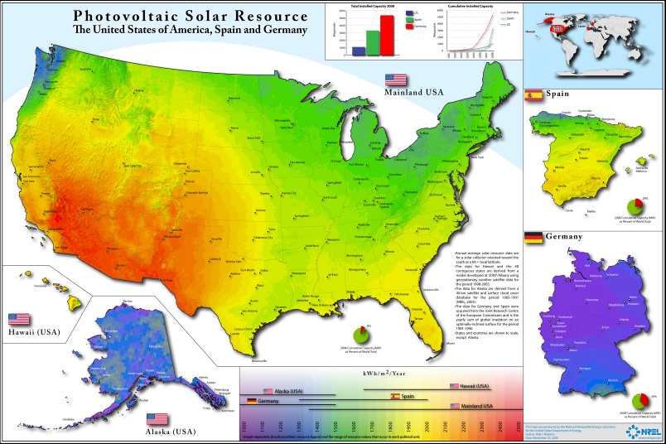
Solar works well in all parts of the continental U.S.
FACT:
Source: http://www.nrel.gov/gis/images/us_germany_spain/pvmap_usgermanyspain%20poster-01.jpg
Notes:
Comparison between continental US and Germany and Spain. Germany has the world’s largest solar market and gets nearly 2% of its total electricity from solar. The US, on the other hand, sits around .01%. And Germany isn’t particularly sunny! In addition, Germany expects more jobs in the renewable industry than the automotive industry within the next decade.

Slide 33
Myth:
Solar technology is immature and inefficient!

Slide 34
Solar technologies have matured and are becoming more efficient
FACT:
Life expectancies of solar systems are now 25-30 years
Solar heating technology has achieved vast improvements
Notes:
Solar technologies have been around for 50 years and systems last 25-30 years. Efficiency rates continue to increase, but more importantly solar delivers energy during the peak usage and most expensive part of the day.

Slide 35
Myth:
Solar is too expensive!

Slide 36
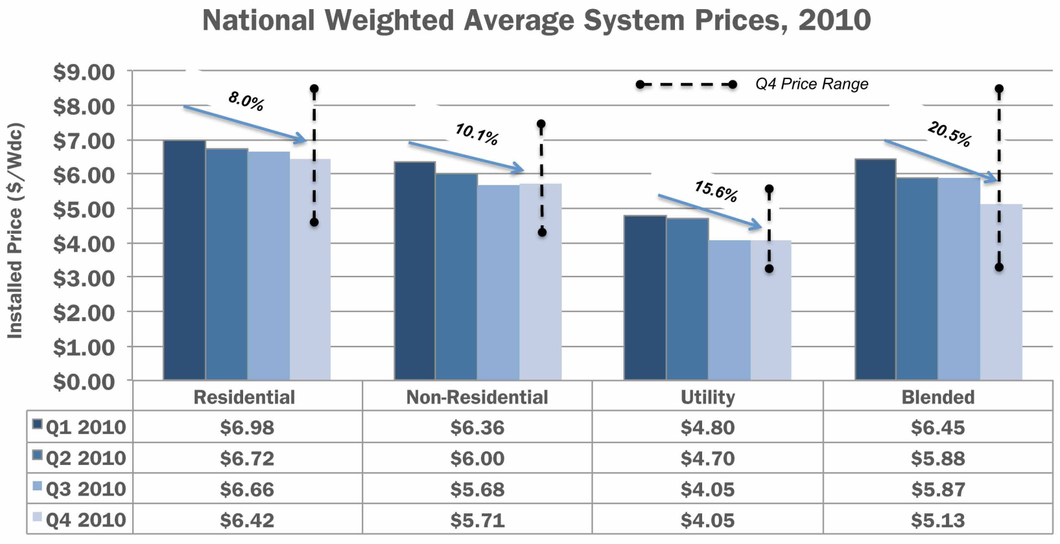
The Cost of Installing PV is Decreasing Rapidly
FACT:
National Weighted Average System Prices 2010
Source: U.S. Solar Market Insight: 2010 Year in Review Executive Summary. Solar Energies Industry Association and GTM Research
Notes:
National weighted-average system prices fell by 20.5% over the course of 2010, from
$6.45/W to $5.13/W. Much of this decline was due to a shift toward larger systems,
particularly utility systems, in the fourth quarter.
The U.S. PV market remains highly disaggregated, resulting in a wide range of installed
prices even within a given state, market segment, and quarter. Figure 2-7 displays the
range of installed system prices in the fourth quarter of 2010. Residential systems
were installed in certain locations (particularly Colorado and Arizona) at prices below
$5.00/W, but other locations saw residential system prices over $8.00/W. Non-residential
installations ranged from $4.11/W to $7.31/W. Utility installations show the most
variability, largely due to the choice between low- and high-efficiency modules and between
fixed and tracking mounting structures. Over time, it is possible that maturation of the
U.S. market will bring more consistency to system prices both within and across states.

Slide 37
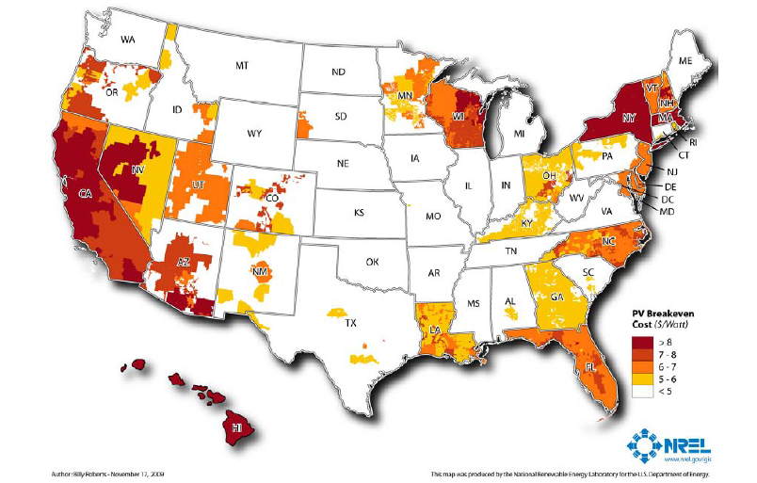
Solar is at or near grid cost parity:
PV Breakeven Cost in 2008 ($/Watt)
FACT:
[uses most common rate structure and all incentives]
Notes:
Source : Break-Even Cost for Residential Photovoltaics in the United States: Key Drivers and Sensitivities
Paul Denholm, Robert M. Margolis, Sean Ong, and Billy Roberts, Technical Report , NREL/TP-6A2-46909, December 2009
http://www.nrel.gov/docs/fy10osti/46909.pdf
Figure 1. Residential solar PV break-even cost ($/W) in 2008 using the most common rate structure and all incentives
When considering the results presented in Figure 1 and elsewhere, readers should note that this analysis represents a single point in time (late 2008 and early 2009). Because incentives and electricity prices are constantly changing, results for any single area may be substantially different when evaluated later.
Figure 1 indicates that the only areas where PV is close to or at breakeven is where there is a combination of high electricity prices and good solar resources (such as California), or a combination of high electricity prices and incentives (such as New York state and Massachusetts). About 11% of residential electricity sales are in utilities where break-even conditions exist for the assumptions used in the base case for a PV system cost of $8/W. At $6/W, 42% of residential electricity sales are in utilities where some customers may be at breakeven (including customers in states such as Florida, North Carolina, New Jersey, and a growing part of the southwest.) It is important to note that in practice only a fraction of customers in these utility service territories are likely to meet all the criteria (full retail net metering, good solar exposure, and financing) to be at breakeven, and the presence of break-even conditions does not necessarily equate to large consumer adoption. Furthermore, there are budget caps for most current incentive programs and typically limits on the amount of net-metered systems that can be connected to the grid in a specific utility service territory.

Slide 38
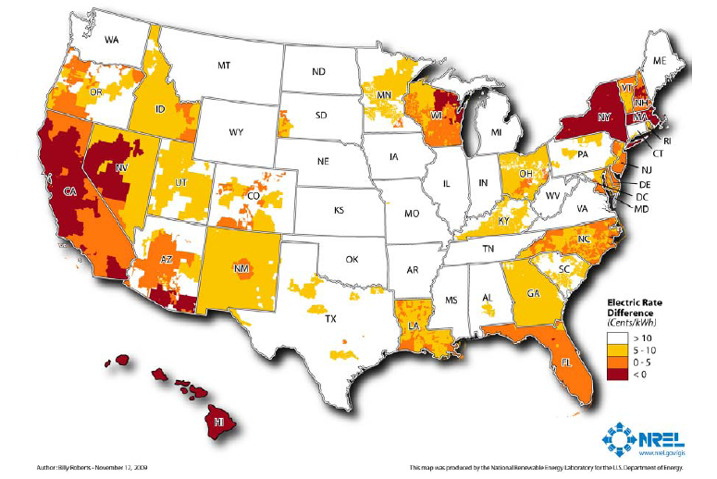
FACT:
Solar is at or near grid cost parity:
Increase in electricity price for PV breakeven
[$8/W using base rate structure]
Notes:
Source : Break-Even Cost for Residential Photovoltaics in the United States: Key Drivers and Sensitivities
Paul Denholm, Robert M. Margolis, Sean Ong, and Billy Roberts, Technical Report , NREL/TP-6A2-46909, December 2009
http://www.nrel.gov/docs/fy10osti/46909.pdf
Figure 4. Increase in electricity price required for residential PV breakeven at $8/W using the base rate structure This figure shows the same trends as the previous figure. The areas indicated by a rate difference of less than zero cents/kWh are by definition at breakeven and matching the areas in the previous figurewhere the break-even price is greater than $8/W. This figure shows that the price of electricity would have to increase by a significant amount in many parts of the country to achieve break-even conditions, assuming no further decrease in the price of PV. For example, if the price of electricity were to increase 5 cents/kWh (from the baseline 2008 values) across the United States, 36% of residential electricity sales would be in utilities where break-even conditions exist for some customers. Again, note that this is not a depth of market analysis and only a fraction of customers are likely to meet all the criteria for breakeven.

Slide 39
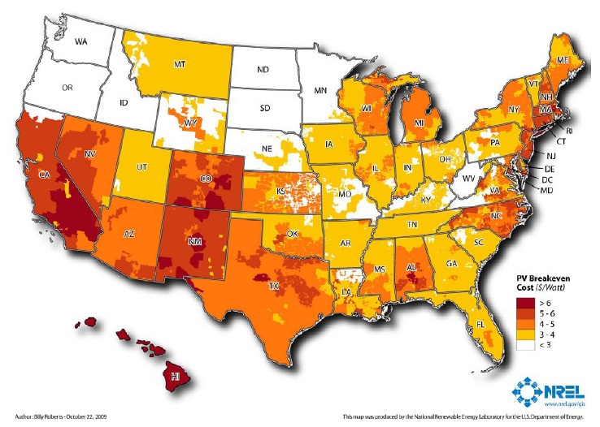
Solar is at or near grid cost parity:
PV Breakeven Cost in 2015
FACT:
[most common rate structure and all incentives]
Notes:
Source : Break-Even Cost for Residential Photovoltaics in the United States: Key Drivers and Sensitivities
Paul Denholm, Robert M. Margolis, Sean Ong, and Billy Roberts, Technical Report , NREL/TP-6A2-46909, December 2009
http://www.nrel.gov/docs/fy10osti/46909.pdf
Figure 6. Residential solar PV break-even cost ($/W) in 2015 using the base-case assumptions in Table 1 and the most common rate structure
The 2015 case shows a dramatic reduction in the break-even cost of PV where local incentives existed in early 2009. Alternatively, in locations where no incentives existed in early 2009, the assumed electricity price escalation increases the break-even price. In this case, 43% of residential electricity sales are in utilities where break-even conditions occur for some customers when PV system costs $4/W. At $3/W, 85% of residential electricity sales are in utilities where some customers are at break-even cost

Slide 40
Myth:
Solar takes more energy to produce than it produces!

Slide 41
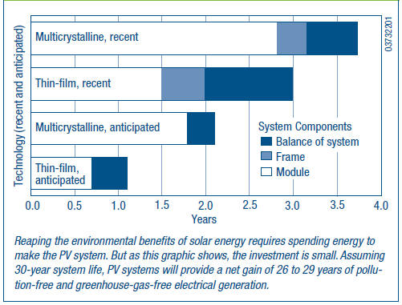
PV modules produce FAR more energy than is consumed in manufacturing them
FACT:
Energy payback for rooftop PV
Source: NREL, PV FAQs, What is the Energy Payback for PV
Notes:
“Energy payback” of PV systems = 1-4 years depending on the technology used
Solar facility lifetime may be ≥ 30 years
Analyses vary, but recent ones suggest even shorter payback times
“Energy payback” of PV systems (modules, frame, and balance of system) from 1 – 4 years depending on the technology used
NREL FAQ: http://www.nrel.gov/docs/fy05osti/37322.pdf (FAQ is from 2004, but it stands to reason that as module efficiency increases and manufacturing efficiency increases, the payback numbers would fall lower still.) For ground mounts, one calculation of the payback for the ground mounting system (concrete foundations and heavy framing) was 3 -5 months, about the same as the mounting systems for Energy payback estimates for rooftop PV systems are 4, 3, 2, and 1 years: 4 years for systems using current multicrystalline-silicon PV modules, 3 years for current thin-film modules, 2 years for anticipated multicrystalline modules, and 1 year for anticipated thin-film modules (see Figure 1). With energy paybacks of 1 to 4 years and assumed life expectancies of 30 years, 87% to 97% of the energy that PV systems generate won’t be plagued by pollution, greenhouse gases, and depletion of resources.
Based on models and real data, the idea that PV cannot pay back its energy investment is simply a myth. Indeed, researchers Dones and Frischknecht found that PV-systems fabrication and fossil fuel energy production have similar energy payback periods (including costs for mining, transportation, refining, and construction).
How Much CO2 and Pollution Does PV Avoid? An average U.S. household uses 830 kWh of electricity per month. On average, producing
1,000 kWh of electricity with solar power reduces emissions by nearly 8 pounds of sulfur dioxide, 5 pounds of nitrogen oxides, and more
than 1,400 pounds of carbon dioxide. During its projected 28 years of clean energy production, a rooftop system with a 2-year energy payback
and meeting half of a household’s electricity use would avoid conventional electrical-plant emissions of more than half a ton of sulfur dioxide, one-third a ton of nitrogen oxides, and 100 tons of carbon dioxide (see Figure 2).
PV is clearly a wise energy investment thataffords impressive environmental benefits.
Another more recent article in Home Power magazine puts it lower: 1-2 years currently, with projections of one year or lower in the near future. http://homepower.com/view/?file=HP127_pg32_Sanchez

Slide 42
Myth:
Solar will cause our grid to overload; blackouts will occur!

Slide 43
Solar Is Reliable
FACT:
Power Outages and PV Availability as % of Ideal Output
L.I. Jul. 3-8
110,000 customers
PV = 82% of ideal
NYC Jul. 6-7
68,000 customers
PV = 93% of ideal
San Francisco Jun 14, 2000 100,000 customers
PV = 99% of ideal
?
Delaware Jul. 6
138,000 customers
PV = 91% of ideal
Entergy Serv. Jul. 23
550,000 customers
PV = 90% of ideal
Chicago Jul. 30 – Aug. 1
1,000,000 customers
PV = 90% of ideal
N.J. Jul. 5-8
112,000 customers
PV = 91% of ideal
Notes:
Reliability is an important value attribute to local governments and consumers, though it is difficult to fully quantify it. The system will require either storage or another generating technology.
We do have the ability to look at the solar availability and analyze availability as a percent of PV ideal output. During large outages (usually caused by heat), PV has high availability. This could also be an identified value to the electric grid.
Intermittency is OK.

Slide 44
Notes:
Remember the large blackout in the NE? This was initially caused by human error, but the domino spread of the blackout was mainly due to the heat present and circuit loads being near or over capacity. A minimal amount of distributed generation – solar – would have mitigated the demand on the grid and prevented the spread of the outage. The cost of the outage was placed at “billions”
500 MW of DG solar would have mitigated the domino effect – not the initial outage

Slide 45
Myth:
Solar is only for tree-huggers!

Slide 46

Solar is for Every One
FACT:
94% of Americans want to see more solar!*
Emergency Response Units
Military
*Source: Schott Barometer:
http://www.us.schott.com/english/news/index.html?NID=358
Notes:
Solar is for Everyone – NOT just for “tree-huggers.” National security, resiliency, reliability are all reasons to go-solar.
The Air Force is negotiating contracts for ~500 MW solar power within the next 3 years, including installations at Nellis AFB, Camp Pendleton, and in Stuttgart, Germany.
States and localities are integrating solar in their emergency plans:
In Montana, 20 PV solar systems totaling 47.5 kW of capacity have been installed on fire stations within North Western Energy’s Montana service territory.
In Boston, the City is installing a Solar Evacuation Route.

Slide 47
More Community Benefits to Going Solar
Adds jobs
Improves national and local economies
Yields positive investment returns
Helps achieve environmental, energy goals
Mitigates land use issues
Can integrate with clean transportation infrastructure
Strengthens energy infrastructure
Notes:
Some of those benefits are rather obvious as we just discussed – among them that they’re clean sources of power and can bring much-needed revenue and jobs to local communities that embrace solar.

Slide 48
Solar Adds Jobs
26% Job Growth!
Estimated U.S. Solar Industry Employment
Source of information on solar jobs: The Solar Foundation’s National Solar Jobs Census 2010
Notes:
That’s right – solar creates jobs. And you can see by the trend line – the number of jobs are increasing. If you recall from watching the video on PV installations over the past decade – installations are increasing and as they increase so do jobs required to support them.
As of August 2010, there are approximately 93,000 solar jobs in the US. This is double what previous best guess estimates indicate.
Between August 2010 and August 2011, job numbers are expected to increase by an astounding 26%, representing 24,000 net new solar jobs across the country.
This is for all types of firms and these findings show an industry that is clearly growing much more rapidly than the economy as a whole, which is slowly creeping along with only 2% average job growth rate across all sectors.
For example, healthcare and IT are creating jobs at a glacial pace and other sectors such as arts, entertainment, recreation, and the fossil fuel electric generation industries are cutting them completely.
With a national unemployment hovering around 9-10% and close to 15 million Americans out of work (not counting the underemployed and discouraged workers) – the growth of the solar industry is great news!
48

Slide 49
Hiring Expectations, All Firms
Between August 2010–2011
Source of information on solar jobs: The Solar Foundation’s National Solar Jobs Census 2010
Notes:
The study found that over half of all solar companies plan to add workers over the next 12 months, while only 2.2% expect to cut workers over the period.
And when we talk about solar jobs – we are talking about installation jobs, roofing jobs, electrician, sales, engineering, planning, assembly, legal, clerical, marketing, policy - which indicates that there are opportunities for people with varying degrees of expertise and experience to enter the solar industry.
49

Slide 50
By August 2011, Manufacturing and Wholesale Trade will have Grown the Fastest at 36%
2010 Jobs
New Jobs
(12 Months)
local jobs!
Source of information on solar jobs: The Solar Foundation’s National Solar Jobs Census 2010
Notes:
Solar installer jobs are helping construction workers, electricians, plumbers and roofers weather the economic downturn. Installation firms make up about 60% of all firms. These are LOCAL JOBS. You can’t send your house to China to have solar put on the roof and then have it sent back. Increased global demand for solar is putting our manufacturers to work. There are also jobs in legal, sales, marketing, and planning –
The red indicates the growth in jobs from August 2010 to August 2011. Manufacturing and wholesale trade are the fastest growing subsectors both with 36% next year – which might be a bit surprising given all the news about US manufacturers outsourcing overseas – and it is true that US manufacturing is at its lowest point in terms of employment since before WWII – but solar manufacturing bucks the trend.
50

Slide 51


Notes:
Domestic companies are also expanding.
These pictures are from the largest manufacturer of thin film solar panels – First Solar – a US company headquartered in Perrysburg Township, Ohio (where it employs more than 1100 employees)
Just last week First Solar confirmed that it will build its second manufacturing plant in Mesa, Ariz.
The facility, scheduled to open next year, will include 600 jobs and produce more than 250 megawatts of thin-film solar panels a year.
….their product – the thin film panels are used in both large and small projects resulting in installation and construction jobs.
In fact, Southern California Edison (SCE) just signed a deal with First Solar for 250 megawatts – resulting in 300 construction jobs in Nevada.
Extra: The solar panels will be ground-mounted on about 2,500 acres of public land near Primm, Nev. First Solar is developing the project, named Silver State South, which will interconnect with SCE’s proposed Eldorado-Ivanpah 220-kilovolt transmission line.
The project is expected to begin producing electricity as early as 2014 and be fully operational by May 2017.
It will create about 300 construction jobs, and the solar panels will be recycled after their useful lifespan.

Slide 52
Solar is Big Business – and Means Business…
Source: SEIA/GTM Research - 2010 Year in Review Report
To Access: http://www.seia.org/galleries/pdf/SMI-YIR-2010-ES.pdf
Notes:
The Solar Energy Industries Association has been tracking the growth of the industry for several years now and found that the solar industry has grown 300% in just four short years. Basically it went from being a $1.5 billion industry in 2006 to a $6 billion industry in 2010. It is big business and means business – attracting billions in venture capital each year.
The solar industry has become the fastest growing energy sector and one of the fastest growing industries in any sector across the U.S.
52

Slide 53
Net Solar Exports Totaled $723m in 2009
Source: GTM Research, International Trade Commission
Notes:
Solar is a major export industry
A new report put out by SEIA and GTM Research found that net exports totaled $723 million in 2009
This is more than the GDP of several developing countries including Tonga, Liberia, Dominica, etc.
In fact - the US exports $2.2B more solar products than it imports
And 72% of the total project value of PV stays in the US – in other words, $0.72 out of every $1 spent on a solar installation in the US finds its way back to the local US economy through wages paid to installers/laborers/legal teams/etc.
These exports help to feed money into local economies
The same report found that solar created $2.6 billion in direct value in 2009 to support the U.S. economy – this money stayed in the US
This report is great because it shows that US trade in the solar industry is more balanced than in the overall economy, which had a trade deficit of $374 billion in 2009.
(Number still not that impressive because it is just the tip of the iceberg – a lot more potential out there – plus we just started)

Slide 54
Solar Develops Local Economies
Property taxes from solar farms
Improves regional economic competitiveness
Induces private capital investment
Serves as a catalyst for other clean-tech companies and investments
Stabilizes long-term energy prices
Enables the region to avoid additional costly environmental controls on other industries
Decreases reliance on energy imports, saving ratepayers’ money
Land leases for solar farms
Increased revenue opportunities for landowners
Notes:
Solar develops local economies –
Increased revenue opportunities for landowners
Land leases for solar farms
Property taxes from solar farms
Improves regional economic competitiveness
Induces private capital investment
Serves as a catalyst for other clean-tech companies and investments
Stabilizes long-term energy prices
Enables the region to avoid additional costly environmental controls on other industries
Decreases reliance on energy imports, saving ratepayers’ money
54

Slide 55
Solar is a Smart Investment
It is a proven technology
Prices for modules are decreasing, while energy costs are increasing
Rebates, grants and incentives are available to increase return on investment

Slide 56
Solar Helps States Achieve
Environmental and Energy Goals
Renewable energy procurement requirements for utilities
Northeast, West, and Midwest states exploring carbon emission caps
State energy plan goals
Other environmental issues linked with fossil fuel electricity generation
29 states (+ D.C.) have renewables portfolio standards (RPSs)
16 states (+ D.C.) have specific solar or distributed generation requirements
mercury pollution
thermal energy pollution
mining impacts
water issues
US Average/MW Solar
Decrease in CO2 (1000 tons) | 42.87
Decrease in NO (1000 tons) | 0.05
Decrease in SO2 (1000 tons | 0.10
Decrease in Mercury (lbs) | 1.31
Water saved (millions of gal) | 5.86
Reduced price volatility
Energy security
Public health, etc.
Notes:
RPS
29 states (+ D.C.) have renewables portfolio standards (RPSs)
16 states (+ D.C.) have specific solar or distributed generation requirements
Many communities with or without municipal utilities have set their own portfolio standards or GHG emission goals
w/munis include Orlando, Gainesville, Sacramento
w/o munis include Aspen, Boulder

Slide 57
Solar Mitigates Land Use Issues
A flexible technology:
Rooftop
Building integrated
Ground mounted
Don’t have to tear up Main Street to upgrade the grid
A sustainable and green redevelopment strategy
Notes:
Dual land use technology – can be rooftop or building integrated
Built Out Areas – can reduce the need for transmission and distribution (T&D) upgrades and service small loads which are extremely expensive and disruptive to other community operations
Redevelopment
Sustainable, green, aesthetic standards
Brownfields to Brightfields

Slide 58
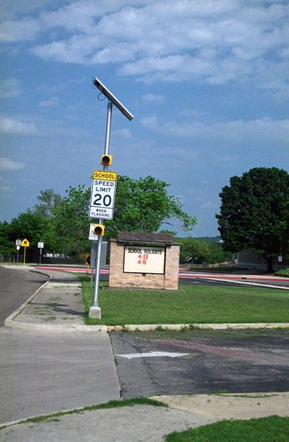
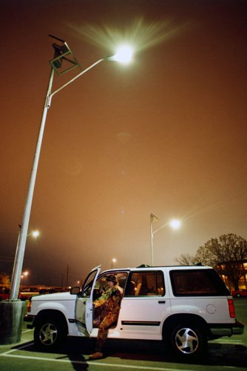
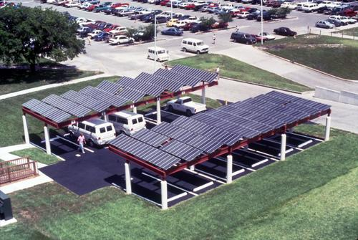
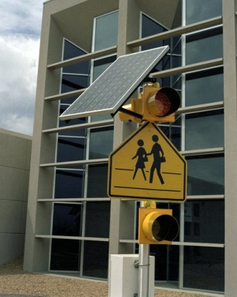
Solar Can Integrate with a Cleaner Transportation Infrastructure
Charging stations for alternative fuel vehicles, public transit awnings
Traffic control reliability
Safety lighting
Source: NREL
Notes:
Alternative fuel vehicles – As communities move towards cleaner transportation fleets and public services that include charging stations for plug-in hybrids and electric vehicles, solar systems resource profile and electronic interconnection work complimentary with these new transportation technologies.
Links with community planning for Smart Grid.
Public transit wait areas weather protection – Often the small amount of lighting needed for safety is perfectly suited to a small solar energy system rather than a service drop and the associated construction disruption of traffic flow (I have a picture)
Safety lighting - with the advent of very high efficiency lighting, solar powered street and safety lighting is very common. Lighting additions are easily done without extra electric service and the associated construction. Communities in more disaster prone areas are implementing a minimum percentage of DG powered street lighting to assure safety lighting during disaster recovery and the long term outages.
Traffic control reliability – nearly standardized on remote solar power
Distributed generation supports increased load in urban areas decreases traffic disruptions – In built-out high density urban areas, distribution upgrades for load increases or even power quality disrupt already congested areas. Often DG support of the grid can eliminate the need for an upgrade.

Slide 59
Solar Strengthens Our Energy Infrastructure
Increases portfolio diversity, reliability
Decreases environmental risks to utilities
Reduces utility investment risk
Can support a strained grid
Notes:
The risk associated with making an investment in a ten year lead time coal plant,
with an extremely large capacity and investment is much higher than small
incremental investments in distributed PV systems. Even the two year lead time of
a combined cycle plant has more risk.
Capital investments are recovered more quickly with immediate revenue streams.
The impact and probability of non-availability of one large plant is much greater
than 1000 small plants.
Also, solar also promotes energy security by reducing peak use of electricity… benefits of distributed generation (reducing stresses on grid, etc.) – it is as available or more available than other types of power.
59

Slide 60
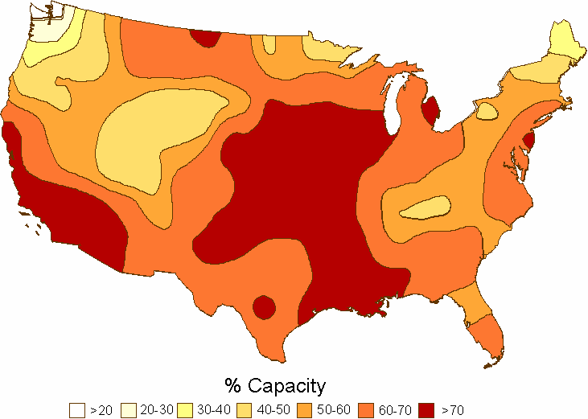
Solar Generation Coincides with Peak Demand/Price
% peak demand match based on utility loads
Notes:
The solar fuels highest availability is coincident with AC load that drives high peak energy costs
The map is based on the solar match to utility peak demand. In specific urban areas or large urban buildings the percent match will be higher.

Slide 61
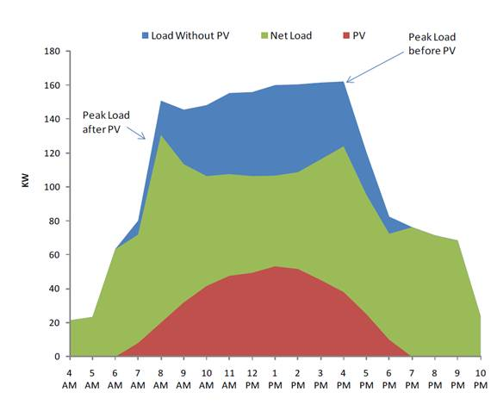
Solar Generation Coincides with Peak Demand/Price
Peak load before PV
Peak load after PV
Load without PV
Net load
PV
Notes:
Solar provides power at the peak and most expensive part of the day. PV can provide key peak-shaving ability for the electricity mix. Often times “peaking” plants that turn on only during the peak are some of the dirtiest oil-fired power plants. PV resources can eliminate the need and avoid these emissions by producing power during those peak times of day.

Slide 62

When Local Governments Lead Solar Efforts, They Show Leadership and Social Responsibility
How
Inspire more installations
Reduce GHGs
Encourage property improvements
Work with local industry
Help save operating costs
Results
Job growth
Improved quality of life
Increase property values
Increased private sector willingness to adopt solar
Savings for constituents
Notes:
When local governments lead solar efforts, they show leadership and social responsibility –
Often it takes the Mayor or the Council President to stand up and proclaim that their city is pro-solar before the market comes in.
Mayors and other elected and appointed officials are responsible for the welfare of their constituents. There is a lot of pressure to be socially responsible, but there is an equal amount of pressure to spend budgets wisely. But you don’t have to be a Mayor or the Council president to be a leader. In fact, many of you are in a decision making position or in a position to make recommendations to decision makers.
When your city goes solar it inspires more installations You can show leadership and social responsibility by:
Inspiring more installations – which leads to job growth
Reducing GHGs – which leads to an improved quality of life
Encouraging property improvements – which leads to increased property values
Working with local industry – which leads to an increase in private sector willingness to adopt solar and get involved
Helping to save on operating costs – which leads to tax savings for constituents – in some ways you can lock in a low fixed rate over the course of 10-20 years
The City of Rifle, CO put 2.3 MW of solar PV on a former uranium and vanadium processing site – reducing GHG emissions by 76,000 tons per year and saving City of Rifle taxpayers approximately $2 million by siting the project on contaminated land already owned by the City.
You too can show leadership and social responsibility by helping to lead solar efforts in your community.

Slide 63
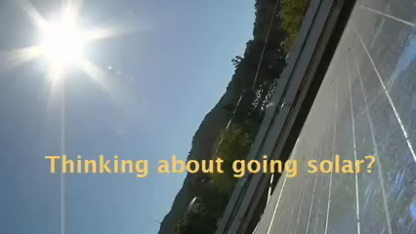
Marin County, CA
http://www.youtube.com/watch?v=HLHlzLVY9gA
Notes:
63

Slide 64
Prepare an Elevator Speech to convince one of your community leaders that it’s worth it for your community to go solar
Individually, prepare your speech (5 minutes)
  What motivates this community leader? What benefit of solar aligns with this person’s motivation?
  It should take <30 seconds to deliver (approximately 90 words)
In pairs, each partner delivers his/her elevator speech; offer suggestions to each other (5 minutes)

Slide 65
Featuring Boston

Slide 66
3-2-1 Review
What are/is:
3
Three types of regulating codes that affect solar?
Two ways to implement Solar Ready design of buildings?
One question you have about how to incorporate solar into your community’s codes and ordinances?
2
1

Slide 67
How and Where to Consider Solar Energy in the Planning Process
Notes:
67

Slide 68
Visioning and long-range goal setting
Plan making
Regulations and incentives
Development work
Public investment
Planning for Solar
Notes:
Visioning and long-range goal setting
Plan making
Comprehensive, sub-area, functional
Regulations and incentives
Development work
Review, approval of projects
Public investment
Infrastructure, community facilities
68

Slide 69
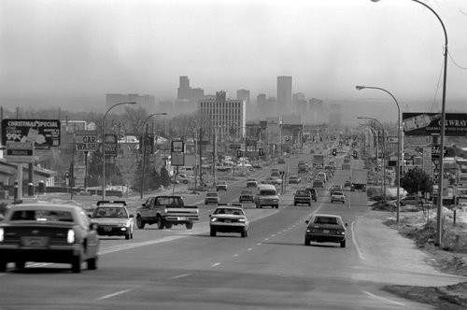

Visioning and long-range goal setting
Does solar play a role in the future vision for your community?
Photo: NREL
Photo: www.solar.calfinder.com
Notes:
Solar might not immediately come up in a visioning process, but ask questions and make connections to long-term goals (e.g., becoming more sustainable or reducing greenhouse gas emissions)
69

Slide 70
Champaign-Urbana: A View from the Year 2025
Visioning and long-range goal setting
http://vimeo.com/10835945
Notes:
70

Slide 71




Plan Making
Comprehensive, general, or master planning
Sub-area plans
Functional plans
Notes:
Building solar into plans
Comprehensive, general, or master planning
Sub-area plans
Neighborhood, downtown, corridors…
Functional plans
Water, open space, transportation/transit…
71

Slide 72
Toledo Reinvents Itself as a Solar Power Leader
Plan Making
http://www.youtube.com/user/TheSolarIndustry#p/u/60/9NTPTn0JL6E
Notes:
Like many manufacturing cities, Toledo has struggled with the loss of jobs and tax revenue, but it has taken pieces of its past as the glass capital to create a new future in solar energy.
72

Slide 73
Regulations and Incentives
Zoning ordinances
Subdivision ordinances or regulations
Form based codes
Planned unit development/ planned residential development ordinances
Transit oriented development regulations and guidelines
Historic district architectural or design guidelines
Transfer of development rights
Wetlands ordinances
Tree ordinances
Notes:
73

Slide 74

Seattle, Washington: Comprehensive Review of City Codes and Practices
Regulations and Incentives
Increase/improve building energy standards
Require solar-ready construction
Add flexibility to height limits and roof coverage limits
Develop or refine definitions in the table of uses to ensure that solar energy projects are not unnecessarily prohibited
Implement a solar access ordinance
Increase focus on commercial and industrial land use/development
Notes:
Seattle conducted a gap analysis of their codes relative to best management practices for solar energy development, recognized in current literature by national subject matter experts.
The report identifies where Seattle meets or exceeds; does not meet; or does not address best management practices. Recommendations are also presented. See slide for some examples.
74

Slide 75

Review and approval of development projects
Public-private development and redevelopment projects
Development agreements
Development Work
Source: www.urbanmilwaukee.com
Notes:
75

Slide 76


City of Corvallis’ Land Development Code Incorporates Solar
Development Work
Administrative procedures and review criteria for land use actions
Provisions for new development or intensification of existing development
Notes:
76

Slide 77

Development Work
Notes:
Example of ground mounted solar
77

Slide 78



Source: NREL
Public Investment
Infrastructure
Streets
Community facilities
Schools
Bike paths
Water systems
Transit…
Libraries
Municipal buildings…
Source: solaramericacommunities.gov
Notes:
78

Slide 79
Visioning and long-range goal setting
Plan making
Regulations and incentives
Development work
Public investment
Planning for Solar
How might solar be incorporated in your community via these five strategic points of intervention?
Think quietly about possible answers (1 minute)
Discuss your thinking with your partner (3 minutes)
Share your responses with your table group (5 minutes)
Notes:
Volunteers then share their responses with the entire group…
79

Slide 80
Steps for Installing Solar on a Local Government Facility
Educate yourself
Assess the site for solar
Develop RFP
Decide on contractor
Make it happen
&
Notes:
Information provided by Andrea Luecke, now Acting Exec Director of The Solar Foundation and formerly the Milwaukee WI Solar America City coordinator.
80

Slide 81
Evaluate your solar potential
Consider the type of solar you are interested in
Utilize DSIRE www.dsireusa.org
Educate yourself
Consider asking these questions:
What resources and financing are available? | What products are available?
What are the potential locations for an installation? | How much does it cost to install the system?
Are building modifications necessary? | What are the local interconnection and net metering arrangements?
What is the customer currently paying for electricity? | How much electricity is the customer using, and when?
http://solar.calfinder.com/blog/solar-information/10-free-online-solar-calculators/
Notes:
There are a few things you can do before you get serious about installing solar on a local public facility – educate yourself
Remember: No hard and fast rules about which solar technologies are appropriate. Depends on the application.
Many residential solar systems are crystalline silicon; smaller available roof space requires higher efficiency panels in order to generate sufficient power for viable economic return
Many commercial solar systems are thin-film; larger available roof area, greater electricity usage means a larger system and higher installation costs – thin-film often cheaper to installer per kW
Remember: Solar economics very complex – different for every customer, technology
Consider these questions (refer to slide)…
You may not have all the answers, but you should begin to familiarize yourself with these concepts and DSIRE as a resource (we’ll look at DSIRE later in this workshop).
At home research: calculate payback on your solar investment – conduct research to see if there are state or local incentives (does energy efficiency first play a role?) DSIRE website is a great start.
81

Slide 82

Size of system needed
Energy production
Best placement
Cost and payback
Technology type
Distance to transmission lines
Distance to graded roads
Conservation areas
Usable acreage
Slope
Assess the site for solar
on the
GROUND
Notes:
Some installation firms will provide site assessments as part of their installation proposal, but it is recommended that the site assessment be conducted by an independent third-party.
If you are serious –get a “Solar Site Assessment” –
What is a Solar Site Assessment and why is it important?
Unbiased – third-party opinion on the right size, location, and technology to meet your energy needs
Will include images of the proposed placement of the installation and where the tanks/inverter will be located
Will take into consideration energy usage and energy costs and include an economic analysis with ROI calculations
Will include recommendations
Often a site assessment is required in order for rebates to be awarded
82

Slide 83
Solar Access Rights
Interconnection, area networks
Best placement
Wind loading
Technology type
Building energy load
Roof age, type, & warranty
Electrical configuration
Optimal conduit paths
Slope, shading, orientation
Assess the site for solar
on
BUILDINGS
Notes:
The assessments should include technical analyses of a building’s energy load; roof age, type, and warranty; weight load limitations; available roof space (or ground space for a ground-mounted system); slope, shading, and orientation; optimal conduit paths; and electrical or water heating configuration.
83

Slide 84

Orientation, Shading
summer
winter
Notes:
You can’t put solar anywhere – there are some site specific considerations for you to keep in mind….
Shading - Solar PV panels can be affected by numerous types of obstructions. Examples include trees, clouds, bird droppings, dust and even the shading from other solar panels.
Solar Access Rights – Solar Access laws vary by state and region. Solar access laws protect the right of an individual to both install and operate solar panels. A thorough access law addresses both unwarranted restrictions to construction as well as changes that may occur after construction like tree shading and newly constructed higher buildings. Currently, 34 states have some sort of solar access rights established to protect individuals.
Structural Capacity and integrity– Buildings that are being proposed for construction can easily modify system plans to incorporate solar PV panels. However, older buildings can be analyzed to ensure that the current roof has the load capacity to handle the solar PV panels. If a roof is close to the end of its expected life, replacing the roof could be a viable option. Many companies can install the solar panels and the new roof at the same time, if needed.
Wind Loading – Due to the large surface area of panels, the effects of wind speed must be considered when installing solar panels. Therefore, it is necessary to hire a structural or civil engineer to properly perform wind loading calculations and other possible code requirements.
Interconnection to the grid – If you are developing in a area where solar is “new”, the approval process from the utility may be lengthy
Maximum energy output for a fixed system is always facing South at latitude tilt. A more horizontal tilt gives more summer energy and a more vertical tilt gives more winter energy.
84

Slide 85
RFP specifications are too restrictive or too unstructured
Competing measures of system efficiency
Finding sufficient number of qualified contractors (bidders)
Lack of effective O&M program
Lack of strong monitoring program
Develop RFP
Direct ownership
Third-party ownership
Start the RFP process with the end in mind
Avoid five common pitfalls
Source: NREL Webinar “Procuring and Implementing Solar Projects on Public Buildings: How to Avoid Common Pitfalls” December 8, 2010
Notes:
This can be for a single site, multiple sites within a jurisdiction with multiple departments, or on behalf of multiple jurisdictions with sites. It can also be either a direct ownership RFP (in which the municipality owns all equipment and is responsible for operations and maintenance) or third-party ownership.
Write and issue a request for proposal (RFP) in compliance with procurement office. It is recommended that a residential or commercial customer solicit bids and interview at least three potential contractors.
85

Slide 86
Consider Collaborative Procurement for Solar
Develop RFP
Energy cost reductions of 10‐15%
Market‐leading contract terms
Early achievement of GHG goals
50% savings in administrative and transaction costs
Stabilized cost of electrical energy
Reduced cost of PV through volume purchasing
Reduced vendor costs through economies of scale
Help smaller cities leverage technical expertise
Stimulate creation of local clean tech jobs
Encourage use of local technologies and resources
See RFP
Notes:
Pioneered by a regional collaborative initiative in California led by Santa Clara County, 9 jurisdictions with 47 sites banded together to procure solar services. The resulting effort led to several significant benefits:
Energy cost reductions of 10‐15%
Market‐leading contract terms
Early achievement of GHG goals, and
50% savings in administrative and transaction costs.
In addition to these, participants:
Conserve government funds available for capital equipment
Reduce greenhouse gas emissions from local government operations
Reduce dependence on fossil fuels
Stabilize the cost of electrical energy during a time when we expect prices to rise sharply (hedge against rising and volatile electricity rates)
Reduce the cost of photovoltaic systems through volume purchasing/ aggregated projects
Reduce vendor costs through economics of scale and standardization of purchasing methods
Help smaller cities leverage technical expertise using a shared collaborative resource pool
Minimize workload for cities through the use of turnkey installations of solar systems including financing, installation, maintenance, and operation
Support / stimulate the creation of local clean tech jobs
Encourage use of local technologies and resources
86

Slide 87
RFP Writing Best Practices
Develop bid weights according to agency priorities
Consider requirements for new roofing or structural enhancements
Attempt broad qualified bidder participation (at least 3)
Show bidders your site homework
Conduct apples-to-apples comparisons among bidders
Require bidder performance in contract
Establish precedents for future renewable investments
Involve necessary internal stakeholders/ departments
Notes:
Require bidder performance in contract for areas such as permitting, utility interconnection, code compliance, construction schedule, warranties, and electricity output
Involve stakeholders/departments
Procurement
Finance
Facilities/engineering
Energy/environmental mgmt.
Executive
Other
First do no harm: roofing
Roof age and condition as important determinants of where and how installations are sited
Integration with roof warranty
Structural analysis/loading limitations
NREL solar rooftop optimization tool (forthcoming)
87

Slide 88
References?
Timeline?
Guarantee or Warranty?
Number of similar systems installed?
Does it does repairs? At what rates?
Will it provide system O&M training?
Questions to ask
Decide on contractor
Notes:
It is recommended that a residential or commercial customer solicit bids and interview at least three potential contractors.
Questions that you may ask the contractor include :
Can you provide references from previous customers with similar systems?
When would you be able to perform the work?
How long will the project take?
Do you provide a performance guarantee and/or warranty, and if so, what are the details?
How many similar systems have you installed?
Have you worked with local building officials and utility representatives when installing similar systems in the past?
Do you have a master electrician (or professional electrical engineer) as part of the project team?
Will you hire subcontractors to complete portions of the project? What firms will you hire and what will they do?
Do you repair systems that you installed, and if so, what are your rates?
What kind of training will you provide me with so that I can better operate and maintain my system?
Contractor will generally apply for permits (building, electrical/plumbing, historic, interconnection).
88

Slide 89

Make it happen
Facilitate contractor’s work
Contractor will generally apply for permits and incentives
Initiate mechanism to track system performance
Publicize completion
Celebrate!
&
Photo: Ribbon Cutting Ceremony at Frontier Fertilizer Superfund site
Notes:
If “Initiate mechanism to track system performance” is the burden of the local government ownership, then need to put system in place. If third-party, then it’s the owner’s responsibility.
89

Slide 90
Incorporating Solar Into Codes & Ordinances
Opportunities to Become More “Solar-Friendly”
Notes:
This section of the workshop will review local codes and ordinances that can have an impact on how “friendly” a community may be towards solar. We will discuss these regulations in terms of tools that can make investing in solar technologies a positive experience, both for the local government and the end user.

Slide 91
Types of Regulating Codes
Codes that affect facility placement on buildings
Codes that affect facility placement on the ground
Codes that affect specific trades
Local regulations that affect solar access
Notes:
Cities and counties have significant authority to control local growth and development, building construction and renovation, and regulate companies that do business in their jurisdiction. We will review the following categories of regulations:
LOCAL REGULATIONS THAT AFFECT SOLAR ACCESS – Here we refer to the full range of local ordinances, regulations, policies and procedures that can have an impact, intended or not, or the ability to install a solar energy system or that may impair or accommodate the flow of sunlight to the solar collector.
CODES THAT AFFECT PLACEMENT OF A SOLAR ENERGY SYSTEM ON A BUILDING - Here we focus in on practices that will have an impact on solar energy devices that are attached to buildings or other structures on the property, which can be quite different from practices that impact solar energy devices that are
PLACED ON THE GROUND, whether as an accessory use to an existing or new structure or in a solar field.
And finally there are
CODES AND STANDARDS THAT AFFECT SPECIFIC TRADES. Because solar energy system installation crosses over several different trade categories, regulating the installation necessarily crosses over codes. As such, what would be typically viewed as an electrical or plumbing job, the installation of a solar energy system now requires compliance with codes that pertain to the roofing trade, for example.

Slide 92
Local regulations that affect solar access
Zoning ordinances
Subdivision ordinances
Planned unit development (PUD) laws
Historic district regulations
Specific plans that detail policies and regulations for an area
Development agreements
Property tax abatements
Notes:
Zoning ordinances control use of land and the area, height, and bulk of structures; administrative regulations provide standards and submission requirements for certain uses that may be subject to special permits; and they also set out the procedures for seeking waivers to zoning ordinances
Subdivision ordinances subject developers of new buildable lots to demonstrate compliance with a variety of requirements, which may include density, type of use, lot size and orientation, easements, pedestrian and vehicle traffic patterns, open spaces and the like.
Historic district regulations allow architectural control over new and existing buildings and requires the applicant to submit detailed drawings and plans of the intended work. In the case of rehabilitation of an existing structure, local, state and federal guidelines have been established that must be adhered to.
Specific plans that detail policies and regulations for an area might include special taxing districts that have been established to provide certain amenities for a particular area or redevelopment zones.
Development agreements between local government and property owner constitute a contract between a municipality and a property owner/developer, through which the municipality agrees to freeze the existing zoning regulations in exchange for public benefits. As such they are not subject to subsequent local zoning and subdivision regulations that affect their activities.
Planned unit development (PUD) laws allow development of a tract of land as a single unit incorporating a multitude of uses, including residential, commercial, industrial, recreational and dedicated public purpose facilities.
Property tax abatements can provide exemption of ad valorem tax on property where a solar energy system is installed. This is often a state law, but is administered locally and directly impacts local government property tax revenue.
Many of the aforementioned regulatory schemes will require permits, engineered sealed drawings, as well as demonstration of compliance with relevant codes and standards prior to the approval of installation.
Depending upon the systems size and characteristics, the review process for PV could include a determination of whether the system is considered a permissible use of the property; aesthetics may be considered, with alternative installation schemes required to be submitted for review during public hearings
Even in states where public and private regulations banning solar are illegal, the regulatory and review process may neglect to enforce these bans, often due to lack of awareness.

Slide 93
Local regulations that affect solar access
Solar Access Laws exist in 38 states and the USVI, but people are often unaware of their rights.
www.dsireusa.org
December 2010
DC
Solar Easements Provision
Solar Rights Provision
Local option to create solar rights provision
Solar Easements and Solar Rights Provisions
U.S. Virgin Islands
Notes:
The previous slide discusses local regulations that may impact the ability to access sunlight or allow for the installation of solar equipment. There is also a body of law that exists that was designed to prevent the intentional deprivation of solar access by public and private regulation. It also addresses the provision for solar easements, which are agreements between adjoining landowners that ensure the uninterrupted flow of sunlight to the solar collector. As you can see here, most states have some level of solar access protection, but the effectiveness of these statutes varies greatly. The Solar America Board of Codes and Standards has prepared a report on this subject and you can access it at the Solar ABCS website: www.solarabcs.org.
93

Slide 94
Solar Access Laws
Local regulations that affect solar access
Rights to install solar, access to sunlight
Can be protected with solar easements
Many state level laws exist, but local governments can supplement and build upon state policies
May involve planning elements in addition to specific resident protections
Notes:
Solar access laws come in several different forms. Various state laws address the details of solar access in different ways. Solar access laws are not going to serve as a catalyst for solar development alone, they are a complementary policy that can encourage solar in combination with other policies/incentives.
1.) Right to install solar (Solar Rights): Private (e.g., HOA) and public (e.g., zoning) restrictions may exist which would restrict system siting and orientation, making the installation more costly or adversely affecting its operation, or prohibit its installation altogether. Such a restriction could take the form of a requirement that systems not be visible from a public street or from a neighboring property. A Solar Rights Law would typically prevent such a restriction from being enforced if it significantly increases the cost of the system or reduces the efficiency of operation.
2.) Access to Sunlight (Right to Sun): A Right to Sun law protects a system owner from having their system adversely impacted by developments (e.g., a building project) or changes (e.g., planting of new trees) to neighboring properties. It would generally not apply to pre-existing impediments. For instance, a right to sun law would typically not compel a neighbor to remove a tree that was in place prior to the installation of the solar system. These laws are very important because even a small amount of shading on a portion of a solar array can have a large impact on system production due to the way systems are installed and wired together.
3.) Solar Easements: Solar easements are voluntary agreements entered into by the solar system owner and the owner of a neighboring property who has the potential to block the flow of sunlight to the solar collector. That party agrees to not undertake changes to their property that would result in shading of the system.

Slide 95

Solar Panels Pit Homeowners Against Associations
Local regulations that affect solar access
http://www.youtube.com/watch?feature=player_profilepage&v=Esk5kq_N77Q
Notes:
On a cloudy day, it might be hard to see the benefit of solar panels. But the Greeman family, of Burnsville, MN, thinks solar panels could help the environment and nearly eliminate their electric bills.
Just one problem: their homeowners association won't allow it, saying the panels would interfere with the development's overall appearance and "architectural integrity."
95

Slide 96
What can YOU do?
Local regulations that affect solar access
☑
Identify and revise any local ordinances that pose unintended obstacles
Consider linking solar permits to solar easements
Set standards for new construction that are “solar friendly”
Establish solar access protections for commercial properties in addition to residential buildings
Publish ordinances, standards, and related information online
☑
☑
☑
Notes:
From the Guide to local governments
Include the following elements when developing solar friendly policies and ordinances:
Define the type of solar energy equipment protected by the law (e.g., photovoltaics [PV], solar water heating [SWH], or solar space heating and cooling). Some states include “passive” solar measures in their scope, most notably clotheslines.
Set a clear and quantifiable standard for what constitutes an unreasonable restriction on solar energy systems. A restriction that increases the cost of a system by 10%, for example, could be considered unreasonable.
Define the types of structures covered by the law (e.g., commercial buildings, residences including single-family homes and multitenant complexes, garages, and other structures).
Award costs and reasonable legal fees to the prevailing party for civil actions with homeowners’ associations.
Don’t restrict solar energy systems because of aesthetics.
Be proactive and establish standards for new construction that are solar friendly and actually encourage builders and owners to install solar equipment. For example,
Colorado – builders must offer homebuyers option to have PV or SWH installed on new home or have hook-ups installed
Tucson – new homes must be “solar ready” with hook-ups for PV or SWH

Slide 97

Historic buildings are unique…
Local regulations that affect solar access
Codes that affect facility placement on buildings
Notes:
Historic buildings are unique: they are usually subject to special restrictions because of their status – e.g., located in historic districts and need to retain an historic “look.” As such, it is often a challenge to overcome those restrictions to install PV.
Even once that challenge has been overcome, the lack of appropriate space on buildings for solar installations has proven to be a significant barrier for many customers wishing to install solar…
Historic buildings and districts are also unique in terms of their regulation. Federal government guidelines dictate what can and cannot be done to these structures, and while these guidelines are voluntary in nature, funding of historic preservation activities are the means by which these guidelines are enforced. Therefore, the local government may have little choice when it comes to making adjustments to accommodate solar applications.
There has been some movement with respect to bringing historic preservation standards in line with the sustainability movement. Historic preservationists contend that the most sustainable building is the one that is retained and restored rather than demolished and rebuilt. There is a great deal of literature available now that discusses the glacial pace and narrowing chasm between the two principles.

Slide 98
Codes that affect facility placement on buildings
Historic district roof pitch and materials requirements
State building codes administered by local building department
Zoning standards
Notes:
Historic Areas – Historic buildings that have slate or metal sloped roofs or flat roofs (regardless of material) can usually be fitted with solar panels. Cities with historic districts will more than likely have adopted an ordinance governing the rehabilitation of historic buildings (which is the area of historic preservation that governs the installation of solar equipment). The ordinances more than likely have adopted the Department of Interior's guidelines for solar (due to the financial incentives that accrue to the city and property owner). The guidelines dictate that solar shall not be visible from public rights of way and that they not disturb the historic characteristics of the building’s façade. They can also require that the property owner make energy efficiency improvements to the property before solar is considered (in order to mitigate the need of solar or at least the size of the system).
Zoning standards: Zoning standards that regulate property use, setbacks, height restrictions, landscaping, aesthetics and the like can make it easier, or more difficult, to install solar energy systems.
Local administration of state building codes can also have a very positive, or very negative impact on the installation of a solar energy system. That includes the state building and energy codes (which are typically model US or international codes that have been adopted with or without modifications by the state and local government). The state may limit what modifications, if any, the local government can make to these codes.

Slide 99
Potential issues
Codes that affect facility placement on buildings
Historic district regulations may severely limit the size and scope of a solar installation
The requirement for public hearings when a solar system is installed on a historic building may have significant economic impacts
Zoning regulations regarding property use may restrict the size of a PV installation
Height restrictions may impact the pitch of solar collectors that are roof mounted
Landscape ordinances may prohibit the removal of trees that have the potential to shade roof mounted solar collectors
Notes:
Historic district regulations are very uniform in their treatment of solar additions to historic buildings. They typically follow the DOI standards to a T and leave very little room for compromise. If the system is going to be visible from the public right of way, it will likely be denied. As a practical matter, installation on an inconspicuous south facing roof that does not impact the historic character of the roof or façade is the only option, other than ground mounting.
Most historic district regulations require public hearings for any improvements that are not considered minor. This can lead to protracted and expensive deliberations between the property owner and the community. This can cause economic impacts due to the cost involved in the hearing process (hiring architects, lawyers, etc), but can also result in the owner missing out on available incentives from the state and federal government if deadlines are missed.
Zoning regulations that limit property uses to residential may foreclose the ability of a homeowner to install a PV system that supplies more energy than what will be used on site. They can also limit the number of accessory structures that could impinge upon the ability to build a structure that is primarily intended to support the collector array.
If the solar collectors add enough height to the roof for the required pitch, they can run afoul of height restrictions and require that a variance from the local government.
Landscape preservation ordinances in the zoning code can also impact solar by either prohibiting the removal of trees that will shade the collector, or require the replanting of trees to replace those removed (which can add significantly to the project cost).

Slide 100
Potential issues
Codes that affect facility placement on buildings
Permits can require a PV system to meet unnecessary requirements
PV may not be identified in existing permitting requirements
Inspections can take up several days to complete
Permit costs vary, may not be tied to the size or complexity of the PV system
In many states, solar requires more than one permit “pulled” by a licensed contractor
Notes:
Permitting and inspection of solar energy systems has taken on a new urgency in the present administration of the Dept of Energy. The Sun Shot Initiative seeks to lower costs of both utility scale and distributed photovoltaic systems. One large factor is the overhead costs that accrue due to a permitting process that is cumbersome and expensive. Another is the operation and maintenance costs that can result in a poorly designed and installed system. These two factors can be mitigated through streamlined permitting systems and building inspector education.
Permit Process – Due to the crossover in trades involved with a solar energy systems installation, there is typically more than one permit that is required before work can begin. Along with these permits are permitting fees and inspections, all of which consumer money and time.
In the case of a roof mounted system, a roofing or general building permit may be required as well as a structural permit. For a photovoltaic system, an electrical permit will be required. In the case of a solar thermal system, a plumbing permit will likely be required. Often engineered sealed drawings are required, as are wind load test results. Since only properly licensed contractors may secure these permits, it can often involve a primary contractor with several subcontractors to complete the installation of a single system. Again, this adds to the cost of the system, unnecessarily so if a regulatory framework specific to solar installations is implemented.

Slide 101
How Planning for Solar Ready affects Costs
Codes that affect facility placement on buildings
During Construction |  |  | After Construction
Equipment ($) | Labor ($) | Total ($) | Equipment ($) | Labor ($) | Total ($)
$833 | $896 | $1729 | $833 | $3540 | $4373
Savings during construction
$2,644
Requires team of solar contractors to travel to site
Relocate vents
Install panels on multiple pitches
Source: Solar Ready: An Overview of Implementation Practices [Draft]. NREL, Feb. 18, 2011.
Notes:
In this example, costs are calculated for making a residential building Solar Ready for a 10-kW PV system.
For this example, there are three main measures associated with making the building Solar Ready that will increase the cost of construction, including:
Upsizing the electrical panel
Installing conduit and wire from the roof to the electrical panel
Installing a combiner box on the roof in which to combine the wiring for the panels.
Costs for these measures were estimated using the 2011 Edition of RS Means Construction Databook.
By these calculations, the building can be made PV ready for $1,729 at the time of construction.
If there were no Solar Ready preparations made at the time of construction, the same preparations would cost $4,373 at the time of solar installation. The measures would be more costly after construction for a number of reasons:
Installing the measures during construction could be completed by a general contractor already on the site, instead of requiring a team of solar contractors to travel to the site; estimated 40% savings in associated labor costs.
In this example, there are vents that need to be relocated and the roof exposure cannot be optimized, so panels need to be installed on multiple pitches. Both these examples would require additional expenditure.
The costs of the materials was assumed to be the same whether the work is done during or after construction.
In this example, the measures completed during construction saved $2,644.

Slide 102

How Differences in Roof Orientation can affect Value of Solar (Golden, CO)
Codes that affect facility placement on buildings
Source: Solar Ready: An Overview of Implementation Practices [Draft]. NREL, Feb. 18, 2011.
Orientation | Annual production (kWh) | Annual energy value | Simple payback period (years)
South | 14,304 | $1,201 | 18.3
East | 11,997 | $1,008 | +3.5
West | 10,999 | $924 | +5.5
Notes:
Another example of the economic impact of planning for solar is the difference that roof orientation can have on the solar energy system’s performance. As you can see, the preferred orientation of due south maximizes the systems energy production and optimizes the payback period, whereas placing the collectors on the east or west roof adds substantially to the number of years required to recoup the building owner’s investment in solar.

Slide 103
What can YOU do?
Codes that affect facility placement on buildings
☑
Encourage or require design of solar-ready buildings
Improve building energy standards and policies for local government facilities
Exempt roof-top PV systems from building height limitations
Exempt roof-top PV systems from landscape preservation codes
☑
☑
☑
Notes:
Encourage or require builders and developers to design solar-ready homes and buildings.
Minimize rooftop equipment or cluster equipment on the north side of the roof to maximize available open area for solar array placement.
Optimize system performance; if the roof is sloped, use the south-facing section; keep the south-facing section obstruction-free if possible.
Plan for the structure to be oriented to avoid shading from trees and buildings, especially during peak sunlight hours.
Install a roof that will support the extra loads of a solar array.
Record roof specifications on drawings; this shows solar designers that the roof was designed to support solar and can prevent a potentially costly engineering study.
Improve building energy standards and policies for local government facilities to make solar energy systems more cost effective and increase local government’s use of clean energy.
Equipment procurement policies that mandate using the most energy-efficient equipment available, such as devices that meet federal ENERGY STAR requirements
Life-cycle cost analysis for all materials and equipment
Green building and solar-ready design for all new buildings and major renovations
Installing PV or SWH systems on suitable municipal facilities.

Slide 104

Consider Solar Ready Design
Codes that affect facility placement on buildings
Legislation
Stakeholder education
Certification programs for design & construction
Implementing
Solar Ready
Notes:
Often, the high initial cost of solar systems prevents them from being included in new construction. However, with better incentives, technological improvements, and rising conventional power prices, energy from solar sources will become more cost competitive. New construction that is solar ready will be in a position to take advantage of an environment more favorable to renewable energy.
Examples of not being Solar Ready and cost-prohibitive scenarios:
Roofs unable to accept added load of a PV system – retrofitting the roof to accept solar can be cost prohibitive
Significant number of roof obstructions – Roof obstructions may be numerous enough that the cost of moving them or reducing PV production may make a project unfeasible
Significant shading – architectural features, other buildings, vegetation
Without the forethought to make buildings solar ready, solar installation may not be technically possible or the added costs of making infrastructure changes may make solar applications economically prohibitive.
Planning for the eventual installation of a solar system when designing a building can significantly improve the economics of the investment. Installation efficiency can be maximized and costs minimized by understanding these systems’ requirements and accounting for them during the design and construction of the building.
In 2009, NREL published a document called Solar Ready Buildings Planning Guide. While other resources we have identified as potentially helpful to you as you work to incorporate solar in your local planning practices, we felt this document deserved special mentioning. It identifies the important aspects of building design and construction to enable installation of solar photovoltaic and heating systems at some time after the building is constructed. Attention to these guidelines in the development of building codes, building design, or any building- or community-related regulations could significantly improve the performance and minimize the cost of solar systems.
NREL is currently working on a companion piece to this document: Solar Ready – An Overview of Implementation Practices. Currently in draft form, it explores three mechanisms for encouraging Solar Ready design and construction:
Solar Ready legislation
Certification programs for Solar Ready design and construction
Stakeholder education

Slide 105


Legislation: Solar Design Requirement for Homes (Tucson, AZ)
Codes that affect facility placement on buildings
Requires all new homes either to have a PV and ST system installed, or to have all the necessary hardware installed so that a system can easily be installed at a later date
Source: http://cms3.tucsonaz.gov/files/dsd/PV_Prep.pdf
Notes:
The City of Tucson, Arizona passed an ordinance in 2008 relating to solar ready design.
To comply with this requirement, new homes must either have a complete solar water heating system installed or comply with one of two solar stub-out options. Option one requires the installation of two insulated pipes and a suitably sized conduit (for two pairs of monitoring and control wires) that run from the water heater area through the roof and are capped. Option two does not require the installation of pipes, but it does require the installation of a sleeve or conduit of sufficient size to hold the two insulated pipes and wires. With option two there must be a straight line from the water heater area to the roof. Both options will greatly cut down on the cost of installing a system at a later date. To comply with the PV requirement, a site plan must indicate the best roof space for locating the PV panels, and provide a roof structure designed for the additional collector weight. The site plan must also illustrate the best space available for accommodating PV equipment (meter, inverter, disconnect), and it should be adjacent to the electrical service panel or on a wall near the proposed location of the panels. There must also be a minimum 3,800-volt-ampere PV electrical load entry on the Service Load Calculation, and an Electrical Panel Schedule with a 240-volt circuit breaker space labeled “reserved for Photovoltaic.”
The ordinance was developed by a stakeholder group which included Technicians for Sustainability, the Tucson Association of Realtors, the Sierra Club, the Southern Arizona Homebuilders Association, architectural professionals, solar energy companies and elements of the city government.
These requirements may be waived if it can be demonstrated to the building official that compliance is not practical due to shading, building orientation, construction constraints, or the configuration of the parcel of land.

Slide 106
Codes that affect facility placement on buildings
Certification: Solar Ready Buildings
City of Boulder, CO
“Green Points Program”
BOTH
Provides points for pre-plumbing for solar water heating
Awards a home extra points for pre-plumbing and pre-wiring for future installations
Award points for installing systems during construction
State of Florida
“Green Building Standards for Homes”
Notes:
Using certification programs is an option for advancing Solar Ready implementation. Such programs could act as stand-alone programs or be integrated into existing programs such as ENERGY STAR and LEED.
In general, certification is used in green building to promote a standard and ensure desirable characteristics such as design, quality, environmental friendliness, safety, reliability, efficiency and interchangeability.
Certifying a building or home as ‘Solar Ready’ helps the building owner advertise Solar Ready status and signifies the potential of the structure to take advantage of solar technologies later in the building’s life. It also helps raise awareness among property owners who may otherwise not have considered solar from the outset.
The City of Boulder’s Residential Building Guide “Green Building and Green Points Guideline Booklet” includes an entire section on solar. In that section, they award points to homes that use a variety of solar energy features or measures, including “pre-plumbing for solar thermal system retrofit” and “pre-wiring for future solar electric”. Their justification for awarding points for this effort is that preparing for the installation of solar will substantially reduce the cost of future installation while adding relatively little to the cost during the time of construction.
The Florida Green Building Coalition’s “Home” Standard provides one point for pre-plumbing for solar water heating and two points for actually installing a system. The standard provides points for the installation of solar photovoltaics, but does not award points for pre-wiring for PV.

Slide 107
Codes that affect facility placement on buildings
Solar Ready Education
Audiences | Tools | Packaging
Owners Real estate developers Engineers Architects | Training programs Robust websites Public awareness campaigns | Combine with Solar Ready policy Combine with Certification Combine with Guidelines for Solar Ready Combine with Incentives
Notes:
Stakeholder education will be a critical component of expanding the implementation of Solar Ready building practices. Whether in conjunction with Solar Ready legislation or certification programs, or as a stand-alone entity, education around Solar Ready is important to promoting widespread Solar Ready buildings. Solar Ready buildings themselves further serve as conduits for solar education.
Audience
Owners and real estate developers are the stakeholder group most likely to benefit from a Solar Ready home or building. An owner is positioning herself to take advantage of falling prices of solar technologies. Real estate developers can advertise Solar Ready homes as a green investment in the future. Education programs should emphasize the merits of equipping a house for solar – or at least make it Solar Ready – at the time of construction as a best practice.
Engineers and architects must understand the simple principles of Solar Ready design. Solar Ready is an added value feature that engineers and architects can offer owners in their design that requires little up front cost.
In terms of packaging the education campaign, such strategies must reach a large number of people in diverse fields. Local governments can implement education campaigns in combination with new Solar Ready policy, certification, published guidelines, or incentives that are put in place.
The actual education tools can vary depending on available resources and capacity. They can include the ones listed here: training programs tailored to the audience; robust websites that provide comprehensive and transparent information about Solar Ready; and public awareness campaigns that attempt to reach the broader populace.

Slide 108
What ELSE can YOU do?
Codes that affect facility placement on buildings
Consider Solar Ready Model Legislation
Incorporate into existing green building codes
Create financial incentives
Notes:
Encourage or require builders and developers to design solar-ready homes and buildings.
Minimize rooftop equipment or cluster equipment on the north side of the roof to maximize available open area for solar array placement.
Optimize system performance; if the roof is sloped, use the south-facing section; keep the south-facing section obstruction-free if possible.
Plan for the structure to be oriented to avoid shading from trees and buildings, especially during peak sunlight hours.
Install a roof that will support the extra loads of a solar array.
Record roof specifications on drawings; this shows solar designers that the roof was designed to support solar and can prevent a potentially costly engineering study.
Improve building energy standards and policies for local government facilities to make solar energy systems more cost effective and increase local government’s use of clean energy.
Equipment procurement policies that mandate using the most energy-efficient equipment available, such as devices that meet federal ENERGY STAR requirements
Life-cycle cost analysis for all materials and equipment
Green building and solar-ready design for all new buildings and major renovations
Installing PV or SWH systems on suitable municipal facilities.
Financial incentives – covered very soon…

Slide 109
Other Provisions That Can Restrict or Enable PV Installations
Codes that affect specific trades
Codes that affect facility placement on the ground
Site Planning/Building Orientation Standards
Structural, Trenching, Electrical and Fire Codes
Permitted Accessory Use Standards
Conditional Use Standards
Notes:
For new communities or subdivisions, adopting building orientation standards for site planning can facilitate solar installations.
In addition, providing for sufficient usable space in the event the system requires ground mounting (in the case of inadequate roof space or poor orientations, and also allowing for ground mounting (given setback requirements, especially in zero lot line communities)
General building codes may impact a solar system when trenching is required for underground conduit and utilities. Structural requirements may be imposed in the event of excessive (real or perceived) roof loading or stand-off mounted collectors.
Accessory use restrictions will impact the installation in the event structures are added to the property to accommodate the solar installations (concrete pads, outbuildings, etc.)
Conditional use permits and standards may come into play when a solar electric system is proposed in a residential area if the system is designed to meet more than the dwelling load, or if solar electric systems are defined as a “utility.”

Slide 110
What can YOU do?
Codes that affect specific trades
Codes that affect facility placement on the ground
☑
Encourage or require design of solar-ready developments
Amend zoning regulations to specifically address solar
Ideally, solar is a permitted or accessory use in most or all zoning districts
Adopt flat fees or fee waivers for PV system permits
☑
☑
☑
Notes:
Encourage or require design of solar-ready developments.
Amend zoning regulations to specifically address solar rather than having systems subject to general requirements that potentially inhibit installation or operation.
Ideally, solar is a permitted or accessory use in most or all zoning districts and does not require a variance or involve restrictive siting or aesthetic requirements.
It may be appropriate to place certain limitations on systems depending on broader planning goals.
Adopt flat fees or fee waivers for PV system permits.
Special considerations may apply in historic districts or for facilities that are designed as wholesale power generators (e.g., large field arrays in agriculturally zoned areas) as opposed to on-site consumption and usage. Some states place restrictions on the limits that a local government is permitted to place on solar or other renewable energy facilities in zoning laws. Local governments should investigate the laws in place in their state to make sure that current zoning rules are compatible with any such state laws (e.g., Madison had to update local codes to be in compliance with solar access laws in WI).
Howard County, MD has special rules/guidelines for solar in historic districts: http://www.howardcountymd.gov/DPZ/DPZDocs/Solarpanels.pdf [Not sure this note content has anything to do with this slide]

Slide 111
3-2-1 Review
What are/is:
3
Three types of regulating codes that affect solar?
Two ways to implement Solar Ready design of buildings?
One question you have about how to incorporate solar into your community’s codes and ordinances?
2
1

Slide 112
3-2-1 Review
What are/is:
3
Three types of regulating codes that affect solar?
Two ways to implement Solar Ready design of buildings?
One question you have about how to incorporate solar into your community’s codes and ordinances?
2
1

Slide 113

What about The PROCESS?
Understand the entire permitting and inspection process.
Simplify permit application forms and review processes.
Coordinate permitting procedures with nearby jurisdictions.
Allow online or over-the-counter building permits.
Provide training to building and electrical inspectors.
✓
✓
✓
✓
✓
Notes:
Understand the entire permitting and inspection process for PV and SWH systems and the dynamics among the entities involved.
Simplify permit application forms and review processes and leverage resources by coordinating permitting procedures with nearby jurisdictions.
Provide training to educate building and electrical inspectors about PV and ST technologies and installations.
Outline the permitting and inspection process in the community so that prospective solar system owners and solar contractors have a clear understanding of the steps for local approval.
Allow online or over-the-counter building permits for standard residential solar energy systems.

Slide 114

What about The PROCESS?
✓
Publicize the fee structure on the permitting agency’s Web site.
Allow document exchanges to be conducted by company representatives, not just the licensed electrician.
Fast-track solar permits to the extent appropriate.
Establish a clear path for communications between code enforcement offices and the local utility provider.
✓
✓
✓
Notes:
Expedite permitting process for residential systems. Could make permitting application process online, which in addition to making it easier to file for a permit, potentially makes it easier to track installation # and installed capacity if the jurisdiction has any sort of formalized solar target or goal.
A local jurisdiction may also find that it is useful to create a solar permitting guide or resource that can be referenced by installers in order to avoid confusion about what permits are required, fees, permitting times, etc. The city of Philadelphia has done this for solar permitting, in addition to offering guidance on many other aspects of solar installation for residents and installers.
For further information on designing an expedited permitting process, see the Solar America Board of Codes and Standards (Solar ABCs) paper covering the subject.

Slide 115
Consider Adopting Model
Expedited Permitting Process
Simplifies technical requirements for PV applications
Facilitates efficient review of content
Minimize need for detailed studies and unnecessary delays
PV modules, utility-interactive inverters, and combiner boxes are identified for use in PV systems
The PV array is composed of 4 series strings or less per inverter, and 15 kWSTC or less.
The total inverter capacity has a continuous ac power output 13,440 Watts or less
The ac interconnection point is on the load side of service disconnecting means (690.64(B)).
The electrical diagram (E1.1) can be used to accurately represent the PV system.
To be eligible for expedited permitting:
SolarABCs.org
Notes:
Developed by the Solar America Board of Codes and Standards (“Solar ABCs”)
Provides a means to differentiate systems that can be permitted quickly and easily due to their similarity with the majority of small-scale PV systems
In order for a PV system to be considered for an expedited permit process, the following must apply:
PV modules, utility-interactive inverters, and combiner boxes are identified for use in PV systems
The PV array is composed of 4 series strings or less per inverter, and 15 kWSTC or less.
The total inverter capacity has a continuous ac power output 13,440 Watts or less
The ac interconnection point is on the load side of service disconnecting means (690.64(B)).
The electrical diagram (E1.1) can be used to accurately represent the PV system.

Slide 116
Permitting and Interconnection Process Considerations
Avg # days to complete (1) permitting, and (2) interconnection processes
# local departments requiring separate applications from installer
How local code and inspection requirements are made available and visible
Online options for applying and tracking status of applications
Nature of communication protocol with utility
Think quietly about possible answers
(1 minute)
Discuss your thinking with your partner (3 minutes)
Share your responses with your table group
(5 minutes)
How do you think your community can improve along these process dimensions?
Notes:
Some aspects of permitting and interconnection procedures can be considered for streamlining.

Slide 117
Important:
Provide training to educate building and electrical inspectors about PV and SHC/SHW technologies and installations

Slide 118
Adopt the most recent version of the NEC
Identify departments that issue permits for solar systems.
Contact organizations that conduct training and education in solar or related trades
Collaborate with local stakeholders to develop a safe and efficient installation and inspection process
Set up training courses for code officials
Work with state authorities regarding offering CEUs to code officials
Code Official
Training
Notes:
Adopt the most recent version of the National Electric Code® (NEC). Although official adoption of versions of the NEC varies in each state, changes in the NEC related to photovoltaic (PV) systems can have a significant impact on the quality and safety of these systems. Some local jurisdictions have created special ordinances to adopt the latest NEC version for PV systems even when the state or region is operating under an earlier code version.
Identify the various permitting and inspection departments that issue building, electrical, and plumbing permits for PV and solar water heating (SWH) systems.
Inquire about code official training by contacting organizations that conduct training and education in solar or related trades, as well as local universities, colleges, and training institutions.
Collaborate with local solar industry representatives, code officials, and training institutions to identify gaps, needs, and barriers to developing a safe and efficient installation and inspection process.
Set up training courses for code officials. Collaborate with other nearby jurisdictions to leverage resources where appropriate.
Work with state code and standards authorities to determine whether continuing education units (CEUs) can be offered for the training. Offering CEUs gives code officials additional incentive to attend.

Slide 119
What can YOU Do? Train Installers
State regulation & licensing of solar contractors continue to evolve.
Notes:
To provide some context for the importance of training, state regulation and licensing of solar contractors continues to evolve. For example – in Wisconsin within two years they will begin requiring that all solar contractors have journey man or master electrician licensing. One of the most important reasons to establish this inspector and contractor infrastructure is to assure quality control at the point of installation. Without a system of codes and standards, licensing, permitting, and inspection, there is no assurance that the systems installed are code compliant or installed properly. Without these assurances, system failures are sure to occur.

Slide 120
An important implication of solar job growth and planning for solar…
Developing the
Workforce
Installers
System Designers
Code Officials
Technical Sales
Building Designers
Utility Personnel
PV Training Priorities
Source: IREC
Notes:
What we have witnessed so far is that much of solar workforce development has focused on system installation training, and for good reason. Recurring problems have been identified with installed PV systems. The process of permitting and inspection is designed to identify, avoid and alleviate problems encountered with the solar system design and/or installation. The process, however, has been spotty at best and has presented problems for industry, building officials, and consumers. Not only do building officials need solar systems training, but permitting and inspection must be included topics in installation training courses and programs. Other areas where problems have been encountered include sales, site assessment and project cost estimating. These three functions are closely related and involve the early interaction between the installation contractor and the customer. Improperly performed site assessment and/or project cost estimating can have serious financial consequences for the contractor, customer or both. These potential problems can often be avoided through training programs that specifically target marketing and sales personnel, site assessors, licensed contractors, architectural and engineering firms, energy managers and facilities personnel.
120

Slide 121
What can YOU Do?
Train & Certify Installers
Assess solar technician training available locally.
Develop a program if one does not exist in the region.
Educate consumers about the value of installer licensing and certification.
Consider requiring consumers to document hiring a licensed and certified contractor.
Notes:
Assess solar technician training available locally.
Develop a training or apprenticeship programs with local or regional solar experts if such a program doesn’t exist.
Educate consumers about the value of installer licensing and certification; the difference between the two; and the options for state and locally licensed contractors and nationally accredited, industry-recognized certifications.
Consider requiring consumers to document hiring a licensed and certified contractor to allow them to participate in a local incentive program or receive a solar permit.

Slide 122
Community Colleges
Private Providers
Labor Unions
Universities
Industry
Workforce Boards
Voc Schools
Training Providers
Notes:
Community colleges, trade schools, proprietary companies and others are introducing solar training. Care should be exercised in promoting programs for which there is no properly trained workforce. Likewise, promoting educational programs that will produce students who cannot find jobs is highly discouraged. The best approach is to design programs that provide add-on skills to existing trades and professions until market demand reaches the point of justifying specialized programs. Training should be concentrated in high demand areas. Don’t forget about introducing education into the secondary level to help prepare the next generation of workers.
122

Slide 123
Training Trend: Toward Greater Depth and Breadth
Half- and Full-Day Workshops
One or Two Courses
Certificate Programs
Degree Programs
Notes:
Training should be aligned with who is being trained and for what job. It is up to the industry’s leaders to ensure that instruction is based on industry-defined workplace knowledge, skills and attitudes that fully address issues of safety, codes and jurisdictional requirements. It is up to educators to combine in-class and hands-on training and to assure that instructors bring both content and practical experience to the class. Both industry and educators should make sure that training is leading to job availability.
123

Slide 124
Still, as we have learned…
Solar has a high up-front cost
Existing utility policies may not be supportive of solar
Solar is a new market for many communities
Existing zoning laws may not accommodate solar
Solar installations may be restricted by covenants
Permitting can be costly or time-consuming
Workers often need additional skills to join the solar workforce
But as we have learned, we can improve these locally-controlled circumstances to encourage more solar!
Notes:
There exists a lack of financing to reduce the upfront costs of solar.
Electric utility policies may not be as supportive as they could be for implementation of solar programs.
Because solar is a new market for many communities, local governments must prove that funds are well spent and many people feel that energy efficiency (and other low hanging fruit) should come first.
Zoning laws may not be receptive to solar.
Private land use restrictions (deed restrictions, etc.) may prohibit the use of solar.
Solar training programs may be necessary to upgrade the skills of the workforce available to install solar.
Permitting is a significant barrier in terms of time and cost.

Slide 125
Other Actions Local Governments Can Take to Go Solar
Adopt Solar-Friendly Policies!

Slide 126

Notes:
The effect that solar-friendly policies have on transforming local markets…
This is a Time Mapper of PV installations being installed across the U.S. through time. Created and maintained by NREL, three "layers" are used to convey different features of the Open PV database. The first "layer" consists of 200 points that represent the current PV installations happening at the current time. The second "layer" is a heat-map that shows the current intensity of installations. This "layer" slowly cools off as the intensity of installations fades over time. Finally, a third "layer" acts a map of existing PV installations. Each PV installation is plotted on the third "layer" so that as time passes a visual sense of PV density is portrayed. The key driver is policy rather than a particular solar resource or number of sunny days.

Slide 127
PV Installations are not dependent on Resource
Source: http://www.nrel.gov/gis/images/us_germany_spain/pvmap_usgermanyspain%20poster-01.jpg
Notes:
Again, policy has been the driver of solar markets.

Slide 128
Policies to Overcoming Barriers
State policies
Local options
RPS with solar carve-out
n/a
Tax credits
(Unless there is a municipal utility)
Third party ownership laws
Notes:
Policy can be used to overcome barriers
Policies might be considered Financial or Regulatory measures, but ultimately, regulatory policies tend to affect the financial aspects of solar
Different policies may be enabled by different levels of government but…
State and local authority/ability often overlap
Jurisdictions with municipal utilities have more extensive policy options
While the state policy context is important, in many cases communities can enact similar policies or offer supplemental programs which build upon state actions.
Define each policy type briefly and emphasize that the state policy context is an important part of determining the most effective way to proceed with local programs. Note that many of these policies have a local iteration.
Details about these can be found in the Resources section

Slide 129
Policies to Overcoming Barriers
State policies
Local options
Direct cash incentives
Cash incentives
Financing programs
Community solar programs
Property tax laws
Property tax incentives
Notes:
Policy can be used to overcome barriers
Policies might be considered Financial or Regulatory measures, but ultimately, regulatory policies tend to affect the financial aspects of solar
Different policies may be enabled by different levels of government but…
State and local authority/ability often overlap
Jurisdictions with municipal utilities have more extensive policy options
While the state policy context is important, in many cases communities can enact similar policies or offer supplemental programs which build upon state actions.
Define each policy type briefly and emphasize that the state policy context is an important part of determining the most effective way to proceed with local programs. Note that many of these policies have a local iteration.
Details about these can be found in the Resources section

Slide 130
Policies to Overcoming Barriers
State policies
Local options
Solar access laws
Permitting
Zoning
Solar-friendly building codes
Solar-friendly building codes
Sales tax laws
Sales tax incentives
Notes:
Policy can be used to overcome barriers
Policies might be considered Financial or Regulatory measures, but ultimately, regulatory policies tend to affect the financial aspects of solar
Different policies may be enabled by different levels of government but…
State and local authority/ability often overlap
Jurisdictions with municipal utilities have more extensive policy options
While the state policy context is important, in many cases communities can enact similar policies or offer supplemental programs which build upon state actions.
Define each policy type briefly and emphasize that the state policy context is an important part of determining the most effective way to proceed with local programs. Note that many of these policies have a local iteration.
Details about these can be found in the Resources section

Slide 131
Policies to Overcoming Barriers
State policies
Local options
Net metering
Net metering
Interconnection
Interconnection
Utility rate structures
Utility rate structures
directly only through municipal utilities
Notes:
Policy can be used to overcome barriers
Policies might be considered Financial or Regulatory measures, but ultimately, regulatory policies tend to affect the financial aspects of solar
Different policies may be enabled by different levels of government but…
State and local authority/ability often overlap
Jurisdictions with municipal utilities have more extensive policy options
While the state policy context is important, in many cases communities can enact similar policies or offer supplemental programs which build upon state actions.
Define each policy type briefly and emphasize that the state policy context is an important part of determining the most effective way to proceed with local programs. Note that many of these policies have a local iteration.
Details about these can be found in the Resources section

Slide 132
Communities can establish sustainable local solar programs to optimize momentum for increasing installations
Notes:
Financing programs are vital to overcoming the barrier to the high initial cost of solar applications. However, once those programs are in place and the market responds, it is essential to make sure those programs continue or have a planned “exit strategy” to avoid catastrophic market failures. Examples of programs that are not sustainable include incentive programs that quickly become over subscribed and create waiting lists, programs with artificial caps that create market bubbles, and programs that don’t take into consideration the declining prices of solar panels that will surely result over time and create wasteful spending of public funds. [insert here some of the information on evolving financing mechanisms]

Slide 133

Cash incentives
Rebates, grants, performance-based incentives, feed-in tariffs, REC purchase programs
Often state programs, but can be implemented locally
43 states have some form of a direct cash incentive
For more information see: www.dsireusa.org/solar/comparisontables/
Notes:
Direct cash incentives bring down upfront cost of solar or provide an enhanced revenue stream over the lifetime of the project. Up front rebates have been the traditional “bread-and-butter” of solar policy, along with tax credits. Many different options are available, although the biggest hurdle may be securing funds for such a program in the first place. In some locations, existing federal and state incentives are already sufficient to stimulate consumer investments in solar so local jurisdictions would be well advised to understand the current state and federal policies in deciding whether an additional local incentive is necessary. Investment hurdles and incentive availability differ for different potential adopters. For a successful program the devil is often in the details (i.e., levels, eligibility, procedures, etc.).
The perpetual downside of incentives is that they cost money and funding may be difficult to obtain to develop a local incentive program.
Program Administration: Ideally, a local program should have consistent funding, an easy application process (might be combined with other local approvals such as permits), incentive levels that are set based on need; quality assurance mechanisms such as contractor certification and/or training. It should also be coordinated with other local policies. For instance, if the local jurisdiction has developed an RPS or a green power purchasing program, it makes sense to procure solar electricity or solar renewable energy certificates from local sources to the extent that it is practical to do so. A direct incentive program has the potential to help create the local projects necessary to meet the program targets.
In cases where other state programs are available, administration may be made easier by piggy-backing on existing programs (i.e., providing an add-on incentive) rather than developing a wholly separate application and administrative process. However, it may also make sense to develop a program for systems that cannot receive or efficiently utilize state or utility incentives in order fill state policy gaps.
Map Source: http://www.dsireusa.org/solar/summarymaps/
133

Slide 134

Community solar programs
Provides power , financial benefit to multiple community members
May help overcome upfront cost barrier
Utility collaboration is a must
Can be initiated by local government, utility, or business
Notes:
SMUD: In July 2008, the Sacramento Municipal Utility District (SMUD) launched an innovative green pricing program called SolarShares. The program, the first of its kind, allows customers to purchase a portion of the solar energy generated by a 1-megawatt PV installation in Sacramento County. SMUD purchases the output of the third-party-owned system and resells it to SolarShares customers for a fixed monthly fee based on customer electricity usage and the size of the block they choose to purchase. Customers can buy the output of 0.5-kilowatt increments up to 4 kilowatts. Participants currently spend an extra $4 to $50 on their electric bill each month, and SMUD credits the value of that generation to each participant’s energy bill through virtual net metering. The program sold out the initial 1-megawatt PV system in the first 6 months, and enrollment has remained stable at about 700 participants. The following Web site has details on the district’s SolarShares program: www.smud.org/en/community-environment/solar/pages/solarshares.aspx. The Solar Shares program actually increases the electric bill of participants but it does allow them to replace their use with locally produced solar at a relatively low cost. Impact actually differs by season and may result in a bill decrease during some months. The fixed fee does not increase although bill credit values may increase over time (i.e., price certainty).
134

Slide 135
Community solar programs
Provides power , financial benefit to multiple community members
May help overcome upfront cost barrier
Utility collaboration is a must
Can be initiated by local government, utility, or business
Notes:
The chief advantage of community solar is that it lets people/customers who would otherwise not be able to invest in a solar system. This sector includes:
Renters
People who do not have a good site on their property (e.g., only 22-27% of residential roofs can support solar)
An additional benefit is that similar to an aggregation program, $/W costs will likely be lower for a large system. However, this may be balanced by the fact that it may be difficult to access the benefits of tax incentives under a community model. Additional obstacles exist in the area of securities regulation (i.e., selling shares in an investment and the accompanying regulatory requirements). Depending on how the program is set up however, it can make solar available to customers with a lower cost for smaller increments of capacity. Community solar may in the long-run be a cheaper option than owning on-site solar for customers. In some cases, participation may increase the customer bill, but the customer is purchasing locally generated solar under what is typically a fixed price regime (i.e., no increases over time), which may ultimately turn out to be a benefit. At the very least, the customer is purchasing clean energy from a local system, which many would consider preferable to purchasing commodity green power (i.e., RECs) or “brown” energy.”
Secondary benefits of community solar include optimal project siting, increased public understanding of solar, generation of local jobs, test new financing mechanisms.
Community solar could be initiated by local government, utility, or business (set up to own project) - it could even be installed on local government-owned land.
As typically arranged, people get “credits” on electric bill through virtual net metering - Alternately, could get $ credit on electric bill. This is often referred to as virtual net metering, and the state policy environment is important as many states do not require utilities to offer such an arrangement. Jurisdictions with municipal utilities have leeway to design virtual net metering programs themselves. A monetary payment could either based on production or a flat payment (as with SMUD Solar Shares). With utility-sponsored model, participants get credit or payment on utility bill proportional to their contribution
and how much electricity the system produces (or it could just be a flat credit). Usually participants don’t actually own system, it’s owned by utility and participants are paying to receive benefits of system
135

Slide 136
Property tax incentives
An abatement, exemption or credit for local taxes on solar property
30 states and Puerto Rico have state property tax incentives
8 states have local option for property tax incentives
Significant variations may exist based the type of system in question
Notes:
Significant variations may exist based the type of solar system in question (e.g., residential vs. commercial, customer-sited vs. wholesale generation.)
Exemptions/Special Assessment Value added by the solar energy system is exempt from real property taxes, or the assessment disregards the added value.
Abatement/Credit: Property taxes on the property as a whole are lowered based on the level of investment in the system. For instance, during a given year the property owner may receive a credit or lowering of property taxes equivalent to a % investment in the system, up to a certain maximum amount. This could take place over a single year or over multiple years. This somewhat akin to traditional tax incentives except the investment credit is redeemed against property taxes rather than income related taxes.
State laws may determine assessment practices for solar or other renewable energy systems. Some states consider property exempt from state property taxes, but then allow the local jurisdiction to decide whether or not to exempt such property from local property taxes. New York city offers a property tax abatement for PV systems located within the city (this had to be authorized by state law). Depending on the level of the incentive, a property tax credit could provide significant value to the system owner. It could be made either refundable or non-refundable. Property tax abatements or credits of this type could have limited applicability to some building/ system owners who are already exempt from property taxes. Differentiating between small or large scale systems or on-site vs. wholesale systems, along with caps on the overall value of the incentive reduces the potential fiscal impact on the local government.
Regardless of whether an incentive is offered, the local taxing jurisdiction should provide property owners with information on how a system will be assessed and taxed. In some cases, an exemption may apply to business or manufacturing equipment, giving rise to the possibility that some types of commercial systems would be exempt from property taxes. Assessment of residential solar property may look different depending on how and how frequently homes are assessed. The question will come up and state guidance may be needed.
For large-scale grid-supply systems, a local government may be able to offer a payment in lieu of property taxes (PILOT) program or something similar in order to create a favorable investment environment for a large-scale developer. Agreements of this type are often seen in the wind energy industry. State laws permitting local governments to designate economic improvement zones (or equivalent) potentially clear the way for a government to work with a developer to reduce property tax expenses or simply provide a more consistent revenue stream over the project life. Without this type of arrangement, the property tax revenue (and payment burden on the developer) would be front-loaded and likely decline significantly over time.
136

Slide 137
Sales tax incentives
Exemption or refund of local or state sales tax on renewable energy equipment purchase
State authorization may be required
Complementary incentive, but may still have an impact
Notes:
Colorado – only state that has local option for sales tax exemption although more than 21 other states (+ Puerto Rico) offer sales tax exemptions from state taxes. Sales tax incentives complements other incentives – not enough to stimulate investment by itself, but can encourage people to invest in solar where sales tax rates are high and other policies are in place.
Local governments can help disseminate information about existing state level sales tax incentives or lobby for exemptions at the state level where they do not exist.
137

Slide 138


Interconnection
Notes:
Procedures for approval vary across states and utilities . Utilities are responsible for their grids, and they want to be sure that interconnecting a new generator isn’t going jeopardize safety or reliability. In the past, it was a busy year if more than one new facility was coming on-line for a utility. There wasn’t a need for standard procedures; each interconnection was unique and a team of engineers would go through every detail. But with thousands of new distributed generators, procedures were needed. Many utilities have implemented tracking software to assure requests do not get buried in at one of the approval stops.
Generators under a few MW usually connect to distribution lines under state rules, but 9 states don’t have rules, and smaller utilities often set their own rules. Federal rules generally impact larger generators, which usually connect to transmission lines under federal rules that are really just a study process that is often costly and lengthy.
Sources: IREC, Connecting to the Grid, 6th Edition
NNEC, Freeing the Grid, 2010 Edition
Coverage of all technologies, rather than just renewable technologies
Interconnection of systems up to at least 10 MW
Apply existing technical standards (e.g., IEEE 1547, UL 1741)
Use standard forms and agreements, with simplified versions for small systems
Screen applications based on degree of complexity and use expedited processes for those that pass technical screens.
A simplified procedure for small solar arrays covering most residential installations
A fast track procedure for systems up to 2 MW that allows interconnection without additional cost or delay if certain screens are met
A scoping meeting if screens are not met to review expected costs and duration of studiesImpose design fees proportionate to project size
Create transparent, uniform process with comprehensive coverage of potential issues
Prohibit redundant or unnecessary additional requirements
A three part study (feasibility, impact and facilities) process for interconnection of more complex and larger systems (CA Rule 21 has supplemental review process as a first step for systems that do not meet
all the screens and, failing that, a single study process that essentially includes the three study areas listed)
138

Slide 139


Net metering
Notes:
Net metering allows for flow of electricity both to and from the customer – typically through a single, bi-directional meter. It is required by law in most states, but policies widely vary. Municipal utilities can enact more favorable net metering policies if state policy is lacking.
When a customer’s generation exceeds the customer’s use, electricity from the customer flows back to the grid, offsetting electricity consumed by the customer at a different time during the same billing cycle. In effect, the customer uses excess generation to offset electricity that the customer otherwise would have to purchase at the utility’s full retail rate. Ultimate benefit may be fairly dependent on state policy details. Variations in monthly rollover, annual reconciliation, and utility rate options can make a significant difference in value. These details become less important as system decreases relative to on-site electric load.
As with interconnection procedures, net metering is different from state to state, and smaller utilities often don’t have to follow the state rules. 43 states have net metering in some form, and lots of smaller utilities do too, but the variety is vast. Indiana doesn’t allow any system bigger than 10 kW to net meter; that’s a good-sized solar array for a home. On the other hand, 20 states allow systems that 100 times larger – as big as a MW or even without any limit other than sizing it to meet the customer’s annual load.
For program size, what seemed adequate a few years ago is insufficient today. Idaho says that a utility doesn’t have to offer net metering once the sum of all of the generation is 0.1% of the utility’s peak load from the year 2000. Peak load at Idaho Power in 200 was under 3,000 MW, so that means no more than 3 MW of distributed generation, like solar arrays, can be net metered - ever. That’s about as much as California installs every day.
Other common roadblocks that can creep into net metering rules are added fees, not crediting the customer for excess generation at the end of the month, and not allowing a customer to use one generator to offset multiple meters on a property. Some are starting to permit creative approaches to allow virtual net metering, such as using one array on a multiple-tenant building and crediting the tenants the got the array built for their share of the energy produced.

Slide 140

Net Metering Best Practices
Notes:
Sources: IREC, Connecting to the Grid, 6th Edition and NNEC, Freeing the Grid, 2010 Edition http://www.newenergychoices.org/uploads/FreeingTheGrid2010.pdf
Net Metering Best Practices
Facility size limited by on-site load
No cap on aggregate program size
Indefinite carry-over of net excess generation
No standby charges and other fees
Applies to all utilities and customer classes
Multiple meter billing arrangements permitted
Third party ownership arrangements permitted
Customer owns renewable energy credits (RECs)
Freeing the Grid lists net metering going from a D to an A from 2008 to 2009. Interconnection was improved from an F to an A from 2009 to 2010. The 2010 rules are based on FERC SGIP, including 3 levels of interconnection for systems up to 20 MW based on system complexity.

Slide 141



Increased adoption of solar energy in Salt Lake City is the result of vast improvements to net metering and interconnection.
Photo credits:
Sara Baldwin Utah Clean Energy
Notes:
That is the roof of the Ashby Apartments in downtown SLC. The larger system (57-kW) provides each residential apartment with solar, which helps power all the electric appliances and electric heat. The historical apartments have been retrofitted and are energy Star rated and serve low-income communities.
http://thelaportegroup.com/ashby.html
Yes, we had pushback from the utility on the third party financing efforts – they were concerned about the possibility of opening the door to deregulation and/or consumer protection; they also voiced concernes about the value of distributed generation and they made an attempt to undermine net metering during the legislative session. We were successful because we had a lot of powerful partners in support and behind the policy (see attached), and we negotiated with the utility, making some concessions with respect to the scope (limiting it to only non-profits, churches, schools, state/local governments). Net metering and interconnection dockets were two year efforts, so the challenge was primarily a matter of perseverance; but, again, we brought numerous stakeholders to the table to weigh in on the issues, demonstrating that there was broad support.
Here are some summaries, if you are interested:
http://utahcleanenergy.org/news/net_metering_victory/21809
http://utahcleanenergy.org/news/solar_salt_lake_project_receives_top_score_peer_review_session_us_department_energy_solar_techn
http://utahcleanenergy.org/current_regulatory_issues/regulatory_archive
Vastly improved net metering and interconnection standards.

Slide 142
Increased adoption of solar energy in Salt Lake City is the result of vast improvements to net metering and interconnection.
Photo credits:
Sara Baldwin Utah Clean Energy
Notes:
From Solar Powering Your Community: Utah law requires the state’s only investor-owned utility, Rocky Mountain Power (RMP), along with most electric cooperatives in the state, to offer net metering to customers who generate electricity using solar energy, wind energy, hydropower, hydrogen, biomass, landfill gas, or geothermal energy. Net metering is available for residential systems up to 25 kilowatts in capacity and nonresidential systems up to 2 megawatts in capacity. In 2008, Solar Salt Lake, a group of organizations implementing Salt Lake City’s Solar America City initiatives, advocated for improvements to Utah’s net-metering policy. With support from the legal team of Keyes & Fox, IREC, NREL, and numerous Utah solar advocates, Solar Salt Lake succeeded in its mission to improve net-metering rules in Utah. In February 2009, the Utah Public Service Commission ruled that PV system owners will retain the RECs associated with electricity produced by a customer’s PV system; customers will receive full retail credit for every kilowatt-hour of excess electricity generated; and RMP must allow aggregate interconnection of PV systems up to 20% of the utility’s 2007 peak demand.
County is negotiating PPA for installation on Salt Palace Convention Center and two other facilities.
Bella Energy will build system and NexGen will pay for it, own it and sell power at fixed rate to County.
Rocky Mountain Power is Utah's only IOU. City and County work closely with utility.
Involved in Integrated Resource Planning process. Utah Clean Energy (Solar Salt Lake's partner) is typically engaged in these proceedings.

Slide 143
Utility rate structures
Vary significantly based on customer class and utility
$/m customer
Fixed charges
$/kWh
$/kW
Demand charges
Volumetric charges
Notes:
Fixed charges: a standard monthly $/customer charge, typically beyond the reach of net metering
Volumetric charges: $/kWh of use, includes both energy and distribution components, may be fixed or vary over time
Demand charges: $/kW of peak demand, usually 15 minute peak demand over a month
The devil is in the details on this issue and it can sometimes be difficult to evaluate. The basic idea behind a tiered structure is that customers with higher usage levels pay higher prices. For instance, a residential customer may pay a low base rate for the first 500 kWh of electricity consumption during a month, and escalating rates for the next 500 kWh block and so forth. Since solar reduces overall grid electricity consumption, the value of solar to the customer is increased because it offsets higher priced electricity in the upper tiers.
Time of use and real time pricing capitalize on the fact that electricity costs vary according to overall demand, and demand peaks during the day time and during different seasons. PV systems tend to produce electricity during higher price periods (e.g., a hot summer afternoon), if not necessarily the highest demand periods. Time of use and real time pricing structures allow the user to capitalize on this fact because the periods for which solar is reducing the most grid consumption tend to be higher price periods. The actual impact may vary substantially based on the load profile of the customer and the details of the rate structure.
Net metering rules also come into play here as well. The electricity being produced by the system could either be used as it is produced on site (lower overall electricity purchases), but at some times may be exported to the grid. Net metering rules determine how grid exports are valued in conjunction with the rate structure.

Slide 144
Rate Structures Best Practices
Develop Robust Customer Options!
Tiered structures (higher use = higher rate)
Time of use pricing (rates match cost)
Low/no demand charges
Source: Solar Alliance, Utility Rates and Revenue Policy
Notes:
Ideal structure depends on customer energy use patterns. Rate elements which can improve value for solar include:
http://www.solaralliance.org/four-pillars/utility-rates-revenue-policies.html
The Solar Alliance has also come up with some sample rate schedules for commercial and residential customers. In order to be beneficial, the metering design must accommodate net metering. Some meters with TOU capability may not be capable of reverse operation. In these cases, a customer may need a meter replacement which can be expensive (100’s of dollars) and may need to be covered by the customer rather than the utility. Utilities sometimes bear the cost of meter replacement for standard meters, but the cost for an enhanced or additional meter may be put upon the customer. Due to scale, likely more of a concern for residential customers.
From the utility perspective, the demand charge is meant to account for the fact that the utility must have resources available to meet a customer’s maximum demand at any point in time. Higher peak demands necessitate the use of peaking resources, which are typically much more expensive and operate less frequently than baseload resources. Thus a capital investment in peaking resources must be recouped over many fewer hours of operation. An alternative to demand charges is to simply use high energy charges for peak periods to reflect the added cost of peak power.
Demand charges can be very significant for commercial customers, perhaps even comprising the majority of an electric bill. Due to the use of small intervals for determining demand charges, in many cases an on-site solar system will not substantially reduce the basis for calculating demand. A good description of the impacts of demand charges is available at the link below.
http://www.brakeyconsulting.com/wp-content/uploads/2009/10/Report_on_Demand_Charges.pdf

Slide 145

How to Use DSIRE
Search by sector, technology, location, incentive type
Solar Policy Comparison Tables
DSIRE Solar Policy Guide
Summary Maps
DSIRE Search Tool: http://www.dsireusa.org/solar/searchby/index.cfm?SPV=1&ST=1

Slide 146
In sum, to enable your community to reap the benefits of solar…
Streamline permitting processes
Train code officials, provide training opportunities for installers
Adopt local solar-friendly policies
Amend zoning regulations
Develop guidelines for solar-ready buildings
Encourage regulatory access to solar
Notes:
Revise solar access laws
Consider solar access permit scheme that links solar permits to the creation of solar easements
Set solar-friendly standards for new construction
Establish solar access protections for commercial (as well as for residential) properties
Create solar-ready building guidelines
Improve building energy standards and policies for local government facilities
Amend zoning regulations
Ensure zoning bylaws specifically address solar rather than general requirements
Improve, streamline, and expedite permitting process
Fast-track solar permits
Make process transparent and easy to access (e.g., on-line)
Reduce/waive fees associated with solar applications
Simplify permit application forms
Leverage resources by coordinating with nearby jurisdictions
Establish a clear path between code enforcement offices and local utility provider to expedite interconnection and inspection processes
Provide training opportunities
For permitting officials and inspectors on solar, as well as installers
Adopt local solar-friendly policies
Such as all those described earlier
Taking these steps will go a long way to making your community a solar-friendly one.

Slide 147
Review
Congratulations! You have convinced the powers-that-be that it is worthwhile to work to overcome the challenges that exist in your community to go solar.
Knowing what you know NOW about your community and about the opportunities communities have for going solar, identify 3 action items that you will take immediately upon returning home (5 minutes)
In groups of 3-4, share and compare each others’ action items; make any adjustments to your items as appropriate based on discussion
Think about additional information do you need to know in order to do more.

Slide 148
Consider…
Review your community’s permitting process
Identify where you might be able to add elements that are ‘solar friendly’

Slide 149

Questions/Comments
www.SolarAmericaCommunities.energy.gov
solar@icma.org
Lisa Milligan, ICLEI lisa.milligan@iclei.org
Colleen Kettles, Florida Solar Energy Center USCF ckettles@fsec.ucf.edu
Suzanne Rynne, APA srynne@planning.org
Chad Laurent, Meister Consultants Group chad.laurent@mc-group.com

Slide 150
Additional Resources
Go-to publications
Content detail
  Efficiencies
  Warranties
Case studies
Notes:
150

Slide 151


The number of new grid-connected PV installations grew by 40% in 2009 compared with the number installed in 2008. The two largest PV systems installed in 2009 together accounted for 12% of the annual installed PV capacity. In IREC’s U.S. Solar Market Trends report (2010), primary author, Larry Sherwood, provides public data on U.S. solar installations by technology, state and market sector.
IREC’s 2010 Updates & Trends Report
Released at IREC's Annual Meeting in Los Angeles on October 11th, here's the 2010 collection of updates and trends covering regulatory issues, policies and incentives, installation and market data, and workforce development and training from IREC's team.
Notes:
151

Slide 152


2010 Field Inspection Guidelines for PV Systems
According to its author, Bill Brooks of Brooks Solar, the intent of the 2010 Guidelines is to consolidate the most import aspects of a field inspection into a simple process that can be performed in as little as 15 minutes. Explanation and illustrative pictures are provided to instruct the inspector on the specific details of each step. The 2010 edition of the Guidelines is an update from the 2006 edition.
IREC has created a Solar Licensing Database as a resource for policy makers, practitioners, consumers, and anyone else looking for solar licensing information in the U.S. The state-by-state information offers a handy comparison for reviewing the different approaches across state lines, and identifies various practices for regulating the solar installation industry.
Notes:
152

Slide 153


Connecting to the Grid Guide 6th Edition (2009)
Net metering and interconnection policies are essential pieces of a supportive state-level regulatory policy framework addressing two important aspects of renewable energy development: whether a customer investing in renewable generation can unlock the full value of his or her investment; and how that customer will interconnect his or her generation system to the distribution grid. This guide introduces readers to the issues surrounding policy and technical considerations of grid-integrated, renewable energy development.
Based on best practices, Model Rules for Community Renewables (2010) are presented to facilitate co-investment in local renewable power facilities. Interest in community solar and wind initiatives stems from recognition that many utility customers are not able to host an on-site renewable power system, yet they would like to invest in local renewable generation. Examples include occupants of multi-tenant residential and commercial buildings, and properties not conducive to an on-site system, due to shading or structural restrictions. IREC’s model rules consider many of the basic issues facing community renewables programs.
Notes:
153

Slide 154


2009 Model Interconnection Procedures.
IREC first developed model interconnection procedures in 2005 in an effort to capture emerging best practices in this vital area. Since that time, IREC has been an active participant in dozens of state utility commission rulemakings that have focused on the development of interconnection procedures. These updated procedures also include footnotes that explain key provisions and provide information on alternatives that are being practiced in some states.
2009 IREC Model Net Metering Rules
On significant points such as size of systems eligible for net metering, program capacity caps, and treatment of annual excess generation, there has been broad variation between states. In an effort to capture this variation, IREC’s model rules now include footnotes that discuss the various approaches states have taken on these issues.
Notes:
154

Slide 155


Best Practices & Recommended Guidelines for Renewable Energy Training (2010)
The 26-page document covers recommended principles for training; reviews industry-approved job/task analyses; discusses types of educational programs; walks through the essential steps of designing a training course; offers a checklist for assessing learning outcomes; looks at certification and accreditation; and lists resources to assist in training.
Good Teaching Matters (2010) discusses five important teaching practices that can improve the quality of a training course. Written by Dr. Barbara Martin, who specializes in instructional design, the five practices include: know your students; write learning objectives; include practice and feedback in the training; create simple Power Point slides; and design test and evaluation measures that promote transfer.
Notes:
155

Slide 156



IREC is the National Administrator of DOE’s Solar Instructor Training Network which was created to improve the quality and accessibility of solar installation training. There are nine Regional Training Providers (RTPs).
IREC is working with the RTPs to develop curricula, solar career paths, best practices and coordinated training efforts.
IREC is working with stakeholders to develop a national framework for solar energy workforce development.
Notes:
Other SACO-P contributing partner organizations to add overview slide
156

Slide 157
Resources from Solar ABCs
All reports are available at www.solarabcs.org
Notes:
157

