Slide 1
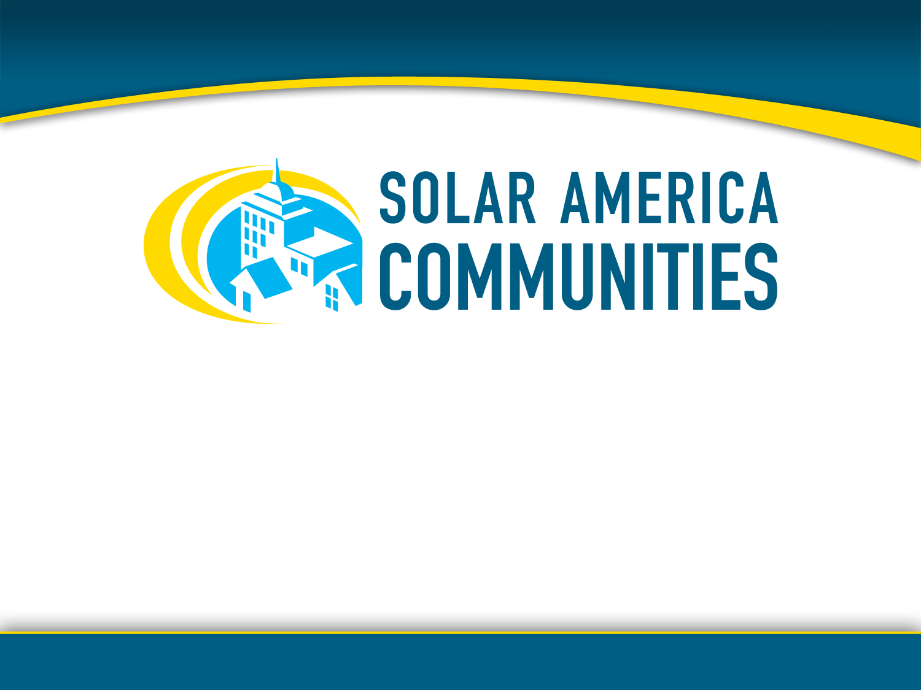
Getting Started with Solar in Your Community
SOLAR 2011 Conference
Raleigh, NC
May 17, 2011

Slide 2

"I'd put my money on the sun and solar energy. What a source of power! I hope we don't have to wait till oil and coal run out before we tackle that."
- Thomas Edison
Notes:
We can thank Thomas Edison for inventing the phonograph, movie camera, and the first long-lasting practical electric light bulb. He was a prolific inventor – holding over 1,000 US patents in his name – he was also a visionary. Edison very clearly saw the benefits of the sun and solar energy to power our lives.
He was one of the first, but slowly others have come to realize the potential of the sun and developed innovative ways to harness it.

Slide 3

Top Solar Trends for 2011
Global PV demand likely to grow well in 2011
U.S. installed PV capacity could double from 2010
U.S. predicted to be 3rd largest in total installed capacity
Expansion of utility-scale systems in the U.S.
Strong expansion of solar development in U.S. states
25% increase in number of Americans employed in solar industry in 2011
Your community has the opportunity to capitalize on these trends.
Notes:
Mainstream news providers like USA Today, NY Times and Reuters are constantly reporting on how the US solar market is rising, more financing opportunities are becoming available, utilities are going solar, solar manufacturing is expanding, etc. There is so much buzz and excitement surrounding solar energy because it has the ability to touch all aspects of our lives – markets, architecture, research and development, economic development, jobs. There is no better time than right now to start engaging in solar.
Most all of the major market research firms have concluded that the global PV demand will increase in 2011. These estimates range anywhere from 12.7 GW and upwards to 20 GW. Installed PV capacity growth in the US will be continue to be solid, backed by federal grants from the federal government that will be valid until the end of 2011. Fueled by the expansion of utility scale projects, the US is projected to possibly rank 3rd in total installed capacity by the end of 2011. This expansion will also be seen in states not traditionally considered strong solar developers, such as Florida, Illinois, Nevada, New Mexico, North Carolina, Ohio, and Texas. Last year, 93,000 Americans were employed in the solar industry - this is twice the number employed in the industry in 2009.
And so, too, your community has an opportunity to capitalize on these trends.

Slide 4
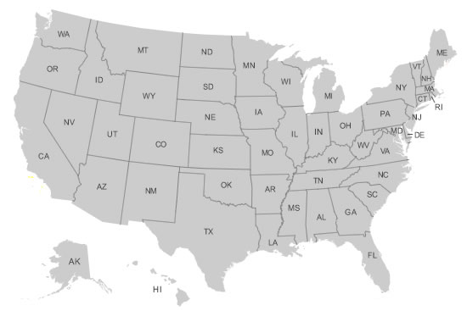
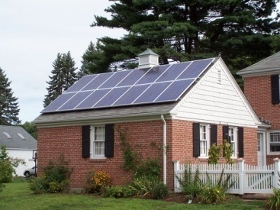
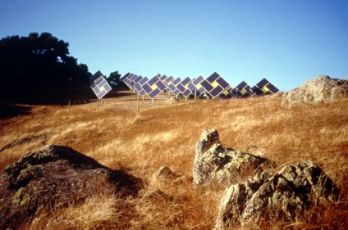
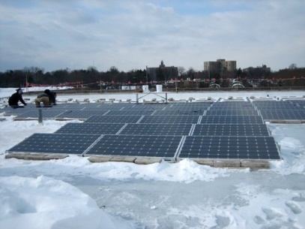
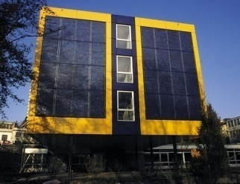
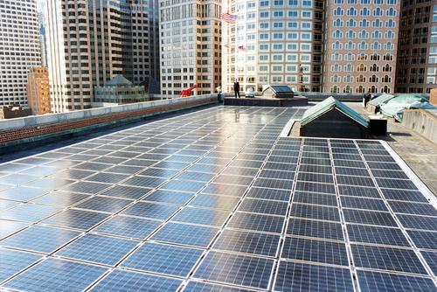
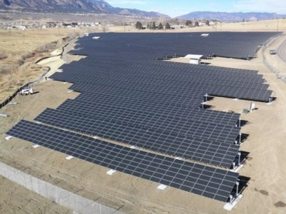
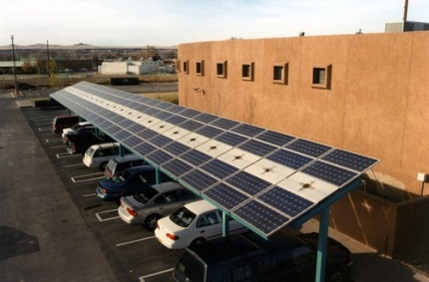
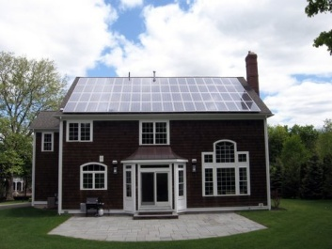
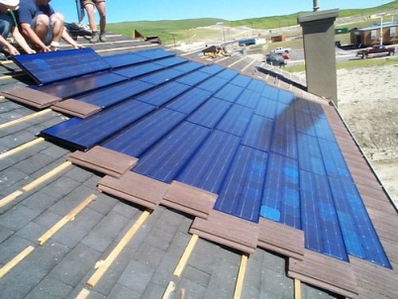
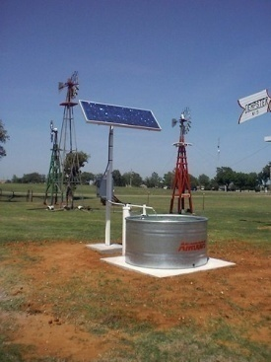
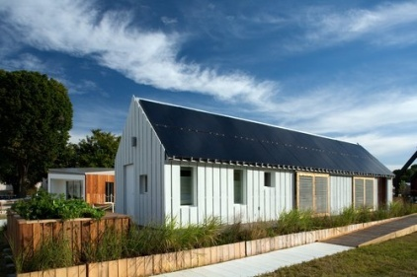
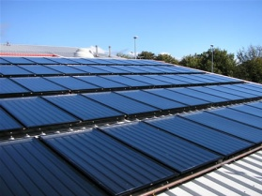
Notes:
Communities across the country have taken advantage of and capitalized on these trends – communities not only in the sunbelt but also all over the country – including Alaska!
There are solar energy systems on firehouses, on your neighbor’s roof, on schools, on landfills, on big-box stores - solar is pumping water out of wells, solar is being used as a shade structure, solar is being incorporated into building design, solar is everywhere.

Slide 5
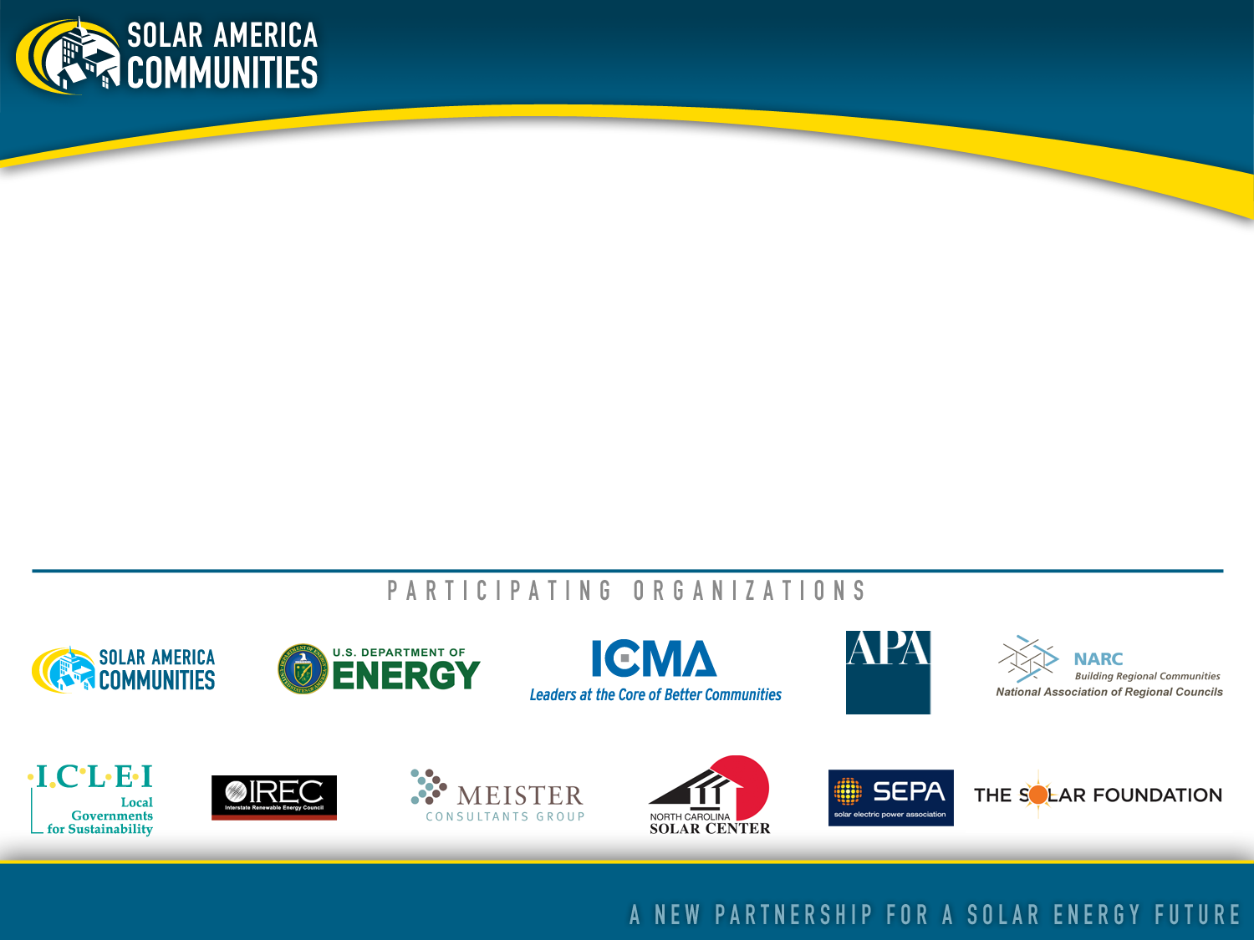
About Solar America Communities
Solar America Communities is a U.S. Department of Energy (DOE) program designed to increase the use and integration of solar energy in communities across the United States. The International City-County Management Association (ICMA) and ICLEI-Local Governments for Sustainability were competitively selected by DOE to conduct outreach to local governments across the United States, enabling them to replicate successful solar practices and quickly expand local adoption of solar energy. For more information visit www.solaramericacommunities.energy.gov.
Notes:
This is why we are bringing you today’s program. The Solar America Communities Outreach program is a five year Department of Energy program designed to increase the use and integration of solar energy in communities across the US.
Led by two organizations – ICLEI Local Governments for Sustainability and ICMA (the International City/County Management Association)– several organizations and subject matter experts in the solar industry are all working together to bring solar best practices to communities nationwide.

Slide 6

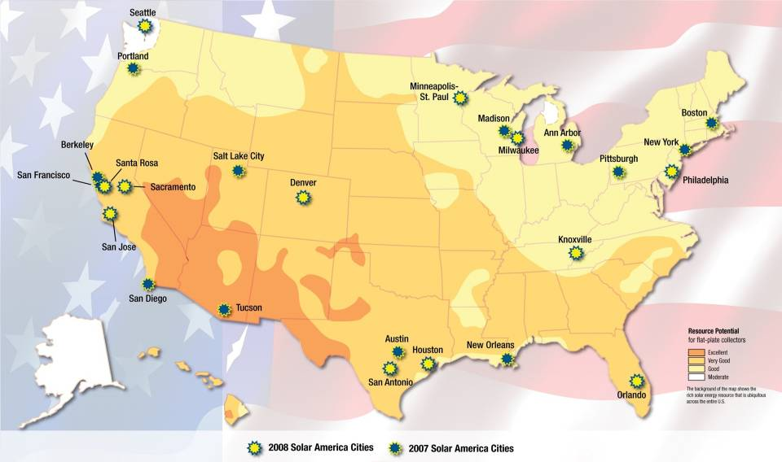
Notes:
Just to give you a little background, the Solar America Communities program was inspired by the highly successful Solar America Cities program where the Department of Energy competitively selected 25 US cities in diverse regions throughout the country as Solar America Cities. This program began in 2007 and is still in operation.
Based on the success of its partnerships with these cities, DOE decided to expand the program to conduct outreach to many more local governments throughout the country to share the lessons learned and best practices from the partner cities. As the Solar America Cities program evolved to include this new outreach effort , the program has been renamed Solar America Communities to reflect DOE’s commitment to supporting solar initiatives in all types of local jurisdictions, including cities and counties.

Slide 7
Our Mission:
Enable local governments, community and private sector stakeholders to replicate successful solar practices and quickly expand local adoption of solar energy
Our Objectives:
Increase installed capacity of solar electricity in U.S. communities
Reduce solar electric project execution time via permitting, inspection and interconnection
Improve building and zoning codes/regulations for solar electric technologies
Increase access to solar electric purchasing options
Notes:
Our outreach effort is focused on trying to scale up the various models that the 25 Solar America Cities have proven to be successful. We’ll be looking to see how much this effort has contributed to increasing installed capacity of solar, helping to streamline various local processes (including permitting, inspection and interconnection) to enable solar installations, improving the regulatory environment for solar vis-à-vis codes and ordinances, as well as increasing access to solar through innovative financing and purchasing options.

Slide 8
As a result of your active participation in this workshop, you should be able to:
Define common solar terminology
Counter common arguments against going solar
Start working to help your community become more “solar-friendly”
Identify where to go for more “go solar” information
objectives
Notes:
We have designed this workshop so that after today’s program, you will be able to do the following:
Define common solar terminology and technologies
Counter common arguments against going solar; this includes being able to effectively communicate the benefits of solar.
Start working with your municipality and community to remove any barriers and create incentives for going solar
Identify where to go for more “go solar” information

Slide 9
Workshop Agenda
Intros
Solar technology basics
Debunking myths to going solar and communicating the benefits of going solar
Addressing barriers through policy
Getting started in your community
Steps to installing Solar on a Public Building
Lunch on your own from 12:00 – 1:30
Industry Panel with representatives from FLS Energy, Southern Energy Management, NABCEP, AEG Power Solutions, and City of Raleigh
Notes:
This workshop is more or less a “Solar 101” – but throughout the workshop we will be weaving in case studies, best practices and practical advice for people particularly interested in installing solar in their community.

Slide 10
On Your Radar…
Today’s workshop presentation & notes will be posted here:
www.SolarAmericaCommunities.Energy.Gov/Resources
AT THE CONFERENCE:
  Solar America Communities in the Exhibit Hall, Booth # 126
  Mapping Out Solar PPAs: Possibilities, Predictions, and Alternatives on Wednesday, May 18th from 4-5:30pm
  Public Day on Saturday, May 21st
Notes:
All of the content from today’s workshop will be posted online at the website address you see here; this is DOE’s Solar America Communities website where you can find a wealth of information and resources to assist in your solar pursuits.
The “Solar Powering Your Community” Guidebook that you have is also available online at the Solar America Communities website. This publication is a treasure trove of useful solar tools and information for local governments.
As well, here at the ASES Conference, on Saturday is Public Day. For $5 you and your colleagues can hear more solar presentations, talk with speakers, and visit the exhibit hall booths. The celebrity green pioneer Ed Begley, Jr. is keynote speaker and people from NC Solar Center and local companies will be available to answer any questions.

Slide 11
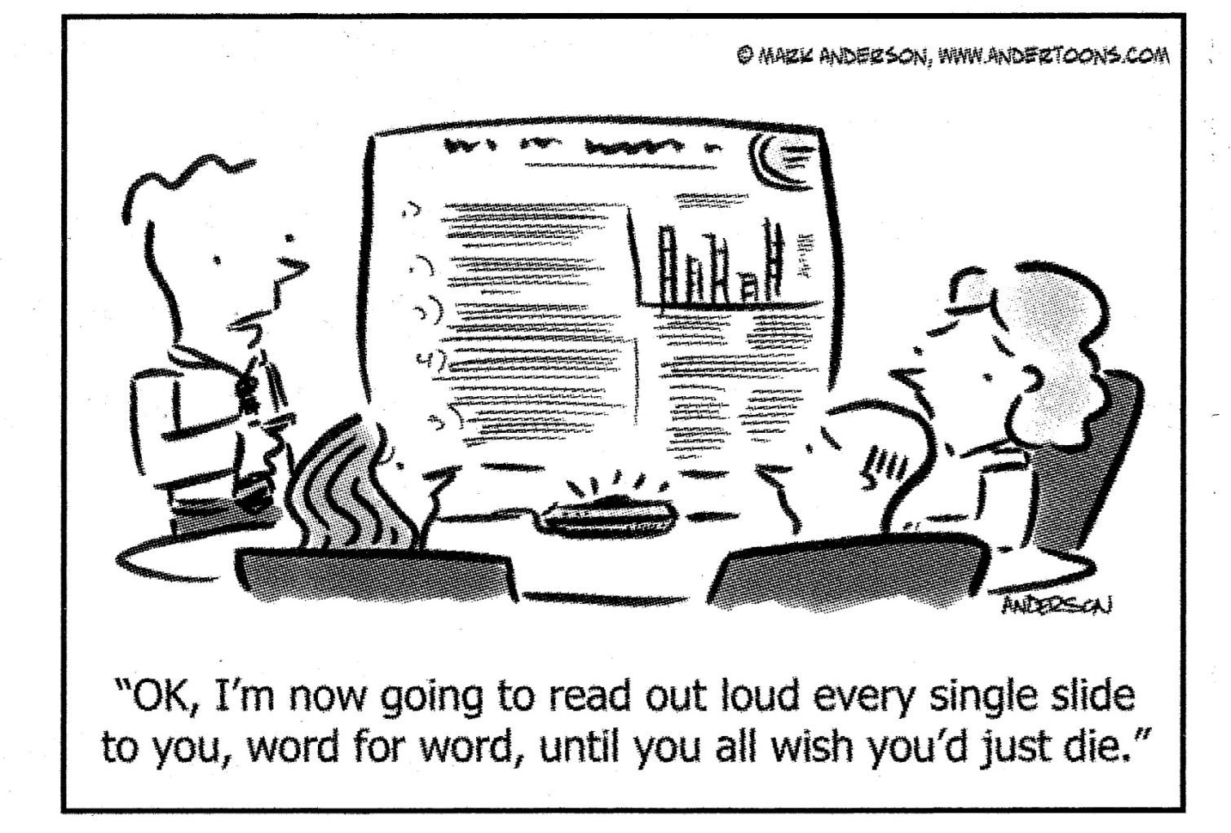
Working Together Today…
Notes:
In our minds, workshops are not lectures in which one person talks to an audience using a Powerpoint deck loaded with slide after slide containing bullet lists of heavy content, with the hope that maybe some bits of information will be retained. Rather, workshops are gatherings during which participants are just that: Participants… actively engaged in the delivery of the content. So while we have some great trainers here who can lend their subject-matter expertise to our discussion about bringing solar into local planning efforts, we have built in activities and discussion points throughout this agenda so we can learn from each other. Each person in this room brings a unique perspective to what it takes to bring solar to communities, and we all want to hear from you. So every 10-15 slides we will pause and discuss what we’re learning together, and at times engage in an activity to expand our learning.
With this in mind:
Because we view workshops as dialogue, clarifying questions are welcome during the presentation. At the same time, we have a lot of content to cover, so if more time on any particular question is desired, we will defer continued discussion to an offline conversation.
Respect diverse viewpoints - we intend to foster a safe learning environment where there is mutual respect for everyone
Please turn off or set to “silent” your cell phone

Slide 12
Introductions
In pairs, interview each other (5 minutes each)
Introduce your partner to your table group (10 minutes total)
What is your name?
Where do you live?
For what agency/organization do you work?
Why did you choose to enroll in today’s workshop?
What is the biggest challenge you believe you face in making your community more solar-friendly?
Notes:
In order to work well together, we need to get to know each other. So to begin our time together today, let’s spend a few minutes talking with each other about why we are at this workshop and what we expect to get out of it.
After we finish going through this brief set of instructions, please pair up with the person sitting next to or nearest to you, and spend 5 minutes interviewing each other.
At the end of that 5 minutes, we will take a few minutes as a group to share some of the answers you have come up with for Questions #4 (“Why did you choose to enroll in today’s workshop?”) and #5 (“What is the biggest challenge you believe you face in making your community more solar-friendly?”); we will record these on a flip chart to make sure we address them in the workshop.

Slide 13
Overview
- Solar Technologies -
Notes:
We know that everyone has some knowledge of solar technologies, so this section is just a brief overview of the different technologies so that we develop a common vocabulary and make sure we all have the same basic level of understanding of solar technologies. We will take a look at the different solar technologies that are in use today, and then we’ll go over in depth how you can plan to incorporate these technologies into your communities.

Slide 14

Every hour, enough solar energy strikes Earth to power human activities for over a year.
U.S. Department of Energy
Solar Energy Technologies Program
Notes:
There is an abundance of solar – there is enough to meet our needs, however only 1% of US electricity is generated by solar. Later, the presentation will go into the reasons for the disconnect between solar market potential and the current solar market.
Solar energy is really a simple concept. It is energy that is derived from either sun’s light or the sun’s heat. Energy from the sun is converted into thermal or electrical energy. It is also possible to use both the sun’s light and heat together as you will see in later in this presentation.

Slide 15
Three Common Solar Technologies
photovoltaic
concentrating solar power
solar heating & cooling/ solar hot water (“solar thermal”)
PV
CSP
SHC/
SHW
Notes:
The three prevalent solar technologies that have been developed to convert the sun’s resources into usable energy are photovoltaics, concentrating solar power, and solar heating & cooling/solar hot water (commonly referred to as ‘solar thermal’).
Photovoltaics use the sun’s light to create direct current electricity. Most household appliances use alternating current electricity, so the DC electricity has to be converted to AC using an inverter. We will touch on this later in the context of net metering.
Concentrating solar power uses the sun’s light to create thermal energy. CSP is also sometimes called CST or concentrating solar thermal. It also creates electricity.
Solar thermal applications take the sun’s heat and transfer it directly to air or fluids for a variety of purposes.
We’ll explore these three technologies in just a little more detail.

Slide 16
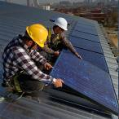
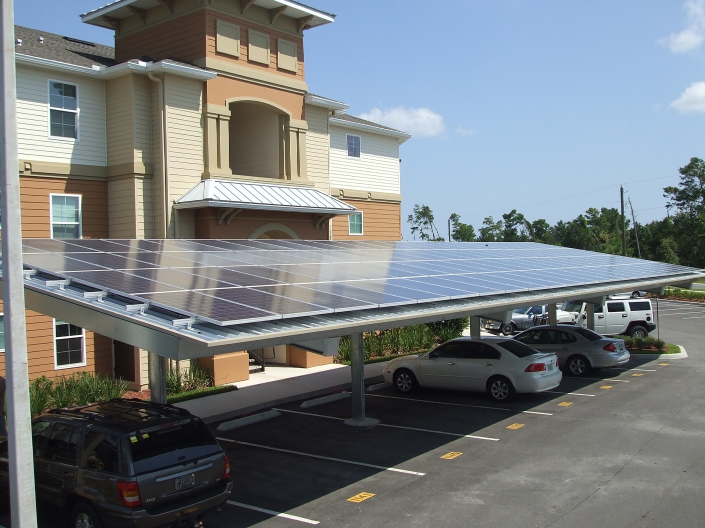
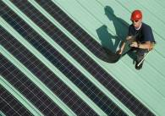
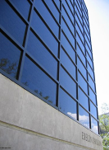
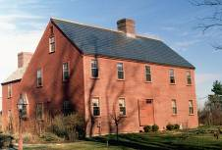
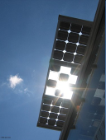
Photovoltaic (PV) Solar Energy
Directly generates electricity from sunlight
Different types you might come across
Building Integrated PV (BIPV), another type
Source: NREL
Crystalline silicon
Thin-film
Source:
www.ecofriend.org
Shingles
Skylights
Architectural glass and granite like materials
Photo Source: NREL http://www.nrel.gov/data/pix/
Notes:
Details about specific types of PV are included in the Appendix.
Crystalline – both polycrystalline and monocrystalline – and thin film are more common than building integrated PV. These different types of PV have different costs and efficiency associated with them. They also have different applications and strengths and weaknesses.
Thin film is also called amorphous silicon. It’s manufactured as a long, think stringlike cell. It’s harder to shade the whole cell, so cloud cover is less of an issue.
Building-integrated photovoltaics (BIPV) are PV materials that are used to replace conventional building materials in parts of the building envelope such as the roof, skylights, or facades. They are increasingly being incorporated into the construction of new buildings as a principal or ancillary source of electrical power, although existing buildings may be retrofitted with BIPV modules as well. The advantage of integrated photovoltaics over more common non-integrated systems is that the initial cost can be offset by reducing the amount spent on building materials and labor that would normally be used to construct the part of the building that the BIPV modules replace. These advantages make BIPV one of the fastest growing segments of the photovoltaic industry.

Slide 17
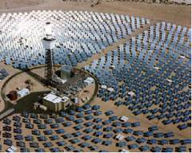
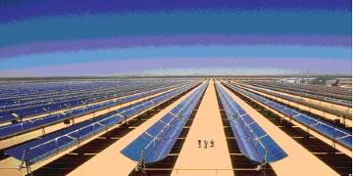
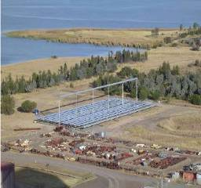
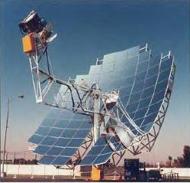
Concentrating Solar Power (CSP)
Central Receiver or Power Tower
Parabolic trough
Compact linear Fresnel reflector
Parabolic – dish engine
Source EPRI and NREL
Notes:
Concentrated solar power (CSP) are systems that use lenses or mirrors to concentrate a large area of sunlight, or solar thermal energy, onto a small area. Electrical power is produced when the concentrated light is converted to heat which drives a heat engine (usually a steam turbine) connected to an electrical power generator. CSP works best in the desert where there is lots of direct sunlight and low humidity, typically in the southwest region of the U.S. CSP systems occupy a lot of land area.
CSP should not be confused with photovoltaics, where solar power is directly converted to electricity without the use of steam turbines. The concentration of sunlight onto photovoltaic surfaces, similar to CSP, is known as concentrated photovoltaics (CPV).
A study done by Greenpeace International, the European Solar Thermal Electricity Association, and the International Energy Agency's SolarPACES group investigated the potential and future of concentrated solar power. The study found that concentrated solar power could account for up to 25% of the world's energy needs by 2050. The increase in investment would be from 2 billion euros worldwide to 92.5 billion euros in that time period. Spain is the leader in concentrated solar power technology, with more than 50 projects approved by the government in the works. Also, it exports its technology, further increasing the technology's stake in energy worldwide. Because of the nature of the technology, it performs best in a desert like area and experts predict the biggest growth in places like Africa, Mexico, the southwest United States. The study examined three different outcomes for this technology: no increases in CSP technology, investment continuing as it has been in Spain and the US, and finally the true potential of CSP without any barriers on its growth.

Slide 18
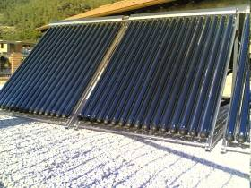
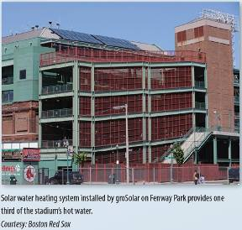
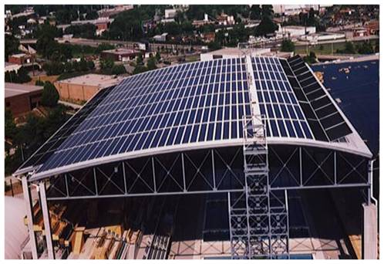
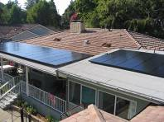
Solar Heating & Cooling/
Solar Hot Water (SHC/SHW)
Solar energy used to heat water or other medium
Applications
Solar pool heating
Domestic hot water use
Process hot water
Space heating
Solar assisted cooling
Notes:
The solar heating & cooling/solar hot water technology works through the direct transfer of heat to fluids or air for residential, business and industrial uses.
Solar pool heating uses low temperature solar collectors to heat swimming pool water and is probably the most cost effective solar application of this type.
Domestic hot water applications on homes and businesses are also very cost effective and have been around for centuries!
Process hot water, space heating and solar assisted cooling are more advanced solar technologies and incorporate higher temperature collectors and combine them with other mechanical equipment for the desired end use.

Slide 19
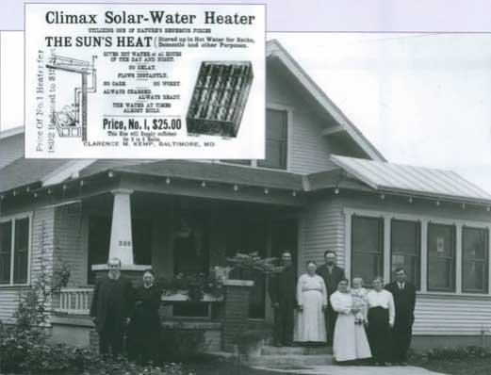
Notes:
Solar thermal has been around for many, many years.
In the early days, there were some issues with systems that were improperly installed. One of the things we learned through the previous experiences is the importance of having properly-trained installers of technologies to make sure the technologies work properly. System certification (equipment certification) also helps with this.

Slide 20
Project processing
Costs relative to grid
Variability
Public awareness
Aesthetics – HOA
Requires persistent load
Lack of consumer education
Shortage of skilled workers
Challenges
of solar technologies
Modularity
Mitigates fuel price volatility
Low environmental impact, no GHGs
Supports grid infrastructure
Economic development potential
Can act independently from the grid
Strengths
of solar technologies
Notes:
As with any industry, there are challenges and strengths. These are some of the common challenges and strengths of these solar technologies. The presentation will come back to this throughout the day. We will provide you with ways to overcome or minimize barriers and will also discuss the strengths and benefits in more detail to help participants effectively champion solar in local communities. Some challenges can relatively easily be addressed – public awareness and lack of consumer education can be addressed through outreach an education and local government demonstration projects. We will go into this in the next section. In terms of strengths of solar, we will focus on modularity and distributed generation benefits, energy independence issues (supporting grid infrastructure), and the economic development and jobs potential of solar.
20

Slide 21
In pairs or threes, answer the following questions:
REVIEW
How much solar energy reaches the Earth?
PV and CSP produce what kind of power?
Why does CSP work best in the US southwest?
Name and explain 2 strengths and 2 challenges of solar energy.
Notes:
The review exercise allows us to go forward with the same base level of knowledge. In pairs or threes, answer the following questions. After 5 minutes, we’ll go over the answers with the group as a whole.
How much solar energy reaches the Earth? Every hour, enough solar energy strikes Earth to power human activities for over a year.
PV and CSP produce what kind of power? Electricity.
Why does CSP work best in the US southwest? Combination of 2 reasons: it requires lots of direct sunlight (not diffused through humid air), and it needs lots of open space.
Name and explain 2 strengths and 2 challenges of solar energy.
Strengths:
Modularity, Mitigates fuel price volatility, Low environmental impact, no GHGs
Supports grid infrastructure, as well as it can act independently from the grid, Economic development potential – promotes local growth in jobs and revenue
Challenges:
Project processing, Costs relative to grid, Variability, Public awareness, Aesthetics – HOA, Requires persistent load, Lack of consumer education, Shortage of skilled workers

Slide 22

Dispelling the Myths and Communicating the Benefits of Going Solar
Notes:
All of you are here (or reading this) because you already have some personal belief about the benefits that solar can bring to communities. Yet I imagine that through the course of your work and even in your daily personal life amongst family and friends, you come across naysayers to solar – these are people who you care about (whether for personal or professional reasons or both), and I also imagine you would want to help them understand – and eventually embrace – the idea that solar offers real and positive opportunities for their community.
So in this section we present a structured, science-based look at the many benefits that solar offers to local communities. We hope that you can use the following evidence-based information to present the positive attributes about solar when you return to the communities where you live and work.
A few additional talking points and statistics to keep in mind:
In the last few years world oil prices have more than tripled and coal prices have more than doubled. Sunshine is still free.
The U.S. has 12 concentrating solar power (CSP) plants totaling 424 MW, more than any other country. Another 21 plants totaling 4,500 megawatts are in development, enough to power 1 million homes.
The U.S. has more than 2,400 square miles of roof space available for solar panels. That’s more than the land area of Delaware and Rhode Island and enough to produce 20% of our electricity.
Under the right circumstances, a rooftop solar power system can cost less than your family’s monthly cell phone plan while reducing or eliminating electricity bills.
ARRA created a 30% grant for solar energy systems owned by businesses that is helping ease the impacts of the credit crunch. However, this program is set to expire at the end of 2011.
ARRA created a 30% tax credit for renewable energy manufacturing facilities but capped the program at $2.3 billion.

Slide 23
Why Isn’t Solar More Widely Adopted?
Project processing
Costs relative to grid
Variability
Public awareness
Aesthetics – HOA
Requires persistent load
Lack of consumer education
Shortage of skilled workers
Notes:
For future widespread development of solar power in the US, it is crucial that cities recognize and learn from barriers that have been present in other parts of the country, and develop strategies to overcome these hurdles. In many cases, inadequate public awareness and lack of consumer education is a significant (although not the only) barrier. Thus one aspect of addressing solar barriers is dispelling these myths borne of lack of consumer knowledge. The most challenging myths to combat are those which contain elements truth, but draw faulty or simplistic conclusions that do not represent the true state of affairs. We discuss myths and facts in the following section, but follow with additional materials in later sections focused on how communities can tackle other barriers to solar implementation.
During the session we posed the question “Why isn’t solar more widely adopted?” as a question to the session participants. Participant responses were as follows, followed by our own comments:
Cost - Can be a real challenge, but we address the generalization that “Solar is too expensive” in the Myths section, and methods to reduce cost in the section on addressing barriers through policy
Subsidies and how they’re changing—going up and down, going away – Definitely a challenge and a reality, although by design incentives should change with the market and ultimately be reduced or go away. The real difficulty may be in understanding how and when things are changing and what that means. The DSIRE database (www.dsireusa.org) is very useful source of information current incentives.
No payback - Along the lines of “Cost”, often can be a real challenge, but we address the generalization that “Solar is too expensive” in the Myths section, and methods to reduce cost in the section on addressing barriers through policy
Weather (cloudy) – A Myth if mentioned in the context of “Solar doesn’t work here”, although a reality in the sense that clouds do decrease solar energy production. In many cases the impact may be somewhat overstated.
Durability of systems – Much more of a myth than reality these days (perhaps in contrast to the 1970’s and 1980’s) due to increase industry and state/federal attention to quality control. Addressed in the Myths section.
Technology improvements – As a justification for not investing now, a Myth rather than a reality in the sense that there are a variety of compelling arguments for investing in solar now sooner rather than later. Addressed in the Myths section. Technology and cost improvements are nevertheless a real trend.
Tree cover (installation issues), access – Can be a significant barrier in some jurisdictions. This is addressed in a later section discussing how to combat barriers through policy
Aesthetics - As with concerns over “solar access” above, can be a significant barrier in some jurisdictions. This is addressed in a later section discussing how to combat barriers through policy
Partnership issues – As a reference to the difficulties associated with developing an individual project, this can be a real barrier which is exacerbated by the number of potential stakeholders who may have an interest in a given project. Unfortunately, some aspects may be unavoidable as any sort of large contract can involve extensive negotiations in order to reach an agreement. Some of the issues may be addressed through policies which provide for clear and transparent administrative processes (e.g., interconnection, permitting, siting, government contracting flexibility) or create multiple options for the financing and installation of a project.
Destabilization of the grid – A Myth at current levels of PV penetration in almost all locations, and high penetration scenarios are typically well-addressed in utility interconnection standards that are specifically intended to maintain grid safety and reliability. Moreover there are circumstances where PV actually stabilizes the grid because all other things being equal, it tends to produce at the highest level on hot, clear days when electricity use is highest. Addressed to some extent in slides focused on the benefits of solar (i.e., coincidence of production with electricity demand).

Slide 24

Solar Myths
Solar takes more energy to produce than it produces!
Today’s solar technology will be obsolete tomorrow!
Solar is too expensive!
Solar technology is immature and inefficient!
Solar is only for tree-huggers!
Solar doesn’t work in the north (or in the south!)
Notes:
These are some of the myths that we’ve heard as we’ve worked in the industry, including some that have come up in educational sessions like this one.

Slide 25
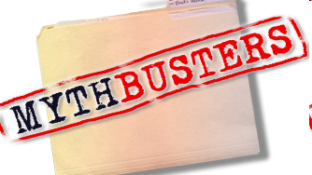
Part of your role as a local solar champion is dispelling these myths.
Notes:
In the following section, we offer scientific evidence to bust the various myths that exist about solar. You will no doubt find yourself among naysayers and others who you want to engage in discussions about bringing more solar to your community. As the solar champions in your community, here’s messaging that we can arm you with, including different approaches for different stakeholders.
We hope you find this series of data and talking points as a useful tool for busting solar myths.

Slide 26
Myth:
Solar is too expensive!
Notes:
This particular assertion is among the most difficult to combat. It is mythical in the sense that it builds on one significant real barrier to solar, the potentially significant up-front cost, and arrives at a general conclusion that solar is always an unwise investment. In reality, this type of evaluation needs to be done on a project specific basis and must incorporate a variety of factors that influence the outcome. On a project specific basis, one might take into account:
The installed cost of a given facility, which may vary from place to place and project to project
The availability of up-front financial incentives which bring down this cost, or other options that allow this cost to be spread out over time (e.g., financing, third-party ownership options)
The value that solar generates over the life of the equipment, including possible incentives and the avoided energy costs. The latter must be evaluated using a long-term perspective that squares with the current reality of increasing fossil fuel and electricity prices, as well as increasingly stringent environmental laws which protect public health, but will also likely result in further increases in electricity prices.
The take away is that while there are undoubtedly circumstances where solar will not meet the investment or payback criteria of a given customer (which of course may also vary), under an even-handed evaluation using a long-term perspective solar often fairs better than some people realize. In addition, it is also important to realize that the solar, incentive, and electricity markets are not static. Historic evaluations (i.e., “we investigated solar years ago and it didn’t pencil out”) are not necessarily representative of current circumstances and a fresh look may reach different conclusions.

Slide 27
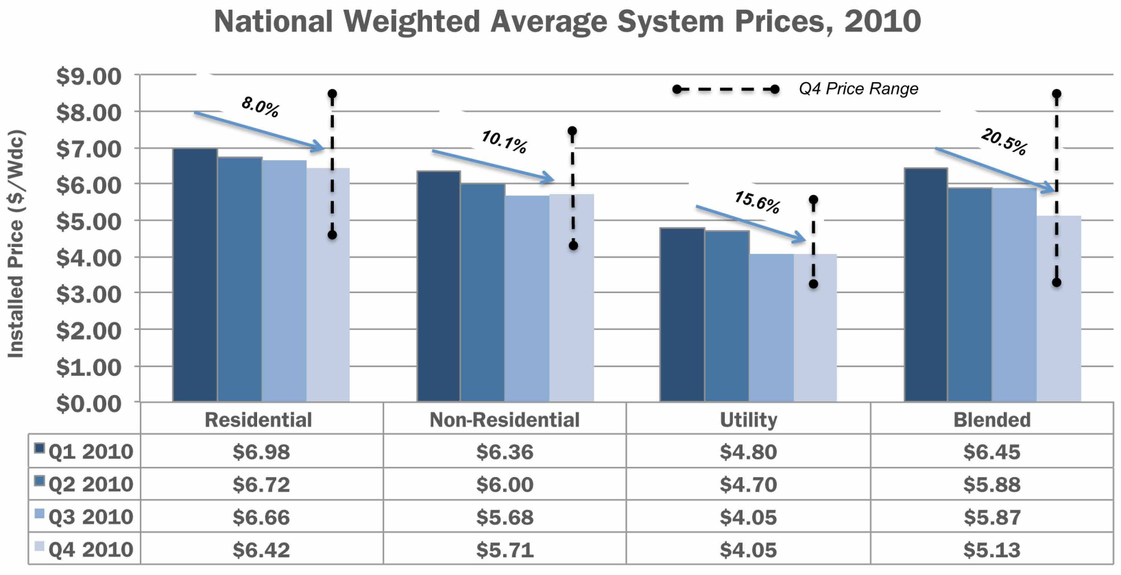
The Cost of Installing PV is Decreasing Rapidly
FACT:
National Weighted Average System Prices 2010
Source: U.S. Solar Market Insight: 2010 Year in Review Executive Summary. Solar Energies Industry Association and GTM Research
Notes:
Take Away: The installed cost of PV in the U.S. has declined and continues to decline rapidly.
National weighted-average system prices fell by 20.5% over the course of 2010, from $6.45/W to $5.13/W. Much of this decline was due to a shift toward larger systems, particularly utility systems, in the fourth quarter. The U.S. PV market remains highly disaggregated, resulting in a wide range of installed prices even within a given state, market segment, and quarter. The figure above displays the range of installed system prices in the fourth quarter of 2010. Residential systems were installed in certain locations (particularly Colorado and Arizona) at prices below $5.00/W, but other locations saw residential system prices over $8.00/W. Non-residential installations ranged from $4.11/W to $7.31/W. Utility installations show the most variability, largely due to the choice between low- and high-efficiency modules and between fixed and tracking mounting structures. Over time, it is possible that maturation of the U.S. market will bring more consistency to system prices both within and across states.
It is also notable that longer term trends also indicate some fairly dramatic declines in PV costs. In 2007, a “standard” response to the question “How much does solar cost?” would in many cases elicited a response of around $10/W. Then, as now, significant variations existed, but nevertheless the general trend has been steeply downward.
Also of Note: Under the DOE’S SUNSHOT INITIATIVE, The target is 5-6 cents per kWh, putting solar on par with current wholesale rates from fossil fuel energy, which in turn would require installed costs to approach $1/W (50% module, 40% BOS, 10% power electronics). For further information on the SUNSHOT INITIATIVE, please see the following link: http://www1.eere.energy.gov/solar/sunshot/about.html

Slide 28
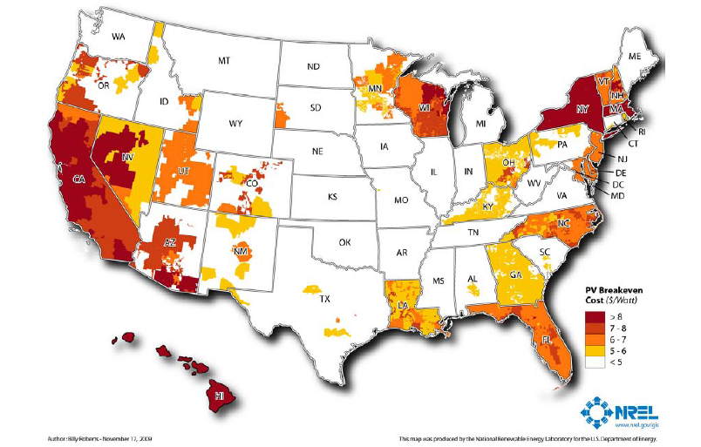
Solar is at or near grid cost parity:
Residential PV Breakeven Cost in 2008 ($/Watt)
FACT:
[uses most common rate structure and all incentives]
Notes:
Source : Break-Even Cost for Residential Photovoltaics in the United States: Key Drivers and Sensitivities . Paul Denholm, Robert M. Margolis, Sean Ong, and Billy Roberts, Technical Report, NREL/TP-6A2-46909, December 2009 http://www.nrel.gov/docs/fy10osti/46909.pdf
Residential solar PV break-even cost ($/W) in 2008 using the most common rate structure and all incentives
When considering the results and elsewhere, readers should note that this analysis represents a single point in time (late 2008 and early 2009). Because incentives and electricity prices are constantly changing, results for any single area may be substantially different when evaluated later. Also note that as described in the prior slide, PV installation costs continue to fall as well.
The Figure indicates that the only areas where PV is close to or at breakeven is where there is a combination of high electricity prices and good solar resources (such as California), or a combination of high electricity prices and incentives (such as New York state and Massachusetts). About 11% of residential electricity sales are in utilities where break-even conditions exist for the assumptions used in the base case for a PV system cost of $8/W. At $6/W, 42% of residential electricity sales are in utilities where some customers may be at breakeven (including customers in states such as Florida, North Carolina, New Jersey, and a growing part of the southwest.) It is important to note that in practice only a fraction of customers in these utility service territories are likely to meet all the criteria (full retail net metering, good solar exposure, and financing) to be at breakeven, and the presence of break-even conditions does not necessarily equate to large consumer adoption. Furthermore, there are budget caps for most current incentive programs and typically limits on the amount of net-metered systems that can be connected to the grid in a specific utility service territory.

Slide 29
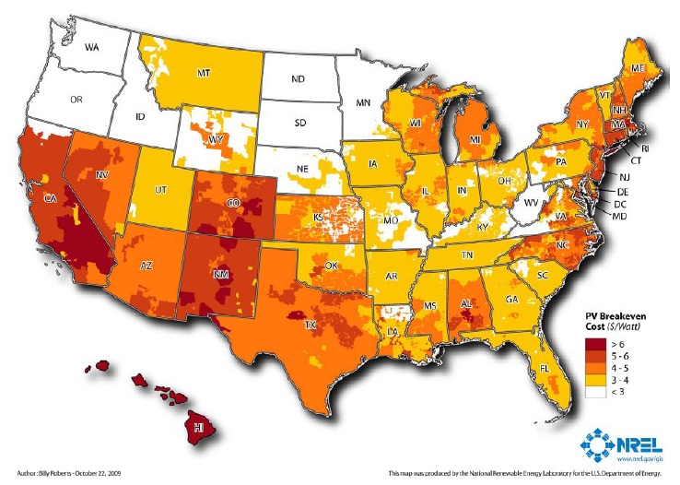
Solar is at or near grid cost parity:
Residential PV Breakeven Cost in 2015 ($/Watt)
FACT:
[most common rate structure and federal ITC]
Notes:
Source : Break-Even Cost for Residential Photovoltaics in the United States: Key Drivers and Sensitivities. Paul Denholm, Robert M. Margolis, Sean Ong, and Billy Roberts, Technical Report , NREL/TP-6A2-46909, December 2009 http://www.nrel.gov/docs/fy10osti/46909.pdf
Residential solar PV break-even cost ($/W) in 2015 using the base-case assumptions in Table 1 and the most common rate structure.
This map actually does not include state incentives, but does include the federal tax credit, modest electricity price escalation (3% total), and a carbon price of $25/ton.
The 2015 case shows a dramatic reduction in the break-even cost of PV where local incentives existed in early 2009. Alternatively, in locations where no incentives existed in early 2009, the assumed electricity price escalation increases the break-even price. In this case, 43% of residential electricity sales are in utilities where break-even conditions occur for some customers when PV system costs $4/W. At $3/W, 85% of residential electricity sales are in utilities where some customers are at break-even cost.

Slide 30
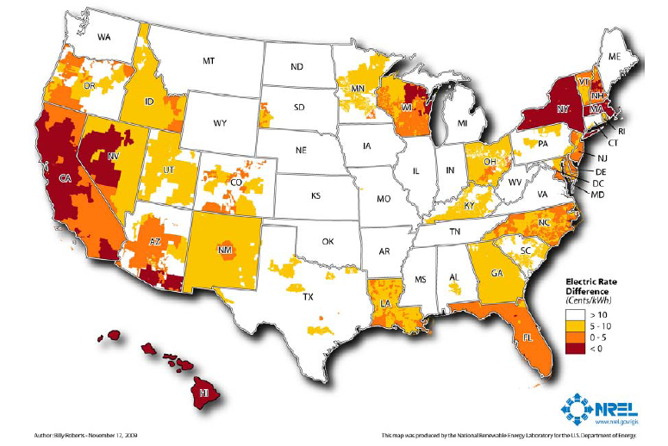
FACT:
Solar is at or near grid cost parity:
Increase in electricity price for PV breakeven
[$8/W using base rate structure]
Notes:
Source : Break-Even Cost for Residential Photovoltaics in the United States: Key Drivers and Sensitivities. Paul Denholm, Robert M. Margolis, Sean Ong, and Billy Roberts, Technical Report , NREL/TP-6A2-46909, December 2009 http://www.nrel.gov/docs/fy10osti/46909.pdf
Increase in electricity price required for residential PV breakeven at $8/W using the base rate structure.
This figure shows the same trends as the previous figure. The areas indicated by a rate difference of less than zero cents/kWh are by definition at breakeven and matching the areas in the previous figure where the break-even price is greater than $8/W. This figure shows that the price of electricity would have to increase by a significant amount in many parts of the country to achieve break-even conditions, assuming no further decrease in the price of PV. For example, if the price of electricity were to increase 5 cents/kWh (from the baseline 2008 values) across the United States, 36% of residential electricity sales would be in utilities where break-even conditions exist for some customers. Again, note that this is not a depth of market analysis and only a fraction of customers are likely to meet all the criteria for breakeven.

Slide 31
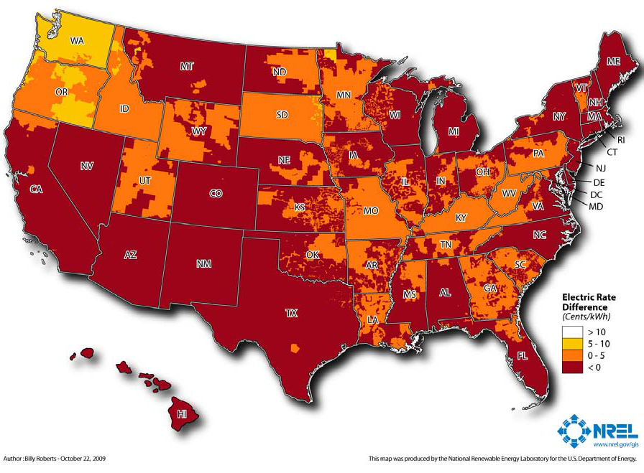
FACT:
Solar is at or near grid cost parity:
Increase in electricity price for PV breakeven
[$3.5/W using base rate structure]
Notes:
Take Away: Under a long-term perspective with relatively modest (or in many cases zero) increases in electricity prices and realistic decreases in installed costs, PV investments (even accounting for a discount rate and financing costs) even without incentives will be paid back over the life of the equipment.
Source: Break-Even Cost for Residential Photovoltaics in the United States: Key Drivers and Sensitivities. Paul Denholm, Robert M. Margolis, Sean Ong, and Billy Roberts, Technical Report , NREL/TP-6A2-46909, December 2009 http://www.nrel.gov/docs/fy10osti/46909.pdf
Increase in electricity price required for residential PV breakeven at $3.5/W in 2015 using the base-case assumptions and the most common rate structure.
As illustrated in the figure, if the Solar Program’s PV cost targets are met by 2015, break-even conditions will exist for some customers in most of the Southwest and New England, representing 67% of U.S. residential electricity sales. However, the base-case assumptions notably include a continuation of the 30% federal ITC27 and a $25/ton carbon cost and do not consider actual consumer adoption behavior under these conditions.

Slide 32
Myth:
Solar technology is immature and inefficient!

Slide 33
Solar technologies have matured and are becoming more efficient
FACT:
Life expectancies of solar systems are now 25-30 years
Solar heating technology has achieved vast improvements
Equipment certification requirements are common
PV: UL-1703, CEC
Solar Thermal: SRCC OG-100, OG-300
Inverters: UL -1741, CEC
Notes:
Solar has been around for 50 years and there are examples of solar equipment (e.g., solar powered gate openers on ranches) which have been operating for more than 30 years. These days it is quite common for solar modules to carry a 20 year warranty (usually against energy production of at least 80% or rated capacity), inverters to carry a 5-10 year warranty, and have a 2 year warranty on parts and labor. Recognizing the need for quality installations and customer satisfactions, most incentive programs have specific equipment requirements, and require installers to meet minimum knowledge and training requirements.
The federal tax credit requires that solar water heating systems be certified by the Solar Rating and Certification Corporation (SRCC) or carry a comparable certification. The SRCC system includes elements related to performance, reliability, ease of service and several other important aspects of solar thermal system quality. The UL certification for inverters addresses safety considerations, while the UL certification for PV modules addresses both safety and performance.
One additional system not included here (not used much if at all in the U.S. to our knowledge): IEC 61215 or 61646, actually incorporated into the CEC process for listing eligible equipment. In addition to the aspects above addressed by UL, the CEC listing also includes elements related to product reliability. For further information see the CEC equipment guidelines at the link below.
http://www.energy.ca.gov/2008publications/CEC-300-2008-007/CEC-300-2008-007-CMF.PDF

Slide 34
Myth:
Solar takes more energy to produce than it produces!

Slide 35
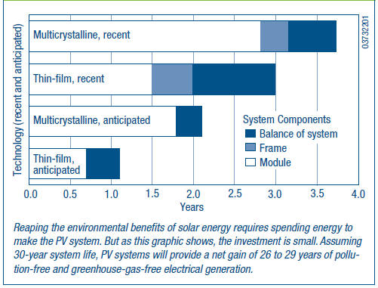
PV modules produce FAR more energy than is consumed in manufacturing them
FACT:
Energy payback for rooftop PV
Source: NREL, PV FAQs, What is the Energy Payback for PV
Notes:
“Energy payback” of PV systems (modules, frame, and balance of system) from 1 – 4 years depending on the technology used while the solar facility lifetime may be ≥ 30 years.
NREL FAQ: http://www.nrel.gov/docs/fy05osti/37322.pdf (FAQ is from 2004, but it stands to reason that as module efficiency increases and manufacturing efficiency increases, the payback numbers would fall lower still.) For ground mounts, one calculation of the payback for the ground mounting system (concrete foundations and heavy framing) was 3 -5 months, about the same as the mounting systems for Energy payback estimates for rooftop PV systems are 4, 3, 2, and 1 years: 4 years for systems using current multicrystalline-silicon PV modules, 3 years for current thin-film modules, 2 years for anticipated multicrystalline modules, and 1 year for anticipated thin-film modules (see Figure 1). With energy paybacks of 1 to 4 years and assumed life expectancies of 30 years, 87% to 97% of the energy that PV systems generate won’t be plagued by pollution, greenhouse gases, and depletion of resources.
Based on models and real data, the idea that PV cannot pay back its energy investment is simply a myth. Indeed, researchers Dones and Frischknecht found that PV-systems fabrication and fossil fuel energy production have similar energy payback periods (including costs for mining, transportation, refining, and construction).
How Much CO2 and Pollution Does PV Avoid? An average U.S. household uses 830 kWh of electricity per month. On average, producing 1,000 kWh of electricity with solar power reduces emissions by nearly 8 pounds of sulfur dioxide, 5 pounds of nitrogen oxides, and more than 1,400 pounds of carbon dioxide. During its projected 28 years of clean energy production, a rooftop system with a 2-year energy payback and meeting half of a household’s electricity use would avoid conventional electrical-plant emissions of more than half a ton of sulfur dioxide, one-third a ton of nitrogen oxides, and 100 tons of carbon dioxide (see Figure 2). PV is clearly a wise energy investment that affords impressive environmental benefits.
Analyses vary, but recent ones suggest even shorter payback times. Another more recent article in Home Power magazine puts it lower: 1-2 years currently, with projections of one year or lower in the near future. http://homepower.com/view/?file=HP127_pg32_Sanchez
The PV industry is neither "squeaky clean" nor a major environmental, safety, or health problem. When it comes to emissions, PV's electricity-generating portion of the fuel cycle is the clear winner vs fossil fuel sources. However, semiconductor processing can involve the use of chemicals and toxic materials. Some 80% of the current PV industry is silicon. Basically, it uses the same processing as the semiconductor industry. PV materials that incorporate heavy metals or toxic materials are continuously scrutinized to ensure safety.

Slide 36
Myth:
Solar is only for tree-huggers!

Slide 37

Solar is for Every One
FACT:
94% of Americans want to see more solar!*
Emergency Response Units
Military
Large Retailers
Financial Institutions
*Source: Schott Barometer:
http://www.us.schott.com/english/news/index.html?NID=358
Notes:
Solar is for Everyone – NOT just for tree-huggers.
The Air Force is negotiating contracts for ~500 MW solar power within the next 3 years, including installations at Nellis AFB, Camp Pendleton, and in Stuttgart, Germany.
States and localities are integrating solar in their emergency plans:
In Montana, 20 PV solar systems totaling 47.5 kW of capacity have been installed on fire stations within North Western Energy’s Montana service territory.
In Boston, the City is installing a Solar Evacuation Route.
Solar is more frequently being used on highways – in Oregon, the intersection of I-5 and I-205 is lined with a 104 kW solar installation.
For profit-businesses are increasingly realizing the potential financial benefits offered by solar:
Major retailers such as Kohl’s (http://www.kohlsgreenscene.com/Energy/EnergyEfficiency.html) and Walmart (http://walmartstores.com/Sustainability/7775.aspx) are doing it because it makes financial sense, and displays an environmental commitment.
Banks like Wells Fargo have become comfortable enough with solar to begin a variety of different financing programs, including partnerships and equity investments in large projects, and equipment leasing arrangements with existing commercial customers.
Bank of America has been heavily involved in tax credit bond issuances/purchases (Clean Renewable Energy Bonds or CREBs) that have been used by many public sector jurisdictions to finance solar on public buildings

Slide 38
Myth:
Solar doesn’t work in the north (or in the south!)

Slide 39
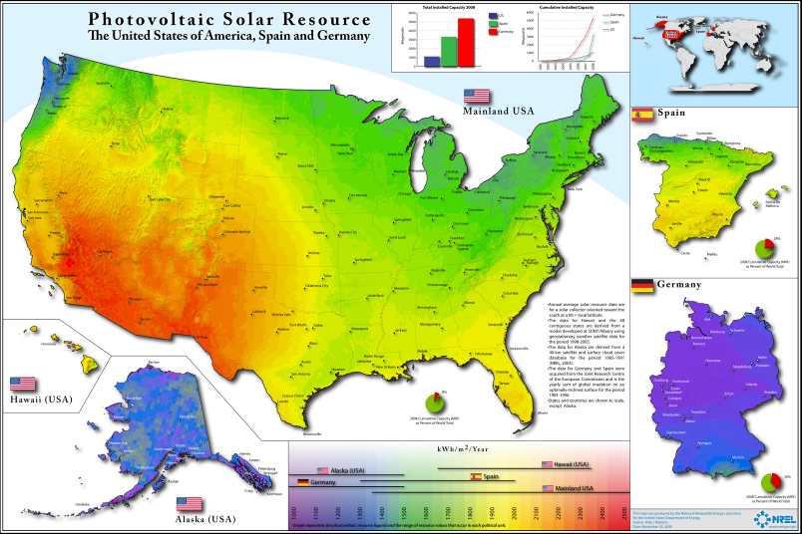
Solar works in all parts of the continental U.S.
FACT:
Source: http://www.nrel.gov/gis/images/us_germany_spain/pvmap_usgermanyspain%20poster-01.jpg
Notes:
This graphic compares the solar resource in the U.S. with the resource in Spain and Germany. Germany is the world leader in solar, with more than 7,000 MW placed in service during 2010. For comparison, U.S. installations totaled around 900 MW in 2010. Germany is a highly developed, sophisticated country with a high level of technical and engineering expertise. The stereotypical description of Germany would not include criticisms of incompetence, inefficiency, or impracticality. It’s instructive to look at what Germany has been able to do with it’s relatively modest solar resource and compare it to what the U.S. has done with it’s distinctly better solar resource. Clearly, the potential is nowhere near to being reached in the U.S., and as a technical matter, solar technologies work well (better than in Germany even) throughout the entire continental U.S..

Slide 40
Myth:
Today’s solar technology will be obsolete tomorrow!

Slide 41
FACT:
Solar
Computer or an iPod
Electricity produced today is the same as electricity produced by a new generation of panels.
Notes:
PV modules are often warranted to produce at 80% output after 20 years. The basic function of a PV panel will not change, although incremental improvements in efficiency and cost will take place. However, the types of improvements in capability and service that we see in computers don’t apply to PV. What you get from a 1980’s solar panel and a 2010 solar panel is the exactly same thing: electricity. What you got from a 1980’s computer and 2010 computer is dramatically different.
Arguments for investing in solar now:
If solar makes financial sense right now, why not make the investment? Technology improvements that take place tomorrow or over successive years does not make your investment any worse. If your current calculations are accurate, you are essentially locking in those gains and beginning to accrue the benefits immediately. By waiting you deprive yourself of those benefits for as long as you decide to wait. This is essentially a “cost”.
While solar costs are trending downward and efficiencies trending upward, it is important to realize that incentives are an important part of the calculation. Incentive programs are designed around costs and the necessary level of incentive needed to spur solar adoption. Thus as the technology and costs improve, available incentives also decline as well. The purpose of incentives is not to create windfall gains for adopters, but rather to provide just enough additional value (or reduced cost) to make solar attractive. Expecting to combine tomorrow’s technology improvements with today’s incentive levels is not realistic.
One great thing about PV is that it is modular. Many people start small and make additions over time as they become more comfortable with the technology and begin to enjoy the benefits it is capable of providing.

Slide 42
There Are Community Benefits to Going Solar
Adds jobs
Improves national and local economies
Yields positive investment returns
Helps achieve environmental, energy goals
Mitigates land use issues
Can integrate with clean transportation infrastructure
Strengthens energy infrastructure
Notes:
Now that we’ve busted some of the common myths that you might encounter, here are some other benefits that communities can get by going solar. Some of those benefits are rather obvious – among them that they’re clean sources of power and can bring much-needed revenue and jobs to local communities that embrace solar. This presentation will only cover the jobs, economic development, land use, and energy infrastructure issues in depth today.

Slide 43
Solar Adds Jobs
26% Job Growth!
Estimated U.S. Solar Industry Employment
Source of information on solar jobs: The Solar Foundation’s National Solar Jobs Census 2010
Notes:
Solar creates jobs and as you can see by the trend line, the number of jobs are increasing. Installations are increasing and as they increase so do jobs required to support them.
The Solar Foundation did a study that was completed in August 2010 – the National Solar Jobs Census. As of August 2010, there were approximately 93,000 solar jobs in the US. This is double what previous best guess estimates indicated. Between August 2010 and August 2011, job numbers are expected to increase by an astounding 26%, representing 24,000 net new solar jobs across the country. These jobs numbers are for all types of firms and these findings show an industry that is clearly growing much more rapidly than the economy as a whole, which is slowly creeping along with only 2% average job growth rate across all sectors.
For example, healthcare and IT are creating jobs at a glacial pace and other sectors such as arts, entertainment, recreation, and the fossil fuel electric generation industries are cutting jobs.
With a national unemployment hovering around 9-10% and close to 15 million Americans out of work (not counting the underemployed and discouraged workers) – the growth of the solar industry is great news!
43

Slide 44
Solar is Big Business – and Means Business…
Source: SEIA/GTM Research - 2010 Year in Review Report
To Access: http://www.seia.org/galleries/pdf/SMI-YIR-2010-ES.pdf
Notes:
The US is actually a net solar exporter. Net solar exports totaled $723 million in 2009, according to SEIA and GTM Research. This is more than the GDP of some developing countries.
The Solar Energy Industries Association has been tracking the growth of the industry for several years now and found that the solar industry has grown 300% from 2006 to 2010. It went from being a $1.5 billion industry in 2006 to a $6 billion industry in 2010. It is big business and means business – attracting billions in venture capital each year.
The solar industry has become the fastest growing energy sector and one of the fastest growing industries in any sector across the U.S.

Slide 45


Notes:
Domestic companies are also expanding.
These pictures are from the largest manufacturer of thin film solar panels – First Solar – a US company headquartered in Perrysburg Township, Ohio (where it employs more than 1100 employees)
Recently, First Solar confirmed that it will build its second manufacturing plant in Mesa, Ariz. The facility, scheduled to open next year, will include 600 jobs and produce more than 250 megawatts of thin-film solar panels a year. Their product – the thin film panels are used in both large and small projects resulting in installation and construction jobs. In fact, Southern California Edison (SCE) just signed a deal with First Solar for 250 megawatts – resulting in 300 construction jobs in Nevada.
Extra info on solar facility in Nevada: The solar panels will be ground-mounted on about 2,500 acres of public land near Primm, Nev. First Solar is developing the project, named Silver State South, which will interconnect with SCE’s proposed Eldorado-Ivanpah 220-kilovolt transmission line. The project is expected to begin producing electricity as early as 2014 and be fully operational by May 2017. It will create about 300 construction jobs, and the solar panels will be recycled after their useful lifespan.

Slide 46
Solar Develops Local Economies
Property taxes from solar farms
Improves regional economic competitiveness
Induces private capital investment
Serves as a catalyst for other clean-tech companies and investments
Stabilizes long-term energy prices
Enables the region to avoid additional costly environmental controls on other industries
Decreases reliance on energy imports, saving ratepayers’ money
Land leases for solar farms
Increased revenue opportunities for landowners
Notes:
In addition to bringing jobs to local communities, solar develops local economies in a variety of ways:
Increased revenue opportunities for landowners
Land leases for solar farms
Property taxes from solar farms
Improves regional economic competitiveness
Induces private capital investment
Serves as a catalyst for other clean-tech companies and investments
Stabilizes long-term energy prices
Enables the region to avoid additional costly environmental controls on other industries
Decreases reliance on energy imports, saving ratepayers’ money
Investing in clean technologies (like installing solar) can attract other clean tech businesses to an area. Incorporating renewable energy into the electricity mix also has environmental benefits for other industries.
46

Slide 47
Solar Mitigates Land Use Issues
A flexible technology:
Rooftop
Building integrated
Ground mounted
Don’t have to tear up Main Street to upgrade the grid
A sustainable and green redevelopment strategy
Notes:
Another benefit of solar is that it doesn’t always necessitate a choice between different land uses. Solar is a distributed generation technology, so solar can be sited where there is electricity demand. It is a dual land use technology – it can be installed on a rooftop, building integrated, or can be integrated with the transportation infrastructure.
Because electricity generation can be sited near electricity demand in built out areas, solar can reduce the need for transmission and distribution (T&D) upgrades and service small loads which can be expensive.
Solar can also be a positive redevelopment strategy:
It is consistent with sustainable, green, aesthetic standards
Brownfields to Brightfields: The EPA estimates that there are 490,000 contaminated sites in the US. Brockton Brightfields in Massachusetts has a 425 kW array sited on a remediated landfill. This generates enough electricity to power 77 homes. Closed landfills or sites that do not have many other uses can be reused or repurposed to host solar installations.

Slide 48
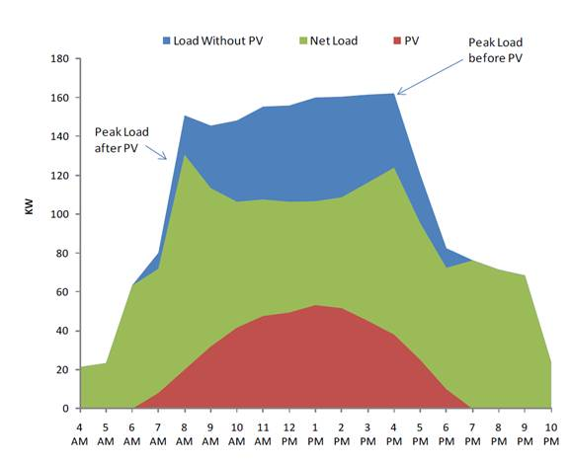
Solar Generation Coincides with Peak Demand/Price
Peak load before PV
Peak load after PV
Load without PV
Net load
PV
Notes:
Solar strengthens our energy infrastructure in a variety of ways. It coincides with peak demand relatively well. In addition, it increases portfolio diversity and reliability, decreases environmental risks to utilities, reduces utility investment risk, and can support a strained grid.
To expand upon how solar decreases environmental risk to utilities, environmental regulation is changing rapidly often without grandfathering. A changing regulatory framework can pose a risk to utilities, including the following:
The risk associated with making an investment in a ten year lead time coal plant, with an extremely large capacity and investment is much higher than small
incremental investments in distributed PV systems. Even the two year lead time of a combined cycle plant has risk.
Capital investments are recovered more quickly with immediate revenue streams.
The impact and probability of non-availability of one large plant is much greater than 1000 small plants.
Also, solar also promotes energy security by reducing peak use of electricity. There are benefits of distributed generation (reducing stresses on grid, etc.) – it is as available or more available than other types of power.

Slide 49

When Local Governments Lead Solar Efforts, They Show Leadership and Social Responsibility
How
Inspire more installations
Reduce GHGs
Encourage property improvements
Work with local industry
Help save operating costs
Results
Job growth
Improved quality of life
Increase property values
Increased private sector willingness to adopt solar
Savings for constituents
Notes:
When local governments lead solar efforts, they show leadership and social responsibility – there are lots of ways that local governments can affect change and improve conditions for solar. Many barrier-reducing actions are under a local government’s purview.
Often it takes the Mayor or the Council President to stand up and proclaim that their city is pro-solar before the market comes in.
Mayors and other elected and appointed officials are responsible for the welfare of their constituents. There is a lot of pressure to be socially responsible, but there is an equal amount of pressure to spend budgets wisely.
But you don’t have to be a Mayor or the Council president to be a leader. In fact, many of you are in a decision making position or in a position to make recommendations to decision makers.
When your city goes solar it inspires more installations You can show leadership and social responsibility by:
Inspiring more installations – which leads to job growth
Reducing GHGs – which leads to an improved quality of life
Encouraging property improvements – which leads to increased property values. In April 2011, Lawrence Berkeley National Lab did a study that solar adds approximately $17,000 in value to an average home.
Working with local industry – which leads to an increase in private sector willingness to adopt solar and get involved
Helping to save on operating costs – which leads to tax savings for constituents – in some ways you can lock in a low fixed rate over the course of 10-20 years
The City of Rifle, CO put 2.3 MW of solar PV on a former uranium and vanadium processing site – reducing GHG emissions by 76,000 tons per year and saving City of Rifle taxpayers approximately $2 million by siting the project on contaminated land already owned by the City.
You too can show leadership and social responsibility by helping to lead solar efforts in your community.

Slide 50
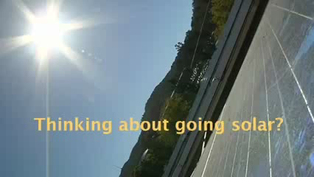
Marin County, CA
http://www.youtube.com/watch?v=HLHlzLVY9gA
Notes:
This 4 minute interview with Dana from Marin County, CA was produced by NACO. It provides a bit of information on one of Marin County’s solar installations and their solar program.
YouTube video: www.youtube.com/watch?v=HLHlzLVY9gA
Report on Best Practices: http://admin.naco.org/research/pubs/Documents/County%20Management%20and%20Structure/Research%20County%20Management%20and%20Structure/Best%20Practices%20Urban%20Sustainability.pdf

Slide 51
Yet Barriers Remain…
Project processing
Costs relative to grid
Variability
Public awareness
Aesthetics – HOA
Requires persistent load
Lack of consumer education
Shortage of skilled workers
Notes:
Even after consumers have been educated, barriers still remain. Solar is still only 1% of the overall energy mix in the US. Following a short break, we will talk about how to address many of the remaining barriers through policy. Some of the remaining, real barriers, are the high up-front cost of solar. There is a lack of financing to reduce the upfront costs of solar. Existing utility policies may not be supportive of solar. Solar is a new market for many communities and local governments must prove that funds are well spent.
Existing zoning laws may not accommodate solar. Solar installations may be restricted by covenants. Permitting can be costly or time-consuming. Workers often need additional skills to join the solar workforce. But as we will learn next, we can improve these locally-controlled circumstances to encourage more solar!
Local governments must prove that funds are well spent and many people feel that energy efficiency (and other low hanging fruit) should come first.
51

Slide 52
15 Minute Break
Notes:
3 SEIA Solar Generation USA Road Trip videos will play during break.

Slide 53

SEIA Webisode 1: http://www.seia.org/cs/the_solar_generation
Notes:
In 2010, SEIA contracted an award-winning director and producer to interview remarkable solar advocates and tour equally as impressive solar installations. Released in three short webisodes, the “Solar Generation USA Road Trip” takes you on a coast-to-coast excursion where solar bears, solar bread, solar wine, a solar powered governor’s mansion, and solar EV charging stations are discovered.

Slide 54
SEIA Webisode 2: http://www.seia.org/cs/the_solar_generation

Slide 55
SEIA Webisode 3: http://www.seia.org/cs/the_solar_generation

Slide 56
Other Actions Local Governments Can Take to Go Solar
Adopt Solar-Friendly Policies!
Notes:
Hopefully we’ve dispelled some of the myths about solar. However, it is important to realized that real barriers remain. Supportive policies and programs at all levels of government are an important aspect of local adoption and advancement.
POLICIES and other measures might be considered Financial or Regulatory, but in reality the dividing line between these two categories is very fuzzy. Regulatory measures often directly or indirectly impact the financial aspects of a project.
Different measures may be enabled by different levels of government but…
State and local authority/ability often overlap
Jurisdictions with municipal utilities have more extensive policy options because they can directly affect utility operations and practices.
At state level we see a combination of legislation, public utilities commission regulation, and occasional Governor’s Executive Orders.

Slide 57
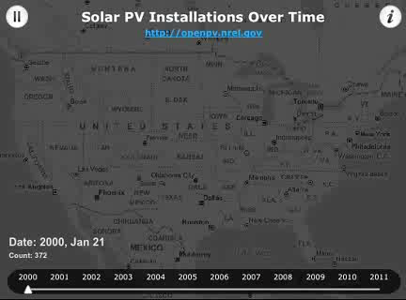
Notes:
In fact, solar installations aren’t dependent on having a great resource - this is one of the roles that policy plays.
This is a Time Mapper of PV installations being installed across the U.S. through time. Created and maintained by NREL, three "layers" are used to convey different features of the Open PV database. The first "layer" consists of 200 points that represent the current PV installations happening at the current time. The second "layer" is a heat-map that shows the current intensity of installations. This "layer" slowly cools off as the intensity of installations fades over time. Finally, a third "layer" acts a map of existing PV installations. Each PV installation is plotted on the third "layer" so that as time passes a visual sense of PV density is portrayed.
When viewing the evolution of the U.S. solar market, it is important to note that it is a slow building process. While some policies/programs such solar energy mandates for utilities and major rebate programs are comparatively more powerful than others, the reality is that the increased adoption of solar is supported by a variety of different policies which each evolve at their own pace. Overarching policies such as a solar energy mandate must be supported by other policies and programs such as favorable net metering, financing options, and the removal of regulatory impediments at the state and local level (e.g., siting prohibitions or solar access, permitting, interconnection, etc.). As the level of adoption increases, new barriers often present themselves and then need to be addressed in order to ensure that the industry continues to grow. In many cases, communities (and states) can take advantage of the lessons learned by other jurisdictions and hopefully avoid some of the impediments and issues that the “early adopters” experienced.

Slide 58
Financial Measures to Make Solar More Affordable
RPS/SRECs
Rebates
PBIs/FITs
3rd Party Ownership
PACE
Loans/ Financing
Bulk Purchasing
Community Solar
Property & Sales Taxes
Notes:
While the state policy context is important, in many cases communities can enact similar policies or offer supplemental programs which build upon state actions. Thus, the local government “policy tool box” includes the state framework as well as the additional options or opportunities created by that framework
State policy context is an important part of determining the most effective way to proceed with local programs (i.e., what’s missing that a local government can provide, or push for?). Local initiatives take advantage of the state policies which all local jurisdictions enjoy and offer the opportunity to “stand” out.
Favorable policies don’t spontaneously arise. Where lack of favorable state policies exist, local governments can be a valuable voice in support of improving those policies.
For future widespread development of solar power in the US, it is crucial that cities recognize and learn from barriers that have been present in other parts of the country, and develop strategies to overcome these hurdles. The slide above is acronym heavy, so below are some basic definitions for these terms.
Renewable Portfolio Standards (RPS) – A mandatory target for utilities to procure renewables, sometimes with specific requirements for solar or distributed generation. This is usually a state level policy. It is also important to note that an RPS is fundamentally a goal, not necessarily a path to reaching that goal. It does however help to create a long-term “demand” for solar that is necessary in order to build the industry. SRECs are a type of performance incentive, but their value typically fluctuates with the market rather than being guaranteed.
Rebates – Rebates or grants help lower upfront cost of installing solar. These are often funded at the state level through electricity ratepayer surcharges, but many examples of local and utility programs exist as well.
PBIs/Feed-in Tariffs – Performance based incentives or PBIs provide an additional revenue stream which accrues as the solar facility generates energy (e.g., $/kWh). The Feed-in Tariff or FIT is a special kind of direct incentive, common in Europe, which pays for energy production through a long-term, standard contract. The use of a long-term standard contract creates a guaranteed revenue stream which in turn improves the ability to finance a given project.
Third-party Ownership Models – Refers to an arrangement where a professional solar service provider owns, operates, and finances a system on the site of the customer, but the customer receives the benefits of the on-site generation (i.e., reduced energy costs). This model is increasingly common these days for a variety of reasons, but the viability is often affected by the availability of incentives and state laws which permit or prohibit such arrangements.
Property Assessed Clean Energy (PACE) Financing Models – PACE is a locally implemented financing program backed by the security of property tax assessments on the host site (loan paid back as a special assessment on property taxes). While implemented at the local level, PACE financing must typically be authorized at the state level.
Low-interest Loans – State or local programs that provide additional financing options for those without access to financing, or better financing terms
Group Purchasing – Bulk buying can result in lower equipment and installation prices. In reality this is a program rather than a policy, and can be implemented with a varying level of local government involvement (i.e., from full program administration at the local government level to technical assistance to completely private)
Community Solar – Refers generally to centralized solar project(s), owned by multiple community members who all share in the benefits. This arrangement can make solar more flexible and equitable. In reality a type of program rather than a policy, but viability can be heavily influenced by policy (e.g., ability to offer “virtual net metering”)
Property and Sales Tax Incentives – Complementary incentives which can improve financial viability of a project. In some cases these may already exist at the state level, but may need to be authorized at the state level in order to be implemented at the local level. Property tax incentives may include exemptions, special assessments, tax credits, abatements, or payment in lieu of taxes (usually only for large projects). Sales tax incentives would typically be exemptions.

Slide 59
Regulatory Measures to Make Solar More Affordable
Codes
Siting
Permitting
Training
Utility Policies
Interconnection
Net Metering
Rates
Notes:
Again, the distinction between regulatory and financial policies and measures is fuzzy. Below are some basic definitions associated with the terms in the slide.
Interconnection: The technical standards and processes involved in connecting a system to the electric grid (equipment standards, timelines, contacts, review criteria, etc.)
Net Metering: System energy production does not always match customer consumption in real time. Net metering rules determine how the excess which a customer sends back on the grid during a specified time period is valued.
Rate Structures: A customer’s rate structure is important in determining the value of solar to a customer because it determines the value of not purchasing that electricity. Different kinds of rate structures are more or less favorable to solar although the right rate in many cases depends on the customer.
Siting: Can I install a system? Where can a system be installed? What private and public limitations might be placed on a hypothetical installation?
Permitting and Inspection: What permits or permissions are needed? What do they cost? How long does it take?
Training: High-quality, safe systems are in everyone’s best interest. To achieve this goal, solar training is essential on both the contractor and code official side of the equation.

Slide 60
Policies to Overcoming Barriers
State policies
Local options
RPS with solar carve-out
n/a
Tax credits
(Unless there is a municipal utility)
Third party ownership laws
Notes:
The RPS, state tax credits, and third-party ownership laws are dominantly state level policies, although jurisdictions with a municipal utility may set their own solar RPS targets or permit/prohibit third-party ownership structures. It is however important to note that communities or coalitions of communities can be powerful advocates for more favorable state policies. For instance, Salt Lake City was able to successfully advocate for state legislation removing restrictions on third-party ownership for non-profits, schools, and public facilities (as well as improved net metering and interconnection standards).

Slide 61
Policies to Overcoming Barriers
State policies
Local options
Cash incentives
Cash incentives
Financing programs
Financing programs
Community solar programs
Property tax laws
Property tax incentives
Notes:
This slide addresses policies and programs that have a healthy level of overlap and complementary nature at the state and local level. Local programs can be designed to build off of or supplement existing state programs or can fill gaps in existing state policies. For instance, Texas does not have a state level solar rebate program, but a number of local rebates (usually through municipal utilities) have created local solar clusters in the state. Care should be taken to make sure that any local program properly considers the existing opportunities and pursues programs that are not duplicative or unnecessary. For example, in Maryland at least one county (Howard County) is contemplating removing its local property tax credit for solar facilities because it is oversubscribed with a long waiting list, and may in fact be unnecessary because other state energy programs provide an incentive significant enough to attract investment.
Community solar programs and certain property tax incentive programs may be implemented at the local level, but in many cases require some form of state enabling legislation, such as the promulgation of rules governing virtual net metering, or the creation of a local option to offer property tax credits.

Slide 62
Policies to Overcoming Barriers
State policies
Local options
Net metering
Net metering
Interconnection
Interconnection
Utility rate structures
Utility rate structures
directly only through municipal utilities
Notes:
Utility policies, or changes there to, may be undertaken through advocacy at the state level, or through direct influence at the local level in jurisdictions where there is a municipal utility. It may also be possible for a large energy purchaser (e.g., a municipal government) to extract concessions or cooperation from an incumbent investor-owned utility or even a cooperatively owned utility. Net metering and rate structure play directly to the long-term value that a solar energy system has to a customer. Interconnection may indirectly impact project costs and timelines, and some provisions could conceivably prevent a project from being built at all (e.g., if the proper level of insurance is not available, or contains provisions which are not supported by the policies available). One truly important part about interconnection standards is simply that they actually be standardized across multiple jurisdictions.

Slide 63
Policies to Overcoming Barriers
State policies
Local options
Solar access laws
Permitting
Zoning
Solar-friendly building codes
Solar-friendly building codes
Sales tax laws
Sales tax incentives
Notes:
Policy can be used to overcome barriers
Policies might be considered Financial or Regulatory measures, but ultimately, regulatory policies tend to affect the financial aspects of solar
Different policies may be enabled by different levels of government but…
State and local authority/ability often overlap
Jurisdictions with municipal utilities have more extensive policy options
While the state policy context is important, in many cases communities can enact similar policies or offer supplemental programs which build upon state actions.
Define each policy type briefly and emphasize that the state policy context is an important part of determining the most effective way to proceed with local programs. Note that many of these policies have a local iteration.
Details about these can be found in the Resources section

Slide 64
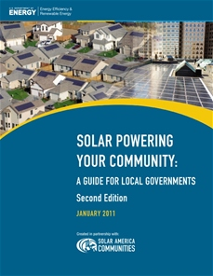
Communities can establish sustainable local solar programs to optimize momentum for increasing installations
Notes:
Financing programs are vital to overcoming the barrier to the high initial cost of solar applications. However, once those programs are in place and the market responds, it is essential to make sure those programs continue or have a planned “exit strategy” to avoid catastrophic market failures. Examples of programs that are not sustainable include incentive programs that quickly become over subscribed and create waiting lists, programs with artificial caps that create market bubbles, and programs that don’t take into consideration the declining prices of solar panels that will surely result over time and create wasteful spending of public funds. [insert here some of the information on evolving financing mechanisms]

Slide 65
Third-Party Ownership Options
Customer
Utility
System Owner
Customer supplied with solar electricity by system owner
Customer purchases traditional electricity from utility
Customer makes lease/electricity payment to system owner
Utility credits customer for net excess generation
Utility purchases RECs from system owner
System owner transfers REC to utility
Solar power developer finances, owns and operates the system
Customer receives benefits of on-site electric generation (i.e., lower electric bill) and compensates the owner through electricity purchases or lease payments
Benefits: Tax incentive utilization, up-front costs reduced/eliminated, lower “hassle factor”
Property leases are a distinctly different option.
Notes:
Retail power purchase agreements (PPAs) and leases are often available for all sectors (e.g., residential, commercial, tax-exempt)
State (utility regulation, incentives) and federal policy (tax credits) influence what may be offered in a given state at any given time. Developers may only operate in certain markets (i.e., states)
At retail level, around 50% of systems are installed with PPA
Under third party ownership, tax incentives accrue to system owner (i.e., solar service provider) rather than the site owner. These filter down to the customer through the price paid by the customer under a PPA or a lease.
Local governments may be able to facilitate the use of third-party financing options by forming partnerships with solar service companies, pursue local (e.g., permitting) or state law (legality of model) to make the local environment more attractive. Local governments may also pursue projects under a third-party ownership arrangement themselves.
There is an increasing pool of solar financiers offering residential PPAs -- SolarCity, SunRun, Sungevity, & BrightGrid in NY are some examples of this. Each of these firms has their own spin on the business plan; for example, SolarCity does the actual installation while SunRun and Sungevity work with a network of installers.
Drawbacks to third-party ownership may include high transaction costs for commercial scale installations, thus third-party ownership in the commercial context has typically been limited to systems of 250 kW and above. At the same time, it could be that transaction costs are lower than for other financing methods (e.g., debt issuance). Public agencies may also experience a variety of other obstacles when electing to enter into a PPA (debt restrictions, contracting restrictions, competitive procurement requirements, site access).
From the customer perspective, the real difference between a lease and a PPA is that under a lease the performance risk is placed on the customer. The customer pays the same amount regardless of what the system produces and if the system under-produces, the customer pays a higher utility bill. Under a PPA the customer only pays for what they get. Leases however may be simpler for a residential customer to understand.
Resources
The Lex Helius publication has a detailed description of the considerations which need to be addressed when entering a PPA: http://www.stoel.com/webfiles/lawofsolarenergy.pdf
The NREL PPA Checklist for State and Local Governments is also a good resource for local governments interested in this arrangement: http://www.nrel.gov/docs/fy10osti/46668.pdf
65

Slide 66
Third-Party Ownership Options
Customer
Utility
System Owner
Customer supplied with solar electricity by system owner
Customer purchases traditional electricity from utility
Customer makes lease/electricity payment to system owner
Utility credits customer for net excess generation
Utility purchases RECs from system owner
System owner transfers REC to utility
Lower, Predictable Energy Costs
Notes:
66

Slide 67
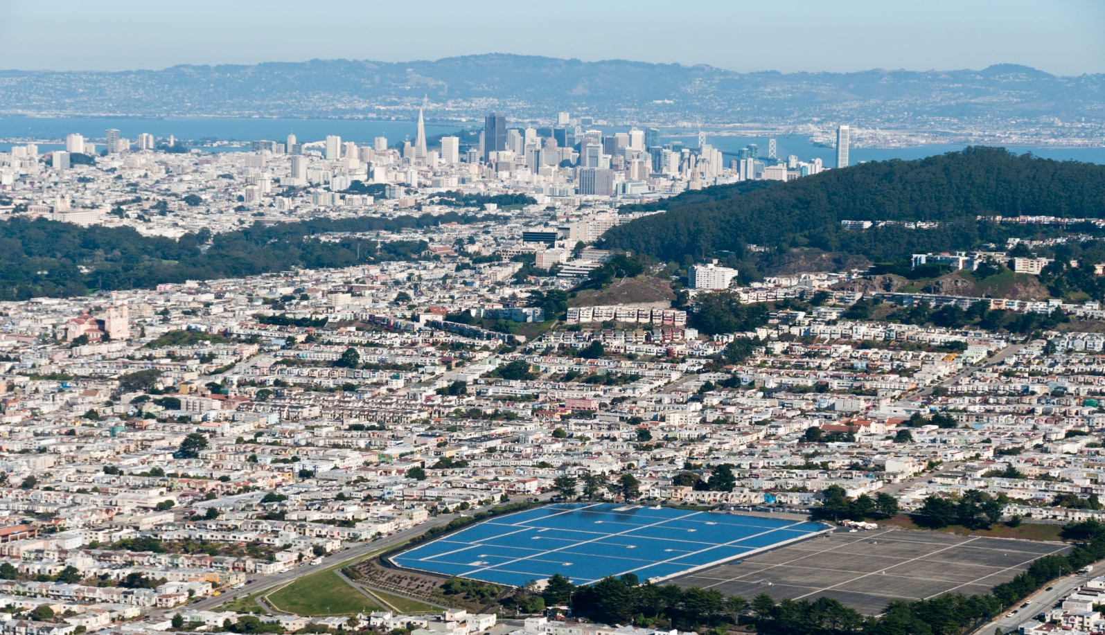
City of San Francisco Sunset Reservoir
PPA Financed 5 MW PV system
Photo attribution: San Francisco Public Utilities Commission
Notes:
This image is of The City of San Francisco’s 5 megawatt (MW) solar photovoltaic (PV) system, on top of the north basin of Sunset Reservoir, the City’s largest reservoir.
Sunset Reservoir Solar Project (San Francisco PPA)
The City of San Francisco’s 5 megawatt (MW) solar photovoltaic (PV) system, on top of the north basin of Sunset Reservoir, the City’s largest reservoir. Completed in 2010, nearly 25,000 solar panels installed covering an area the size of 12 football fields. The Sunset Reservoir Solar Project is California’s largest solar PV system and the nation’s largest municipal solar project. With this installation, the total municipal solar generation in San Francisco will more than triple from the current 2 MW to 7 MW. Over the 25-year life of the project, the system will reduce carbon emissions by more than 109,000 metric tons, equivalent to taking more than 1,000 typical San Francisco residences off the grid. PPA with Recurrent Energy. Over the 25-year life of the contract, the city estimates that the power purchased from the project will cost $50.3 million, $36 million less than the lifetime cost of $86.3 million had the city built and financed the system itself. Under the agreement, Recurrent Energy also assumes all the risk of financing, building, and operating the project. The SFPUC is responsible only for purchasing the solar power produced at a competitive rate. Photo credit: SFPUC

Slide 68
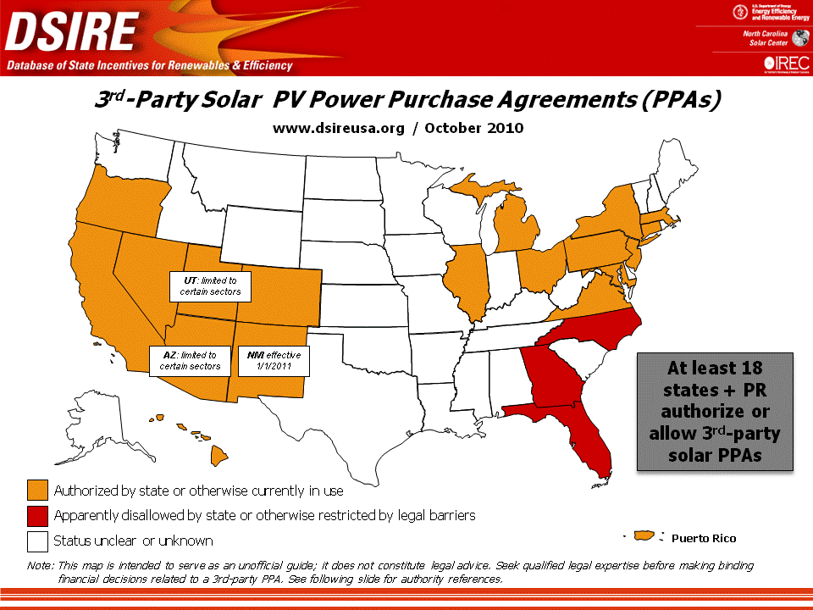
Notes:
State policy can be important for determining third-party ownership options. This includes both the state incentive environment, which ultimately determines whether a solar service provider can make an attractive offer to customers, as well as regulatory laws which either permit or prohibit certain structures.
18 states and Puerto Rico allow third-party (retail) PPAs - At least 3 states prohibit or restrict via legal barriers. Rules unclear in many other states.
Leases are a possible option where PPA’s are illegal but systems using federal tax credit cannot be leased to tax exempt entities; the current Treasury grants avoid this problem and permit leases to tax-exempt entities.
In some states, net metering laws can also be an issue (i.e., customer generator is defined as the system owner, hence net metering may not be allowed for third-party owned systems).
The Nature of the Legal Hurdle
The core issue of legality is much more apparent in states that continue to have regulated electricity markets. In states with retail choice, retail electricity providers other than utilities already exist and operate. In some states (e.g., CO, NM) the legality of PPAs has been addressed through the legislature. In others (e.g., OR, AZ) it has been addressed through proceedings of a public utilities commission or the equivalent electricity industry regulatory body. Other states have yet to make anything resembling a blanket determination. Solar thermal systems installed under PPA’s potentially avoid these problems because the facility is selling thermal energy and not electricity. This is actually taking place in North Carolina despite what appears to be a generally unfavorable policy/regulatory environment.
The regulatory issues have been addressed in several states through either legislation or regulatory determinations. For information on the legal means by which PPA’s are authorized by the states in the map above, please see the on-line version which contains citations on the second page: http://www.dsireusa.org/documents/summarymaps/3rd_Party_PPA_map.ppt
68

Slide 69
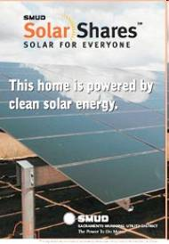
Community solar programs
Provides power , financial benefit to multiple community members
May help overcome upfront cost barrier
Utility collaboration is a must
Can be initiated by local government, utility, or business
Notes:
The chief advantage of community solar is that it lets people/customers who would otherwise not be able to invest in a solar system. This sector includes Renters and people who do not have a good site on their property (e.g., only 22-27% of residential roofs can support solar)
An additional benefit is that similar to an aggregation program, $/W costs will likely be lower for a large system and smaller purchases might be made without losing the economies of scale associated with a large system. However, this may be balanced by the fact that it may be difficult to access the benefits of tax incentives under a community model. Additional obstacles exist in the area of securities regulation (i.e., selling shares in an investment and the accompanying regulatory requirements). Depending on how the program is set up however, it can make solar available to customers with a lower cost for smaller increments of capacity. Community solar may in the long-run be a cheaper option than owning on-site solar for customers. In some cases, participation may increase the customer bill, but the customer is purchasing locally generated solar under what is typically a fixed price regime (i.e., no increases over time), which may ultimately turn out to be a benefit. At the very least, the customer is purchasing clean energy from a local system, which many would consider preferable to purchasing commodity green power (i.e., RECs) or “brown” energy.”
Secondary benefits of community solar include optimal project siting, increased public understanding of solar, generation of local jobs, test new financing mechanisms.
Many different models exist, and community solar could be initiated by local government, utility, or business (set up to own project) - it could even be installed on local government-owned land.
As typically arranged, people get “credits” on electric bill through virtual net metering - (Alternately, the customer could get $ credit on electric bill.) This is often referred to as virtual net metering, and the state policy environment is important as many states do not require utilities to offer such an arrangement. Jurisdictions with municipal utilities have leeway to design virtual net metering programs themselves. A monetary payment could either based on production or a flat payment (as with SMUD Solar Shares). With utility-sponsored model, participants get credit or payment on utility bill proportional to their contribution and how much electricity the system produces (or it could just be a flat credit). Usually participants don’t actually own system, it’s owned by utility and participants are paying to receive benefits of system
SMUD: In July 2008, the Sacramento Municipal Utility District (SMUD) launched an innovative green pricing program called SolarShares. The program, the first of its kind, allows customers to purchase a portion of the solar energy generated by a 1-megawatt PV installation in Sacramento County. SMUD purchases the output of the third-party-owned system and resells it to SolarShares customers for a fixed monthly fee based on customer electricity usage and the size of the block they choose to purchase. Customers can buy the output of 0.5-kilowatt increments up to 4 kilowatts. Participants currently spend an extra $4 to $50 on their electric bill each month, and SMUD credits the value of that generation to each participant’s energy bill through virtual net metering. The program sold out the initial 1-megawatt PV system in the first 6 months, and enrollment has remained stable at about 700 participants. The following Web site has details on the district’s SolarShares program: www.smud.org/en/community-environment/solar/pages/solarshares.aspx. The Solar Shares program actually increases the electric bill of participants but it does allow them to replace their use with locally produced solar at a relatively low cost. Impact actually differs by season and may result in a bill decrease during some months. The fixed fee does not increase although bill credit values may increase over time (i.e., price certainty).
Other examples of community solar projects include St. George Utah: http://sgsunsmart.com/index.htm and Seattle Washington: http://www.seattle.gov/light/Solar/community.asp
69

Slide 70
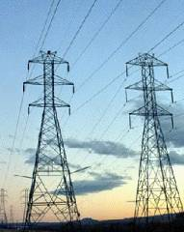
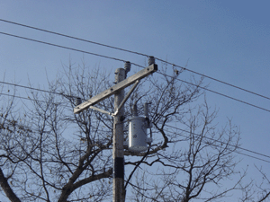
Interconnection
Notes:
Procedures for approval vary across states and utilities . Utilities are responsible for their grids, and they want to be sure that interconnecting a new generator isn’t going jeopardize safety or reliability. In the past, it was a busy year if more than one new facility was coming on-line for a utility. There wasn’t a need for standard procedures; each interconnection was unique and a team of engineers would go through every detail. But with thousands of new distributed generators, procedures were needed. Many utilities have implemented tracking software to ensure requests do not get buried in at one of the approval stops.
Generators under a few MW usually connect to distribution lines under state rules, but 9 states don’t have rules, and smaller utilities often set their own rules. Federal rules generally impact larger generators, which usually connect to transmission lines under federal rules that are really just a study process that is often costly and lengthy.
Interconnection Best Practices (Sources: IREC, Connecting to the Grid, 6th Edition and NNEC, Freeing the Grid, 2010 Edition)
Coverage of all technologies, rather than just renewable technologies
Interconnection of systems up to at least 10 MW
Apply existing technical standards (e.g., IEEE 1547, UL 1741)
Use standard forms and agreements, with simplified versions for small systems
Screen applications based on degree of complexity and use expedited processes for those that pass technical screens.
A simplified procedure for small solar arrays covering most residential installations
A fast track procedure for systems up to 2 MW that allows interconnection without additional cost or delay if certain screens are met
A scoping meeting if screens are not met to review expected costs and duration of studies
Impose design fees proportionate to project size
Create transparent, uniform process with comprehensive coverage of potential issues
Prohibit redundant or unnecessary additional requirements
A three part study (feasibility, impact and facilities) process for interconnection of more complex and larger systems (CA Rule 21 has supplemental review process as a first step for systems that do not meet all the screens and, failing that, a single study process that essentially includes the three study areas listed)
70

Slide 71
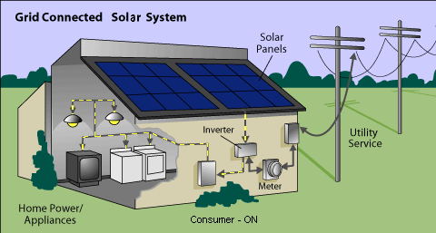

Net metering
Notes:
When a customer’s generation exceeds the customer’s use, electricity from the customer flows back to the grid, offsetting electricity consumed by the customer at a different time during the same billing cycle. In effect, the customer uses excess generation to offset electricity that the customer otherwise would have to purchase at the utility’s full retail rate. Most states have net metering laws in one form or another, but the ultimate benefit is fairly dependent on state policy details, which can vary widely. Variations in monthly rollover, annual reconciliation, and utility rate options can make a significant difference in value. These details become less important as system size decreases relative to on-site electric load (i.e., fewer exports to the grid) . Under a common arrangement, net metering allows for the flow of electricity both to and from the customer through a single, bi-directional meter.
Net Metering Best Practices (Sources: IREC, Connecting to the Grid, 6th Edition and NNEC, Freeing the Grid, 2010 Edition)
Facility size limited by on-site load
No cap on aggregate program size
Indefinite carry-over of net excess generation
No standby charges and other fees
Applies to all utilities and customer classes
Multiple meter billing arrangements permitted
Third party ownership arrangements permitted
Customer owns renewable energy credits (RECs)
As with interconnection procedures, net metering is different from state to state, and smaller utilities often don’t have to follow the state rules. 43 states have net metering in some form, and lots of smaller utilities do too, but the variety is vast. Indiana doesn’t allow any system bigger than 10 kW to net meter; that’s a good-sized solar array for a home. On the other hand, 20 states allow systems that 100 times larger – as big as a MW or even without any limit other than sizing it to meet the customer’s annual load. For program size, what seemed adequate a few years ago is insufficient today. Idaho says that a utility doesn’t have to offer net metering once the sum of all of the generation is 0.1% of the utility’s peak load from the year 2000. Peak load at Idaho Power in 2010 was under 3,000 MW, so that means no more than 3 MW of distributed generation, like solar arrays, can be net metered - ever. That’s about as much as California installs every day.
The other common roadblocks that can creep into net metering rules are added fees, not crediting the customer for excess generation at the end of the month, and not allowing a customer to use one generator to offset multiple meters on a property. On the other hand, some are starting to permit creative approaches to allow virtual net metering, such as using one array on a multiple-tenant building and crediting the tenants the got the array built for their share of the energy produced.

Slide 72

Interconnection and Net Metering Best Practices
Notes:
Freeing the Grid is a publication from the Network for New Energy Choices, which grades state net metering and interconnection rules. Because of the large set of policy details which affect how well a state’s interconnection and net metering policies support solar, it can be difficult to know where your state stands and what might be improved. Freeing the Grid takes a detailed look at each state under a set of policy variables and scoring criteria. It can be a great resource for determining what is important, understanding the wide range of considerations, and where improvements are needed. Jurisdictions with a municipal utility can compare their own policies to the best practices and scoring criteria to help determine a course of action or improvement. At the state level, a poor Freeing the Grid grade may prove to be a compelling talking point for advocacy (i.e., who wants to hear that their state has an F?).
Freeing the Grid: http://www.newenergychoices.org/uploads/FreeingTheGrid2010.pdf

Slide 73



Increased adoption of solar energy in Salt Lake City is the result of vast improvements to net metering and interconnection.
Photo credits:
Sara Baldwin Utah Clean Energy
Notes:
That is the roof of the Ashby Apartments in downtown SLC. The larger system (57-kW) provides each residential apartment with solar, which helps power all the electric appliances and electric heat. The historical apartments have been retrofitted and are energy Star rated and serve low-income communities. http://thelaportegroup.com/ashby.html
Yes, we had pushback from the utility on the third party financing efforts – they were concerned about the possibility of opening the door to deregulation and/or consumer protection; they also voiced concerns about the value of distributed generation and they made an attempt to undermine net metering during the legislative session. We were successful because we had a lot of powerful partners in support and behind the policy (see attached), and we negotiated with the utility, making some concessions with respect to the scope (limiting it to only non-profits, churches, schools, state/local governments). Net metering and interconnection dockets were two year efforts, so the challenge was primarily a matter of perseverance; but, again, we brought numerous stakeholders to the table to weigh in on the issues, demonstrating that there was broad support.
Here are some summaries, if you are interested:
http://utahcleanenergy.org/news/net_metering_victory/21809
http://utahcleanenergy.org/news/solar_salt_lake_project_receives_top_score_peer_review_session_us_department_energy_solar_techn
http://utahcleanenergy.org/current_regulatory_issues/regulatory_archive
From Solar Powering Your Community: Utah law requires the state’s only investor-owned utility, Rocky Mountain Power (RMP), along with most electric cooperatives in the state, to offer net metering to customers who generate electricity using solar energy, wind energy, hydropower, hydrogen, biomass, landfill gas, or geothermal energy. Net metering is available for residential systems up to 25 kilowatts in capacity and nonresidential systems up to 2 megawatts in capacity. In 2008, Solar Salt Lake, a group of organizations implementing Salt Lake City’s Solar America City initiatives, advocated for improvements to Utah’s net-metering policy. With support from the legal team of Keyes & Fox, IREC, NREL, and numerous Utah solar advocates, Solar Salt Lake succeeded in its mission to improve net-metering rules in Utah. In February 2009, the Utah Public Service Commission ruled that PV system owners will retain the RECs associated with electricity produced by a customer’s PV system; customers will receive full retail credit for every kilowatt-hour of excess electricity generated; and RMP must allow aggregate interconnection of PV systems up to 20% of the utility’s 2007 peak demand.
Can reference this document, Solar Implementation Plan: http://solaramericacommunities.energy.gov/pdfs/Solar_Salt_Lake_Implementation_Plan_SM.pdf
County is negotiating PPA for installation on Salt Palace Convention Center and two other facilities.
Bella Energy will build system and NexGen will pay for it, own it and sell power at fixed rate to County.
Rocky Mountain Power is Utah's only IOU. City and County work closely with utility.
Involved in Integrated Resource Planning process. Utah Clean Energy (Solar Salt Lake's partner) is typically engaged in these proceedings.

Slide 74
Utility rate structures
Vary significantly based on customer class and utility
$/m customer
Fixed charges
$/kWh
$/kW
Demand charges
Volumetric charges
Notes:
Definitions:
Fixed charges: a standard monthly $/customer charge, typically beyond the reach of net metering
Volumetric charges: $/kWh of use, includes both energy and distribution components, may be fixed or vary over time
Demand charges: $/kW of peak demand, usually 15 minute peak demand over a month
Net metering rules also come into play here as well. The electricity being produced by the system could either be used as it is produced on site (lower overall electricity purchases), but at some times may be exported to the grid. Net metering rules determine how grid exports are valued in conjunction with the rate structure.

Slide 75
Rate Structures Best Practices
Develop Robust Customer Options!
Tiered structures (higher use = higher rate)
Time of use pricing (rates match cost)
Low/no demand charges
Source: Solar Alliance, Utility Rates and Revenue Policy
Notes:
The ideal rate structure depends on customer energy use patterns. Rate elements which can improve value for solar include tiered structures, time of use pricing, and low/no demand charges.
The devil is in the details on this issue and it can sometimes be difficult to evaluate. The basic idea behind a tiered structure is that customers with higher usage levels pay higher prices. For instance, a residential customer may pay a low base rate for the first 500 kWh of electricity consumption during a month, and escalating rates for the next 500 kWh block and so forth. Since solar reduces overall grid electricity consumption, the value of solar to the customer is increased because it offsets higher priced electricity in the upper tiers.
Time of use and real time pricing capitalize on the fact that electricity costs vary according to overall demand, and demand peaks during the day time and during different seasons. PV systems tend to produce electricity during higher price periods (e.g., a hot summer afternoon), if not necessarily the highest demand periods. Time of use and real time pricing structures allow the user to capitalize on this fact because the periods for which solar is reducing the most grid consumption tend to be higher price periods. The actual impact may vary substantially based on the load profile of the customer and the details of the rate structure.
Demand charges can be very significant for commercial customers, perhaps even comprising the majority of an electric bill. Due to the use of small intervals for determining demand charges, in many cases an on-site solar system will not substantially reduce the basis for calculating demand (e.g., a single 15 minute interval during a month where high use and low solar production coincide can result in a high demand charge). A good description of the impacts of demand charges is available at the link below.
http://www.brakeyconsulting.com/wp-content/uploads/2009/10/Report_on_Demand_Charges.pdf
From the utility perspective, the demand charge is meant to account for the fact that the utility must have resources available to meet a customer’s maximum demand at any point in time. Higher peak demands necessitate the use of peaking resources, which are typically much more expensive and operate less frequently than baseload resources. Thus a capital investment in peaking resources must be recouped over many fewer hours of operation. An alternative to demand charges is to simply use high energy charges for peak periods to reflect the added cost of peak power.
The Solar Alliance has also come up with some sample rate schedules for commercial and residential customers. In order to be beneficial, the metering design must accommodate net metering. Some meters with TOU capability may not be capable of reverse operation. In these cases, a customer may need a meter replacement which can be expensive (100’s of dollars) and may need to be covered by the customer rather than the utility. Utilities sometimes bear the cost of meter replacement for standard meters, but the cost for an enhanced or additional meter may be put upon the customer. Due to scale, this is likely more of a concern for residential customers.
Solar Alliance Rate Structure Web Site: http://www.solaralliance.org/four-pillars/utility-rates-revenue-policies.html

Slide 76
Incorporating Solar Into Codes & Ordinances
Opportunities to Become More “Solar-Friendly”
Notes:
This section of the workshop will review local codes and ordinances that can have an impact on how “friendly” a community may be towards solar. We will discuss these regulations in terms of tools that can make investing in solar technologies a positive experience, both for the local government and the end user.

Slide 77
Types of Regulating Codes
Codes that affect facility placement on buildings
Codes that affect facility placement on the ground
Codes that affect specific trades
Local regulations that affect solar access
Notes:
Cities and counties have significant authority to control local growth and development, building construction and renovation, and regulate companies that do business in their jurisdiction. We will review the following categories of regulations:
LOCAL REGULATIONS THAT AFFECT SOLAR ACCESS – Here we refer to the full range of local ordinances, regulations, policies and procedures that can have an impact, intended or not, or the ability to install a solar energy system or that may impair or accommodate the flow of sunlight to the solar collector.
CODES THAT AFFECT PLACEMENT OF A SOLAR ENERGY SYSTEM ON A BUILDING - Here we focus in on practices that will have an impact on solar energy devices that are attached to buildings or other structures on the property, which can be quite different from practices that impact solar energy devices that are
PLACED ON THE GROUND, whether as an accessory use to an existing or new structure or in a solar field.
And finally there are
CODES AND STANDARDS THAT AFFECT SPECIFIC TRADES. Because solar energy system installation crosses over several different trade categories, regulating the installation necessarily crosses over codes. As such, what would be typically viewed as an electrical or plumbing job, the installation of a solar energy system now requires compliance with codes that pertain to the roofing trade, for example.

Slide 78
Local regulations that affect solar access
Zoning ordinances
Subdivision ordinances
Planned unit development (PUD) laws
Historic district regulations
Specific plans that detail policies and regulations for an area
Development agreements
Property tax abatements
Notes:
HERE ARE SOME OF THE LOCAL REGULATIONS THAT CAN AFFECT SOLAR ACCESS:
Zoning ordinances control use of land and the area, height, and bulk of structures; administrative regulations provide standards and submission requirements for certain uses that may be subject to special permits; and they also set out the procedures for seeking waivers to zoning ordinances
Subdivision ordinances subject developers of new buildable lots to demonstrate compliance with a variety of requirements, which may include density, type of use, lot size and orientation, easements, pedestrian and vehicle traffic patterns, open spaces and the like.
Historic district regulations allow architectural control over new and existing buildings and requires the applicant to submit detailed drawings and plans of the intended work. In the case of rehabilitation of an existing structure, local, state and federal guidelines have been established that must be adhered to.
Specific plans that detail policies and regulations for an area might include special taxing districts that have been established ot provide certain amenities for a particular area or redevelopment zones.
Development agreements between local government and property owner constitute a contract between a municipality and a property owner/developer, through which the municipality agrees to freeze the existing zoning regulations in exchange for public benefits. As such they are not subject to subsequent local zoning and subdivision regulations that affect their activities.
Planned unit development (PUD) laws allow development of a tract of land as a single unit incorporating a multitude of uses, including residential, commercial, industrial, recreational and dedicated public purpose facilities.
Property tax abatements can provide exemption of ad valorem tax on property where a solar energy system is installed. This is often a state law, but is administered locally and directly impacts local government property tax revenue.
Many of the aforementioned regulatory schemes will require permits, engineered sealed drawings, as well as demonstration of compliance with relevant codes and standards prior to the approval of installation.
Depending upon the systems size and characteristics, the review process for PV could include a determination of whether the system is considered a permissible use of the property; aesthetics may be considered, with alternative installation schemes required to be submitted for review during public hearings
Even in states where public and private regulations banning solar are illegal, the regulatory and review process may neglect to enforce these bans, often due to lack of awareness.

Slide 79
Local regulations that affect solar access
Solar Access Laws exist in 38 states and the USVI, but people are often unaware of their rights.
www.dsireusa.org
April 2011
DC
Solar Easements Provision
Solar Rights Provision
Local option to create solar rights provision
Solar Easements and Solar Rights Provisions
U.S. Virgin Islands
Notes:
The previous slide discusses local regulations that may impact the ability to access sunlight or allow for the installation of solar equipment. There is also a body of law that exists that was designed to prevent the intentional deprivation of solar access by public and private regulation. It also addresses the provision for solar easements, which are agreements between adjoining landowners that ensure the uninterrupted flow of sunlight to the solar collector. As you can see here, most states have some level of solar access protection, but the effectiveness of these statutes varies greatly. The Solar America Board of Codes and Standards has prepared a report on this subject and you can access it at the Solar ABCS website: www.solarabcs.org.
79

Slide 80
Solar Access Laws
Local regulations that affect solar access
The right to install solar and the ability to access sunlight
Many state level laws exist, but local governments can supplement and build upon state policies
May involve planning elements in addition to specific protections, like solar easements
Notes:
Solar access laws come in several different forms. Various state laws address the details of solar access in different ways. Solar access laws are not going to serve as a catalyst for solar development alone, they are a complementary policy that can encourage solar in combination with other policies/incentives.
Right to install solar (Solar Rights): Private (e.g., HOA) and public (e.g., zoning) restrictions may exist which would restrict system siting and orientation, making the installation more costly or adversely affecting its operation, or prohibit its installation altogether. Such a restriction could take the form of a requirement that systems not be visible from a public street or from a neighboring property. A Solar Rights Law would typically prevent such a restriction from being enforced if it significantly increases the cost of the system or reduces the efficiency of operation.
Access to Sunlight (Right to Sun): A Right to Sun law protects a system owner from having their system adversely impacted by developments (e.g., a building project) or changes (e.g., planting of new trees) to neighboring properties. It would generally not apply to pre-existing impediments. For instance, a right to sun law would typically not compel a neighbor to remove a tree that was in place prior to the installation of the solar system. These laws are very important because even a small amount of shading on a portion of a solar array can have a large impact on system production due to the way systems are installed and wired together.
Solar Easements: Solar easements are voluntary agreements entered into by the solar system owner and the owner of a neighboring property who has the potential to block the flow of sunlight to the solar collector. That party agrees to not undertake changes to their property that would result in shading of the system.

Slide 81
Solar Panels Pit Homeowners Against Associations
Local regulations that affect solar access
http://www.youtube.com/watch?feature=player_profilepage&v=Esk5kq_N77Q
Notes:
On a cloudy day, it might be hard to see the benefit of solar panels. But the Greeman family, of Burnsville, MN, thinks solar panels could help the environment and nearly eliminate their electric bills.
Just one problem: their homeowners association won't allow it, saying the panels would interfere with the development's overall appearance and "architectural integrity."

Slide 82

Historic buildings are unique…
Local regulations that affect solar access
Codes that affect facility placement on buildings
Notes:
Historic buildings are unique: they are usually subject to special restrictions because of their status – e.g., located in historic districts and need to retain an historic “look.” As such, it is often a challenge to overcome those restrictions to install PV.
Even once that challenge has been overcome, the lack of appropriate space on buildings for solar installations has proven to be a significant barrier for many customers wishing to install solar…
Historic buildings and districts are also unique in terms of their regulation. Federal government guidelines dictate what can and cannot be done to these structures, and while these guidelines are voluntary in nature, funding of historic preservation activities are the means by which these guidelines are enforced. Therefore, the local government may have little choice when it comes to making adjustments to accommodate solar applications.
There has been some movement with respect to bringing historic preservation standards in line with the sustainability movement. Historic preservationists contend that the most sustainable building is the one that is retained and restored rather than demolished and rebuilt. There is a great deal of literature available now that discusses the glacial pace and narrowing chasm between the two principles.

Slide 83
Potential issues
Codes that affect facility placement on buildings
Historic district regulations may severely limit the size and scope of a solar installation
The requirement for public hearings when a solar system is installed on a historic building may have significant economic impacts
Zoning regulations regarding property use may restrict the size of a PV installation
Height restrictions may impact the pitch of solar collectors that are roof mounted
Landscape ordinances may prohibit the removal of trees that have the potential to shade roof mounted solar collectors
Notes:
Historic district regulations are very uniform in their treatment of solar additions to historic buildings. They typically follow the DOI standards to a T and leave very little room for compromise. If the system is going to be visible from the public right of way, it will likely be denied. As a practical matter, installation on an inconspicuous south facing roof that does not impact the historic character of the roof or façade is the only option, other than ground mounting.
Most historic district regulations require public hearings for any improvements that are not considered minor. This can lead to protracted and expensive deliberations between the property owner and the community. This can cause economic impacts due to the cost involved in the hearing process (hiring architects, lawyers, etc), but can also result in the owner missing out on available incentives from the state and federal government if deadlines are missed.
Zoning regulations that limit property uses to residential may foreclose the ability of a homeowner to install a PV system that supplies more energy than what will be used on site. They can also limit the number of accessory structures that could impinge upon the ability to build a structure that is primarily intended to support the collector array.
If the solar collectors add enough height to the roof for the required pitch, they can run afoul of height restrictions and require that a variance from the local government.
Landscape preservation ordinances in the zoning code can also impact solar by either prohibiting the removal of trees that will shade the collector, or require the replanting of trees to replace those removed (which can add significantly to the project cost).

Slide 84
How Planning for Solar Ready affects Costs
Codes that affect facility placement on buildings
During Construction |  |  | After Construction
Equipment ($) | Labor ($) | Total ($) | Equipment ($) | Labor ($) | Total ($)
$833 | $896 | $1729 | $833 | $3540 | $4373
Savings during construction
$2,644
Requires team of solar contractors to travel to site
Relocate vents
Install panels on multiple pitches
Source: Solar Ready: An Overview of Implementation Practices [Draft]. NREL, Feb. 18, 2011.
Notes:
Much of the previous discussion deals with the existing building inventory. However, there are tremendous opportunities to plan for solar, not only in subdivision or development design, but also in the aspect of preparing newly constructed buildings to accommodate solar in the future. There are significant economic benefits in doing so.
In this example, costs are calculated for making a residential building Solar Ready for a 10-kW PV system. For this example, there are three main measures associated with making the building Solar Ready that will increase the cost of construction, including:
Upsizing the electrical panel
Installing conduit and wire from the roof to the electrical panel
Installing a combiner box on the roof in which to combine the wiring for the panels.
Costs for these measures were estimated using the 2011 Edition of RS Means Construction Databook. By these calculations, the building can be made PV ready for $1,729 at the time of construction.
If there were no Solar Ready preparations made at the time of construction, the same preparations would cost $4,373 at the time of solar installation. The measures would be more costly after construction for a number of reasons:
Installing the measures during construction could be completed by a general contractor already on the site, instead of requiring a team of solar contractors to travel to the site; estimated 40% savings in associated labor costs.
In this example, there are vents that need to be relocated and the roof exposure cannot be optimized, so panels need to be installed on multiple pitches. Both these examples would require additional expenditure.
The costs of the materials was assumed to be the same whether the work is done during or after construction.
In this example, the measures completed during construction saved $2,644.

Slide 85

How Differences in Roof Orientation can affect Value of Solar (Golden, CO)
Codes that affect facility placement on buildings
Source: Solar Ready: An Overview of Implementation Practices [Draft]. NREL, Feb. 18, 2011.
Orientation | Annual production (kWh) | Annual energy value | Simple payback period (years)
South | 14,304 | $1,201 | 18.3
East | 11,997 | $1,008 | +3.5
West | 10,999 | $924 | +5.5
Notes:
Another example of the economic impact of planning for solar is the difference that roof orientation can have on the solar energy system’s performance. As you can see, the preferred orientation of due south maximizes the systems energy production and optimizes the payback period, whereas placing the collectors on the east or west roof adds substantially to the number of years required to recoup the building owner’s investment in solar.

Slide 86
What can YOU do?
Local regulations that affect solar access
☑
Identify and revise any local ordinances that pose unintended obstacles
Set standards for new construction that are “solar friendly”
Establish solar access protections for commercial properties in addition to residential buildings
Publish ordinances, standards, and related information online
☑
☑
☑
Notes:
From the Guide to local governments
Include the following elements when developing solar friendly policies and ordinances:
Define the type of solar energy equipment protected by the law (e.g., photovoltaics [PV], solar water heating [SWH], or solar space heating and cooling). Some states include “passive” solar measures in their scope, most notably clotheslines.
Set a clear and quantifiable standard for what constitutes an unreasonable restriction on solar energy systems. A restriction that increases the cost of a system by 10%, for example, could be considered unreasonable.
Define the types of structures covered by the law (e.g., commercial buildings, residences including single-family homes and multitenant complexes, garages, and other structures).
Award costs and reasonable legal fees to the prevailing party for civil actions with homeowners’ associations.
Don’t restrict solar energy systems because of aesthetics.
Be proactive and establish standards for new construction that are solar friendly and actually encourage builders and owners to install solar equipment. For example,
Colorado – builders must offer homebuyers option to have PV or SWH installed on new home or have hook-ups installed
Tucson – new homes must be “solar ready” with hook-ups for PV or SWH

Slide 87
What can YOU do?
Codes that affect facility placement on buildings
☑
Encourage or require design of solar-ready buildings
Improve building energy standards and policies for local government facilities
Exempt roof-top PV systems from building height limitations
Exempt roof-top PV systems from landscape preservation codes
☑
☑
☑
Notes:
Encourage or require builders and developers to design solar-ready homes and buildings.
Minimize rooftop equipment or cluster equipment on the north side of the roof to maximize available open area for solar array placement.
Optimize system performance; if the roof is sloped, use the south-facing section; keep the south-facing section obstruction-free if possible.
Plan for the structure to be oriented to avoid shading from trees and buildings, especially during peak sunlight hours.
Install a roof that will support the extra loads of a solar array.
Record roof specifications on drawings; this shows solar designers that the roof was designed to support solar and can prevent a potentially costly engineering study.
Improve building energy standards and policies for local government facilities to make solar energy systems more cost effective and increase local government’s use of clean energy.
Equipment procurement policies that mandate using the most energy-efficient equipment available, such as devices that meet federal ENERGY STAR requirements
Life-cycle cost analysis for all materials and equipment
Green building and solar-ready design for all new buildings and major renovations
Installing PV or SWH systems on suitable municipal facilities.

Slide 88

NREL’s New Resource
Codes that affect facility placement on buildings
Legislation
Stakeholder education
Certification programs for design & construction
Implementing
Solar Ready
Notes:
Often, the high initial cost of solar systems prevents them from being included in new construction. However, with better incentives, technological improvements, and rising conventional power prices, energy from solar sources will become more cost competitive. New construction that is solar ready will be in a position to take advantage of an environment more favorable to renewable energy.
Examples of not being Solar Ready and cost-prohibitive scenarios:
Roofs unable to accept added load of a PV system – retrofitting the roof to accept solar can be cost prohibitive
Significant number of roof obstructions – Roof obstructions may be numerous enough that the cost of moving them or reducing PV production may make a project unfeasible
Significant shading – architectural features, other buildings, vegetation
Without the forethought to make buildings solar ready, solar installation may not be technically possible or the added costs of making infrastructure changes may make solar applications economically prohibitive.
Planning for the eventual installation of a solar system when designing a building can significantly improve the economics of the investment. Installation efficiency can be maximized and costs minimized by understanding these systems’ requirements and accounting for them during the design and construction of the building.
In 2009, NREL published a document called Solar Ready Buildings Planning Guide. While other resources we have identified as potentially helpful to you as you work to incorporate solar in your local planning practices, we felt this document deserved special mentioning. It identifies the important aspects of building design and construction to enable installation of solar photovoltaic and heating systems at some time after the building is constructed. Attention to these guidelines in the development of building codes, building design, or any building- or community-related regulations could significantly improve the performance and minimize the cost of solar systems.
NREL is currently working on a companion piece to this document: Solar Ready – An Overview of Implementation Practices. Currently in draft form, it explores three mechanisms for encouraging Solar Ready design and construction:
Solar Ready legislation
Certification programs for Solar Ready design and construction
Stakeholder education

Slide 89
Potential issues
Codes that affect facility placement on buildings
Permits can require a PV system to meet unnecessary requirements
PV may not be identified in existing permitting requirements
Inspections can take up several days to complete
Permit costs vary, may not be tied to the size or complexity of the PV system
In many states, solar requires more than one permit “pulled” by a licensed contractor
Notes:
Permitting and inspection of solar energy systems has taken on a new urgency in the present administration of the Dept of Energy. The Sun Shot Initiative seeks to lower costs of both utility scale and distributed photovoltaic systems. One large factor is the overhead costs that accrue due to a permitting process that is cumbersome and expensive. Another is the operation and maintenance costs that can result in a poorly designed and installed system. These two factors can be mitigated through streamlined permitting systems and building inspector education.
Permit Process – Due to the crossover in trades involved with a solar energy systems installation, there is typically more than one permit that is required before work can begin. Along with these permits are permitting fees and inspections, all of which consumer money and time.
In the case of a roof mounted system, a roofing or general building permit may be required as well as a structural permit. For a photovoltaic system, an electrical permit will be required. In the case of a solar thermal system, a plumbing permit will likely be required. Often engineered sealed drawings are required, as are wind load test results. Since only properly licensed contractors may secure these permits, it can often involve a primary contractor with several subcontractors to complete the installation of a single system. Again, this adds to the cost of the system, unnecessarily so if a regulatory framework specific to solar installations is implemented.

Slide 90

What about The PROCESS?
How codes are implemented
Understand the entire permitting and inspection process.
Simplify permit application forms and review processes.
Coordinate permitting procedures with nearby jurisdictions.
Allow online or over-the-counter building permits.
Provide training to building and electrical inspectors.
✓
✓
✓
✓
✓
Notes:
How can the community begin to address this challenge?
Understand the entire permitting and inspection process for PV and SWH systems and the dynamics among the entities involved.
Simplify permit application forms and review processes and leverage resources by coordinating permitting procedures with nearby jurisdictions.
Provide training to educate building and electrical inspectors about PV and ST technologies and installations.
Outline the permitting and inspection process in the community so that prospective solar system owners and solar contractors have a clear understanding of the steps for local approval.
Allow online or over-the-counter building permits for standard residential solar energy systems.

Slide 91

What about The PROCESS?
How codes are implemented
✓
Publicize the fee structure on the permitting agency’s Web site.
Allow document exchanges to be conducted by company representatives, not just the licensed electrician.
Fast-track solar permits to the extent appropriate.
Establish a clear path for communications between code enforcement offices and the local utility provider.
✓
✓
✓
Notes:
Expedite permitting process for residential systems. Could make permitting application process online, which in addition to making it easier to file for a permit, potentially makes it easier to track installation number and installed capacity if the jurisdiction has any sort of formalized solar target or goal.
A local jurisdiction may also find that it is useful to create a solar permitting guide or resource that can be referenced by installers in order to avoid confusion about what permits are required, fees, permitting times, etc. The city of Philadelphia has done this for solar permitting, in addition to offering guidance on many other aspects of solar installation for residents and installers.

Slide 92
Consider Adopting Model
Expedited Permitting Process
How codes are implemented
Simplifies technical requirements for PV applications
Facilitates efficient review of content
Minimize need for detailed studies and unnecessary delays
SolarABCs.org
PV modules, utility-interactive inverters, and combiner boxes are identified for use in PV systems
The PV array is composed of 4 series strings or less per inverter, and 15 kW STC or less
The total inverter capacity has a continuous AC power output 13,440 Watts or less
The AC interconnection point is on the load side of service disconnecting means (690.64(B))
The electrical diagram (E1.1) can be used to accurately represent the PV system
To be eligible for expedited permitting:
Notes:
Developed by the Solar America Board of Codes and Standards (“Solar ABCs”)
Provides a means to differentiate systems that can be permitted quickly and easily due to their similarity with the majority of small-scale PV systems
In order for a PV system to be considered for an expedited permit process, the following must apply:
PV modules, utility-interactive inverters, and combiner boxes are identified for use in PV systems
The PV array is composed of 4 series strings or less per inverter, and 15 kW STC or less.
The total inverter capacity has a continuous AC power output 13,440 Watts or less
The AC interconnection point is on the load side of service disconnecting means (690.64(B)).
The electrical diagram (E1.1) can be used to accurately represent the PV system.

Slide 93

Orientation, Shading
summer
winter
Notes:
You can’t put solar anywhere – there are some site specific considerations for you to keep in mind….
Shading - Solar PV modules can be affected by numerous types of obstructions. Examples include trees, clouds, bird droppings, dust and even the shading from other solar panels. Shading one cell in a module or a series can lower electricity production of the whole array. It cal also be bad for a system if it becomes a crimp point – it can burn out prematurely.
Solar Access Rights – Solar Access laws vary by state and region. Solar access laws protect the right of an individual to both install and operate solar panels. A thorough access law addresses both unwarranted restrictions to construction as well as changes that may occur after construction like tree shading and newly constructed higher buildings. Currently, 34 states have some sort of solar access rights established to protect individuals.
Structural Capacity and integrity– Buildings that are being proposed for construction can easily modify system plans to incorporate solar PV panels. However, older building been analyzed to ensure that the current roof has the load capacity to handle the solar PV panels. If a roof is close to the end of its expected life, replacing the roof could be a viable option. Many companies can install the solar panels and the new roof at the same time, if needed.
Wind Loading – Due to the large surface area of panels, the effects of wind speed must be considered when installing solar panels. Therefore, it is necessary to hire a structural or civil engineer to properly perform wind loading calculations and other possible code requirements.
Interconnection to the grid – If you are developing in a area where solar is “new”, the approval process from the utility may be lengthy.
Maximum energy output for a fixed system is always facing South at latitude tilt. A more horizontal tilt gives more summer energy and a more vertical tilt gives more winter energy. The winter path of the sun is important – you need to design for the worst shading situation for a system when the sun is low on the horizon.

Slide 94


Site Specific Considerations –
Solar Pathfinder Exercise
Moscone Center
San Francisco, CA
Source: SunPower Website
Notes:
We have just been talking about issues with solar access. An important consideration when designing a system is siting the system. We are going to go outside and learn how to use a Solar Pathfinder, a tool for siting systems, factoring in and working around shading, and estimating the maximum annual output for a system. As an example, in a dense urban environment future redevelopment must be considered. In less dense applications, the potential for tree shading is still possible.
When siting a system using a Solar Pathfinder, here are some important things to keep in mind. The cards are specific to a latitude. Align the Pathfinder to point south and then adjust for magnetic declination to true South. The reflection shows the solar window of the site and where there is shading. Stand north of the Pathfinder to not shade it, take a photo of the reflection. Put the photo into a computer program that traces the shading on a system during different times of days and months. Ideally, a system should be unshaded between 9am-3pm, as roughly 75% of the energy that hits a system hits during this time. When using the Pathfinder, you should identify any object that would shade the array and move the Pathfinder around to find the ideal location. You can oversize the system to offset losses due to shading.

Slide 95
How to Get Started
&
Engage Stakeholders

Slide 96

Establish Advisory Committee
Comprehensive and Coordinated Effort
Notes:
Creation of sustainable local solar market requires comprehensive and coordinated effort among many stakeholders. Time spent planning and analyzing at the outset is well worth the effort when designing the policies and procedures to serve as the legal and economic framework for solar energy in you community. A good starting point is to build a diverse advisory committee or task force that includes a broad cross section of the community. Your team should include: local government, utilities, universities and community colleges, local for-profit companies, banks, energy attorneys, solar or environmental nonprofits, state energy offices, economic development councils, incentive program administrators, concerned citizen groups, etc.
The earlier you bring them in – the better. The goal is to create “buy-in” so that the solar program has long-term viability. The role of the task force or advisory committee is to help develop a sustainable work plan and leverage resources. Get their “buy-in” – often a written letter of commitment works. At the minimum, they should commit to providing in-kind advisory services. Once your committee is established you will need to determine who the lead organization will be. The lead should be established as community solar hub/resource for all things solar and dedicate staff to the process. If money to fund a staff person is a problem – ask your stakeholders to pool their resources.
Be flexible so you can add to or segment the advisory committee as needs arise. Task force should meet regularly – every month for the first year, quarterly after that.

Slide 97
Milwaukee’s Advisory Committee
Top-down commitment from Mayor/Council Lead organization (City) funded staff Diverse advisory committee formed Met regularly Sub-committees formed Voluntary committees ensure “buy-in”
Notes:
In 2008 Milwaukee was selected as a Solar America City. Milwaukee had Mayor Tom Barrett’s hearty commitment and it also put together a strong advisory committee consisting of:
City of Milwaukee’s Office of Environmental Sustainability (lead)
We Energies (utility)
Focus on Energy (state public benefits fund)
Johnson Controls (local for-profit)
Midwest Renewable Energy Association (installer training provider)
University of Wisconsin-Milwaukee (university)
Milwaukee Area Technical College (community college)
When Milwaukee started the program – one of the first things they did was hire a staff to lead the effort, create a website, and bring the team together for regular meetings and phone calls. With a strong and diverse base – Milwaukee was able to attract other stakeholders such as the big regional economic development council, Milwaukee School of Engineering, Milwaukee County, etc.. Eventually sub-committees were formed to address particular areas:
Finance
Manufacturing
Marketing
Committee participation was voluntary which helped to ensure “buy-in”

Slide 98
Assess Community
Assess solar policy environment
Conduct surveys to identify barriers
Establish installation baseline and targets
Develop realistic plan
Determine how to measure and track progress
Notes:
When you assess the community, it should be done in a comprehensive and coordinated way. Look at policies. What pro-solar policies do you have and which ones are you lacking? Conduct surveys to identify barriers and your region’s strengths and weaknesses. Be open to the suggestions of local installers, industry, and other stakeholders.
Think about your economic development strengths and consider building off of them:
Is your region known for its manufacturing legacy?
Is your region particularly sunny and, therefore, great for installer workforce development?
Is your region known for its top universities?
Is your municipality or state energy office known for being unusually progressive?
Or, alternatively, think about your weaknesses and consider building off of them:
Does your region lack a local installer workforce?
Does your state have a high RPS, but no solar rebate programs?
Figure out what your installation baseline is and what your installation goals should be. To figure out your baseline, you will likely have to compile data from multiple sources.
Develop a realistic plan. Realistic plans – obviously – are more likely to be met. And goals will vary! Don’t feel discouraged if your goals seem modest compared to other communities. Remember, every community has a different starting point and conditions.
As you think about your short-term objectives and long term goals – develop a realistic plan that incorporates soar into long term planning (i.e. zoning, building codes, procurement, other policies).
Finally, determine how to measure and track progress. And, of course, make adjustments to your plan along the way.

Slide 99

Communicate Your Message
Billboard. PG&E.
Notes:
After you create your task force and put together your plan, the third step is to communicate your message. All task force members must be equipped to be spokespeople. They need to know how to field questions from the media and they should be willing to write letters to the editor of your local newspaper and sit on panels at conferences.
It is important to unify your message!
Most marketing efforts – but not all – require some kind of budget. If money is tight, this is where your advisory committee can come in handy. Work with your partners to collaborate, expand your media channels and leverage resources.
Know your audience and be creative!
Some ideas include: billboards, signs, radio spots, interviews, PSAs, YouTube, website, editorials, press releases/ events, outreach, demonstration projects, guerilla marketing/stunts, charettes, contests, tours, bumper stickers, brochures, t-shirts, solar maps, testimonials, mayoral proclamations, speaking engagements at conferences

Slide 100

Communicate Your Message
Billboard. Solar America City - Salt Lake City

Slide 101

Communicate Your Message
Solar Maps. Solar America City – Milwaukee: http://city.milwaukee.gov/milwaukeeshines/Map.htm
Solar America City – San Francisco: http://sf.solarmap.org/
Notes:
Many Solar America Cities have created solar maps to raise awareness about solar and allow residents (or anyone) to search for local systems. Showcasing existing solar energy installations through online solar mapping tools is a mechanism that is growing in popularity.
The City of San Francisco, Madison and Boston have beautiful, sophisticated, but pricey solar maps.
The City of Ann Arbor and the City of Milwaukee have created maps in Google for FREE!
This is a great summer project for an intern.
To create your free solar map in Google click here: http://maps.google.com/support/bin/static.py?hl=en&page=guide.cs&guide=21670&topic=21676&from=21676&rd=2

Slide 102

Communicate Your Message
Website. Solar America City - Portland
Notes:
City of Portland and their partners were innovative and created Solar NOW!, a statewide solar educational campaign. Through pooling their resources and expertise, Solar NOW! put together media campaigns, workshops, educational displays, events, competitions, and highly visible demonstration projects to help educate the public about solar technologies. SolarNOW! believes that citizens who are educated about the benefits of solar energy and understand financing options and the installation process are more likely to be interested in purchasing and installing solar technologies in their homes or businesses, which increases local demand for solar energy and helps local governments meet their solar energy goals.
Their website is a one-stop resource for homeowners and businesses interested in going solar.
http://www.solarnoworegon.org/
http://www.sustainableportland.org/bps/index.cfm?c=43478

Slide 103
Remove Barriers to Solar
Codes and Regulations
Train building department
Create solar ready buildings guidelines/code requirements
Financing
Investigate how to make solar more affordable
Consider offering financing options
Revise solar access laws
Amend zoning regulations
Improve permitting process
Work with other local governments or state to increase availability of financing
Publicize, Inform and Update
Notes:
These barriers and solutions are the main takeaways from the session. One point to emphasize here is that the process is iterative and continuous and involves the community as a whole. As time progresses, new barriers and issues become apparent and must be addressed. Sometimes policy changes can have unintended consequences which then require further action.

Slide 104
Steps for Installing Solar on a Local Government Facility
Educate yourself
Assess the site for solar
Develop RFP
Decide on contractor
Make it happen
&
Notes:
After discussing solar technologies, policies, and financing options with the audience, now we can put the all of that into context by discussing solar installations on a local government facility. These are the general steps in installing solar on a local government facility. After lunch, we will have five speakers from local companies/organizations that will talk with us about installations they’ve done on local government facilities, jobs and economic development associated with the solar industry, and any potential solar barriers/roadblocks that local governments can help address through policy.

Slide 105
Lunch Break
12:00 – 1:30 pm

Slide 106
Steps for Installing Solar on a Local Government Facility
Educate yourself
Assess the site for solar
Develop RFP
Decide on contractor
Make it happen
&
Notes:
After discussing financing options with the audience, now we can put the financing options into context by discussing solar installations on a local government facility.

Slide 107
Evaluate your solar potential
Consider the type of solar you are interested in
Utilize DSIRE www.dsireusa.org
Educate yourself
Consider asking these questions:
What resources and financing are available? | What products are available?
What are the potential locations for an installation? | How much does it cost to install the system?
Are building modifications necessary? | What are the local interconnection and net metering arrangements?
What is the customer currently paying for electricity? | How much electricity is the customer using, and when?
http://solar.calfinder.com/blog/solar-information/10-free-online-solar-calculators/
Notes:
There are a few things you can do before you get serious about installing solar on a local public facility – educate yourself
Remember: No hard and fast rules about which solar technologies are appropriate. Depends on the application.
Many residential solar systems are crystalline silicon; smaller available roof space requires higher efficiency panels in order to generate sufficient power for viable economic return
Many commercial solar systems are thin-film; larger available roof area, greater electricity usage means a larger system and higher installation costs – thin-film often cheaper to installer per kW
Remember: Solar economics very complex – different for every customer, technology
Consider the questions on the slide.
You may not have all the answers, but you should begin to familiarize yourself with these concepts and DSIRE as a resource.
At home research: calculate payback on your solar investment – conduct research to see if there are state or local incentives (does energy efficiency first play a role?) DSIRE website is a great start. You can look at the levelized cost of energy ($/kWh) over the life of a system rather than looking at the payback.

Slide 108

How to Use DSIRE
Search by sector, technology, location, incentive type
Solar Policy Comparison Tables
DSIRE Solar Policy Guide
Summary Maps
DSIRE Search Tool: http://www.dsireusa.org/solar/searchby/index.cfm?SPV=1&ST=1
Notes:
The screenshot is a hyperlink to DSIRE Solar. Click on state and explain what you can find there, under federal incentives, check boxes (remove different technologies), go through search function, show solar policy comparison tables, summary maps, and solar policy guide

Slide 109

Size of system needed
Energy production
Best placement
Cost and payback
Technology type
Distance to transmission lines
Distance to graded roads
Conservation areas
Usable acreage
Slope
Assess the site for solar
on the
GROUND
Notes:
Some installation firms will provide site assessments as part of their installation proposal, but it is recommended that the site assessment be conducted by an independent third-party.
If you are serious –get a “Solar Site Assessment” –
What is a Solar Site Assessment and why is it important?
Unbiased – third-party opinion on the right size, location, and technology to meet your energy needs
Will include images of the proposed placement of the installation and where the tanks/inverter will be located
Will take into consideration energy usage and energy costs and include an economic analysis with ROI calculations
Will include recommendations
Often a site assessment is required in order for rebates to be awarded
The assessments should include technical analyses of slope, shading, and orientation; optimal conduit paths; and electrical or water heating configuration.

Slide 110
Solar Access Rights
Interconnection, area networks
Best placement
Wind loading
Technology type
Building energy load
Roof age, type, & warranty
Electrical configuration
Optimal conduit paths
Slope, shading, orientation
Assess the site for solar
on
BUILDINGS
Notes:
Some installation firms will provide site assessments as part of their installation proposal, but it is recommended that the site assessment be conducted by an independent third-party.
If you are serious –get a “Solar Site Assessment” –
What is a Solar Site Assessment and why is it important?
Unbiased – third-party opinion on the right size, location, and technology to meet your energy needs
Will include images of the proposed placement of the installation and where the tanks/inverter will be located
Will take into consideration energy usage and energy costs and include an economic analysis with ROI calculations
Will include recommendations
Often a site assessment is required in order for rebates to be awarded
The assessments should include technical analyses of a building’s energy load; roof age, type, and warranty; weight load limitations; available roof space (or ground space for a ground-mounted system); slope, shading, and orientation; optimal conduit paths; and electrical or water heating configuration.

Slide 111
RFP specifications are too restrictive or too unstructured
Competing measures of system efficiency
Finding sufficient number of qualified contractors (bidders)
Lack of effective O&M program
Lack of strong monitoring program
Develop RFP
Direct ownership
Third-party ownership
Start the RFP process with the end in mind
Avoid five common pitfalls
Source: NREL Webinar “Procuring and Implementing Solar Projects on Public Buildings: How to Avoid Common Pitfalls” December 8, 2010
Notes:
An RFP can be issued for a single site, multiple sites within a jurisdiction with multiple departments, or on behalf of multiple jurisdictions with sites.
Local governments should write and issue a request for proposal (RFP) in compliance with the procurement office. It is recommended that a residential or commercial customer solicit bids and interview at least three potential contractors.

Slide 112
Consider Collaborative Procurement for Solar
Develop RFP
Energy cost reductions of 10‐15%
Market‐leading contract terms
Early achievement of GHG goals
50% savings in administrative and transaction costs
Stabilized cost of electrical energy
Reduced cost of PV through volume purchasing
Reduced vendor costs through economies of scale
Help smaller cities leverage technical expertise
Stimulate creation of local clean tech jobs
Encourage use of local technologies and resources
See RFP
Notes:
A great example for collaborative procurement is an effort pioneered by a regional collaborative initiative in California led by Santa Clara County, 9 jurisdictions with 47 sites banded together to procure solar services. The resulting effort led to several significant benefits:
Energy cost reductions of 10‐15%
Market‐leading contract terms
Early achievement of GHG goals, and
50% savings in administrative and transaction costs.
In addition to these, participants:
Conserve government funds available for capital equipment
Reduce greenhouse gas emissions from local government operations
Reduce dependence on fossil fuels
Stabilize the cost of electrical energy during a time when we expect prices to rise sharply (hedge against rising and volatile electricity rates)
Reduce the cost of photovoltaic systems through volume purchasing/ aggregated projects
Reduce vendor costs through economics of scale and standardization of purchasing methods
Help smaller cities leverage technical expertise using a shared collaborative resource pool
Minimize workload for cities through the use of turnkey installations of solar systems including financing, installation, maintenance, and operation
Support / stimulate the creation of local clean tech jobs
Encourage use of local technologies and resources

Slide 113
RFP Writing Best Practices
Develop bid weights according to agency priorities
Consider requirements for new roofing or structural enhancements
Attempt broad qualified bidder participation (at least 3)
Show bidders your site homework
Conduct apples-to-apples comparisons among bidders
Require bidder performance in contract
Establish precedents for future renewable investments
Involve necessary internal stakeholders/ departments
Notes:
In an RFP, you should require bidder performance in contract for areas such as permitting, utility interconnection, code compliance, construction schedule, warranties, and electricity output
Involve stakeholders/departments
Procurement
Finance
Facilities/engineering
Energy/environmental mgmt.
Executive
Other
First do no harm: roofing
Roof age and condition as important determinants of where and how installations are sited
Integration with roof warranty
Structural analysis/loading limitations
NREL solar rooftop optimization tool (forthcoming)

Slide 114
References?
Timeline?
Guarantee or Warranty?
Number of similar systems installed?
Does it does repairs? At what rates?
Will it provide system O&M training?
Questions to ask
Decide on contractor
Notes:
It is recommended that a residential or commercial customer solicit bids and interview at least three potential contractors.
Questions that you may ask the contractor include :
Can you provide references from previous customers with similar systems?
When would you be able to perform the work?
How long will the project take?
Do you provide a performance guarantee and/or warranty, and if so, what are the details?
How many similar systems have you installed?
Have you worked with local building officials and utility representatives when installing similar systems in the past?
Do you have a master electrician (or professional electrical engineer) as part of the project team?
Will you hire subcontractors to complete portions of the project? What firms will you hire and what will they do?
Do you repair systems that you installed, and if so, what are your rates?
What kind of training will you provide me with so that I can better operate and maintain my system?
Contractor will generally apply for permits (building, electrical/plumbing, historic, interconnection).

Slide 115

Make it happen
Facilitate contractor’s work
Contractor will generally apply for permits and incentives
Initiate mechanism to track system performance
Publicize completion
Celebrate!
&
Photo: Ribbon Cutting Ceremony at Frontier Fertilizer Superfund site
Notes:
Celebrating and publicizing the completion of an installation is an important step. Local government installations are an example for others in the area. Local governments can lead the way and stimulate interest and investment by others to help grow the local solar market and local jobs. If “Initiate mechanism to track system performance” is the burden of the local government ownership, then the local government needs to put a system in place. If third-party, then it’s the owner’s responsibility.

Slide 116
To Industry Panelists
Tyler Johnson, FLS Energy
Blair Kendall, Southern Energy Management
Neal Mitchell, AEG Power Solutions
Timothee Neron-Bancel, NABCEP
Julian Prosser, City of Raleigh

Slide 117
Closing Activity
Team up with others from your local government
With your Community Team, identify the strategies and approaches that you feel are the most feasible to act on right away

Slide 118
Don’t Forget…
Today’s workshop presentation & notes will be posted here:
www.SolarAmericaCommunities.Energy.Gov/Resources

Slide 119
Questions/Comments www.SolarAmericaCommunities.energy.gov solar@icma.org
Justin Barnes justin_barnes@ncsu.edu, www.dsireusa.org
Amy Heinemann amy.heinemann@ncsu.edu, www.dsireusa.org
Colleen Kettles ckettles@fsec.ucf.edu, www.fsec.ucf.edu

