Slide 1
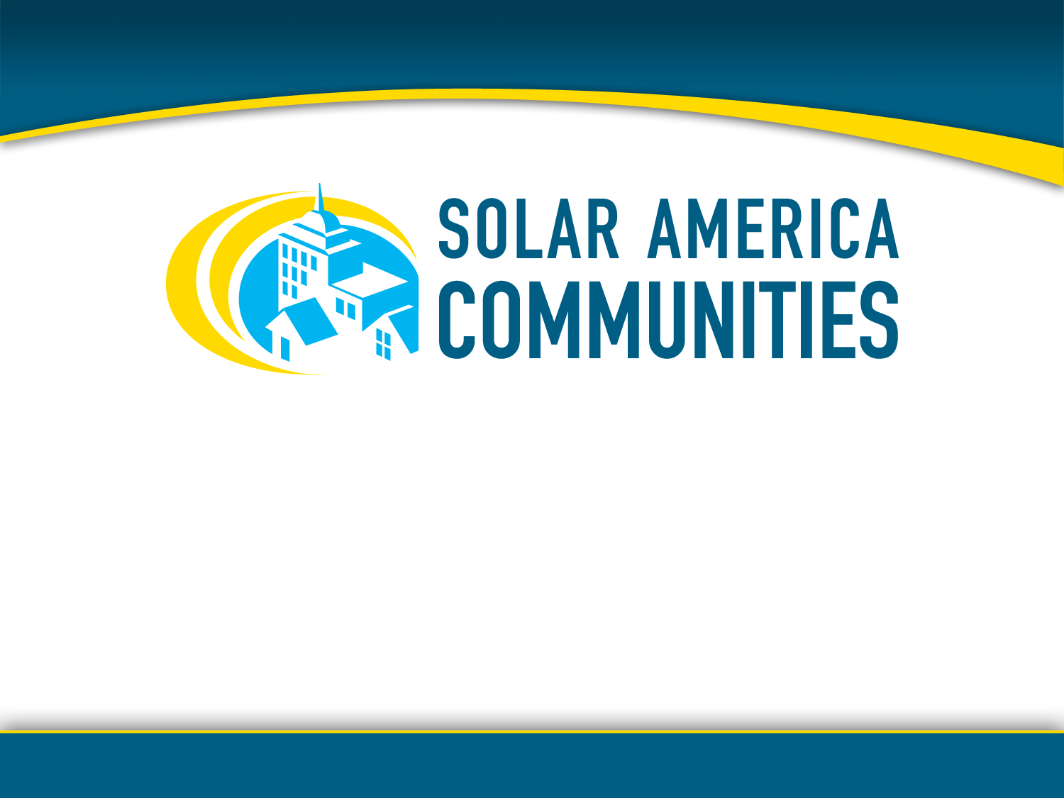
Getting Started with Solar Workshop & Tour
45th Annual National Association of Regional Councils
Conference and Exhibition
San Diego, CA
June 15, 2011
Notes:
Good Morning, everyone. Welcome to our program today. My name is Casey Johnston, from ICLEI… I am the official convener of today’s workshop; bringing you several experts and testimonials on how to catalyze solar development in the regions that you come from around the country.

Slide 2
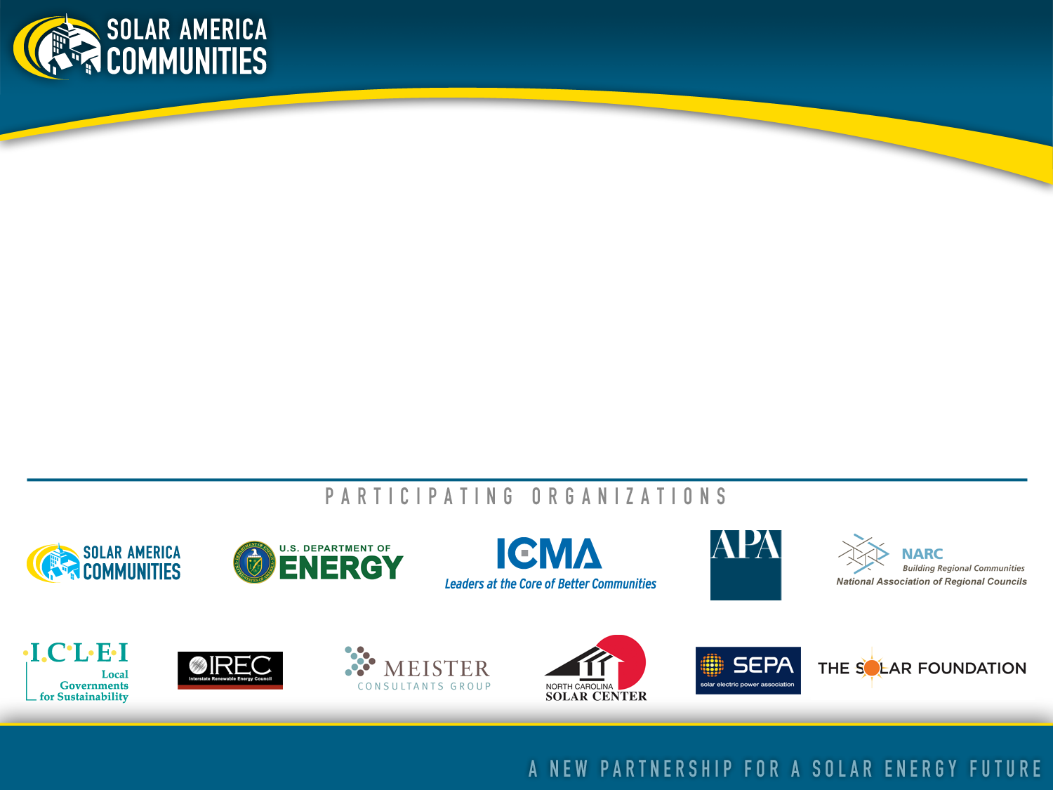
About Solar America Communities
Solar America Communities is a U.S. Department of Energy (DOE) program designed to increase the use and integration of solar energy in communities across the United States. The International City-County Management Association (ICMA) and ICLEI-Local Governments for Sustainability were competitively selected by DOE to conduct outreach to local governments across the United States, enabling them to replicate successful solar practices and quickly expand local adoption of solar energy. For more information visit www.solaramericacommunities.energy.gov.
Notes:
Andrea, Chad and I are part of the Solar America Communities program – which is a five year Department of Energy program designed to increase the use and integration of solar energy in communities across the US.
Led by two organizations – ICLEI Local Governments for Sustainability (the organization I represent) and ICMA (also known as the International City/County Management Association) – several organizations and subject matter experts in the solar industry are all working together to bring solar best practices to communities nationwide.

Slide 3

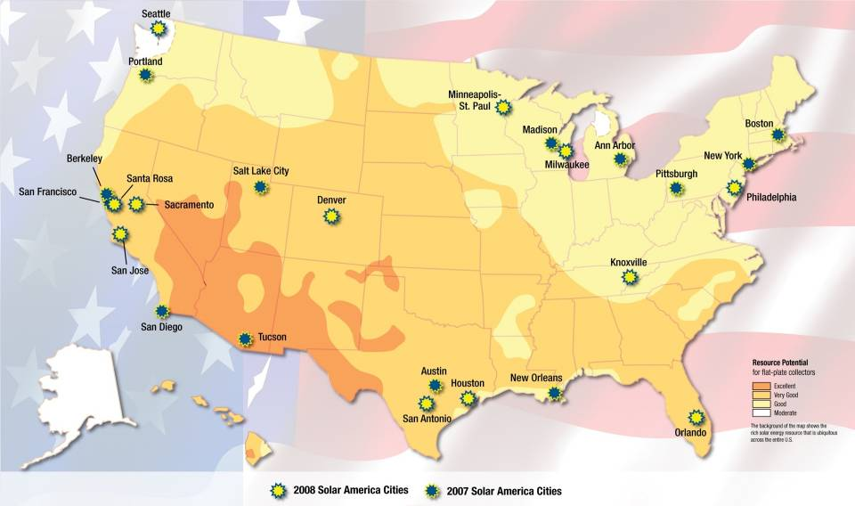
Notes:
Just to give you a little background, the Solar America Communities program was inspired by the highly successful Solar America Cities program where the Department of Energy competitively selected 25 US cities in diverse regions throughout the country as Solar America Cities. This program began in 2007 and is still in operation.
Based on the success of its partnerships with these cities, DOE decided to expand the program to conduct outreach to many more local governments throughout the country to share the lessons learned and best practices from the partner cities. As the Solar America Cities program evolved to include this new outreach effort , the program was renamed Solar America Communities to reflect DOE’s commitment to supporting solar initiatives in all types of local jurisdictions, including cities and counties.

Slide 4
Our Mission:
Enable local governments, community and private sector stakeholders to replicate successful solar practices and quickly expand local adoption of solar energy
Our Objectives:
Increase installed capacity of solar electricity in U.S. communities
Streamline and standardize permitting and interconnection processes
Improve planning and zoning codes/regulations for solar electric technologies
Increase access to solar financing options
Notes:
Our outreach effort is focused on trying to scale up the various models that the 25 Solar America Cities have proven to be successful. We’ll be looking to see how much this effort has contributed to increasing installed capacity of solar, helping to streamline various local processes (including permitting, inspection and interconnection) to enable solar installations, improving the regulatory environment for solar vis-à-vis codes and ordinances, as well as increasing access to solar through innovative financing and purchasing options.

Slide 5
As a result of your active participation in this workshop and tour, you should be able to:
Identify opportunities and address the popular myths that commonly stand in the way of adoption of solar technologies
Provide basic descriptions of common solar technologies
Deliver contents of solar planning toolkit: “Solar Powering Your Community”
Relay information about tools and approaches that many regions are using to accelerate their solar markets
Expand your professional network to support your solar efforts
objectives
Notes:
We have designed this workshop so that after today’s program, you will be able to do the following:
Identify opportunities and address the popular myths that commonly stand in the way of adoption of solar technologies;
Gain basic knowledge of the full range of current solar technologies;
Be prepared to deliver the contents of a powerful planning tool kit (Solar Powering Your Community: A Guide for Local Governments) designed specifically for local elected officials and staff members;
Relay compelling case studies that can used to build the case for implementation of programs and projects in their respective regions and communities; and..
Gain valuable contacts with solar industry experts and colleagues who are currently working to incorporate solar into their respective planning initiatives.

Slide 6
Workshop Agenda
Introduction
Session I – Solar: Dispelling the Myths and Identifying Opportunities (9:15-10:15)
Session 2 – Creating Value for Your Region with Solar Energy (10:30-11:30)
Lunch (with keynote)
Session 3 – Regional Solar Energy Best Practices: Panel Session (2:00-3:00)
Solar Tour (3:00-6:00)
Notes:
Session 1 – Solar: Dispelling the Myths and Identifying Opportunities (9:15-10:15am)
In this interactive workshop session, learn about the economic benefits of solar energy, and how to dispel the myths and barriers to solar in your communities. Solar energy experts will provide an overview of current solar technologies and how these and other renewable energy technologies can play a role in your region’s energy future. In addition, hear about the new Solar America Communities program and its regional opportunities.
Session 2 – Creating Value for Your Region with Solar Energy (10:30-11:30am)
Discover how your organization can play a role in promoting solar energy in your communities, especially through regional
collaboration. Hear from solar energy experts about current federal funding opportunities for regions and local governments, and new tools and resources.
Session 3 – Regional Solar Energy Best Practices: Panel Session (2:00-3:00pm)
Come listen to your colleagues discuss their experiences working regionally to promote solar energy deployment in their communities. These compelling case studies can be used to build the case for implementation of programs and projects in your respective regions and communities.
Presenters will include the City of San Diego’s Solar America Program Coordinator and the California Center for Sustainable Energy.
Solar Tour – (3:00-6:00pm)
You are all encourage all to stay for the entire day.

Slide 7
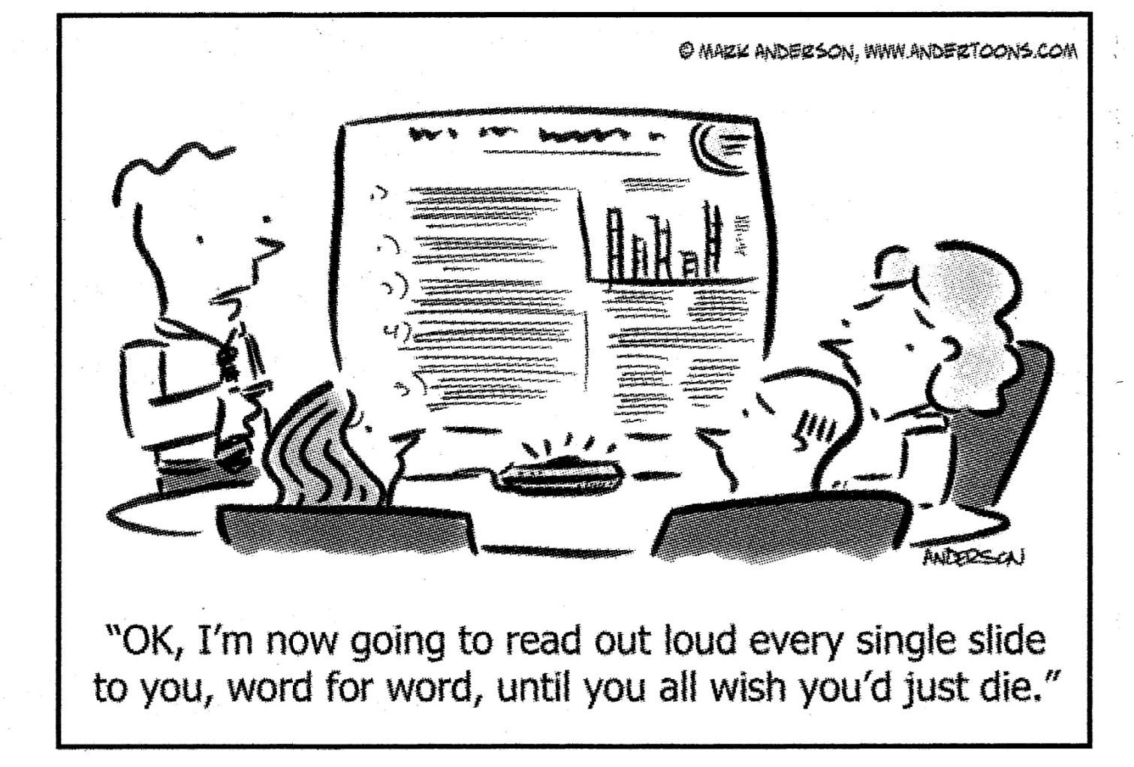
Working Together Today…
Notes:
We have a great program for you today, complete with trainers and hands on practitioners who can lend their subject-matter expertise to our discussion about getting started with solar in your communities. We’ve built in activities and discussion points throughout this agenda so we can learn from each other. Each person in this room brings a unique perspective to what it takes to accelerate deployment of solar in your communities, and we all will benefit from hearing from you. So please bring your clarifying questions and comments to the fore as we move through the day’s activities. We’ll do our best to address your questions, and for those that we aren’t able to get to during the program, please follow up with us in person during breaks over the course of the day, or later in the week by email.
Some other ground rules…
Respect diverse viewpoints - we intend to foster a safe learning environment based on mutual respect
Turn off your cell phone and be aware of the emergency exits

Slide 8
Introductions
In pairs, interview each other (2 minutes each)
In group, volunteer some of your responses
What is your name?
Where do you live?
For what agency/organization do you work?
Why did you choose to enroll in today’s workshop?
What is the biggest challenge you believe you face in making your community more solar-friendly?
Notes:
In order to work well together, we need to get to know each other. So to begin, let’s spend a few minutes talking with each other about why we’re at this workshop and what we expect to get out of it.
[After groups complete their introductions, ask the group for some responses to questions 4 and 5, record them on the flip chart.]

Slide 9
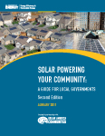
On Your Radar…
Solar Powering Your Community: A Guide for Local Governments (2011)
The U.S. Department of Energy developed this comprehensive resource to assist local governments and stakeholders in building sustainable local solar markets. The guide introduces a range of policy and program options that have been successfully field tested in cities and counties around the country.
Today’s workshop presentation & notes will be posted here:
www.SolarAmericaCommunities.Energy.Gov/Resources
Notes:
One resource that we will be frequently referencing throughout this morning’s sessions is Solar Powering Your Community: A Guide for Local Governments. This guide is a compilation of the case studies and best policies and practices coming out of the Solar America Cities program. If you bring anything back to your staff members, we hope you’ll bring this. It’s a great resource for them to draw upon as they look to setting at designing and implementing local solar initiatives.

Slide 10
Intro to Solar Technologies

Slide 11
Three Common Solar Technologies
photovoltaic
concentrating solar power
solar heating & cooling/ solar hot water (“solar thermal”)
PV
CSP
SHC/
SHW
Notes:
The three prevalent solar technologies that have been developed to convert the sun’s resources into usable energy are photovoltaics, concentrating solar power, and solar heating & cooling/solar hot water (commonly referred to as ‘solar thermal’).
Photovoltaics use the sun’s light to create direct current electricity.
Concentrating solar power uses the sun’s light to create thermal energy. CSP is also sometimes called CST or concentrating solar thermal. It also creates electricity.
Solar thermal applications take the sun’s heat and transfer it directly to air or fluids for a variety of purposes.
We’ll explore these three technologies in just a little more detail.

Slide 12
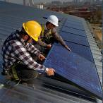
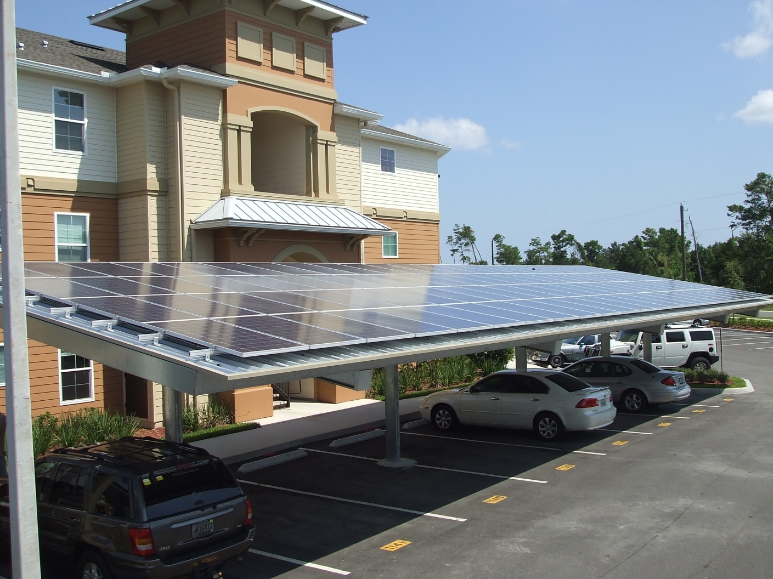
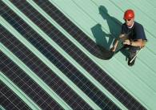
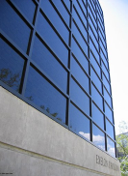
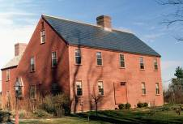

Photovoltaic (PV) Solar Energy
Directly generates electricity from sunlight
Different types you might come across
Building Integrated PV (BIPV), another type
Source: NREL
Crystalline silicon
Thin-film
Source:
www.ecofriend.org
Shingles
Skylights
Architectural glass and granite like materials
Photo Source: NREL http://www.nrel.gov/data/pix/
Notes:
Details about specific types of PV are included in the Appendix.
Building-integrated photovoltaics (BIPV) are PV materials that are used to replace conventional building materials in parts of the building envelope such as the roof, skylights, or facades. They are increasingly being incorporated into the construction of new buildings as a principal or ancillary source of electrical power, although existing buildings may be retrofitted with BIPV modules as well.
The advantage of integrated photovoltaics over more common non-integrated systems is that the initial cost can be offset by reducing the amount spent on building materials and labor that would normally be used to construct the part of the building that the BIPV modules replace. These advantages make BIPV one of the fastest growing segments of the photovoltaic industry.

Slide 13
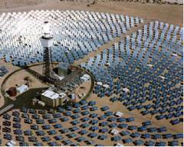
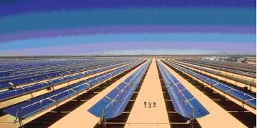
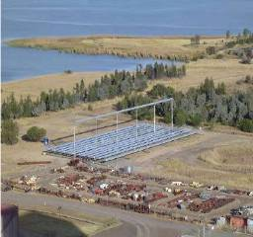
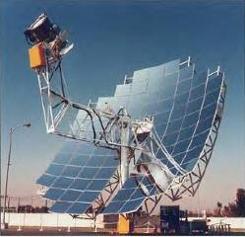
Concentrating Solar Power (CSP)
Central Receiver or Power Tower
Parabolic trough
Compact linear Fresnel reflector
Parabolic – dish engine
Source EPRI and NREL
Notes:
Concentrated solar power (CSP) are systems that use lenses or mirrors to concentrate a large area of sunlight, or solar thermal energy, onto a small area. Electrical power is produced when the concentrated light is converted to heat which drives a heat engine (usually a steam turbine) connected to an electrical power generator. CSP works best in the desert where there is lots of direct sunlight, typically in the southwest region of the U.S.
CSP should not be confused with photovoltaics, where solar power is directly converted to electricity without the use of steam turbines. The concentration of sunlight onto photovoltaic surfaces, similar to CSP, is known as concentrated photovoltaics (CPV).
A study done by Greenpeace International, the European Solar Thermal Electricity Association, and the International Energy Agency's SolarPACES group investigated the potential and future of concentrated solar power. The study found that concentrated solar power could account for up to 25% of the world's energy needs by 2050. The increase in investment would be from 2 billion euros worldwide to 92.5 billion euros in that time period. Spain is the leader in concentrated solar power technology, with more than 50 projects approved by the government in the works. Also, it exports its technology, further increasing the technology's stake in energy worldwide. Because of the nature of the technology needing a desert like area, experts predicted the biggest growth in places like Africa, Mexico, the southwest United States. The study examined three different outcomes for this technology: no increases in CSP technology, investment continuing as it has been in Spain and the US, and finally the true potential of CSP without any barriers on its growth.

Slide 14
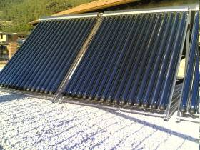
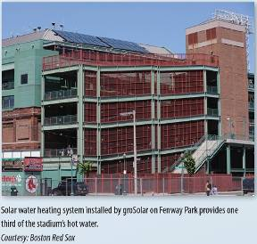
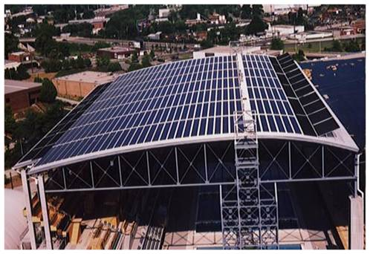
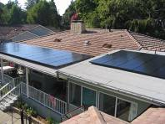
Solar Heating & Cooling/
Solar Hot Water (SHC/SHW)
Solar energy used to heat water or other medium
Applications
Solar pool heating
Domestic hot water use
Process hot water
Space heating
Solar assisted cooling
Notes:
The solar heating & cooling/solar hot water energy is the direct transfer of heat to fluids or air for residential, business and industrial uses. Solar pool heating uses low temperature solar collectors to heat swimming pool water and is probably the most cost effective solar application of this type. Domestic hot water applications on homes and businesses are also very cost effective and have been around for centuries! Process hot water, space heating and solar assisted cooling are more advanced solar technologies and incorporate higher temperature collectors and combine them with other mechanical equipment for the desired end use. [and here we see some examples of these technologies…]

Slide 15
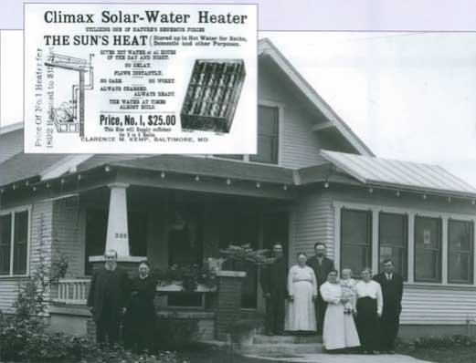
Notes:
Technologies that take advantage of the sun’s energy to heat, cool and generate electricity have been around for many years.

Slide 16

Solar in Context
Source: www.nextgenpe.com
Notes:
While our focus today will primarily be on the advantages of solar electric technologies and the trends and opportunities that exist in today’s solar market, it is important for local and regional governments to bare in mind that solar is one among many renewable sources of energy, and that the first step towards a more sustainable energy future should be exploring opportunities to adopt systems that operate more efficiently.

Slide 17

Session 1:
Dispelling the Myths and Communicating the Benefits of Solar
Chad Laurent, Meister Consultants Group
chad.laurent@mc-group.com
Notes:
I imagine that through the course of your work and even in your daily personal life amongst family and friends, you come across naysayers to solar – these are people who you care about (whether for personal or professional reasons or both), and I also imagine you would want to help them understand – and eventually embrace – the idea that solar offers real and positive opportunities for their community.
So in this section we present look at the many benefits that solar offers to local communities. We hope that you can use this evidence-based information to present the positive attributes about solar when you return to the communities where you live and work.

Slide 18

Every hour, enough solar energy strikes Earth to power human activities for over a year.
U.S. Department of Energy
Solar Energy Technologies Program
Notes:
Solar energy is really a simple concept. It is energy that is derived from either sun’s light or the sun’s heat. These are two very distinct processes that result in the production of either thermal energy or electrical energy. It is also possible to use both the sun’s light and heat together as you will see in later in this presentation. Energy from the sun that is converted into thermal or electrical energy.

Slide 19
Why Isn’t Solar More Widely Adopted?
Notes:
Development of solar projects in the US has faced many different types of impediments. The next slides will highlight the most common barriers.
For future widespread development of solar power in the US, it is crucial that cities recognize and learn from barriers that have been present in other parts of the country, and develop strategies to overcome these hurdles.

Slide 20
Solar Myths
Notes:
These are some of the myths that we’ve heard as we’ve worked in the industry, including some that have come up in educational sessions like this one.

Slide 21

Part of your role as a local solar champion is dispelling these myths.
Notes:
In the following section, we offer scientific evidence to bust the various myths that exist about solar. You will no doubt find yourself among naysayers and others who you want to engage in discussions about bringing more solar to your community. As the solar champions in your community, here’s messaging that we can arm you with different approaches for different stakeholders.
We hope you find this series of data and talking points as a useful tool for busting solar myths.

Slide 22
Myth:
Solar is too expensive!
Notes:
22

Slide 23
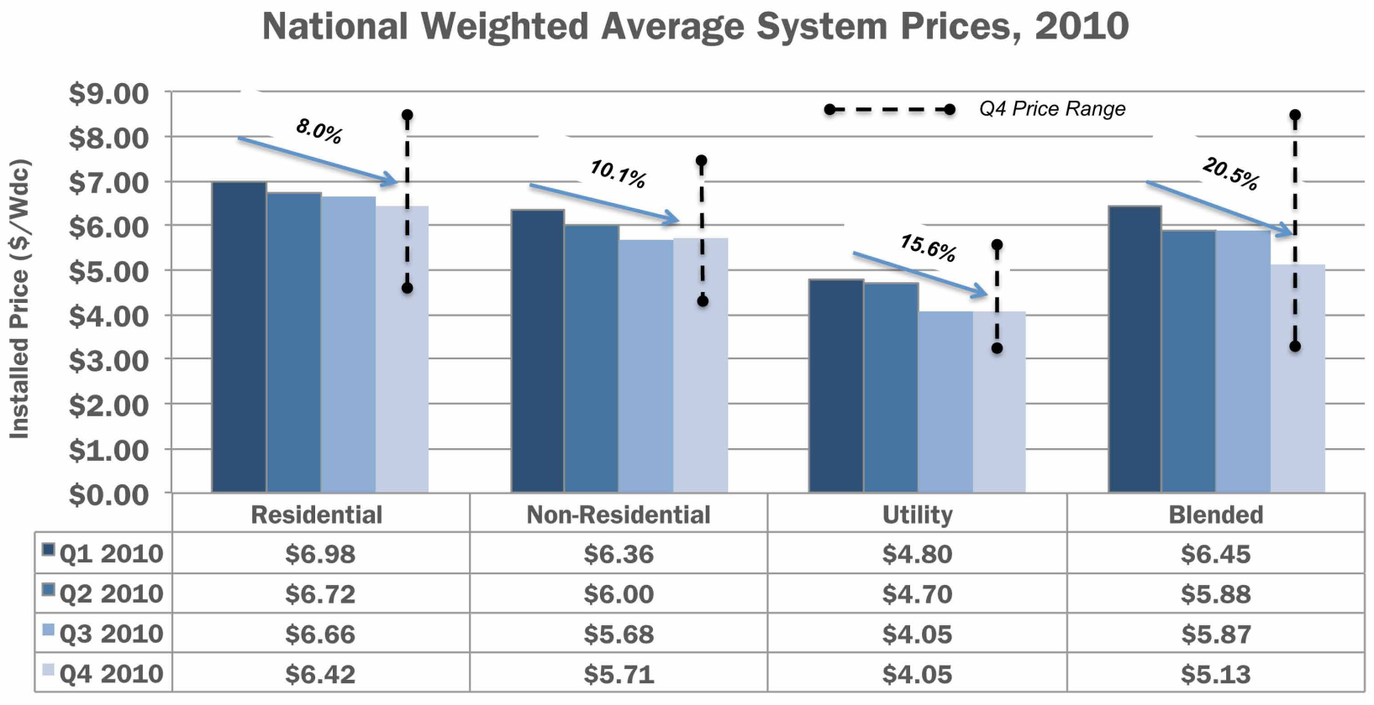
The Cost of Installing PV is Decreasing Rapidly
FACT:
National Weighted Average System Prices 2010
Source: U.S. Solar Market Insight: 2010 Year in Review Executive Summary. Solar Energies Industry Association and GTM Research
Notes:
National weighted-average system prices fell by 20.5% over the course of 2010, from
$6.45/W to $5.13/W. Much of this decline was due to a shift toward larger systems,
particularly utility systems, in the fourth quarter.
The U.S. PV market remains highly disaggregated, resulting in a wide range of installed
prices even within a given state, market segment, and quarter. Figure 2-7 displays the
range of installed system prices in the fourth quarter of 2010. Residential systems
were installed in certain locations (particularly Colorado and Arizona) at prices below
$5.00/W, but other locations saw residential system prices over $8.00/W. Non-residential installations ranged from $4.11/W to $7.31/W. Utility installations show the most variability, largely due to the choice between low- and high-efficiency modules and between fixed and tracking mounting structures. Over time, it is possible that maturation of the U.S. market will bring more consistency to system prices both within and across states.

Slide 24
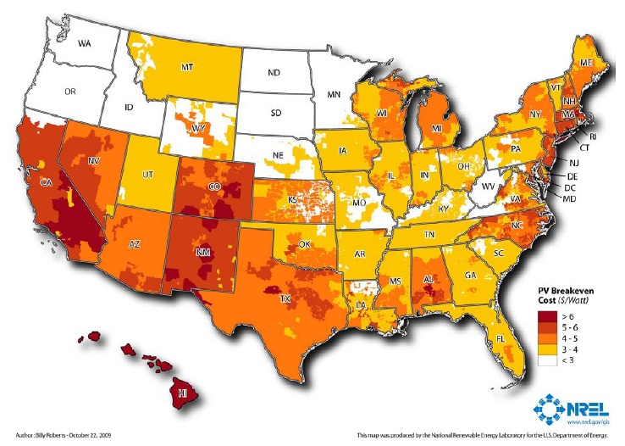
Solar is at or near grid cost parity:
Residential PV Breakeven Cost in 2015 ($/Watt)
FACT:
[most common rate structure and federal ITC]
Notes:
Source : Break-Even Cost for Residential Photovoltaics in the United States: Key Drivers and Sensitivities
Paul Denholm, Robert M. Margolis, Sean Ong, and Billy Roberts, Technical Report , NREL/TP-6A2-46909, December 2009
http://www.nrel.gov/docs/fy10osti/46909.pdf
Figure 6. Residential solar PV break-even cost ($/W) in 2015 using the base-case assumptions in Table 1 and the most common rate structure.
This map actually does not include state incentives, but does include the federal tax credit, modest electricity price escalation (3% total), and a carbon price of $25/ton.
The 2015 case shows a dramatic reduction in the break-even cost of PV where local incentives existed in early 2009. Alternatively, in locations where no incentives existed in early 2009, the assumed electricity price escalation increases the break-even price. In this case, 43% of residential electricity sales are in utilities where break-even conditions occur for some customers when PV system costs $4/W. At $3/W, 85% of residential electricity sales are in utilities where some customers are at break-even cost.

Slide 25
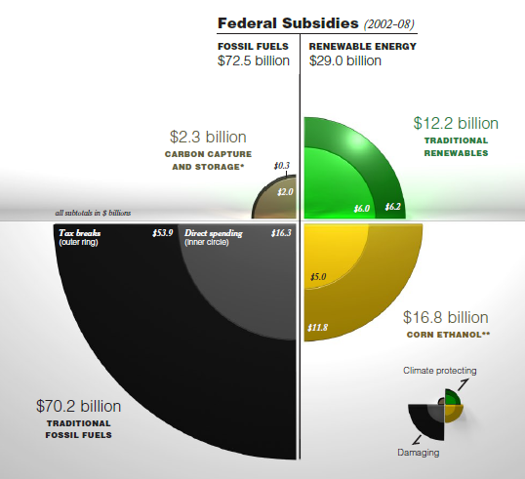
Source: Environmental Law Institute
Notes:
Policies and subsidies drive price and fossil fuels receive enormous amounts of federal subsidies.
See: http://www.elistore.org/Data/products/d19_07.pdf
25

Slide 26
Myth:
Solar technology is immature and inefficient!
Notes:
26

Slide 27
Solar technologies have matured and are becoming more efficient
FACT:
Life expectancies of solar systems are now 25-30 years
Solar heating technology has achieved vast improvements
Equipment certification requirements are common
PV: UL-1703, CEC
Solar Thermal: SRCC OG-100, OG-300
Inverters: UL -1741, CEC
Notes:
Solar has been around for 50 years….
It is quite common for solar modules to carry a 20 year warranty, inverters to carry a 5-10 year warranty, and have a 2 year warranty on parts and labor. Most incentive programs have specific installation and equipment requirements. The federal tax credit requires that solar water heating systems be SRCC certified, or carry a comparable certification.
One additional system not included here (not used much if at all in the U.S. to our knowledge): IEC 61215 or 61646, actually incorporated into the CEC process for listing eligible equipment. For further information see the CEC equipment guidelines at the link below.
http://www.energy.ca.gov/2008publications/CEC-300-2008-007/CEC-300-2008-007-CMF.PDF

Slide 28
Myth:
Solar takes more energy to produce than it produces!
Notes:
28

Slide 29
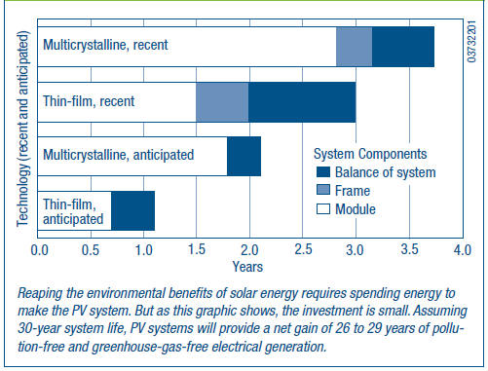
PV modules produce FAR more energy than is consumed in manufacturing them
FACT:
Energy payback for rooftop PV
Source: NREL, PV FAQs, What is the Energy Payback for PV
Notes:
“Energy payback” of PV systems = 1-4 years depending on the technology used
Solar facility lifetime may be ≥ 30 years
Analyses vary, but recent ones suggest even shorter payback times
“Energy payback” of PV systems (modules, frame, and balance of system) from 1 – 4 years depending on the technology used
NREL FAQ: http://www.nrel.gov/docs/fy05osti/37322.pdf (FAQ is from 2004, but it stands to reason that as module efficiency increases and manufacturing efficiency increases, the payback numbers would fall lower still.) For ground mounts, one calculation of the payback for the ground mounting system (concrete foundations and heavy framing) was 3 -5 months, about the same as the mounting systems for Energy payback estimates for rooftop PV systems are 4, 3, 2, and 1 years: 4 years for systems using current multicrystalline-silicon PV modules, 3 years for current thin-film modules, 2 years for anticipated multicrystalline modules, and 1 year for anticipated thin-film modules (see Figure 1). With energy paybacks of 1 to 4 years and assumed life expectancies of 30 years, 87% to 97% of the energy that PV systems generate won’t be plagued by pollution, greenhouse gases, and depletion of resources.
Based on models and real data, the idea that PV cannot pay back its energy investment is simply a myth. Indeed, researchers Dones and Frischknecht found that PV-systems fabrication and fossil fuel energy production have similar energy payback periods (including costs for mining, transportation, refining, and construction).

Slide 30
Myth:
Solar is only for tree-huggers!
Notes:
30

Slide 31
Solar is for Everyone
FACT:
94% of Americans want to see more solar!*
Emergency Response Units
Military
Large Retailers
Financial Institutions
*Source: Schott Barometer:
http://www.us.schott.com/english/news/index.html?NID=358
Notes:
Solar is for Everyone – NOT just for tree-huggers.
The Air Force is negotiating contracts for ~500 MW solar power within the next 3 years, including installations at Nellis AFB, Camp Pendleton, and in Stuttgart, Germany.
States and localities are integrating solar in their emergency plans:
In Montana, 20 PV solar systems totaling 47.5 kW of capacity have been installed on fire stations within North Western Energy’s Montana service territory.
In Boston, the City is installing a Solar Evacuation Route.
Solar is more frequently being used on highways – in Oregon, the intersection of I-5 and I-205 is lined with a 104 kW solar installation.
Major retailers such as Kohl’s and Walmart are installing solar because it makes financial sense, and displays an environmental commitment
Banks like Wells Fargo have become comfortable enough with solar to begin a variety of different financing programs, including partnerships and equity investments in large projects, and equipment leasing arrangements with existing commercial customers.
Bank of America has been heavily involved in tax credit bond issuances/purchases.

Slide 32
Myth:
Solar doesn’t work in my part of the country.
Notes:
32

Slide 33
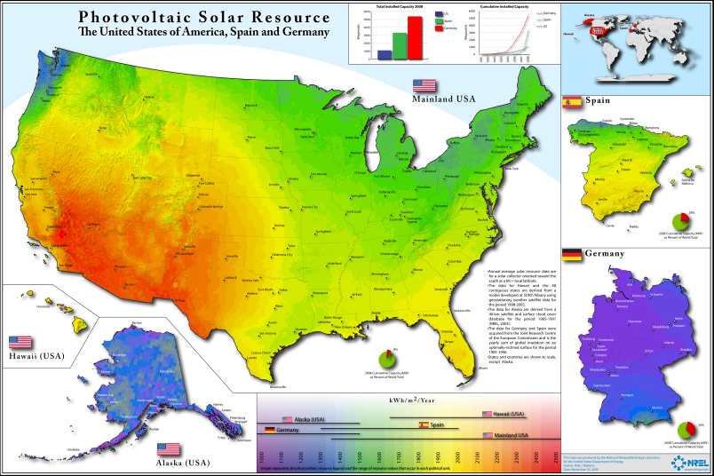
Solar works in all parts of the continental U.S.
FACT:
Source: http://www.nrel.gov/gis/images/us_germany_spain/pvmap_usgermanyspain%20poster-01.jpg
Notes:
Comparison between continental US and Germany and Spain. Germany has the world’s largest solar market and gets nearly 2% of its total electricity from solar. The US, on the other hand, sits around .01%. Germany has installed 17,000 MW and the entire US, 1,000. And Germany isn’t particularly sunny! In addition, Germany expects more jobs to be had in the renewable industry than the automotive industry within the next decade.

Slide 34
Myth:
Today’s solar technology will be obsolete tomorrow!
Notes:
34

Slide 35
FACT:
Solar
TV or IPod
Electricity produced today is the same as electricity produced by a new generation of panels!
Notes:
PV modules are rated to produce at 80% output after 25 years. The basic function of a PV panel will not change, although incremental improvements in efficiency and cost will take place. However, the types of improvements in capability and service that we see in computers don’t apply to PV. What you get from a 1980’s solar panel and a 2010 solar panel is the same thing. What you got from a 1980’s computer and 2010 computer is dramatically different.
If it makes financial sense right now, why not make the investment. Better technology tomorrow does not make your investment any worse. You’re basically weighing opportunity cost of beginning saving money now vs. the opportunity cost of waiting to possibly earn a better return at a later date. There is risk associated with that because you don’t know exactly what the future will hold (e.g., will declines in cost equal declines in incentive levels?).
One great thing about PV is that it is modular. Many people start small and make additions over time.
35

Slide 36
Myth:
It won’t add to the value of my home.

Slide 37
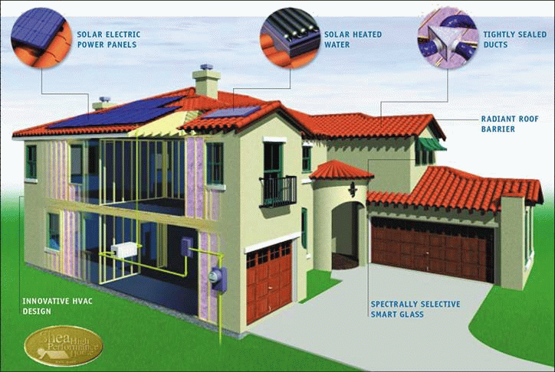
Beauty is in the eye of the beholder, however, the National Renewable Energy Laboratory (NREL) found that: solar homes sold 20% faster, and for 17% more than the equivalent non-solar homes, across several subdivisions built by different California builders.
FACT:
Source: NREL
Source: NREL
Notes:
While this is a limited study, it and other studies have shown that solar systems do not inherently decrease the value of a home, rather they can actually add value.
See: http://www.nrel.gov/docs/fy07osti/38304-01.pdf
37

Slide 38
Myth
Solar takes up too much land!

Slide 39
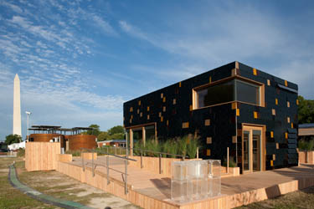
FACT:
RPS and goals can be met with small distributed generation and rooftop pv systems. CA potential of rooftop PV alone is enough to meet 33% goals.
Germany has installed 17,000 MW without any deserts and the vast majority is on rooftops.
Source: Solar Decathlon 2010 http://www.solardecathlon.gov/past/2009/gallery_homes.html#Germany
Notes:
Studies show that California's ENTIRE RPS, for example, could be met just with decentralized PV. To meet California's target of 33 percent renewables by 2020, about 2,000-2,500 megawatts of PV would have to be installed each year. Even with its small size and low solar insolation, Germany installed about 3,000 MW of mostly decentralized PV in 2009 alone—and in 2010, about 6,500 MW of distributed PV. Studies of distributed PV potential in California have found more than enough capacity on rooftops to meet the RPS, and have also identified 27,000 MW in ground-mounted capacity near rural transmission stations.
39

Slide 40
More Community Benefits to Going Solar
Adds jobs
Improves national and local economies
Yields positive investment returns
Helps achieve environmental, energy goals
Mitigates land use issues
Can integrate with clean transportation infrastructure
Strengthens energy infrastructure
Notes:
Some of these benefits are rather obvious as we just discussed – among them that they’re clean sources of power and can bring much-needed revenue and jobs to local communities that embrace solar.

Slide 41
15 Minute Break
Notes:
41

Slide 42
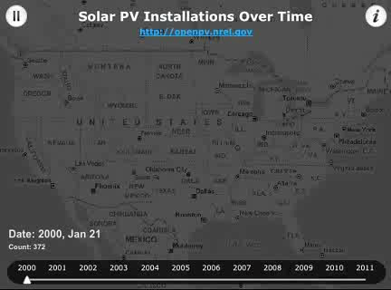
Notes:
This is a Time Mapper of PV installations being installed across the U.S. through time. Created and maintained by NREL, three "layers" are used to convey different features of the Open PV database. The first "layer" consists of 200 points that represent the current PV installations happening at the current time. The second "layer" is a heat-map that shows the current intensity of installations. This "layer" slowly cools off as the intensity of installations fades over time. Finally, a third "layer" acts a map of existing PV installations. Each PV installation is plotted on the third "layer" so that as time passes a visual sense of PV density is portrayed.

Slide 43
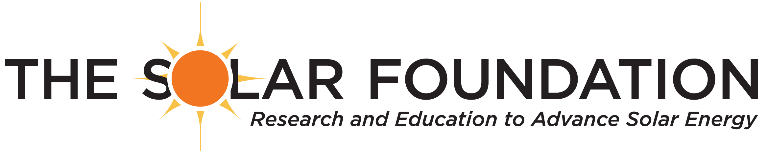
Session 2:
Creating Value for
Your Region with Solar
Andrea Luecke, Acting Executive Director
andrea.luecke@solarfound.org
www.TheSolarFoundation.org
Notes:
The Solar Foundation (TSF) is a national 501(c)(3) nonprofit working to demonstrate the global benefits of solar energy through research and education. Founded in 1977 and based in Washington, DC, TSF is increasing the widespread adoption of solar energy and transforming the marketplace through its coordinated public education & outreach efforts, high-level data collection, and innovative research. TSF plays a key role on the Solar America Communities team, is a contractor to IREC on the Solar Instructor Training Network, and is the charitable research and education arm of the Solar Energy Industries Association (SEIA).
Andrea Luecke is responsible for developing and implementing national educational initiatives and high-level research that promote the widespread adoption of solar energy. Ms. Luecke played a key role in authoring and releasing the National Solar Jobs Census 2010 and is currently playing a leadership role on two long-term U.S. Department of Energy programs: Solar America Communities and the Solar Instructor Training Network. Ms. Luecke is regularly asked to present on practical "best practice" approaches to widespread solar deployment at the national and international levels
Practical approaches. There are challenges to regional coordination – but, as regional councils, you are in a position to really address some of the issues that individual jurisdictions face.
First, I am going to talk about what a city or region can do to remove barriers to solar . Second, I am going to provide some examples of some of the efforts that have been led by a few Solar America Cities. Third, I am going to talk about how regional coordination has its advantages to scaling up solar. Last, I am going to introduce a new funding opportunity by the DOE – that is specially designed to mobilize regions to take a comprehensive and coordinated approach to going solar.

Slide 44
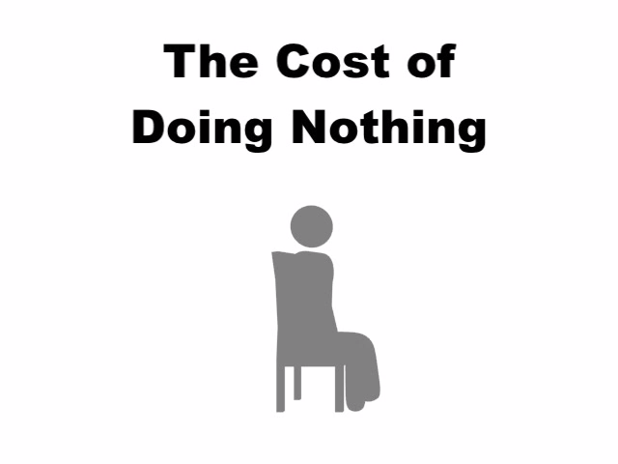
http://www.vimeo.com/14676549
Source: Florida Solar Energy Center
Notes:
There IS a cost to doing nothing…
6 minute video created by Florida Solar Energy Center

Slide 45
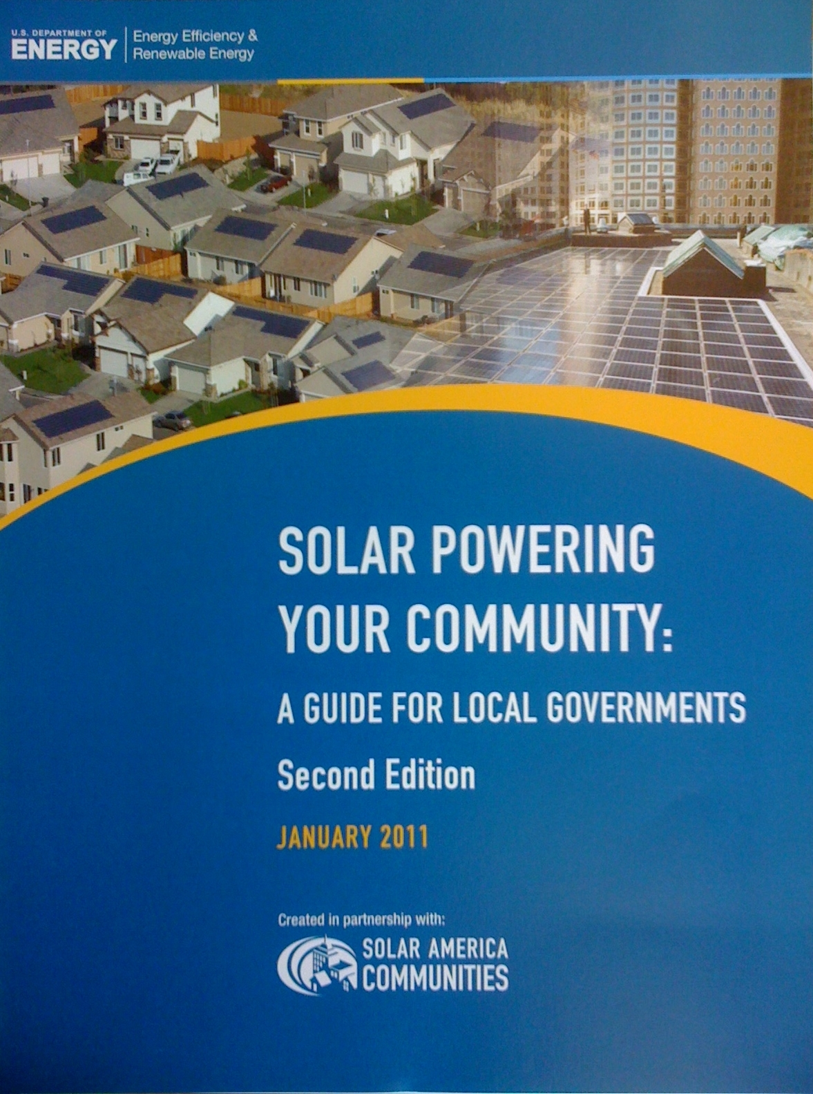
Solar Powering Your Community: A Guide for Local Governments (2011)
The U.S. Department of Energy developed this comprehensive resource to assist local governments and stakeholders in building sustainable local solar markets. The guide introduces a range of policy and program options that have been successfully field tested in cities and counties around the country.
Published by U.S. Department of Energy: http://solaramericacommunities.energy.gov/resources/guide_for_local_governments/
Notes:
45
The U.S. Department of Energy developed this comprehensive resource to assist local governments and stakeholders in building sustainable local solar markets. The guide introduces a range of policy and program options that have been successfully field tested in cities and counties around the country.

Slide 46
Remove Barriers to Solar
Codes and Regulations
Train building department
Create solar ready buildings guidelines/code requirements
Financing
Investigate how to make solar more affordable
Consider offering financing options
Revise solar access laws
Amend zoning regulations
Improve permitting process
Work with other local governments or state to increase availability of financing
Publicize, Inform and Update
Notes:
The Guide discusses the role of regional councils and/or AHJs (authorities having jurisdiction) in removing barriers to solar. This slide shows you some of the things you can do.
46

Slide 47

Establish Advisory Committee
Comprehensive and Coordinated Effort
Notes:
It doesn’t matter if you represent a regional consortium or an individual jurisdiction – the creation of sustainable local solar market requires comprehensive and coordinated effort among many stakeholders. Time spent planning and analyzing at the outset is well worth the effort when designing the policies and procedures to serve as the legal and economic framework for solar energy in you community.
47

Slide 48
TEAM
Universities/
Colleges
Regional Planning Councils
Environment Groups
Solar Industry
Local Government
Utilities
Banks
Attorneys
Economic Development Councils
Businesses
Concerned Citizens
State Energy Office
Notes:
A good starting point is to build a diverse advisory committee or task force that includes a broad cross section of the community.
Your team should include: local government, utilities, universities and community colleges, local for-profit companies, banks, energy attorneys, solar or environmental nonprofits, state energy offices, economic development councils, incentive program administrators, concerned citizen groups, etc.
The earlier you bring them in – the better. The goal is to create “buy-in” so that the solar program has long-term viability. The role of the task force or advisory committee is to help develop a sustainable work plan and leverage resources. Get their “buy-in” – often a written letter of commitment works. At the minimum, they should commit to providing in-kind advisory services.
Once your committee is established you will need to determine who the lead organization will be. The lead should be established as community solar hub/resource for all things solar and dedicate staff to the process. If money to fund a staff person is a problem – ask your stakeholders to pool their resources.
Be flexible so you can add to or segment the advisory committee as needs arise.
Task force should meet regularly – every month for the first year, quarterly after that.
48

Slide 49
Assess Region
Assess solar policy environment
Conduct surveys to identify barriers
Establish installation baseline and targets
Notes:
The next thing you will want to do – if you haven’t already – is assess your community. Again, when you assess the community, it should be done in a comprehensive and coordinated way.
Look at policies. What pro-solar policies do you have and which ones are you lacking?
Conduct surveys to identify barriers and your region’s strengths and weaknesses. Be open to the suggestions of local installers, industry, and other stakeholders.
Think about your economic development strengths and consider building off of them:
Is your region known for its manufacturing legacy?
Is your region particularly sunny and, therefore, great for installer workforce development?
Is your region known for its top universities?
Is your municipality or state energy office known for being unusually progressive?
Or, alternatively, think about your weaknesses and consider building off of them:
Does your region lack a local installer workforce?
Does your state have a high RPS, but no solar rebate programs?
Figure out what your installation baseline is and what your installation goals should be. To figure out your baseline, you will likely have to compile data from multiple sources.
Goals will vary! Don’t feel discouraged if your goals seem modest compared to other communities. Remember, every community has a different starting point and conditions.
49

Slide 50

Create Plan
Short-Term Plan Integration
  Encourage regulatory access to solar
  Develop guidelines for solar-ready buildings
  Amend zoning regulations
  Streamline permitting processes
  Train code officials on solar
Long-Term Plan Integration
  Solar Plan, Energy Plan, Comprehensive Plan
Get involved in community visioning and long-range goal setting
Notes:
Then you will want to create your plan –
It cannot be emphasized enough how TIME spent planning and analyzing in the beginning is well worth the effort because the plan that you eventually come up with will serve as the legal and economic framework for solar energy in you community.
When developing your plan – think about the low hanging fruit – the easy – or easier - stuff that you can accomplish in a year or so – like training code officials or creating a manual or guide to help streamline and quicken the permitting process – and also think about the long-term goals (like getting solar incorporated into the comprehensive plan or making changes to zoning or building codes) – these goals can take years or require state approval.
Long term planning is important because comp plans, for example, have a longer shelf life than most elected officials (who come and go) – thus creating a stable market – which investors and business owners love.
Finally, determine how to measure and track progress. And, of course, make adjustments to your plan along the way.
GET INVOLVED IN ANY AND ALL COMMUNITY VISIONING EXERCISES and ANY DISCUSSIONS ABOUT SETTING GOALS
50

Slide 51

Execute: Salt Lake City
Solar Implementation Plan - Solar America City – Salt Lake
Notes:
Examples of how some Solar America Cities have executed their plan – what they have focused on –
About The Solar Salt Lake Project
The Solar Salt Lake Project is led by a partnership among Salt Lake City, Salt Lake County, Utah Clean Energy, and other stakeholders (see below) whose goal is to significantly drive the use of solar energy throughout Salt Lake Valley over the next eight years and beyond. With roughly 40% of Utah's 2,500,000 residents living within the boundaries of Salt Lake City and Salt Lake County, and given the area's excellent solar resources, the Solar Salt Lake Project has the potential to significantly impact the development of solar energy in the state of Utah.
Goal
The Solar Salt Lake Project has recently completed a fully-scoped city and county-level Solar Implementation Plan to facilitate at least 10 megawatts (or an additional 10,000 solar PV systems) of new solar photovoltaic (PV) installations in the government, commercial, industrial, and residential sectors by 2015.
51

Slide 52
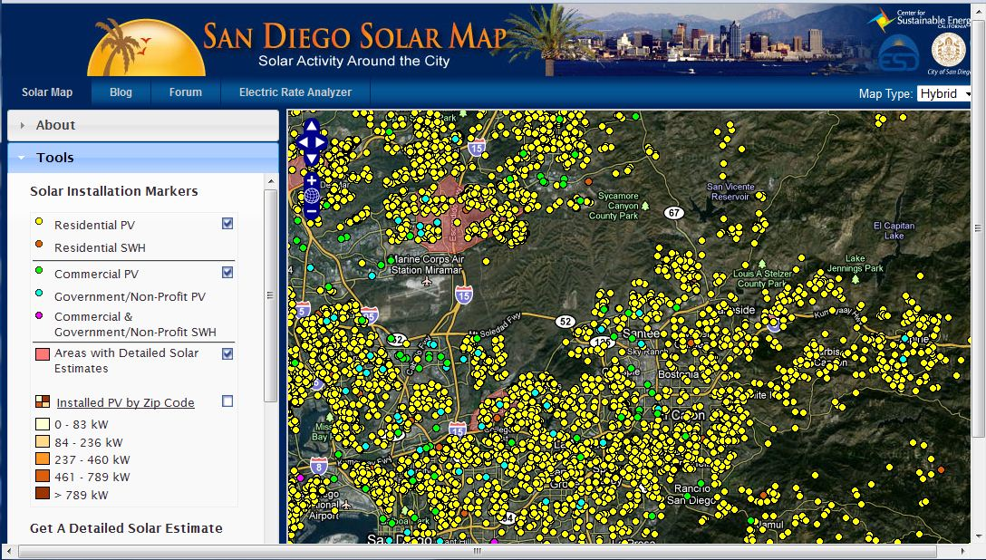
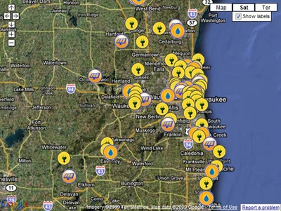
Execute: San Diego/Milwaukee
Solar Maps. Solar America City – San Francisco: http://sf.solarmap.org/
Solar America City – Milwaukee: http://city.milwaukee.gov/milwaukeeshines/Map.htm
Notes:
Many Solar America Cities have created solar maps to raise awareness about solar.
Showcasing existing solar energy installations through online solar mapping tools is a mechanism that is growing in popularity.
The City of San Francisco, San Diego, Madison and Boston have beautiful, sophisticated (but pricey) solar maps.
The City of Ann Arbor and the City of Milwaukee have created maps in Google for FREE!
This is a great project for a summer intern.
To create your free solar map in Google click here: http://maps.google.com/support/bin/static.py?hl=en&page=guide.cs&guide=21670&topic=21676&from=21676&rd=2
52

Slide 53

Execute: Portland, OR
One-Stop Website: Solar America City – Portland, OR
Notes:
City of Portland and their partners were innovative and created Solar NOW!, a statewide solar educational campaign.
Through pooling their resources and expertise, Solar NOW! put together media campaigns, workshops, educational displays, events, competitions, and highly visible demonstration projects to help educate the public about solar technologies.
SolarNOW! believes that citizens who are educated about the benefits of solar energy and understand financing options and the installation process are more likely to be interested in purchasing and installing solar technologies in their homes or businesses, which increases local demand for solar energy and helps local governments meet their solar energy goals.
Their website is a one-stop resource for homeowners and businesses interested in going solar.
http://www.solarnoworegon.org/
http://www.sustainableportland.org/bps/index.cfm?c=43478
53

Slide 54
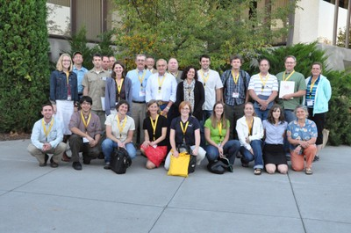
Execute: Portland, OR
Solar Now! University. Solar America City – Portland, OR
Notes:
The 2010 Solar Now! University brought together over thirty municipal and community leaders representing five Eastern Oregon communities for a 3-day conference.
-Topics covered included:
-Solar Technology Basics
-Community Outreach Strategies
-Tax Credits, Incentives & Grants
-Web & Online Resources
-Financing Options
-Permitting & Codes
Solar NOW! Team held conference last fall for community solar champions with another scheduled for Fall 2011
54

Slide 55
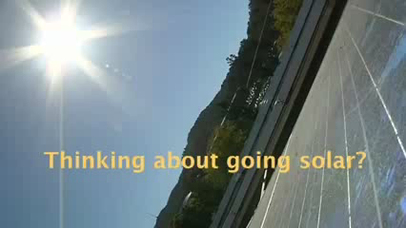
Execute: Marin County, CA
http://www.youtube.com/watch?v=HLHlzLVY9gA
Notes:
This 8 minute interview with Dana Armanino from Marin County, CA was produced by National Association of Counties (NACO). YouTube video: www.youtube.com/watch?v=HLHlzLVY9gA
GoSolarMarin website: http://www.gosolarmarin.com/index.html
Report on Best Practices: http://admin.naco.org/research/pubs/Documents/County%20Management%20and%20Structure/Research%20County%20Management%20and%20Structure/Best%20Practices%20Urban%20Sustainability.pdf
55

Slide 56
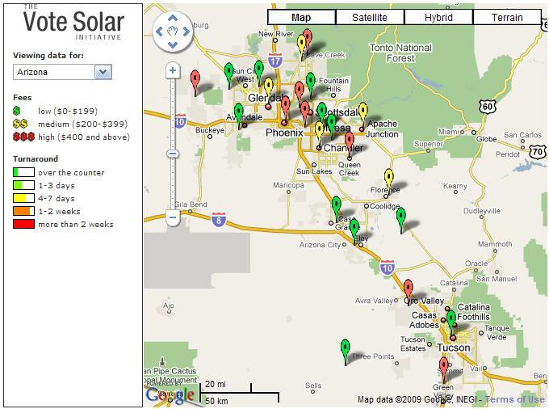
Regional Coordination and Standardization is the Solution!
Notes:
It is not easy to create a solar program in a city or county – let alone initiative a regional solar initiative – but it can be done – and, in fact, it is the solution.
A lot of the barriers that individual jurisdictions face – regions also face such as: high up-front cost, lack of financing options, lack of qualified/skilled workforce and/or permitting/inspection staff, outdated local ordinances, lack of awareness, and lack of political support – but one of the biggest issues that regions face in particular is a lack of standards at the state and local level and a patchwork of regulatory processes.
Not having standardized permitting and interconnection processes can really cause problems for contractors that are working across multiple jurisdictions. Considering that neighboring jurisdictions – say the City of San Diego and the City of La Jolla are only 12 miles apart – they very likely follow dramatically different permitting and interconnection processes. Its not a problem if a contractor has only one or two systems to learn, but a lot of installers are working across several dozen jurisdictions – thus making their job unnecessarily complicated and more time consuming – which, in turn, drives up the cost.
Regional Coordination is often difficult – but it can be done! And there are a lot of advantages to it – although they are all very different, many of the challenges individual jurisdictions face are very similar. Recognizing and supporting community individuality while promoting community cooperation and development is paramount to many regional councils. That’s why many take a strategic regional approach to solving issues—by looking at common needs, mutual problem solving helps everyone across the region.
56

Slide 57
Regional Coordination and Standardization is the Solution!
Notes:
PER VOTE SOLAR WEBSITE: http://votesolar.org/tag/municipal/ PV panel prices are falling fast, but that’s not the whole picture. About half of solar’s total price tag comes from non-panel costs, factors like the cost of labor and overhead. Local permitting practices can put a serious damper on that part of the cost equation. The good news is, it’s also very much within the power of the local government (and a city’s residents) to change all that to make solar more accessible. And that’s what our new Project: Permit is all about . . .
First we’re tracking down current practices from around the nation and showcasing them through our interactive online map. By highlighting the real time and cost involved in solar permitting, we will be able to celebrate the cities who get it right and motivate the laggards to improve.
Then we’re helping local partners and solar friends implement best practices in the cities that need it most. Don’t like what you see in your hometown? We have a solar permitting toolkit with the resources you’ll need to convince your mayor and city council to get with the program.
Our campaign kicks-off with sunny Arizona. Thanks to help from our intrepid Vote Solar volunteers and in-state partners (special thanks American Solar Electric), we gathered data on the permitting practices in the major cities and towns.
57

Slide 58
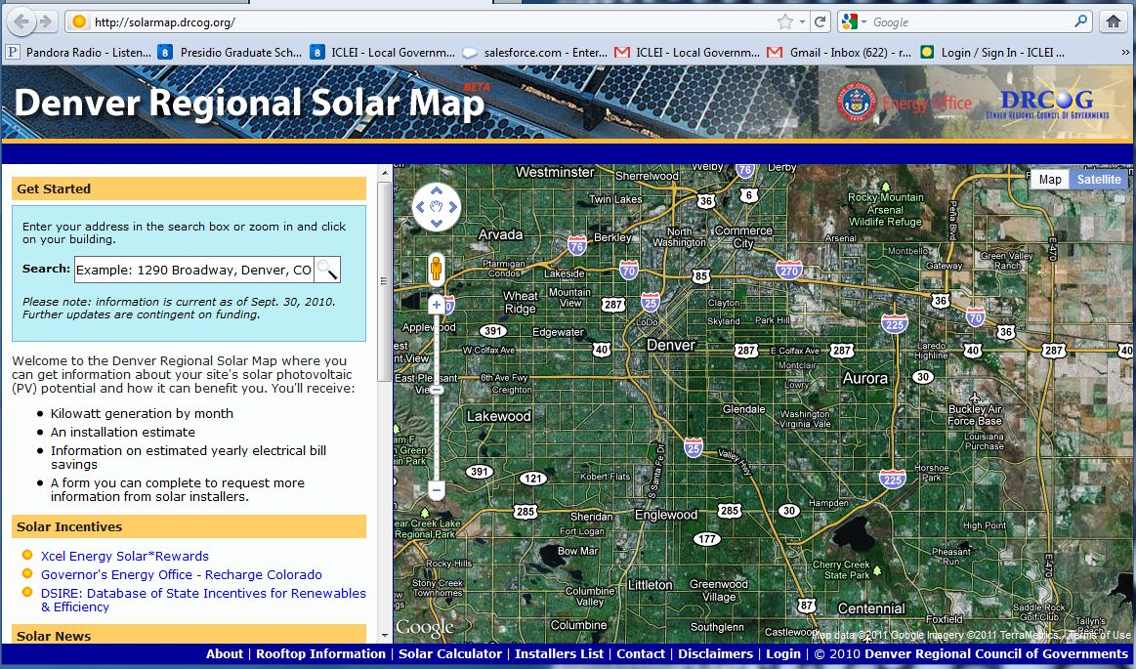
Case Study: Regional Education
Denver Regional Council of Gov’ts
http://solarmap.drcog.org/
Notes:
Map shows:
Kilowatt generation by month;
An installation estimate;
Information on estimated yearly electrical bill savings;
A form you can complete to request more information from solar installers.
The Denver Regional Solar Map – http://solarmap.drcog.org -- is a new website the Denver Regional Council of Governments (DRCOG) developed with funding from a New Energy Economic Development grant through the Colorado Governor’s Energy Office. DRCOG began developing the site March 1, 2010 and launched the site November 12, 2010. The site lets users easily locate their properties and explore the benefits of solar PV installation, and allows solar installers login access to respond to consumer inquiries. DRCOG expects the project to not only bolster adoption of renewable energy in the region, but also create jobs by connecting contractors to building owners. Installers are actively using the site to respond to consumer inquiries. Job creation numbers are pending.
58

Slide 59
Case Study: Regional Education
Denver Regional Council of Gov’ts
http://solarmap.drcog.org/
Notes:
Regional data collaboration and challenges:
The Denver metropolitan area encompasses over 5,000 square miles making it a challenge to find contiguous, detailed geospatial data to support the solar map’s needs. In order to accurately calculate solar PV potential for buildings in the region, DRCOG needed several key datasets to support the application, including digital orthophotography for feature and building identification, LiDAR to quickly identify rooftop obstructions on buildings that would potentially inhibit solar PV panel placement and building footprints where LiDAR information might not exist.
The website is unique in enabling users to immediately calculate maximum potential solar system size, how much electricity a system would generate and potential cost savings. In addition, the site links consumers directly with installers.. The spatial data that drives the application comprises more than 800,000 building footprints. DRCOG developed this data in collaboration with various partners, including many of DRCOG’s 56 member governments that make up the region’s towns, cities and counties. In addition to collecting building footprints directly from local governments, DRCOG also derived footprints from LiDAR data the Denver region collected in 2008 in support of the Democratic National Convention.
59

Slide 60
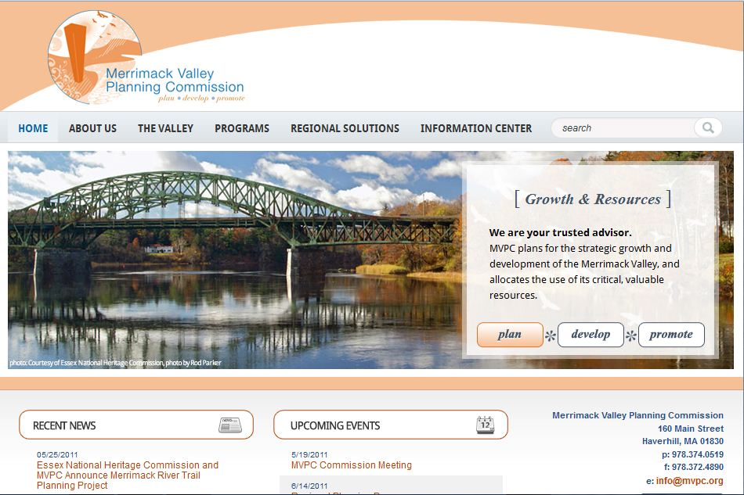
Case Study: Regional Installations
Merrimack Valley Planning Commission
Notes:
Regional planning agency provides planning services to fifteen communities in Northeastern Massachusetts.
MVPC represents 15 individual communities in the region, and has learned that although they are all very different, many of the challenges they face are very similar. Recognizing and supporting community individuality while promoting community cooperation and development is paramount to MVPCs mission. That’s why we take a strategic regional approach to solving issues—by looking at common needs, mutual problem solving helps everyone across the region.
Merrimack recently met with their participating communities and decided upon next steps. They presented the communities with 2 approaches: issuing a regional RFP for solar developers to implement a solar farm with Power Purchase Agreements or issue a regional RFP for a renewable energy manager that can help the communities identify the best projects, obtain local buy in (zoning & community support), develop a PPA RFP based on the community needs determined during the local buy in process, evaluate the RFP responses and help decide on a best developer, negotiate the PPA terms and conditions, and monitor implementation to ensure consistency with community goals. Merrimack recommended option 2 and it was chosen by the participating communities unanimously. They also agreed to serve on an evaluation committee to help decide on the best consultant. They hope to have someone under contract within the next 3 months.
Merrimack Valley: The program evolved through a deliberate process. As a subset to our planning commission a Coalition of Mayors and Managers was established to meet regularly to identify common challenges that could be addressed regionally. One of the challenges was energy management. To get started a regional energy advisor was brought on board by MVPC to help the communities develop energy strategies. During the development of these strategies common needs were identified.
60

Slide 61
Case Study: Regional Installations
Merrimack Valley Planning Commission
Notes:
(cont… )
The first was a successful regional ESCO procurement and implementation. The second interest was converting closed landfills into solar farms “Brightfields”. To assess feasibility MVPC procured engineering services to conduct “Fatal Flaws” analysis on 11 landfills in the region. Based on results communities interested in realizing any potential decided to bring on, through MVPC, expertise to develop “Brightfields” on their landfills. The process will continue to identify other renewable energy efforts that can be advanced regionally.
Pros: There are 2 major advantages to our program. First is that none of our communities have expertise to pursue the development of solar farms on landfills. This approach allows us to develop regional capacity that the individual communities can access. Not only does it give them access to technical capacity but also creates a point person for their effort. The communities are very focus on delivering municipal services and with downsizing becoming more of the norm there is no local staff that can administer such an effort. The second advantage is one solicitation for services as opposed to 9 (in our case) separate processes and only one contract to administer. It reduces costs and improves efficiency.
Cons: The only disadvantage we have identified is that based on feedback and discussion with potential solar developers, entering into a Power Purchasing Agreement (PPA) will not fit cleanly into a regional bid. Each site is unique and some sites are more attractive than others and the stronger projects should not have to subsidize the weaker projects. There are no economies of scale per se. When we get to the point when a PPA is procured we will need to decide if any joint RFPs are practical. That is why we decided to pursue a regional renewable manager approach versus a regional PPA RFP.
61

Slide 62
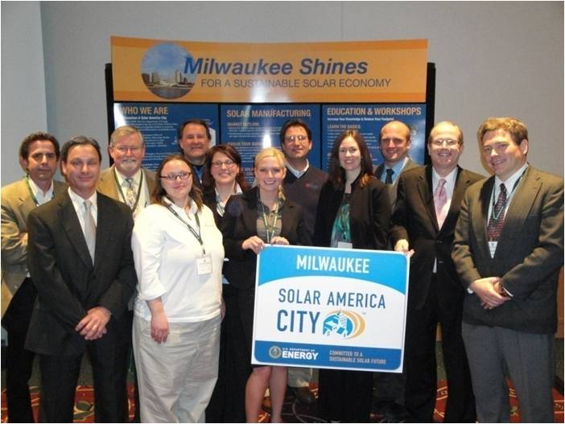
Case Study: Regional Manufacturing
Metro Milwaukee
Notes:
In 2008 Milwaukee was selected as a Solar America City. Milwaukee had Mayor Tom Barrett’s hearty commitment. They also put together a strong advisory committee consisting of:
City of Milwaukee’s Office of Environmental Sustainability (lead)
We Energies (utility)
Focus on Energy (state public benefits fund)
Johnson Controls (local for-profit)
Midwest Renewable Energy Association (installer training provider)
University of Wisconsin-Milwaukee (university)
Milwaukee Area Technical College (community college)
Milwaukee will promote solar thermal and solar-electric technologies by developing:
A robust local workforce and industry
Innovative financing options
Consumer outreach campaigns
Increase the number of local solar installers through assistance in training and preparation for the certification process;
Support solar manufacturing businesses by working with existing manufacturers and by encouraging new businesses to locate in the city
Examine market segments to determine which are most viable for various incentive-based business models
Incorporate non-financial benefits, such as accelerated project permitting, reduced permit fees, and feebates into solar projects.
62

Slide 63
Manufacturing Report
Analyzed 8 Criteria
Existence of solar manufacturing initiatives
Existence of technology firms
Solar Products R&D
Electricity availability and costs
Proximity to market
Availability of manufacturing sites
Workforce
Manufacturing incentives
Source: Solar Products Manufacturing in Milwaukee. CH2MHill, July 2009.
Notes:
Milwaukee metro region is particularly interested in solar components manufacturing and had a report commissioned to explore the feasibility. The report, released in July 2009, analyzed 8 key criteria in Milwaukee…(which can be asked just about anywhere local manufacturing of solar is of interest)
Solar Manufacturing Initiatives –Is there local support?
Base of Tech Businesses – Are there companies familiar with technology manufacturing and experienced dealing with technical industries?
Solar Products R&D –Does Milwaukee have good access to the kinds of technology that is important for ongoing improvement?
Electricity Availability and Costs –Is electricity economical?
Proximity to Markets –Is Milwaukee within reach of its end markets?
Sites –Are land and buildings readily available?
Workforce –Does Milwaukee have an economical and technically experienced workforce?
Incentives for Manufacturing – Is there funding to bridge funding gaps?

Slide 64
Milwaukee Metro’s Advantage
Existing manufacturing and engineering base
Skilled manufacturing workforce
Three university engineering research programs
Abundant, high-quality water supply
Competitive electricity rates
Good transportation/distribution channels and facilities
Public/private enthusiasm and support for creating solar product
Milwaukee-area companies already involved in solar product supply chain
Utility committed to developing solar generation
Federal, state and city incentives
Source: Solar Products Manufacturing in Milwaukee. CH2MHill, July 2009.
Notes:
The report found that the Milwaukee metro area has a natural advantage in becoming a solar hot water cluster
64

Slide 65
Results
Strength and expertise in metals manufacturing that can be leveraged into:
Fittings, valves and tanks
Assembly of frames
Mounting and tracking systems
Experience in electronics can be leveraged into:
Controllers
Inverters
Solar products manufacturing industry is about to enter a long growth phase, BUT…
Source: Solar Products Manufacturing in Milwaukee. CH2MHill, July 2009.
Notes:
65

Slide 66
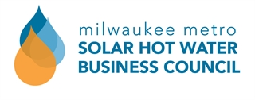
...BUT Milwaukee will need to invest substantial time and effort, recruit the right people, and commit the necessary funding to compete.
Notes:
Thus, the Milwaukee Metro Solar Hot Water Business Council was conceived.
The SHW Business Council was kick-started by recovery act money but is a true metro-wide public/private effort
Missions:
To grow the SHW industry in the Milwaukee seven county (M7) region through the cultivation and education of businesses and manufacturers
To create opportunities for interaction and technical partnerships
To support businesses as they enter the solar hot water manufacturing and supply chain markets
To increase the number of local manufacturers that produce solar hot water components
66

Slide 67
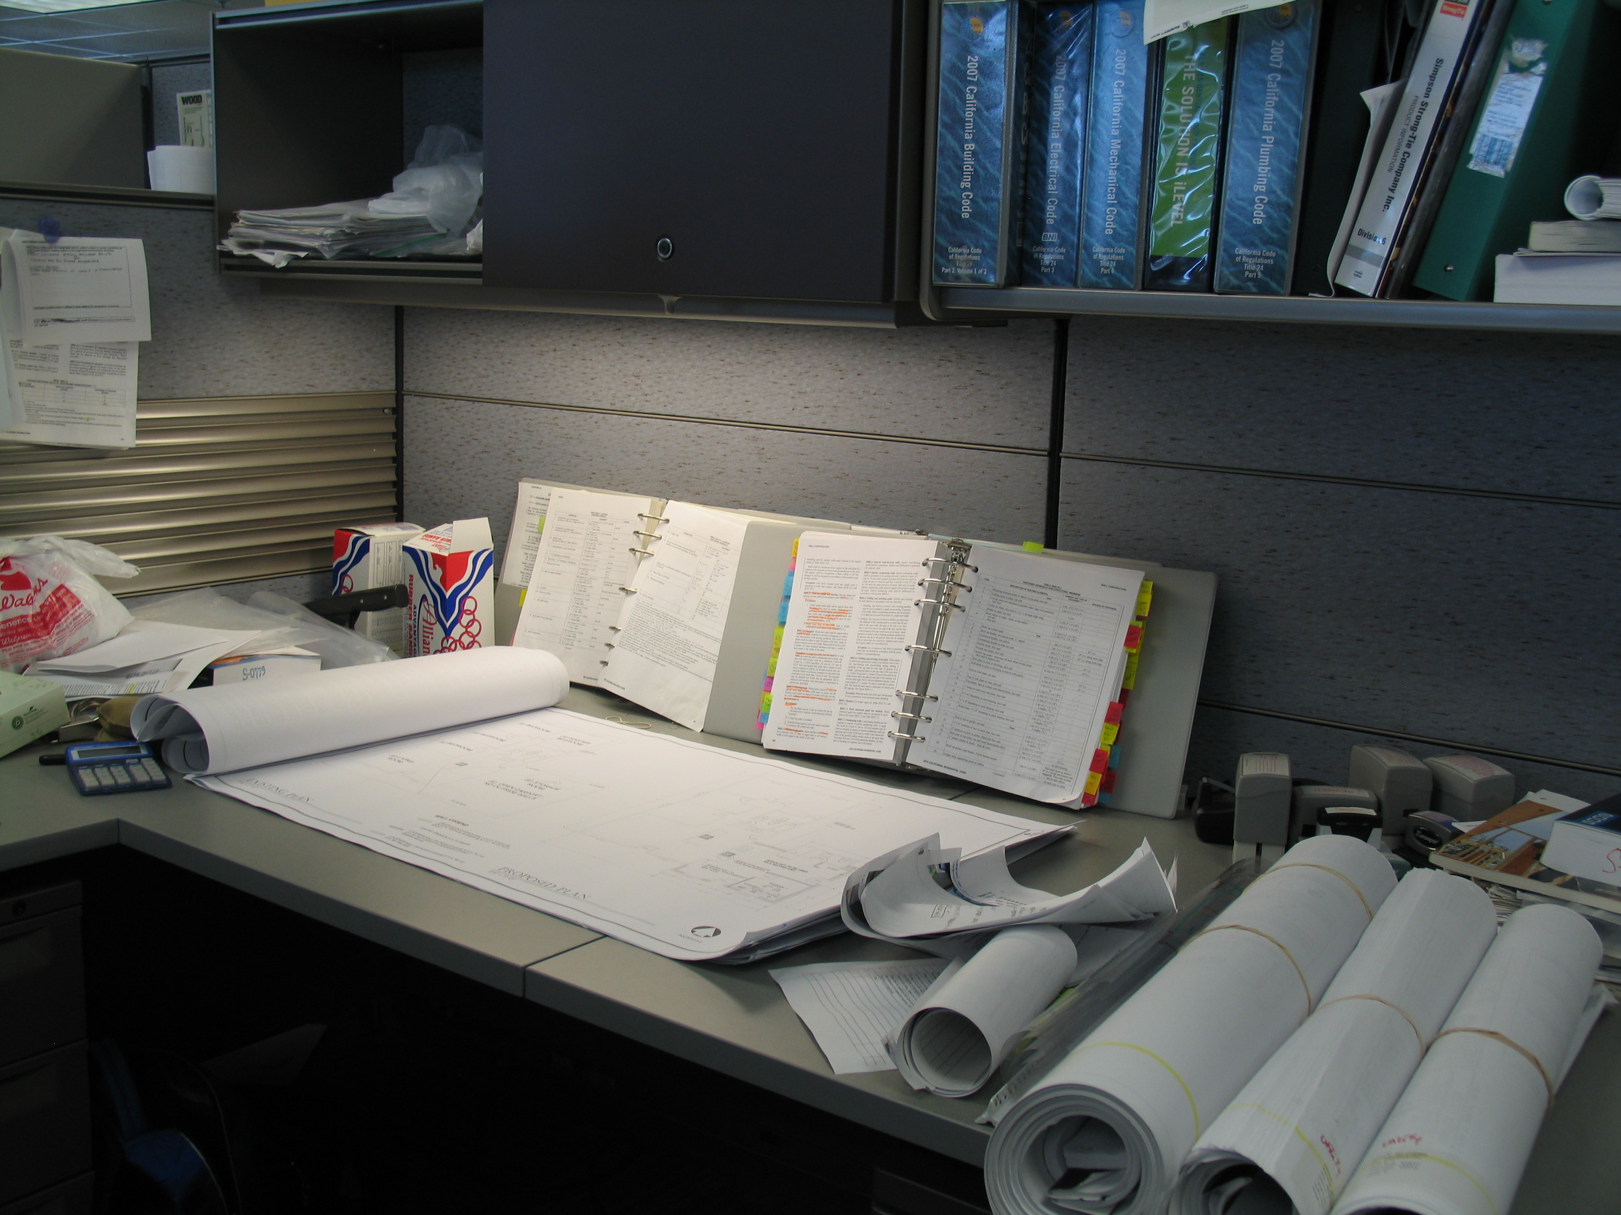
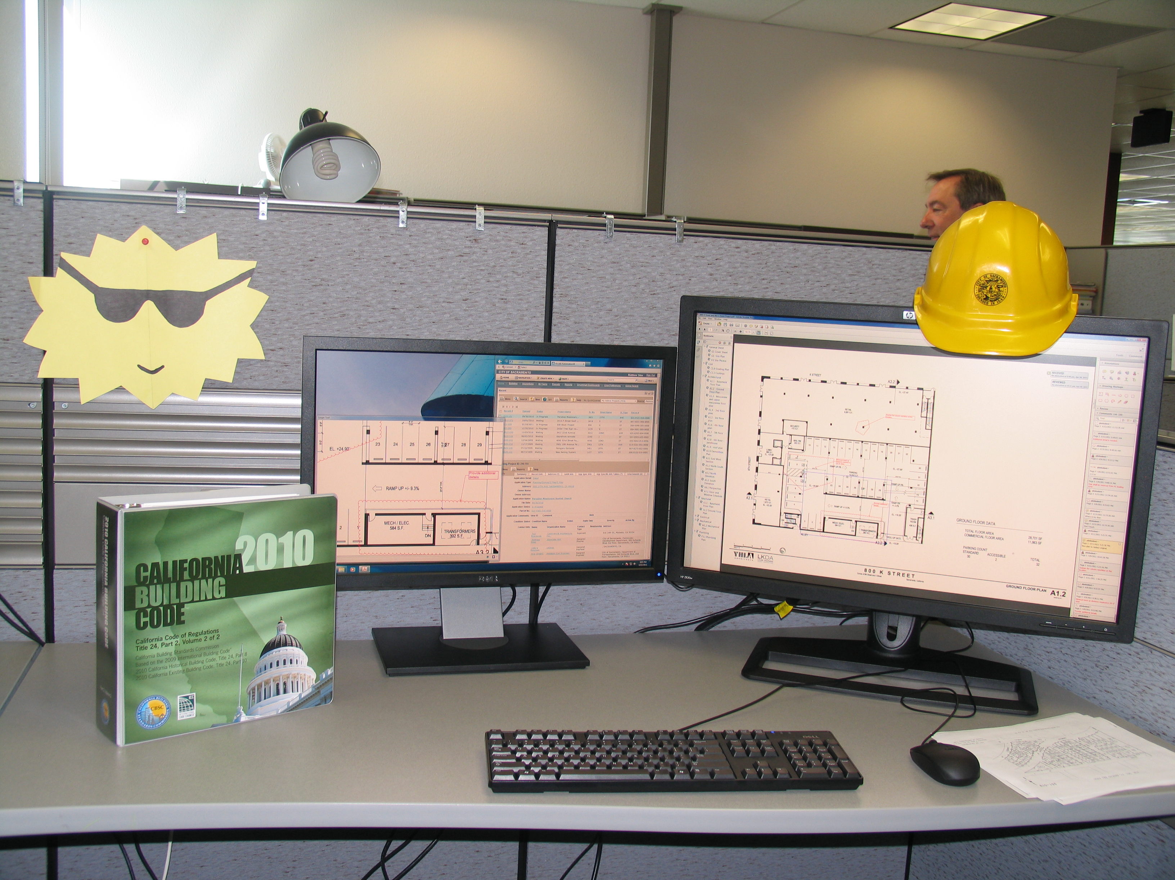
Case Study: Regional Permitting
City of Sacramento
BEFORE
AFTER
Photo Credit: Jamie Cutlip, City of Sacramento
Notes:
In 2007, SMUD (utility) pioneered streamlined permitting – wanted to have all cities and towns in their service territory utilizing one standard application template. 7 different jurisdictions with permitting authority signed on and the results were: 1) permitting fee waivers (for three years) and 2) simple standardized application for small residential PV promoting consistency within the region and 3) commitment to over-the-counter or 1-day turnaround for plan reviews.
Templates that SMUD designed was very good with a checklist and sample plans but revisions were determined to be necessary once individual cities began working with the template. At the end of 2009, all fee waivers had expired and individual jurisdictions reverted to charging either a flat fee or a fee based on project valuation (=cost of materials plus labor) with permit fees ranging from $192 - $823 for a 3kW system. The City of Sacramento is updating the templates and adopting a flat fee (from valuation-based fees of $724 on average to a flat fee of $280 for a 4 kW system or less and same flat fee for Solar Hot Water Systems, 50 gallons or less). The flat fees assumes one hour of plan check and one on-site inspection. The development of the templates and online submission provides less chance for incomplete applications, errors and call-backs.
67

Slide 68
Case Study: Regional Permitting
City of Sacramento
BEFORE
AFTER
Photo Credit: Jamie Cutlip, City of Sacramento
Notes:
All these reforms are designed to speed up the process for permitting and archiving, reduce cost to both the applicant and the city, with the added environmental benefits of reducing paper, automobile trips to the public counter, etc.. Now the City of Sacramento is incorporating electronic/online permit submission for solar permits utilizing the general permitting software (Accela) that they use. They are also working to disseminate what they have learned internally to the region.
City of Sacramento’s goals are to:
Lead by example
Develop a local solar industry
Break down near- and long-term barriers.
68

Slide 69

Case Study: Regional Standards
Pima Association of Governments
Notes:
PAG: (Pima Association of Governments)
Colleen Crowninshield provided her cell phone (520) 440-0949 in case you had any further questions and wished to speak with her directly. She is my contact in PAG and the Clean Cities Manager at PAG.
Southern Arizona Solar Standards Board
The Southern Arizona Solar Standards Board is a nonprofit board of solar energy installation businesses in southern Arizona. SASSB directs its efforts at promoting best practices in the solar electric/hot water industry and carrying out consumer education and protection.
Pima Association of Governments
The Southern Arizona Solar Standards Board is a program of Pima Association of Governments. PAG is a nonprofit metropolitan planning organization with Transportation Planning, Environmental Planning, Energy Planning and Technical Services divisions. SASSB is managed under the Energy Planning Program at PAG.
In each of these areas, PAG coordinates with all local jurisdictions in Pima County, and with the Pascua Yaqui Tribe and Tohono O'odham Nation. PAG's nine-member Regional Council has reprentatives from local, state and tribal governments.

Slide 70
Case Study: Regional Standards
Pima Association of Governments
Notes:
Pros and Cons for the Southern Arizona Solar Standards Board
Pros:
We received strong support from community, utilities, and most installers.
Provides solutions to a need voiced by the broader community.
Having the organization conceived by installers meant immediate expertise and an understanding of the needs of the business community.
The public/private partnership between PAG and the installers has been positive and productive.
Being a pioneer in the field has provided excitement, momentum, and visibility.
We have already received positive feedback from the general and installer community.
Strategically partnering with Utility (marketing)
Helping consumers make an more informed decision
Cons:
Some installers have doubts about the need, legitimacy, and fairness of the program.
Some groups perceive the organization as a layer of unnecessary regulation/bureaucracy.
Being a pioneer means creating the model as needs arise and not foreseeing all obstacles.
70

Slide 71
Case Study: Regional Standards
Pima Association of Governments
Notes:
Hurdles for So. AZ Standards Board:
Creating the right standards
Enforcing the standards
Showing the value proposition to attract more members
Pros and Cons for Solar Partnership
Pros:
A positive arena for disparate groups to form a cohesive strategy for advancing solar
A wide variety of expertise provides better effectiveness
Provides solutions to a need voiced by the broader community
Democratic structure provides a means for ideas to form horizontally
Cons:
Broad interests of the group occasionally lead to conflicting goals
Voluntary nature of the group means work is done in members’ spare time, sometimes slowing progress
The both broad and nuanced field of solar can challenge a clear vision and lead to mission creep
Hurdles for Solar Partnership
After successes in the region mission is now unclear. We must take time to help it to recreate itself, to address a different set of challenges and different solar landscape.
71

Slide 72
Importance of Regional Standards
SunShot Initiative
Rooftop Solar Challenge
$12.5M to up to 25 Awardees!
FOA # DE-FOA-0000549
Letters of Intent Due: 07/29/11
Application Due: 08/31/11
www.solar.energy.gov/challenge
Notes:
Our nation is trending toward the MEGAPOLITAN - hence the reason regional standards are vital.
Last year, the U.S. government has set a goal of reaching $1 per watt for utility scale solar installations by 2017 with SunShot helping push costs down industry-wide. The Department of Energy’s SunShot initiative will reduce overall costs by 74% in just seven years.
The objective of this Funding Opportunity Announcement (FOA) for a Rooftop Solar Challenge is to achieve measurable improvements in market conditions for rooftop photovoltaic across the United States, with an emphasis on streamlined and standardized permitting and interconnection processes. DOE anticipates providing up to $12.5M to up to 25 awardees to accomplish the goals of this funding opportunity. This FOA directly supports the goals of the Department of Energy’s Office of Energy Efficiency and Renewable Energy, Solar Energy Technologies Program and the SunShot Initiative.
72

Slide 73
Importance of Regional Standards
SunShot Initiative
Rooftop Solar Challenge
$12.5M to up to 25 Awardees!
FOA # DE-FOA-0000549
Letters of Intent Due: 07/29/11
Application Due: 08/31/11
www.solar.energy.gov/challenge
Notes:
This FOA will take a phased approach addressing four main action areas (listed below), designed so that awardees that succeed in all action areas will have the necessary policy and process framework in place to support a robust solar market in their region:
Permitting and Interconnection Processes
Net Metering and Interconnection Standards
Financing Options
Planning and Zoning
State or territorial governments; local governments; consortia, made up of regional or statewide teams of local government; or non-profit or for-profit entities authorized to act on behalf of a consortia of state and/or local s governments, large single jurisdictions, or Indian Tribes representing areas with a population greater than 500,000 are eligible to apply.
DOE expects to make 20-25 awards of between $250,000 and $1,000,000 under Phase 1 of this FOA.
:
73

Slide 74
Questions/Comments www.SolarAmericaCommunities.energy.gov solar@icma.org
Today’s workshop presentation & notes will be posted here:
www.SolarAmericaCommunities.Energy.Gov/Resources
Notes:
Questions/Comments
Reactions: What have you found useful and what additional resources would be helpful for you?
THANK YOU!
74

Slide 75
Additional Resources
Notes:
75

Slide 76
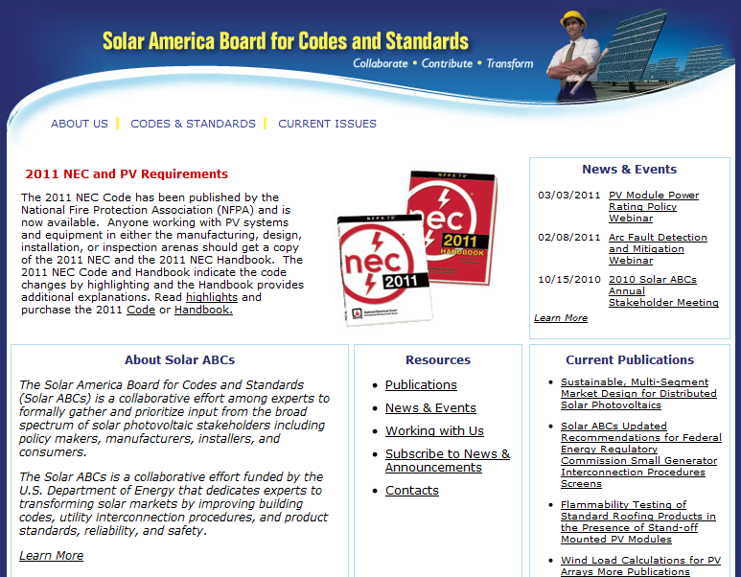
Resources from Solar ABCs
All reports are available at www.SolarABCs.org
Notes:
76

Slide 77
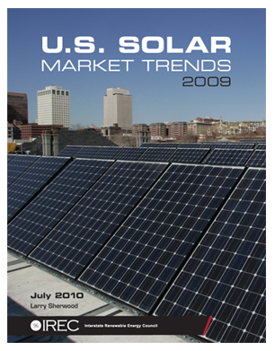
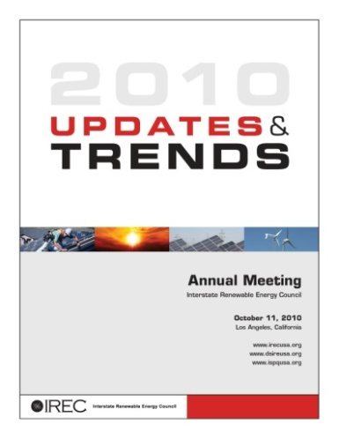
The number of new grid-connected PV installations grew by 40% in 2009 compared with the number installed in 2008. The two largest PV systems installed in 2009 together accounted for 12% of the annual installed PV capacity. In IREC’s U.S. Solar Market Trends report (2010), primary author, Larry Sherwood, provides public data on U.S. solar installations by technology, state and market sector.
Published by IREC: http://irecusa.org/irec-programs/publications-reports/
IREC’s 2010 Updates & Trends Report
Released at IREC's Annual Meeting in Los Angeles on October 11th, here's the 2010 collection of updates and trends covering regulatory issues, policies and incentives, installation and market data, and workforce development and training from IREC's team.
Published by IREC: http://irecusa.org/irec-programs/publications-reports/
Notes:
77

Slide 78
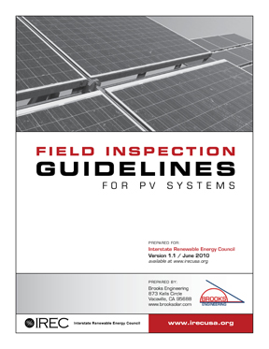
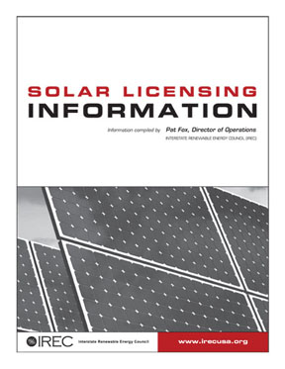
2010 Field Inspection Guidelines for PV Systems
According to its author, Bill Brooks of Brooks Solar, the intent of the 2010 Guidelines is to consolidate the most import aspects of a field inspection into a simple process that can be performed in as little as 15 minutes. Explanation and illustrative pictures are provided to instruct the inspector on the specific details of each step. The 2010 edition of the Guidelines is an update from the 2006 edition.
Published by IREC: http://irecusa.org/irec-programs/publications-reports/
IREC has created a Solar Licensing Database as a resource for policy makers, practitioners, consumers, and anyone else looking for solar licensing information in the U.S. The state-by-state information offers a handy comparison for reviewing the different approaches across state lines, and identifies various practices for regulating the solar installation industry.
Published by IREC: http://irecusa.org/irec-programs/publications-reports/
Notes:
78

Slide 79
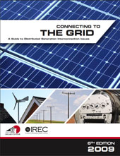
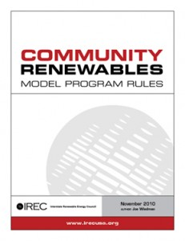
Connecting to the Grid Guide 6th Edition (2009)
Net metering and interconnection policies are essential pieces of a supportive state-level regulatory policy framework addressing two important aspects of renewable energy development: whether a customer investing in renewable generation can unlock the full value of his or her investment; and how that customer will interconnect his or her generation system to the distribution grid. This guide introduces readers to the issues surrounding policy and technical considerations of grid-integrated, renewable energy development.
Published by IREC: http://irecusa.org/irec-programs/publications-reports/
Based on best practices, Model Rules for Community Renewables (2010) are presented to facilitate co-investment in local renewable power facilities. Interest in community solar and wind initiatives stems from recognition that many utility customers are not able to host an on-site renewable power system, yet they would like to invest in local renewable generation. Examples include occupants of multi-tenant residential and commercial buildings, and properties not conducive to an on-site system, due to shading or structural restrictions.
Published by IREC: http://irecusa.org/irec-programs/publications-reports/
Notes:
79

Slide 80
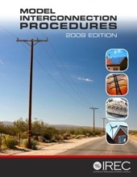
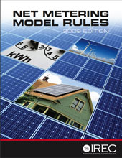
2009 Model Interconnection Procedures.
IREC first developed model interconnection procedures in 2005 in an effort to capture emerging best practices in this vital area. Since that time, IREC has been an active participant in dozens of state utility commission rulemakings that have focused on the development of interconnection procedures. These updated procedures also include footnotes that explain key provisions and provide information on alternatives that are being practiced in some states.
Published by IREC: http://irecusa.org/irec-programs/publications-reports/
2009 IREC Model Net Metering Rules
On significant points such as size of systems eligible for net metering, program capacity caps, and treatment of annual excess generation, there has been broad variation between states. In an effort to capture this variation, IREC’s model rules now include footnotes that discuss the various approaches states have taken on these issues.
Published by IREC: http://irecusa.org/irec-programs/publications-reports/
Notes:
80

Slide 81


Best Practices & Recommended Guidelines for Renewable Energy Training (2010)
The 26-page document covers recommended principles for training; reviews industry-approved job/task analyses; discusses types of educational programs; walks through the essential steps of designing a training course; offers a checklist for assessing learning outcomes; looks at
certification and accreditation; and lists resources to assist in training. Published by IREC: http://irecusa.org/irec-programs/publications-reports/
Good Teaching Matters (2010) discusses five important teaching practices that can improve the quality of a training course. Written by Dr. Barbara Martin, who specializes in instructional design, the five practices include: know your students; write learning objectives; include practice and feedback in the training; create simple Power Point slides; and design test and evaluation measures that promote transfer.
Published by IREC: http://irecusa.org/irec-programs/publications-reports/
Notes:
81

Slide 82

Solar Powering Your Community: A Guide for Local Governments (2011)
The U.S. Department of Energy developed this comprehensive resource to assist local governments and stakeholders in building sustainable local solar markets. The guide introduces a range of policy and program options that have been successfully field tested in cities and counties around the country.
Published by U.S. Department of Energy: http://solaramericacommunities.energy.gov/resources/guide_for_local_governments/
National Solar Jobs Census 2010: A Review of the US Solar Workforce
This first-of-its-kind study produced by The Solar Foundation directly quantifies solar jobs across the value chain. The Census found that as of August 2010 there are 93,000 solar workers with over half of all employers expecting to add jobs within the next 12 months, representing a job growth rate of 26%. The Census looks at 31 distinct occupations.
Published by The Solar Foundation: www.TheSolarFoundation.org
Notes:
82

Slide 83


U.S. Solar Energy Trade Assessment 2010 (2010)
This study shows that U.S. solar installations created $3.6 billion in direct value to the global economy in 2009. Of that, nearly 74 percent, or $2.6 billion, directly benefited the U.S. economy. It also shows that the U.S. was a net exporter of solar energy products in 2009, led by the $1.1 billion in exports of polysilicon, the primary feedstock in most PV cells.
Published by SEIA: www.seia.org/cs/news_detail?pressrelease.id=1144
U.S. Solar Market Insight 2010 Year in Review (2011)
The quarterly SEIA/GTM Research U.S. Solar Market Insight™ report is a complete account of trends in U.S. photovoltaic (PV), concentrating solar power (CSP), and solar heating and cooling (SHC) markets. Each quarter, SEIA and GTM Research provide the most valuable current information on the U.S. solar market.
Published by SEIA: www.seia.org/galleries/pdf/SMI-YIR-2010-ES.pdf
Notes:
83

Slide 84


Break-Even Cost for Residential Photovoltaics in the United States: Key Drivers and Sensitivities (December 2009)
An solar relative cost analysis report which provides snapshots of PV cost effectiveness relative to grid costs. This report will be updated in mid-2011
Published by NREL/TP-6A2-46909: www.nrel.gov/docs/fy10osti/46909.pdf
Freeing the Grid: Best Practices in State Net Metering Policies and Interconnection Procedure (December 2010)
This report develops a state by state score card on net metering and interconnection rules.
Published by Network for New Energy Choices: www.freeingthegrid.org
Notes:
84

Slide 85
Solar Contractor Licensing Requirements
www.dsireusa.org / December 2010
DC
12 states + PR
have solar contractor licensing requirements
Puerto Rico
State Solar Contractor Licensing Requirement
Source: DSIRE Solar, Summary Maps
Notes:
States establish licensing requirements for contractors in order to protect consumers from unsafe practices and protect the reputation of the industry, as improper installation may create safety risks or result in poor system performance. Contractor licensing is a mandatory state standard that contractors must meet to install systems. Licensing is distinct from certification; certification is a voluntary standard that installers attain to differentiate themselves from competition and to instill confidence in consumers. Certification may entail completing coursework, installing systems for a certain period of time, or taking an exam, but it is typically not required to install systems.
The North American Board of Certified Energy Practitioners (NABCEP) is a nationally-recognized, independent, voluntary certification program for photovoltaic (PV) and solar thermal system installers. To become NABCEP-certified, installers must have at least one year of installation experience and must document systems training and installation. Installers must also pass a four-hour, 60-question examination, sign a code of ethics, and take continuing education courses for re-certification every three years.
Licensing and certification have different advantages and disadvantages. From a financial point of view, voluntary national certification is preferable to mandatory state licensing because it results in a lower cost of installation and provides greater consumer choice than mandatory licensing. In areas that do not require solar contractor licensing, certification can provide a baseline level of quality. State licensing may be restrictive, as state licenses do not typically transfer, so geographic mobility may be an issue for installers. Yet, in states where solar installation is becoming more common, state licensure may protect consumers from potential safety hazards and will ensure that systems are installed properly. While both licensing and certification have drawbacks, requiring solar contractors to be licensed or certified is preferable to no regulation of installers and will result in baseline standards being met, which will in turn lead to higher consumer satisfaction.[1]
85

