Slide 1
Sustainable Textile Recycling Programs with USAgain
www.usagain.com
Notes:
Intro slide

Slide 2
A Global Problem: A simple solution
12.7 million tons of textiles end up in landfills each year
Massive amounts of energy wasted and pollutants released in manufacturing and disposing of textiles
Third world nations struggle to afford basic clothing items while industrialized economies continue trashing used clothing
www.usagain.com

Slide 3
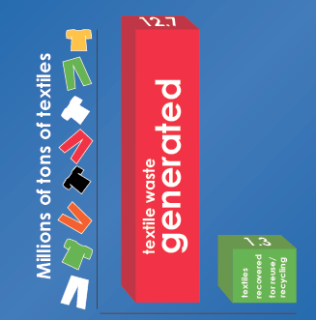
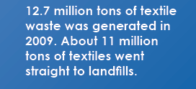
EPA Statistics
www.usagain.com

Slide 4
Since 1980, U.S. textile consumption has increased 5x.
The average American now purchases more than 81 pounds of textiles per year.
1. 12% (10 pounds) will be reused and/or recycled
2. 69% (56 pounds) will simply be thrown away, finding its way to our dangerously overcapacity landfills
www.usagain.com

Slide 5
Consumer Concern about the Global Environment
According to a 2009 Nielsen survey: 80% of consumers are concerned about global environment, the products they purchase (79%), the products/services they recommend to others (77%), where they shop (74%), where they choose to work (73%), and where they invest their money (72%).
www.usagain.com

Slide 6
Who is USAgain?
Private, for profit
Founded in 1999
Curb greenhouse gas emissions and unnecessary wastefulness
200+ employees operating in 15 states
10,000 collection bins nationwide
Industry leader
www.usagain.com

Slide 7
Where does USAgain operate?
California
Colorado
Connecticut
Georgia
Illinois
Indiana
Iowa
Michigan
Minnesota
Missouri
New Jersey
New York
Pennsylvania
Washington
Wisconsin
www.usagain.com

Slide 8
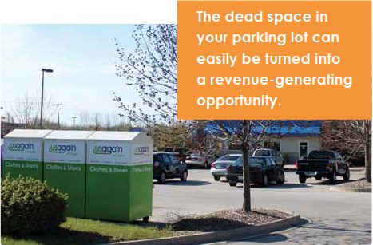
Economic & Environmental Benefits
Only transportation needed
Conserves landfill space
Economic development
Domestic and foreign employment opportunities
USAgain shares profits with collection site sponsors!
www.usagain.com

Slide 9
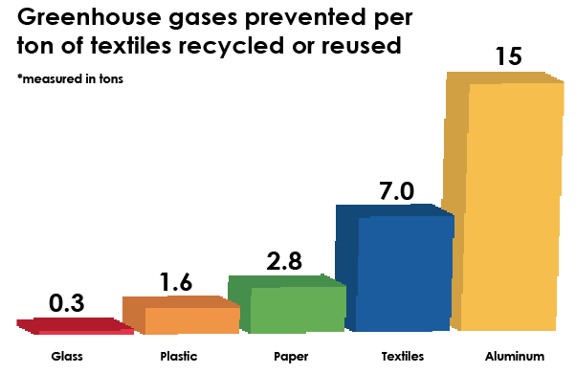
www.usagain.com

Slide 10
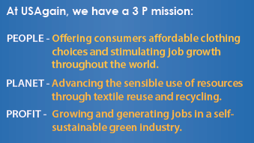
www.usagain.com

Slide 11
www.usagain.com

Slide 12
How does it work?
1
2
3
Church and community members drop off clothing
USAgain services bin when 2/3 full, or as needed
Clothing is compacted into half-ton cubes
4
5
6
About 25 full containers leave our warehouse each week
Entrepreneurs resell the items into local economy
For 5.4 billion people, used clothing is often the only option
www.usagain.com

Slide 13
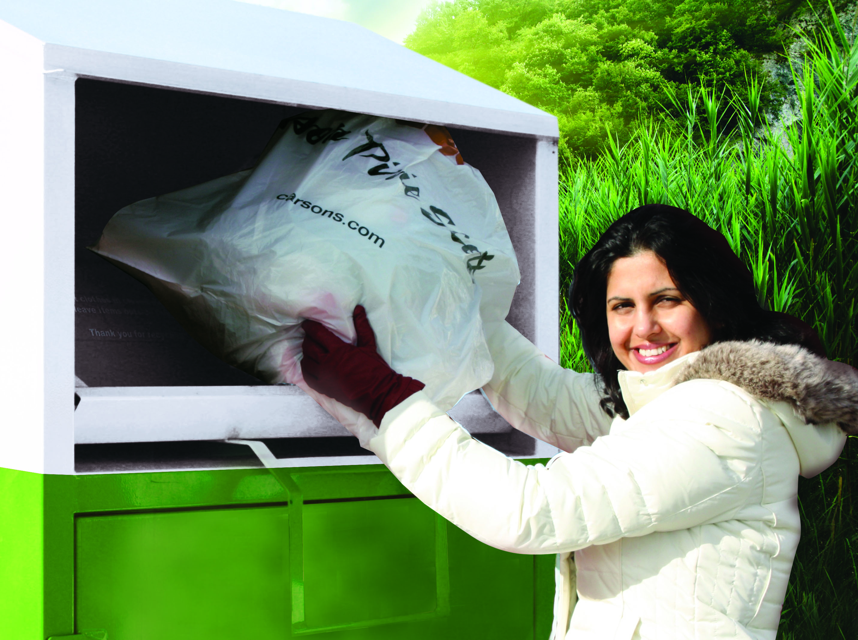
USAgain Collection Bins
4’x4’x7’
Contact information
Regularly serviced
User-friendly
24/7 hotline
www.usagain.com

Slide 14
Passionate & Professional
Branded, convenient & user-friendly bins
Branded fleet of vehicles for service
24/7 hotline
Fully insured employees and equipment
$1 mil in liability, employee, vehicle and property damage coverage
Sophisticated monitoring database tools
Full service website with personal partner login
www.usagain.com

Slide 15
Contact USAgain:
USAgain Corporate office:
1555 W Hawthorne Lane, 4W
West Chicago, IL 60185
800-604-9533
www.usagain.com
info@usagain.com
www.usagain.com

Slide 16
Waste and
Recycling

Slide 17
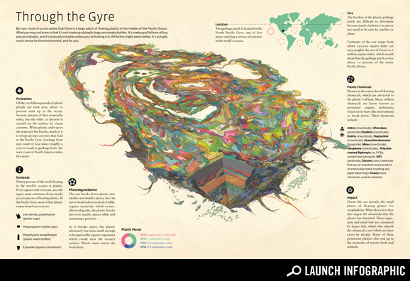

Slide 18
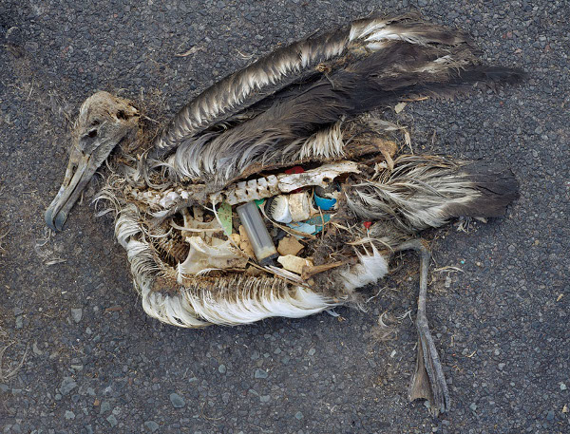
Midway Atoll, approximately 2,800 nautical miles west from San Francisco

Slide 19
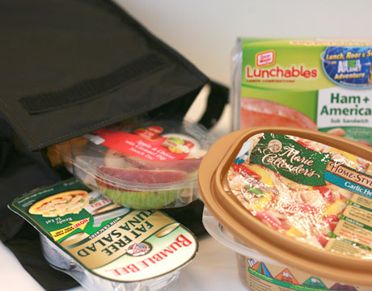

Slide 20
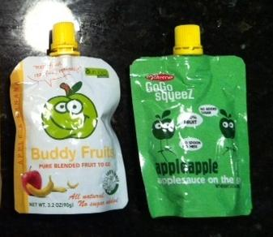

Slide 21
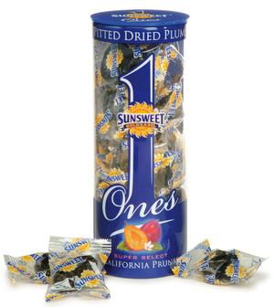

Slide 22
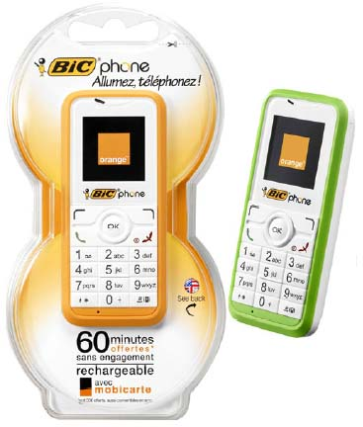

Slide 23
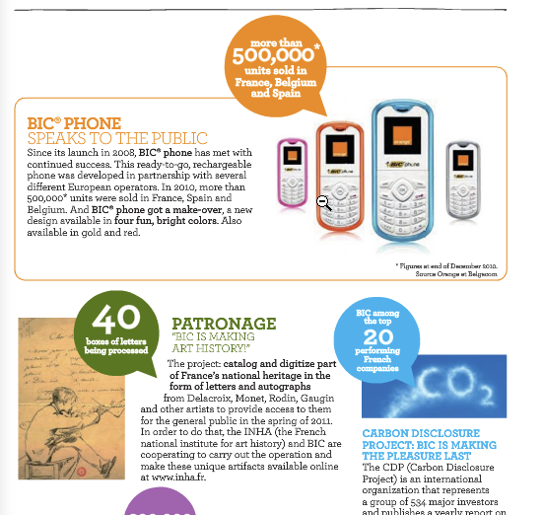

Slide 24
Notes:
Opportunites to turn our single use society to a multi-use society….need help

Slide 26
Notes:
http://www.ca-ilg.org/node/1630
http://www.ca-ilg.org/node/1636, Businesses required to subscribe to recycling services and establish onsite recycling procedures and signage for employees.
The City of Irvine has adopted a Construction and Demolition (C&D) Debris Recycling and Reuse Ordinance (07-18) . Under this new ordinance, certain projects are required to recycle or reuse 75 percent of concrete and asphalt and 50 percent of the other debris generated.
http://www.cityofirvine.us/programs/zero-waste/reuse-tips/reuse-everyday-items/
Sixty percent of landfill waste is generated by businesses. Promoting commercial recycling helps keep recyclable materials out of landfills.
- Institute for Local Government, www.ca-ilg.org

Slide 28
Sustainability Plan - Waste and Recycling
Goal I. Increase recycling and waste reduction in the business sector of the community.
^{Goal II.} Encourage increased recycling, composting, source reduction and waste reduction in residential properties.
Goal III. Encourage the city of Elgin and its residents to purchase and use products made from recycled or reclaimed materials, most importantly, or environmentally friendly materials.

Slide 29
Image Sources
http://ranirecommends.blogspot.com/
http://urbancanteen.com/blog/
http://www.good.is/post/transparency-the-great-pacific-garbage-patch/
http://www.thedailygreen.com/healthy-eating/latest/wasteful-packaging-for-food
http://nexus404.com/Blog/2008/07/14/orange-bic-disposable-bic-cell-phone-ready-to-go-handset/
http://www.bicworld.com/BIC-Annual-Report-2010/#/8
http://www.marghanita.com/perfect-use-for-your-plastic-water-bottles/

