Slide 1
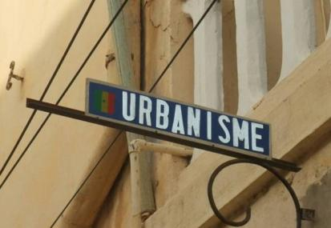
The Value of Well-Managed Cities in USAID Programs
Anthony Kolb
USAID Urban Health Advisor
ICMA Conference, Milwaukee, Wisconsin
19 September 2011

Slide 2
My talking points
Evolution of USAID’s urban programming
Current priorities (GCC, FtF, GHI)
How can USAID benefit from ICMA expertise?

Slide 3

USAID Regional Urban Development Offices (RUDOs)
Circa 2000
USAID
Office of Infrastructure and Engineering
Energy
Urban Programs
5 person team
in Washington
Engineering Services
Information Communication Technology (ICT)
Red: Active Countries
Green: Potential Countries

Slide 4
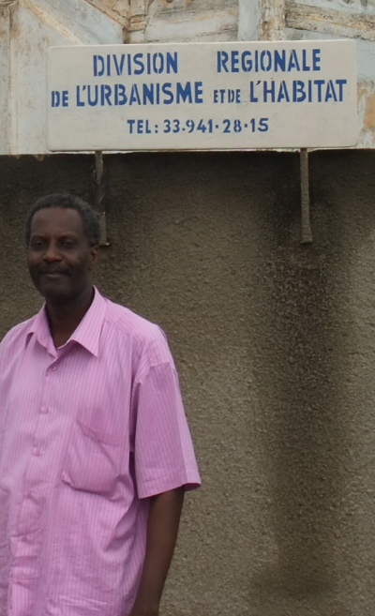
Direction moving forward
What has been suggested:
a) Better integrate sectoral programs across the urban landscape
b) Seek synergies among assistance programs

Slide 5
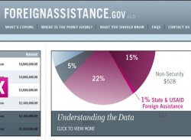
Key Foreign Assistance Initiatives
Global Climate Change (GCC)
Feed the Future (FtF)
Global Health Initiative (GHI)

Slide 6
Adaptation Costs - largely urban ($ billions)
Global Climate Change (GCC)
Sector | Climate Scenarios
 | DRY | WET
Agriculture, forestry, fisheries | 2.5 | 2.6
Water supply | 19.7 | 14.4
Human health | 1.5 | 2.0
Coastal zones | 27.6 | 28.5
Infrastructure | 13.0 | 27.5
Extreme events | 6.4 | 6.7
Total | 71.2 | 81.5
2005 Constant Prices, 0% Discounting
Source: World Bank Economics of Adaptation to Climate Change
Notes:
These are the latest WB estimated costs of adaptation by sector. Most costs of the $70-100 billion will be in cities.

Slide 7

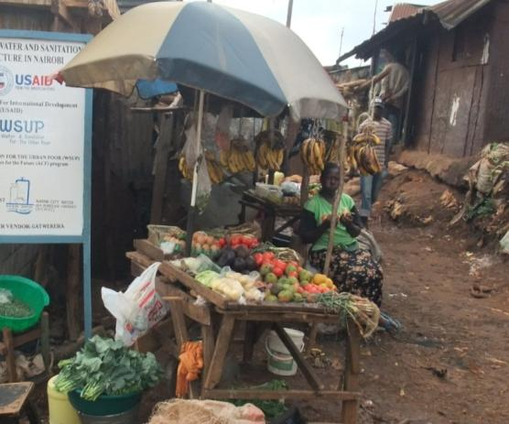
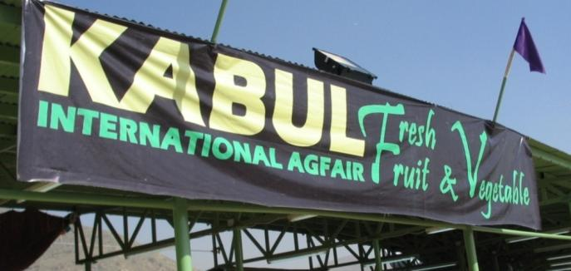
Feed the Future (FfF)
1) Improved Food Markets
Expanding access to larger and better functioning regional markets – making the Rural-Urban connection

Slide 8
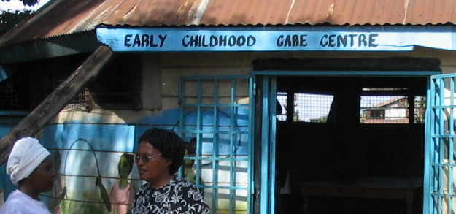
Feed the Future (FtF)
2) Nutrition of Vulnerable Groups
Urban poor lack subsistence safety net
Most vulnerable to global price spikes
Notes:
A survey in Accra, Ghana found on average families spent
54% of their income on food and up to 60% in the lowest income bracket (Maxwell, D., Levin, C.,
Amer-Klemesu, M., Ruel, M., Morris, S. and Ahiadeke, C., 2000).
(see: http://foodafrica.nri.org/urbanisation/urbspapers/GinaKennedyFoodsecurity.pdf)

Slide 9
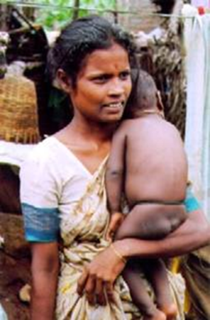
Infant Mortality and Nutrition: Poorest Quintiles in India ‘92-‘93
Global Health Initiative (GHI)
Urban Poor = The fastest growing demographic Sanitation
Source: Socio-Economic Differences in Health, Nutrition, and Population, The World Bank, 2000

Slide 10
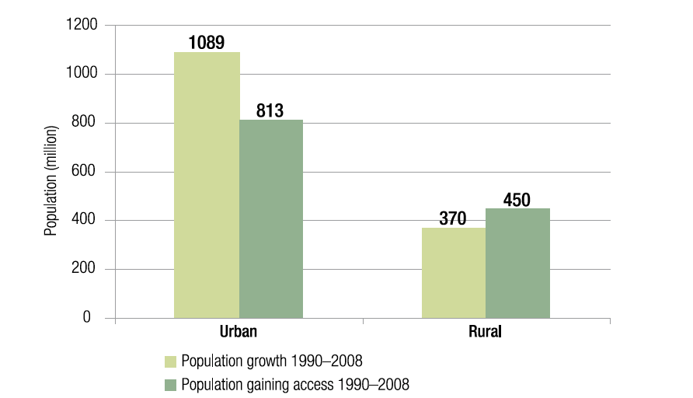
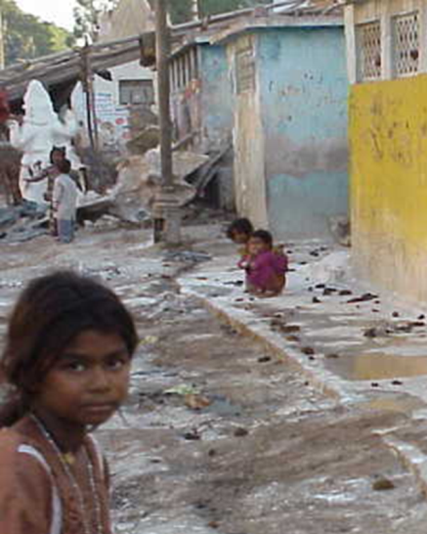
One billion urban dwellers lack safe water and sanitation and we’re losing ground!
Region Water Sanitation
Global Health Initiative (GHI)

Slide 11

How has ICMA already helped?
My firsthand experience…

Slide 12
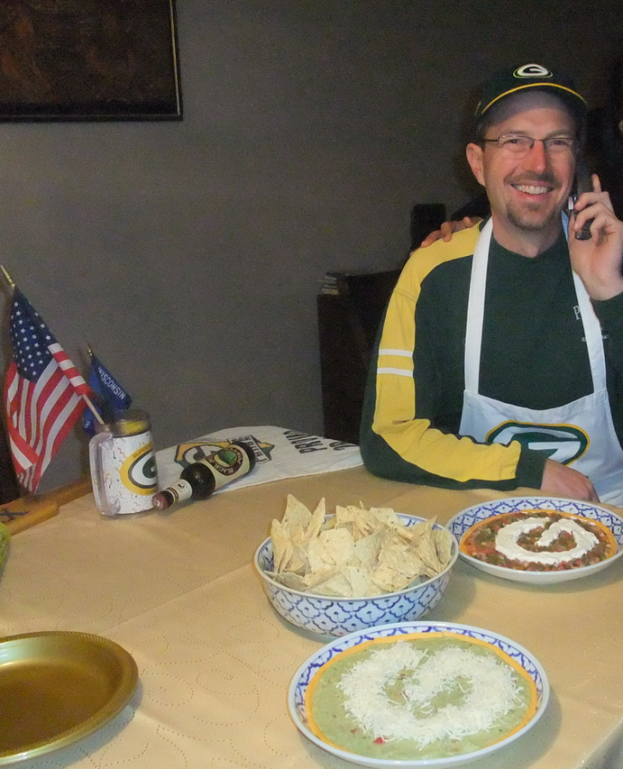
Moving forward
Hoping for continued “Teaming” success
…with ICMA
Good governance is key to all initiatives
In a rapidly urbanizing world – improved city governance is especially critical
In that world, North American urban challenges start to look a lot like common global challenges

Slide 13
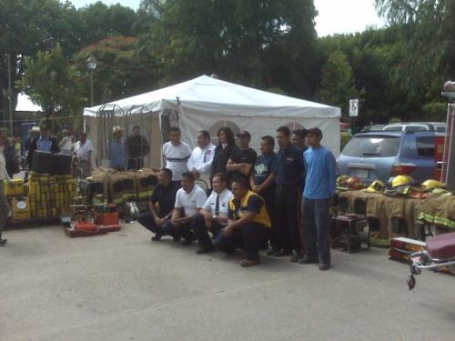
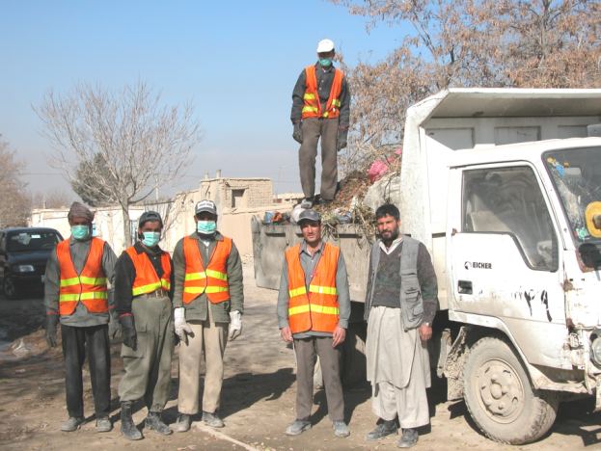
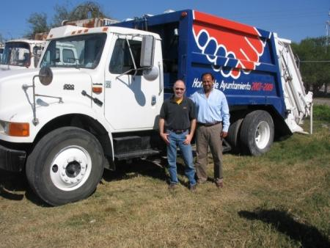
City Partnerships
Kabul, Afghanistan
Rioverde, Mexico and Campbell, California
Notes:
First called Resource Cities and then CityLinks, our program was designed in 1997 to leverage American expertise in municipal management. While the program officially ended in 2008, lasting partnerships continue to yield results today.
Other partnerships (not in Americas)
Tirana, Albania and Catawba County, North Carolina
Umag, Croatia and Port Townsend, Washington
Pazardjik, Bulgaria and West Bend, Wisconsin
Veliko Turnovo, Bulgaria and Golden, Colorado
Samarinda, Indonesia and Tigard, Oregon

Slide 14
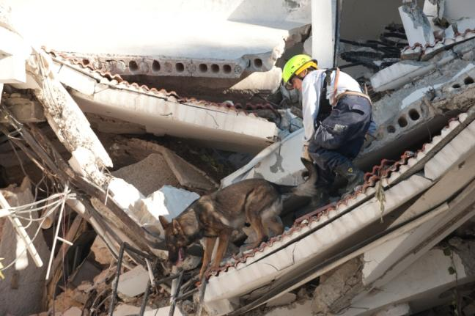
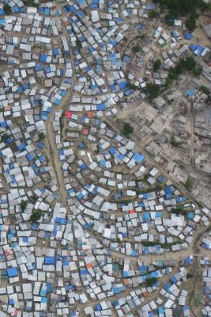
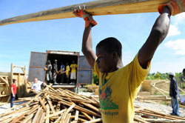
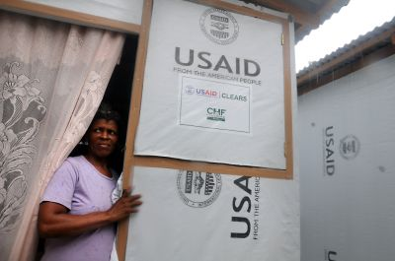
Good governance at the core
Notes:
USAID sent Urban Search and Rescue teams to Haiti immediately after the earthquake. Since then our focus has been on rubble removal (through cash for work), and transitional shelter

