Slide 1

Crime Reduction Tools
Dallas City Hall
First Assistant Chief
Charles Cato

Slide 2
Tracking Devices
  Current Capacity
Burglary of vehicle bait cars
Stolen vehicle bait cars
Tracking equipment
Covert cameras

Slide 3
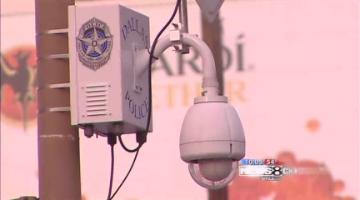
Existing Camera Network
CBD 2010/2011 Activity
  Camera Involved Calls-19,875
  Arrests- 4520
  Offenses (reviewed for Inv.)-876
  Crime Reduction-32%
  Events Monitored-347
Jubilee Park
Five Points
Uptown
113 cameras

Slide 4
Creation of a Targeted Area Action Grid (TAAG)
  30% of total Violent Crime
  20-25 areas
  Those areas equal about 20 Sq Miles or about 5% of city
  Easily measured (reports) and monitored
  Areas to be worked for a complete year
  *Buy in by Command Staff*

Slide 5
Building of the TAAG Areas
  Violent crime less Family Violence
  Property crime less Shoplifting
  1/16 sq mi grids became the building blocks
  ½ sq mi(8grids) – 2 sq mi (32) mile… average 1 (16) sq miles

Slide 6
A Look at the Future
Centralized Monitoring and Control
Existing Camera Network
License Plate Readers
Hotspots; Command Van, In-Car; Substation
Camera systems extended to TAAGs
Private Camera Registration
Covert Mobile Cameras for Problem Resolution
GPS Trackers
Bait Cars

Slide 7
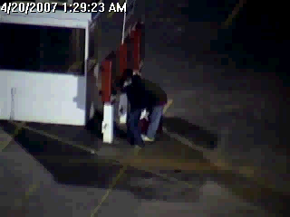
Camera systems extended to TAAGs
Successes should be extended to TAAG’s
Placement – public spaces to deter/detect crime
Central/ Mobile Monitoring
  In-car IP based system
  Substation
  Mobile camera platforms
  Fusion

Slide 8
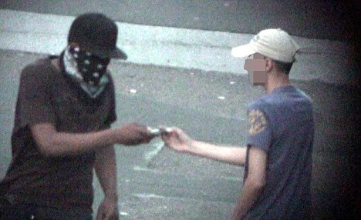
Covert Mobile Cameras for Problem Resolution
Fencing
Graffiti (Calatrava Bridge; Woodall Rogers Tunnel)
Narcotics
Public nuisance locations – car washes; bars; chronic crowd issues

Slide 9
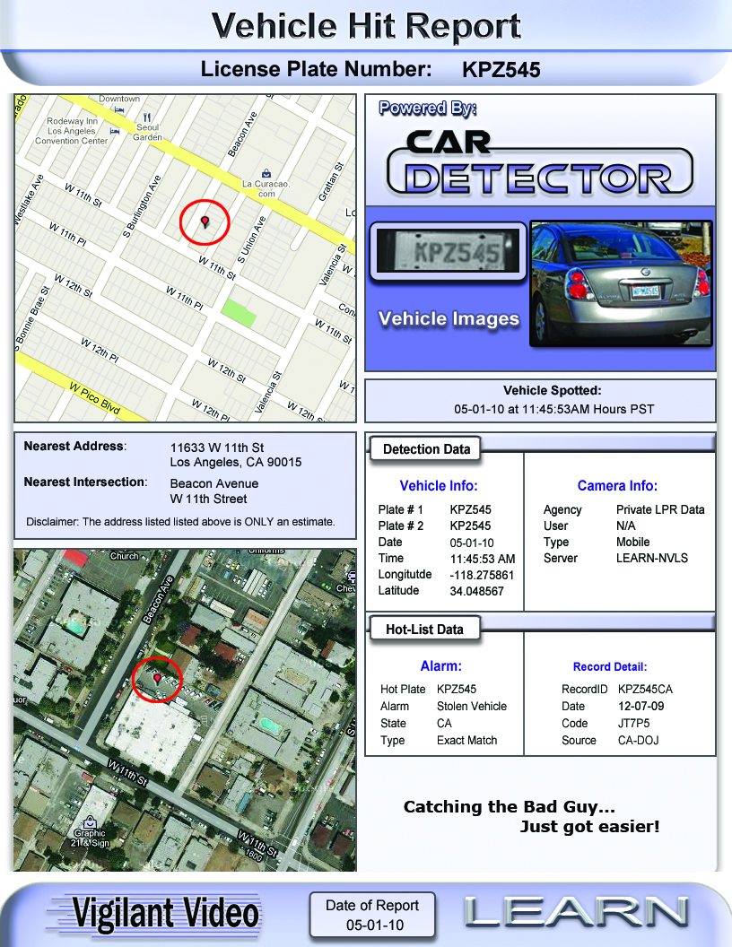

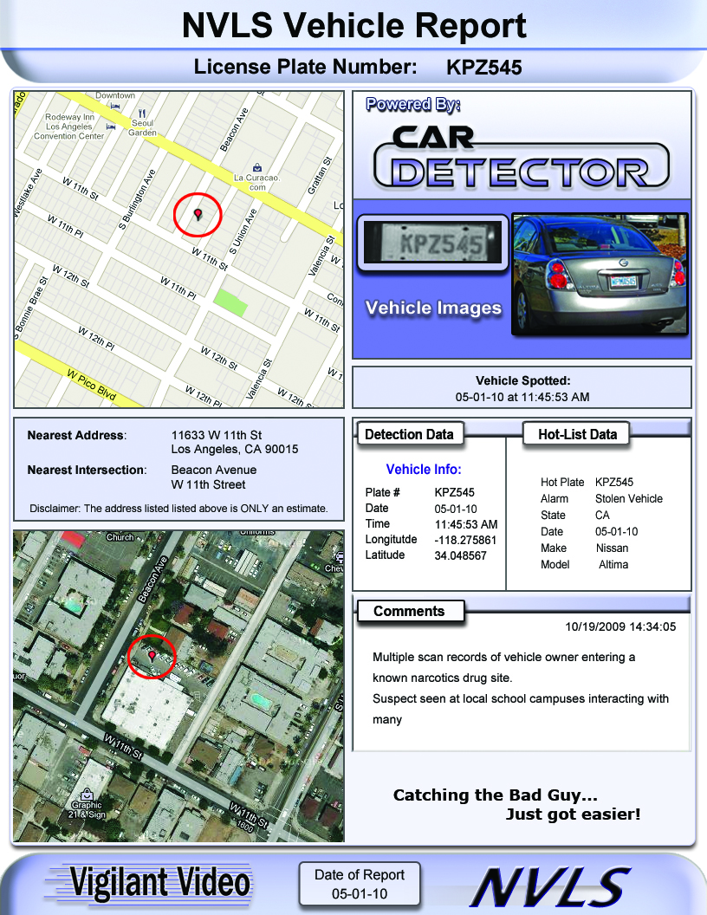
License Plate Readers
Fixed and Mobile
Mobile deployment
  4 per Patrol Division (2 Fixed, 2 Mobile)
  2 for Auto Theft (Mobile)
Interface with parking enforcement
National Vehicle Locator Service

Slide 10
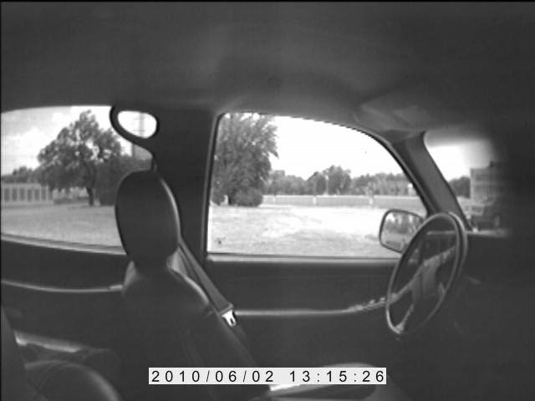
GPS Trackers and Bait Cars
GPS Trackers used in property/merchandise
Auto Theft Bait Cars
BMV Bait Cars

Slide 11
Private Camera Registration
Access to private camera video
Mapped to allow ease of review
Public voluntary registration (Philadelphia Police)
  Open records – Anonymity
  Priority response to immediate incidents
Promotion through
  CEU and Investigative Units
  Downtown Dallas
  Stemmons Corridor Association
  Hotel Motel Security Network

Slide 12
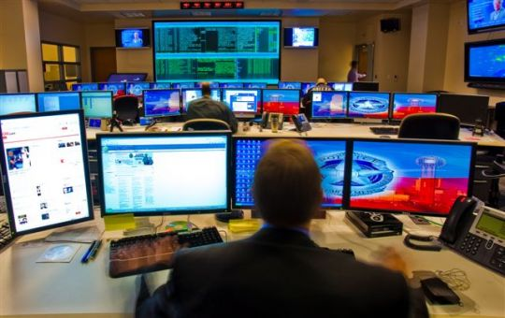
Centralized Monitoring/Control
Centralized monitoring coordinated with Fusion Center
Available as command post for incidents
Enhanced communication
Allow for growth
Helicopter downlink capability

Slide 13



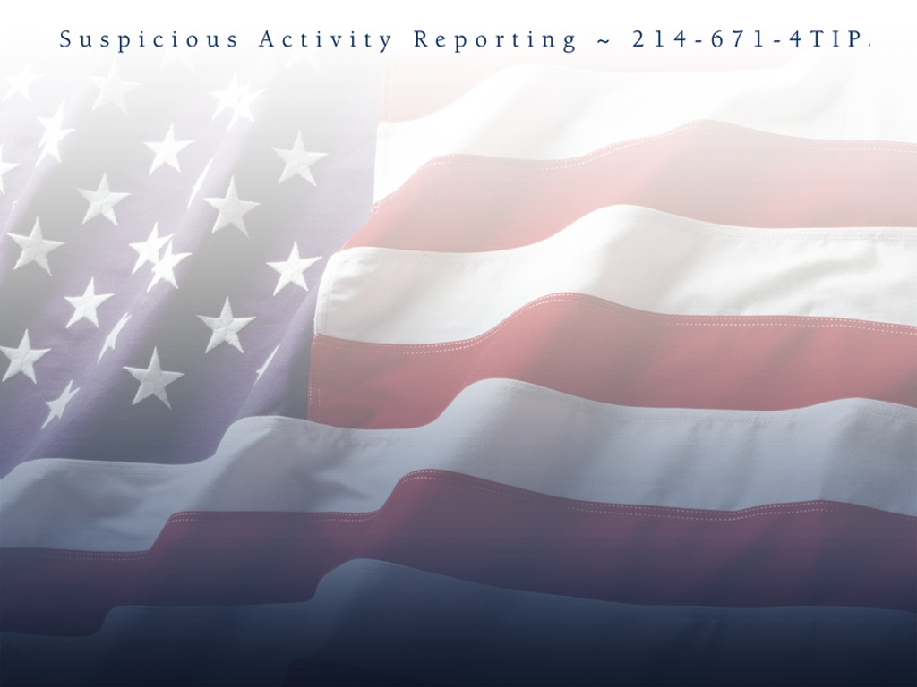



Slide 14
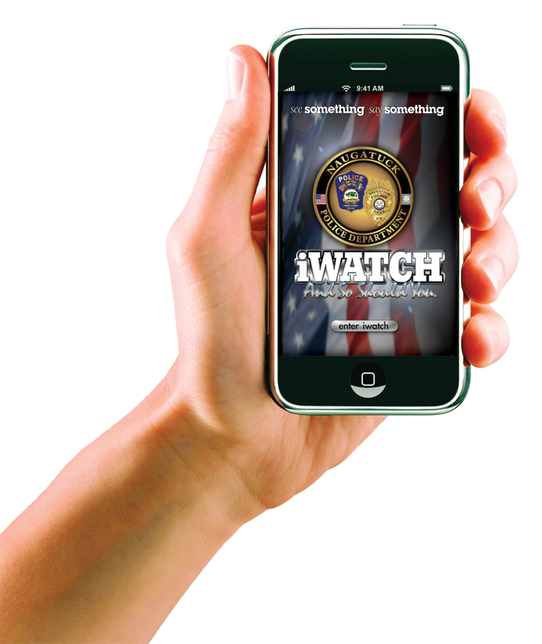


New iWatch Version
Get DPD Alerts
Send A Text Message
Send A Complete Tip
Send A 311 Report
View DPD Crime Videos
View DPD Facebook Tips
App on load declares itself as iWatchDallas
All tips are received by Fusion staff can reply to user as text message, forward the tip to Intelligence teams and share with other Departments.

Slide 15

Version 10
Officers/Detectives/Other can access to the tip thread for alerting if there are updates to the tip(s).
Tips are mapped on Google maps along with images and video, and displayed with the text of the report.
Phone tips are received as sound files and stored as mp3 files that are then transcribed from the call and converted to text messages and email.
Alerting groups can be assigned by the administrator (example a single email address may represent a department, homicide, fraud, burglary, assault) and the administrator may forward the message to one email or all by selecting the group.
Tips may include video and multiple images which are displayed along with the tip text and related offense data and may be forwarded to alert groups.
Images may be mapped to Google maps using exit data to plot geocode of the location of the photograph when taken.

Slide 16
Leveraging Effective Youth Programs to Transform TAAG Neighborhoods
Project Guidelines:
Expand PAL, Explorer, and Junior Police Academy (JPA) programs to reach more youth
Expand youth activities to include cultural arts and Blue in the School (restructured LETS program)
Responsible
Youth Outreach Unit (Y.O.U.)

Slide 17
Increase Senior Citizen Engagement
Project Guidelines:
Collaborate with faith-based organizations to improve engagement with seniors (60+)
Responsible:
Office of Community Affairs
Senior Affairs Commission

Slide 18
Increase Senior Citizen Engagement (cont.)
Plan Implementation (cont.):
Developing partnerships with faith based organizations
Collaborate with community resources
Develop an Elder Abuse Awareness Coalition/Task Force
Individual case management by DPD geriatric case workers

Slide 19
Emerging Technology
E-Citation
Head-Body Mounted Video Cameras
Satellite Telecommunication
Analog to Digital video conversion
Gunshot Detection systems
Biometrics

