Slide 1
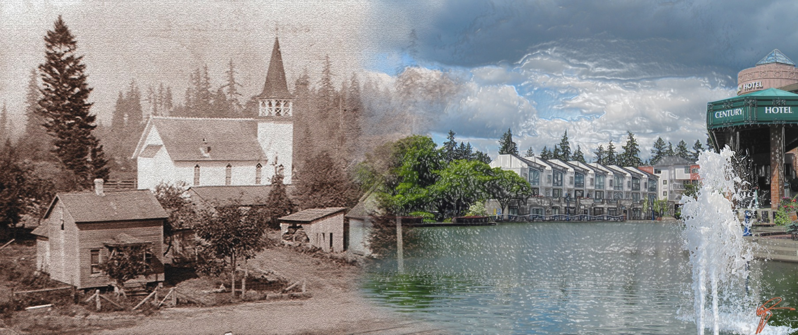
Center for Priority Based Budgeting Conference July 10, 2013

Slide 2
Tualatin’s Path to Fiscal Health
Summer 2009 -Began discussions with Jon and Chris
Fall 2009 -Model developed for Tualatin
Spring 2010 -Presented Fiscal Health and began using “On-Going” vs. “One-Time”
Nov 2011 - Began Quarterly Financial Reports to the City Council

Slide 3
General Fund Revenues – April 2010

Slide 4
General Fund Expenditures – April 2010

Slide 5
Fiscal Health Update – 1st Qtr FY12

Slide 6
Fiscal Health Update – 3rd Qtr FY12
2.5% of Expenditures

Slide 7
Fiscal Health Model (Status Quo)

Slide 8
Fiscal Health Model (With Revenue Growth)

Slide 9
Fiscal Health Model (Revenue Growth & Expenditure Savings)

Slide 10
Don Hudson Finance Director City of Tualatin dhudson@ci.tualatin.or.us (503) 691-3050

