Slide 1

PRIORITY BASE BUDGETING -
Approach and Outcomes
Center for Priority Based Budgeting
2013 ANNUAL CONFERENCE “A SUMMIT of LEADING PRACTICES”
Jon Johnson & Chris Fabian
July 9, 2013

Slide 2


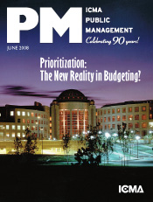

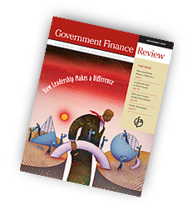
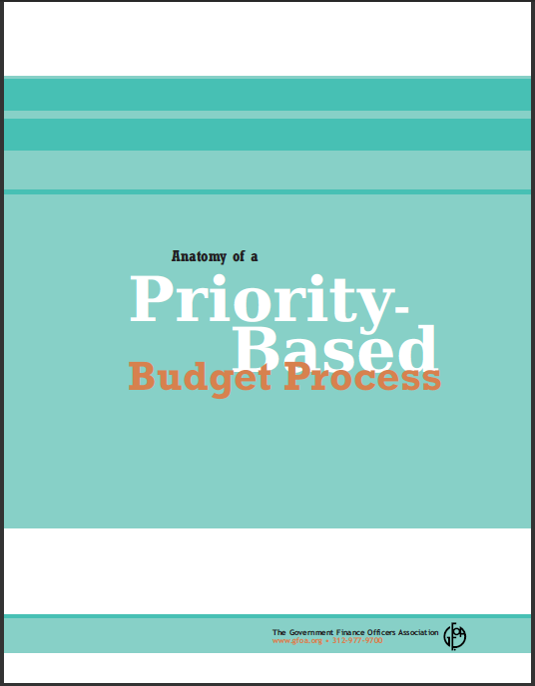
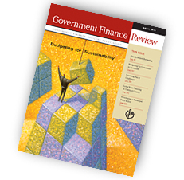
CPBB Publications on
Fiscal Health & Wellness

Slide 3
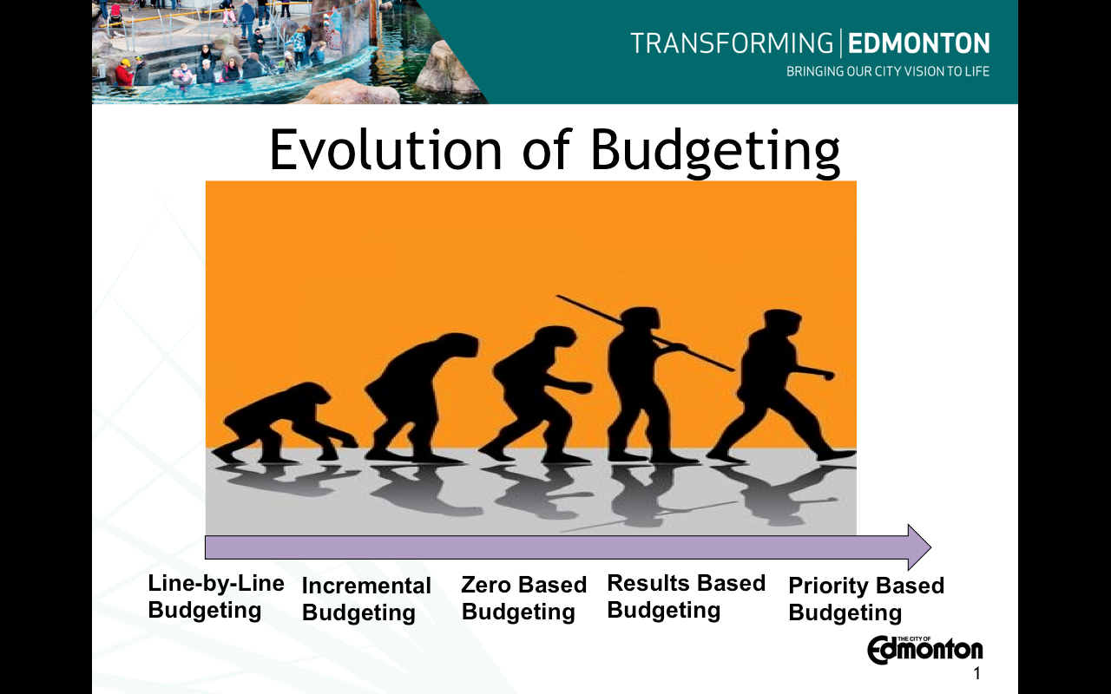

Slide 4

From 2007
Across the Board Cuts Address $14.5 Billion Shortfall
California Governor’s Office: “Across-the-board approach spreads reductions as evenly as possible so no single program gets singled out.”
Reaction: “the governor’s approach would be like a family deciding to cuts its monthly mortgage payment, dining-out tab and Netflix subscription each by 10%, rather than eliminating the restaurant and DVD spending in order to keep up the house payments.”

Slide 5

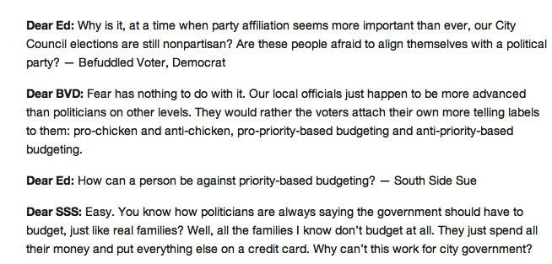

Slide 6

According to Moody’s:
Across-the-Board versus Targeted Budget Cuts
  “Across-the-board cuts can be a way to avoid tough decisions”
  “Targeted cuts require a serious discussion of community values, relative benefits of different services, and long-term implications”
Moody's wants to see how local governments plan for and respond to financial challenges over the long term
  “Making targeted cuts can demonstrate a more strategic approach to managing the fiscal crisis”

Slide 7

“Across the board cuts spreads the pain evenly and also evenly spreads the mediocrity”
- Budget Director for the State of Louisiana

Slide 9
STEPS to SUCCESS – Priority Based Budgeting
1. Determine Results
  Accurate prioritization of programs, reflecting the organization’s stated objectives, depends on the comprehensive identification of the Results it is in business to achieve
2. Clarify Result Definitions
  Precision in prioritization depends on the articulation of the cause and effect relationship between a program and a Result
  Using clearly defined “Result Maps”, detailing the factors that influence the way Results are achieved, the organization can minimize subjectivity in the process of linking programs with its Results
3. Identify Programs and Services
  Comparing individual programs and services as opposed to comparing departments that provide those services allows for better prioritization
4. Value Programs Based on Results
  With the right Results that are clearly defined, the organization can more accurately “value” a program relative to its influence on achieving Results
5. Allocate Resources Based on Priorities
  Using “Resource Alignment Diagnostic Tool”

Slide 10

Strategic Questions
What are we in “business” to do?

Slide 11
What are “Results”
High-level and over-arching reasons the organization exists in the eyes of the community
Remain consistent and unchanged over time
Comprehensive
Distinguished from (i.e. “Results” are not…)
  Vision or Mission Statements
  Organizational Values
    How we want to achieve our results
  “Marketing” statements
    Look and feel of the community
  Specific short-term, projects, goals or initiatives

Slide 12
Step 1: Determine Results
City of Grand Island, Nebraska
Community Results
Used to Differentiate Programs Offered to the Community
Not All Programs Achieve these Results
Programs that Achieve Many Results, with a High Degree of Influence, Achieve Highly in Prioritization (demonstrate high degree of relevance)
Quality Service Results
Every Program Should Achieve these Results (though potentially, not every program does)
Not Used to Differentiate the Relevance of Programs in Prioritization
Governance Results
Used to Differentiate Programs Designed to Support Governance
Stewardship of the Environment
Safe Community
Strategic, Sustainable and Maintained Development
Mobility Options
Efficient Services
Transparent Services
Financial Stewardship
High-quality Workforce
Regulatory Compliance

Slide 13
SUMMARY of RESULTS by COMMUNITY
 | CHANDLER, AZ |  | QUEEN CREEK, AZ |  | SACRAMENTO, CA |  | BOULDER, CO |  | WHEAT RIDGE, CO
 | Safe Community |  | Safe Community |  | Safe Community |  | Safe Community |  | Safe Community
 | Healthy and Attractive Community |  | Preservation of a Healthy, Sustainable Environment |  | Healthy, Sustainable Environment |  | Healthy Environment and Community |  | Healthy, Attractive and Well-Maintained Community
 | Leisure, Culture and Education |  | Partnering for Community Benefit |  | Leisure, Cultural and Social Opportunities |  | Inclusive and Socially Thriving Community |  | Desirable, Diverse and Connected Neighborhoods
 | Sustainable Economic Health |  | Economic Development |  | Youth Opportunities and Education |  | Economically Vital Community |  | Effective Transportation and Mobility Options
 | Effective Transportation |  | Managed Land Use and Development |  | Economic Vitality |  | Accessible and Connected Community |  | Economic Vitality
 | Good Governance |  | Community Involvement and Identify |  | Reliable Infrastructure and Effective Mobility |  | Governance |  | Good Governance
 |  |  | Effective and Sustainable Infrastructure |  | Efficient Government (Governance)
 |  |  | Good Governance

Slide 14
SUMMARY of RESULTS by COMMUNITY
 | BILLINGS, MT |  | CARY, NC |  | BLUE ASH, OH |  | LEHIGH COUNTY, PA |  | CHESAPEAKE, VA
 | Safe Community |  | Safe Community |  | Safe Community |  | Safe Community |  | Safe Community
 | Preservation of Community Resources |  | Quality Cultural, Recreational & Leisure Opportunities |  | Attractive and Well-Maintained Community |  | Quality Recreation, Leisure and Lifestyle Opportunities |  | Ecological Stewardship
 | Leisure, Cultural and Learning Opportunities |  | Economic Vitality & Development |  | Quality and Diverse Leisure-time Activities |  | Healthy Nurturing & Social Responsible Environment |  | Healthy, Nurturing and Secure Community
 | Involved, Engaged and United Community |  | Attractive, Well-Planned & Livable Community |  | Quality and Desirable Neighborhoods |  | Economic Health & Vitality |  | Economic Vitality
 | Sustainable Economic Development |  | Effective Transportation & Mobility |  | Strong and Vibrant Economic Environment |  | Quality Infrastructure & Transportation Systems |  | Quality Infrastructure and Transportation Systems
 | Comprehensive, Orderly Growth and Development |  | Reliable, Sustainable Infrastructure |  | Connected, Accessible and Reliable Transportation Network |  | Managed, Well-Planned Growth |  | Good Governance
 | Effective and Connected Transportation Systems |  | Good Governance |  | Governance |  | Good Governance
 | Honest, Responsive Government (Governance)

Slide 15
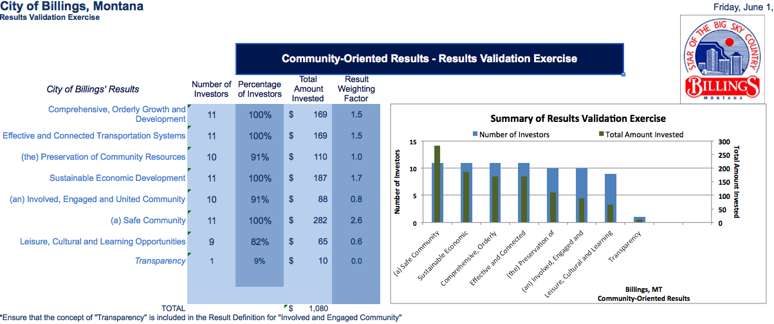
Validating Results

Slide 16
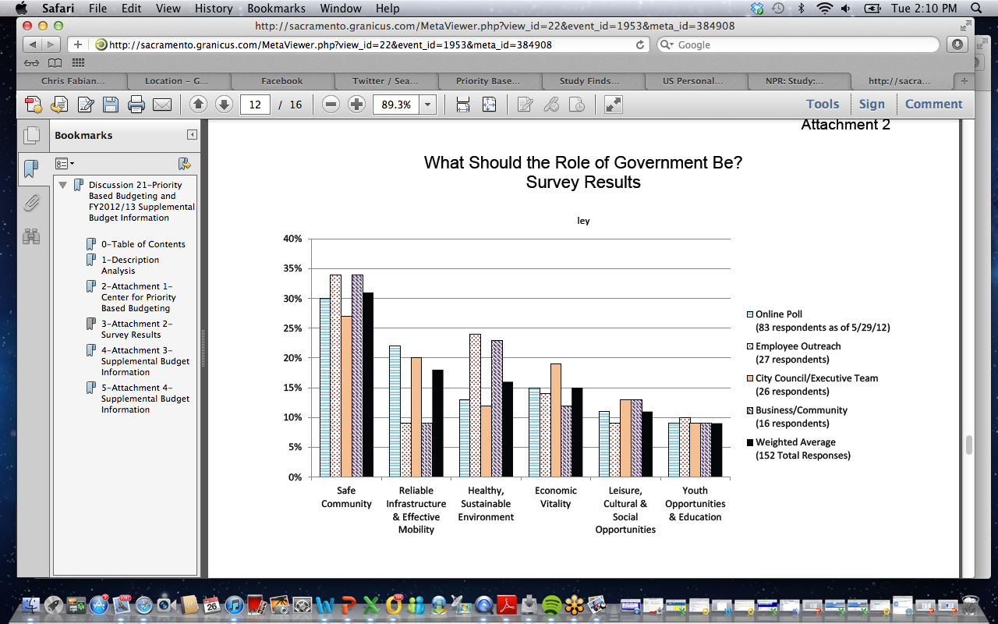
Validating Results
City of Sacramento, CA

Slide 17
Step 2: Clarify Result Definitions
(Result Maps)
City of Boulder, CO Results
Accessible & Connected Community
Economically Vital Community
Healthy Environment & Community
Inclusive & Socially Thriving Community
Safe Community

Slide 18
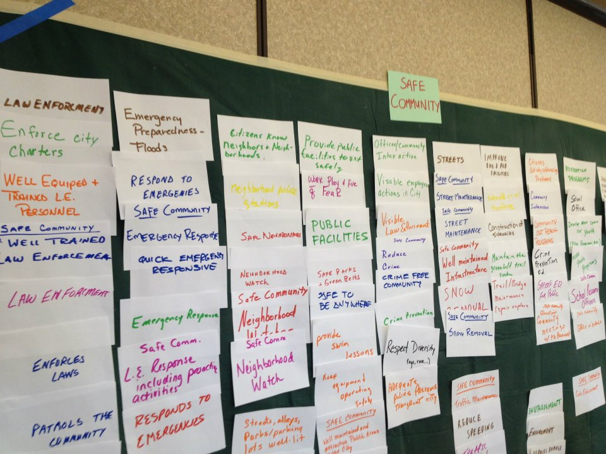
Defining Results
Result Mapping Exercise

Slide 19
Creating Result Maps
CITY OF BILLINGS, MONTANA
Result: COMPREHENSIVE, ORDERLY GROWTH and DEVELOPMENT
 | If the CITY OF BILLINGS _____________________________, then it will have successfully achieved the result of providing COMPREHENSIVE, ORDERLY GROWTH and DEVELOPMENT
 | Provides, maintains and invests in a well-planned public infrastructure network that accommodates the long-range growth needs of the community |  | Develops, preserves and revitalizes residential neighborhoods that are safe, attractive and provide diverse, affordable housing options |  | Appropriately plans for the creation, maintenance and accessibility of open space, parks, recreational activities and educational opportunities |  | Optimizes the City's resources and enhances the growth needs of the community through well-planned infill and annexation |  | Develops and prepares integrated, comprehensive long-range zoning and land use plans that are consistently followed and managed |  |  | Partners to plan, prepare and collaboratively invest in properly regulated, quality and future-focused development and redevelopment that stimulates the local economy and is consistent with community standards
 | Fix existing infrastructure before building new |  | Support affordable housing development city-wide, not just in low income areas |  | Park/trails/open space creation & maintenance |  | Incentivize infill development |  | Structured/consistent land use regulations | Funds the planning department |  | Following existing phase policies | Invests in downtown & neighborhoods
 | Administers and prioritizes its CIP |  | Promote neighborhood revitalization |  | Develop resources to support park development |  | Continue annexation policy that identifies areas for growth already served by City programs |  | Updates & reviews as zoning/land use regulations | Planning related to growth |  | Developer buy-in | Blighted/run-down area redevelopment
 | Fund CIP on regular basis so infrastructure is built, repaired & replaced |  | Invests in downtown & neighborhoods |  | Water Park 15 minutes from every home |  | Annexation plan |  | Zoning regulations (2) | Planning for development |  | Reviews & approves fees for service that cover at least 75% of that true cost of development review | Invest in downtown
 | Reviews & approves the CIP |  | Blighted/run-down area redevelopment |  | Public indoor recreation centers |  | Well-defined annexation plan/map/policy |  | Mixed use structures and neighborhoods | Master plan |  | Figure "real cost" of developments before approving | Dangerous building abatement
 | Long-term arterial road plan |  | Provides broad housing choices |  | Parks where needed |  | Identify whether infill areas are sufficient to meet future growth needs |  | Good zoning | Prepare/implement neighborhood plans |  | Development review boards | De-localize businesses (so that I don't have to travel across town to get what I want)
 | Infrastructure paid for by development |  | Ensure affordable housing |  | New recreation programs for youth |  | Infill policy |  | Zoning control | Future planning |  | Developers follow the rules | Support & encourage small business
 | Anticipate, plan & provide for increased infrastructure |  | SUBDIVISION ZONING - INCLUDES LOW INCOME HOUSING |  | A park within walking distance from every home |  | Stops annexing areas not up to City standards |  | Green zone | Provide for long-range planning & annexation |  | Partnering with development community | Save small businesses

Slide 20
Identify and Define Results

Slide 21
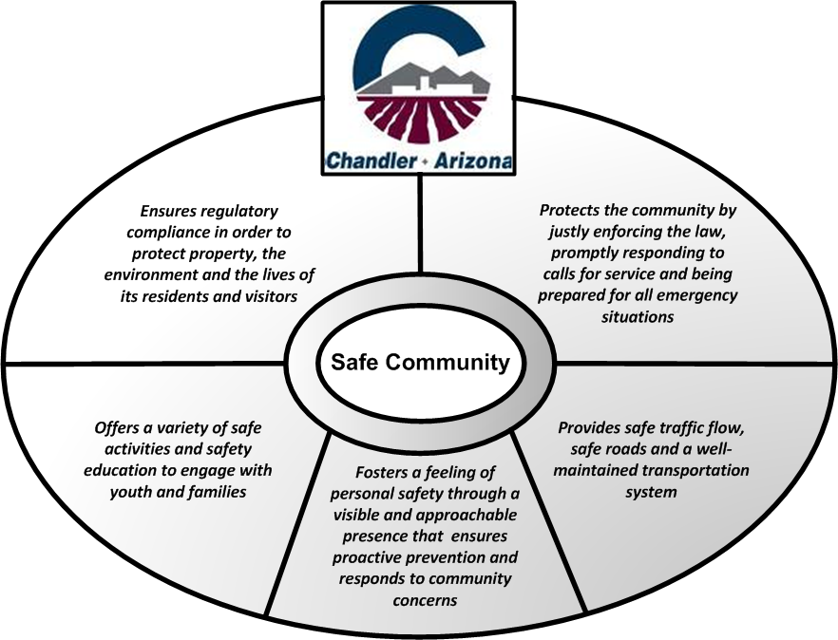

Slide 24
Role of the Council/Board
Develop and/or endorse the Results
Partner with Staff to develop and/or endorse the Results Definitions
Decide on the level of public engagement
Role of the Citizens
Partner with the Council/Board to develop and/or endorse the Results
Partner with Council/Board and Staff to develop or endorse the Results Definitions

Slide 25

Strategic Questions
What are we in “business” to do?
What exactly do we do?

Slide 26
Step 3: Identify “Programs”
Departments develop their own “program” inventories – only ongoing; exclude capital & one-time
Comprehensive list of “what we do”
Comparing relative value of programs, not relative value of departments
Goldilocks & the Three Bears: Not too big, not too small, just right!
  TOO BIG = Departments/Divisions
  TOO SMALL = Tasks
  JUST RIGHT = Measure relative size based on costs/people associated with program to more discretely demonstrate how resources are used
City of Boulder, Colorado

Slide 27
OBJECTIVES for
Developing Program Inventories
  Create a comprehensive listing of all services offered by each operating division ( to both “external” and “internal” users
  Provide a better understanding of “what we do” to staff, administration, elected officials and citizens
  Provide a framework to better understand how resources are used to support “what we do”
  Provide a valuable tool for staff, management and elected officials to use when faced with budgetary “choices” about how funds are distributed.
  Allow for the preparation and discussion of a “program budget” rather than a “line-item budget”

Slide 28
Defining Programs
To determine “just right”, look for “differences” that might help determine if an activity can be defined as a “stand-alone” program
  “Who” are you doing the activity for?
    Does it benefit a specific demographic group or population?
  “Where” are you offering the service?
    Does it impact a specific area, location or environment
  “What” are you doing the service to?
    Does it affect a specific property or asset (infrastructure, facility, etc.)
  “How” is it funded? – Is there someone paying for it?
    Are there revenue sources associated directly with the program (“Program Revenues”)

Slide 29
Defining Programs
  “What” percentage of your resources are used to provide it? - Do you need “specialized resources?
    Is the estimated annual cost of the program a significant percentage of your total section’s budget?
    Are the number of FTE’s associated with the program a significant portion of your total section’s staff?
  Has someone told us we “have to do it?
    Are there statutes, ordinances, resolutions, or other legislative documents that require us to provide the service?
  What “type” of service are you providing?
    Preventative, Replacement; Repair/Maintenance; Instruction; Protection; Informative; etc.

Slide 30
Defining Programs
  Is there an “End Product” as a result of doing it?
    Does the external or internal user get something tangible when the service is delivered?
  “Is there someone outside the organization that “does the same thing”?
    Does a private business offer a similar service (“Yellow Pages test”)
  Do we “advertise” that we do it?
    Is there a separate phone directory or website reference to the service?

Slide 31
Role of the Council/Board
Have transparent access to listing of all programs offered along with associated costs and FTE
Educate themselves on the variety and diversity of programs offered
Role of the Citizens
Have transparent access to listing of all programs offered along with associated costs and FTE
Be informed about the nature of the programs offered to residents businesses and visitors

Slide 32


Strategic Questions
What are we in “business” to do?
What exactly do we do?
How do we figure out what is “core” OR What is of the highest importance?

Slide 33
Step 4: Score Programs against
Results & Attributes
City of Boulder’s Results
Basic Program Attributes
Accessible & Connected Community
Economically Vital Community
Healthy Environment & Community
Inclusive & Socially Thriving Community
Safe Community
Mandated to Provide the Program
Reliance on the City to Provide the Program
Cost Recovery of the Program
Change in Demand for the Program
Portion of Community Served by the Program
And/or any other criteria that is relevant to your community

Slide 34
Simple Scoring Scale –
“Degree” of Relevance to a Result
4 = Program has an essential or critical role in achieving Result
3 = Program has a strong influence on achieving Result
2 = Program has some degree of influence on achieving Result
1 = Program has minimal (but some) influence on achieving Result
0 = Program has no influence on achieving Result
“High Degree” of Relevance
“Lower Degree” of Relevance (still a clear connection)
No Clear Connection

Slide 35
Basic Program Attributes:
Mandated to Provide Program
Programs that are mandated by another level of government (i.e. federal, state or county) will receive a higher score for this attribute compared to programs that are mandated solely by the City or have no mandate whatsoever.
The grading criterion established to score programs, on a 0 to 4 scale is as follows:
  4 = Required by Federal, State or County legislation
  3 = Required by Charter or other incorporation documents OR to comply with regulatory agency standards
  2 = Required by Code, ordinance, resolution or policy OR to fulfill franchise or contractual agreement
  1 = Recommended by national professional organization to meet published standards or as a best practice
  0 = No requirement or mandate exists

Slide 36
Basic Program Attributes:
Reliance on City to Provide Program
Programs will be graded on the degree of reliance residents have on the City to provide a service as compared with their ability to obtain the same or a similar service from another intergovernmental agency or a private business. Programs for which residents can only look to the City will receive a higher score for this attribute compared to programs that are offered by other providers.
The grading criterion established to score programs, on a 0 to 4 scale is as follows:
  4 = City is the sole provider of the service and there are no other public or private entities that provide this type of service
  3 = City is the sole provider but there are other public or private entities which could be contracted to provide this service
  2 = Program is only offered by another governmental, non-profit or civic agency
  1 = Program is offered by other private businesses not within City limits
  0 = Program is offered by other private businesses within City limits

Slide 37
Basic Program Attributes:
Change in Demand for Program
Programs demonstrating an increase in demand or utilization will receive a higher score for this attribute compared to programs that show no growth in demand for the program or service. Programs demonstrating a decrease in demand or utilization will actually receive a negative score for this attribute.
The grading criterion established to score programs, on a -4 to 4 scale is as follows:
  4 = Program experiencing a SUBSTANTIAL increase in demand of 25% or more
  3 = Program experiencing a SIGNIFICANT increase in demand of 15% to 24%
  2 = Program experiencing a MODEST increase in demand of 5% to 14%
  1 = Program experiencing a MINIMAL increase in demand of 1% to 4%
  0 = Program experiencing NO change in demand
  -1 = Program experiencing a MINIMAL decrease in demand of 1% to 4%
  -2 =Program experiencing a MODEST decrease in demand of 5% to 14%
  -3 =Program experiencing a SIGNIFICANT decrease in demand of 15% to 24%
  -4 =Program experiencing a SUBSTANTIAL decrease in demand of 25% or more

Slide 38
Basic Program Attributes:
Cost Recovery of Program
Programs that demonstrate the ability to “pay for themselves” through user fees, intergovernmental grants or other specifically dedicated revenues will receive a higher score for this attribute compared to programs that generate limited or no funding to cover their cost.
The grading criterion established to score programs, on a 0 to 4 scale is as follows:
  4 = Fees generated cover 75% to 100% of the cost to provide the program
  3 = Fees generated cover 50% to 74% of the cost to provide the program
  2 = Fees generated cover 25% to 49% of the cost to provide the program
  1 = Fees generated cover 1% to 24% of the cost to provide the program
  0 = No fees are generated that cover the cost to provide the program

Slide 39
Basic Program Attributes:
Portion of Community Served by Program
Programs that benefit or serve a larger segment of the City’s residents, businesses and/or visitors will receive a higher score for this attribute compared to programs that benefit or serve only a small segment of the population.
The grading criterion established to score programs, on a 0 to 4 scale is as follows:
  4 = Program benefits/serves the ENTIRE community and adds to their quality of life
  3 = Program benefits/serves a SUBSTANTIAL portion of the community and adds to their quality of life
  2 = Program benefits/serves a SIGNIFICANT portion of the community and adds to their quality of life
  1 = Program benefits/serves SOME portion of the community and adds to their quality of life
  0 = Program benefits/serves only a SMALL portion of the community, but still adds to their quality of life

Slide 40
Identify “Value” of Program Based on their Influence on Results

Slide 41
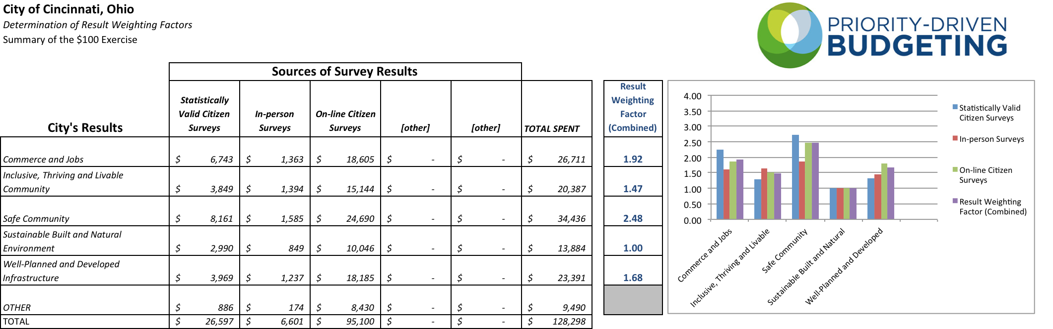
Not all Results are of Equal Relevance:
Result “Weighting Factor”
*Result “Weighting Factor” applied to program scores for each Result

Slide 42

Strategic Questions
What are we in “business” to do?
What exactly do we do?
How do we figure out what is “core” OR What is of the highest importance?
How do we know we are successful?

Slide 43
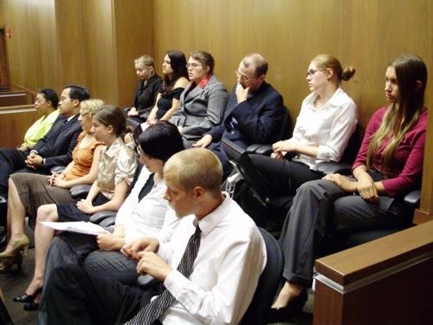
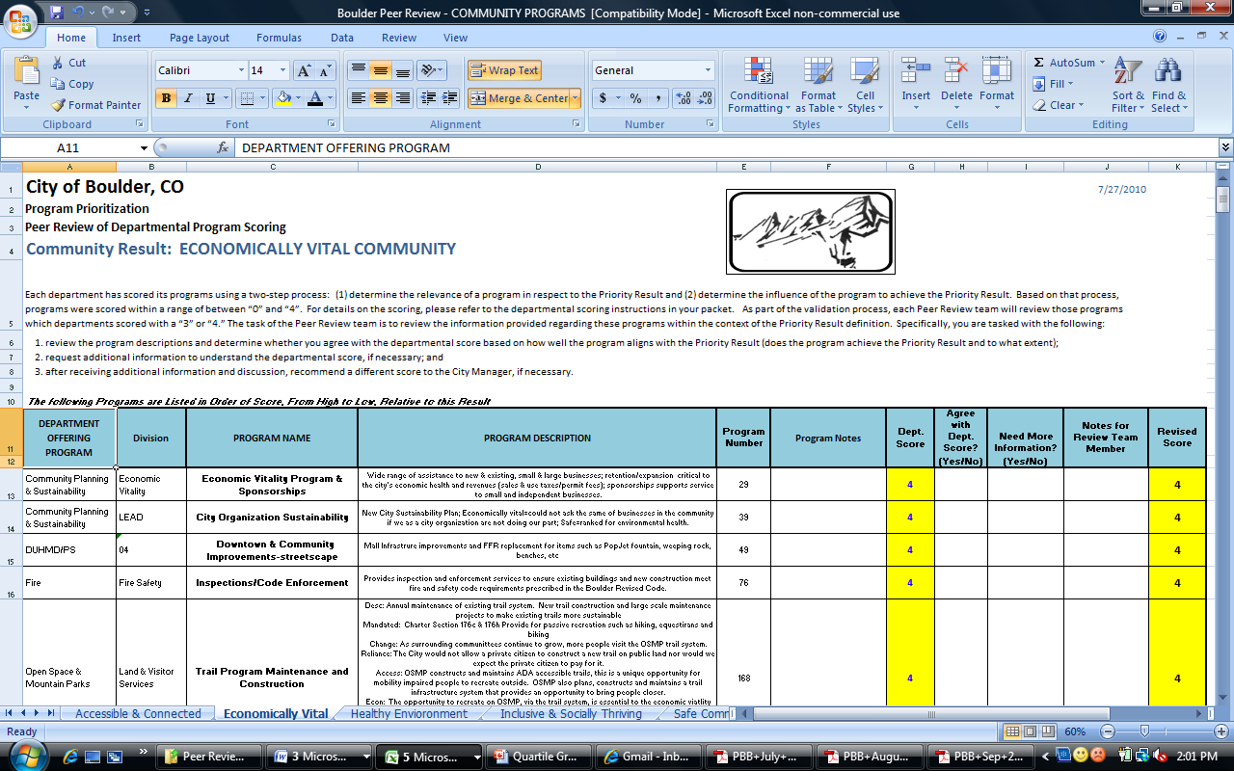
Peer Review (Quality Control) Process

Slide 44
Role of the Council/Board
Offer input and/or endorse the Basic Program Attributes.
If desired, individually participate in Peer Review process as member of one Result Team
Understand and evaluate the “key indicators” being used to validate achievement of desired Results
Role of the Citizens
Selectively participate in Peer Review process as member of one Result Team – City of San Jose, CA
Understand and evaluate the “key indicators” being used to validate achievement of desired Results

Slide 45
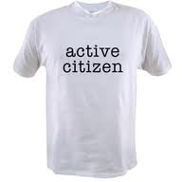

Strategic Questions
What are we in “business” to do?
What exactly do we do?
How do we figure out what is “core” OR What is of the highest importance?
How do we know we are successful?
How do we ask “better” questions that lead to “better” decisions about “what we do” and “why we do it”?
What do you want to “keep” (not “What do you want to cut”) – THE ROLE OF CITIZENS

Slide 46
Keys to Public Engagement
1.) Determine objective for engaging the Public
  Is it a “Means to an End” or an “End in and of Itself”?
2.) Design the role of the Public so it will have a meaningful influence
3.) Ensure higher participation – GO TO THEM
  Use the Web
  Mail enclosures with Newsletters or Utility Bills
  Attend Community Meetings (i.e. Chamber of Commerce; Civic Groups; School Board; HOA Meetings)
  Set up kiosks at Library, Rec Center, Senior Center, etc.

Slide 47
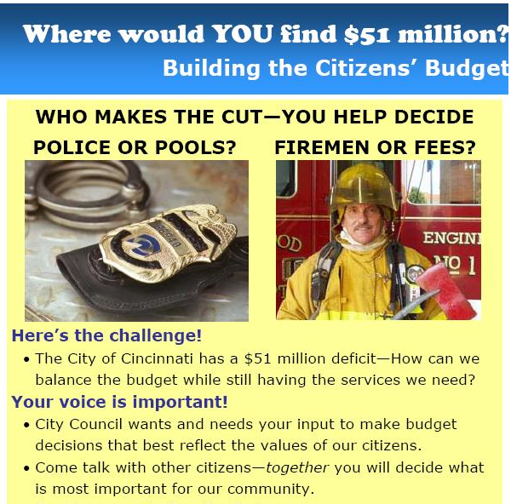
Many Challenges Inherent in Engaging Public
Level of discussion too “Big Picture”
Conversation is framed contentiously (and possibly with “fear”)
Unclear about “how” citizens will be able to participate

Slide 48
Valuing the Results of Government
Invest $100 in Results, according to their relative importance

Slide 49
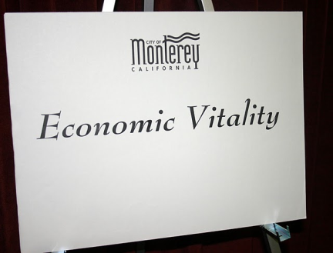
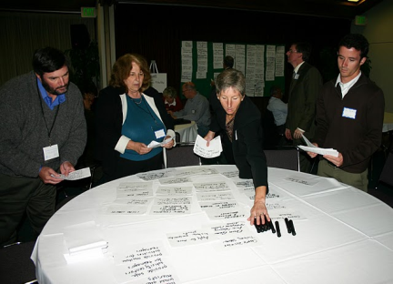
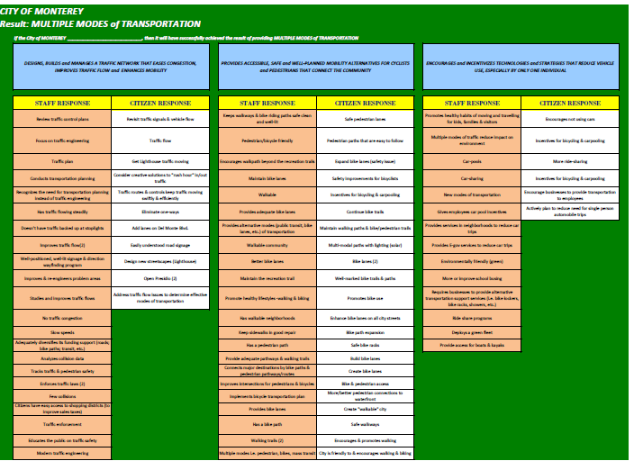
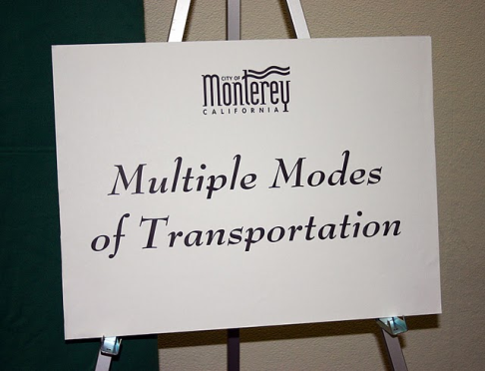
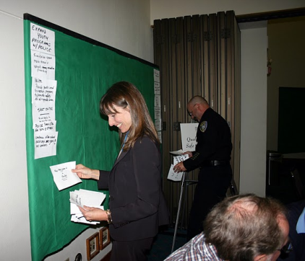
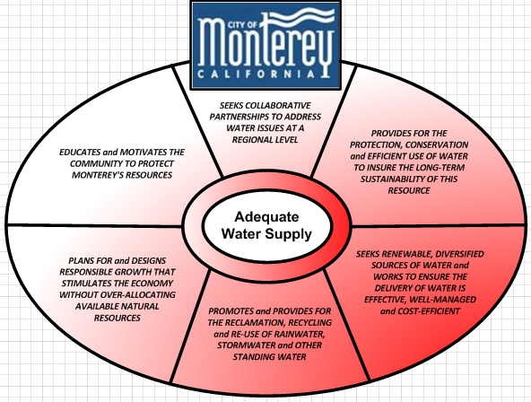

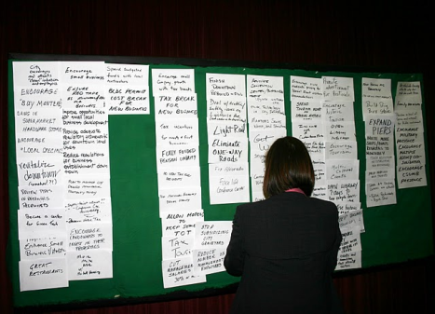
City of Monterey, California
Engaging Public in New Discussion
About “What They Want to Keep”

Slide 50
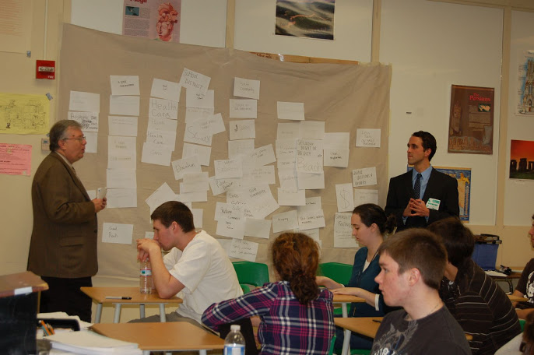
City of Blue Ash, Ohio

Slide 51
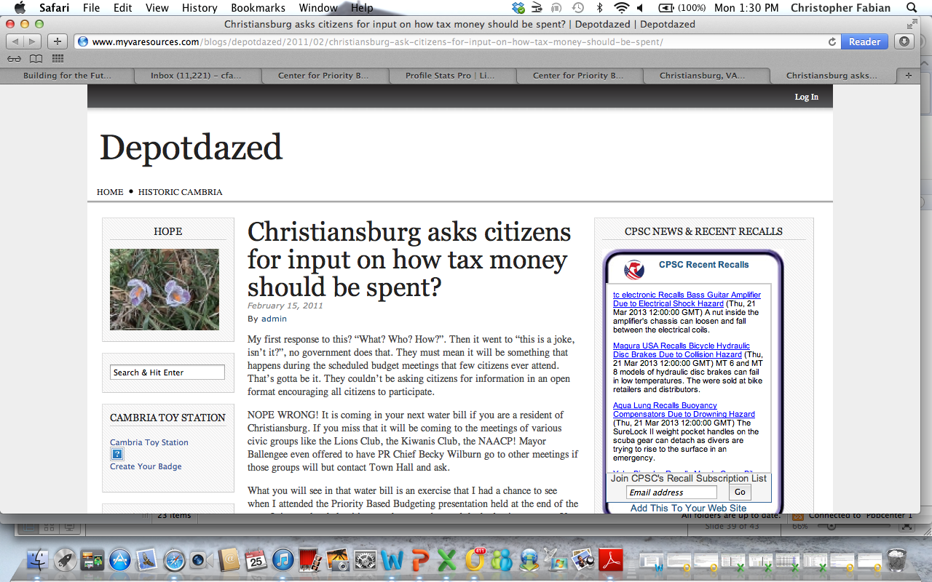
Town of Christiansburg, Virginia

Slide 52
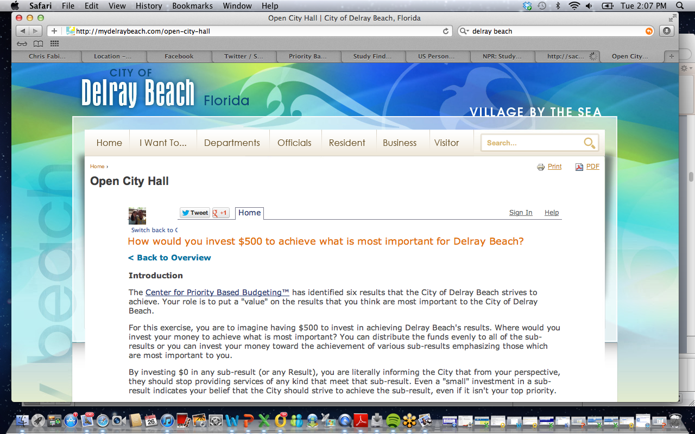
City of Delray Beach, Florida

Slide 53
Thank You !
    Jon Johnson, Co-Founder Chris Fabian, Co-Founder
    303-756-9090, ext. 326 303-756-9090, ext. 325
    303-909-9052 (cell) 303-520-1356 (cell)
    jjohnson@pbbcenter.org cfabian@pbbcenter.org
www.pbbcenter.org
Copyright ©2009 by Chris Fabian and Jon Johnson d/b/a the Center for Priority Based Budgeting,
Denver, Colorado.

