Slide 1

FISCAL HEALTH –
Technology and Tools
Showcase
Center for Priority Based Budgeting
2013 ANNUAL CONFERENCE “A SUMMIT of LEADING PRACTICES”
Jon Johnson & Chris Fabian
July 9, 2013

Slide 2


BRINGING VISION INTO FOCUS
WITH A NEW “LENS”

Slide 4

Strategic Questions
How much do we have available to spend? - (not “How much do you need”?)
Why do we need to keep “money in the bank”?
What’s the “difference”?
“It costs how much”????????

Slide 5
How to
Identify Program Costs
1) Associate Salary & Benefit Costs with your Personnel
2) Assign Personnel to the Programs they Provide
3) Associate Non-Personnel Costs with Programs
4) Line item Budget is now expressed as a Program Budget!

Slide 6
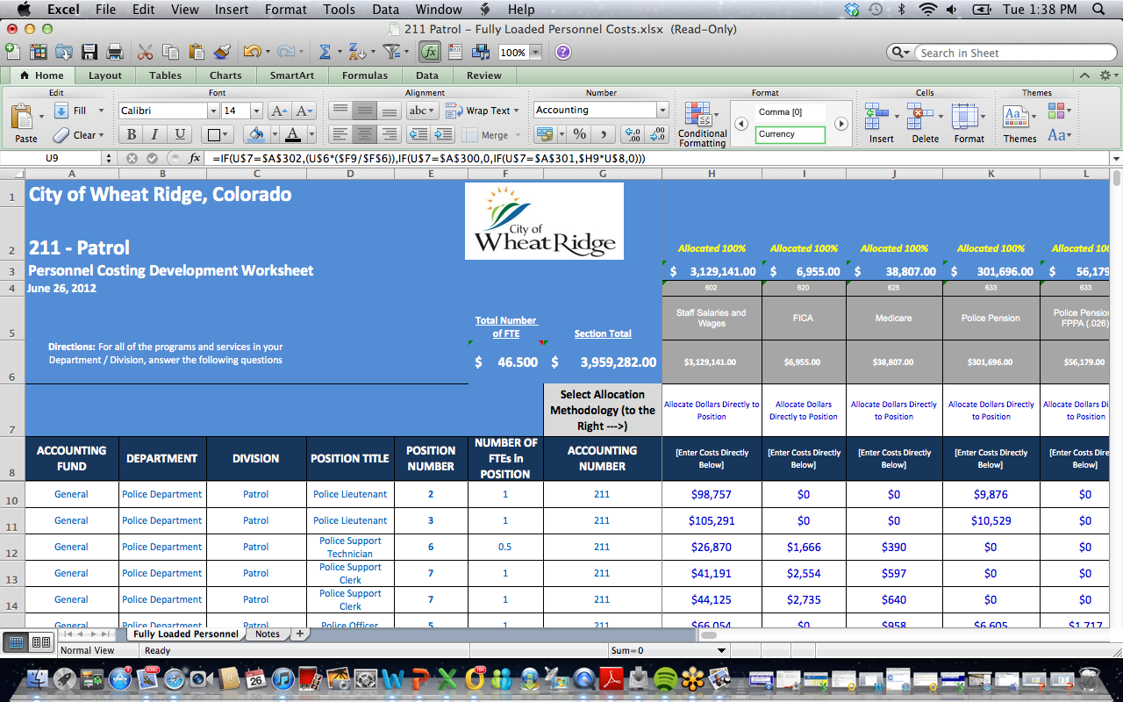
1) Associate Salary & Benefit Costs with your Personnel
Key is understanding how personnel line items are distributed (per FTE, on a percentage of salary basis, etc.)

Slide 7
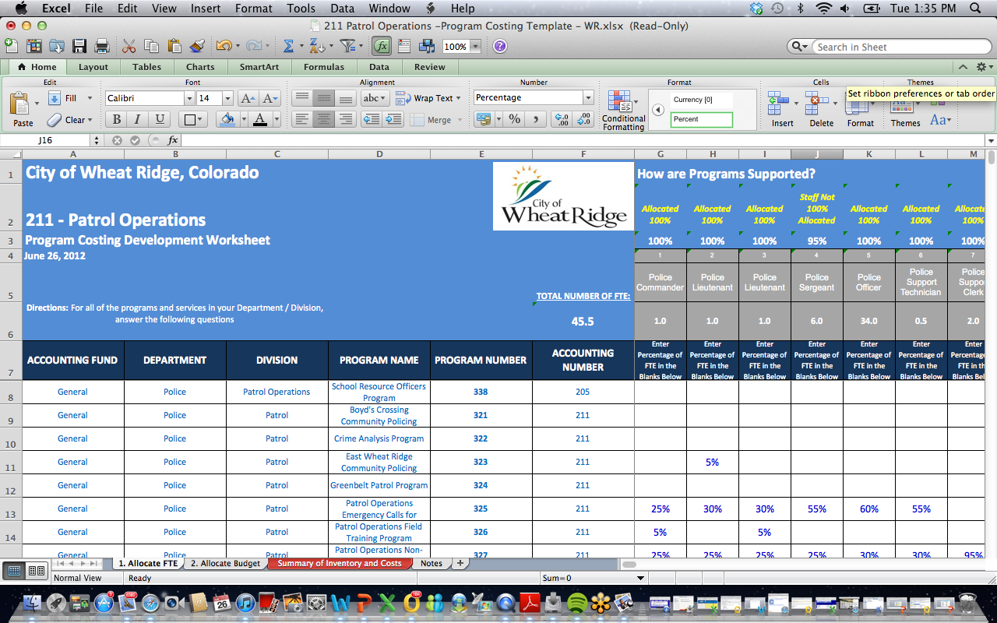
2) Assign Personnel to the
Programs they Provide
Estimate for a given year (this is not a time study!)
Accuracy, not precision, is the goal
Can’t allocate an FTE over 100% (no matter how overworked they think they are)

Slide 8
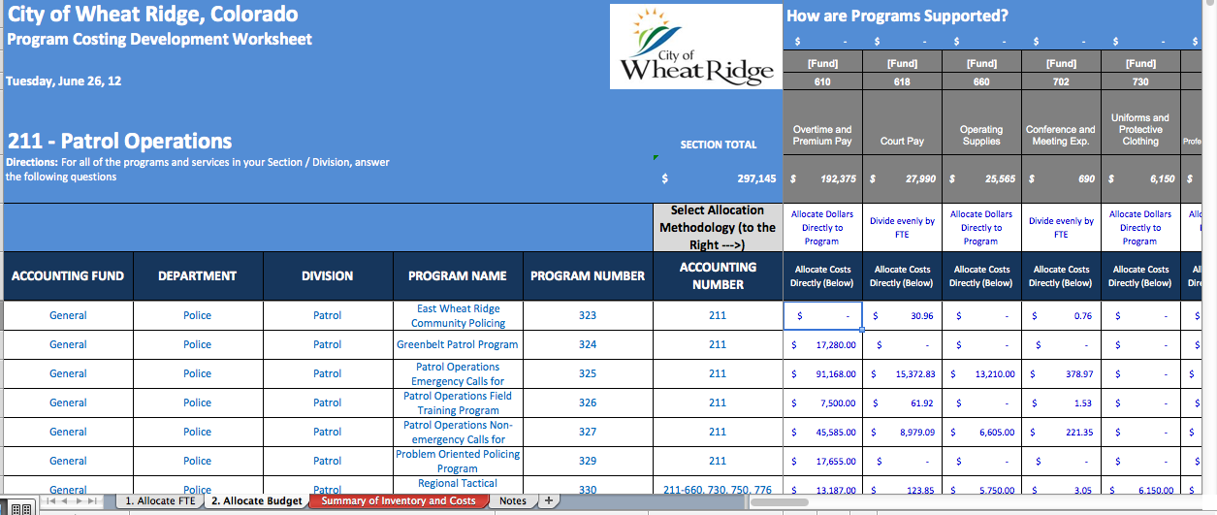
3) Associate Non-Personnel Costs with Programs
Choose a reasonable allocation methodology:
  Divide costs by FTE (i.e. supplies line item)
  Assign costs directly to program (i.e. annual audit)

Slide 9

Strategic Questions
How much do we have available to spend? - (not “How much do you need”?)
Why do we need to keep “money in the bank”?
What’s the “difference”?
“It costs how much”????????
“What’s the plan and what could cause it to change?
What does the future look like?
What if………..???

Slide 10
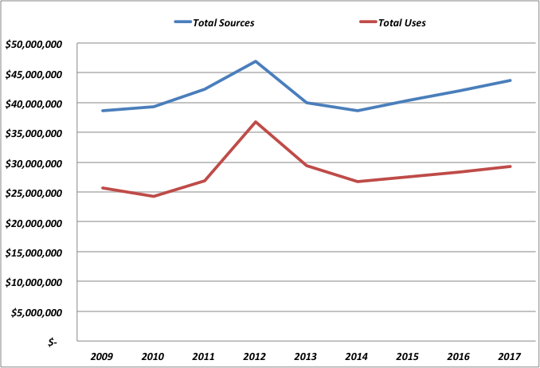
Looks like a Financially “Healthy” Organization – Right?

Slide 11
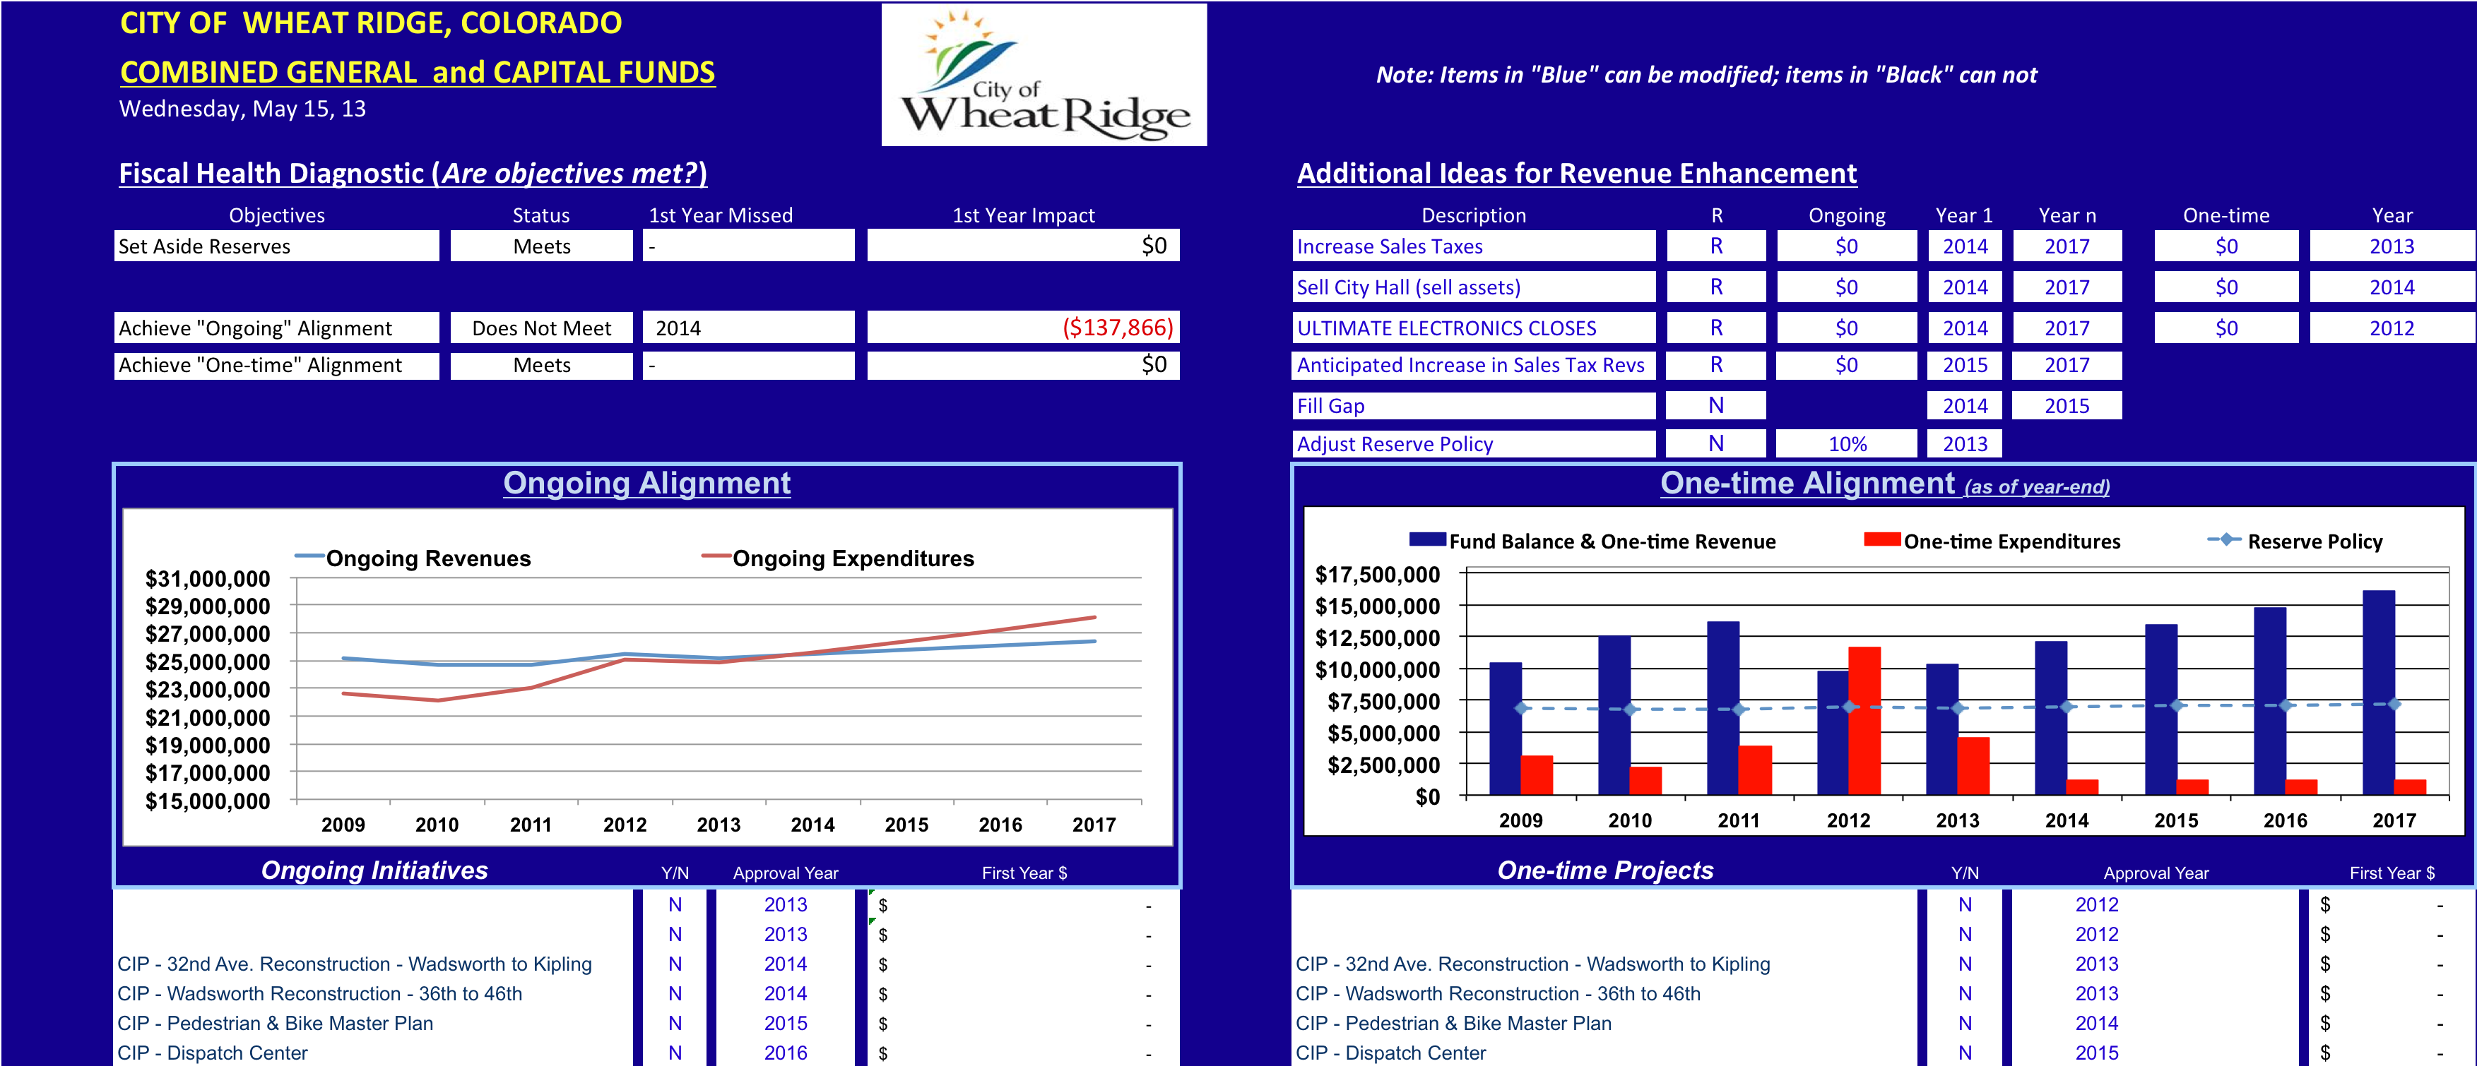
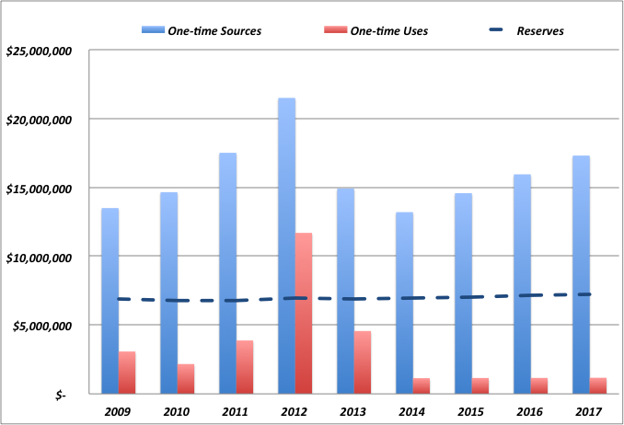
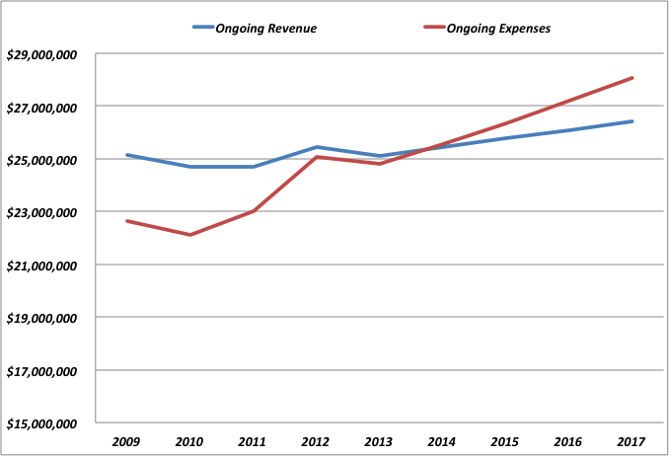
Let’s Look through a Different Lens!

Slide 12
“FISCAL HEALTH DIAGNOSTIC TOOL” –
Tell the Story with a “Picture”

Slide 13
Live Demonstration of
“Fiscal Health Diagnostic Tool”

Slide 14
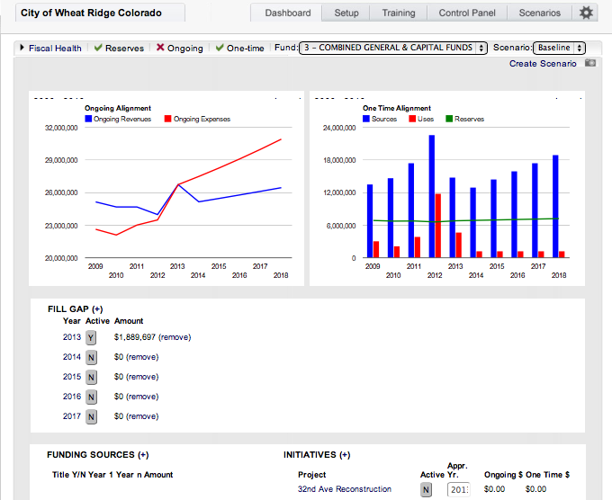

Slide 15
Thank You !
    Jon Johnson, Co-Founder Chris Fabian, Co-Founder
    303-756-9090, ext. 326 303-756-9090, ext. 325
    303-909-9052 (cell) 303-520-1356 (cell)
    jjohnson@pbbcenter.org cfabian@pbbcenter.org
www.pbbcenter.org
Copyright ©2009 by Chris Fabian and Jon Johnson d/b/a the Center for Priority Based Budgeting,
Denver, Colorado.

