Slide 1



Commonwealth Centers
FOR HIGH-PERFORMANCE ORGANIZATIONS
www.highperformanceorg.com
THE FEDERAL EXECUTIVE INSTITUTE
THE WELDON COOPER
CENTER FOR PUBLIC SERVICE
UNIVERSITY OF VIRGINIA
BUILDING
HIGH-PERFORMANCE
ORGANIZATIONS IN
THE TWENTY-FIRST
CENTURY
John W. Pickering, Ph.D.
jpickering@highperformanceorg.com
Gerald S. Brokaw, B.S.
gbrokaw@highperformanceorg.com
Philip D. Harnden, Ph.D.
pharnden@highperformanceorg.com
Anton S. Gardner, M.A.
agardner@highperformanceorg.com
For information about custom programs at The Federal Executive Institute, contact:
Director of the FEI
CEL@opm.gov v 434.980.6200
For information about the Weldon Cooper Center for Public Service at the University of Virginia, contact:
Director of Executive Development carmie@virginia.edu v 434.982.5512

Slide 2

  HPO Overview
Commonwealth Centers for High Performance Organizations
    WHERE ARE WE GOING?
  What are we after?
  Are we getting there?
  What do our stakeholders value?
    HOW DO WE GET THERE?
  Are we doing the right things?
  Are we doing them “right”?
    WHAT CULTURE PROPELS US?
  How do we treat each other?
  How do we keep energized?
    HOW DO WE WORK TOGETHER?
  How do we organize to improve performance?

Slide 3
  HPO OVERVIEW
Commonwealth Centers for High Performance Organizations
  EMPLOYEE ENGAGEMENT
    A significant Influence on whether sustained High Performance is achieved in today’s dynamic, fast-paced environment.

Slide 4
  HPO OVERVIEW
Commonwealth Centers for High Performance Organizations
  EMPLOYEE ENGAGEMENT
  Consider all types of workers who are:
    Engaged
    Not Engaged
    Actively Disengaged
  What’s the percentage of each in the national and your localities’ workforces?

Slide 5
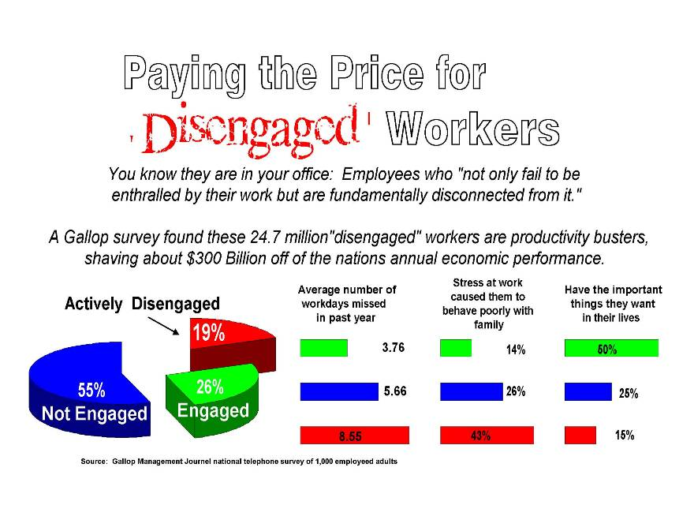

Slide 6
I-4
THE NETWORKED TALENT MODEL and LEADERSHIP AT ALL LEVELS
Commonwealth Centers for High-Performance Organizations
INDUSTRIAL ENGINEERS
“SCIENTIFIC MANAGERS”
1900
L
OWNERS
EXECUTIVES
Upper Class
M
M
M
INDUSTRIAL PHASE
MANAGERS
FOREMEN
T
T
T
T
T
Division of Labor
LABOR
Vertical
Horizontal
Working Class
© 1989-2012 Commonwealth Center for High-Performance Organizations, Inc. – permission to use for non-commercial purposes granted with citation

Slide 7
  HPO OVERVIEW
Commonwealth Centers for High Performance Organizations
    WHY SUCH DISENGAGEMENT?
  Most private and public organizations use an hierarchical system developed for the industrial revolution, updated some for the mid twentieth century.
  Evidence over the last 40+ years: much disengagement results from operating in such a controlling, stifling environment.

Slide 8
  HPO OVERVIEW
Commonwealth Centers for High Performance Organizations
  A TIME OF TRANSITION
  Led by the most profitable and successful enterprises, many businesses and governments are transitioning to elicit and utilize the full range of talents, skills and abilities in their workforces.
  Results:
    more engaged workers
    more productive, effective workers
    workers who enjoy their jobs more

Slide 9
  HPO OVERVIEW
Commonwealth Centers for High Performance Organizations
JACK WELCH’S LESSON
  “All these years you paid me for my hands – when you could have had my brains for free.”

Slide 10
SM-35
LEADERSHIP PHILOSOPHY
Commonwealth Centers for High Performance Organizations
FEDERAL EXPRESS ORGANIZATION CHART
EXTERNAL CUSTOMERS
Front-Line Employees
Managers
Senior Managers
Managing Directors
VP’s, Sr. VP’s, COO, CEO
“Our challenge is to manage a work force and create a workplace that empowers people and continually taps human potential, so here’s the message we try to communicate to our people: The purpose of a business is to gain and keep customers. A courier’s job…is to work directly for the customer. A front-line manager’s job is to make the courier’s job easier, and his/her manager’s job is to make the front-line manager’s job easier, and so on until you get to the executive suite, where the job is to do whatever it takes to help everybody do their best. If you look at your organization chart this way, everyone in the company is the CEO’s customer.”
Frederick W. Smith, CEO at Federal Express quoted in Blueprints for Service Quality: The Federal Express Approach, (New York: American Management Association Management Briefing, 1991)

Slide 11
  HPO OVERVIEW
Commonwealth Centers for High Performance Organizations
  HOW DO WE ENGAGE ALL THE EMPLOYEE HAS TO OFFER?
  Redefine what’s expected
  Everyone responsible for:
    Leadership
    Management
    Tasks
    Appropriate to where they work

Slide 12
“WORK” IS HOLISTIC IN THE NETWORKED TALENT MODEL
I-8
THE NETWORKED TALENT MODEL and LEADERSHIP AT ALL LEVELS
Commonwealth Centers for High-Performance Organizations
Management
Skills, Abilities, and Behaviors (partial list)
Business Models / Value Propositions
Business Plan Creation, Implementation, Measurement, Monitoring, and Corrective Action
Financial Management Systems
Project / Change Management
Process Improvement Tools
People Systems
Information / Technology Management Systems
Open Communication Systems
Leadership
Skills, Abilities, and Behaviors
Strategic Stakeholder Value Analysis
Vision / Values to Strategy / Structure / Systems
Suprasystems Integration / Stewardship
Learning / Thinking / Changing / Renewing
Enabling / Empowering / Engaging / Energizing
M
L
TS
T
Task / Technical
Skills, Abilities, and Behaviors
continuously broaden and deepen task / technical skills and abilities
Team Skills,
Abilities, and Behaviors
see next slide (I-9 ) for these skills
© 1989-2012 Commonwealth Center for High-Performance Organizations, Inc. – permission to use for non-commercial purposes granted with citation

Slide 13
The HPO Diagnostic Change Model:
7 Key Diagnostic Questions…
What is high performance for us?
How would we know if we were high performing?
According to whom are we high performing?
Why do we need to be high performing?
Are we delivering the right what?
How good are we at delivering our services?
How will we treat each other and our customers?
Source: Commonwealth Center for High-Performance Organizations, Inc.
67
Notes:
TONY

Slide 14
What is High Performance?
The simultaneous delivery of
Appropriate
Product
and Service
Quality with Excellent Execution
Quality
Outstanding
Customer/
Stakeholder
Value
HPO
Sound
Financial
Performance
Source: Commonwealth Center for High-Performance Organizations, Inc.
6
Notes:
CHERYL
One of the ways we have found to combat some of the issues related to employee disengagement and improve the delivery of quality service is the utilization of the High-Performance Organization (HPO) model.
High Performance is defined as the simultaneous delivered of appropriate product and service quality with excellent execution, outstanding customer value, and sound financial performance.
It is critical that all of these variables are delivered and delivered at the same time.
Organizations often zero in on one or two of these variables at the expense of the third. When budgets are tight, service quality and customer value are often unwittingly sacrificed, for example by reducing staffing levels or hours of service. When service demand is high, the temptation can be to throw resources into addressing the demand at the expense of sound financial performance.
High-performance organizations do not compromise or trade-off product and service quality, customer value, or financial performance.

Slide 15
The HPO Diagnostic Change Model:
7 Key Diagnostic Questions…
What is high performance for us?
How would we know if we were high performing?
According to whom are we high performing?
Why do we need to be high performing?
Are we delivering the right what?
How good are we at delivering our services?
How will we treat each other and our customers?
Source: Commonwealth Center for High-Performance Organizations, Inc.
67
Notes:
TONY

Slide 16
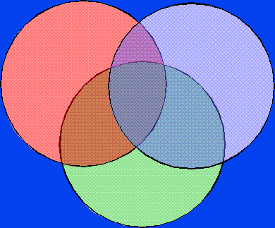
II-19
Introduction/Overview: HPO CHANGE MODEL
Commonwealth Centers for High Performance Organizations
Seven Key Diagnostic Questions
5. Right
what?
1. What is it?
6. How
good?
7. How
treat?
Quality
Customer
“Value”
Financial
Performance
3. According to whom?
4. Why do we need to be high performing?
2. How would we know?
HP
“PICK 3+”

Slide 17
The HPO Diagnostic Change Model:
6 Change Levers…
Leadership (Philosophy, Functions, and Form)
Vision
Values / Work Culture
Strategies (Business Model, Value Proposition)
Structure
Systems (Administrative Systems/Work Processes)
Source: Commonwealth Center for High-Performance Organizations, Inc.
68
Notes:
TONY

Slide 18
II-6
Introduction/Overview: HPO CHANGE MODEL
Commonwealth Centers for High Performance Organizations
What do we need to do to Build a High Performance Organization?
VISION
STRATEGY
STRUCTURE
SYSTEMS
ENV
LEADERSHIP
HP
VALUES

Slide 19
II-19
Introduction/Overview: HPO CHANGE MODEL
Commonwealth Centers for High Performance Organizations
Putting It All Together
5. Right
what?
STRATEGY
STRUCTURE
SYSTEMS
VISION
1. What is it?
LEADERSHIP
Philosophy
Functions
Form
6. How
good?
ENV
HP
VALUES
7. How
treat?
WORK CULTURE
Quality
Customer
“Value”
Financial
Performance
3. According to whom?
4. Why do we need to be high performing?
2. How would we know?
HP
“PICK 3+”

Slide 20
II-20
THE HPO DIAGNOSTIC / CHANGE MODEL
Commonwealth Centers for High-Performance Organizations
HOW DO WE CAUSE CHANGE TO OCCUR IN ORGANIZATIONS?
Top of Organization
Office/Division/Etc.
Build a
Change
Mechanism
at every appropriate level of the organization
Units and Microbusinesses
Engaged Individuals

Slide 21
HPO’s Five Functions of Leadership
(the “work of leadership”)
1. Strategic Stakeholder Value Analysis
2. Vision/Values Implemented through Strategy,
Structure, and Systems
3. Suprasystems Integration/Stewardship
4. Learning, Thinking, Changing, Renewing
5. Enabling, Empowering, Engaging, Energizing
Source: Commonwealth Center for High-Performance Organizations, Inc.
39
Notes:
JOHN

Slide 22
  HPO OVERVIEW
Commonwealth Centers for High Performance Organizations
TWO BODIES OF WORK NEEDED
  THROUGHOUT THE ORGANIZATION
  Taking the vision – what we are trying to achieve – and drilling it down with discipline into High Performance.
  2. Establishing and living values that create a work culture more likely to support achievement of our goals

Slide 23
II-17
THE HPO DIAGNOSTIC / CHANGE MODEL
Commonwealth Centers for High-Performance Organizations
THE TWO ‘SPIRALS’
A more developed view of the “change levers” showing the vision to performance” spiral and the “values to work culture” spiral
STRATEGY
STRUCTURE
SYSTEMS
LEADERSHIP
Philosophy
Functions
Form
VISION
HIGH
PERFOR-
MANCE
ENVIRON-
MENT
VALUES
WORK CULTURE

Slide 24
The Second Leadership Function:
Vision/Values Implemented Through Strategy/Structure/Systems
VISION
VALUES
PM
PM
Strategic Thinking:
(Outcome and Impact Metrics)
Leadership Philosophy
Individual Behavioral Values
Operating System Values
Mission/Niche
Theory of the Business
(strategy/structures/systems)
Behaviors
PM
Strategic Planning
PM
+
~~~
~~~
~~~
-
~~~
~~~
~~~
Set Direction
Capacity Building
(Strategic Objectives and Performance Metrics
PM
Feedback/Coaching (360º)
Resolution Process
(Discipline System)
Tactical Operational Plan
Tactical Goals and Action Plan
Resources Plan
(Input, Through-
put, Output Metrics)
Monitoring & Corrective Action
WORK
CULTURE
PM
PERFORMANCE
PM
= Performance Measures
Source: Commonwealth Center for High-Performance Organizations, Inc.
40
Notes:
JOHN
Content Key Learnings
Review the steps from the Vision to Strategic Thinking to Strategic Planning to Tactical/Operational Plan.
7/7 JWP – I took out the questions on the left, so this text doesn’t apply anymore. We are going to start answering the questions listed on the left as we work our way through the Vision to Performance steps
As a group goes through these steps they will create artifacts – documents, presentations, working papers, notes that collect the information from each step. At the end of the first run through, the objective is to have a rough strategic plan, business/tactical plan, perhaps a set of project plans, and some rough measures of whether we are executing the plans or not. It will be up to the group to decide on the final repository for their work. Don’t let “perfect” get in the way of “good enough” at this point; we’ll be running through the spirals over and over. The goal is to get better each time we go through the cycle. Identify tough spots and work of them between cycles.
Focus here is on the Vision to Performance spiral for this effort, we will do a check against existing organizational values later on to see if any values need to be modified to support the organization’s strategies and goals.
Discuss the connections to the values to work culture spiral, that both are interrelated and build upon each other to create higher performance.
Describe Measurement at each step and the connections between the different performance measures.
Process Suggestions/Notes
Use the existing organization vision and values statements here or have one sub-team develop a “current version”

Slide 25


EXAMPLE OF ADAPTING THE SPIRALS TO A LOCAL GOVERNMENT
Montgomery Vision Spiral
Environmental Scan
Citizen Survey and Feedback
Focus Groups
Council and Staff Retreat
Organizational Vision and Mission
Outcome Performance Measures
Strategic Thinking
PM
Strategic Planning
City Strategic Plan
Strategic Goals, Objectives, and Performance Measures
PM
Tactical &
Operational Plans
Departmental Strategic and Operational Plans (nested into organizational plans)
Employee Goals
Employee Feedback
Tactical Performance Measures
PM
Performance
Source: City of Montgomery, Ohio, 2011
43
Notes:
CHERYL
This is what Montgomery’s Vision Spiral looks like.
As a reminder, this type of work focuses on performing strategic thinking and developing city strategic plans and department operating plans to achieve those goals. It is designed to get us all on the same page and headed in the right direction. You will also note that those little PMs out there are performance measures. It is critical in all our work that we measure our successes in knowing if we reached our goals.
For Strategic Thinking, we did and
Environmental Scan
Citizen Survey to gauge their satisfaction with city services and what they see as important for the City.
Focus Groups
Once we had all of those completed we:
Conducted a retreat for Council and staff to formulate our strategic plan.
One of the outcomes of the retreat was a new, more cohesive mission and vision and a strategic plan to set the direction to the future.
Once we had our strategic plan, mission and vision developed, we:
Developed Department operation plans to address the overall strategic plan and
Had employees set personal goals on how they will address their department plans. These goals are part of the their annual performance appraisal.
We quickly noticed that we were missing a big piece ad that was on performance measures.
How do we know if we are meeting our goals?
How efficient and effective are we?
To address this, we created a team of employees to develop performance measures based on our strategic plan. We did not have expertise in this area so we did hire a consultant to educate and point us in the right direction.

Slide 26

EXAMPLE OF ADAPTING THE SPIRALS TO A LOCAL GOVERNMENT
Montgomery Values Spiral
Organizational Values
Leadership Philosophy
Work Culture
Performance Measures
Leadership Philosophy
Individual Behavioral Values
Operating Systems Values
PM
Employee/Manager Expectations
Performance Measures
Behaviors
PM
Work Culture Assessment
Manager and Employee Development, including 360⁰ feedback and coaching
Performance Appraisals
Feedback
PM
Work Culture
Source: City of Montgomery, Ohio, 2011
44
Notes:
CHERYL
This graphic represents the work our city has done in the values spiral under the HPO model.
This work includes establishing organizational and behavioral values, a leadership philosophy, and employee expectations. It also includes developing appropriate employee training programs, appraisal instruments that actually provide useful feedback, 360 peer feedback as well as coaching and mentoring.
This work is all about how you treat each other and ultimately your citizens.
While we all believe this is important work, we often don’t take the time to fully develop our organization in the type of values work discussed.

Slide 27
  HPO OVERVIEW
Commonwealth Centers for High Performance Organizations
LEADERSHIP PHILOSOPHY
  Strong research says the philosophy of how one does leadership influences engagement and dramatically affects performance.
  2. Leadership Philosophy coincides with one or two systems indentified by Rensis Likert.

Slide 28
LEADERSHIP PHILOSOPHY
III-9
Commonwealth Centers for High Performance Organizations
LIKERT’S FOUR ORGANIZATIONAL PHILOSOPHIES*
SYSTEM 1
(Exploitative
Autocratic)
Security
Money
None
Down
Only
Boss Alone
Top Down
Hostile
Mediocre
SYSTEM 2
(Benevolent
Autocratic)
Status
Little
Mostly
Down
Boss Mostly, Some Technical at 1st Level
Top Down
Mixed
(toward
negative)
Fair to
Good
SYSTEM 3
(Consultative)
Growth
Recognition
Some
Up
and
Down
Boss Focused: Asks, Decides, Explains
At Top, with
Consultation
Mixed
(toward
positive)
Good to
Excellent
SYSTEM 4
(Participative)
Identity
Achievement
Influence
Much
Up, Down,
and
Sideways
Team Based
Group Participation
Favorable
Excellent
SYSTEM
“Zero”**
(Laissez Faire)
Higher Level
(comes from outside org.)
Mixed (but mostly within tech. areas)
Mixed
(but mostly on technical issues)
Mixed
(often avoided)
Mixed
(sometimes not set at all)
Mixed
(positive toward job but not org.)
Mixed
(poor to good)
EMPLOYEE
MOTIVATION
TEAMWORK
COMMUNI-CATION
DECISION
MAKING
GOALS SET
EMPLOYEE ATTITUDES
OUTPUT
* Adapted from Rensis Likert, The Human Organization, (New York: McGraw-Hill, 1967)
** Adapted from Marvin Weisbord, “Why Organizational Development Hasn’t Worked (So Far) in Medical Centers” Health Care Management Review (Spring, 1976).

Slide 29
II-19
Introduction/Overview: HPO CHANGE MODEL
Commonwealth Centers for High Performance Organizations
Putting It All Together
5. Right
what?
STRATEGY
STRUCTURE
SYSTEMS
VISION
1. What is it?
LEADERSHIP
Philosophy
Functions
Form
6. How
good?
ENV
HP
VALUES
7. How
treat?
WORK CULTURE
Quality
Customer
“Value”
Financial
Performance
3. According to whom?
4. Why do we need to be high performing?
2. How would we know?
HP
“PICK 3+”

