Slide 1
GFOA Leading Practices and
Long-Term Financial Planning
By Shayne Kavanagh
Senior Manager of Research

Slide 2
2013 Survey: Multi-Year Fiscal Planning & Projections
In Spring 2013, a survey was developed by Holly Sun in collaboration with GFOA to study the practice and perceived impact of multi-year fiscal planning and projections among local governments
The survey was distributed to approximately 1,300 GFOA Distinguished Budget Presentation Award winners, with 560 responses (43%)

Slide 3
Findings : Implementation
The majority of survey respondents report implementing multi-year projections. But approximately 1/3 of them generally keep it as internal practice only.
Implementation of multi-year projections:
  CIP: 89.6%
  General Fund: 78.3%
  Other Funds: 68.2%
  Debt Analysis: 54.8%
Publication of multi-year projections/analysis (among those implementing it):
  CIP: 92.0%
  General Fund: 70.3%
  Other Funds: 68.5%
  Debt Analysis: 56.1%

Slide 4
Finding : Impact Assessment
Most survey respondents find multi-year projections and fiscal planning a useful policy tool:
  97.6% believe it helps improve fiscal discipline and long-term fiscal sustainability; close to 60% rate this impact as “significant” and 28.6% rate “some” impact

Slide 5
Topics
What is long-term financial planning and why do it?
Five Pillars of LTFP
Risk-based analysis of reserve levels
Lean process improvement

Slide 6
Part I
What is LTFP and Why?
Definition
Essential Characteristics
Why do it

Slide 7
What is Long-Term Financial Planning?
A combination of technical analysis & strategizing
  Forecasting & strategy development
A collaborative and visionary process
  Elected officials, staff, & public
An anchor of financial sustainability
  Changing mindsets
  Institutionalize long-term thinking
Notes:
Forecasting and analysis reveals problems, and then strategies are developed to address them
Above all, the plan is strategic and visionary. It doesn’t just forecast the status quo into the future. It also involves others – particularly elected officials and other departments to develop consensus strategies and ensure a successful implementation.
Develop big picture, long-term thinking among elected and appointed officials.
WE WILL REVIEW THESE IDEAS IN A LITTLE MORE DEPTH ON THE NEXT FEW SLIDES.

Slide 8
What is a Financial plan?
Essential characteristics
  What is the time horizon?
  What funds are considered?
  How often is a plan done?
  What is in it?
Notes:
A plan is between 5-10 years. Some plans included 20-year forecasts, but these are usually speculative in nature. Key is to align the time frame with issues driving the plannign process. If an issue’s impact is 6-years out then a 5 year plan is not going to work.
A plan could consider a range of funds but beginners tend to limit to fewer funds. However, the plan must include the funds that are relevant to the most pressing issues (e.g., if street repair is a big issue, then the street repair fund must be included)
3. A plan can be done annually or as-needed. Annually is ideal so that the plan can act as prelude to the budget process and contribute a long-term perspective to budget deliberations. As-needed plans may be driven by special issues like a large debt issuance or a financial crisis. A hybrid approach is also possible, where a plan is done annually but more sophisticated elements are only undertaken every few years. For example, your could do extensive community visioning and workshops only every few years.
4. A plan contains a scan of the environment, long-term forecasts, debt analysis, and financial strategies.

Slide 9
Part I – Take Aways
LTFP is a strategic and visionary process
The scope of the LTFP should be driven by the characteristics of the issues that are motivating planning
The presence of long-term strategies for structural balance characterizes a true LTFP
LTFP helps avoid & deal with financial stress

Slide 10
Part II
Five Pillars of LTFP
Long-Term Service Vision
Financial Policies
Technically Sound Analysis & Forecasting
Collaborative & participative process
Connection to other plans

Slide 11
Long-Term Service Vision
Define the future the community wants
  Great opportunity to engage elected officials and the public
  Makes planning more meaningful for participants
  Key for aligning finances with service levels
Notes:
This is crucial first step to rectifying the trust gap that often exists between citizens and government – define the future the community wants so you can align finances accordingly. Further, this is the favorite part of the process for elected officials because it is where they articulate what they want the community to be.
An official or citizen doesn’t have to be a financial expert to participate – everyone can understand visioning.
The service vision helps officials start to tie services to finance and realize the trade-offs inherent in decision making. Data visualization can be hugely helpful here to provide an interactive means for seeing the impact of service decisions on finances. There sometimes is an excel demonstration as part of the show. Foreshadow excel demonstration if there is one.

Slide 12
Financial Policies
Define standards for stewardship of public’s tax dollars
  Define financial future community wants
  Forms basis for accountability and increasing trust in government
  Another crucial point of elected official involvement
Notes:
Policies help refine vision of the community, contributing to trust
Policies help define standards of accountability by suggesting measures for a financial health scorecard – for example, what size of fund balance should we have and why?
Elected official involvement is crucial for active support of policies. Developing checklists and scorecards will help them see how policies make a difference.

Slide 13
Most critical policies
Reserve targets
  Conditions for use of reserves
Debt limits
User fee policies
  Subsidization
One time and volatile revenue policies

Slide 14
Analysis and Forecasting
Sound analysis and forecasting provides:
  Credibility
  Scenario analysis capabilities
  Adaptability
Notes:
Credibility is key. Improve product and perception of product!
Scenario analysis is used to examine different futures and to expand thinking. Scenarios should be limited in number of focus on truly critical “unknowable” variables.
Forecasts must be adaptable. Adjusting forecasts to account for new developments and decisions not only makes them more useful but emphasizes that forecasts are an evolving tool, not a crystal ball.

Slide 15
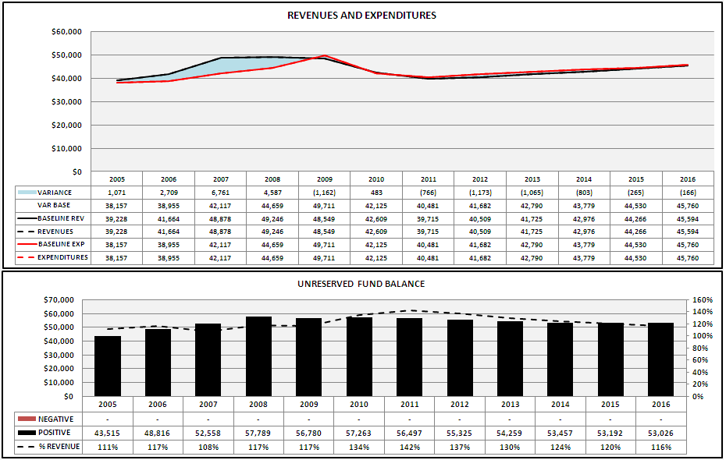
Forecast Model
Notes:
Develop a forecast model that shows financial conditions over a long-term period and that shows the impact on reserves. Ideally, a forecast model will be able to accommodate what-if scenarios to demonstrate different possible financial futures.

Slide 16
Collaborative & Participative Process
Process must engage different groups to
  Gain different vantage points
  Increase plan quality
  Build a wide basis of support for strategies
Notes:
Different vantage points are needed to get the most accurate picture of the future that the community wants. Perform a stakeholder analysis to determine which groups to bring into the process.
Other departments must also be engaged – for example, community development can help increase the quality of analysis by giving information on land-use trends, while the police department must be involved to develop operational solutions – for example, defining public safety service strategies or containing operational costs
Getting a wide array of input puts in place community support for strategy implementation. For example, your could engage community groups to help implement the vision, including holding them to standards of accountability for delivering on their part of the implementation. This is crucial for holding down the price of government

Slide 17
Collaborative & Visionary Process
Notes:
Orange are good points of potential council interaction. This is from the City of San Clemente, but is broadly applicable.

Slide 18
Connection to Other Plans
Notes:
LTFP has an important connection to other plans
The strategic plan provides the long-term service vision, while the LTFP highlights financial balance and injects financial reality in decisions.
The LTFP highlights maintenance and operational costs of long-term assets, while the capital plan suggests future spending and debt burden
The budget implements the LTFP

Slide 19
Part II – Take Aways
LTFP needs to be connected to a service vision
A credible technical analysis is the foundation for the plan
  It gives participants confidence in the process
LTFP is part of a complete planning portfolio
Notes:
This is summary slide. Highlight any other key points.

Slide 20
Part III
Risk Based Reserve Analysis
A Case Study of the City of Colorado Springs

Slide 21
Agenda
Primary risks faced by Colorado Springs
“Triple-A” approach to addressing uncertainty
Applying the Triple-A approach

Slide 22
Three Primary Risks
Volatility of sales tax revenue (and other revenues)
Potential for the storm sewer and bridge infrastructure to fail
Vulnerability to extreme events
Secondary risk factors
  Unexpected spikes in expenditures (lawsuits)
  Pension cost volatility
Notes:
such as wildfires, floods, and, to a lesser extent, snowstorms.

Slide 23
Triple-A Approach to Dealing with Uncertainty
Accept
  Uncertainty is inevitable, including black swans
Assess
  Find potential impact, using reference cases
Augment
  Uncertainty will usually be underestimated!
Notes:
The accomplished forecasting scientist, Spyros Makridakis, has suggested a “triple-A” approach for dealing with uncertainty.
Accept. First, we must accept that we are subject to uncertainty, including events that we haven’t even imagined. The term “black swan” derives from a belief held in England before 1697 that all swans were white – in fact, the term “black swan” was a common metaphor for an impossibility. Black swans were discovered in Australia in 1697 demonstrating the limits of human knowledge about the world.
•Assess. Next, we must assess the potential impact of the uncertainty. Historical reference cases are a useful baseline.
•Augment. The range of uncertainty we really face will almost always be greater than we assess it to be, so we should augment that range. Historical reference cases provide a baseline, but that baseline may not be adequate to account for all future possibilities.

Slide 24
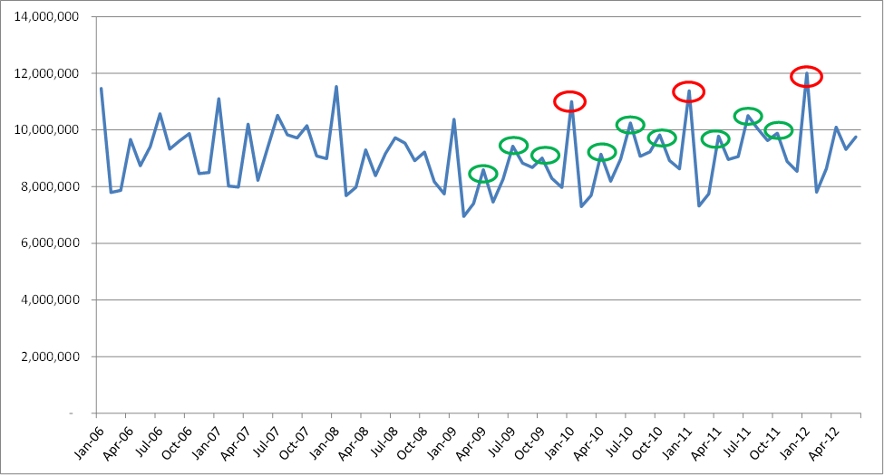
Revenue Volatility
Notes:
shows monthly sales tax revenue since 2006. The red circles denote January revenues which are always the highest of the year due to holiday shopping. The green circles show revenues from July, October, and April, which all see revenue spikes (due to quarterly sales tax filings for smaller vendors). This pattern and even the relative magnitude of the spikes is quite consistent from year to year, even as far back as 1996. In fact, a statistical analysis shows that that only 2% change in sales tax revenue is attributable to random variation. About 91% is due to fundamental economic trends / business cycles (also known simply as “trend-cycle”) and 7% is explainable by seasonal variation.
This means that random fluctuations in the sales tax should not be a concern for the City. However, it also means that the influence of economic cycles is very strong. An unexpected shift in the economy could have serious ramifications for City revenues, as the City has experienced in the wake of the 2001 recession and the more recent Great Recession.

Slide 25
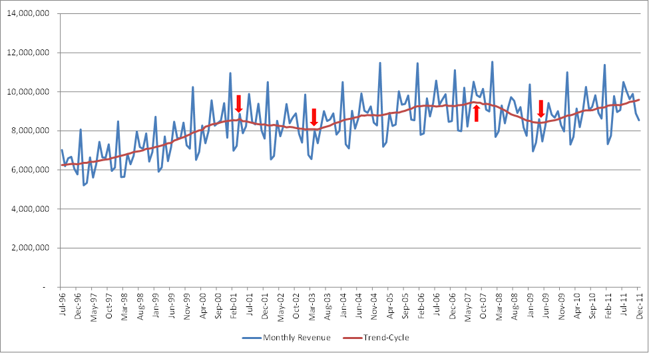
Revenue Volatility
Notes:
shows the trend-cycle line for sales tax overlaid on monthly sales tax revenues. The red arrows show the beginning and end-points of significant downtrends. The first one started in April 2001 and lasted until May 2003. The trend-cycle declined 6.6% over 25 months, or about a quarter percent per month. The second started in July ’07 and lasted until April’09. The trend-cycle declined 11.2% or just over half a percent per month.
The trend-cycle line is calculated by taking a 12-month centered moving average of actual monthly sales tax revenue. For example, the moving average for January ’05 would be an average of August ’04 through July ’05. February ‘05 would be an average of September ’04 through August ’05, and so on. A 12-month moving average smooths out seasonal variation, leaving only the trend cycle.
Obviously, the decline associated with the Great Recession was much sharper than the 2001 recession, both in terms of overall decline and speed of the decline. In fact, so severe was some of the financial fallout from the Great Recession that some have dubbed it what acclaimed financial thinker Nasim Talib has termed a “Black Swan” event – a rare and unpredictable event that has an extreme impact. Black Swans are, by definition, impossible to predict, so the best that anyone can do is to be prepared.

Slide 26
Triple-A Applied to Sales Tax
Accept
  Little random variation, but Black Swans are possible
  Easy to imagine sources of future trouble
Assess
  Max length of down turn has been 25 months
  Max decline during has been 0.53% per month
Augment
  Raise expectations for risk (1.5X)
  Max 0.8% monthly decline
$23M loss over 25 months is “worst case”
  Budget can be reduced in response, though
  $13M judged adequate to make a “soft landing”
Notes:
Accept. Even though the sales tax is subject to relatively little random variation, it is clearly subject to Black Swans.
Assess. A downturn in the trend-cycle has lasted as long as 25 months and has been as severe as a 0.53% monthly decline.
Augment. The Great Recession was our reference point, but many economists believe that the effects of the Great Recession would have been much worse
Double your range of uncertainty if you have little historical data or multiply by 1.5 if you have more. We had a good deal of data, so a 1.5 multiplier seemed appropriate giving us a 0.8% monthly decline. That translates to a potential 20% decline over 25 months. This does not necessarily mean that the City should reserve this entire amount,, because, in the event of a financial Black Swan, the City would take action to reduce spending – not just continue to spend as it had before.
The City budget office estimates that the budget could be reduced by just under $10 million without creating a major disruption to services (though service quality would be negatively affected to some degree, of course). This means the City should maintain a reserve of at least $13 million to fill the remaining portion of the revenue gap and to help the City make a “soft landing”

Slide 27
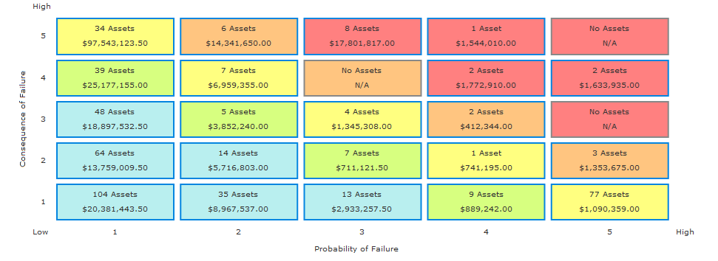
Infrastructure – Bridges & Culverts
Notes:
In Colorado Springs, the two asset classes that were deemed to be of the greatest importance are bridges and storm sewers.
Exhibit shows a risk profile for bridges and culverts. Risk is defined as the product of probability of failure and the consequences of failure. Probability of failure is based on the Bridge Sufficiency Index (BSI) provided by the City staff. A lower BSI indicates a bridge that is in worse condition and ultimately a higher risk (probability) to fail. Consequence is based on cost - the higher the replacement cost of an asset, the higher the consequence to the City if that asset were to fail
13 bridge structures have been identified as having a high risk rating (those bridges in the red area, which have a total score of between 8-10, when the scores from each axis is added together). These bridges have an estimated replacement value of $22.8 M. This averages out to about $1.75 million per bridge. A reserve that covers one or two bridges should be adequate, but using the “Triple-A” rule of doubling our expectation for uncertainty, preparing for the premature failure of three of these bridges might be more prudent. This equates to a $5.25 million reserve.

Slide 28
Extreme Events - Wildfires
Use 2012 wildfire as a reference case
$3.75M in personnel, mutual aid costs, & other expenses
$2.15M eligible for 75% FEMA reimbursement
FEMA ineligible expenses plus City’s 25% share equals $2.14M
Limited data, so multiply $3.75M by 2x?
May be excessive because City bears some cost in regular budget & FEMA reimburses
$5M is a middle ground
Notes:
estimated costs for the 2012 fire was $3.75 million in personnel time and other direct expenses. Of this, of the expenses eligible for a 75% FEMA reimbursement were $2.15 million. Adding together the FEMA ineligible expenses, plus the 25% unreimbursed expenses results in $2.14 million. Some of this is expenses that the City would have incurred anyhow (e.g., firefighters on duty).
A reserve of $4 million would be more than adequate to cover the cost of the most recent fire before FEMA reimbursement. However, it may behoove the City to augment the level of risk it is preparing for. If we multiplied $3.75 million by 2 we would get $7.5 million. However, much of an extreme event’s cost would be reimbursed by other parties and some of this figure would represent costs the City would incur anyhow, so $7.5 M might be excessive. Discussions with City staff indicated that about 1/3 of the most recent fire’s costs would have been incurred anyhow in the normal cost of doing business and that about half of the reimbursement from FEMA can be expected to be received within 6 months of the expenditure. Using this as a reference point, a reserve of $3.3 million might represent the minimum prudent reserve amount because it accounts for the fact that the City will bear some of the costs of responding to an extreme event in its regular budget, and that another significant portion of the cost will be reimbursed quickly by FEMA. A reserve of $5 million might be a middle ground because it does not account for FEMA reimbursement (which is outside the control of the City).

Slide 29
The Results
Budgetary Uncertainty Reserve
$13 million for sales tax economic uncertainty +
$7.5 million for economic uncertainty in other revenues +
$6.25 million for pension payment uncertainty =
$27 million or about 12.5% of general fund revenues as budgetary uncertainty reserve
Emergency Reserve
$5.25 million for critical bridge failure and $11.6 million critical storm sewer replacement, for a total of $16.85 million +
$5-7.5 million for extreme events +
$2-4 million for expenditure spikes from lawsuits =
$27 million or about 12.5% of general fund revenues as an emergency reserve
Notes:
Many cities express their reserve policy target as single number (e.g., 16% of revenues). However, GFOA has found that leading municipalities often find it helpful to segment their reserves into different categories because this makes the purpose of the reserve more transparent. For example, a reserve for “emergencies” and a reserve for “economic uncertainty” would provide more clarity on the purpose of the reserves than one all-encompassing reserve. The first three bullets could comprise the budgetary uncertainty reserve, while the last three would form the emergency reserve, leading to the following targets:
This provides a target of about 25% of general fund revenues, which is also about in line with the range of reserves actually maintained by other cities that are comparable to Colorado Springs and is above the level that GFOA considers the minimum baseline level that a government should maintain (16%)
Note that it was just luck that the two figures worked out to be more or less equal. Doesn’t necessarily have to be equal.

Slide 30
Part III - Take-Aways
Identify major risks
  See GFOA’s Financial Policies for guidance
Use the Triple-A approach to estimate uncertainty associated with risks
Don’t ignore political considerations
  Work them into the process of identifying and managing risks
  Examples
    Highlight other extreme event risk mitigating strategies
    Address elected officials’ preferences

Slide 31
Part IV
Lean Process Improvement
A critical complement to priority-based budgeting?

Slide 32
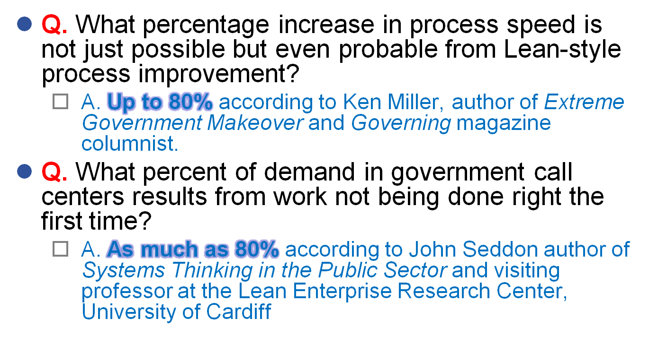
What Can Lean Do For You?
Notes:
These are good books that you might want to buy
Miller refers to straightening out processes using many of the same principles we will learn in this training.
Seddon refers to calls that represent defects, such as calling for information on unclear forms, checking up on progress for prior requests, etc.

Slide 33


Irving’s Results
Began in 2007:
Eliminated 50,000+ hours
Saved $44 million
  Cost savings and avoidances
  Businesses & Residents:
Improved service and satisfaction
Faster services
Employees’ Increased:
Productivity
Job satisfaction
Communication
Collaboration / teamwork
Development/leadership opportunities
Notes:
Irving is a baldrige award winner and has been doing this a while
Has saved a lot of money
Has saved a lot of time

Slide 34
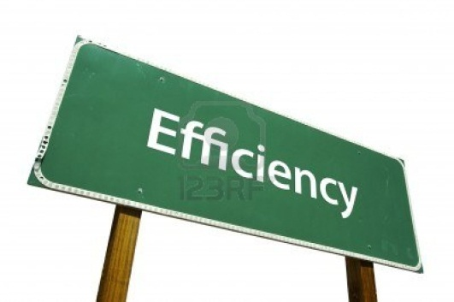
Results
Commercial Permit Process
Plan review time reduced by 76% (15.7 to 3.7 days)
Maximum plan review time reduced 88% (49 to 6 days)
Street Cut Repairs
Reduced repair cycle time from average of 14 weeks to <6 weeks
Utility Locates
Reduced process steps from 32 to 7
Reduced cycle time by 48% (from 75 to 39 hours)
Animal Services Processes
Decreased shelter processing time by 50-66%, saving 1,120 hours annually
Decreased field officer time by 50-66%, saving 2,330 hours annually

Slide 35
A Brief History of Lean
What we think of as Lean originated with the Toyota Motor Company
  Toyota was looking for a way to provide variety with limited capital equipment
Popularized in the West and dubbed “Lean” by an MIT study of the global car industry
  The Machine that Changed the World
Lean has since spread far and wide
  Now virtually de rigueur in the auto industry and spread to many other manufacturing industries
  Extremely popular in many industries outside of manufacturing, from health care to fast food.
  Now making inroads into government
Notes:
In short, Lean is a Japanese method with roots in the quality movement associated with individuals we are more familiar with, such as W. Edwards Deming. It has become popular not only in manufacturing industries, but also increasingly in service industries, including increasing popularity of government. Government has looked at programs, line items, outcomes, but not much of the reform efforts have been focused on process improvement.

Slide 36

A Definition of Lean
Lean is…
  A system of thinking and way of working that emphasizes providing value to the customer of a service and eliminating waste found in the workplace.
  Often thought of as “process improvement” and is known for its expansive toolset.
These tools are important, but at its best Lean becomes a way of life for an organization where there is a continuous journey toward perfection.
Lean is not something that is done once or a few times per year, rather it is ingrained into the DNA of the organization.
Notes:
Lean very well known for its various tool sets used to improve processes. However, at its best Lean is a system of thinking that permeates the organization it becomes a way of working and a way of thinking. In fact, at governments we have worked people have even started to use Lean at home – that’s when you know it has taken hold!
PW AA cut dinner time in half and morning routine by 1/3

Slide 37
In Lean Waste is the Enemy
Lean postulates there are 8 forms of waste that occur in business processes
Lean teaches employees to recognize these forms of waste
Kaizen and lean tools are used to make the waste visible and to eliminate it
Gradually, employees are able to recognize waste immediately, so they can continually strive to eliminate it.
Notes:
The 8 wastes is one of the most powerful concepts in Lean because people like categories because categories help people recognize patterns. It is has been said in Lean that getting rid of waste is easy, recognizing waste is hard. These categories are the foundation of recognizing waste. Other tools in lean are used to help reduce or eliminate waste
A goal of Lean is to enable employees to spot waste in their everyday lives so that immediate countermeasures can be taken on the spot. Kaizen is a dedicated time used for improving a process during which waste is identified and eliminated.
Note that the 8 forms of waste are not written in stone. Different authors have different spins on it. The number of wastes also can vary from 7 to as high as 10, but 8 is the most common. Our list represents the most widely accepted 8 categories, with a spin for government specific concerns.

Slide 38
A Critical Complement to PBB?
Lean focuses on processes
  ““If you can't describe what you are doing as a process, you don't know what you're doing.”
  - W. Edwards Deming
Lean focuses on efficiency & cost effectiveness
  Budgeting typically produces efficiency gains as a by-product.
  “Certainly we want good results, but management by results is not the way to get good results…work on the causes of results”
    -W. Edwards Deming

Slide 39
Part IV Take-Aways
Lean is a process improvement approach that has proven success in government
Lean is characterized by its powerful toolset, but is also a mindset.
Lean is a potentially powerful complement to priority-based budgeting

Slide 40
The End
Contact info: skavanagh@gfoa.org
Research reports: www.gfoa.org/research
  Colorado Springs case study
  Case studies of performance measurement leaders
  Lean
  Priority-based budgeting and ZBB
Books
  Financing the Future
  Financial Policies
Magazine
  June 2013 issue is 100% Lean.
  GFOA website for lead article. See me for the rest

