Slide 1
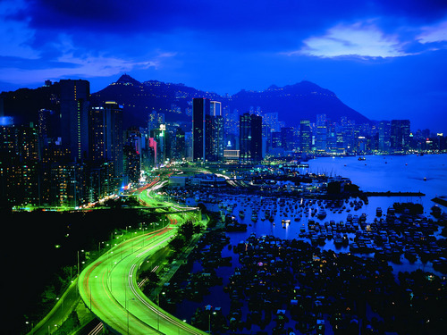



Climate Leadership Academy Jakarta, August 2013
Urban
Systems
Joseph Fiksel
Executive Director, Center for Resilience
The Ohio State University
Sustainability Advisor, Office of Research & Development
U.S. Environmental Protection Agency
The content of this presentation reflects the views of the author and does not represent the policies or position of the U.S. EPA.

Slide 2









Assets
Resources
Built capital
Natural capital
Social capital
Enterprises
Governance
Minerals
Energy
Water
Food
Waste

Slide 3
Sustainability is the capacity for:
  human health and well being
  economic vitality and prosperity
  environmental resource abundance
Resilience is the capacity to:
  overcome unexpected problems
  adapt to change (e.g., sea level rise)
  prepare for and survive catastrophes
continuity
fitness

Slide 4
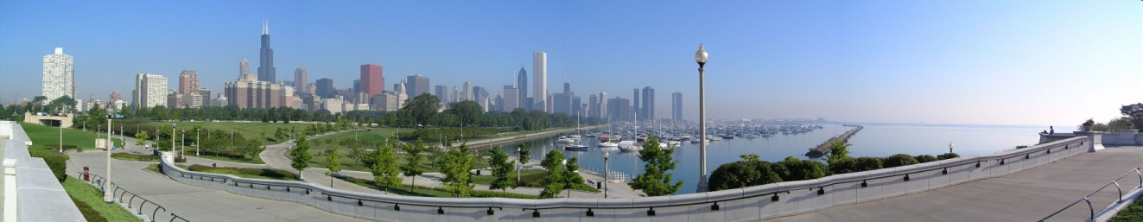
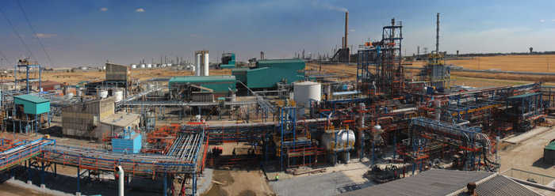

Urban and Natural Systems
Community
Economy
Innovation
Collaboration
Environment

Slide 5
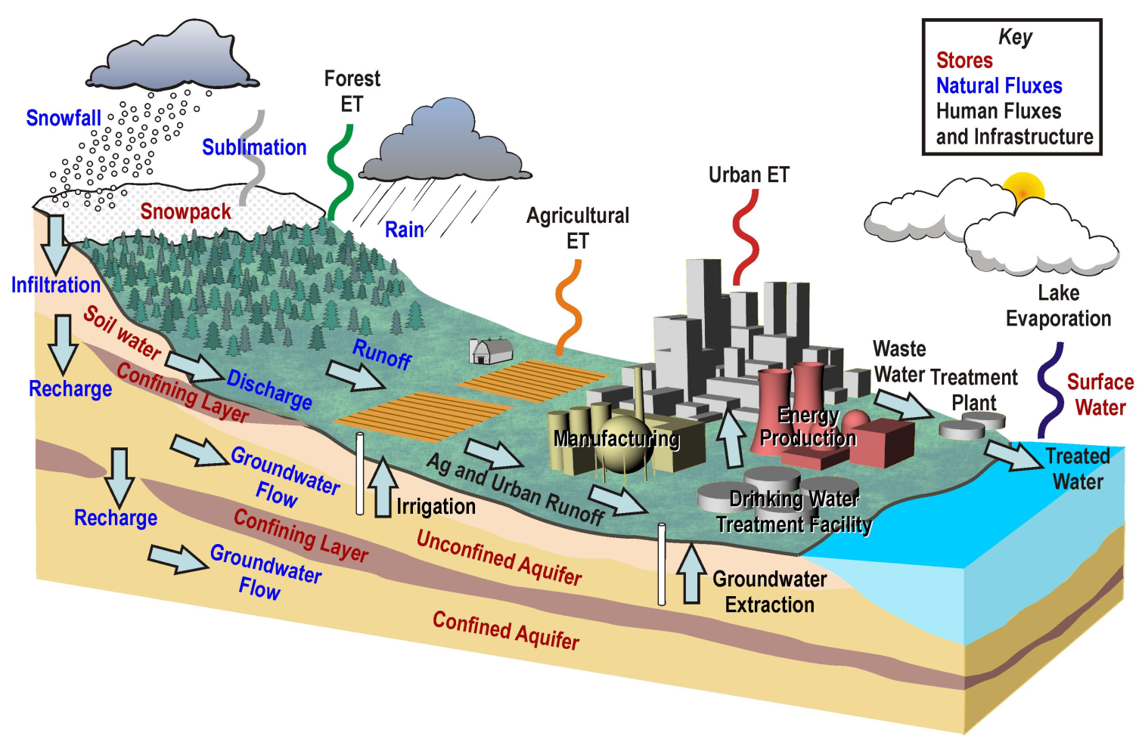
Systems Thinking: Urban Watershed

Slide 6
EPA Tools for Urban Climate Adaptation
Eco-Health Relationship Browser
http://www.epa.gov/research/healthscience/browser/
Framework for Sustainability Indicators
http://epa.gov/sustainability/
Sustainable Water Infrastructure
http://water.epa.gov/infrastructure/sustain/index.cfm
Triple-Value Simulation (3VS)
www.epa.gov/research/docs/3vs-tool-nutrient-mgt-narr-bay.pdf
Stormwater Calculator
http://www.epa.gov/nrmrl/wswrd/wq/models/swc/

