Slide 1
Climate Leadership Academy
Welcome!
From Risk Barriers to Results: Managing the Risks of Urban Infrastructure
CityLinks Pilot Partnership Between US and ASEAN Member States

Slide 2
Our goal, simply put…
…to help you do your jobs even better by providing information about the barriers and opportunities to improve urban climate adaptation through resilient urban infrastructure….
Notes:
Engage engage engage! This is a peer-learning event, the more you put in the more you and everyone get out.
Accelerate and advance implementation
Peer learning and networking

Slide 3
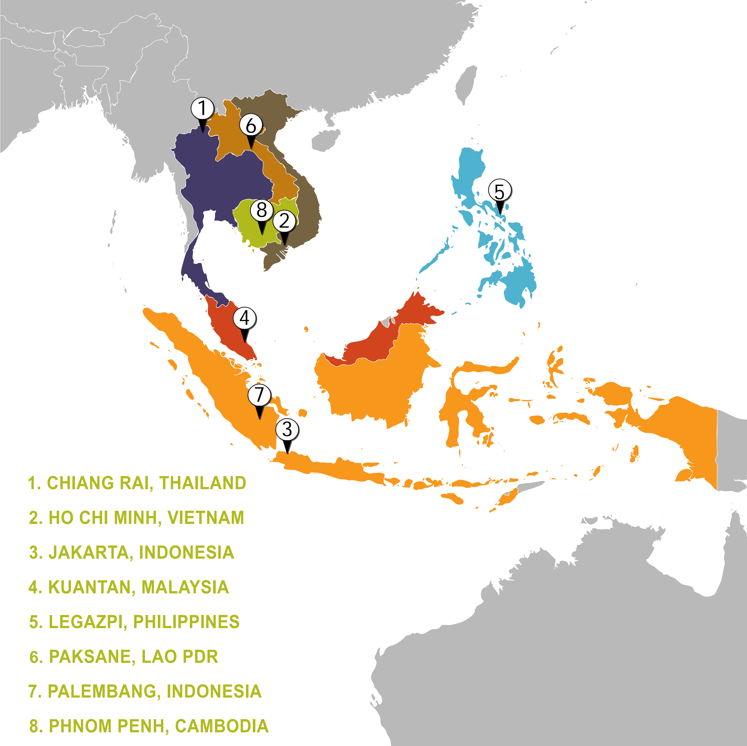
Who’s here?

Slide 4
What we heard from you…
Building Broad-Based Support
Restoring Urban Ecosystems
Re-thinking Urbanization
Aligning Financial Investments
Elevating Social Equity

