Slide 1

City of Cincinnati
Priority-Driven Budgeting: Citizen Engagement, Policy Direction, and What’s Next
Lea Eriksen
July 10, 2013

Slide 2

Priority-Driven Budgeting
Presentation Outline
Overview of Cincinnati & Why Priority Driven Budgeting
Citizen Engagement
City Council Policy Direction
Follow-up & Next Steps

Slide 3
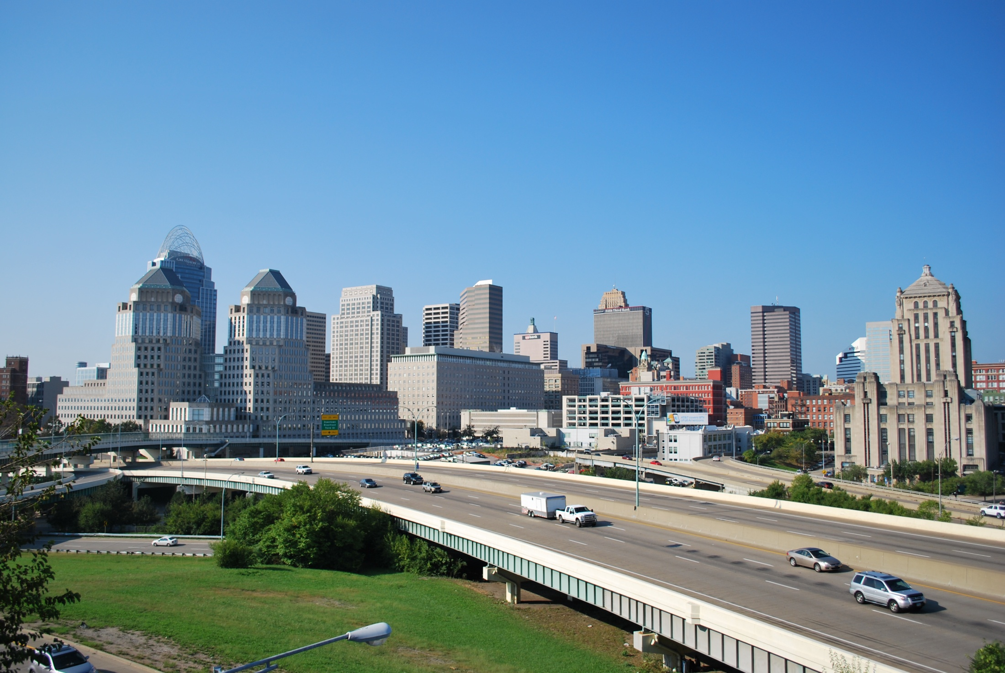
Priority Driven Budgeting
- Cincinnati & Why PDB

Slide 4
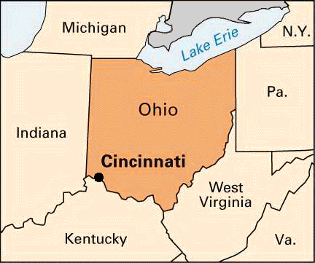

City of Cincinnati
Population: 296,550, CMSA 2.1 million
Land Size: 77 Square Miles, CMSA 3,343 Square Miles
Location: 54% of the nation’s population & 53% of the nation’s manufacturing establishment reside within 600 miles of Cincinnati
Composition: 52 Neighborhoods

Slide 5
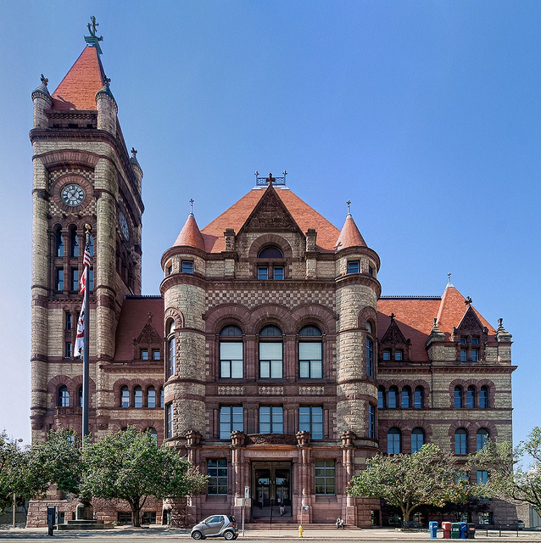
City of Cincinnati
Founded in 1788
Chartered as a village in 1802
Incorporated as a city within Hamilton County in 1819
Mayor is elected to a 4-year term through a direct election
There are nine Councilmembers, elected at large to 4-year terms
City Manager Form of Government
City Manager is appointed by the Mayor with prior approval by the City Council

Slide 6
Retirement

Slide 7
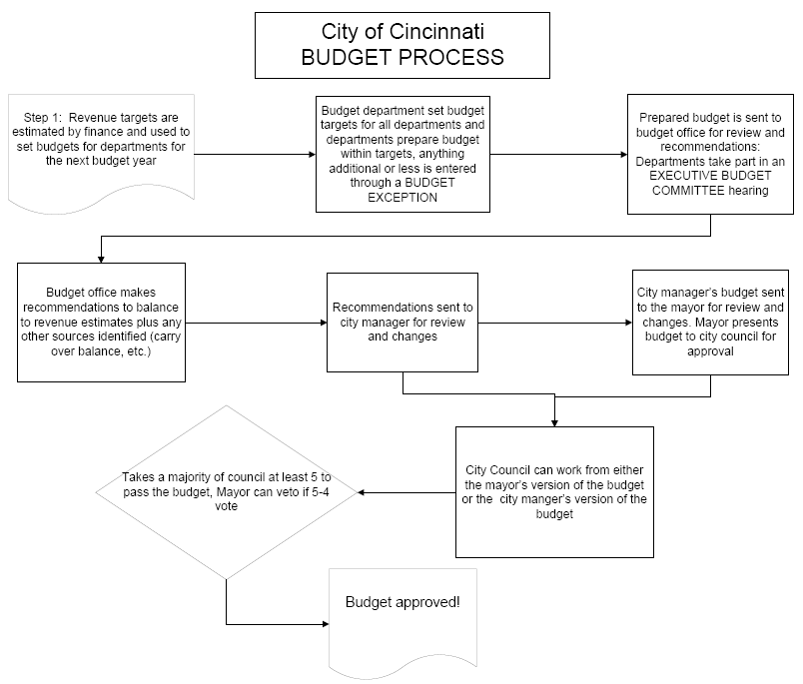
Why Priority Driven Budgeting?
  Base Budgeting
  Program Based Budgeting – starting in 2008
  No clear consensus on strategic priorities for the City
  No clear prioritization process between programs
  Process starts out with across-the-board cut
  Recession Impact and State Shared Revenue cuts

Slide 8
Cincinnati Priority-Driven Budgeting - Step by Step Process
Step 1 - Identify City Priorities
Step 2 - Develop Strategy Maps
Step 3 - Review Existing Programs and Identify Decision Units
Step 4 - Score Decision Units Against Priority Results
Step 5 - Compile and Compare Scored Programs
Step 6 - Allocate Resources Based on Prioritization
Citizen Engagement
City Council Policy Direction

Slide 9
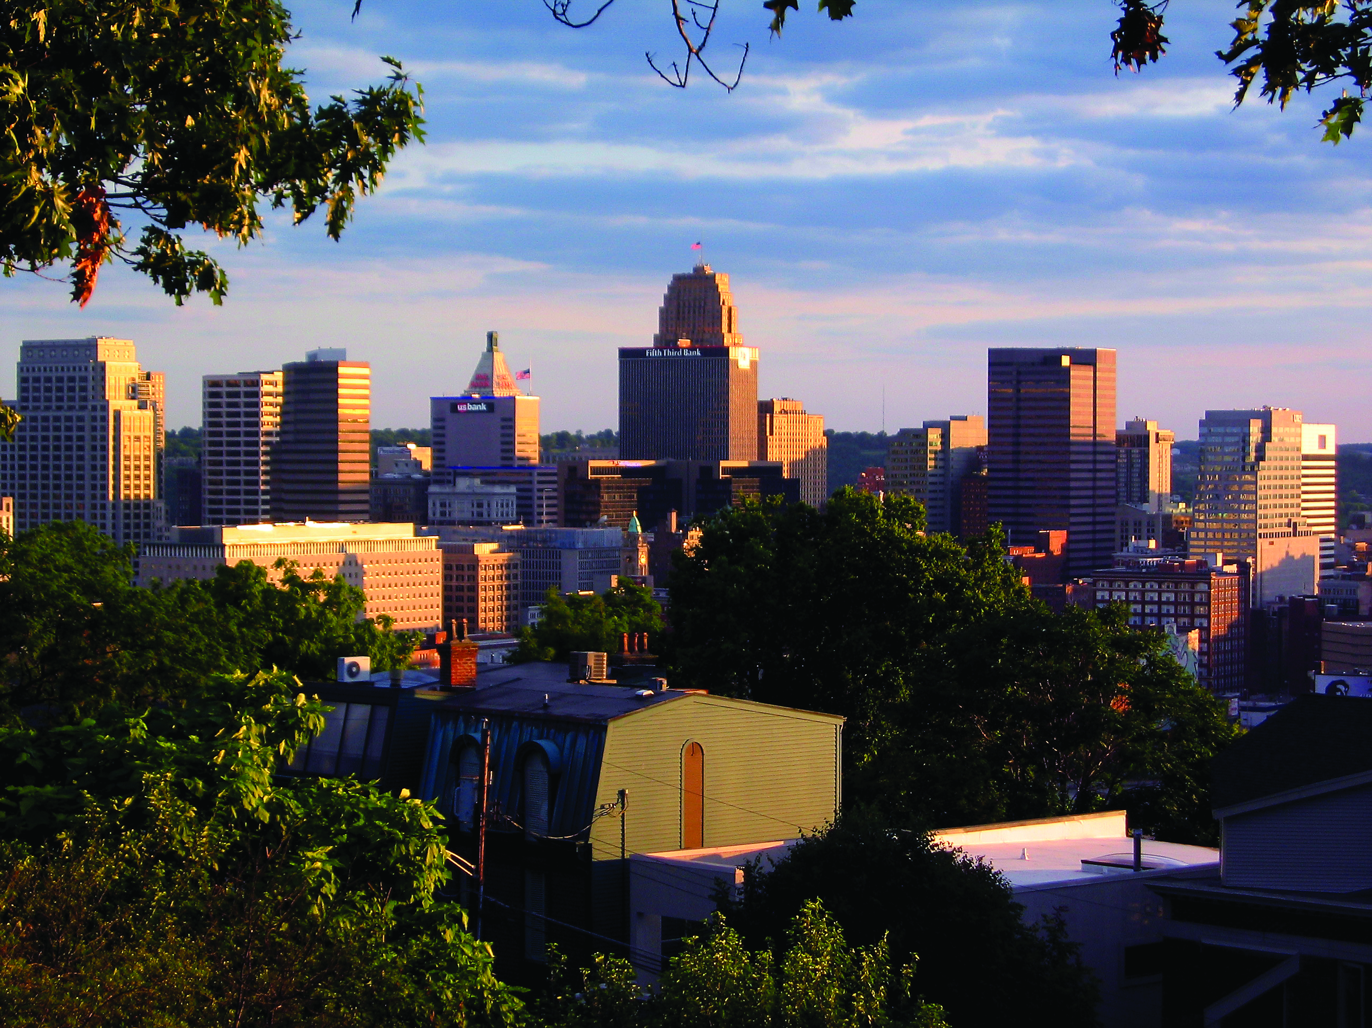
Priority Driven Budgeting
- Citizen Engagement

Slide 10
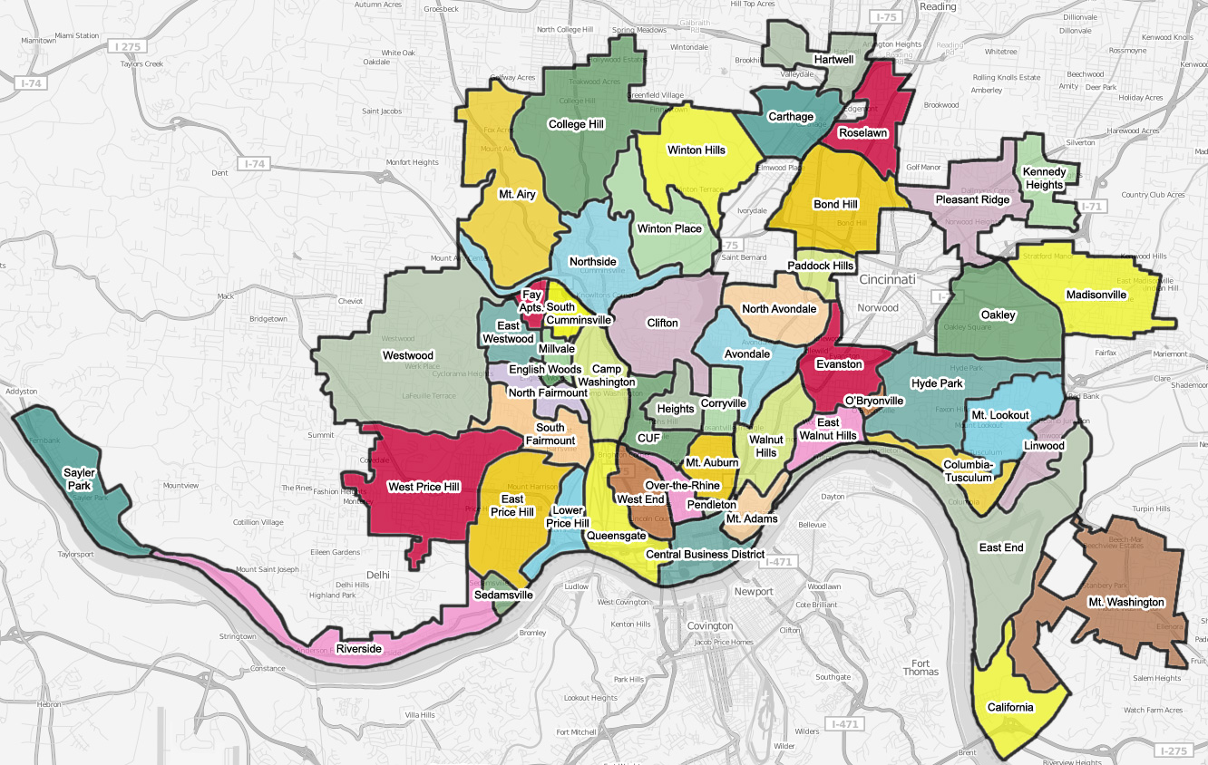
Public Meeting Process
Novak Consulting conducted 6 Open to the Public meetings

Slide 11
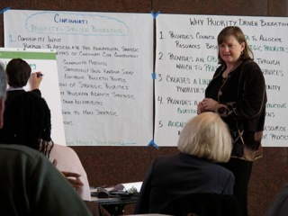
Public Meeting Process
Novak Consulting conducted 8 Focus group sessions with the following targeted populations:
  City Board and Commission members
  Community Council leaders
  Large employers
  SBE/MBE/WBE
  Socially disadvantaged
  United Way service recipients
  Health Clinic patients
  Senior Citizens

Slide 12

City of Cincinnati’s Results
Commerce and Jobs
Inclusive, Thriving and Livable Community
Safe Community
Sustainable Built and Natural Environment
Well- Planned and Developed Infrastructure
Leadership and Financial Stewardship (Governance)
Efficient and Effective Basic Services (Quality Management)
Notes:
12

Slide 20
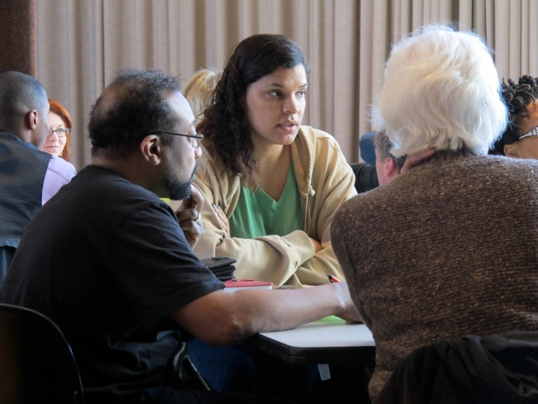
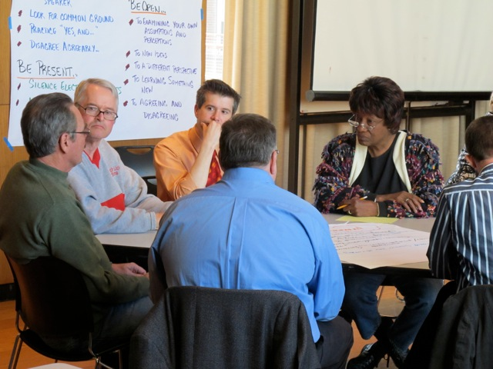
Public Meeting Process
241 people shared basic demographic information
102 from the Targeted Populations
  The majority indicated they have attended fewer than 5 City sponsored meetings over the past year.
139 at the Open Meetings
  The majority have attended fewer than 4 City sponsored meetings over the past year.

Slide 21
Public Meeting Process – Who Participated
 | Meeting Population | 2010 Census Data
Male | 41% | 48%
Female | 59% | 52%
Under 20 | 1.5% | 26.2%
21 to 64 | 69% | 69.5%
65 or older | 29.5% | 10%
African American | 39.3% | 44.8%
Caucasian | 56.8% | 49.3%
Hispanic or Latino Ethnicity | 3.7% | 2.8%

Slide 22
Public Meeting Process – Who Participated
 | Meeting Population | 2010 Census Data
Renters | 25.7% | 61%
Home owners | 72.6% | 39%
Income: Under $23,050 $23,051- $49,999 $50,000 and $74,999 $75,000 to $99,999 $100,000 to $149,999 $150,000 or more | 22% 19.3% 22% 10.1% 15.6% 11% | 40.8% 24% 22.8% 8.7% 6.5% 6%

Slide 23
Electronic Participation
Emails - 337 organizations plus forwarded:
  Email sent April 4, 2012: 786 recipients
  Email sent April 15, 2012: 2,383 recipients
  Email sent April 20, 2012: 930 recipients
City Website/Twitter
  593 clicks to PDB page on City website
  12 Tweets sent to 2,000 followers and retweeted to a combined 10,000 followers

Slide 24
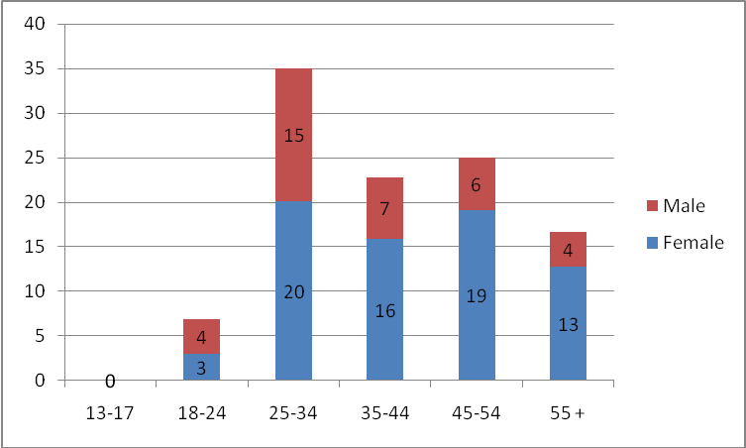
Electronic Participation
Wiki/Facebook
  1,102 clicks to wiki
  228 clicks to Facebook
Number of Facebook Page “Likes” by Age Group & Sex

Slide 25
Validation Survey Outreach
Statistically Valid Survey
3,000: Surveys mailed to randomly-selected sample
665: Responses received
Provide 95% confidence level with margin of error +/- 4%
Participants tested the Strategy Maps
Took $100 exercise

Slide 26
Validation Survey Outreach
Online Survey - $100 Exercise
2,486: Emails with online survey
1,700: Online surveys completed
11,000 (approximate): Persons reached via tweets/retweets
200: Business cards distributed with link to online survey
In person - $100 Exercise
66: Councilmembers, Neighborhood Summit Participants, Union Leaders

Slide 27
Testing the City’s Results

Slide 28
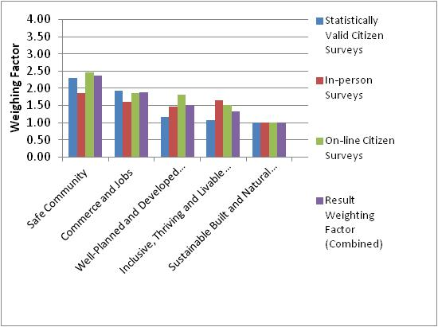
Testing the City’s Results
Notes:
28

Slide 29
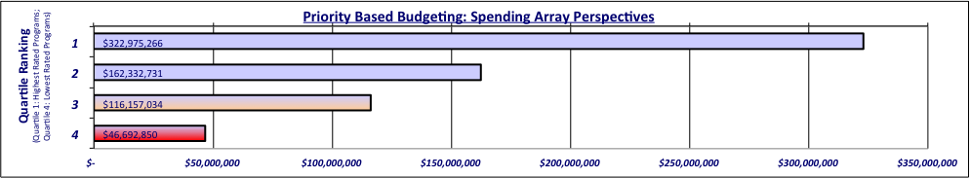

Resource Alignment Diagnostic Tool Results
57 Programs
78 Programs
80 Programs
57 Programs
Notes:
29

Slide 30
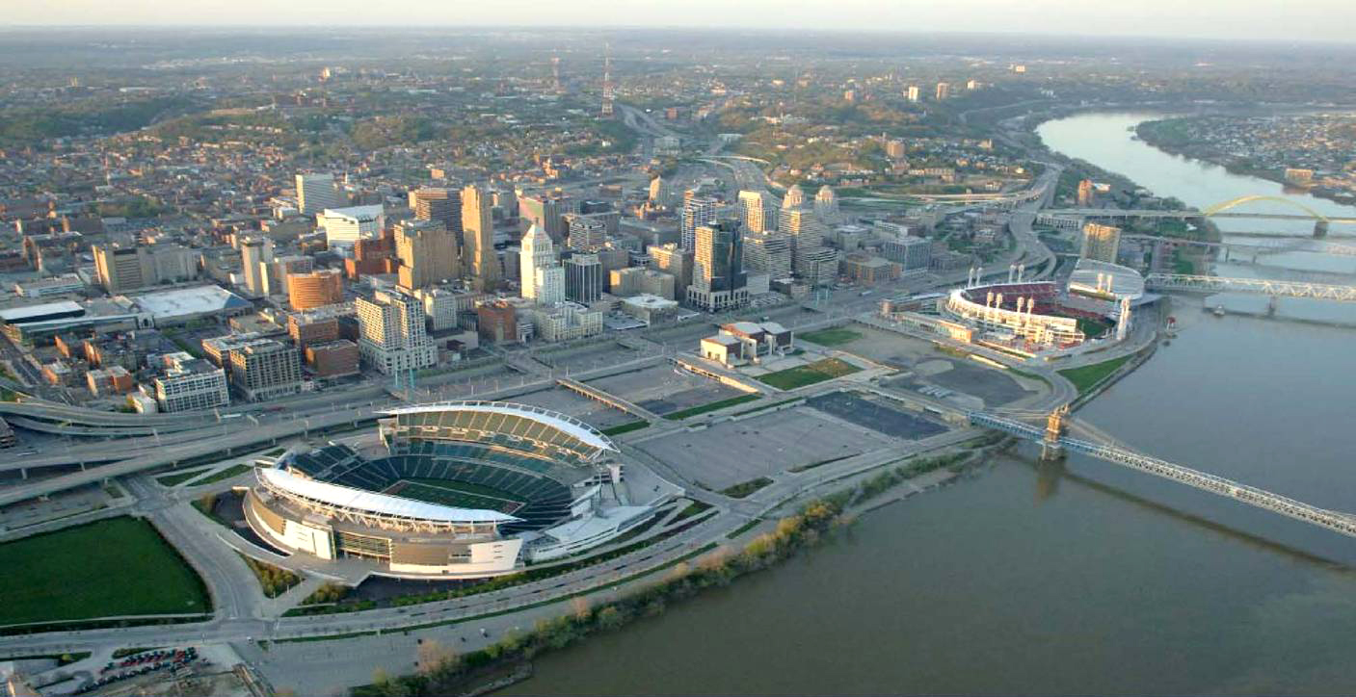
Priority Driven Budgeting
- Council Policy Direction

Slide 31
Score Programs against Results & Attributes
City of Cincinnati's Results
Basic Program Attributes
COMMERCE and JOBS
INCLUSIVE, THRIVING and LIVABLE COMMUNITY
WELL- PLANNED and DEVELOPED INFRASTRUCTURE
SUSTAINABLE BUILT and NATURAL ENVIRONMENT
SAFE COMMUNITY
LEADERSHIP and FINANCIAL STEWARDSHIP (Governance)
MANDATED to Provide the Program
RELIANCE on the CITY to Provide the Program
COST RECOVERY of the Program
LEVEL of DEMAND for the Program
Notes:
31

Slide 32
City Council Policy Direction
Administration construct a budget based on the following factors:
Use the information from the Priority Driven Budget process to recommend elimination or reduction of functions based upon whether other organizations or entities are serving the same populations or providing the same function.
Recommend changes to mandated programs that exceed the minimum requirements of the mandate.
Identify functions that can be shared with other political jurisdictions.
Identify functions that, rather than eliminate them, can be made self sufficient through the establishment of a fee structure.

Slide 33
City Council Policy Direction Results
… recommend elimination or reduction of functions based upon whether other organizations or entities are serving the same populations or providing the same function.
  5 programs were eliminated or scaled back that fit into this category
  All Quartile 3 or 4
  Examples included:
    Juvenile Firesetter Program
    Child Seat Installation Program
    Pools

Slide 34
City Council Policy Direction Results
Recommend changes to mandated programs that exceed the minimum requirements of the mandate.
  19 programs are mandated, but ranked Quartile 3 or 4
  Six are under review or reduced
  Examples included:
    Human Resources Services (Civil Service, Testing, etc.)
    Cemetery Maintenance Program
    Vital Records Program

Slide 35
City Council Policy Direction Results
Identify functions that can be shared with other political jurisdictions.
  17 programs/services are under review, examples include:
    Regional Crime Lab
    joint procurement
    joint use of public safety training facilities
    provide human resources services to other jurisdictions (training, civil service testing, etc.)
    centralize printing and stores

Slide 36
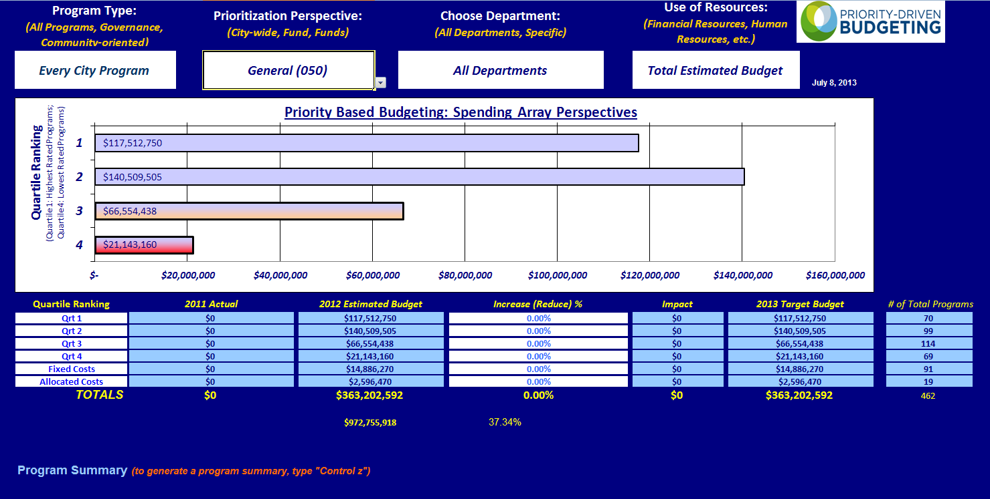
City Council Policy Direction Results
In total, 27 total quartile 3 and 4 programs were severely reduced or eliminated in the FY 2013 and FY 2014 budgets

Slide 37
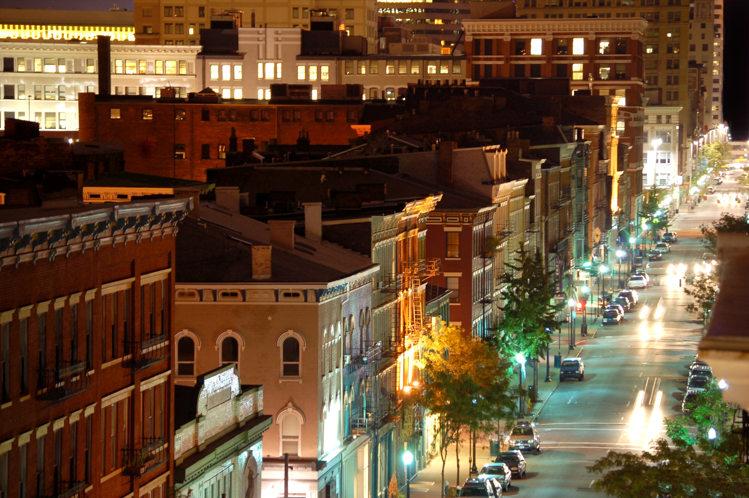
Priority Driven Budgeting
- Follow-up & Next Steps
OVERVIEW

Slide 38
Follow-Up & Next Steps
Held three follow-up sessions with Citizens
  October 2, 2012 General Session
  November 5, 2012 Environmental Quality session
  February 16, 2013 Neighborhood Summit
Formed Citizens Budget Committee
  Members of City Staff (union and Administration)
  Community Members
Conducting Citizen Engagement Experiments
  Cincinnati Open Budgeting
Priority Driven Budgeting – Next Full Round FY 2016-2017

Slide 39

Priority Driven Budgeting
- Questions?

