Slide 1

Prioritization, Services & Performance Measurements
Lakeland’s Budgeting by Priorities Process
July 10, 2013

Slide 2
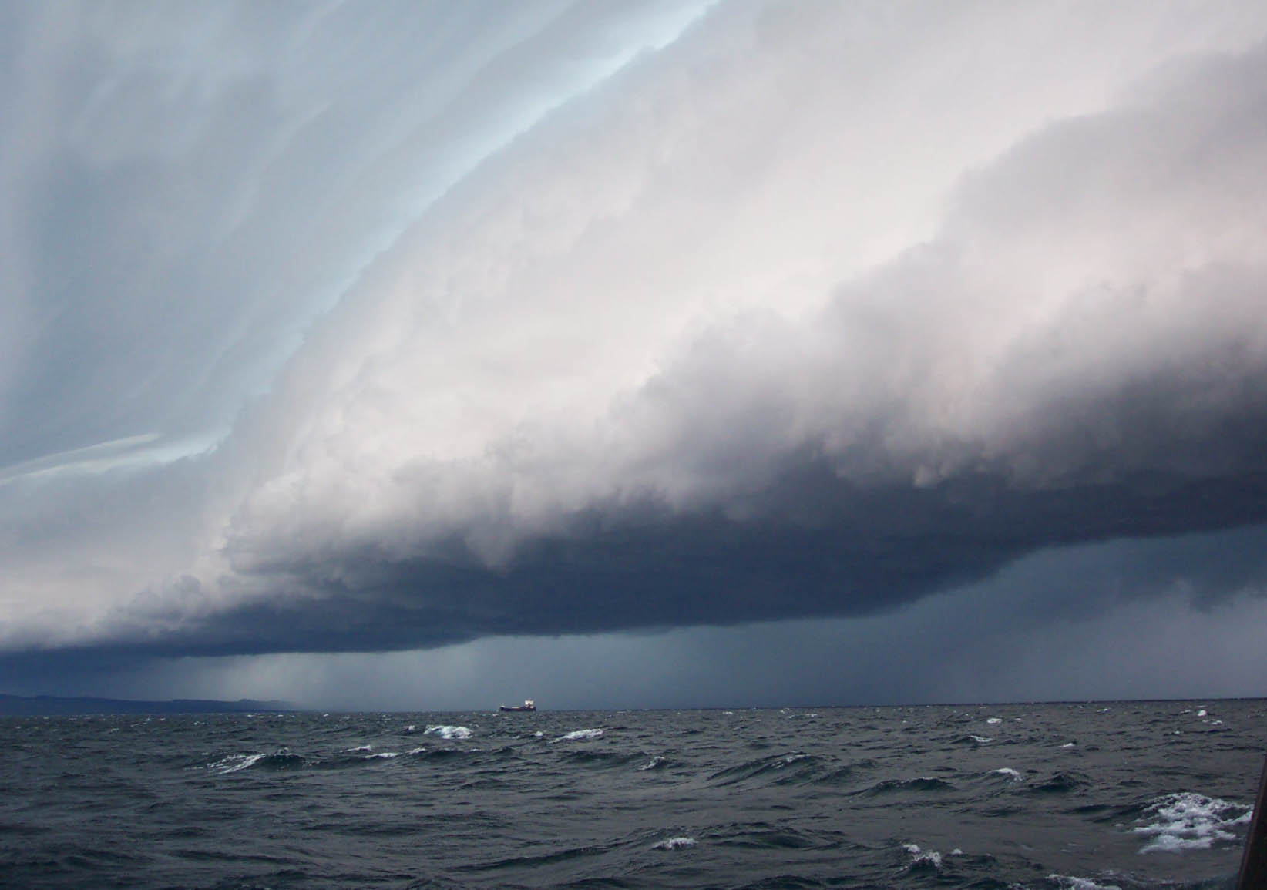

Changing Environment
Higher Citizen Expectations
Property Tax Challenges
Economic Declines
Unfunded Mandates
Fiscal Uncertainty

Slide 3
Changing Environment
One of the challenges Lakeland (and our peer cities) face now more than ever is the need to better connect the value & associated costs of municipal services to our constituencies
Clearly, through their actions, our constituents have asked:
  What should be kept?
  What should be changed?
  What should be eliminated?

Slide 4
Changing Environment
  Our Constituents expect that we will operate at improved efficiencies:
    How do we compare? (e.g. benchmarks & comparative data)
    What are the impacts associated with service cuts?
  The City Commission requires the same:
    What services can/should we provide at quality levels and at costs that are acceptable to the community?
  The City Commission, Administration and the Community will need a roadmap of how we will get there based upon prioritization of programs and services
Notes:
In light of such challenges and questions, Strategic Planning remains vitally important:
If we don’t do it, who will?

Slide 5
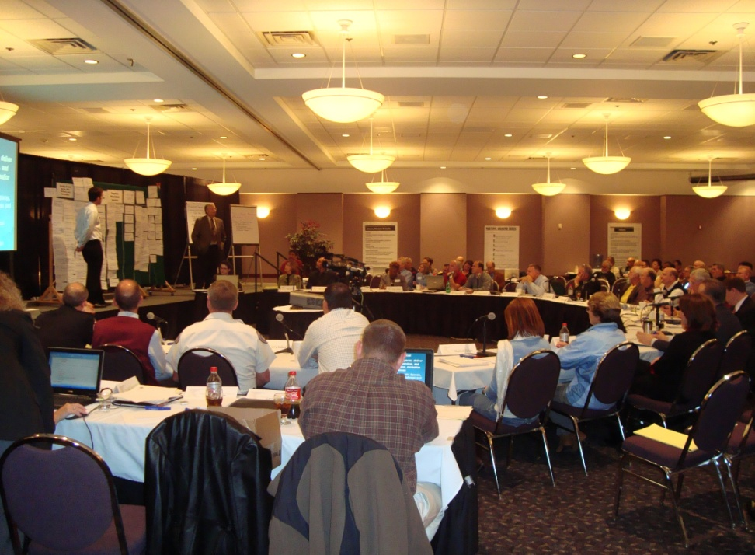
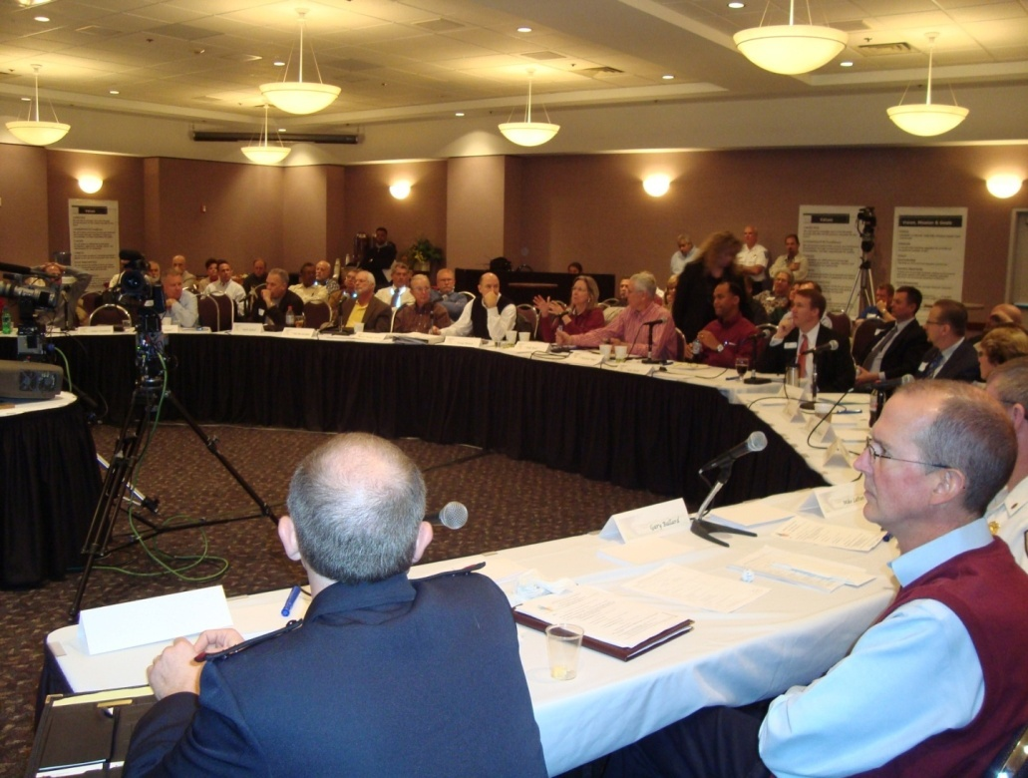
Where did our Journey begin?
2009 City Commission Retreat
5
Notes:
Focus of Retreat was new Budget prioritization process involving our facilitators Chris Fabian & Jon Johnson from Jefferson County Colorado

Slide 6
Identify, Define & Value
The Goals of Government
DIAGNOSTICS
TREATMENTS
Have We Clearly Identified the Goals of Our Government? Are Our Goals Clear, Defined, and Measurable? Does Our Elected Leadership Influence the Importance (or “Value”) of Each Goal, Relative to the Other Goals? Do We Distinguish Between Core Services Serving External vs. Internal Stakeholders?
Establish Goals of the Organization (draw distinction between results of Public-serving Core Services and Internal “Governance” Core Services) Allow Elected Leadership to Establish Relative Value of Goals

Slide 7
Strategic Goals
  Outcomes
    Prioritized Services
      Resource Allocation
7
Notes:
Doug….I took the word “Core” out because really it’s Core & Support
7

Slide 8
Strategic Operating Plan Goals
Strategic Goals
Quality of Life
Economic Opportunity
Growth Management
Fiscal Management
Communication
Governance
Notes:
Validation of right Goals and the decision to add a City-Wide Governance Goal as part of the mix

Slide 9
Strategic Goals
  Outcomes
    Prioritized Services
      Resource Allocation
9
Notes:
9

Slide 10
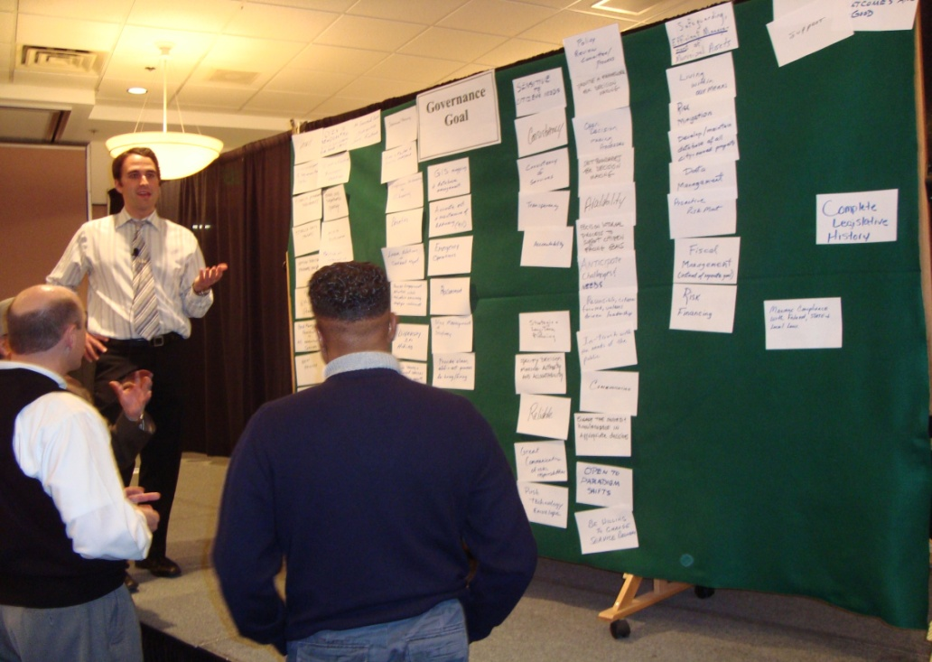
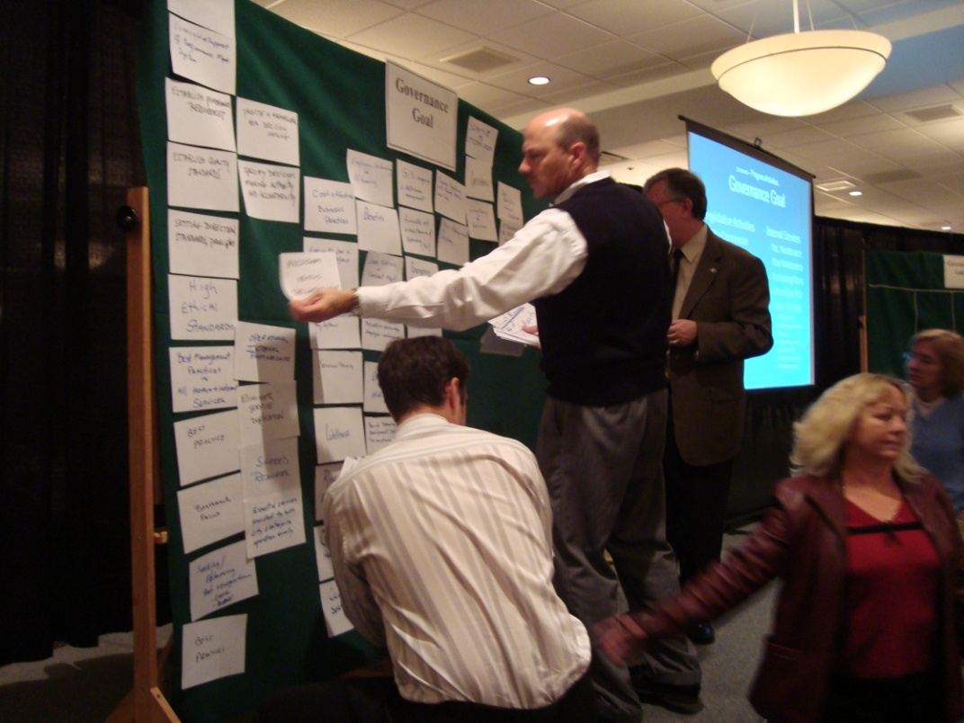
The 2009 Green Board Outcome Process Experience
10
Notes:
Green Board exercises. Attempt to better clarify what exactly we were trying to accomplish in each of the goals areas through an interactive and shared sense of outcomes
10

Slide 11
2009 Outcome Green-Board Example
Does the Core Service help Achieve this Outcome?
How?
Responsive, Efficient and Superior Standard of Municipal Services
Adequate electric service maintenance/delivery | Dependable low cost electric power | Easy access to municipal services | Effective sewer system | High level of citizen/customer satisfaction | Highly trained and prepared staff
Improved coordination of government services | Maintain high standards for municipal services | Recruit best employees for City of Lakeland (to provide the best services) | Responsive government officials and staff | Safe drinking water | Top flight municipal services
Volunteers | Well trained knowledgeable staff
Notes:
Quality of Life Goal
Example of what staff did with the various input statements following sorting of information within categories for each Goal/Outcome

Slide 12
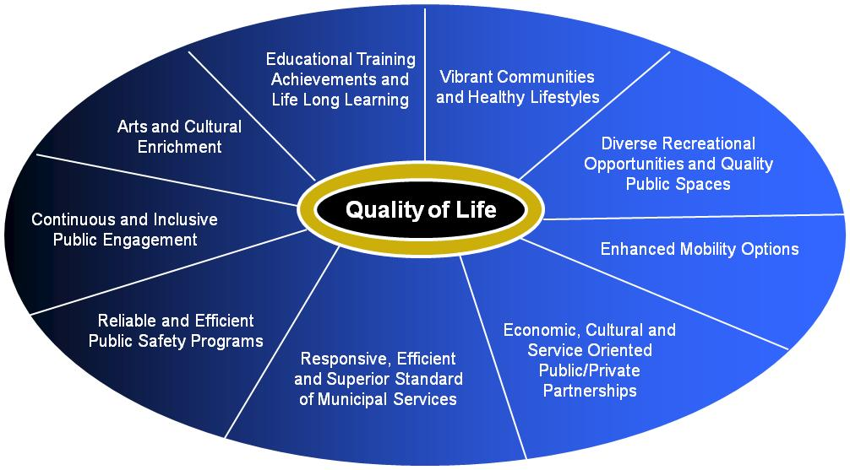
FY2009 Grade Core Services Based on Evidence of their Influence on Strategic Goals/Outcome Achievement
Responsive, Efficient and Superior Standard of Municipal Services
Adequate electric service maintenance/delivery | Dependable low cost electric power | Easy access to municipal services | Effective sewer system | High level of citizen/customer satisfaction | Highly trained and prepared staff
Improved coordination of government services | Maintain high standards for municipal services | Recruit best employees for City of Lakeland (to provide the best services) | Responsive government officials and staff | Safe drinking water | Top flight municipal services
Volunteers | Well trained knowledgeable staff
12
Notes:
The next Step is to value the Core Services to the extent they advance the desired outcomes of a given Goal

Slide 13
FY2009 Quality of Life
“Provide quality public spaces; deliver superior municipal services, and support arts, education, recreation and wellness.”
Educational Training Achievements and Life Long Learning
Vibrant Communities and Healthy Lifestyles
Arts and Cultural Enrichment
Diverse Recreational Opportunities and Quality Public Spaces
Quality of Life
Continuous and Inclusive Public Engagement
Enhanced Mobility Options
Reliable and Efficient Public Safety Programs
Economic, Cultural and Service Oriented Public/Private Partnerships
Responsive, Efficient and Superior Standard of Municipal Services
Notes:
9 Outcomes

Slide 14
FY2014 Quality of Life
“Provide quality public spaces; deliver superior municipal services, and support arts, education, recreation and wellness.”
Promote career training and programs aimed at life-long learning
Improve communication and Citizen participation in setting community priorities
Cultivate public/private partnerships to facilitate a cultural and service-oriented community
Provide reliable and efficient emergency response and effective safety, fire and crime prevention
Quality of Life
Influence the environment to promote active, healthy and enriched lifestyles within
the community
Provide outstanding municipal services
Enhance mobility options to include extended hours of public transportation, bike paths, bike
lanes and pedestrian connections to activity centers
Provide diverse recreational events, accessible parks, libraries and entertainment venues
Promote arts and culture throughout the City
Notes:
9 Outcomes

Slide 15
FY2009 Growth Management
“Ensure planning and infrastructure results in quality development and safe, attractive neighborhoods.”
Comprehensive Integrated Approach to Land Use Decisions
Fiscal Responsibility and Shared Resources
Growth Management
Regionally Adequate Transportation Systems
Safe, Attractive Neighborhoods Across the Economic Spectrum
Reliable, Adequate Infrastructure
Quality Developments Consistent with Community, Industry and Green Standards
Notes:
6 Outcomes

Slide 16
FY2014 Growth Management
“Ensure planning and infrastructure results in quality development and safe, attractive neighborhoods.”
Provide long-range planning to direct investment in infrastructure necessary for growth and redevelopment
Establish dynamic standards to respond to the changing environment including “green initiatives”
Growth Management
Maintain diverse, safe, attractive neighborhoods throughout the City
Provide reliable adequate infrastructure
Efficient and effective use of all resources
Implement an effective multi-modal transportation plan that considers regional objectives
Notes:
6 Outcomes

Slide 17
FY2009 Economic Opportunity
“Create and encourage inclusive lasting environments that grow, attract and retain a creative, talented, educated and technically qualified workforce.”
Generationally Diverse and Attractive Environment
Partnering for Economic Connections, Collaboration and Creation
Economic Opportunity
Enriched Community Workforce/Creative Class Jobs
Downtown Focus and Vibrancy
Sustainable Business Environment and Tourism
Notes:
5 Outcomes

Slide 18
FY2014 Economic Opportunity
“Create and encourage inclusive lasting environments that grow, attract and retain a creative, talented, educated and technically qualified workforce.”
Attract diverse job opportunities and cultivate high skill/high wage/high technology initiatives
Foster an inclusive and diverse environment that is welcoming to all ages
Economic Opportunity
Promote downtown as a regional center with a vibrant mix of high quality residential, retail, professional, civic and entertainment options
Collaborate with business and tourism partners for sustaining viable economic environment
Participate with economic partners creating business opportunities and aligning regional interests
Notes:
5 Outcomes

Slide 19
FY2009 Fiscal Management
“Develop and effectively manage financial resources.”
New or Diversified Revenue Streams to Fund Priorities
Strategic, Accountable and Transparent Cost Management
Fiscal Management
Strategic and Budgetary Planning with Prioritization
Measurable Performance of Innovation Efficiency and Effectiveness
Notes:
4 Outcomes

Slide 20
FY2014 Fiscal Management
“Develop and effectively manage financial resources.”
Continually monitor and evaluate cost effectiveness as well as efficient and accountable business practices
Develop greater transparency into the costs, utilization and operations of City services
Fiscal Management
Explore alternative sources of revenues, evaluate fiscal capacity including areas that should be paying user fees, form strategic alliances, expand profitable services and continually look for other creative opportunities
Maintain financial stability and align financial resources to core service priorities and regulatory requirements
Notes:
4 Outcomes

Slide 21
FY2009 Communication
“Develop an informed and engaged community.”
Effective and Timely Communication With Customers
Transparent and Understandable Message Content
Communication
Media Partnerships for Real Time Communication Feedback
Customer Experience Deemed Professional Responsive and Productive
Notes:
4 Outcomes

Slide 22
FY2014 Communication
“Develop an informed and engaged community.”
Develop social media connections to increase real-time communication outreach to the public
Respond to all customer inquires in a responsive, efficient, professional and courteous manner
Communication
Provide understandable information content through transparent processes
Notes:
4 Outcomes

Slide 23
FY2009 City-Wide Governance
“Provide for responsive and responsible governmental service.”
Results Oriented and Value Based Leadership
Customer and Market Focus (Benchmarking)
Transparent, Accountable and Efficient Business Processes
Safeguarding of Assets and Prudent Management of Fiscal Resources
Governance
Enriched, Informed and Engaged Workforce
Strategic and Long Term Planning
Regulatory and Policy Compliance
Knowledge and Analysis Based Decision-making
Notes:
8 Outcomes

Slide 24
FY2014 City-Wide Governance
“Provide for responsive and responsible governmental service.”
Practice strategic, long-term planning through alignment of goals, outcome expectations and key success indicators
Live our Core Values
top to bottom
Utilize sound and best practice methodologies to ensure effective, efficient, transparent, and fiscally accountable governance
Provide a work environment that enriches, informs and engages the workforce
Governance
Provide priority based services needed by Citizens and fund those desirable services that customers are willing to pay
Comply with Federal, State and local laws and City policies
Practice knowledge and analysis based decision making through business process improvement tools and resources; critical thinking; and pushing decision making down to the lowest feasible level to eliminate red tape
Notes:
8 Outcomes

Slide 25
Strategic Goals
  Outcomes
    Prioritized Services
      Resource Allocation
25
Notes:
25

Slide 26
FY2009 Municipal Core Services Breakdown
General Fund – Operational 210
General Fund – Governance 115
Internal Service Funds 56
Misc. (CRA’s, CDBG, etc.) 25
Enterprise Funds 78
TOTAL 484
Notes:
Identified a total of 484 Municipal Core Services provided to the community

Slide 27
FY2014 Municipal Core Services Breakdown
General Fund – Operational 92
General Fund – Governance 37
Internal Service Funds 15
Misc. (CRA’s, CDBG, etc.) 10
Enterprise Funds 30
TOTAL 184
Notes:
Refined and more concise list in FY14!

Slide 28
Key Objectives of Prioritization
Comparatively evaluate municipal core services relative to their influence on achieving Goals & Outcomes in the Strategic Operating Plan
Better understand our core services in the context of the cause-and-effect relationship they have on the Strategic Operating Plan
Provide a higher degree of understanding among decision makers regarding the scope, costs and impact of municipal core services
Publicly articulate how we value our services, invest in our priorities and ultimately divest ourselves of lower priority services
28
Notes:
Essence of what we are striving to accomplish through this process
28

Slide 29
FY2009 City Commission Valuation of Strategic Goals
Strategic Goal | Goal Statement | VALUE POINTS
Quality of Life | Provide quality public spaces; deliver superior municipal services, and support arts, education, recreation and wellness | 25
Economic Opportunity | Create and encourage inclusive, lasting environments that grow, attract and retain a creative, talented, educated and technically qualified workforce | 23
Growth Management | Ensure planning and infrastructure results in quality development and safe, attractive neighborhoods. | 18
Fiscal Management | Develop and effectively manage financial resources | 17.5
Communication | Develop an informed and engaged community | 16.5
TOTAL = 100
Notes:
As part of this process, the City Commission valued each of the five Goals to provide weight to the scoring process
[Weighting Factor=Goal Valuation/Lowest Goal Valuation]
29

Slide 30
FY2014 City Commission Valuation of Strategic Goals
Strategic Goal | Goal Statement | VALUE POINTS
Quality of Life | Provide quality public spaces; deliver superior municipal services, and support arts, education, recreation and wellness | 27
Communication | Develop an informed and engaged community | 21.57
Economic Opportunity | Create and encourage inclusive, lasting environments that grow, attract and retain a creative, talented, educated and technically qualified workforce | 19.14
Fiscal Management | Develop and effectively manage financial resources | 18.57
Growth Management | Ensure planning and infrastructure results in quality development and safe, attractive neighborhoods. | 13.72
TOTAL = 100
Notes:
As part of this process, the City Commission valued each of the five Goals to provide weight to the scoring process
[Weighting Factor=Goal Valuation/Lowest Goal Valuation]
30

Slide 31
FY2009 Core Services
Evaluation Criteria
Notes:
Excel spreadsheet

Slide 32
Goal Evaluation
  Grading Benchmarks:
    No Influence=0 points
    Some Influence=1 points
    Influence=2 points
    Strong Influence=3 points
    Essential=4 points
Notes:
Goal grading benchmarks are 0=No Influence, 1=Some Influence, 2=Influence, 3=Strong Influence, 4=Essential

Slide 33
Mandated to Provide Core Service
  Grading Benchmarks:
    No Mandate=0 points
    COL Adm. Policy=2 points
    County/City Ordinance=3 points
    Local Initiative w/State Regulation=4 points
    State or Federal Mandate=5 points
Notes:
This is an area that we will revisit next year as a lessons learned.

Slide 34
Core Service Sustained by Direct User Fee
  Grading Benchmarks:
    0% Funding=0 points
    Percentage Covered by a Direct User Fee:
      1% - 20%=1 point
      21% - 40%=2 points
      41% - 60%=3 points
      61% - 80%=4 points
      81% - 100%=5 points

Slide 35
Demand for Service
(Changes in Demand for Service)
  Grading Benchmarks:
    Significant Decrease = -2 points
    Decreasing = -1 point
    No Change = 0 points
    Increasing = 1 point
    Significant Increase = 2 points

Slide 36
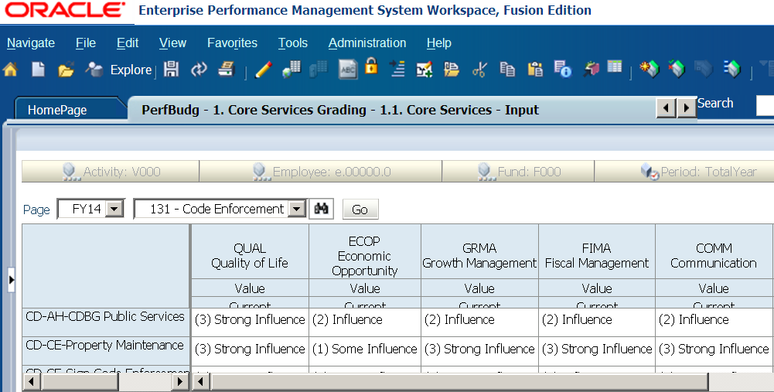
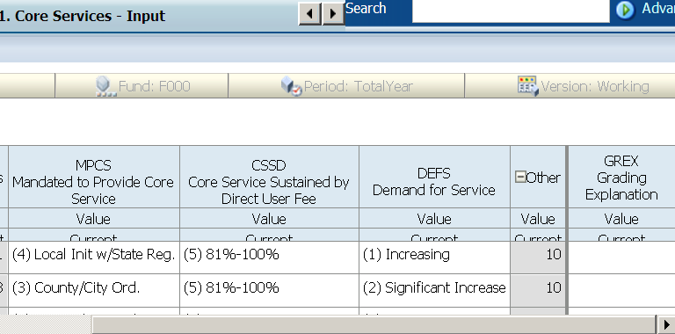
FY2014 Core Services
Evaluation Criteria Forms
Notes:
3rd Year using New Hyperion System, allows for better consistency and reporting. Goal grading benchmarks are 0=No Influence, 1=Some Influence, 2=Influence, 3=Strong Influence, 4=Essential

Slide 37
GRC Review Process
Assigned individual Committee Members to review specific Governance Outcomes and Operational Goals/Other Category Criteria
Criteria Specialist (GRC Member) shared High through Low benchmark examples and explained rationale for grades assigned
Criteria Specialist facilitated the review and discussion of Core Services
Changes to Core Service Grading were discussed, with consensus reached before assigning final Grades
GRC reconsideration of Grade assignments to be based on Departmental requests where total GRC Grade was reduced by 8 or more points from original Departmental Grades
Mayor & City Commission review and input
Notes:
GRC Committee Members:
Doug Thomas - City Manager
Tony Delgado - Deputy City Manager
Brad Johnson - Assistant City Manager
Mike Brossart - Finance Director
Kindle Bowden – OMB Manager

Slide 38
FY2013 Prioritization
Core Services
Quadrant | Number
 | Services | Departments | Enterprise
1 | 28 | 9 | 13
2 | 32 | 10 | 7
3 & 4 | 63 | 11 | 12
Support Services
Quadrant | Number
 | Services | Departments
1 & 2 | 35 | 11
3 & 4 | 26 | 8

Slide 39
FY2013 Prioritization Graph Operational - Quadrant 1
28 Core Services were included in Quadrant 1
Of the 28 Core Services, 9 Departments were represented
Of the 28 Core Services, 13 were related to Enterprise Funds
Notes:
We believe the points added from mandated services unduly impacted core services in Quartile #1 due to virtually all such services being mandated. (Examples – Fire code permits, plans review, zoning, etc.)
Not sure that is the intended outcome of the prioritization exercise, as most of our constituents relate to “typical” municipal core services starting in Quadrant #2 (examples – DART, response to emergency calls for service, Parks maintenance, etc.)

Slide 40
FY 2013 Prioritization Graph: Operational - Quadrant 2
32 Core Services were included in Quadrant 2
Of the 32 Core Services, 10 Departments were represented
Of the 32 Core Services, 7 were related to Enterprise Funds

Slide 41
FY2013 Prioritization Graph: Operational - Quadrants 3 & 4
63 Core Services were included in Quadrants 3 & 4
Of the 63 Core Services, 11 Departments were represented
Of the 63 Core Services, 12 were related to Enterprise Funds

Slide 42
FY13 Prioritization Graph: Governance - Quadrants 1 & 2
35 Support Services were included in Quadrants 1 & 2
Of the 35 Support Services, 11 Departments were represented

Slide 43
FY 2013 Prioritization Graph:
Governance - Quadrants 3 & 4
26 Support Services were included in Quadrants 3 & 4
Of the 26 Support Services, 8 Departments were represented
Notes:
Important to note that for the first year, we did not run core services for enterprise and “other” operations through the GRC process. Will include in FY 2011

Slide 44
Strategic Goals
  Outcomes
    Prioritized Services
      Resource Allocation
44
Notes:
This is where the rubber truly meets the road…..how much money are we going to spend in the respective core services and/or will we ultimately eliminate some of the lower ranked core services?

Slide 45
Budget Theme
No you can’t always get what you want,
You can’t always get what you want,
You can’t always get what you want…
But if you try sometimes you might find,
You get what you need…..
“You Can’t Always Get What You Want”
Mick Jagger & Keith Richards
The Rolling Stones

Slide 46
FY2009 Budget Policies
  Departmental budget targets averaged 2% cuts from FY 2009, less compensation built-ins, one-time projects and carryovers
  Prioritization Quadrant budget targets based upon following cuts:
    1.75% - Quadrant 1 Services
    2.00% - Quadrant 2 Services
    2.25% - Quadrant 3 Services
    2.50% - Quadrant 4 Services
Notes:
Approximately 70% of city-wide employees would normally be eligible for a merit increase in 2010, with roughly 20% of those being only one step from the top of their pay scale
Freezing merits for ALL General Fund employees saves $933k for 2010
City wide, the impact of freezing merits (included ALL of LE) would be $2.2 million
Average General Fund salary is $52,025 (assuming NO merit increases)
Average City-Wide Salary is $53,138 (assuming NO merit increases)

Slide 47
Strategic Planning Inputs/Outputs
Meetings
Outputs
Inputs

Slide 48
Process Improvements
FY 2014 – Added the Values Campaign
  Benefits Included:
    Involving Citizenry in the Strategic Planning and Budgeting of the City. Their Values were gathered and integrated into the Actionable Items Development process during the Strategic Planning Retreat with Commissioners.
    Great participation, 2,019 survey participants.
    Reportable Data gathered and stored for reference by internal or external requestors.

Slide 49


Strategic Planning Inputs/Outputs
Meeting
Outputs

Slide 50
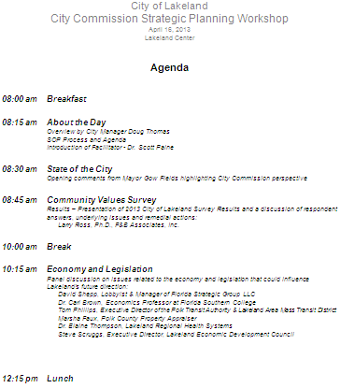
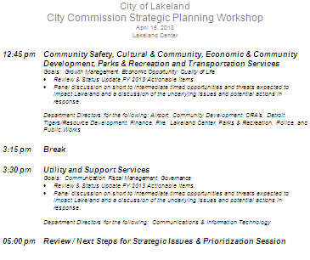
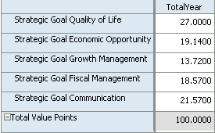
Strategic Planning Inputs/Outputs
Inputs
Meetings
Outputs

Slide 51
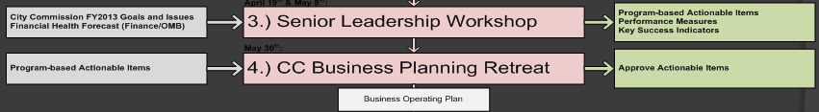
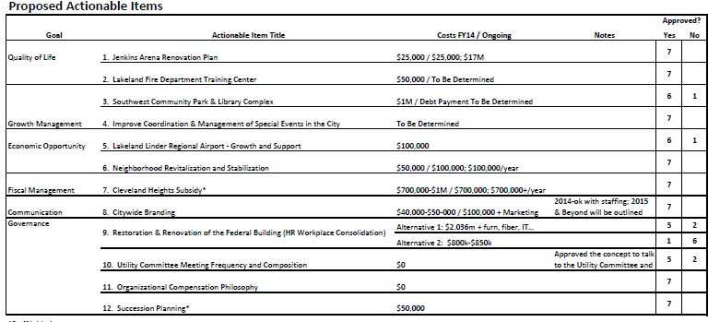
Business Planning Inputs/Outputs
Inputs
Meetings
Outputs

Slide 52
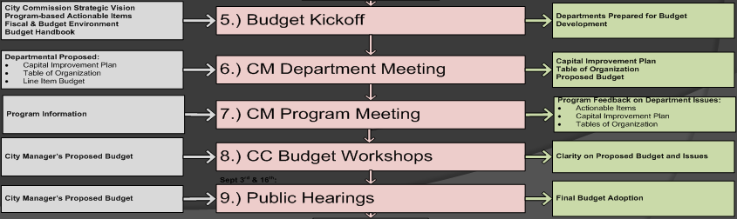

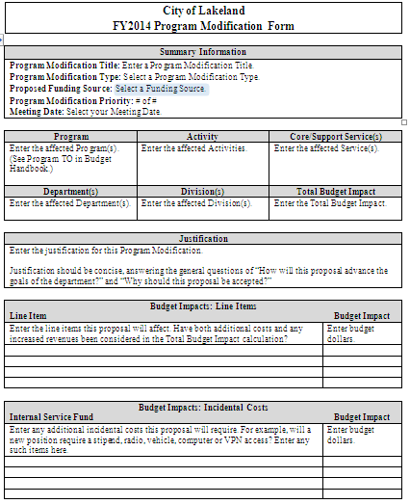
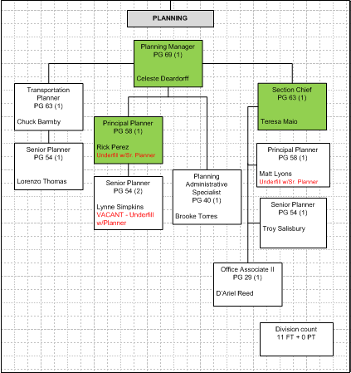
Budget Process Inputs/Outputs
Inputs
Meetings
Outputs

Slide 53
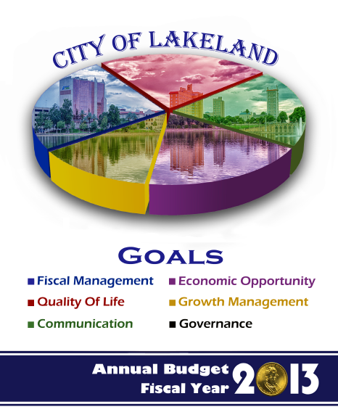

Slide 54
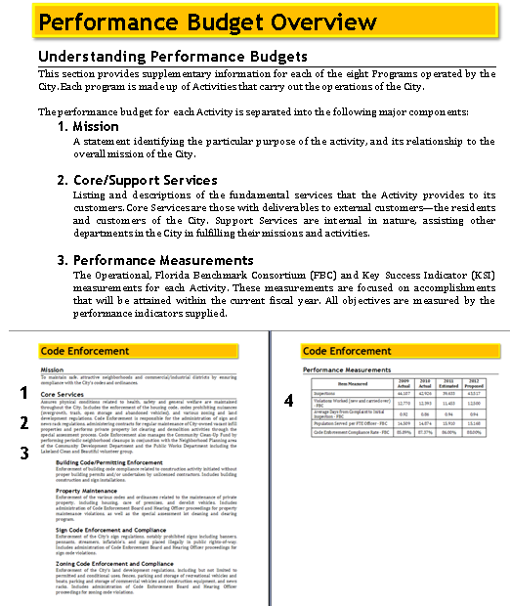
Performance Budget Format

Slide 55
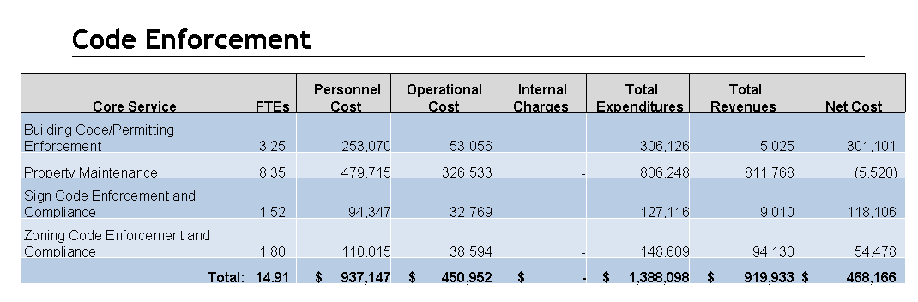
Performance Budget Format
Notes:
Costs broken down by core municipal services including dedicated FTE, total expenditures, total dedicated revenues and net cost/profit

Slide 56
FY15 Planned Process Improvements
Perform the Values Campaign for the 2nd year.
Provide 2 yr trending for the Values Campaign data.
Further explore and expand the need for Program based City Manager meetings with Departments.
Attempt to automate the Table of Organization Visio generation and reconciliation process.
More to come……

Slide 57
“Lakeland – A Vibrant, Culturally Inclusive World-Class Community”
Questions?

