Slide 1

ACHIEVING FISCAL HEALTH -
5 Step Diagnostic and
Treatment Process
Center for Priority Based Budgeting
2013 ANNUAL CONFERENCE “A SUMMIT of LEADING PRACTICES”
Jon Johnson & Chris Fabian
July 9, 2013

Slide 2


A Brief Introduction…
Jon Johnson
CHRIS FABIAN

Slide 3



Slide 4




The “New Normal "for Local Governments
  2 out of 3 local governments believe that changes made during the recession represent a “new way” of doing business that will continue beyond the fiscal crisis. - ICMA ‘s “State of the Profession Survey”
  Local governments are rethinking what services they provide, how much they pay for them and what taxpayers expect for their tax dollar. - Financial Times
  9 in 10 City finance directors report their cities are less able to meet fiscal needs than in the previous year. - NLC‘s “City Fiscal Conditions” Survey
  Ending fund balances decreased as cities used them to weather the effects of the downturn. -NLC‘s “City Fiscal Conditions” Survey
  States will continue to struggle to find the resources needed to support critical public services for a number of years. - Center on Budget and Policy Priorities
  32 % of citizens report that their recently depressed spending habits will become a “new normal” in the years ahead. New normal” consumer spending implies slower economic growth than in the past. - Gallup Poll

Slide 5
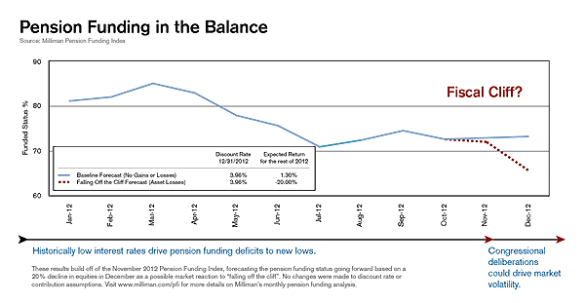

Slide 6
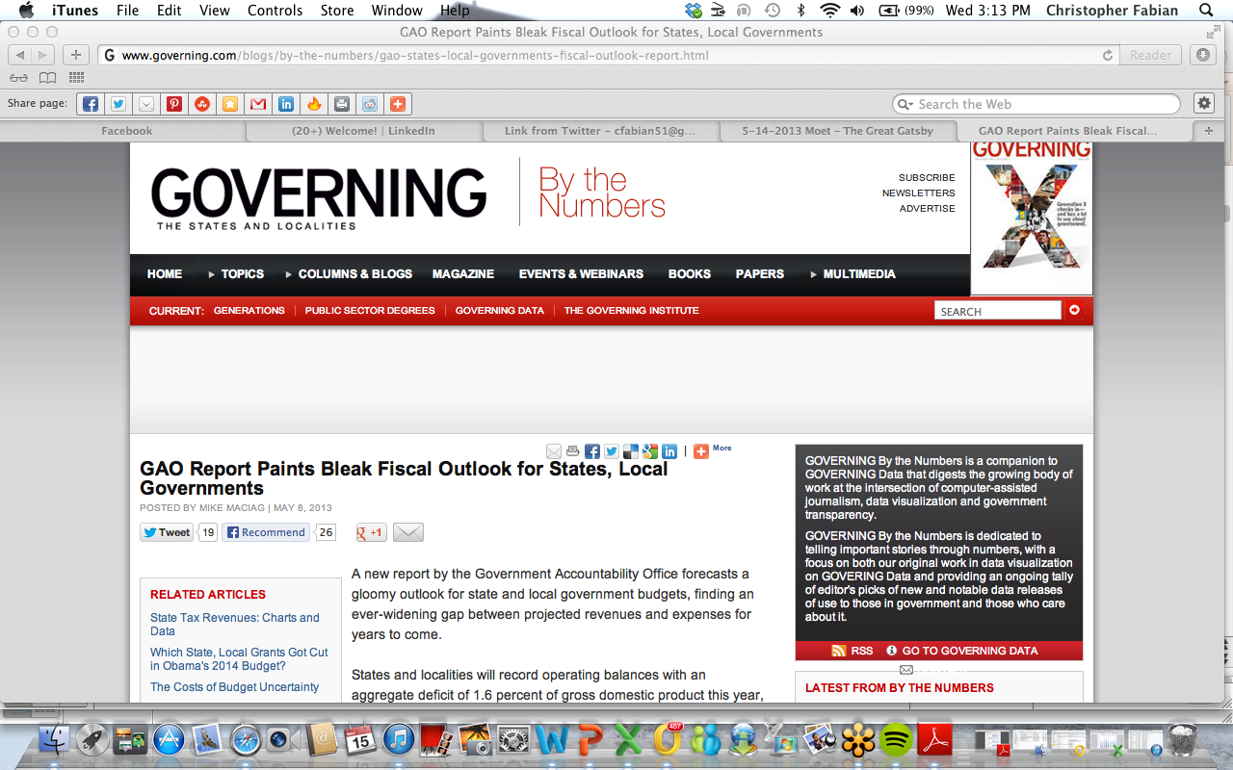
Latest Headlines…
  States and localities will record operating balances with an aggregate deficit of 1.6 percent of gross domestic product this year
  To close the fiscal gap, governments would need to trim current expenditures by 14.2 percent and maintain that level of spending
  On the revenue side, eroding tax bases have “buried” states. The economy has slowly shifted from goods to services, which governments traditionally are reluctant to collect taxes on
  A slowdown of health care cost increases or an economy that gains momentum could help considerably. On the other hand, changes to federal mandates, tax policy or funding cuts could make a dent in state and local government coffers for years to come
  “They need to tackle these programs bit by bit, year after year,” Boyd said. “Governments don’t have the luxury of waiting 10 years.”

Slide 7
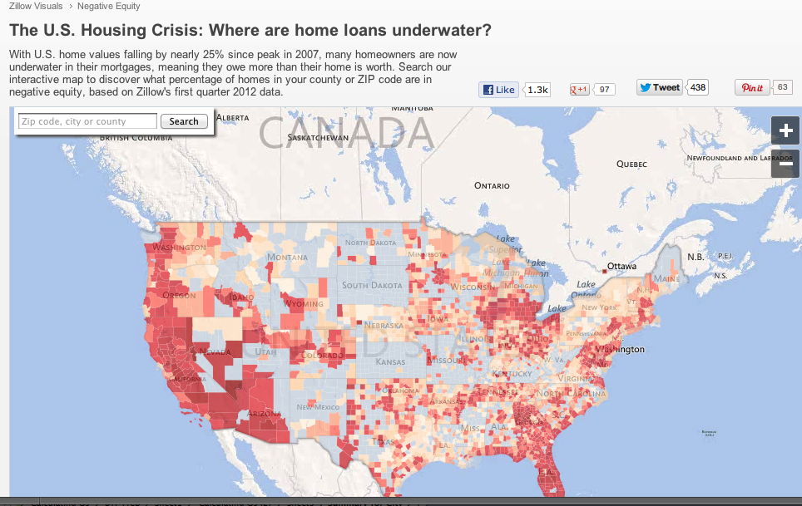
Housing Market –Still Underwater!
Source: Zillow.com June 2012

Slide 8
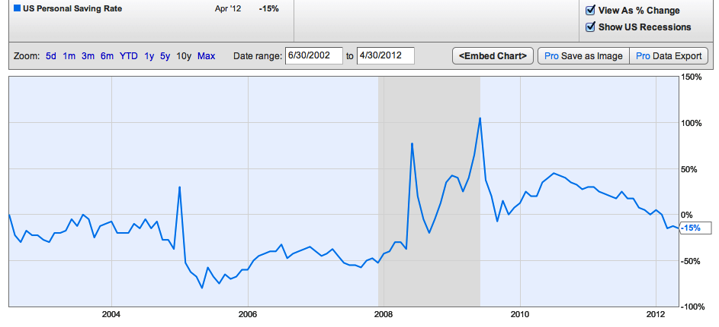
Personal Savings Rates Trending Toward 0% – AGAIN!!!
Source: US BEA June 2012

Slide 9
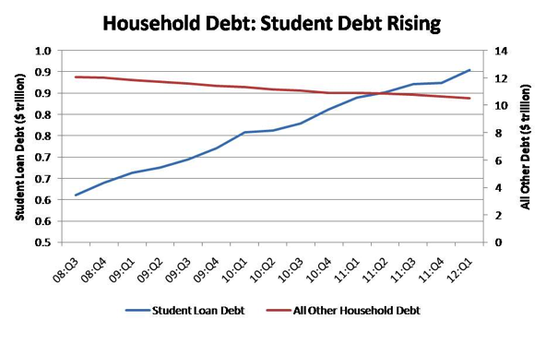
Student Loan Debt – the Next Collapse ????

Slide 10
DOES THIS LOOK FAMILIAR ?????

Slide 11
Achieving Fiscal Health -OR-
Confessions of a 30-year Finance Director !

Slide 12

Become a Diagnostician

Slide 13

“Over the Counter” Treatments
Treatment Options:
Fees for Service = Cost of Delivery
Freeze Vacant Positions (Temporaries?)
Across the Board “Cuts”
Defer/Delay Capital Projects
“Sharpen” Revenue Billing/Collection
Consolidated Purchasing/Contracting
Sell Underutilized Assets
Cost Allocation/Overhead Transfers
Freeze Salaries/Overtime
Treatment Considerations:
Only a Short-Term “Fix” to Relieve Pain
Safe to apply with minimal diagnosis
Must have follow up diagnosis

Slide 14

“Emergency-Room” Treatments
Treatment Options:
Across the Board Budget “Amputation”
Hiring Freeze/Furloughs
Reduction in Workforce
4-Day work weeks
Reduce Services
Spend “Savings” Reserves
Early Retirement Incentives
Outsourcing/Shared Services
Resize or Restructure
Treatment Considerations:
Don’t apply without diagnosis
Don’t be guilty of malpractice
Only to “Stop the Bleeding”

Slide 15
“Cosmetic” Treatments
(Not a Solution!!!)
Accounting Gimmicks
Shifting Operational Costs to Capital Budgets
Deferring Compensation
Underfund Accrued Liabilities
Short –term borrowing
“Distort” estimates or projections
Notes:
State of California – poster child
First – increased withholding tax tables – refund when folks filed tax returns
Second – no money for refunds so issued “IOU” in form of vouchers – soon became worthless
Third – borrowed $20 million for 20 years to cover 9 months of operating expense

Slide 16
Achieving Fiscal Health & Wellness
2 Strategic Initiatives
Fiscal Health
Long-term Fiscal Wellness

Slide 17


BRINGING VISION INTO FOCUS
WITH A NEW “LENS”

Slide 18
Who is Looking through the “New Lens”
ILLINOIS - Boone County
KANSAS - Shawnee
MISSOURI - Branson
MONTANA - Billings (2)
NEBRASKA - Grand Island (3)
NEW MEXICO - San Juan County
NEVADA - Douglas County (2)
NORTH CAROLINA - Cary
OHIO - Blue Ash; Cincinnati
OREGON - Springfield, Tualatin
PENNSYLVANIA - Lehigh County
TEXAS - Plano (3), Southlake
VIRGINIA - Chesapeake (2); Christiansburg (2)
WYOMING - Green River
ARIZONA - Chandler (2 ); Queen Creek; Gilbert Public Schools
CALIFORNIA - Walnut Creek (3) ; San Jose (3); Sacramento (2); Monterey (3); Salinas; Seaside; Fairfield; Placentia; Mission Viejo;
CANADA - Edmonton; Alberta Ministry of Health;
COLORADO - Boulder (3); Longmont (3); Fort Collins (2); Wheat Ridge (2); Jefferson County; Thornton; Victor; Mountain View Fire Protection District: Manitou Springs; Denver International Airport; Dillon Valley Water/Sewer District
FLORIDA - Lakeland (3); Delray Beach (2); Plantation; Pasco County
IDAHO – Post Falls

Slide 19



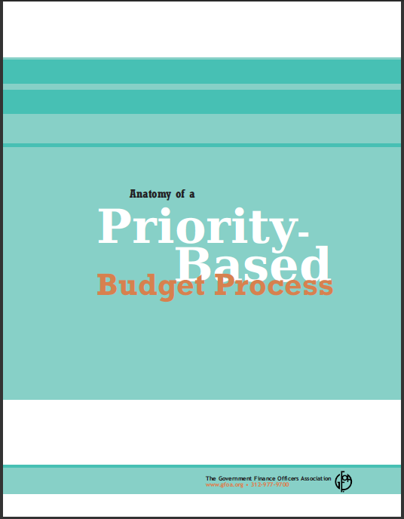

Slide 20
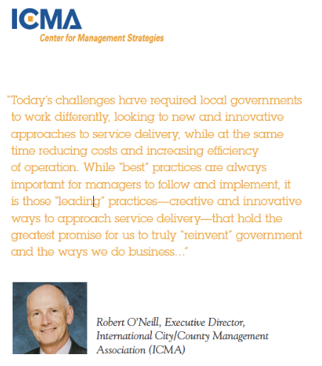

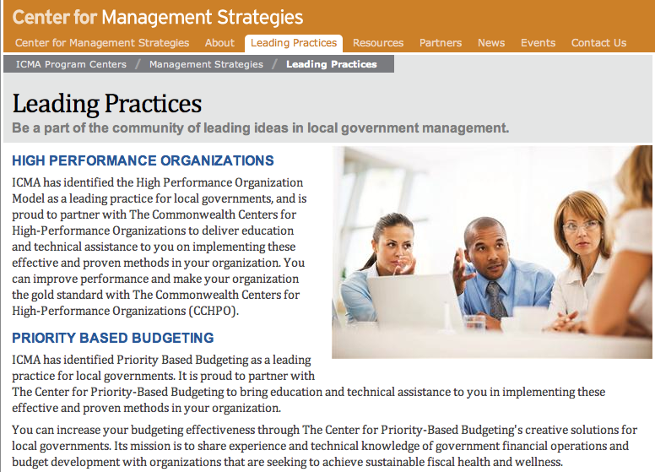
Fiscal Health & Wellness through Priority Based Budgeting

Slide 22

Strategic Questions
How much do we have available to spend? (not “How much do you need”?)

Slide 23
Approach to Fiscal Health #1:
“Spend Within Your Means”
Apply Diagnostics – DO YOU…
  Start with revenues?
    Know what “drives” each major revenue source?
    Prepare a formal organization-wide Revenue Manual?
  Distinguish one-time from ongoing sources and uses?
    Have a process in place to “track” them separately?
    Demonstrate this differentiation in your forecasts and other financial documents?
  Differentiate Program Revenues from General Government Revenues?
    Adjust budget allocations to departments for changes in associated Program Revenues?

Slide 24
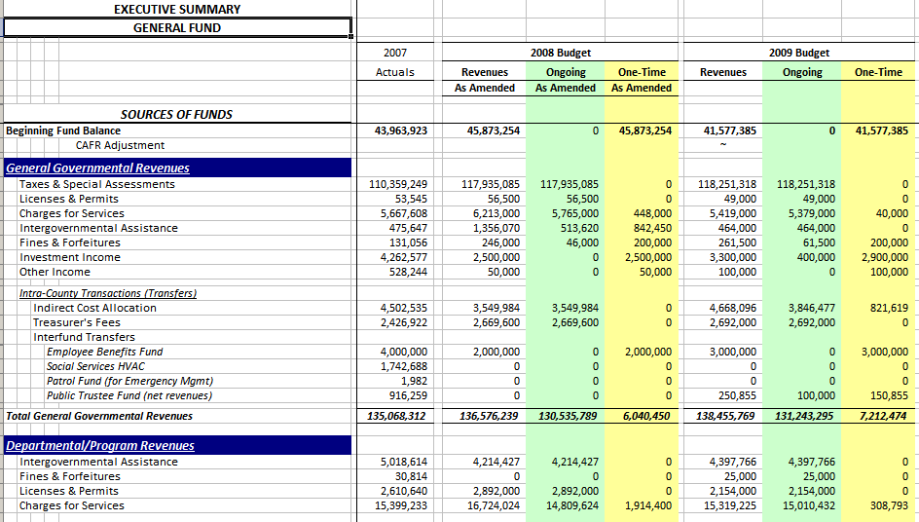
Differentiate Ongoing and One-time
2012 Budget
2013 Budget

Slide 25
Approach to Fiscal Health #1:
“Spend Within Your Means”
Available Treatments:
  Achieve ongoing alignment
    Fund operating expenditures with reliable ongoing revenues
    Prevent reliance on volatile revenues (that might not come in!)
  Achieve one-time alignment
    Fund one-time costs with one-time sources
    Ensure reserves aren’t used for ongoing expenses
  Promote revenue diversification and enhancement

Slide 26

Strategic Questions
How much do we have available to spend? - (not “How much do you need”?)
Why do we need to keep “money in the bank”?

Slide 27
Approach to Fiscal Health #2:
Establish and Maintain Reserves
Apply Diagnostics – DO YOU…
  Understand what makes up Fund Balance(s) and why you hold reserves?
    Have a formal “inventory” of all restricted or designated fund balance reserves, stating their purpose, the authority establishing them and how they are to be calculated?
  Have a written fund balance reservation policy?
    Monitor fund balances to ensure that reserves are maintained?
    Ensure established working capital reserves are sufficient to meet emergency needs or short-term revenue shortfalls?
  Monitor Fund Balance levels to ensure they “aren’t too little” OR “too much”, but “just right”?

Slide 28

Determining the “Right” Level
Baseline recommendation (General Fund)–
  5% to 15% of operating revenue
  1 to 2 months operating expenditures
Adjust for:
  Historic Events and Past Experience
  Government Size
  Revenue Stability
  Future Capital Needs
Notes:
Expenditures – 8% is approximately 1 month 15% is approximately 2 months
Diagnostic exercise – what local government hasn’t been hit with natural disaster during this economic disaster
EXAMPLE: Hayman Fire
EXAMPLE: Oil Spill

Slide 29
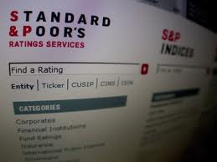
Standard & Poor's View
Low = 0% or “below”
Adequate = 1% to 4%
Good = 4% to 8%
Strong = 8% to 15%
Very Strong = Above 15%

Slide 30
Approach to Fiscal Health #2:
Establish and Maintain Reserves
Available Treatments
  Establish a written Working Capital/Emergency Reserve policy
    Provides back-up plan for emergencies, revenue shortfalls, or other unforeseen changes
  Identify, document and understand all reserves
  Review adequacy of Fund Balance levels
    Hold only appropriate amount in reserve to establish credibility with internal and external stakeholders
  Set aside funding for long-range plans, major maintenance and asset replacement

Slide 31

Strategic Questions
How much do we have available to spend? - (not “How much do you need”?)
Why do we need to keep “money in the bank”?
What’s the “difference”?

Slide 32

Approach to Fiscal Health #3:
Understand Variances
Apply Diagnostics – DO YOU…
  Allow Departments to budget for contingencies rather than appropriating at the fund level?
  Have large capital project “carry-forwards” at year end?
  Utilize a formal Compensation Plan to establish employee salary/wage ranges?
    Update the plan on a regular basis?
  Include employee benefit packages as part of total personnel costs when assessing the adequacy of employee compensation?

Slide 33

Types of Variance Analysis
  Revenues & Expenditures
    Budget to Actual
    Historical year to year actuals
    Cyclical trends
    Ongoing vs. one-time occurrence
  Multi-year Capital Projects
    Eliminate Carry-forwards
    Avoid excessive “change orders”

Slide 34

Types of Variance Analysis
  Employee Compensation
    Comp Plan vs. Actual Wages Paid
      Hiring Range
      Maximum Range
    Market Comparison - based on total compensation
    Approved FTE Count
  Accounts Receivable
    Difference between amounts due and amounts billed?
    Difference between amounts billed and amounts collected

Slide 35
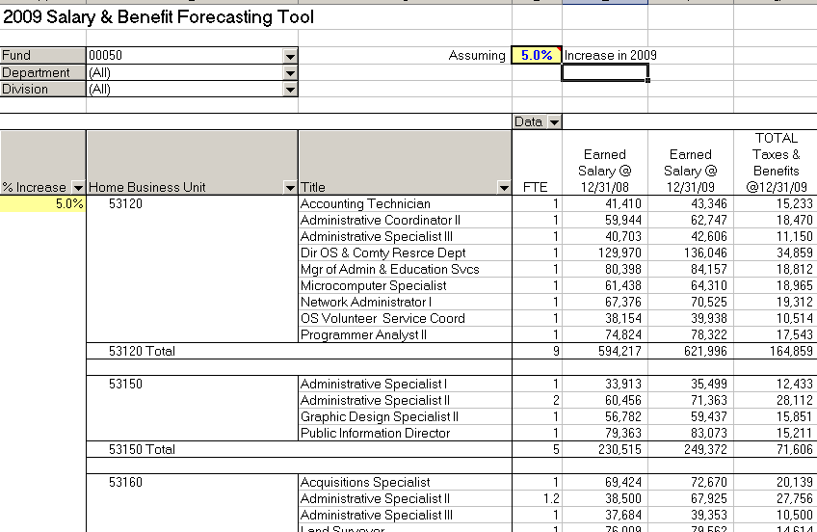
Salary/Benefit Projection Tool

Slide 36
Approach to Fiscal Health #3:
Understand Variances
Available Treatments:
  Strive to align budget with actuals (a source of “hidden treasure”)
    Refine salary and benefit projections, to align with actual costs incurred
    Provide more effective budget monitoring and management to eliminate variances
    Identify and eliminate the “fluff”
  Fund cyclical expenditures with one-time funding sources
  Consolidate contingencies maintained in department budgets
  Analyze and understand revenue & expenditure variances
  Promote multi-year budgeting for capital projects

Slide 37

Strategic Questions
How much do we have available to spend? - (not “How much do you need”?)
Why do we need to keep “money in the bank”?
What’s the “difference”?
“It costs how much”????????

Slide 38
Approach to Fiscal Health #4:
Transparent About “True Cost of Doing Business”
Apply Diagnostics – DO YOU…
  Allocate overhead and administrative costs to Funds and/or Departments that benefit from those services?
  Utilize Internal Service Funds to align delivery and cost of internal services with customer demand?
    Know what services are best adapted to an Internal Service Fund approach?
    Understand how internal charges are established and distributed?
    Ensure that internal customers perceive that costs are transparent and there is an ability to influence those costs by altering their own demand?

Slide 39
Approach to Fiscal Health #4:
Transparent About “True Cost of Doing Business”
Apply Diagnostics – DO YOU…
  Identify total cost (direct AND indirect) for all programs?
    Prepare a Full Cost Allocation plan in addition to an OMB A-87 Cost Allocation Plan?
    How is this Plan incorporated into the budget process?
  Establish fees for service that recapture appropriate level of total costs of providing that service?

Slide 40
Internal Service Funds (ISF)
What Do We Mean?
  Approach to fairly and equitably allocate costs of “internally focused” services to those who use them
  Usually involve internal service providers such as Fleet, I.T. and Facilities
Why Should They Be Used?
  Better articulate what services are provided
  Identify the “true cost of doing business”
  Generate better conversations about value of these services to end user
  Facilitate better dialogue about service delivery options and choices

Slide 41

Key Components of an ISF
Program Inventory
  Identify programs – distinct from “tasks” (too small) or divisions (too large)
  Determine base level of service
  Determine discretionary levels of service above base levels
Program Costs
  Direct costs
  Indirect costs (internal services have these too!)
  Organizational administrative/overhead costs
Basis for “Charging” Program Costs to End User
  Identify how “demand” or “need” is generated
  Determine appropriate allocation methodology

Slide 42
Approach to Fiscal Health #4:
Transparent About “True Cost of Doing Business”
Available Treatments:
  Establish Internal Service Funds and engage Departments in assessing demands for these services
  Promote enhancement of cost recovery for programs where appropriate
  Diversify cost burden from General Fund by appropriately sharing costs among other dedicated revenue streams
  Inventory and cost all programs
    Utilize Full Cost Plans to better determine the true cost(direct and indirect) of offering programs/services

Slide 43

Strategic Questions
How much do we have available to spend? - (not “How much do you need”?)
Why do we need to keep “money in the bank”?
What’s the “difference”?
“It costs how much”????????
“What’s the plan and what could cause it to change?
What does the future look like?
What if………..???

Slide 44

Approach to Fiscal Health #5:
Economic Analysis & Long-term Planning
Apply Diagnostics – DO YOU…
  Incorporate ALL long-term plans developed within the organization into your financial forecasts?
  Prepare comprehensive, multi-year Capital Improvement Plan, and clearly identify associated ongoing operating costs?
    Understand how the CIP impacts the budget process and your long-term financial forecasts?
  Identify only relevant economic indicators to monitor?
  Effectively utilize appropriate “tools” to communicate financial position to all stakeholders (elected officials, citizens and staff)?

Slide 45
KEY ECONOMIC INDICATORS
  Both External and Internal
  Focus on only what is relevant!!!!!!
  Utilize TRENDS over Benchmarks
  Demonstrate organizational impacts

Slide 46
Approach to Fiscal Health #5:
Economic Analysis & Long-term Planning
Available Treatments:
  Prepare a 5 to 10 year financial forecast
    Use relevant key indicators and trend analysis to improve decision-making
    Update and present on regular basis throughout the year
    Identify potential points of failure and plan for needed changes
  Utilize simple, graphic communication tools to illustrate fiscal health position to all stakeholders
    Help keep decision makers focused on high-level stewardship role
    Access impact of “today’s” decisions on future financial sustainability
    Allow scenario-planning which encourages flexible and adaptive decision-making

Slide 47
Diagnostic Questions to Ask
Does your organization differentiate between one-time and ongoing revenues and expenditures?
  If yes, how are they tracked? Does your forecast demonstrate this differentiation?
How does your organization differentiate “program” revenues from “enterprise” revenues such as taxes, earnings on investments, franchise fees, etc.?
Does your organization prepare a formal Revenue Manual?
  If yes, what type of information is included?

Slide 48
Diagnostic Questions to Ask
Does your organization have a written fund balance reservation policy?
  If yes, how are you monitoring to ensure that reserves are maintained?
Check to see if established working capital reserves are sufficient to meet emergency needs or short-term revenue shortfalls.
Check to see if there is an inventory of all other restricted or designated fund balance reserves, stating their purpose, the authority establishing them and how they are to be calculated.

Slide 49
Diagnostic Questions to Ask
Are variances between budgeted and actual revenues and expenditures analyzed and explained?
  If yes, how do those variances impact future budget cycles?
Does your organization utilize a formal Compensation Plan to establish employee salary/wage ranges?
  How often is the plan updated?
When assessing the adequacy of employee compensation, are employee benefit packages included in this assessment?

Slide 50
Diagnostic Questions to Ask
Does your organization utilize Internal Service Funds?
  If yes, what are the services provided by each fund and how are the internal charges established and distributed?
Check to see if appropriate demand metrics are evaluated when determining costs.
Check to see if customers perceive that costs are transparent, and they have the ability to influence those costs by altering their own demand.
Does your organization prepare a Full Cost Allocation plan in addition to an OMB A-87 Cost Allocation Plan?
  If yes, how is this plan incorporated into the budget process?

Slide 51
Diagnostic Questions to Ask
Does your Five-Year forecast incorporate other long-term plans developed by your organization?
Does your organization prepare a Capital Improvement Plan?
  If yes, what information is included and how is it utilized in your budget process and your financial forecasts?
What tools does your organization use to communicate financial information to its elected decision-makers?

Slide 52
Thank You !
    Jon Johnson, Co-Founder Chris Fabian, Co-Founder
    303-756-9090, ext. 326 303-756-9090, ext. 325
    303-909-9052 (cell) 303-520-1356 (cell)
    jjohnson@pbbcenter.org cfabian@pbbcenter.org
www.pbbcenter.org
Copyright ©2009 by Chris Fabian and Jon Johnson d/b/a the Center for Priority Based Budgeting,
Denver, Colorado.

