Slide 1

PRIORITY BASED BUDGETING –
Technology and Tools
Showcase
Center for Priority Based Budgeting
2013 ANNUAL CONFERENCE “A SUMMIT of LEADING PRACTICES”
Jon Johnson & Chris Fabian
July 9, 2013

Slide 2
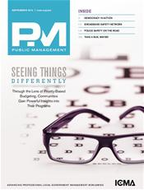

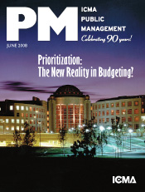

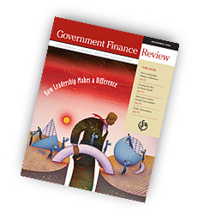
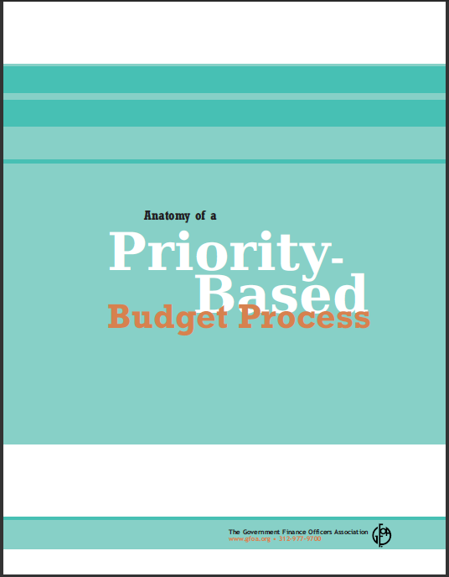
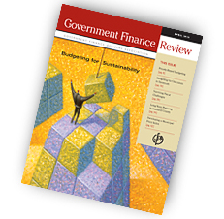
CPBB Publications on
Fiscal Health & Wellness

Slide 3


BRINGING VISION INTO FOCUS
WITH A NEW “LENS”

Slide 5
Identify and Define Results

Slide 6


Strategic Questions
What are we in “business” to do?
What exactly do we do?
How do we figure out what is “core” OR What is of the highest importance?
How do we know we are successful?
How do we ask “better” questions that lead to “better” decisions about “what we do” and “why we do it”?

Slide 7
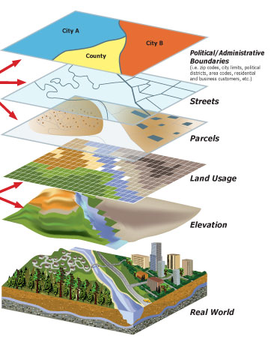
PRIORITY BASED BUDGETING -
(A “GIS” Approach to the Budget)
Example of an “information system” we’re already familiar with: GIS
Far better understanding of the budget when we can aggregate & disaggregate information

Slide 8
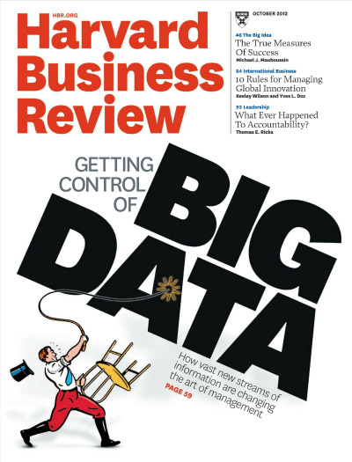
PBB as “BIG DATA”?
What is the promise of Big Data?
Different systems store data in different formats, even within the same organization, making it difficult to aggregate data for analysis
As a result, an organization’s investment in data, one of its most highly valued assets, goes underutilized
Increased awareness of the value gained by analyzing data in context drives desire for the ability to discover patterns and relationships to enable improved decision making for better outcomes
Gartner Press Release, “Gartner Says Solving ‘Big Data’ Challenge Involves More Than Just Managing Volumes of Data”, June 27, 2011.

Slide 9
PBB – RELEVANCE FIRST!
  Relevance is the foundational assumption of Priority Based Budgeting
  Program relevance is the “base layer” of information on which to base your discussions
  All other conversations are much more powerful within the context of whether a program is relevant or not
Service Delivery
Efficiency
Performance
Relevance

Slide 10
RELEVANCE
PERFORMANCE
EFFICIENCY
SERVICE DELIVERY
Increasing Relevance
What can be done to ensure this program continues to remain relevant in the future?
Is this highly-relevant program performing at its highest possible potential?
How can this highly-relevant program be provided more efficiently ?
Would a change in service level impact this program’s ability to achieve Results?
Quartile
1
What can be done to increase the relevance of this program?
Are the key indicators that demonstrate this program is solidly achieving results?
Is this program being provided as efficiently as possible?
What is the optimal level of service required for this program ?
Quartile
2
Decreasing Relevance
Can anything be done to change the way this program is offered to make it more relevant?
Would improved performance increase the relevance of this program?
What is the lowest investment of resources needed to provide this program?
Can we lessen the level of service for this program, engage a partner or find an alternative provider?
Quartile
3
Has this program lost it’s relevance? Is there any chance it will regain relevance in the future?
If this program is continued, what is the minimum level of acceptable performance?
If this program is continued, what is the bare minimum level of resources needed?
If this program is continued, what is the lowest level of service that can be offered?
Quartile
4

Slide 11
New Layers – New Perspectives
Workforce Data
  Vacant Positions
  Retirement Eligible Positions
  Nearing Retirement Eligible Positions
Workforce
Service Delivery
Efficiency
Performance
Relevance

Slide 12
Defining Quartile Groupings
Quartile 4:
58 Programs
Quartile 1:
79 Programs
Key:
Programs are grouped into Quartiles (not ranked, one versus the other)
Quartile 3:
103 Programs
Quartile 2:
103 Programs
City of Boulder, Colorado

Slide 13
Step 5: Allocate Resources Based on Prioritization
79 Programs
103 Programs
103Programs
58 Programs
City of Boulder, Colorado

Slide 14
“Resource Alignment Diagnostic Tool”
City of Boulder, CO
Applying Prioritization to
Frame A New Conversation

Slide 15
Live Demonstration of
“Resource Alignment Diagnostic Tool”

Slide 16
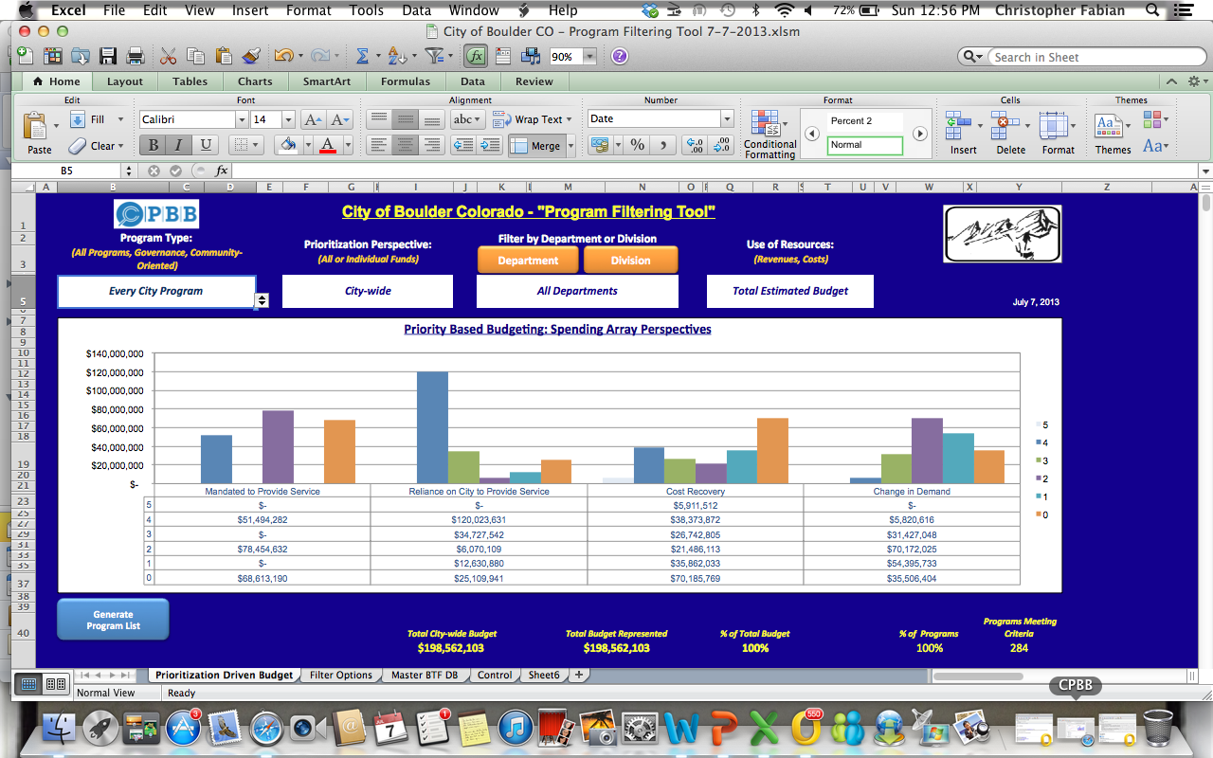
NEW “Program Filtering Tool”

Slide 17
Role of the Council/Board
Engage in the discussions by looking through this “new lens.”
Be guided to ask the “right” questions – focused on POLICY rather than OPERATIONS.
Allocated resources based on priorities of the community
Make better decisions that you can easily communicate to your citizens.
Role of the Citizens
See through the “new lens” how decision-makers are more objectively allocating resources to achieve the community’s priorities
Better understand the budget “choices” that need to be made and the impacts of those choices on the community

Slide 18
Thank You !
    Jon Johnson, Co-Founder Chris Fabian, Co-Founder
    303-756-9090, ext. 326 303-756-9090, ext. 325
    303-909-9052 (cell) 303-520-1356 (cell)
    jjohnson@pbbcenter.org cfabian@pbbcenter.org
www.pbbcenter.org
Copyright ©2009 by Chris Fabian and Jon Johnson d/b/a the Center for Priority Based Budgeting,
Denver, Colorado.

