Slide 1
Case Study #1 - Douglas County Nevada
Center for Priority Based Budgeting
2013 Annual Conference

Slide 2
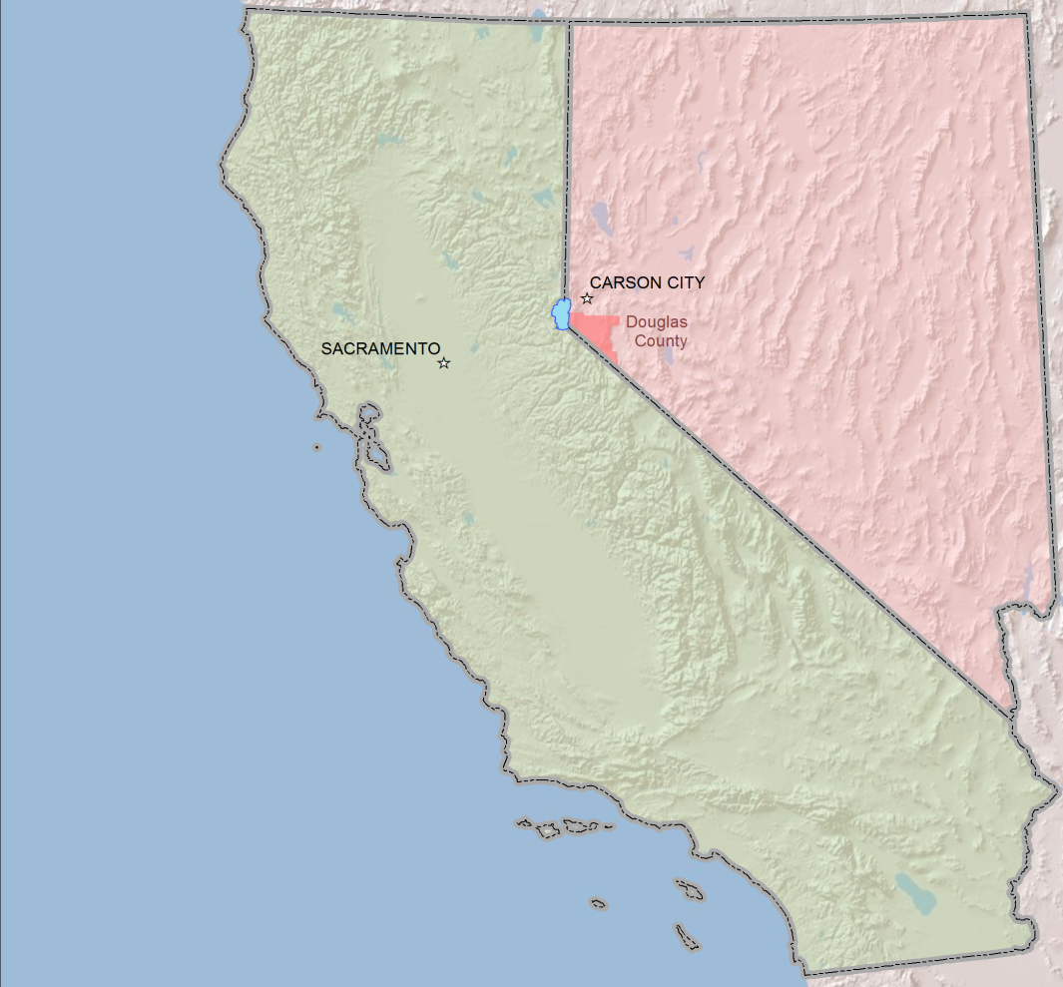
douglas county overview
Over 750 square miles
18 % of Lake Tahoe shoreline
Towns:
  Minden, Gardnerville & Genoa in Carson Valley
  Stateline at Lake Tahoe
47,000 residents
Location of Douglas County Nevada

Slide 3

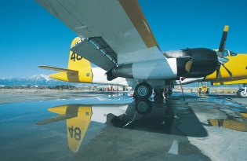
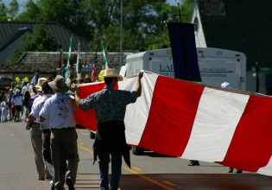
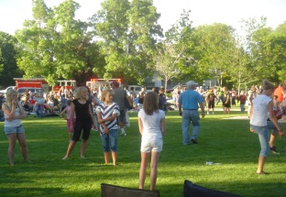
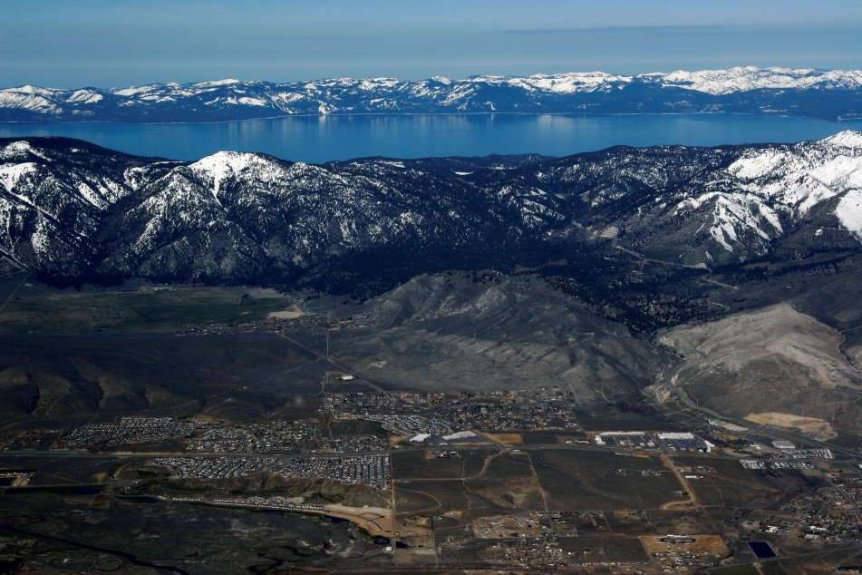
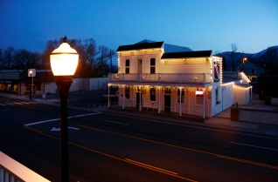
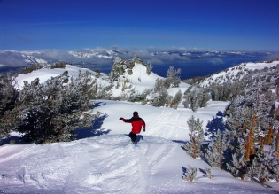
douglas county overview
$127 Million Annual Operating Budget
457 Full-Time Employees
Community Support:
    UNR Cooperative Extension, Senior Center
Culture and Recreation:
    Airport, Library, Parks and Recreation
General Government:
    Assessor, Clerk/Treasurer, Economic Development, General Administration, Recorder
Health and Human Services:
    Public Health, Social Services, Weed Control
Judicial:
    District Courts, Justice Courts, District Attorney, Juvenile Care
Public Safety:
    Animal Care, Fire Protection, Paramedic, Law Enforcement
Public Works:
    Building and Safety, Planning and Building, Street Construction and Maintenance, Water and Sewer Utilities, Zoning and Code Enforcement

Slide 4
What led douglas county to priority based budgeting?
In the past annual County budgeting process was like “flavor of the year”:
  Pareto Charts
  Across the board budget cuts of 5% -10%
  Zero Based Budgeting
Five-year forecast identified the need to balance an ongoing structural budget deficit
County sought to shift the conversation from across the board cuts to a long-term solution to invest taxpayer funds in the highest priority programs established by the Board and public
Ongoing structural Budget deficit, expenses higher than revenues

Slide 5

What led douglas county to priority based budgeting?
Reached out to Alliance for Innovation, searching for a standardized, benchmarked process being used by other communities
Rating agencies want to know how local governments plan for and respond to financial challenges over the long term
  According to Moody’s:
      “Across-the-board cuts can be a way to avoid tough decisions”
      “Targeted cuts require a serious discussion of community values, relative benefits of different services, and long-term implications”

Slide 6

Learning from others
Attended Center for Priority Based Budgeting 2012 Annual Conference:
    Walnut Creek – “Three Legged Stool” concept was key:
      Internal Stakeholders
      Policy Makers
      Community
    Elected Officials’ Perspective
    Citizen Engagement
    Peak Democracy
Lesson learned: make sure you have buy-in from all stakeholders

Slide 7

Unique county environment
Five Elected members of the Board of Commissioners
11 Independently Elected Officials (separate from Board)
  Board cannot direct their operations, but does set their budget
  66% of General fund (i.e. Sheriff, Courts, Assessor, Clerk-Treasurer, Recorder, District Attorney)
Six County Manager departments
Several other seperately operated agencies
  Library, 3 towns, Fire District, etc

Slide 8
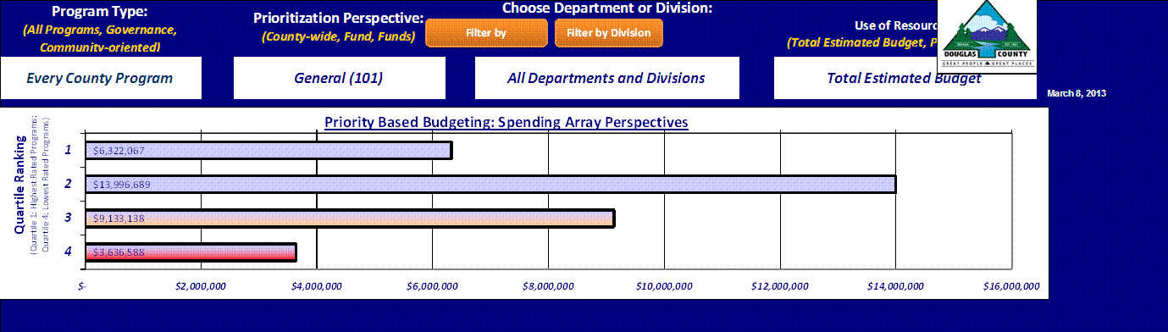
Internal stakeholders
First review of PBB model – refinement needed
  Payroll’s initial ranking in Quartile 4
Built trust with quality control process
  Individual meetings with all 30 departments
  Showed how PBB tool could be used to effectively manage their department
Lesson Learned: Give individual attention to each department, build trust and show value for all internal stakeholders

Slide 9
360 degree evaluation tool
PBB drove strategic decisions:
  Dispelled the idea of “cuts on a silver platter”
  Focus on specific programs vs. all 700 programs
  Initial Results of using PBB:
    Eliminated Home Occupation Permits
    Departmental Reorganizations
      Finance, Library, others in progress
    Discussed elimination of DMV services
    Continued expansion of regional partnerships
Lesson Learned: PBB is not top-to-bottom, but a tool that everyone in the organization can use
The Board reviewed Quartile 4, but did not eliminate programs
Departments identified programs to eliminate

Slide 10
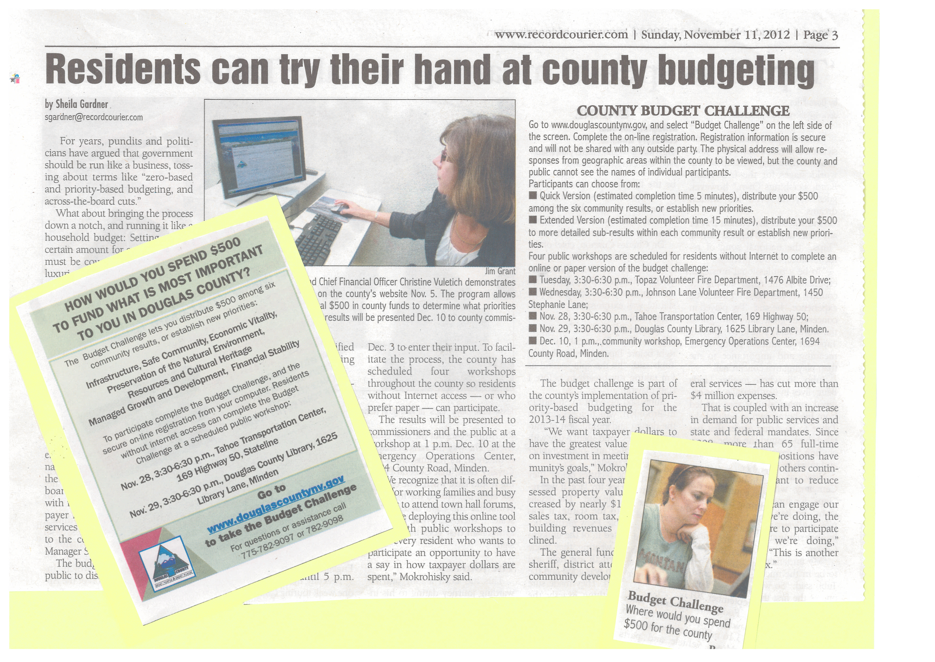
Citizen engagement
Engaged citizens with Douglas County Budget Challenge in fall 2012 and built trust within the community

Slide 11
Citizen engagement
Results of Budget Challenge:
    Budget Challenge gave a voice to all citizens including staff and those who do not regularly attend Board meetings
    Gave the County a broader view of what the community thinks is most important and a basis for comparison to how we currently invest our resources
Citizens wanted more investment in Infrastructure and Natural Environment/ Cultural Heritage

Slide 12
Citizen engagement
Budget Challenge results were summarized by master plan areas within the County:
  Infrastructure ranked highest almost across the board

Slide 13
Citizen engagement
Budget Challenge participants allocated resources to sub-results within the priorities – Well Maintained Streets and Trails ranked highest
19.21%
27.96%
12.08%
11.23%
21.55%

Slide 14

2013-14 budget process
Utilized PBB for the FY 2013-14 Budget:
  Balanced $1 million shortfall in General Fund
  Budget Challenge participants’ highest priority of well maintained streets served as a catalyst in developing the budget
After 10 years of little action, Board directed over $1 million of existing revenue be shifted to road maintenance
Lesson Learned: Use PBB and citizen engagement together to accomplish strategic objectives
Commissioner requested list of all 700 programs to make cuts

Slide 15

Summary of results
Shifted over $1 million of existing revenue to roads
Eliminated some lower priority programs
Reorganized several departments
Regional partnerships, consolidations and privatization
Stabilized bond ratings:
  Moody’s Aa2
  Standard & Poor’s A+

Slide 16

Where we are going from here
Continue to weave PBB into everything we do
Reformat Budget Document based on PBB
Continue to build citizen engagement
  Online forums (Budget Challenge and others)
  Road Task Force
Continue to refine PBB model with departments annually
Continue to analyze programs and service delivery models vs. priorities
Continue workshops with the Board to discuss PBB and use in the budget development process

Slide 17


Lessons Learned
Build internal support – particularly from policy makers and elected officials
Engage citizens in the process
Use as a long-range tool to make strategic decisions and add value, not cuts on a silver platter
Weave PBB into everything you do
  Board/Council strategic budget decisions
  Department evaluations/reorganizations
  Finance staff analysis of programs

Slide 18
Questions?

