Slide 1
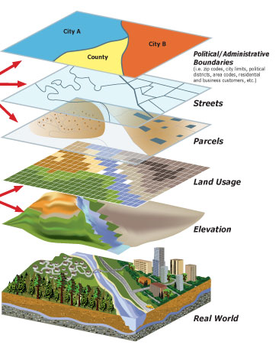
Priority Based Budgeting (Resemblance to Information Systems)
Example of an “information system” we’re familiar with: GIS
Far better understanding of our world when we can aggregate (and disaggregate) information

Slide 2
PBB as “BIG DATA”?
What is the promise of Big Data?
Different systems store data in different formats, even within the same organization, making it difficult to aggregate data for analysis
As a result, an organization’s investment in data, one of its most highly valued assets, goes underutilized
Increased awareness of the value gained by analyzing data in context drives desire for the ability to discover patterns and relationships to enable improved decision making for better outcomes
Gartner Press Release, “Gartner Says Solving ‘Big Data’ Challenge Involves More Than Just Managing Volumes of Data”, June 27, 2011.

Slide 3
Priority Based Budgeting
Relevance First!
Relevance is the foundation of Priority Based Budgeting
All of the other conversations are much more powerful within the context of whether or not the program is relevant
Program “relevance” is the “base layer” of information
Service Delivery
Efficiency
Performance
Relevance

Slide 4
Relevance
Conversation
Performance
Conversation
Efficiency
Conversation
Service Delivery
Conversation
Increasing Relevance
What can we do to ensure this program’s relevance into the future?
Do measures provide evidence that this highly-relevant program is performing at it’s best?
Can we provide this highly-relevant program more efficiently?
Would a change in service level impact this program’s ability to achieve Results?
Quartile
1
What can be done to increase the relevance of this program?
Are we absolutely compelled by evidence that this program is truly achieving results?
Quartile
2
Decreasing Relevance
Is performance impacting this program’s relevance? Would higher performance increase influence?
Can we ensure that this program is as efficient as possible?
Can we lessen the level of service we provide for this program, or find an alternative provider?
Quartile
3
Has this program lost it’s relevance? Is there any chance it will regain relevance in the future?
If we choose to remain in this business, how can performance be maintained for the least investment?
If we choose to remain in this business, can we maximize efficiency?
What can we do to lower the level of service, or perhaps stop providing this program?
Quartile
4

