Slide 1
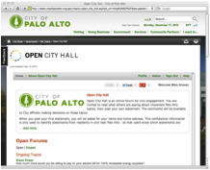
Online Civic Participation
In the budgeting Process
2013 July 9 Conference:
Center for Priority Based Budgeting
Notes:
(I recommend a laser pointer for this presentation.)
My name is Mike Cohen.
I’m a co-founder of Peak Democracy Inc.
I have a background in the computer industry and
also in local government.
For example,
I’m currently the chair of Berkeley’s Zoning Adjustments Board.
My knowledge from the tech industry and
my experience with local government
motivated me to co-found Peak Democracy.

Slide 2
Premise
Online civic participation
is becoming increasingly important
to growing public trust in government…
… Especially
in the budgeting process
Notes:
This slide is largely self-explanatory
by reading it from top to bottom.
I like to transition from this slide to the next slide by emphasizing
“the key is, broad, diversified public participation…”

Slide 3
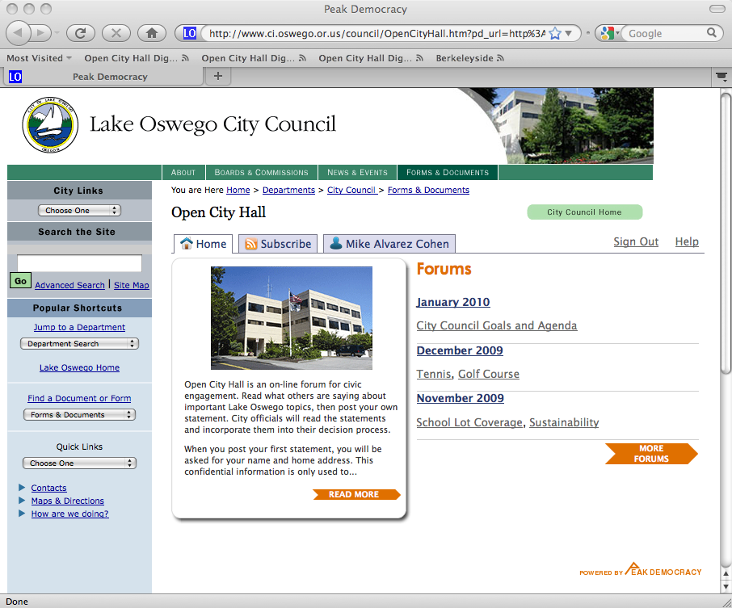
Agenda: 30 Minutes
Intro to Company (2 minutes)
Why Online Civic Engagement (3 minutes)
Live Demos (10-20 Minutes)
Q & A
Best Practices to Avoid Common Online Participation Pitfalls
Best Practices to Increase Quality & Quantity of Online Participation
3
Notes:
I’ve prepared a 10-20 minute presentation
(depending on your questions).
I’ll start with a brief introduction to Peak Democracy Inc, and
then I’ll summarize why online civic engagement is
becoming important to increasing public trust in government.
Next I’ll take a few minutes to
highlight the pitfalls of online civic engagement, and
the corresponding best practices to avoid those pitfalls.
Finally, I’ll demonstrate how our service works
by showing how other counties, cities and towns across the US
are using our service.

Slide 4
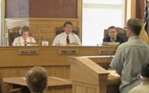
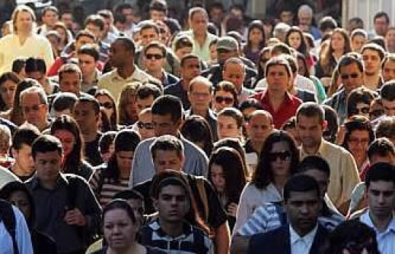
INtro: Company Mission
Online civic engagement
that increases
public trust
in government
Contrasted with
crowd-sourcing & “click-tivism”
that are optimized for activists
in ways that erode
public trust in government
Notes:
Peak Democracy Inc was founded in 2007 with a simple mission:
to increase public trust in government
via online civic engagement.
(Our motivation is different from many companies
that are using crowd-sourcing and click-tivism
to enable activists to promote their causes.)
(Incidentally, for the first few years of the Company’s existence,
we quietly and patiently developed a software platform
to meet the unique needs of government agencies --
by piloting a solution with a small set of cities, and
then offering it to other cities as we scale our infrastructure.)

Slide 5
INtro: Company Status*
Sample of Clients
Founded in 2007
Employees across the US
Over 1,000 online forum topics (Over10% related to budgets)
Over 120,000 online attendees
Over 60 client government agencies
95% satisfaction rating from about 7,000 user surveys (available on request)
Partnerships: Alliance for Innovation, CfPBB, the Planning Center / DC&E
Berkeley CA
Bay Area MTC CA
Contra Costa County CA
Fremont CA
Humboldt County CA
Marin County CA
Menlo Park CA
Morgan Hill
Mountain House CA
Mountain View CA
Novato CA*
Palo Alto CA
Rancho Cordova CA
San Leandro CA
San Ramon CA
Santa Clara CA*
Santa Cruz County CA
Sausalito CA
Vacaville CA*
Vallejo CA
Walnut Creek CA
Yucca Valley CA
Salt Lake City UT
South Salt Lake UT
Sandy City UT*
Salt Lake County UT
Arlington County VA
Norfolk VA
Virginia Beach VA
Lake Oswego OR
Ashland OR
Portland Dev Comm OR
Decatur GA
Alpharetta GA
Delray Beach FL
Gainesville FL*
Ocala FL*
Wellington FL
West Palm Beach FL
Douglas County NV
Washoe County NV
Saint Paul MN
Ann Arbor MI
Sugar Land TX
Tyler TX
Tempe AZ
Depart of Transportation AZ
Germantown TN
Aspen CO
Durham NC
Olathe KS
Middletown RI
State College PA
Tulsa OK
Los Alamos NM
Rock Hill SC
Bozeman MT
New Hanover County NC
* For the latest stats on the Peak Democracy Network,
go to http://www.PeakDemocracy.com
* Client established but forums not publicly launched yet
Notes:
We have been working with over 50
counties, cities and towns across the US;
and have powered over 900 government online forums
that have attracted over 100,000 online attendees, and
have garnered user satisfaction ratings of over 95%.
This is a sample list of some of our clients.

Slide 6
Premise: Opportunities & Problems Addressed
Online civic participation
is becoming increasingly important
to growing public trust in government…
… Especially
in the budgeting process
Notes:
This slide is largely self-explanatory
by reading it from top to bottom.
I like to transition from this slide to the next slide by emphasizing
“the key is, broad, diversified public participation…”

Slide 7
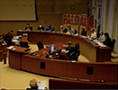
Why Online Civic Engagement: Opportunities
Constituents are accustomed to online interaction
With friends & family via social networks
With businesses & colleagues
Why not with their government ?
Robust Gov Decision Making Process: Starts with…
1. Broad, diversified public participation
That leads to…
2. Well-informed government staff & leaders
That enables them to…
3. Deliberate in ways that increase public trust
Notes:
This slide is largely self-explanatory
by reading it from top to bottom.
I like to transition from this slide to the next slide by emphasizing
“the key is, broad, diversified public participation…”

Slide 8
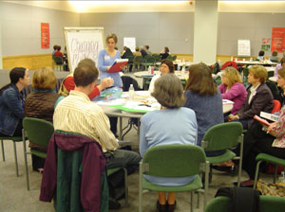
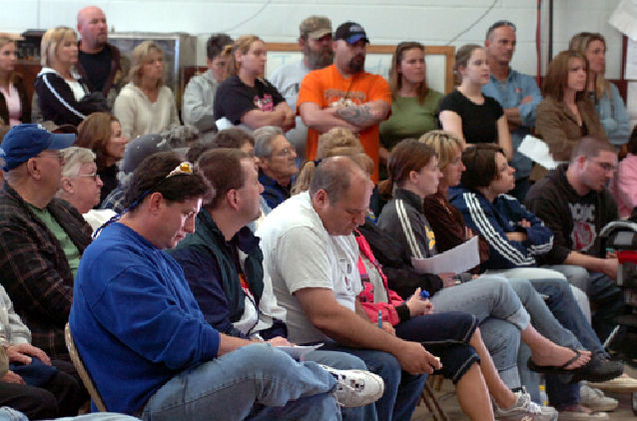
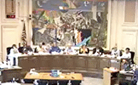
Civic Engagement: Conventional Approach
High
Public hearings & workshops
often most influential channel
of participation:
Often largest channel of participation
Often most transparent channel of participation
Amount
of Public
Participation
Low
Notes:
This slide is largely self-explanatory by
reading what is in the oval:
Public hearings and workshops are often the most influential channel of participation.
Why? Because they are frequently the largest channel of participation, and
they are often the most transparent channel --
so that gives them lots of exposure in the press.

Slide 9
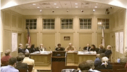
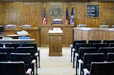
Civic Engagement: Conventional Problems
High
Attendance at public hearings & workshops are biased against many citizens who don’t have the time or inclination to attend:
Don’t have time to attend (parenting, working, elderly, etc)
Don’t like to speak in public
Don’t want to seem confrontational or impolite
Don’t want to face intimidating opposition
Have moderate views (not extreme views)
Amount
of Public
Participation
Low
Viewpoint
of
Citizens
Indifferent
Apathetic
Moderate
Extreme
Notes:
This slide is largely self-explanatory by
reading what is in the rectangle:
Attendance at public hearings & workshops are biased against many citizens that don’t have the time or inclination to attend those meetings.
Many don’t have the time to attend because they’re parenting or working.
Some are elderly and therefore not too mobile.
A lot of people don’t like to speak in public, or they might find the meetings to be too confrontational or intimidating.
Also, we have lots of evidence that people with moderate views in your community don’t typically attend these meetings.

Slide 10
Engagement: Doesn't Represent Community
Public meeting
not necessarily
representative
of the community
Can Lead to government decisions that frustrate many in the community
High
Amount
of Public
Participation
Low
Viewpoint
of
Citizens
Indifferent
Apathetic
Moderate
Extreme
Notes:
This slide is largely self-explanatory by
reading the text on the upper right side:
The result is that
Public meetings are not necessarily representative of the community.
And that can lead to government decisions that frustrate many in the community.

Slide 11
Engagement: Online Complement
High
Amount
of Public
Participation
Online Public Comment Forums
Convenient Place & Time
No Public Speaking
No Confrontations
No Intimidations
Inviting to moderates (as well as extremists)
Low
Viewpoint
of
Citizens
Indifferent
Apathetic
Moderate
Extreme
Notes:
To address those opportunities and problems,
we have been complementing (not replacing)
conventional communication channels
with an online channel.
Then I read the bullets:
Government online forums
enable people to participate
at a convenient place & time; and
There’s no
public speaking, confrontations, or intimidations.
We also have lots of evidence, that it’s
inviting to moderate-minded people in the community.

Slide 12
Online Engagement: Augment & Diversify
Public
participation more
representative
of the community
Gov leaders are more informed & deliberate in ways that can increase public trust
High
Amount
of Public
Participation
Low
Viewpoint
of
Citizens
Indifferent
Apathetic
Moderate
Extreme
Notes:
Together,
the conventional and online communication channels
result in:
Public participation that is more representative of the community.
And, gov leaders that are more informed & can deliberate in ways that can increase public trust.

Slide 13
How It Works: Online Engagement Spectrum
311,
Customer Service,
Potholes, Graffiti, etc
Brainstorming
Order & Decorum
Quick & Easy
Workshops
&
Charrettes
Council & Commission
Public Hearings
Telephone,
Texting, Email, Facebook, Twitter
General Ideation
Specific Feedback
Ad Hoc Comments
Civic Engagement Spectrum
Notes:
Let’s move to how the service works, and
I’ll start by analogizing
online civic engagement to
conventional civic engagement.
Many view civic engagement as a spectrum.
It can start with brainstorming on early stage topics at workshops & charrettes; and
it can evolve to specific feedback at public hearings during council & commission meetings.
Civic engagement also includes adhoc feedback on customer service issues such as potholes & graffiti.
That can be handled via telephones, texting, email & social media.
So we aren’t focus on that area.

Slide 14
How it Works: Focus on Decision Making
Augment, Diversify & Synthesize
Online Civic Engagement in
Gov Decision Making Process –
in ways that Increase Public Trust in Government
Brainstorming
Order & Decorum
Workshops
&
Charrettes
Council & Commission
Public Hearings
General Ideation
Specific Feedback
Ad Hoc Comments
Civic Engagement Spectrum
Notes:
Our service is focused on
augmenting, diversifying & synthesizing
online civic engagement in the government decision making process
(but avoiding the pitfalls by following best practices).

Slide 15
How it Works: Focus on Decision Making
Configured to model best practices of phased brainstorming workshops professionally facilitated to optimize for collaboration & consensus-building
Configured to emulate order & decorum of government public hearings -- making the forums insightful & civil yet, compliant with free speech & other gov legal requirements
Brainstorming
Order & Decorum
Workshops
&
Charrettes
Council & Commission
Public Hearings
General Ideation
Specific Feedback
Ad Hoc Comments
Civic Engagement Spectrum
Notes:
We have 2 services to address these 2 areas.
They look completely integrated to your users,
but they have different features for your staff.
Open Town Hall - Feedback
has a feature-set that emulates the order & decorum of government public hearings.
And, Open Town Hall - Ideas
has a feature-set that is modeled after the best practices of phased brainstorming workshops.

Slide 16
Open Town Hall
Online Civic Engagement That
Increases Public Trust in Government
For more information, go to
www.PeakDemocracy.com
866-535-8894
mike@PeakDemocracy.com
robert@PeakDemocracy.com
Notes:
Thanks for your time and attention.
Any questions or comments ?

