Slide 1
Economic Benefits of Repurposing/ Redeveloping Brownfields
Ryan Niles
ICMA Conference Presenter

Slide 2
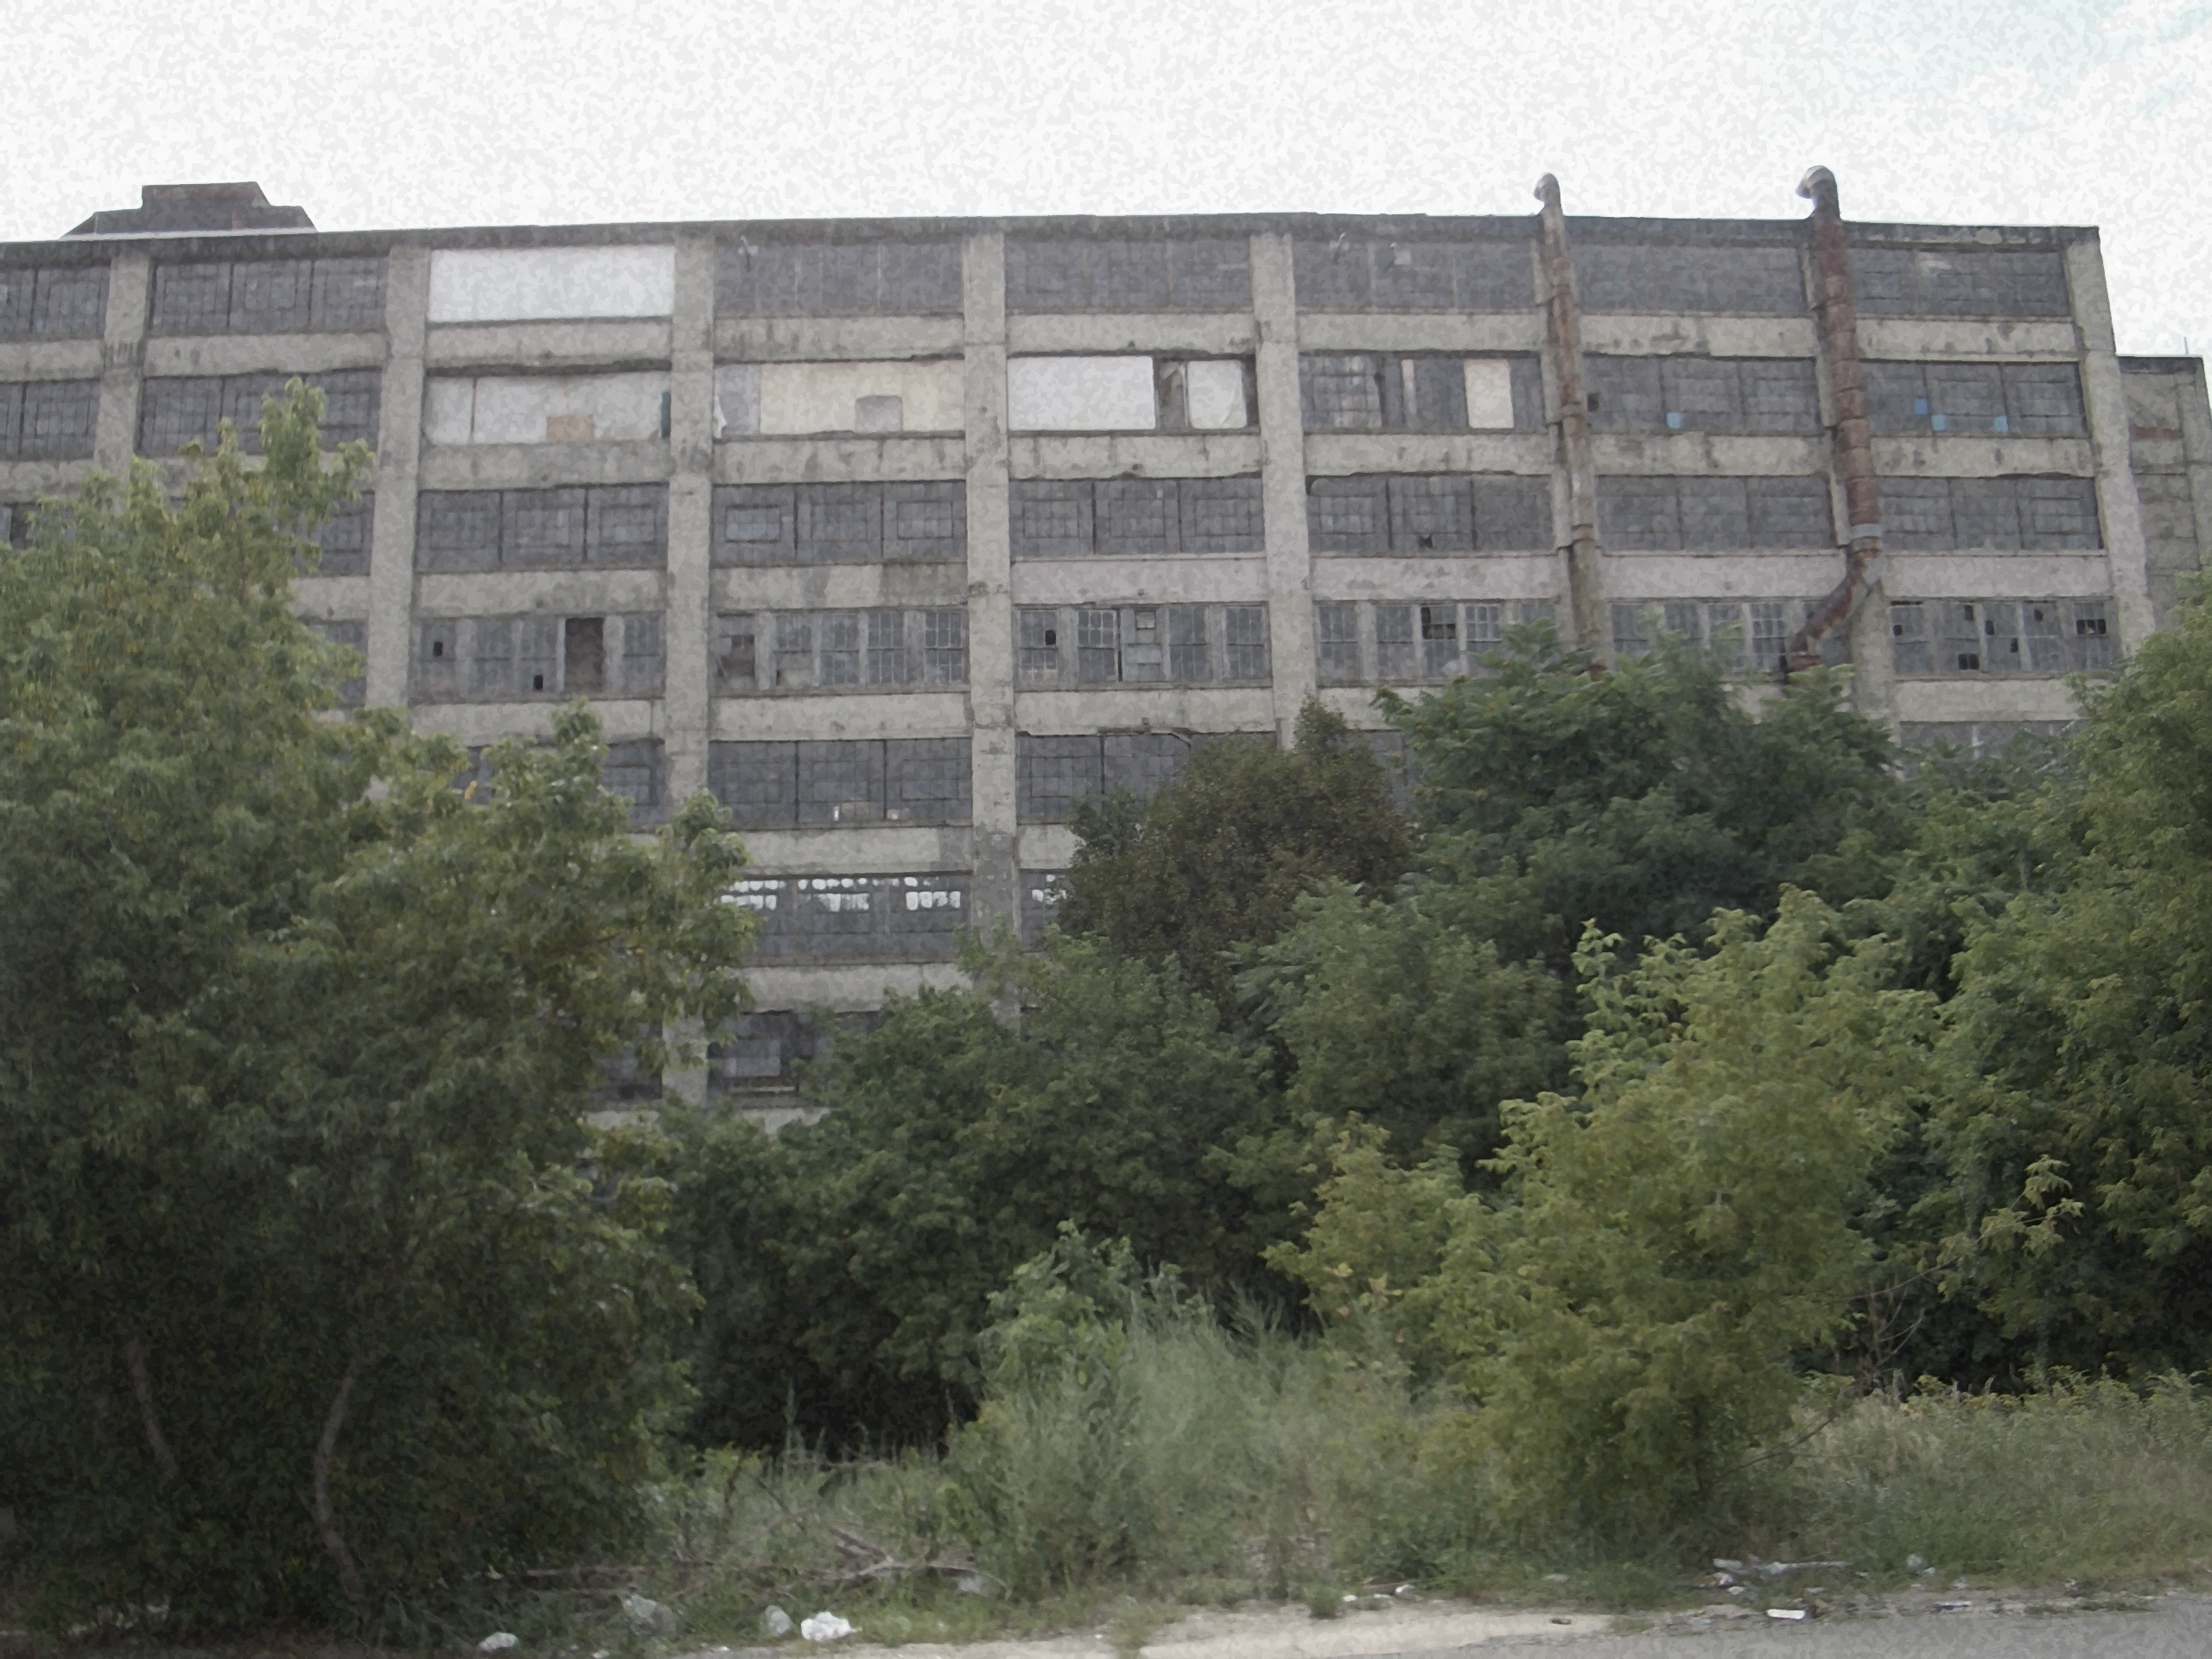
Brownfields Realities and Opportunities
Underutilized
Antiquated Building
Contaminated?
Existing Infrastructure
Near Transportation
Repurposing?

Slide 3
Economic Impact of Brownfields Redevelopment
Before Redevelopment | After Redevelopment
- Unpaid Back Taxes | + Taxes Paid in Full
- Legacy Property Assessment | + Fresh Property Assessments
- Drain on Property Values | + Enhanced Property Values
- Eyesore Effects | + Increased Developer Interest
- Legacy Property Use | + Site Use Targeted to Achieve Desired Results

Slide 4
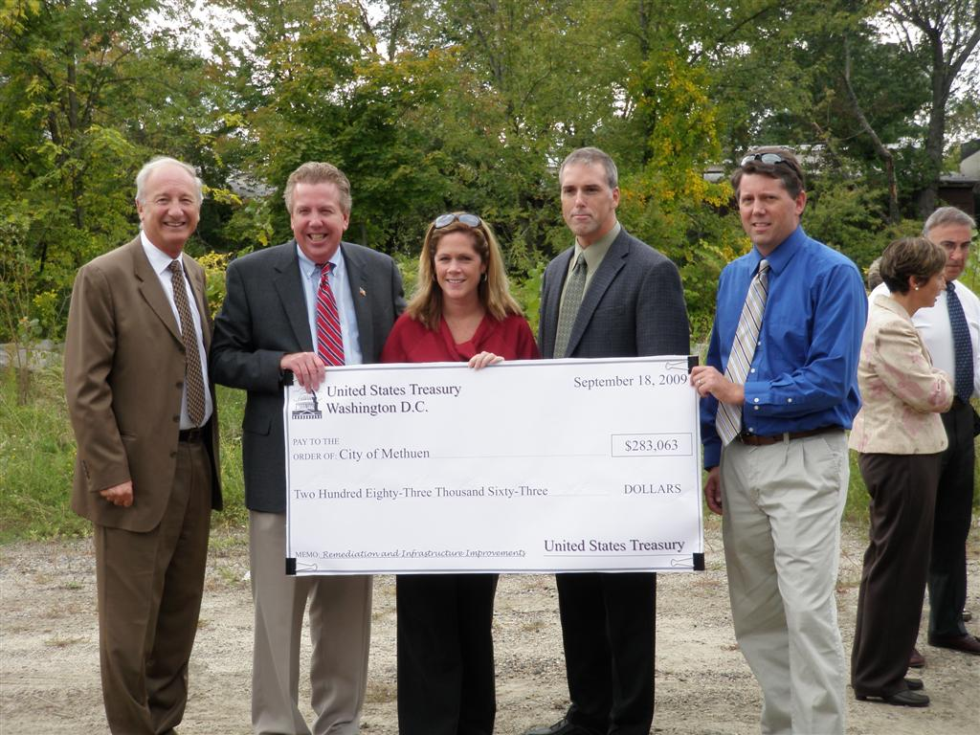
Public Funding for Brownfields
State/Federal
Planning Grants
Assessment Grants
Cleanup Grants
Loan Programs

Slide 5
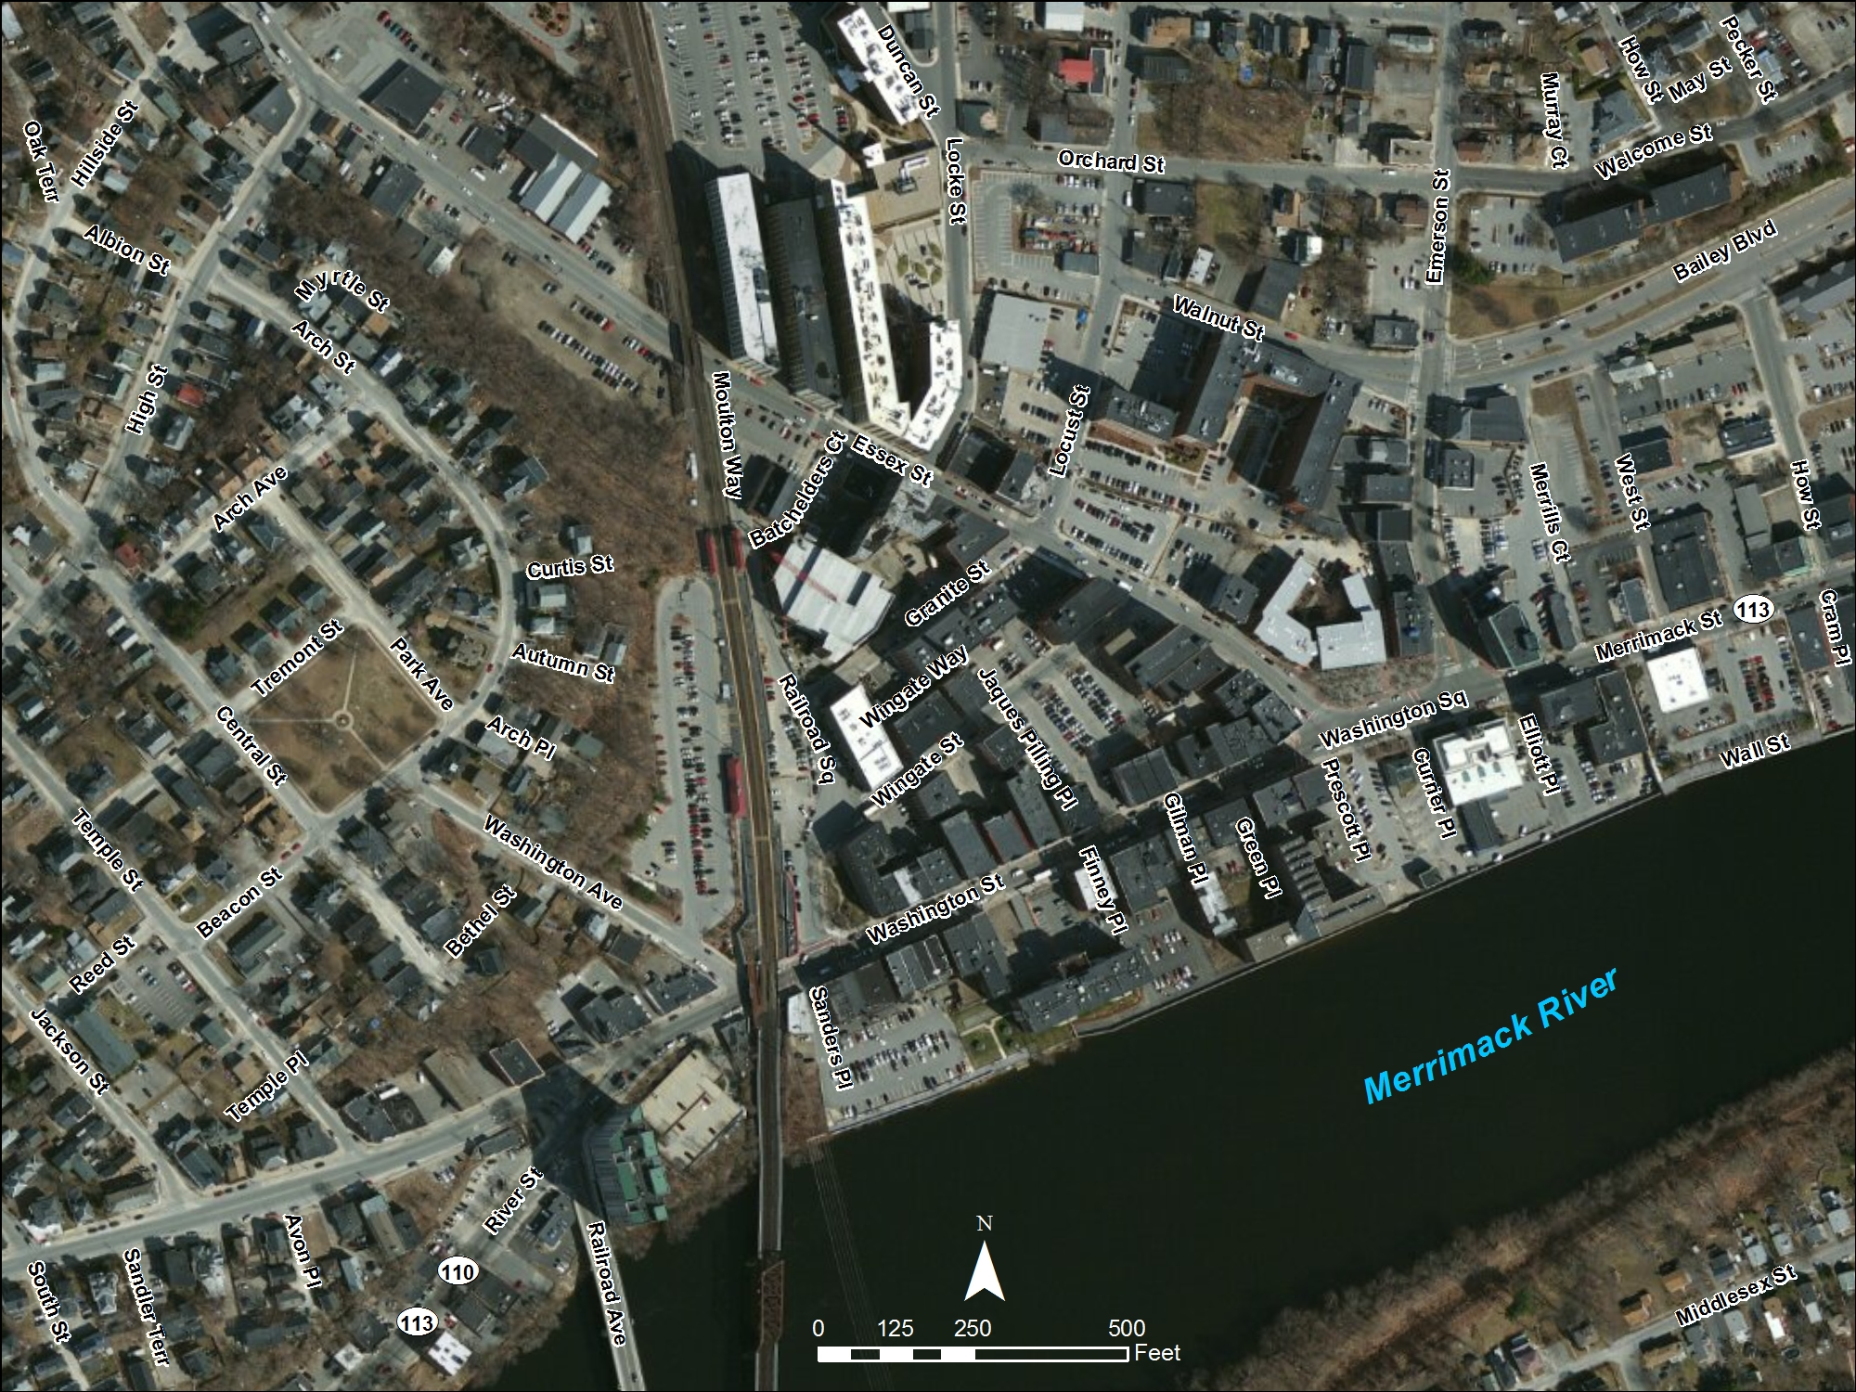
- Commuter Rail/Amtrak
- Identified Brownfield Sites
- Active pedestrian commercial corridor
- Abandoned rail line
Haverhill, Massachusetts Made a Significant Investment in Downtown Brownfields
1 hr to Boston

Slide 6
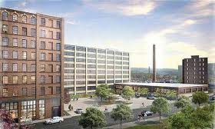
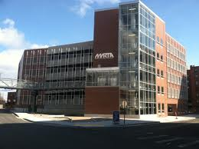
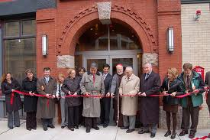
How it worked
$1.18M Grants
$15M Inf Funds
New Transit Facility (Parking +315)
2 Residential Developments (342 Units)
$100M Private Funds

Slide 7
Questions/Comments?
rniles@trcsolutions.com

