Slide 1
Is That Really a Best Practice or Just You Practicing?
Dr. Thomas I Miller, Facilitator
ICMA Conference Presenter

Slide 2
This is about
Taking Meaningful Action with Data

Slide 3
It’s not about how well we listen.

Slide 4
It’s about how well we do!

Slide 5
Data, We Get Data
National Research center, Inc.

Slide 6
The E’s of Community Betterment
Educate
Earmark
Envision
Quality Community
Engage
Empower
Evaluate

Slide 7
Envision
“Give me six hours to chop down a tree
and I will spend the first four sharpening the axe.” ― Abraham Lincoln

Slide 8
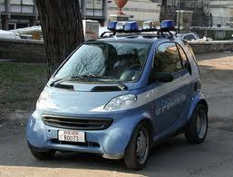
Earmark

Slide 9
Educate

Slide 10
Engage

Slide 11
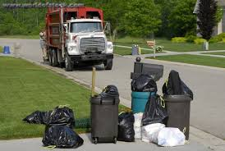
Empower

Slide 12
Evaluate

Slide 13
City of Twin Falls, ID
Travis Rothweiler, City Manager
ICMA Conference Presenter

Slide 14
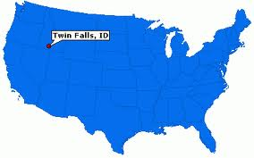
Travis Rothweiler, ICMA – CM City of Twin Falls, ID trothweiler@tfid.org
Utilize meaningful data for improved service delivery
Success in curbside recycling program
Enhance existing services to meet citizen demand
Sustainable services in demanding market
Measuring results

Slide 15
Previous City Survey Method
Previous community surveys were prepared and analyzed internally
Sent to only registered voters who voted in the most recent election
Approval ratings seemed too good to be true

Slide 16
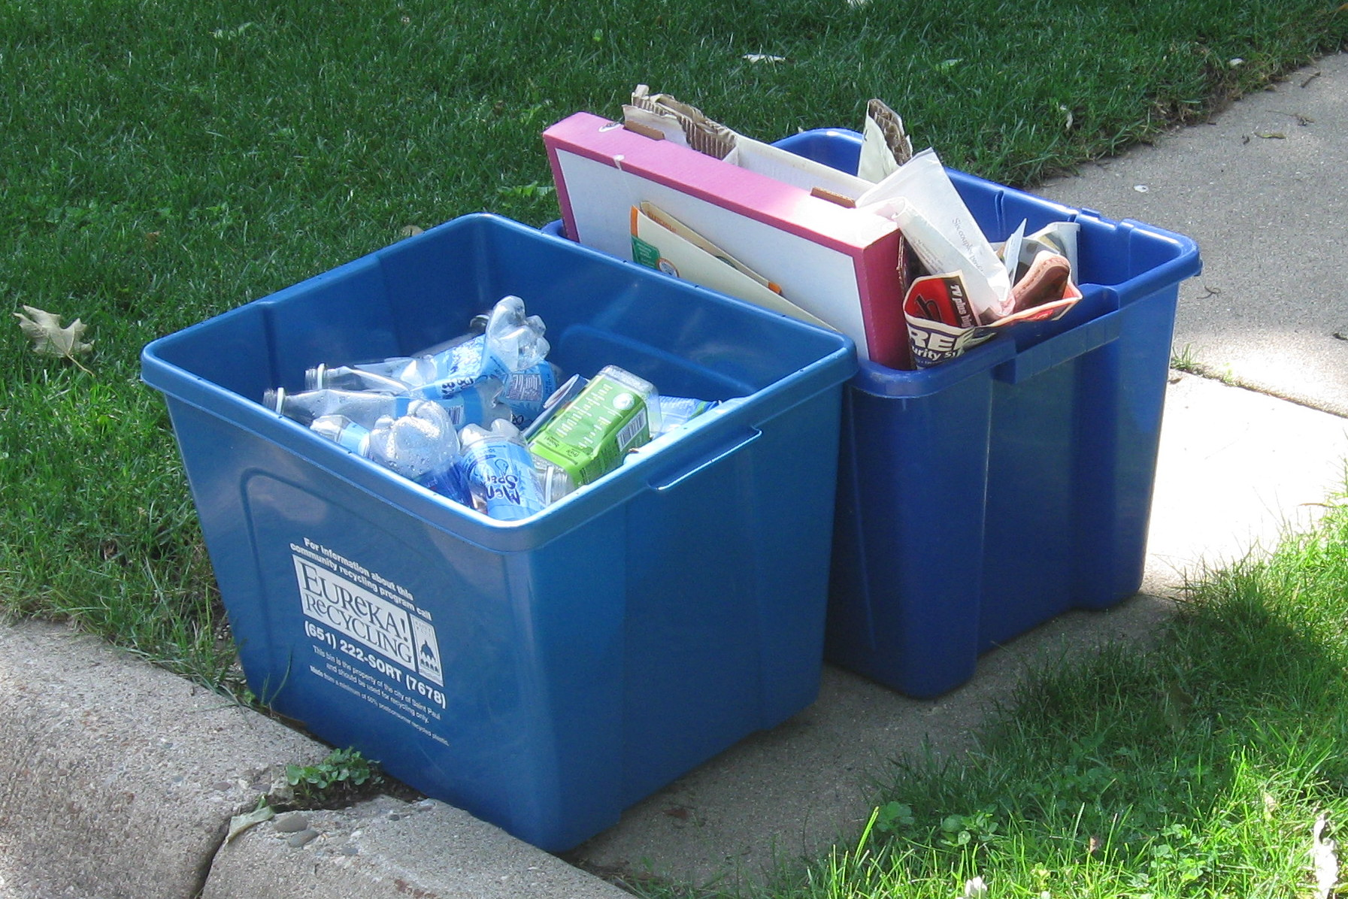
Recycling Program - 2009

Slide 17
Citizen Satisfaction – 2009
FIGURE 42: UTILITY SERVICES BENCHMARKS
 | National comparison | Western region, populations 25,000 - 70,000 comparison
Recycling | Below | Below

Slide 18
Recycling Program 2012
In 2011, the City of Twin Falls moved to a single stream recycling program
More convenient for customers
Sustainable both fiscally and for the environment

Slide 19
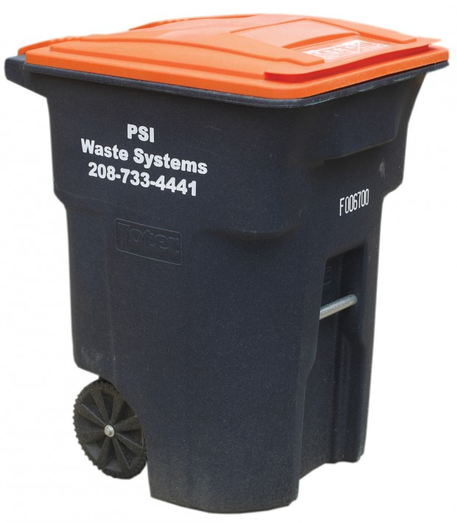
Old Program
New Program

Slide 20
Program Comparison

Slide 21
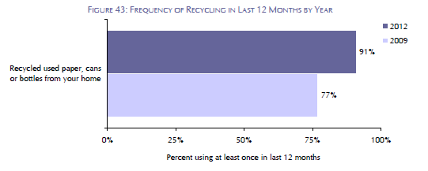
Program Comparison
Environmental Sustainability
Resident recycling was much greater than recycling reported in comparison communities, and had increased compared to recycling reported in the previous survey year.

Slide 22
Performance
Program Performance | Old Program | New Program
Tons of Recyclables (annual average) | 388 tons | 1,995 tons
Disposal Savings (annual average) | $13,758 | $71,290

Slide 23
Next Steps
Continue to evaluate and make improvements to recycling program
The NCS is key to our performance measurement system

Slide 24
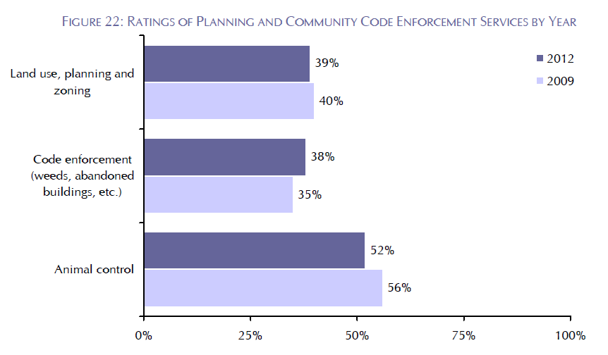
Other Lessons from The NCS
Prior to 2013, code enforcement efforts were decentralized; duties were spread amongst several departments. The rating by our citizens initiated conversations to improve code enforcement efforts

Slide 25
Code Enforcement Improvements
2013 - Restructured code enforcement as a new division of the City to adequately enforce all aspects of our code
more authority and consistency to enforce all aspects the code including sanitation, signage, water use, weeds, etc.
Total Code Enforcement Cases
July 2010 | 229
July 2011 | 382
July 2012 | 1,388

Slide 26
City of Dublin, OH
Charlotte Colley
ICMA Conference Presenter

Slide 27
Charlotte Colley Senior Projects Manager City of New Albany, OH
Lessons learned and best practices from the City of Dublin, OH

Slide 28
City of Dublin - 2013 VoP Awards
Police
Fire
Garbage Collection
Recycling
Street Repair
City Parks
Recreation Programs/Classes
Code Enforcement
Overall Quality of Services

Slide 29
Dublin Surveys
The NCS in 2009 and 2012
Voice of the People Awards: 2010 and 2013
Previously conducted citizen survey - Dublin specific - every 2-3 years
Conducted phone survey in 2013 after results from 2012 NCS were released
Used NCS results to help target phone survey areas and develop customized questions

Slide 30
Emergency Preparedness

Slide 31
Public Parking
City knew this was an issue already
Created more on street parking
Facilitated agreement with Historic District restaurants to use valet parking for their customers
Continued talks with local businesses to encourage their employees to park in Indian Run lot

Slide 32
Traffic Flow
City already had many roundabouts in place (and several more planned) to help with traffic flow and reduce emissions from idling
During 2012 NCS survey and 2013 Phone survey City probed into the “roundabout issue”
City continues to seek out innovative solutions to help improve traffic flow

Slide 33
Eight out of ten residents have positive impressions of Dublin’s roundabouts. Only one out of ten dislikes them.
Roundabouts
Step
Backward
11%
Step
Forward
81%
No difference
6%
Not sure
2%
33
Notes:
P16, Q30

Slide 34
City of Decatur, GA
Peggy Merriss, City Manager
ICMA Conference Presenter

Slide 35
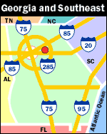
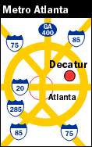
Decatur, Georgia 30030
12 Minutes East of Downtown Atlanta
Population 19,853 in 4.27 sq. miles
County Seat
Home to Agnes Scott College and close to Emory University and the CDC.
Full Range of Municipal Services
AA+ Bond Rating
All combined budgets = $49mm
207 FTE

Slide 36
The National Citizen Survey
Used the National Research Center, Inc. “Citizen Survey” four times.
Last survey conducted March 2012. Will conduct next survey in Spring 2014.
1,200 randomly selected residential addresses
468 returned for a response rate of 40%

Slide 37
The National Citizen Survey
How Do We Use It (part one):
Presentation to City Commission
Presentation to operating departments/divisions
Part of Mayor’s “State of the City” Address
Ratings Agency presentations

Slide 38
Citizen Survey Results
How Government Service Providers
are Perceived
Combined Ratings of “excellent” or “good.”
City of Decatur – 94%
United States – 45%
DeKalb County – 37%
State of Georgia – 29%

Slide 39
Citizen Survey Results
Impression of City of Decatur staff as
“excellent” or “good.”

Slide 40
The National Citizen Survey
How Do We Use It (part two):
Use to assess progress of Strategic Plan
In Cooperation with Center for Performance Management (CPM) Efforts
Publication in Annual Report
Part of Budget Process
Resource allocation
Organizational Development
Included in Narrative

Slide 41
Citizen Survey Results
Impression of City of Decatur as “excellent” or “good.”

Slide 42
National Benchmarks – Quality of Life
Job the government does at welcoming citizen involvement 1st out of 307 jurisdictions
Opportunities to participate in community issues
1st out of 179 jurisdictions
Overall quality of businesses and service establishments
1st out of 171

Slide 43
Important Take Aways
The National Citizen Survey is:
Part of an integrated community engagement effort –
it provides a measurement of how you are doing;
it solicits feedback from parts of the community you may not regularly hear from; and,
it is an opportunity to show the community you care about what they think.
Part of a comprehensive communication plan –
it provides substance to support the work of the organization;
it allows you to tell your story to the public, civic organizations and community
groups; and,
it makes great copy in newsletters, blogs and social media posts.
Part of a broad performance measurement program –
it supplements quantity and efficiency measures with quality measures and
effectiveness measures;
it informs budget and resource decisions; and,
it supports strategic planning.

Slide 44
Questions/Comments?
Additional Information…
Tom Miller
tom@n-r-c.com
303-444-7863
Peggy Merriss
Peggy.Merriss@decaturga.com
404-370-4102
Travis Rothweiler
trothweiler@tfid.org
208-735-7272
Charlotte Colley
ccolley@newalbanyohio.org
614-855-3913

