Slide 1

Edge: Where People Connect, Communities Achieve
Craig Gerhart, Facilitator
International City County Management Association / Edge Initiative
Joyce Wilson, City Manager Dionne Mack, Director of Libraries
El Paso, Texas El Paso Public Library
Jill Fitzgibbon, Asst. City Manager Marcia Johnson, Library Director
Miami, Oklahoma Miami Public Library

Slide 2



Session Overview
The Essential Role Libraries Play in Communities
Edge Overview in Miami, OK
Edge Overview in El Paso, TX

Slide 3


Libraries in the 21st Century
Partners in Community Progress
  Jobs, health care, education, demographic change, infrastructure
  TRUST
What is Edge?
  www.libraryedge.org
Challenge to City and County Managers
  Use Libraries as a organizational and community wide resource
  Engage Directors as leadership team members
@LibraryEdge

Slide 4
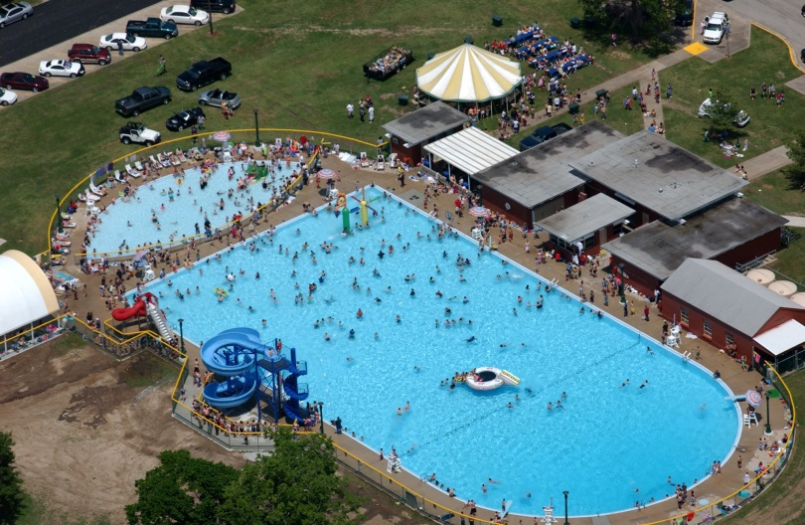
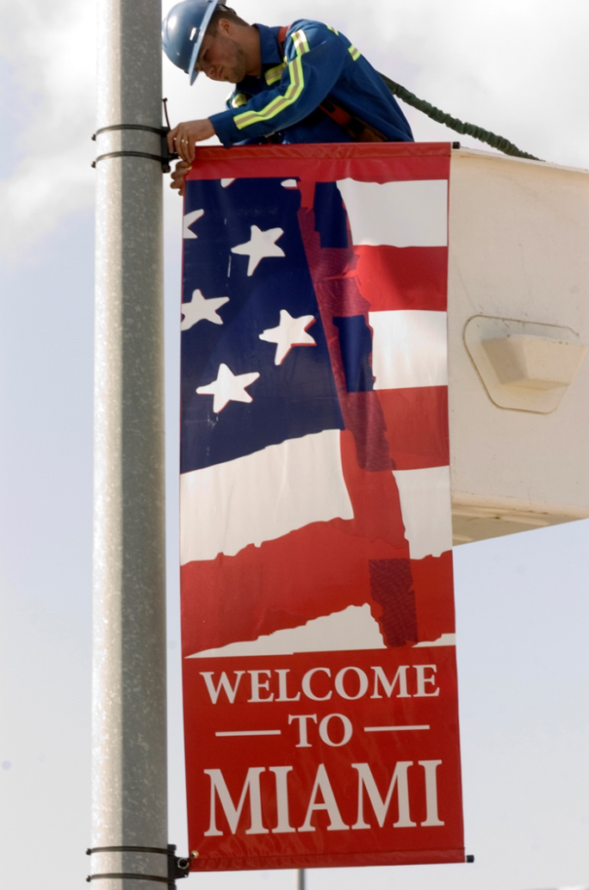

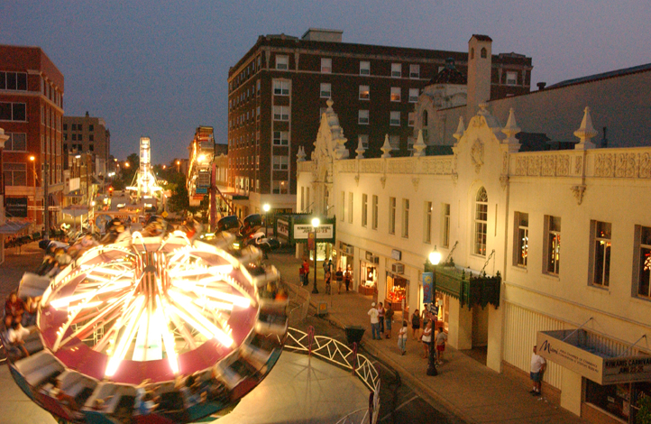

MIAMI, OKLAHOMA

Slide 5
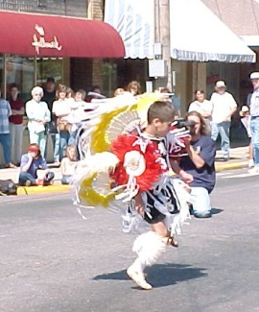
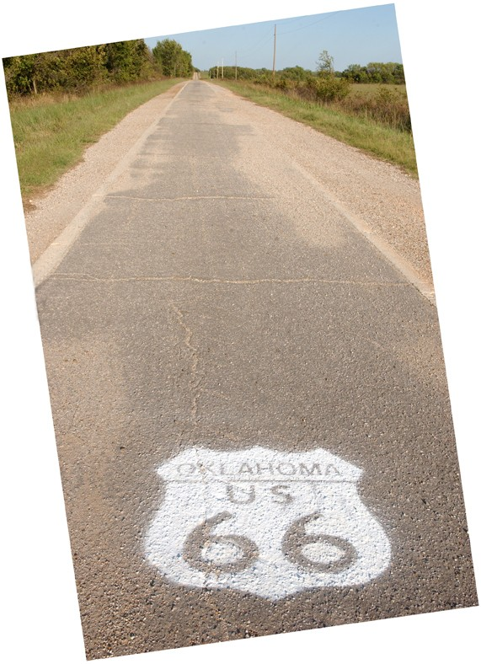
MIAMI DEMOGRAPHICS & FACTS
Population 13,570
17% Native American
Median household income $34,561
70% of students eligible for free/reduced lunch
87% do not have a college degree
17% have less than a high-school diploma
Miami is 10 square miles
180 City employees
Local Sales Tax 9.5%
Home to NEO A&M College (Junior College)

Slide 6
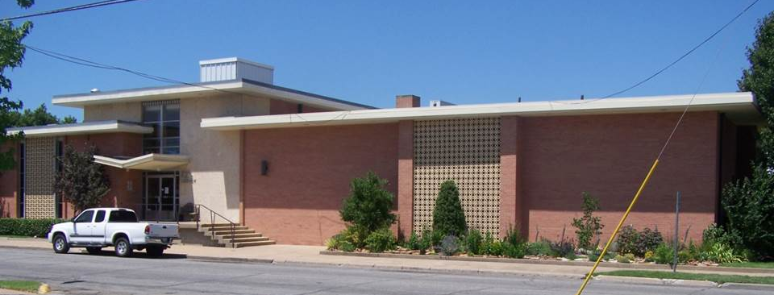
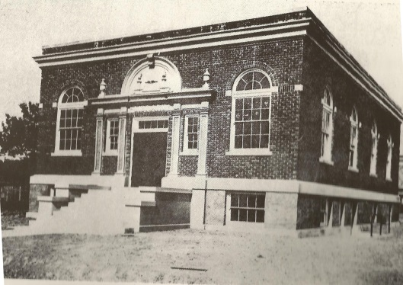
MIAMI PUBLIC LIBRARY
Text
The mission of the Miami Public Library is to enhance the quality of life in our community by promoting the joy of reading, providing lifelong learning and facilitating digital inclusion
FY 2012-13
13,126 card holders
79,089 visits
106,733 items circulated
7,251 electronic items downloaded
25,250 computer sessions
Miami Public Library (1921) – Last Carnegie library built in Oklahoma

Slide 7
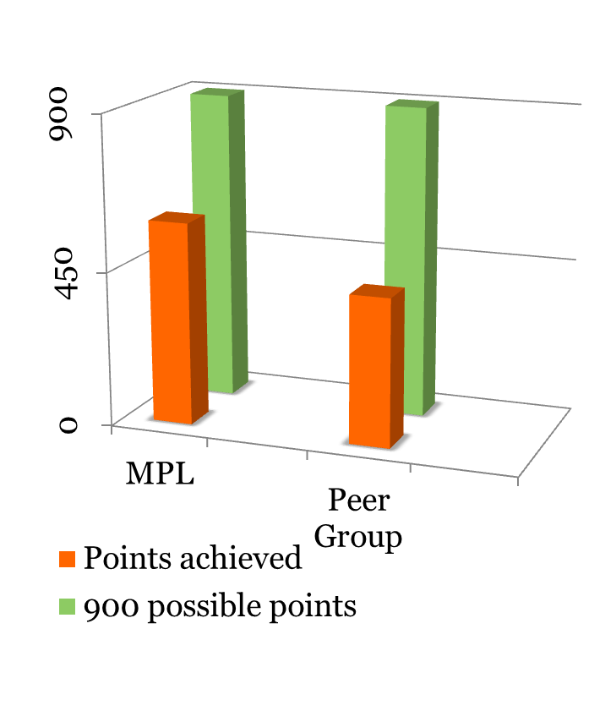
MIAMI’S BENCHMARK ASSESSMENT
Community Value
Engaging Community and Decision Makers
Organizational Management

Slide 8
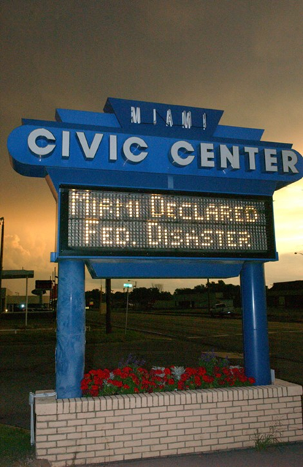
COMMUNITY VALUE
Libraries provide:
assistance and training with the goal of increasing the level of digital literacy in the community
access to relevant digital content and enable community members to create their own digital content
technology resources to help patrons meet important needs related to personal goals and community priorities

Slide 9
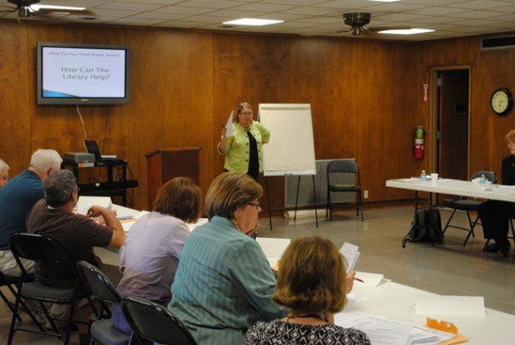
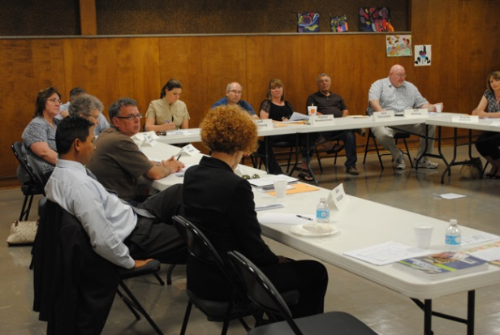
ENGAGING COMMUNITY & DECISION MAKERS
Libraries make strategic decisions based on community priorities for digital inclusion and innovation
Libraries build strategic relationships with community partners to maximize public access technology resources and services provided to the community
Libraries support continuous improvement in public access technology services by sharing expertise and best practices with other digital inclusion organizations

Slide 10
ORGANIZATIONAL MANAGEMENT
Libraries integrate public access technology into planning and policies
Libraries have sufficient staff with technology expertise to help patrons achieve their goals
Libraries have sufficient devices and bandwidth to accommodate user demand
Libraries manage their technology resources to maximize quality
Libraries ensure participation in digital technology for people with disabilities

Slide 11
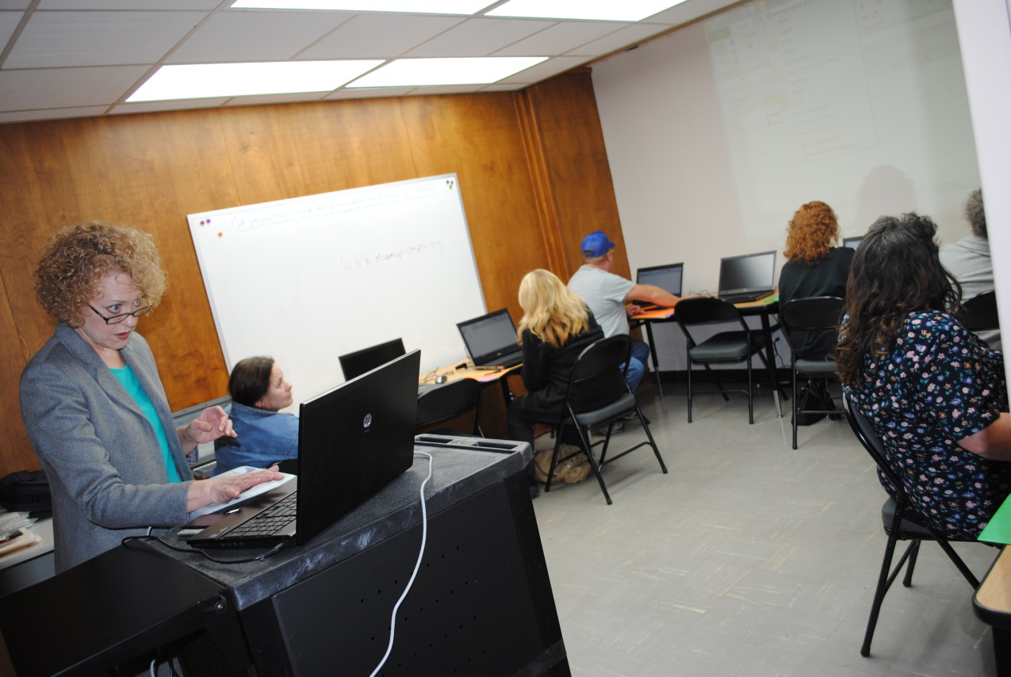
CONTINUOUS PROCESS
Text

Slide 12
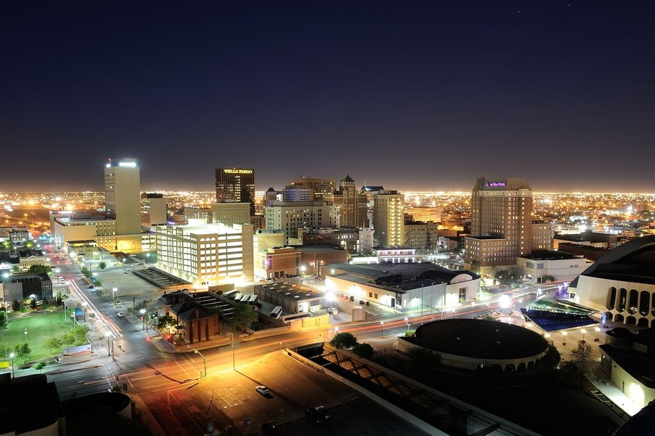

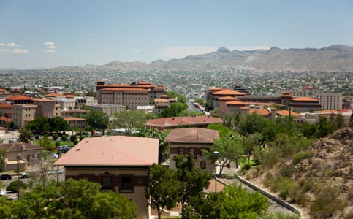
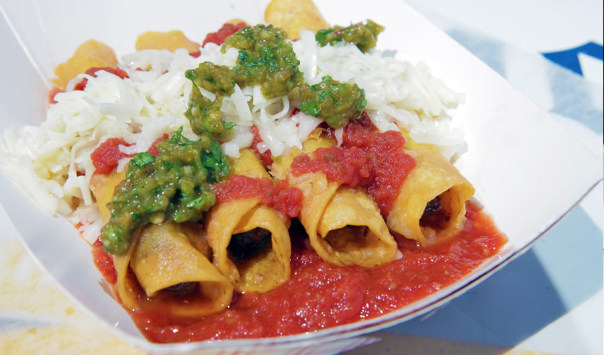

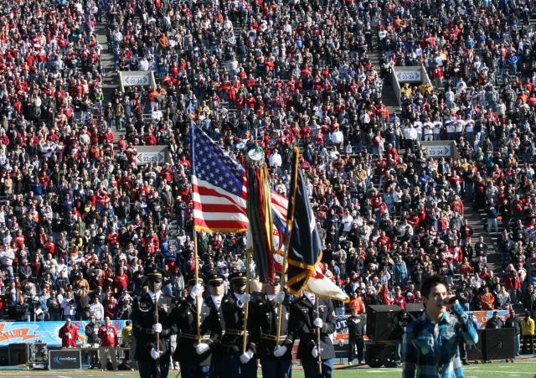



Slide 13



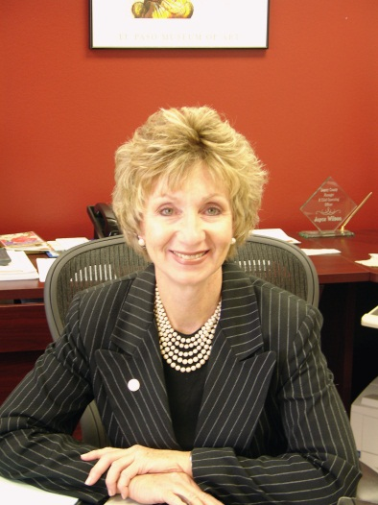
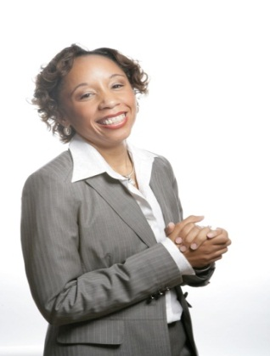

Slide 14
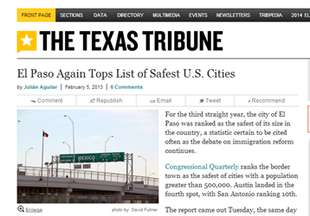
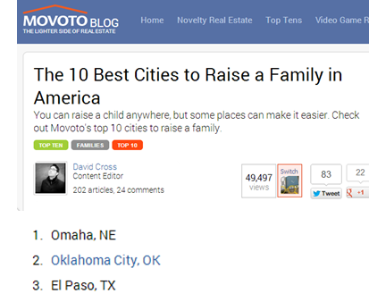
About El Paso, Texas
19th most populous city in the United States and the Sixth most populous city in the state of Texas
Median age: 32 years of age
31% under 18 years of age
25% of residents born outside of the United States
43% of residents lack internet connectivity at home
78% of residents do not have a four year college degree

Slide 15
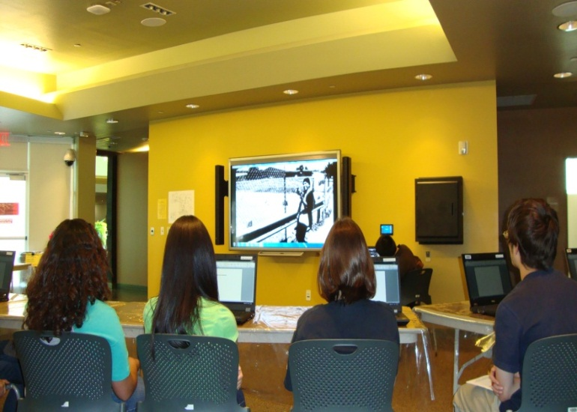
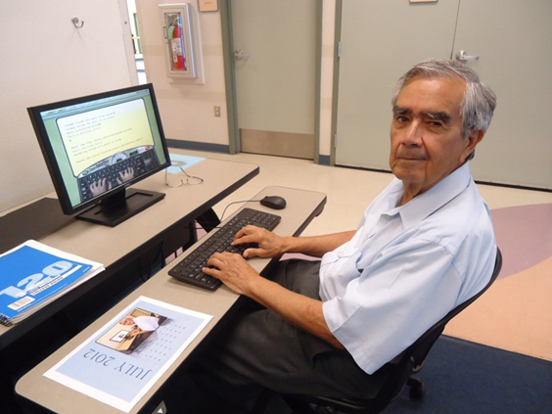

The Library
12 Neighborhood Libraries, 2 Partnership Libraries, 1 Bookmobile, 1 Tech-mobile
284,000 active cardholders; 2 million visits annually
Budget: $8.5 million; 13.71 per capita
Free children’s and family programs
587 public computers with internet access
Free WiFi network
Free adult education classes
(ESL, citizenship, computer literacy)

Slide 16

Workforce Development
Virtual Village (Broadband Technology Opportunity Grant)
BTOP’s purpose was to establish public computer centers; deploy new or improved broadband Internet facilities; increase broadband Internet usage and adoption, including among vulnerable populations.
Created 89 Public Computing Sites, trained 133,000 residents

Slide 17
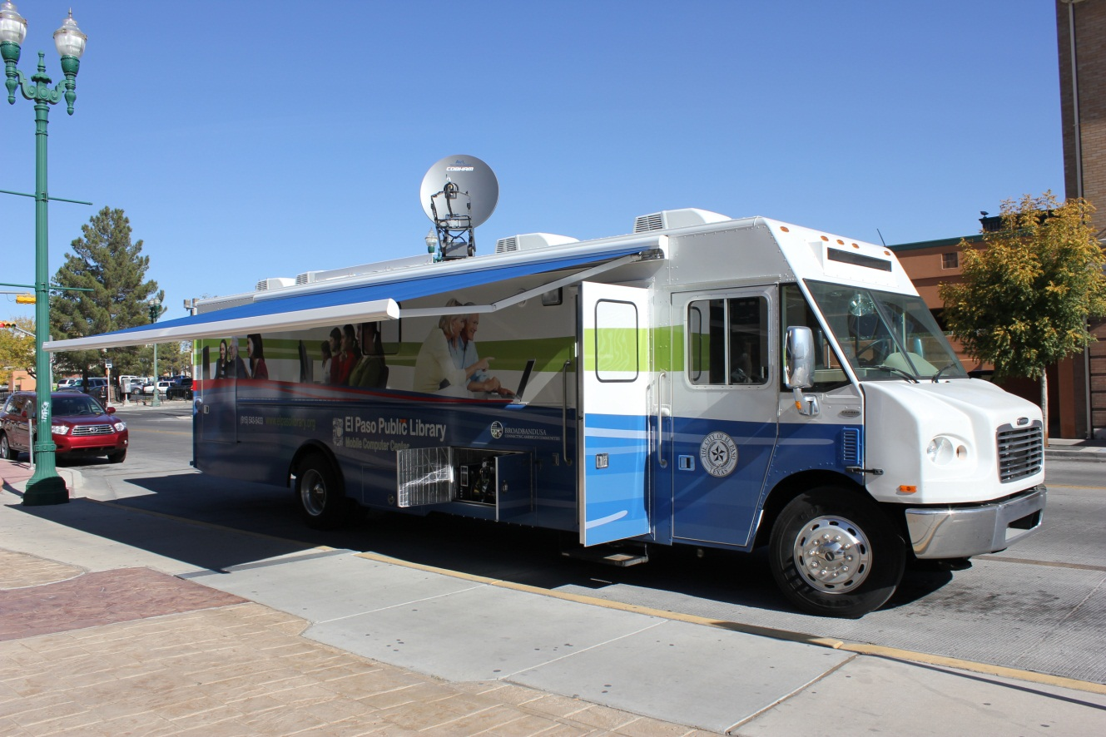
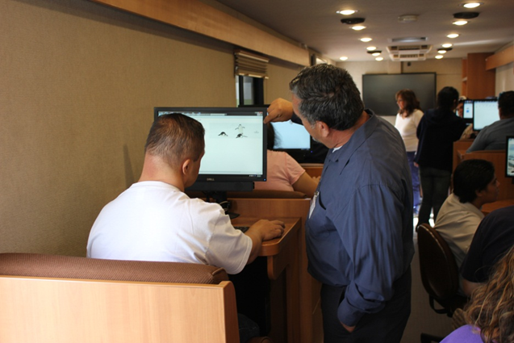
Tech-Mobile
Mobile Classroom extends the reach to locations
underserved by library buildings.

Slide 18

What did we learn from our benchmarks assessment?
EDGE BENCHMARKS IN EL PASO, TEXAS

Slide 19
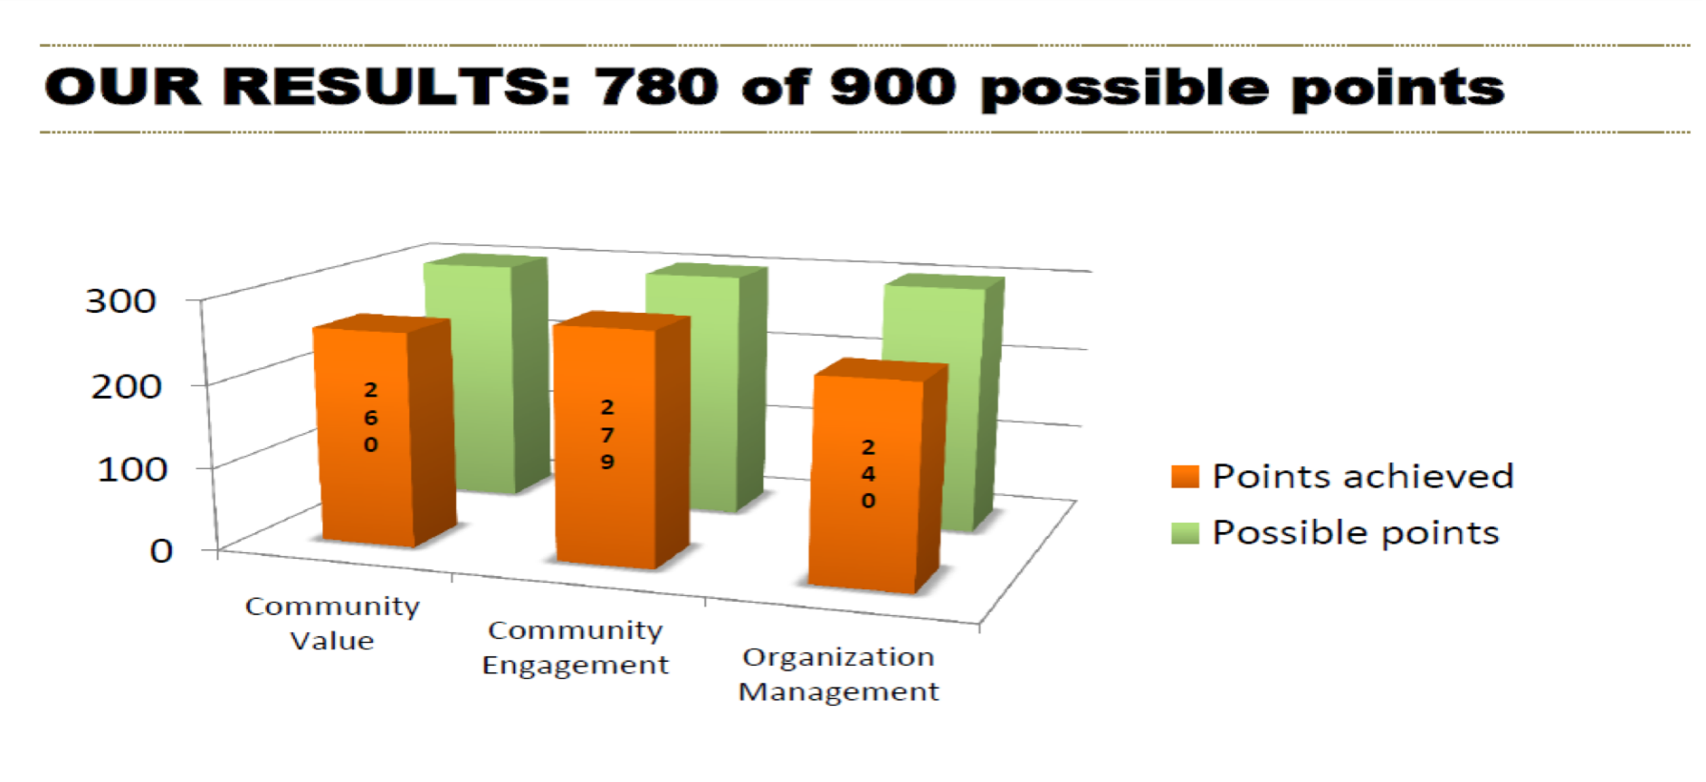
BENCHMARK RESULTS

Slide 20
ACTION STEPS: UNDERSTANDING USERS
A recent survey of students participating in technology classes citywide revealed:
55% report earning less than $10,000 annually
46% of respondents reported that they were not employed at this time
25% reported they are retired.
33% of respondents reported not having a High School level of educational attainment.
47% of respondents are Spanish-speaking only
43% report being bi-lingual

Slide 21
ACTION STEPS: OUR COMMUNITY PRIORITIES
  Grow...
  Digital literacy help & training
  Meeting employment needs
  Improve...
  Provide sufficient bandwidth capacity to support user demand
  Staff technology expertise to support community members needs and goals

Slide 22
Questions/Comments?
www.libraryedge.org

Slide 23


