Slide 1
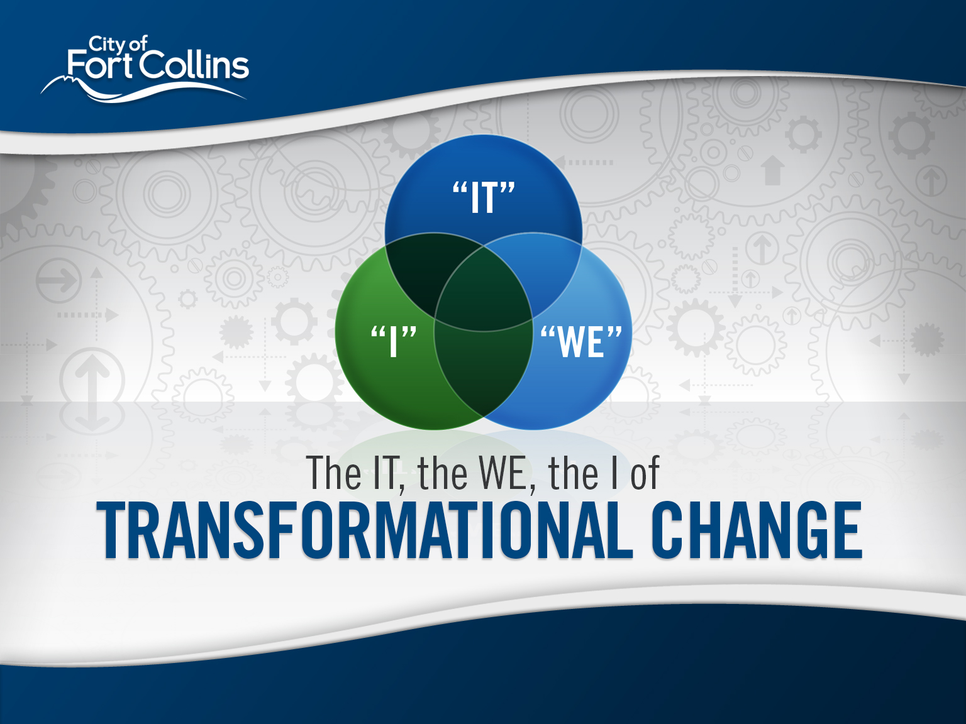
5.1.14
ICMA 2014 Mountain Plains Regional Summit
by Darin Atteberry, City Manager, City of Fort Collins, CO

Slide 2
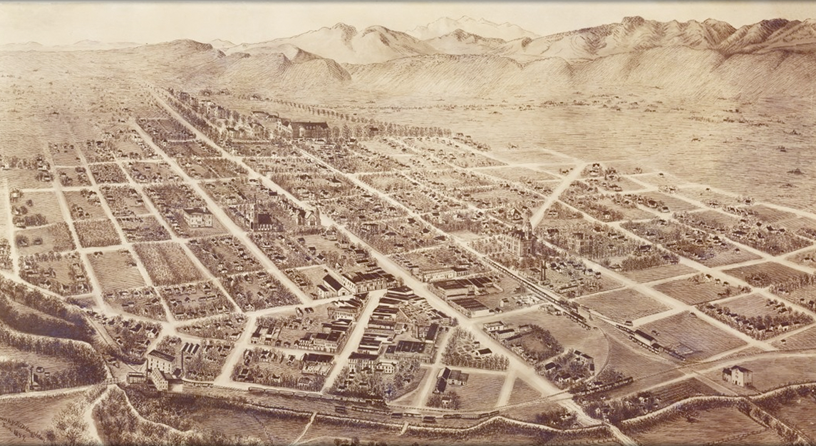
WHO WE WERE

Slide 3
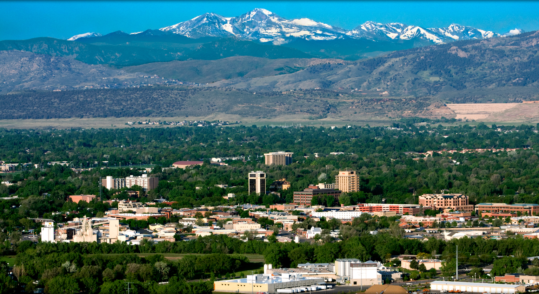
WHO WE ARE

Slide 4

WHO WE ARE
BIKES

Slide 5

WHO WE ARE
BEER

Slide 6

WHO WE ARE
BANDS

Slide 7
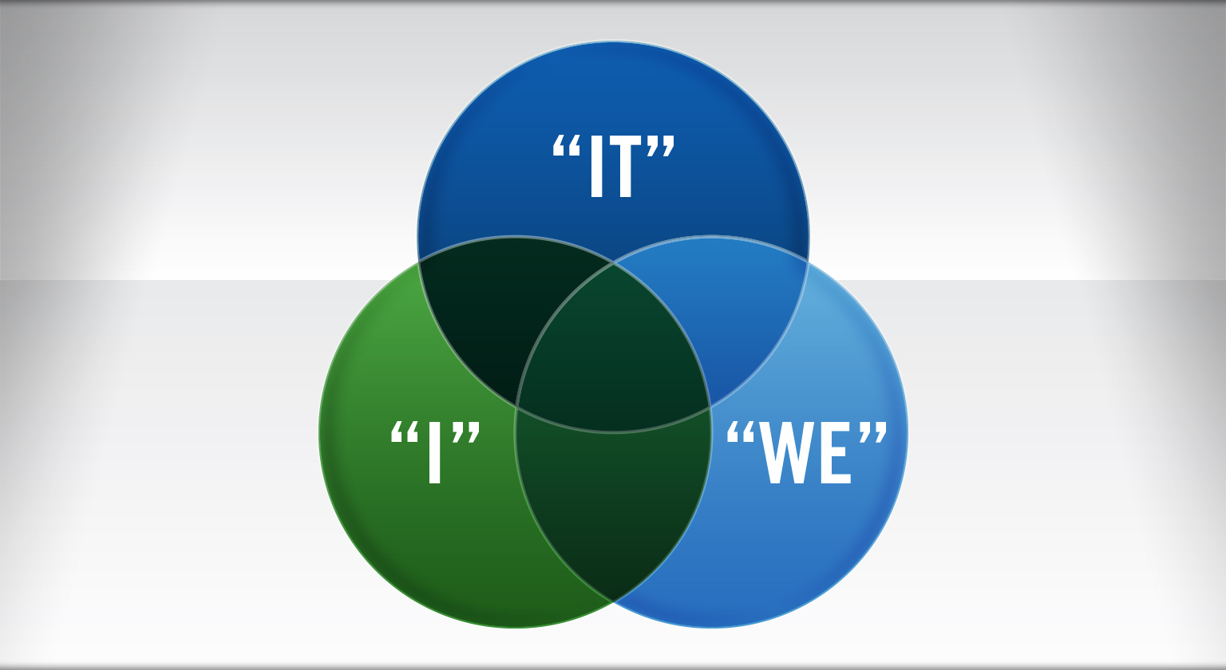
The IT, the WE, the I

Slide 8


The IT
VISION
To provide world-class municipal services through operational excellence and a culture of innovation.
MISSION
Exceptional service for an exceptional community.
VALUES
OUTSTANDING SERVICE
INNOVATION AND CREATIVITY
RESPECT
INTEGRITY
INITIATIVE
COLLABORATION AND TEAMWORK
STEWARDSHIP

Slide 9

The IT
STRATEGIC OUTCOMES
COMMUNITY &
NEIGHBORHOOD LIVABILITY
CULTURE &
RECREATION
ECONOMIC
HEALTH
ENVIRONMENTAL
HEALTH
SAFE
COMMUNITY
HIGH
PERFORMING
GOVERNMENT
TRANSPORTATION

Slide 10

The WE
THE LEADERSHIP SYSTEM
It takes the “we” to provide systems and processes in order to provide the “it” that our citizens want
THE WORKFORCE
The people and groups that provide the systems

Slide 11









CONTINUOUS IMPROVEMENT

Slide 12
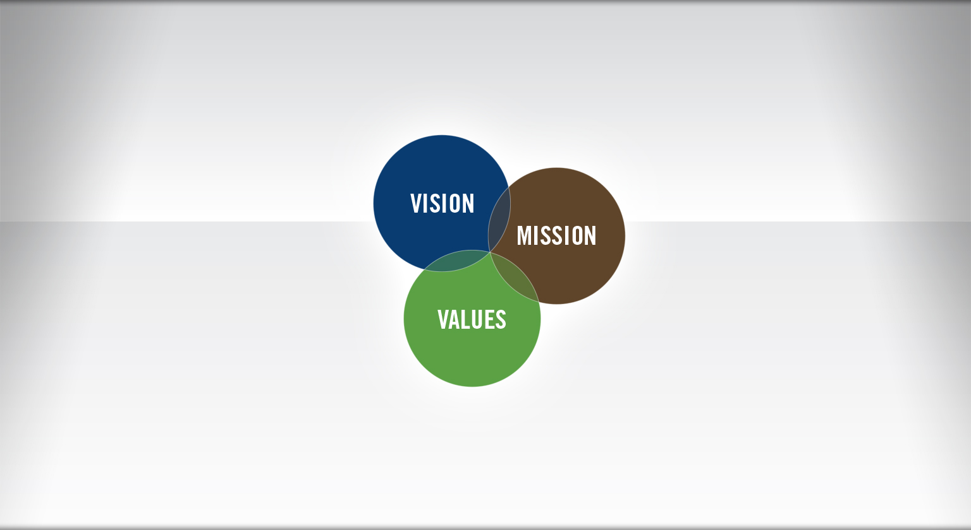
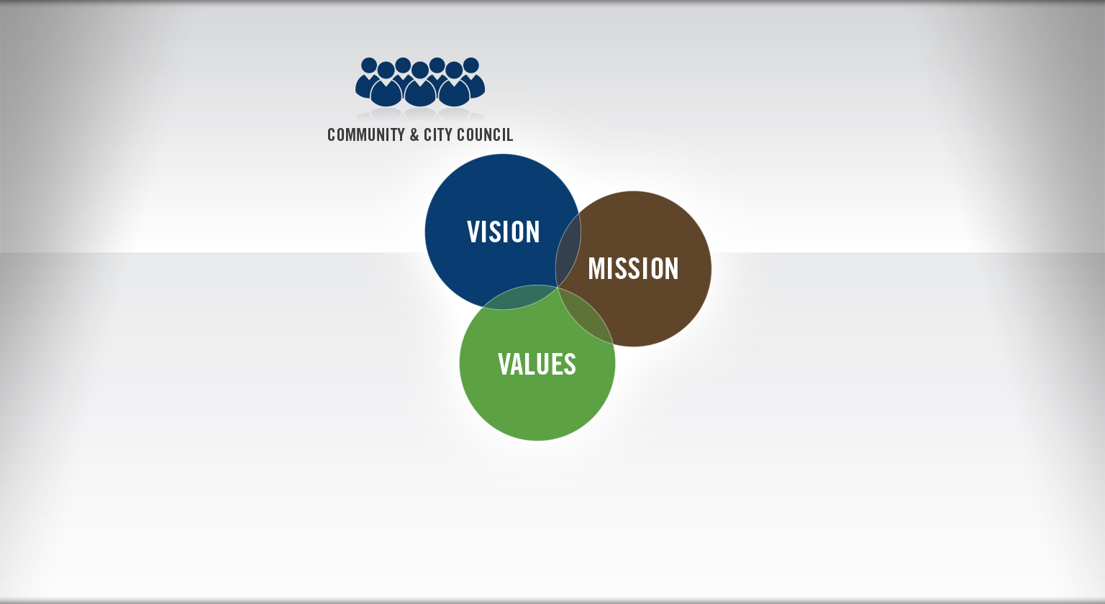
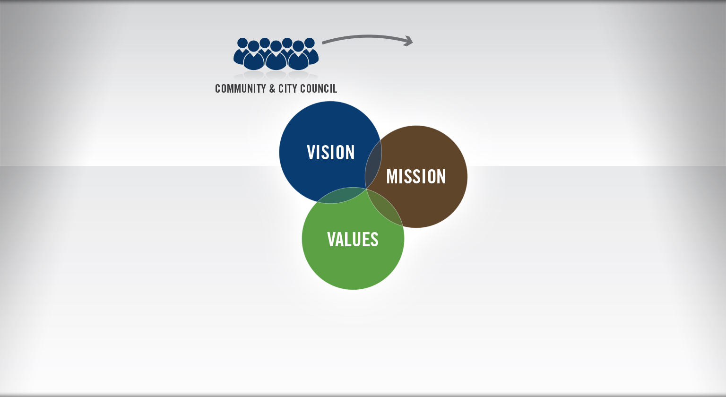
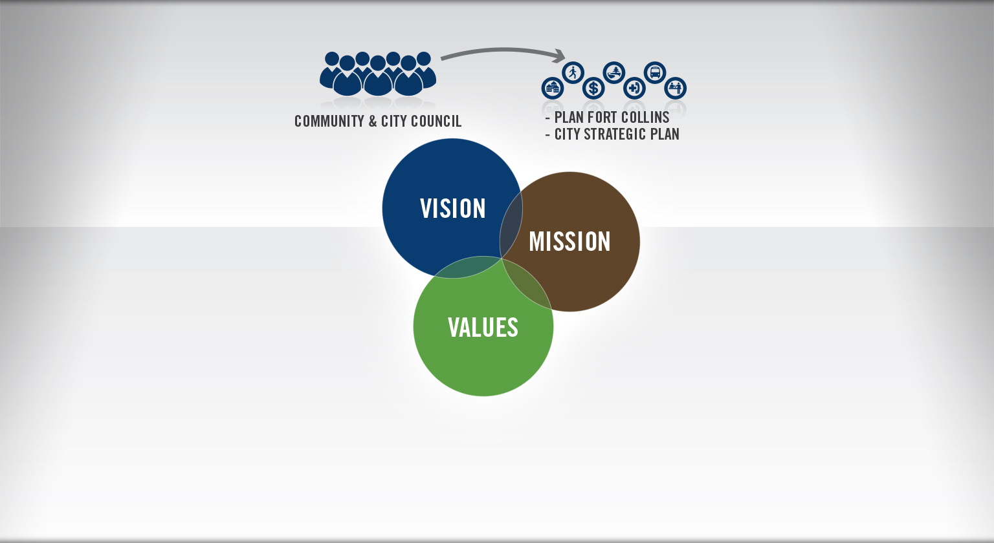
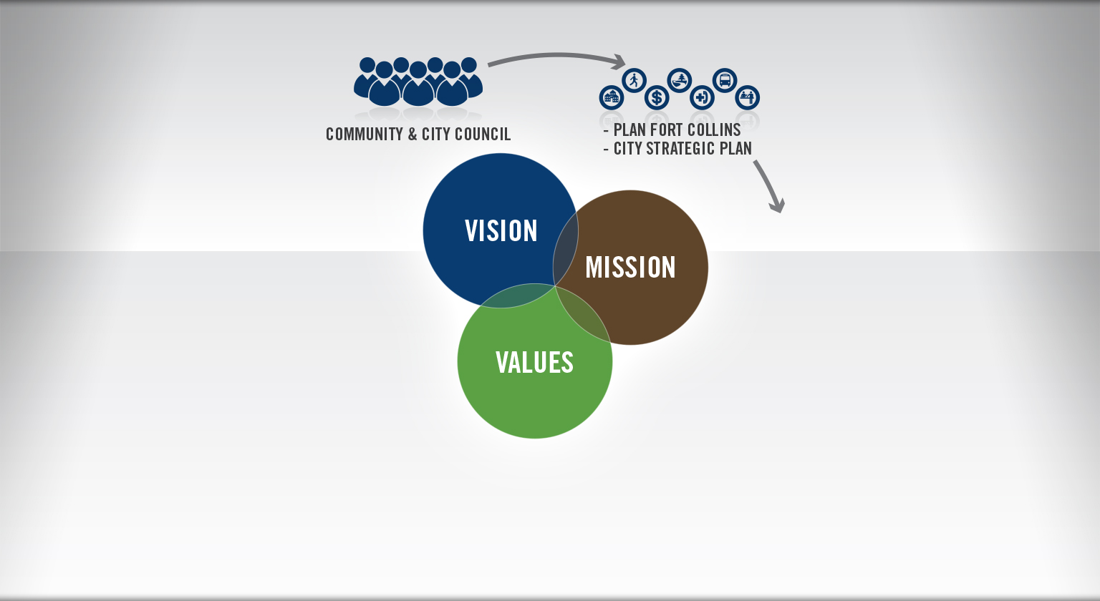
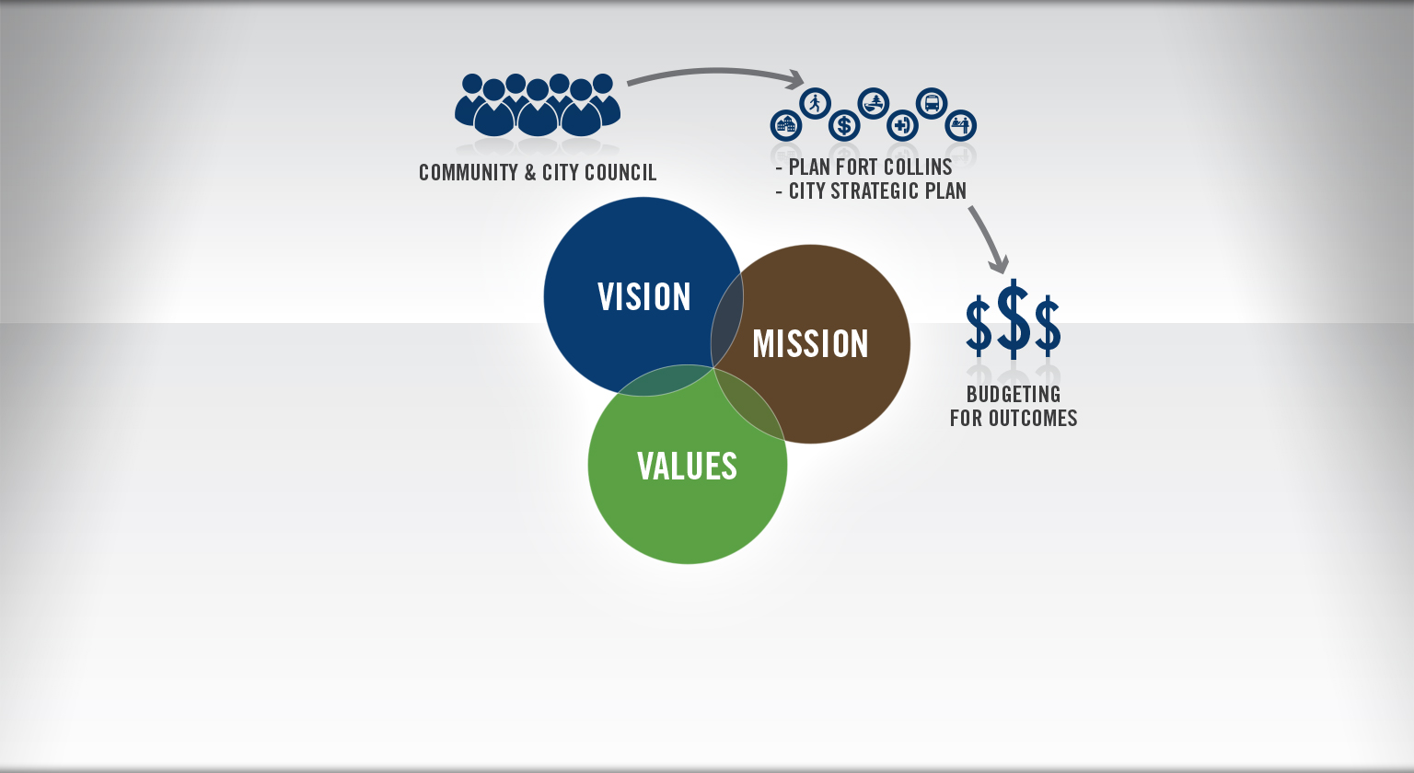

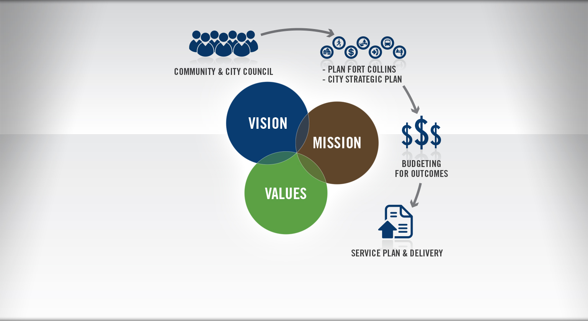

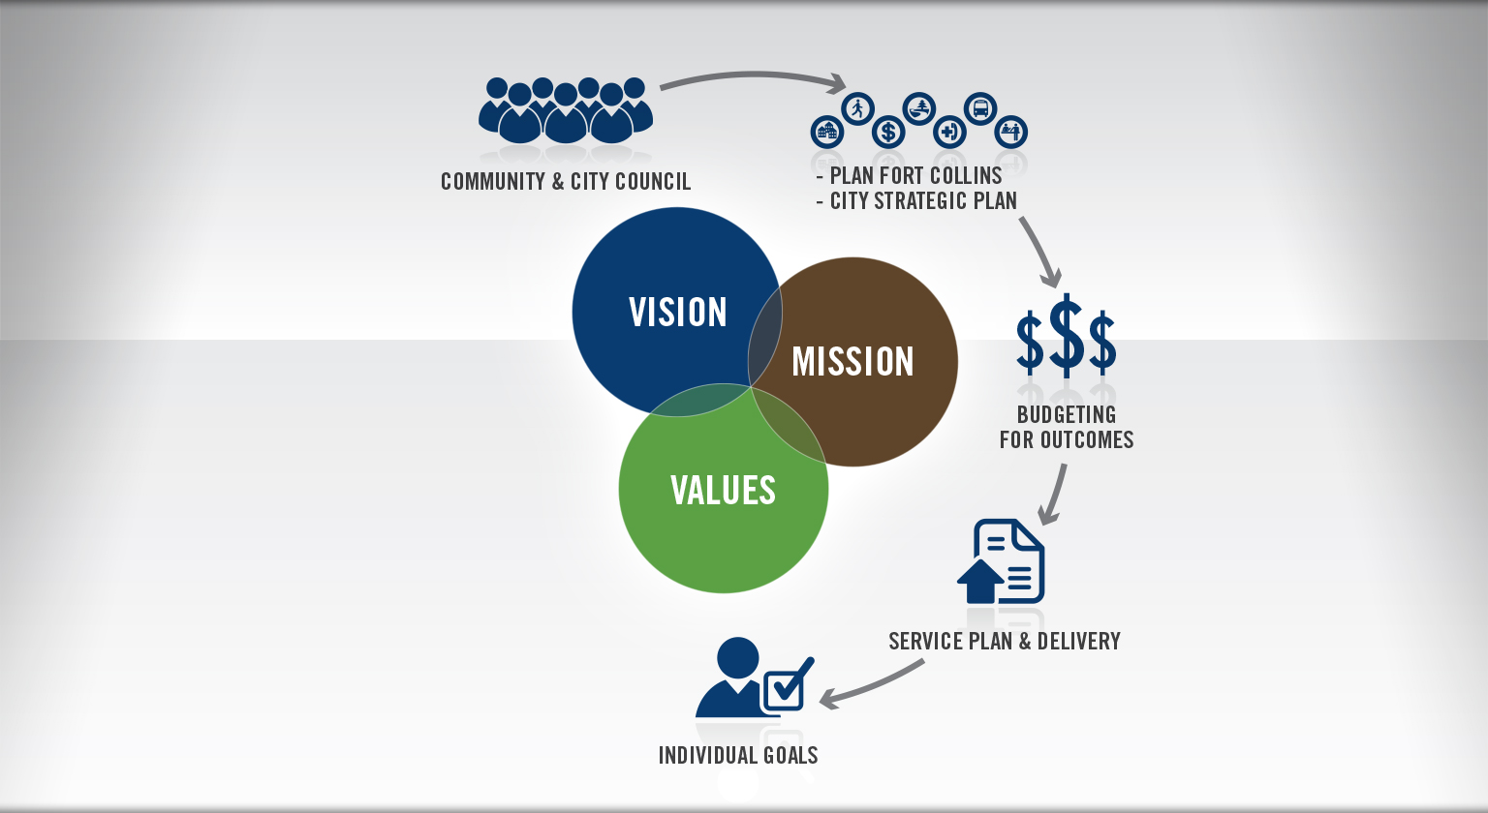
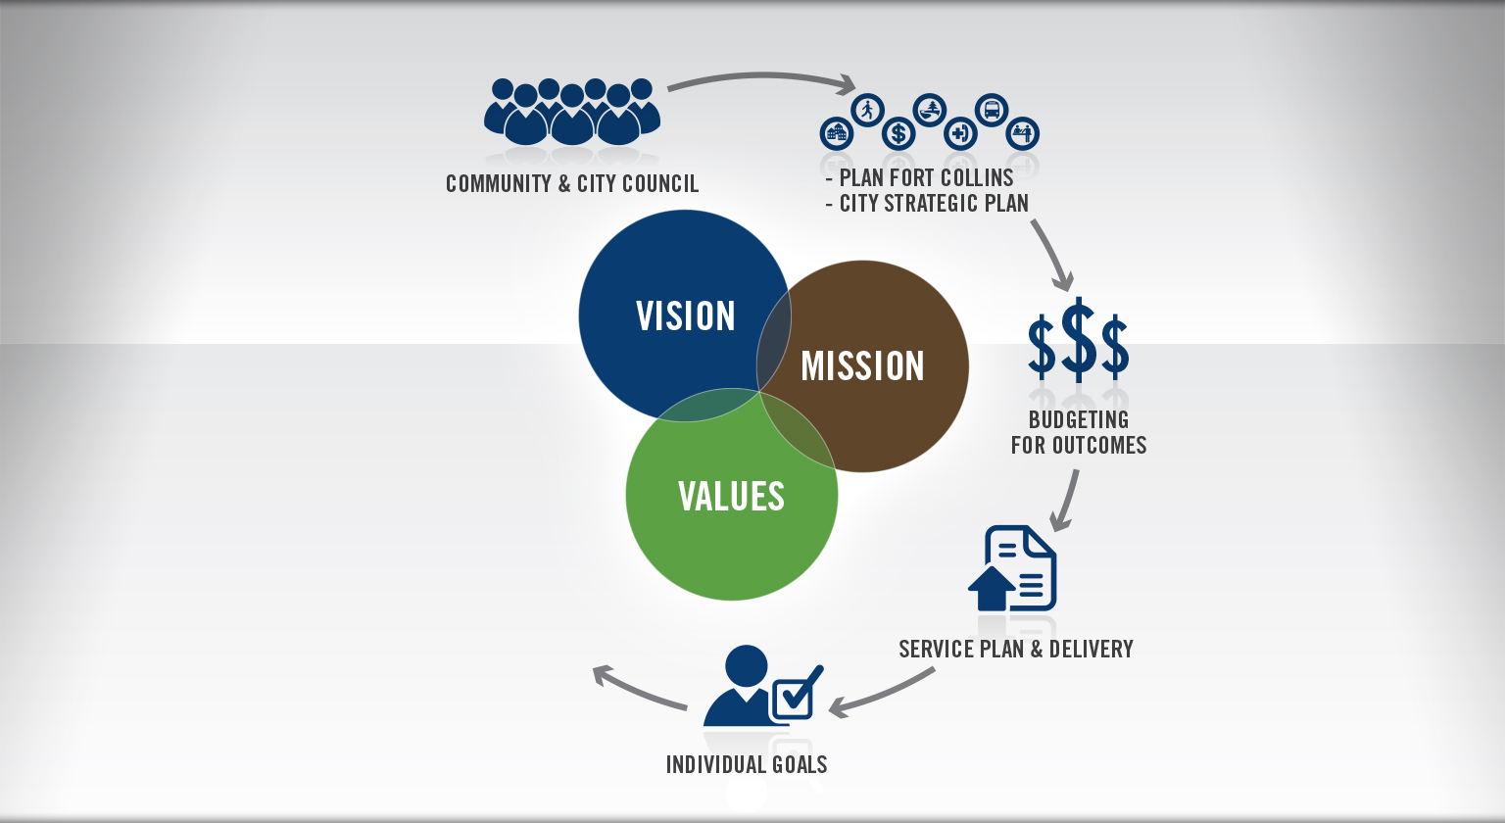
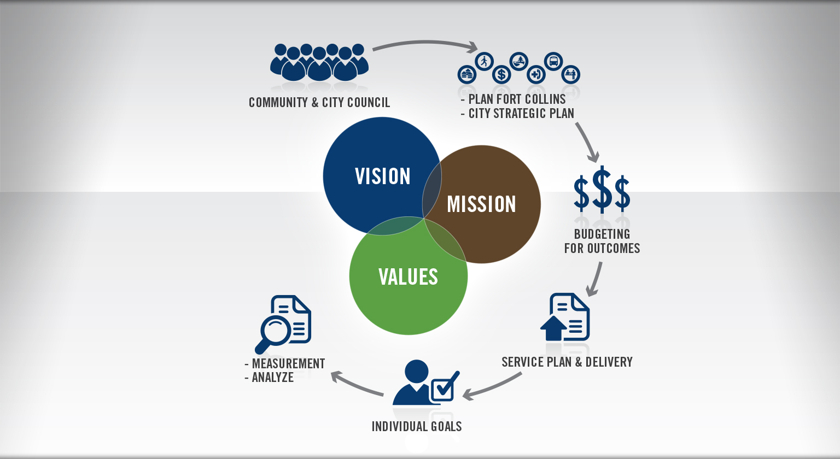

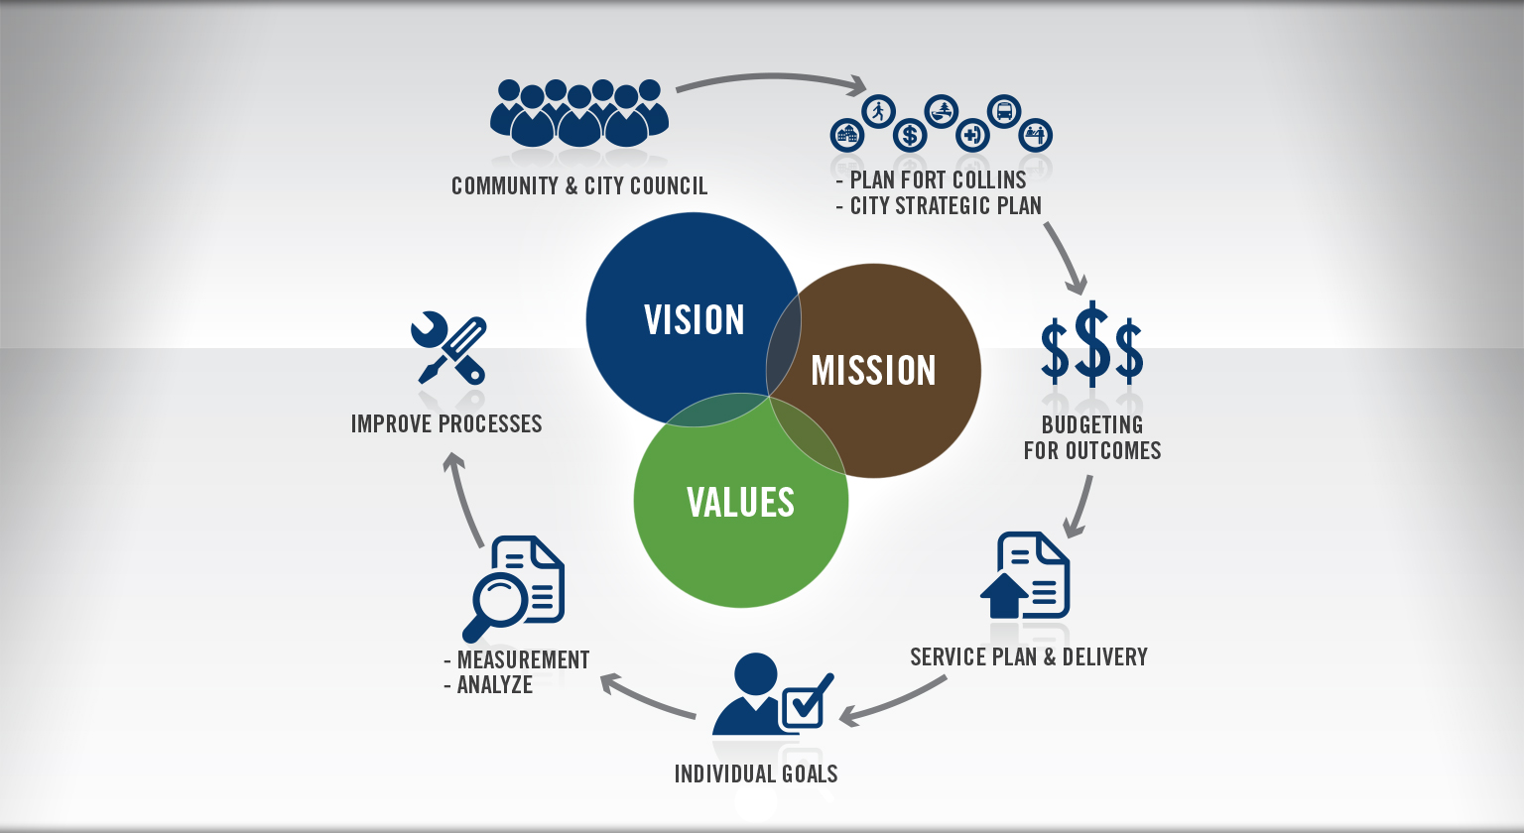
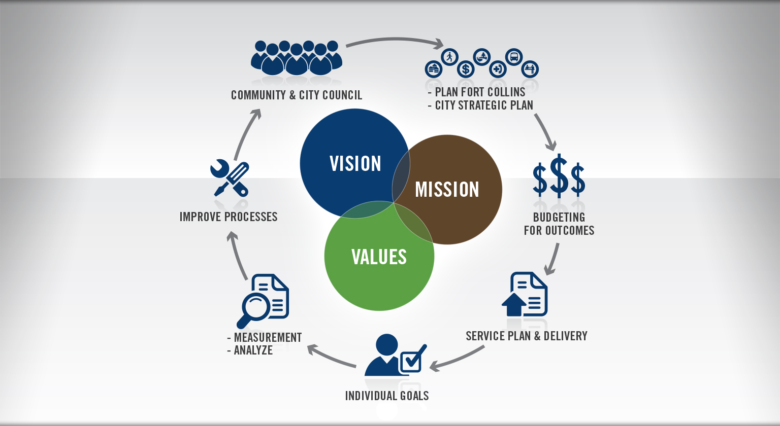
THE LEADERSHIP SYSTEM

Slide 13

The I
THE LEADER(S)
The critical role of the leader(s) and the importance of “Innovators DNA” in successful organizational transformation
Notes:
The I-
The I is about the individual- each of our team members contribute to our successful outcomes. It takes an engaged workforce that performs with energy, enthusiasm and eloquence for what they do each day. Now, some days are better than others of course, but overall, this is what gives me goose bumps about our team members.
In order to create an culture with the 3 “e’s”…it takes strong leaders

Slide 14

The I
CHALLENGING
THE STATUS QUO

Slide 15

The I FOUR BEHAVIORS OF CREATIVE PEOPLE
CHALLENGING
THE STATUS QUO
QUESTIONING
OBSERVING
NETWORKING
EXPERIMENTING

Slide 16
The IT, the WE, the I

