Slide 1
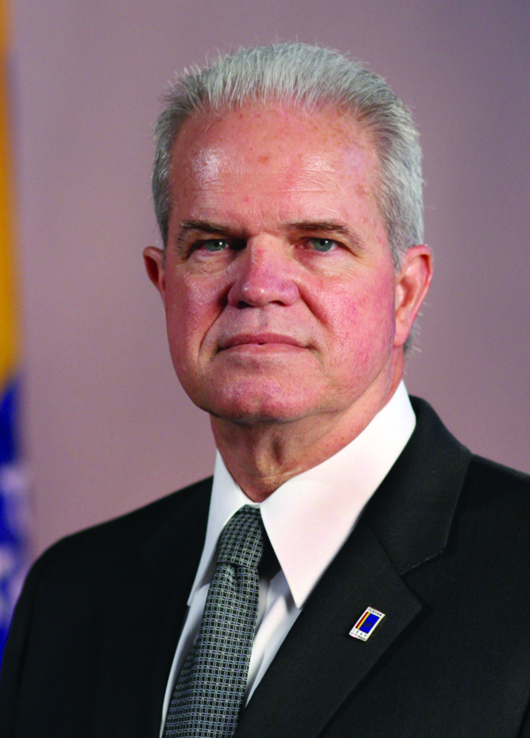
A “Culture of Service”
in Durham, North Carolina
Tom Bonfield
City Manager

Slide 2
Organized Chaos
Future Focused
(aligned and integrated)

Slide 3
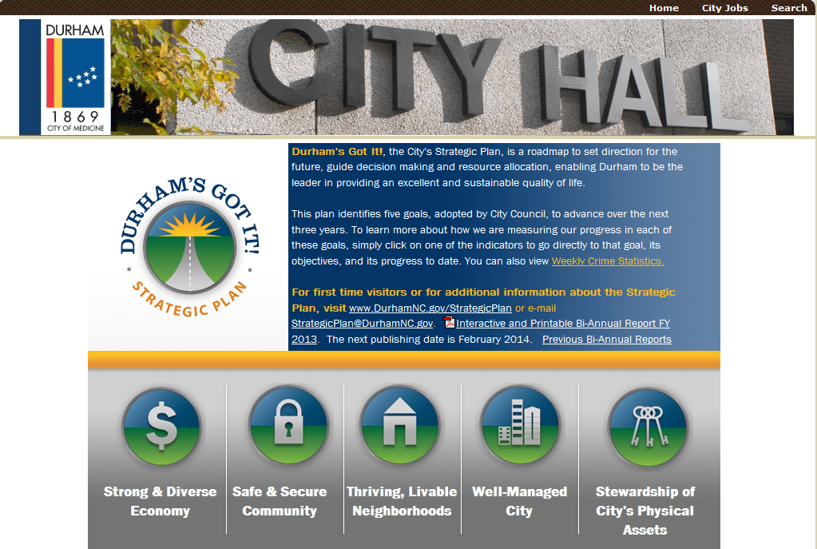

Slide 4

ENGAGEMENT
Rational Engagement
vs.
Emotional Engagement
Employee Satisfaction
vs.
Employee Engagement
Notes:
Important to recognize difference between rational engagement and emotional engagement
Employees can be rationally engaged because they want to get paid (means to other ends), they want to get a promotion, or in some cases because they want to keep their job or cannot find another one.
Emotional engagement occurs when employees are fulfilled by their work, understand it and connect with meaning to it.
Similarly it is important to recognize the difference between employee satisfaction and employee engagement.
Employees can be satisfied with their work again because it provides an income, they like the hours, security, retirement, health benefits or any number of other reasons but that does not make them engaged employees.

Slide 5
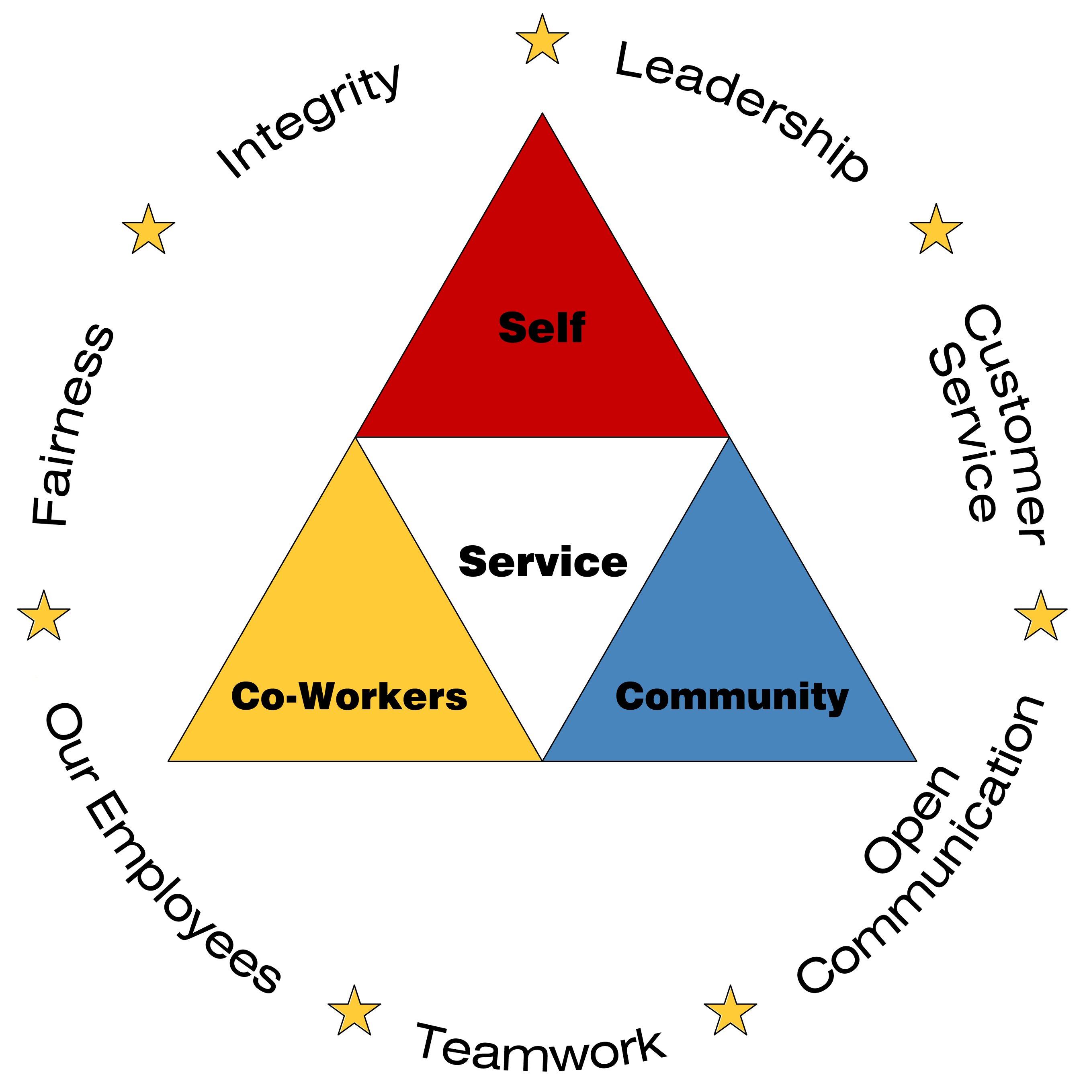

Slide 6
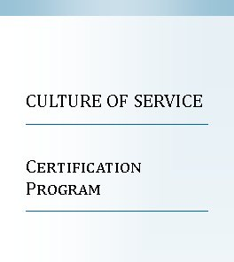
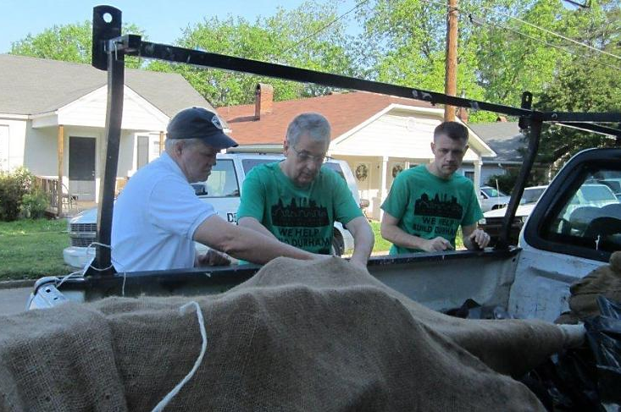
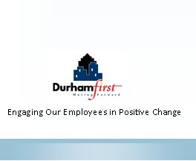
Culture of Service
Certification Program
Notes:
COS Certification program.
Influence positive change through training and interaction
Raise awareness of positive behaviors that lead to culture change
Bring values to life and demonstrate their interdependency
Make City values more concrete
Brochure and details in webinar materials.

Slide 7

Results
Employee Opinion Survey
Management demonstrates strong personal commitment towards achieving the City's goals.
+12.5%
City management clearly communicates the City's vision, goals, and objectives.
+20.6%
There is a positive and optimistic outlook about what can be accomplished in the City.
+17.7%
Notes:
Bi-annual employee opinion survey.
These results are in first four years of COS.
Remarkable in a time of no pay raises, benefit reductions, job eliminations and layoffs.

Slide 8
Results
Resident Satisfaction Survey
    Overall Quality of City Service: +15%
    Overall Quality of Life: +19%
    Value Received for Taxes Paid: +17%
    City Moving in the Right Direction: +23%
Notes:
Similar results in resident satisfaction survey over five year period.
Again remarkable results in light of overall economic conditions.
We believe a significant part of these positive numbers from our employees and our residents are due to the culture in the organization and the work of our employees.

Slide 9
Culture of Service “Triangle”

