Slide 1

Changing Organizational
CULTURE
A 20 Year Journey
“Wiring it up” so that it endures
Making it replicable
DAVE CHILDS, CITY MANAGER
Palmdale, California

Slide 2

Culture Change That
LASTS
The metaphor of a bonsai tree

Slide 3
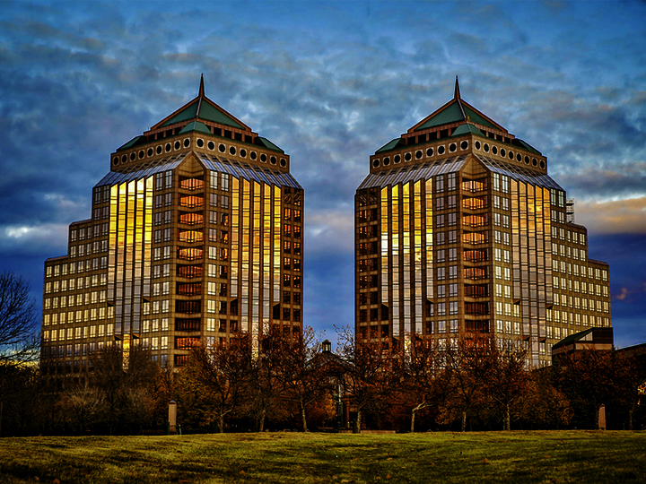

1993 MINNETONKA, MN
Western Minneapolis suburb
55,000 residents
200 employees
AAA Bond Rating
Capital Projects Endowment Fund
Home of Fortune 500 companies

Slide 4


Time to revisit the values

Slide 5

Team of 12 (diagonal slice of org.)
Focus Groups:
What’s important around here?
What should be important around here?
What should be most important around here?
Employees vote on shared values

Slide 6

MINNETONKA’S SHARED VALUES
AUTHENTIC COMMUNICATION
CONTAGIOUS ENTHUSIASM
HEALTHY HUMAN RELATIONSHIPS
SHARED SUCCESS
ADAPTABLE LEARNING & INNOVATION
OUTCOME FOCUSED TEAMWORK

Slide 7
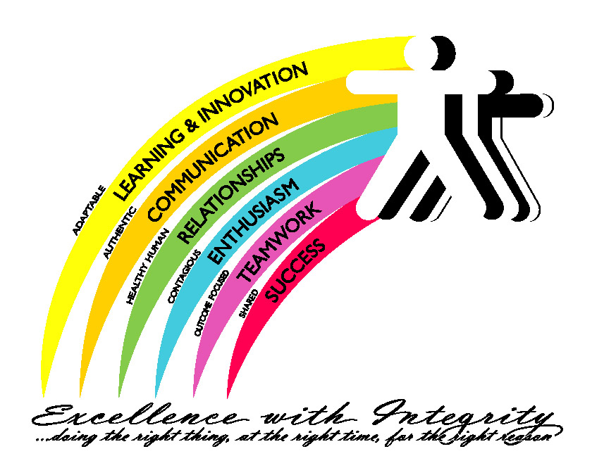
1995 ARTWORK: MINNETONKA’S SHARED VALUES

Slide 8
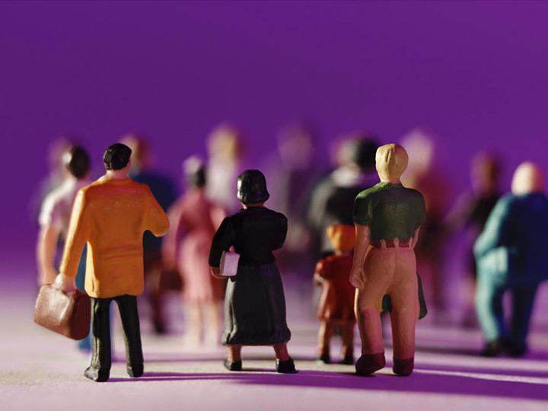
MAKING IT REAL
What do they mean?
What behaviors exist when we live these values?
“WIRING IT UP”
HIRING
EVALUATIONS
TRAINING
COMPENSATION

Slide 9

STORIES OF SUCCESS
Public Works Union Steward
New City Manager 2000
New City Manager 2013
Renewing/Refreshing

Slide 10
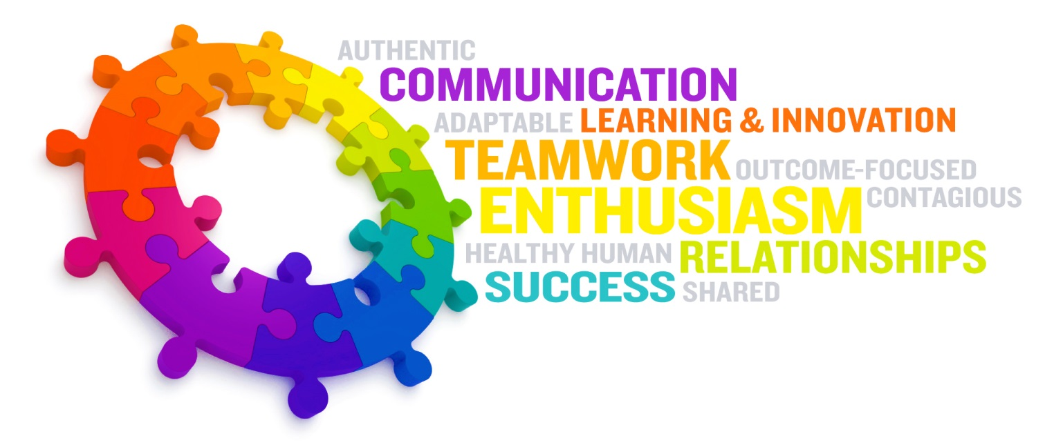
2012 UPDATED ARTWORK: MINNETONKA’S SHARED VALUES

Slide 11
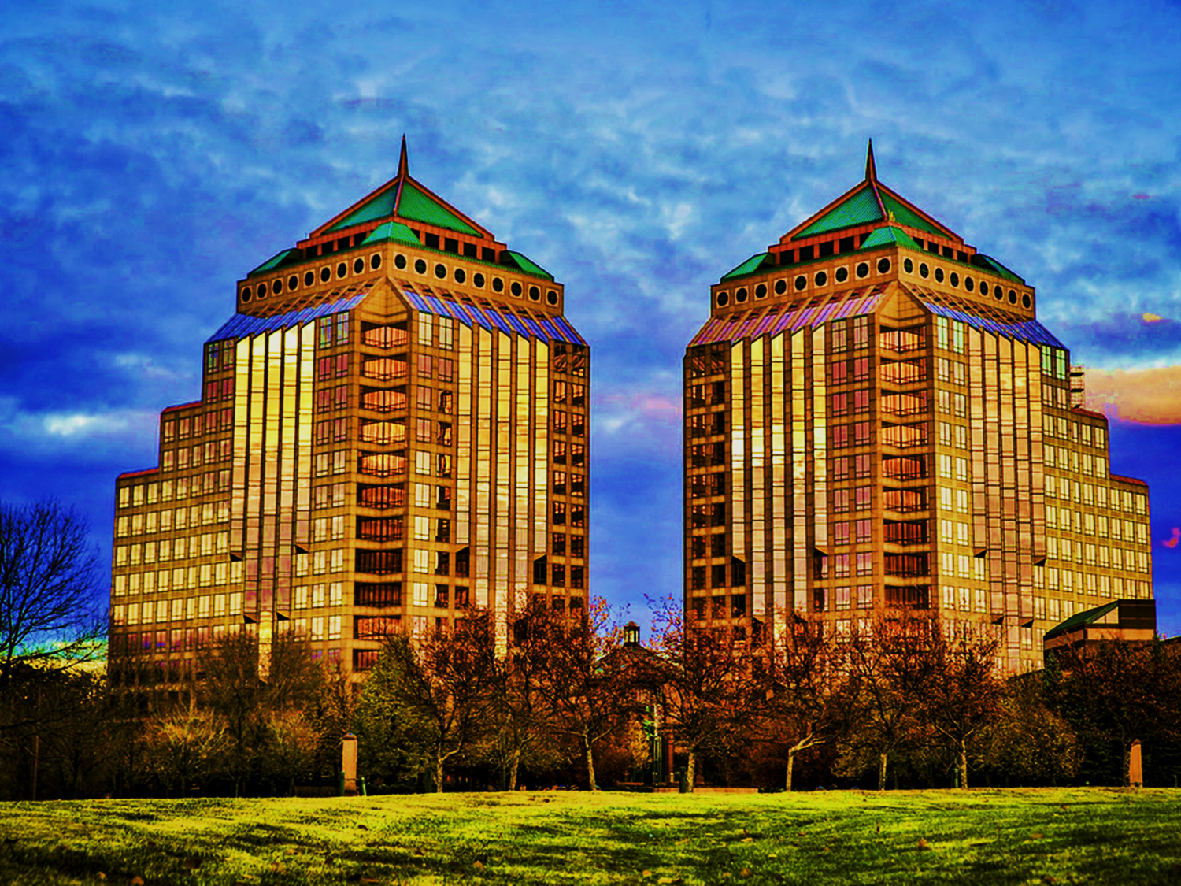
Sure, it worked in a high end suburb with lots of resources. But …
Is this process really replicable?

Slide 12
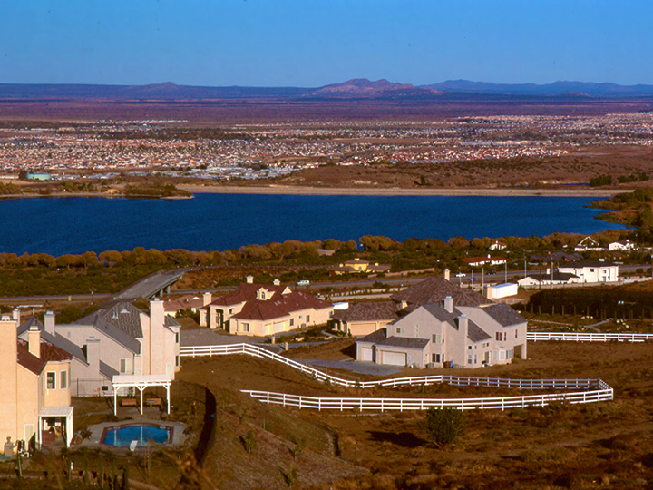
2013 PALMDALE, CA
Northern L.A. County high desert city
155,000 residents
182 employees (down from 365)
Unemployment still at 12%
Contracts:
Districts:
Police
Library
IT
Landscape/Parks Maintenance
Street Sweeping
Fire
Water
Transit

Slide 13

Call for Volunteers to Revisit Values
OVER 50
VOLUNTEERS!

Slide 14
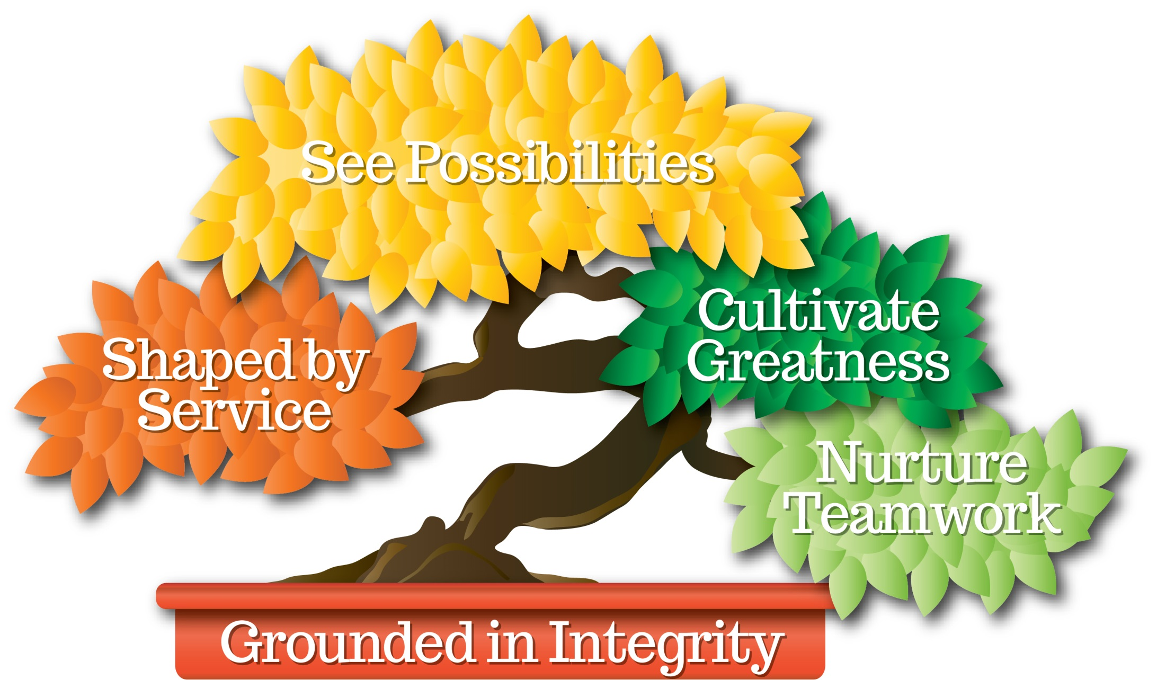
PALMDALE’S SHARED VALUES

Slide 15
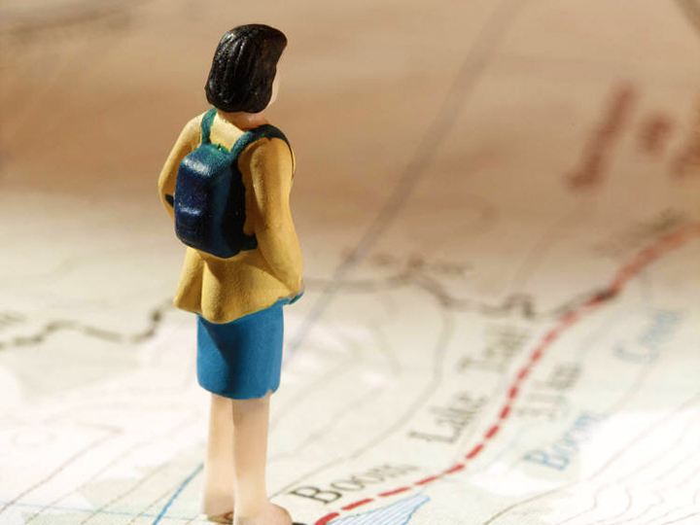
LESSONS LEARNED
CEO Must Lead
Involve Everyone
“Wire It Up”
Stories, metaphors & symbolism are critical to success (must be “our stories”)

