Slide 1
A CULTURE OF INNOVATION FOUR INSIGHTS FROM SAN JOSE
Ed Shikada, City Manager
Notes:
SCRIPT
NEW PARTNERSHIPS FOR ECONOMIC PROSPERITY: San Jose’s Story of Civic Innovation
Where was your City at 6 years ago, in 2007? (pause)
In San Jose:
We had just completed

Slide 2
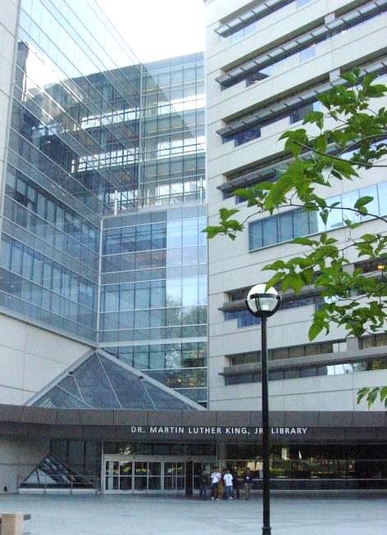
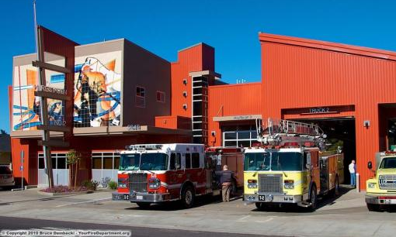
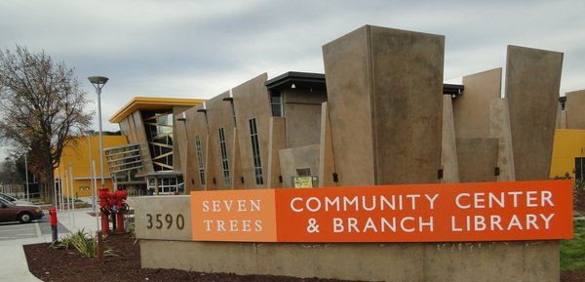
Notes:
our “Decade of Investment”—a $600 million bond measure to finance beautiful new libraries, community centers, fire stations, and new police substation.

Slide 3
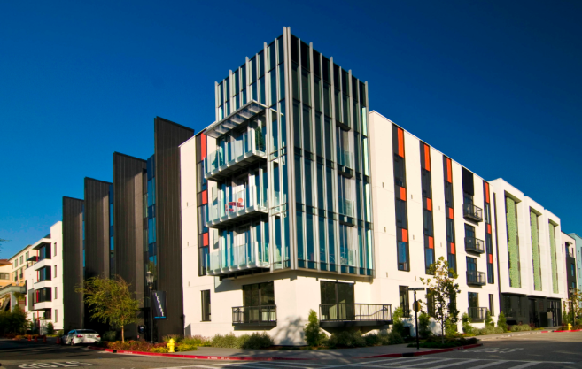
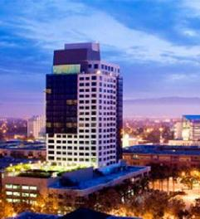
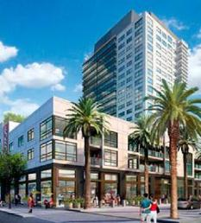
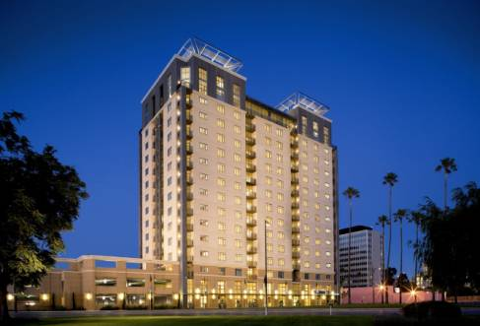
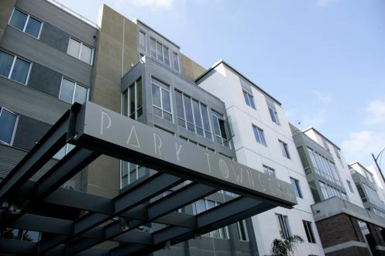
Notes:
Our Redevelopment Agency the second largest in California, had 120 people, a budget of several hundred million

Slide 4
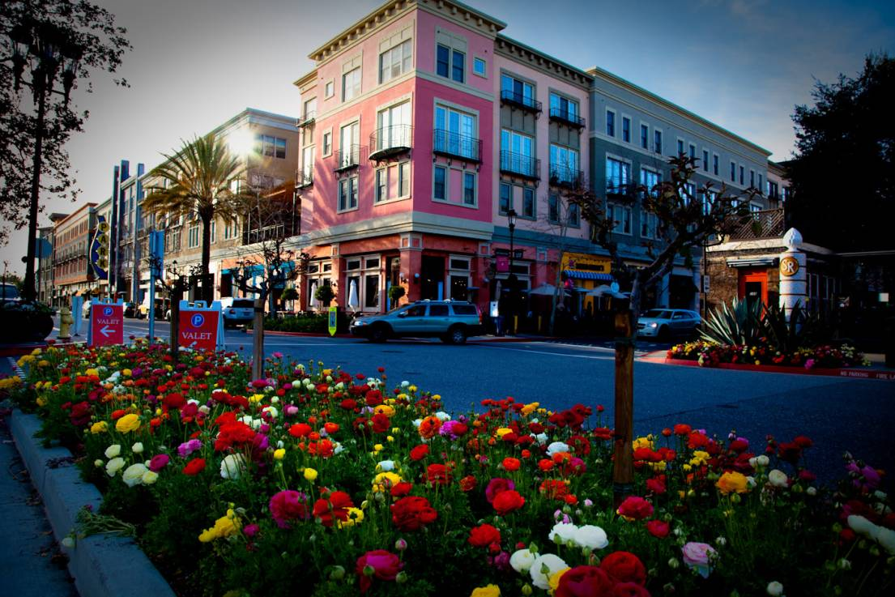
Notes:
Job levels at an all-time high. Times were good. (pause)
Then, in 2008,

Slide 5
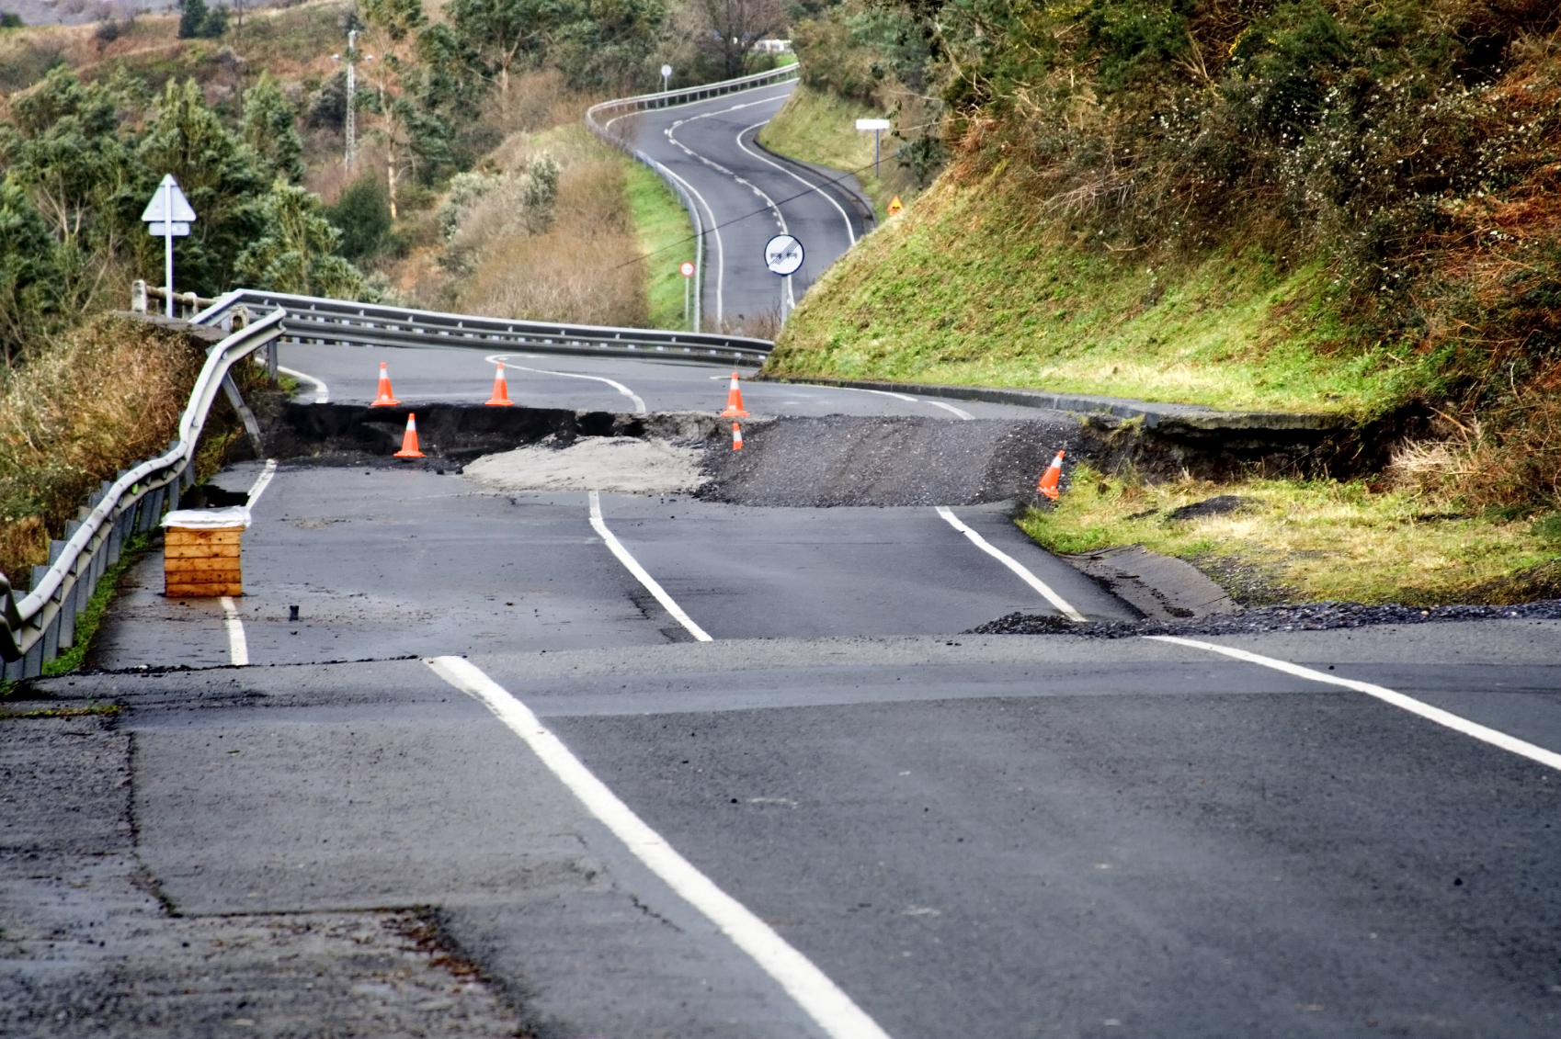
Notes:
Everything started collapsing.
We faced a triple threat: a) city revenues plummeted due to the Great Recession, b) retirement costs started ballooning from 9% to 19% of our city budget, and then c) the sudden elimination of Redevelopment.
There is no question that we in San Jose have just lived through the most difficult time in our City’s history.

Slide 6
RECORD BUDGET DEFICITS
(CUT $700M FROM BUDGET)
Notes:
We found ourselves with record budget deficits and acute fiscal stress.
There is no question that we have just lived through the most difficult time in our City’s history.
We have taken some very tough medicine to try to heal our city’s fiscal woes.
We’re now at a point in time that voters need to consider new revenue sources.

Slide 7
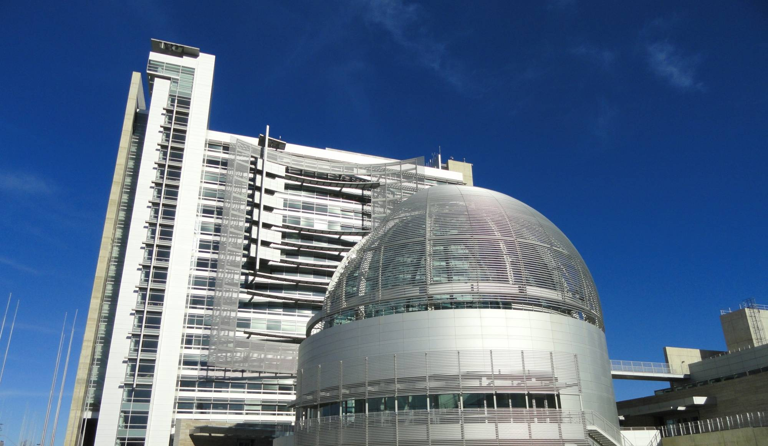
10% COMPENSATION CUT FOR CITY EMPLOYEES

Slide 8
REDUCED POSITIONS BY 23%
-1,584
7239
7012
6635
5630
5805
5655
1989 1994 1999 2004 2009 2014

Slide 9
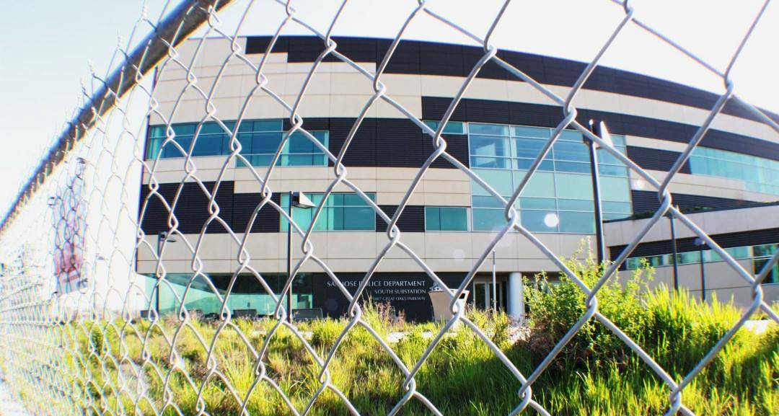

Slide 10
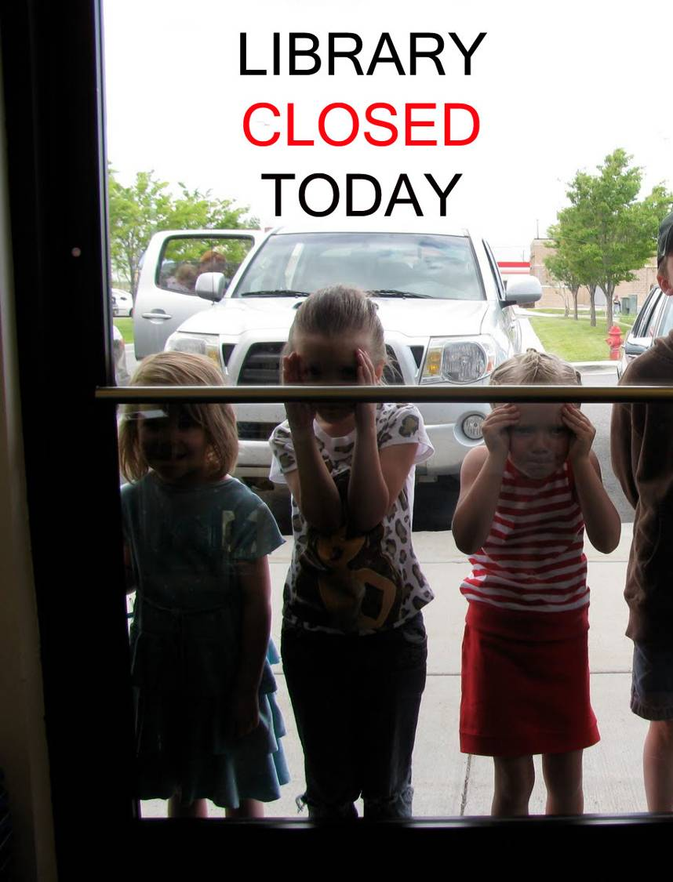
REDUCED LIBRARY DAYS AND HOURS
(FROM 6YEARS AGO)
DAYS/WEEK
X
X
1
2
3
4
5
6
OPEN
OPEN
OPEN
OPEN
OPEN
OPEN
HOURS PER WEEK
47
TO
34

Slide 11
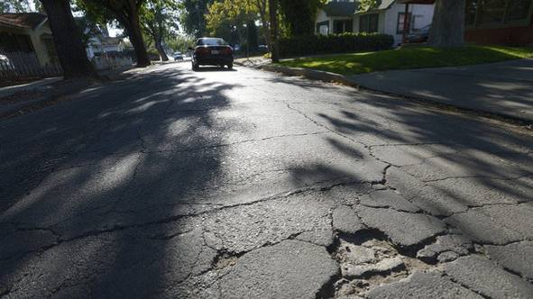
WE STOPPED MAINTAINING OUR NEIGHBORHOOD STREETS

Slide 12
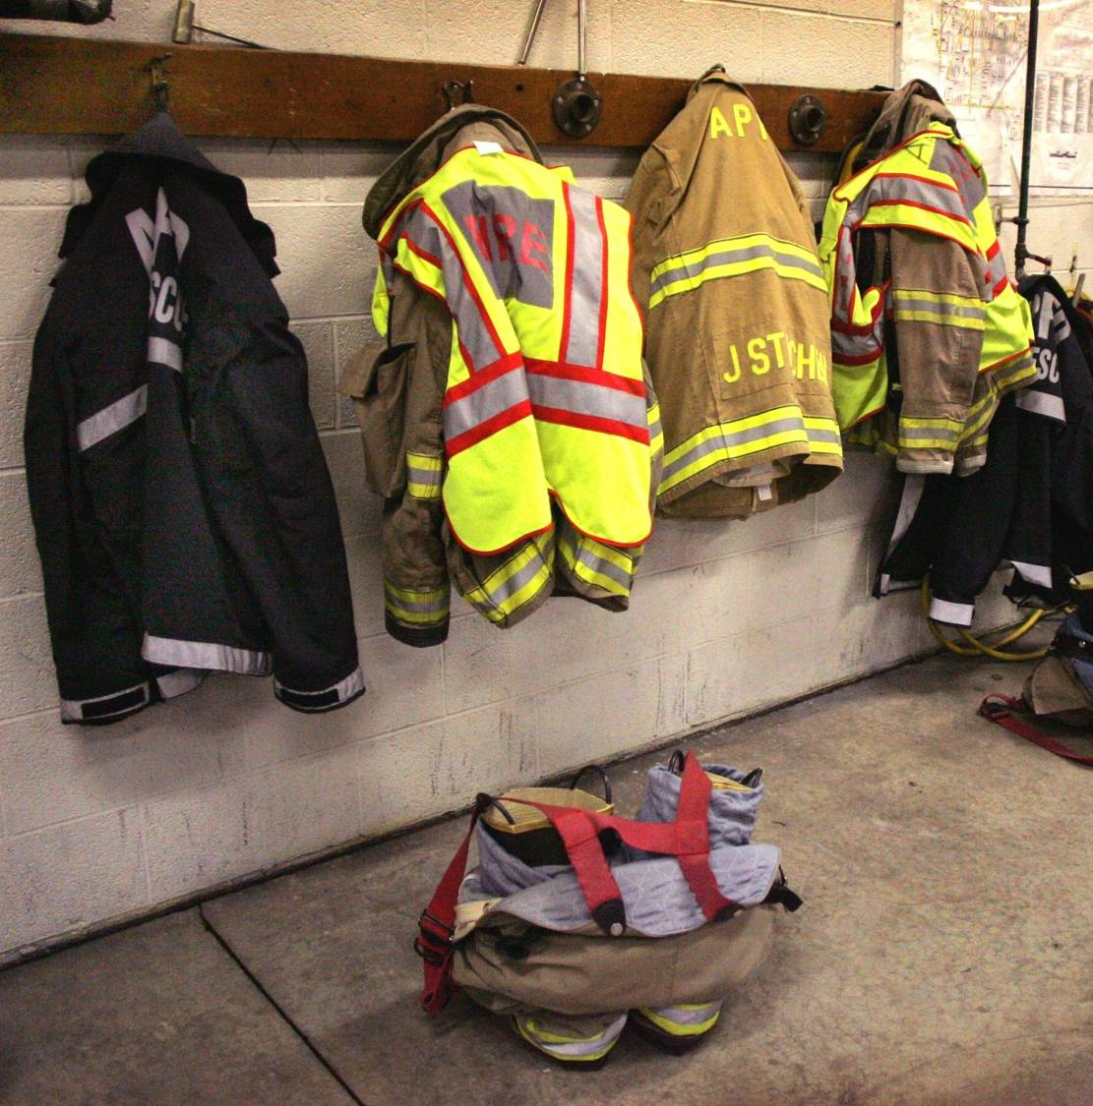
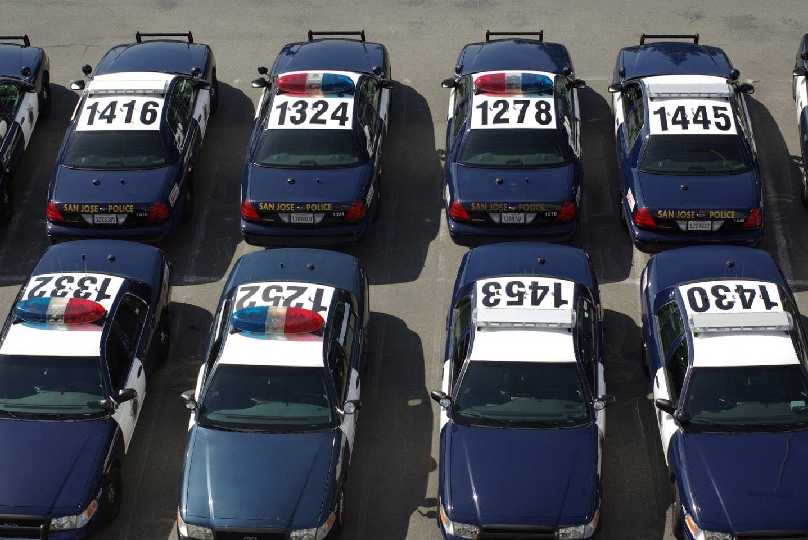
POLICE AND FIRE LAYOFFS

Slide 13
1
Deepen the Conversation
(Draw Connections, Even Uncomfortable Ones)
Notes:
INSIGHT #1: AWAKEN COMMUNITY CAPACITY

Slide 14
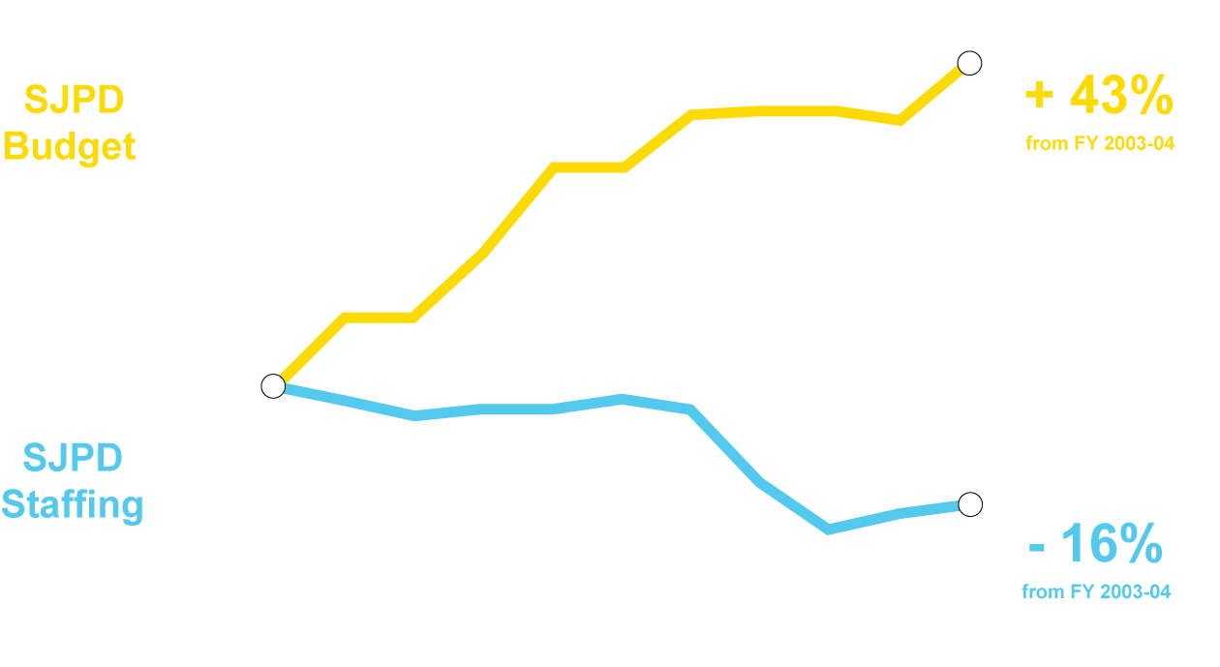
SINCE 2003, SJPD BUDGET UP 43%, FUNDED POSITIONS DOWN 16%
SJPD BUDGET
- 16%
from FY 2003-04
SJPD STAFFING
14
Sources: CSJ Adopted Operating Budgets, FY 03-04 through FY 12-13; FY 13-14 Modifies Operating Budget
Notes:
14

Slide 15
SAN JOSE IS UNIQUELY
RELATIVE TO OUR
RESIDENT BASE
“JOBS-POOR”
15

Slide 16
100
RESIDENTS, THERE ARE ONLY
FOR EVERY
290
184
151
86
134
117
91
JOBS
SAN JOSE
FREMONT
SUNNYVALE
CUPERTINO
MOUNTAIN VIEW
SANTA CLARA
PALO ALTO
16

Slide 17
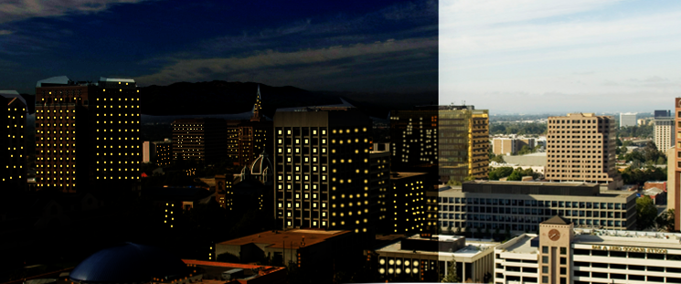
THE ONLY TOP 20 CITY NATIONALLY
WITH MORE NIGHTTIME RESIDENTS THAN DAYTIME WORKERS
17

Slide 18
P A L O A L T O
PROPERTY TAX PER CAPITA
C U P E R T I N O
$376
F R E M O N T
$245
$184
M O U N T A I N V I E W
S A N T A C L A R A
S U N N Y V A L E
$227
S A N J O S E
$165
$210
$123

Slide 19
SALES TAX PER CAPITA
P A L O A L T O
C U P E R T I N O
$366
M O U N T A I N V I E W
$359
$181
S A N T A C L A R A
S U N N Y V A L E
F R E M O N T
S A N J O S E
$314
$165
$183
$137

Slide 20
Align Around Ambition
2
(Set Bold Goals)
Notes:
INSIGHT #2: ACTIVATE UNIQUE ASSETS

Slide 21
Notes:
Green Vision
In 2007, as our hard times set in, our City Council adopted San Jose’s Green Vision. We set 10 ambitious environmental and economic goals to achieve over 15 years.
These goals are specific and measurable.
The idea was to align efforts of companies, residents and partners in a common direction.
This March, we celebrated five years of progress.

Slide 22
21
73
7
10,000
13
% reduction in energy use
% renewable energy
% trash diverted
million sq. ft. of green buildings
clean tech jobs
Notes:
We’ve driven measurable change:
We’ve reduced our per capita energy use by 13%.
We get 21% of our electricity from renewable energy, up from 13% five years ago.
Trash diverted from landfills has increased from 63% to 73%.
Green building count risen from 1 million to 7 million.
Increased our core clean tech jobs from 6000 to 10,000 and was named in 2012 the nation’s top City for Clean Tech
Green Vision has helped us get recognized as a national leader in the areas of clean tech jobs, solar power generation, water and solid waste recycling, and electric vehicle adoption.

Slide 23
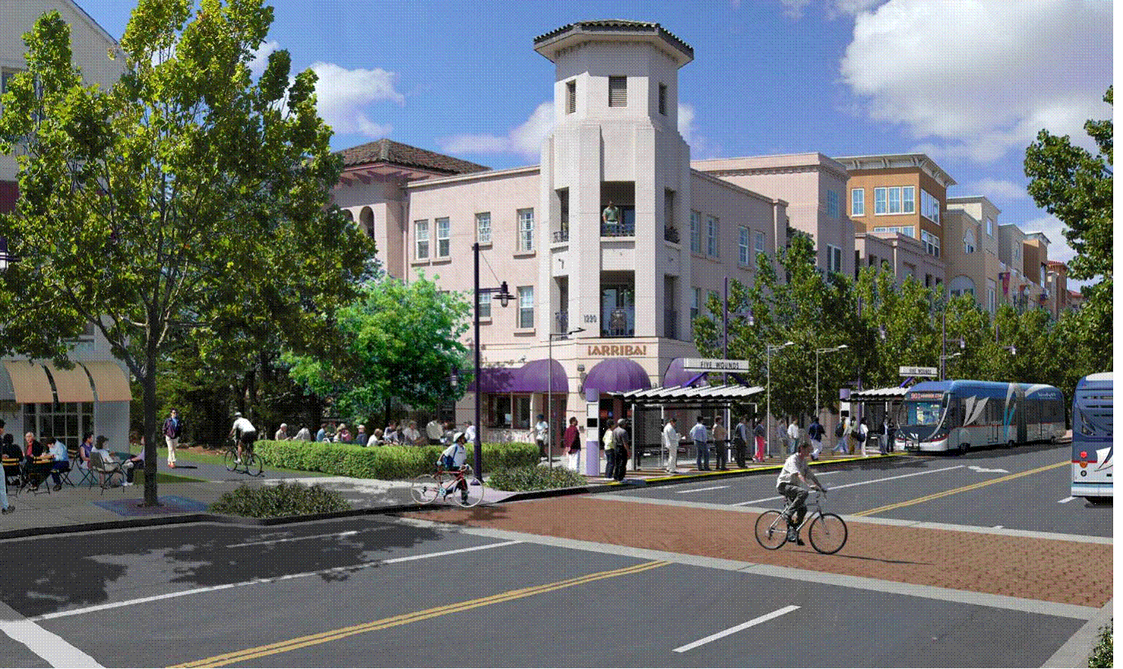
ENVISION SAN JOSE 2040 GENERAL PLAN
Building a City of Great Places
Notes:
Envision 2040
Our second experience in aligning around ambition was adoption of our 30 year General Plan last year.
This General Plan is a radical departure from the suburban growth patterns of San Jose’s past.

Slide 24
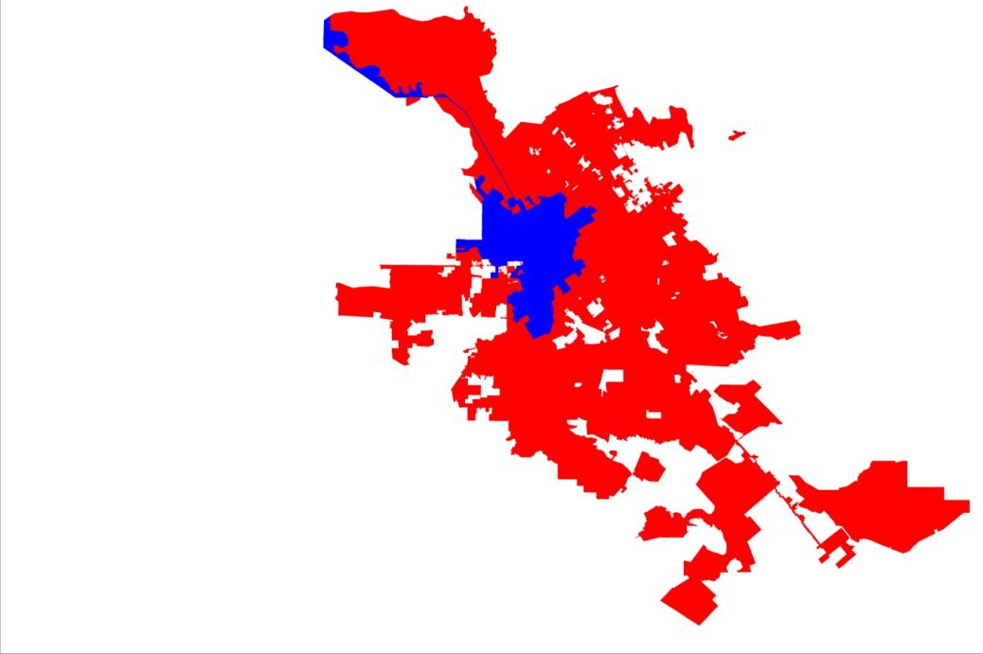
1950
1980
Notes:
The original vision of San Jose was literally a vision of sprawl,
City Manager in 1950s and 1960s, Dutch Hamann, went on an annexation binge to grow San Jose into the “LA of the North.
He literally had a team of city staff and pro-growth civic leaders called the “Panzer Division” which would swoop in to annex nearby smaller communities and rural areas.
SJ’s tentacles spread out, city expanded by 100 square miles

Slide 25
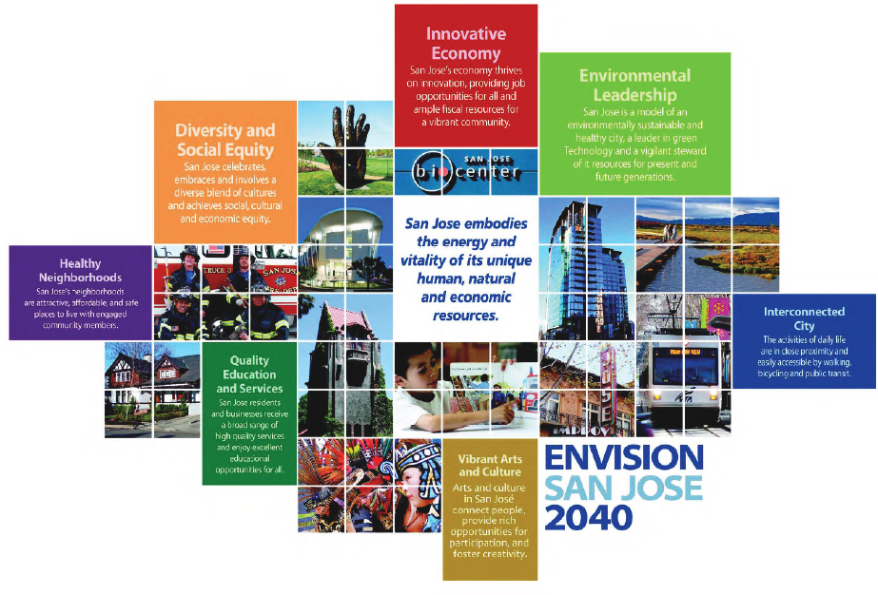
Notes:
The new General Plan, adopted unanimously by our City Council, anticipates 40% population growth from 2010 to 2040.
But it’s a stark contrast to the patterns of the past.
All of our future growth will be in the existing urban area, with a focus on growing up not out.
New homes and workplaces will be clustered in compact, mixed use urban village areas near transit hubs and corridors. There will be no new low-density, single family homes (we have a lot of these!), and instead new kinds of multi-family housing options aimed at singles, empty nesters, young professionals and seniors.

Slide 26
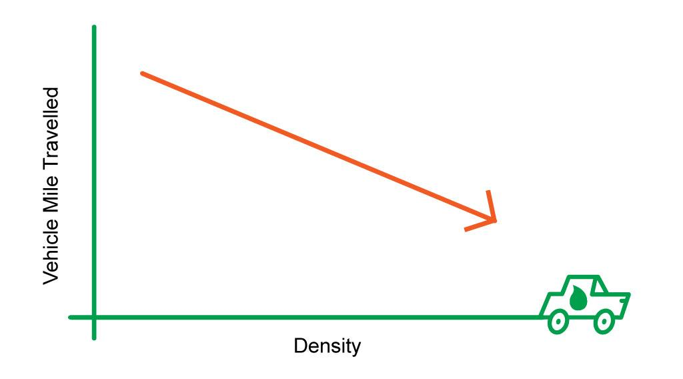
-40% trips by car
Trips by car
Notes:
Perhaps the boldest part of our plan is to reduce auto use by 40%--by redesigning our city for more waking, biking, and transit use.
We’ll face many challenges to implementing Envision 2040. We’re counting on the boldness of our goals to motivate a broad network of residents to consistently advocate for implementation. We’ve already seen start up of a new nonprofit called SPUR San Jose to advocate for quality design and more urbanism.
So, in SJ, its been critically important for our city to articulate and align around ambition.

Slide 27
WORKING TOGETHER
LONG-TENURED
EMPLOYEES
CORPORATE PARTNERS
CUSTOMER
SELF-HELP
NEW (TIER 2+)
EMPLOYEES
CONTRACTOR
SHARED SERVICES
(INTER-AGENCY)
NON-PROFIT
TEMP EMPLOYEE
VOLUNTEER
Notes:
ED
ED
These groups are the key “building blocks” in constructing our future.
27

Slide 28
Activate Unique Assets
3
(Leverage What You Have)
Notes:
“INSIGHT #3”: PARTNER TO TAP OPM (that’s “Other People’s Money”) Ultimately, this is about harnessing the power of networks outside City Hall)

Slide 29
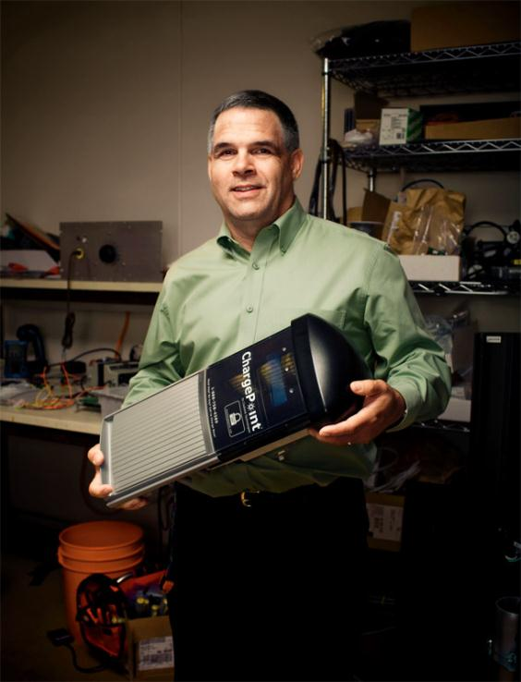
Notes:
Richard was passionate about harnessing the power of the sun to charge electric vehicles easily and cheaply with the swipe of a card. He had started a small company and even created a protoype of his idea, calling it ChargePoint.
But Richard had a hard time selling his idea to investors and customers.
Now, back in the day, our city through our Redevelopment Agency would have figured out how to throw money at Richard’s problem: put him in a RDA-subsidized incubator, offer some kind of government grant or loan.
But it turned out that what Richard needed most was to show that his product worked in a public setting, where it could be tested and demonstrated by real people.
So we gave Richard

Slide 30
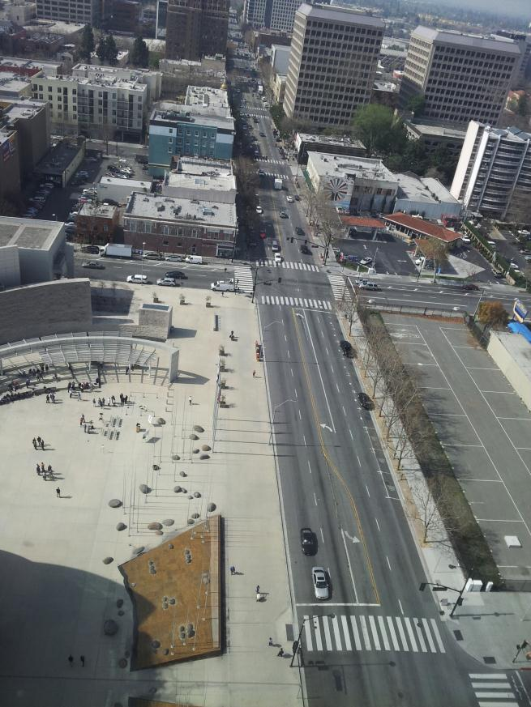
Notes:
something more valuable to him than Money: Access to our street and sidewalk right in front of city hall.

Slide 31
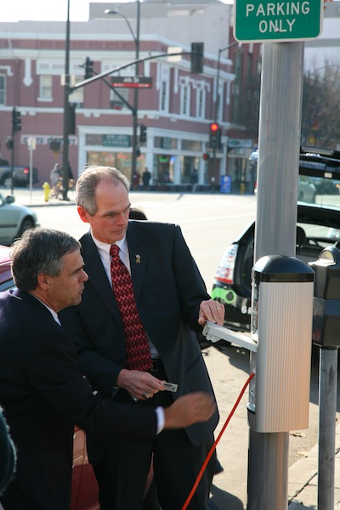
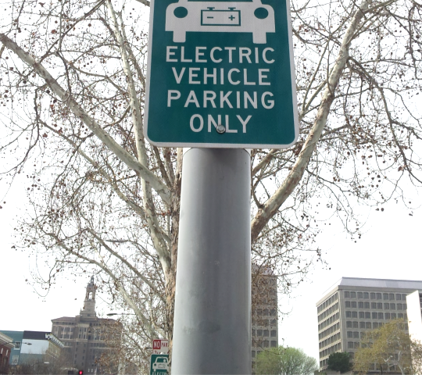
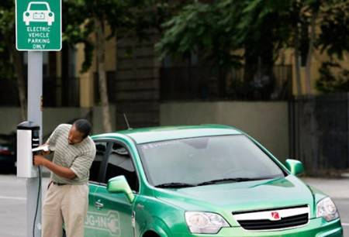
Notes:
In 2009, Richard’s company Chargepoint installed and demonstrated the first public electric vehicle charging station in the nation in front of our City Hall.
Cost to us: ZERO. Value to Richard: Priceless!
This successful demonstration project catapulted Chargepoint

Slide 32
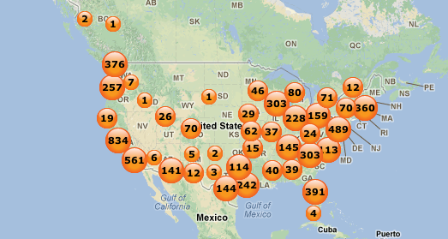
Locations
Notes:
from start-up to scale up! It unlocked venture capital money and a $37 million DOE grant to deploy chargepoint stations in 9 cities across the nation in 9 cities.
Since then, ChargePoint has expanded in 27 states, Canada, Europe, and Australia. And—the products are manufactured in Silicon Valley.
To help more companies like Richard’s, in 2008: Created Demonstration Partnership Policy allowing use of City facilities for demonstration of new technologies.

Slide 33
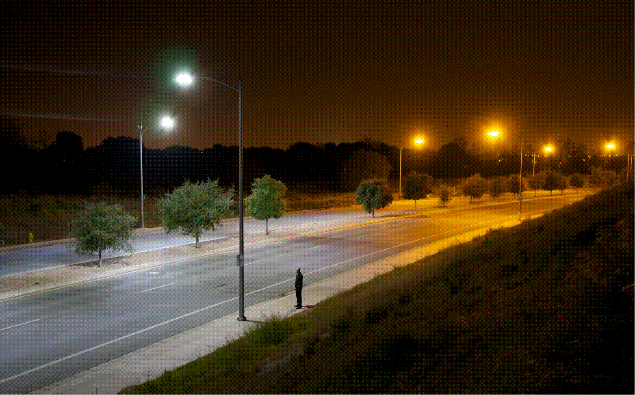
Smart LED lights Low-pressure
sodium lights
Notes:
20 more demonstrations: We have experimental solar on our City Hall rooftops, LED test lights in our building, and a new technology converting fats, oils, and grease waste (FOG) to energy at our treatment plant.
Recently, we worked with 7 companies to test new smart, dimmable LED streetlights to see how residents respond and how much money we save. We established new industry design standards and billing systems for smart dimmable lights, and deployed 3000 of them. Along the way, we’ve become the world leader among public agencies for smart street lighting, and have helped create a new market that didn’t exist.

Slide 34
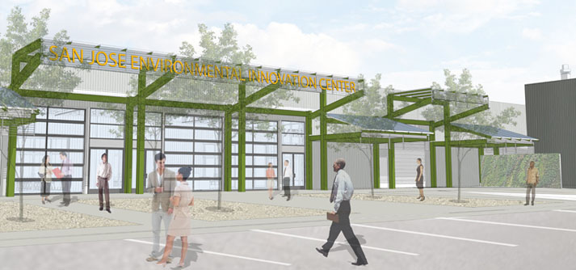
Notes:
These partnerships with startups and global corporation have worked so well that this year we’re moving from Demonstration Policy to a Demonstration Place. Opening the first facility in the nation dedicated to clean-tech demonstration. We call it Prospect SV:
So, in an era of limits and smaller government, in San Jose we’ve learned to value the assets that are unique to the public sector and use them to support growth of jobs and companies.

Slide 35
Tap OPM and OPI
4
(Harness the Power of Networks)
Notes:
INSIGHT #4: ALIGN AROUND AMBITION. (keep setting bold goals)
Despite what has felt at times like a preoccupation with budget cutting and retirement reform, we have continued to set bold goals for San Jose’s future.
We’ve learned the importance of civic ambition, as a motivator for city staff and the community especially during hard times.

Slide 36
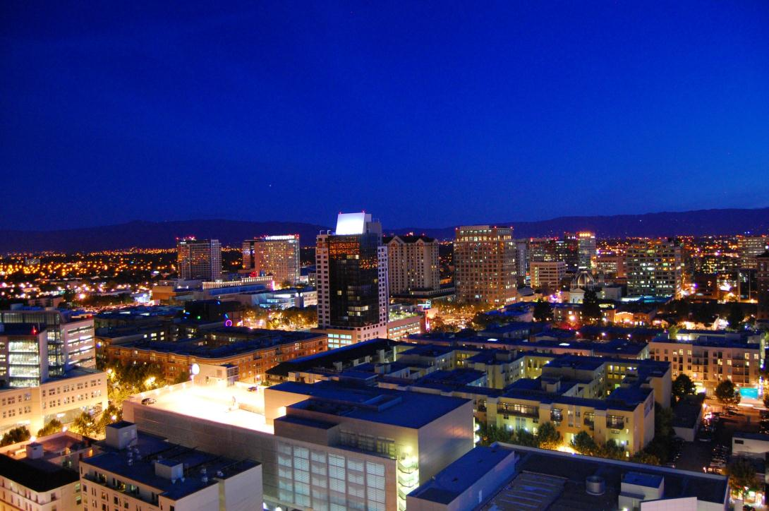
Notes:
Our Redevelopment Agency was a Goliath. Virtually every big deal downtown since the 1980s was crafted and subsidized by Redevelopment. ($1.5 billion)
Graphic: point showing everything attributable to RDA downtown (take laser pointer)
This..mid-rise housing/high-rising housing, this high-tech headquarters, hotels, convention center, parking garages, rep theater, tech museum.
“Basically, the entire photo except the sky and mountains…brought to you by Redevelopment!”
The problems with this approach started becoming clear to us even before Jerry Brown eliminated TIF funding.

Slide 37
Notes:
Our Redevelopment Agency was a Goliath. Virtually every big deal downtown since the 1980s was crafted and subsidized by Redevelopment. ($1.5 billion)
Graphic: point showing everything attributable to RDA downtown (take laser pointer)
This..mid-rise housing/high-rising housing, this high-tech headquarters, hotels, convention center, parking garages, rep theater, tech museum.
“Basically, the entire photo except the sky and mountains…brought to you by Redevelopment!”
The problems with this approach started becoming clear to us even before Jerry Brown eliminated TIF funding.

Slide 38
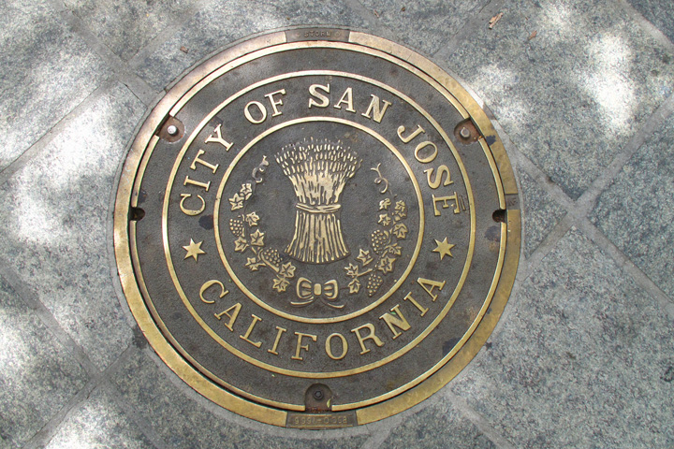
Notes:
The problems with this approach started becoming clear to us even before Jerry Brown eliminated TIF funding.
One problem was no way to maintain this beautiful downtown created by Redevelopment.
We had custom-forged brass manhole covers embedded in granite, but…!!!
No sustainable funding to keep the trees trimmed, sidewalks cleaned and graffiti cleaned up.
Solution: Downtown property owners voted to tax themselves to pay for more services;

Slide 39
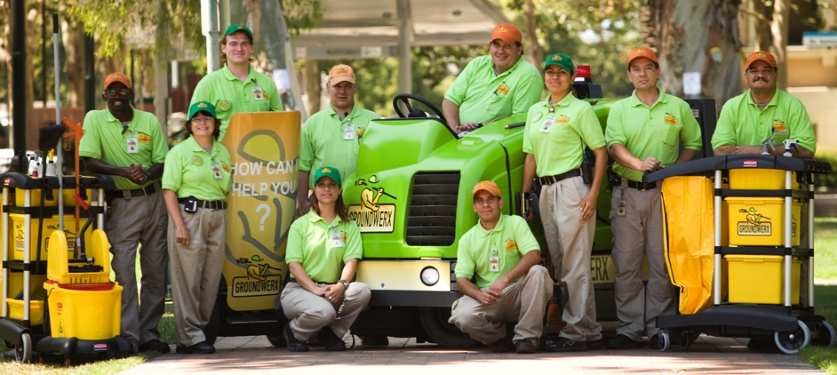
Notes:
five years ago, our Downtown Association launched Groundwerx as Property Based Improvement District. ( affectionately known as the PBID)
Their initial goal—to keep our downtown as clean as Disneyland
Well, we just celebrated the 5th Anniversary of these incredibly friendly Groundwerx Ambassadors. They have…
Picked up half-million pounds of trash
Have removed almost 100,000 graffiti tags
Beautified downtown with colorful plants and flowers
Help locals and visitors find their way around

Slide 40
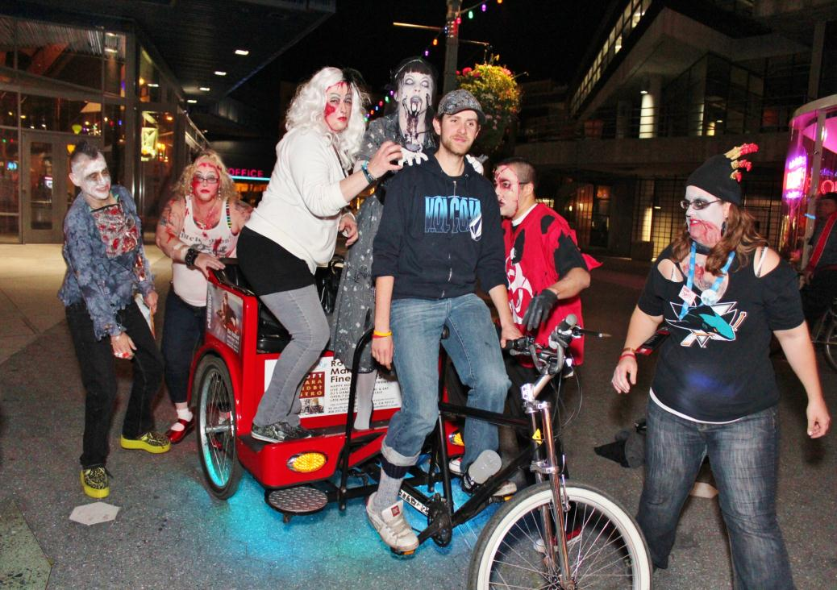
Notes:
But--they didn’t stop at clean and pretty! The PBID has become a true partner in the activation of Downtown and a true partner in economic development.
They plan and support events and activities that bring life to our streets (Zombies and pedicabs, Zombies in pedicabs!).

Slide 41
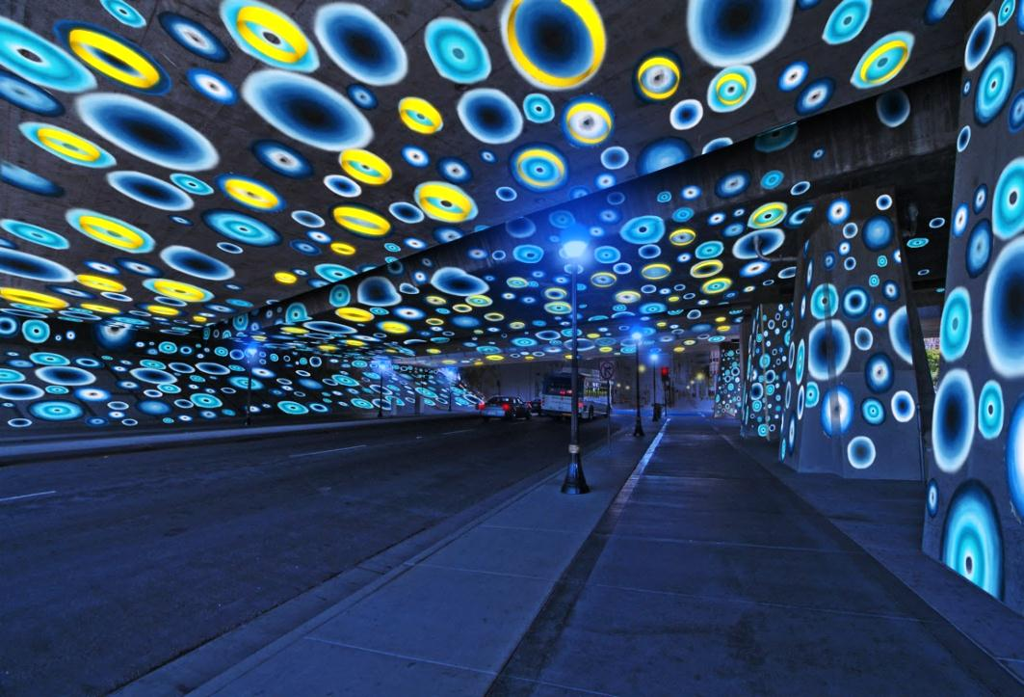
Notes:
They’re now involved in public art, like this incredible moving light installation that turns a dreary underpass on the walk to the San Jose Shark Tank into a fun, interactive experience.
And the PBID recently hired their first Economic Vitality Manager who works side by side with our economic development staff on business retention, expansion and attraction. In the first year of this partnership, we collectively met with over 300 companies—dramatically extending the capacity of City Hall economic development staff.
So, in San Jose, bad budgets have made for good partnerships.

Slide 42
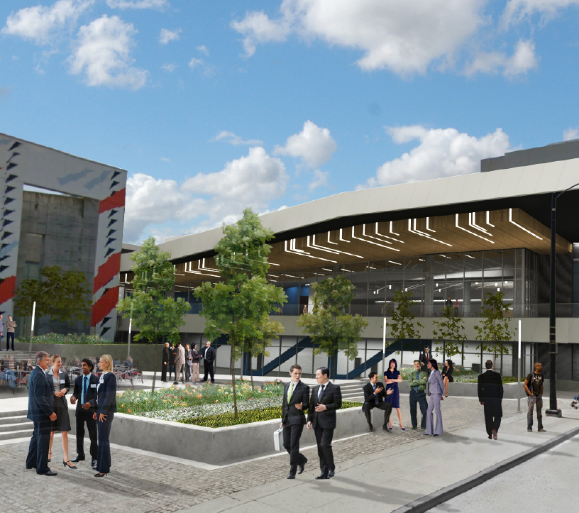
$320M
$120M
Notes:
Another Example: Expanded Convention Center
4 years ago, we made a $320 million plan to renovate and expand our 20-year-old convention Center, chiefly with Redevelopment planning and dollars
When it becomes obvious we needed to rethink this, we developed a partnership with our hotels, refocused the project and cut the budget to $120 million.
Hotels agreed to tax themselves to pay for the convention center by raising our hotel tax from 10% to 4% and bonding off the 4% revenue stream.
The project is on-time and on-budget to open this September, and will be major driver of visitor activity downtown.
So…we’ve clearly had to learn a new skill: tapping Other People’s Money. In addition to PBIDs and CFD’s, we did our first NMTC financing .(alphabet soup of financing mechanisms previously foreign to us).
But it turns out: the real value of needing to tap OPM, is becoming part of a network of players who truly own an issue.

Slide 43
Downtown
Traffic
Jobs
Safety
Arts
Neighborhoods
GOVERNMENT
Notes:
In the past, we saw our city government in the middle of all the key issues…calling the shots, making the plans, paying the bills.

Slide 44
ISSUE
Agencies
Government
Nonprofits
Businesses
Residents
Philanthropy
Notes:
Today, we’ve learned the power of stepping aside, of putting the issue in the middle, of convening others to step up, each bringing their unique resources and perspectives to the table.
In retrospect, I think the presence of a large Redevelopment Agency dampened, rather than deepened, true ownership of Downtown.
Although Redevelopment investment was critical for the first stage of downtown revitalization,

Slide 45
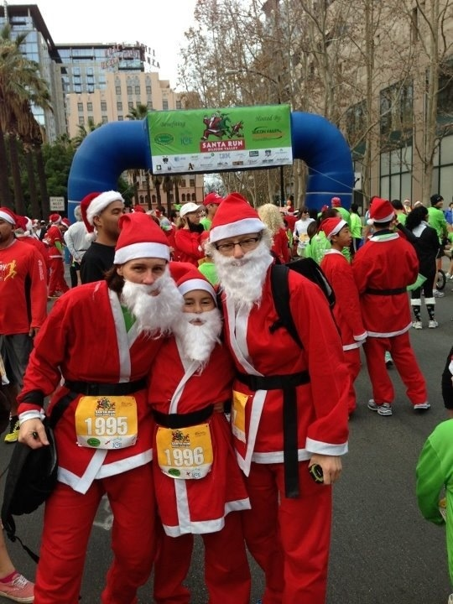
Notes:
I see our Downtown coming alive today precisely because many more people and organizations outside of city government are stepping up and passionately making downtown their own.
So, for your community, ask yourself:
Where can you tap into OPM?
Where can you step away from the center?
What might you gain if you gave up some control?

Slide 46
WORKING TOGETHER
LONG-TENURED
EMPLOYEES
CORPORATE PARTNERS
CUSTOMER
SELF-HELP
NEW (TIER 2+)
EMPLOYEES
CONTRACTOR
SHARED SERVICES
(INTER-AGENCY)
NON-PROFIT
TEMP EMPLOYEE
VOLUNTEER
Notes:
ED
ED
These groups are the key “building blocks” in constructing our future.
46

Slide 47
FLYWHEEL
.
.
.
.
.
.
.
Communicate Actions + Success
Identify Problem / Possible Solution
Focused effort
Builds momentum
Opportunities for involvement Forgives efforts that don’t work
Relies on initiative
Flexible workloads
Ideas with “Skin” in the Game
Decisions
Prioritization of Proposals
Troubleshoot Policy Issues
Develop Actions
Notes:
ED

Slide 48
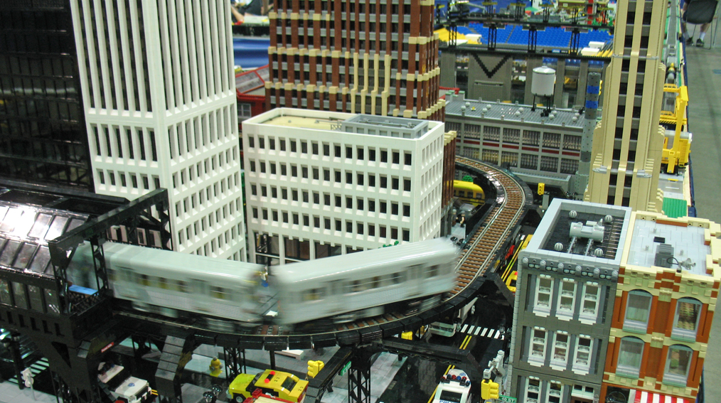
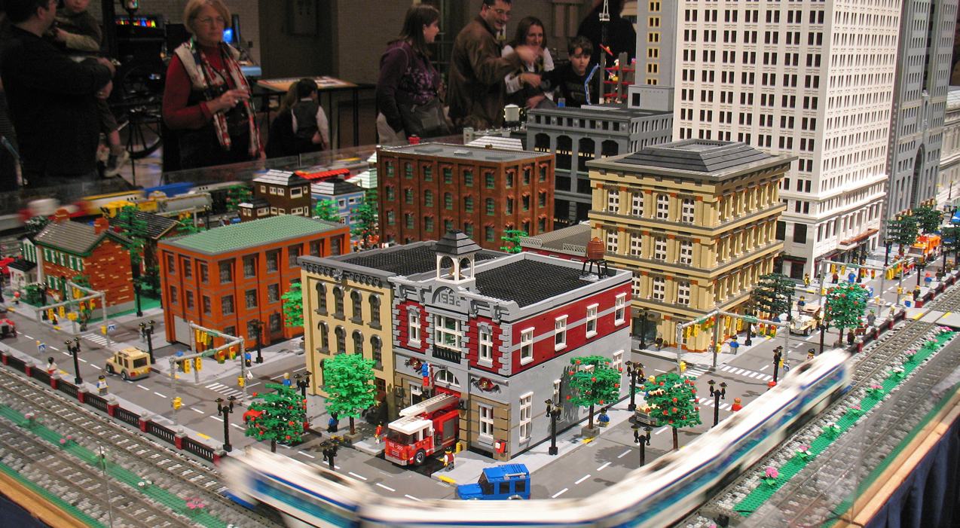
TO ACHIEVE RESULTS
Notes:
ED
48

Slide 49
Deepen the Conversation
1
(Draw Connections, Even Uncomfortable Ones)
Align Around Ambition
2
(Set Bold Goals)
Activate Unique Assets
3
(Leverage What You Have)
Tap OPM and OPI
4
(Harness the Power of Networks)
Notes:
Our city is, perhaps, like your city and perhaps like California. Hard financial times have thrown us into a transition period—where clearly we’re not what we were before, but we’re not what we will become.
Its been time of uncertainty and real challenge, but also a time full of potential
I think the San Jose story tells us that constraint, far from being an obstacle, breeds real creativity.
Its like the art of origami.
If I ask you to make a swan, and give you paper, scissors, glue, and feathers, you’ll probably give me a pretty predictable response.

Slide 50
A CULTURE OF INNOVATION FOUR INSIGHTS FROM SAN JOSE
Ed Shikada, City Manager
Notes:
SCRIPT
NEW PARTNERSHIPS FOR ECONOMIC PROSPERITY: San Jose’s Story of Civic Innovation
Where was your City at 6 years ago, in 2007? (pause)
In San Jose:
We had just completed
50

