Slide 1




Ambassador Forum
November 13, 2014
Mason Municipal Center

Slide 2


What is EMS SignPost?
An abbreviated version of a person’s health history stored online.
Includes items such as meds, chronic conditions, contact info, etc.
A unique ID is stored on a NFC chip inside a highly visible magnetic card.
First responders use a smart phone to securely access health history.
Formally introduced to the community in April of 2014 after
12 months of work of development and testing.

Slide 3
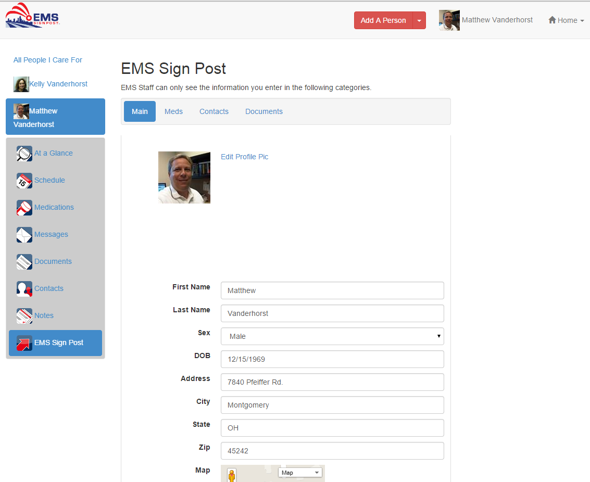

Slide 4
Development and Testing
The City and EC Link worked together to define the information needs of the EMT.
Back office processes were also developed.
First tested at a local long-term living and nursing facility with over 50 residents participating.
Notes:
The program was tested and modified over six months as a way to ensure it worked in a controlled production environment before being available to a larger population. Once it was proven that the program functioned as anticipated, it was introduced the entire community.
Fire Chief Paul Wright, along with Lieutenant Tom Wolf, worked directly with EC Link to direct the software development project.

Slide 5
Why Did We Pursue This?
Vial of Life information not updated.
EMS SignPost Information is stored electronically.
Can be managed by any approved family member.
Reminders are sent out regularly.
Fire department can view when a record was last updated.
Notes:
The problem with the Vial of Life program is that the information is written on a piece of paper and then placed in a vial…and then forgotten. Keeping the information updated has always been a problem.
Fire Department personnel review uploaded documents such as DNRs.

Slide 6
Obstacles
Early registration rates were slow.
Feedback reveled that…
  Many residents had the mentality that they will never need to call for emergency services so they don’t create an account.
  Younger families slow to adopt.
  Website was confusing and the registration process wasn’t clear.

Slide 7
Addressing the Obstacles
Promotional campaign created to reach young families. Elderly population was quick to adopt.
Simplified branding on the website.
Created a simple brochure.
Trained CERT team members to help residents with registration.
Notes:
The elderly population has been quick to embrace the concept.
A promotional campaign is currently in place to reach the young family demographic through interactions at local youth events and the community pool.
In addition, a new post card is being developed that would contain a QR code that a resident could scan and sign up immediately on their mobile device. This would get their basic information in the EMS SignPost system. The EMS SignPost manager would then contact them to set up their magnetic card and medical information.

Slide 8
Can My Community Use EMS SignPost?
The program is currently available to other communities.
As the use of EMS SignPost expands, the region will benefit by mutual aid responders having access.
Notes:
While Montgomery receives no financial proceeds from their sales, we believe that it is a very worthwhile program for communities to institute at a reasonable cost. The City not only realizes the public safety benefits to the residents, but also realizes the public relations benefit from offering the program free to the residents.

Slide 9
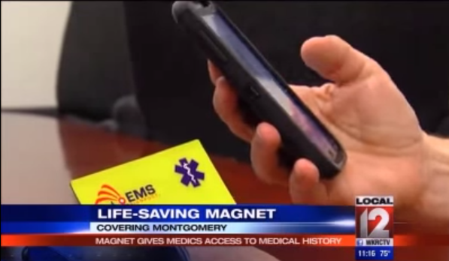
Our Three Minutes of Fame!
https://www.youtube.com/watch?v=0BXfJ5q9AQQ&feature=youtu.be

