Slide 1


Feed-in Tariff Programs:
Supporting Local Demand for Solar
Notes:
Add
Casey’s notes:
Important to stress that this TA is intended principally for local government and elected officials in addition to primary stakeholders such as local utilities and solar advocates(?).
You may want to go back and listen to Farleigh’s introduction in one of the recent webinars to make sure that we cover all the logistical items (eg all participants in listen only mode, questions can be asked through the chat box, any questions that we don’t address during the webinar will be followed up with following, etc.)

Slide 2

About the SunShot Solar Outreach Partnership
The SunShot Solar Outreach Partnership (SolarOPs) is a U.S. Department of Energy (DOE) program designed to increase the use and integration of solar energy in communities across the US.

Slide 3

About the SunShot Solar Outreach Partnership
Resource
Solar Resources Page
www.solaroutreach.org/resources

Slide 4
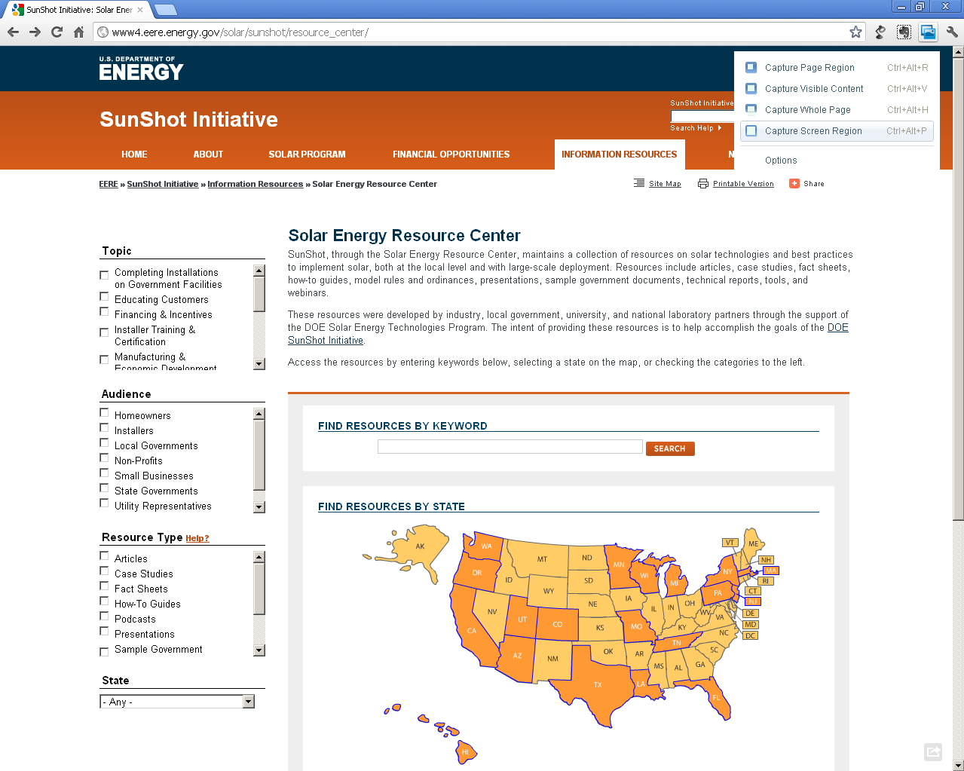
About the SunShot Solar Outreach Partnership
Resource
Sunshot Resource Center
Case Studies
Fact Sheets
How-To Guides
Model Ordinances
Technical Reports
Sample Government Docs
www4.eere.energy.gov/solar/sunshot/resource_center

Slide 5
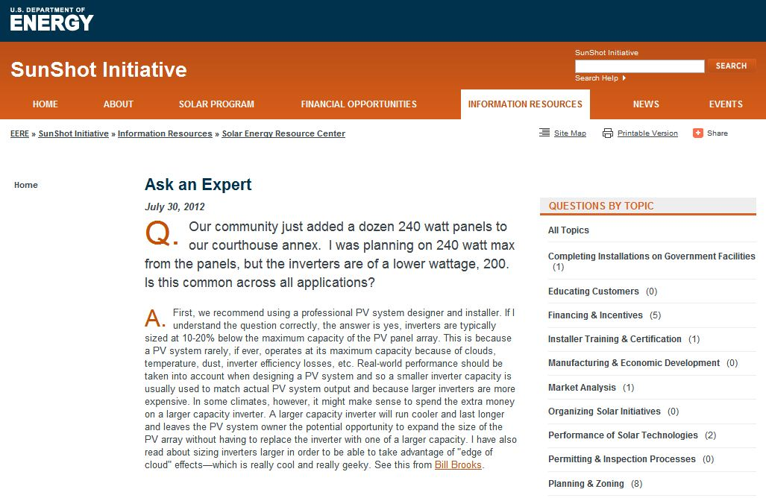
About the SunShot Solar Outreach Partnership
Technical Support
‘Ask an Expert’ Live Web Forums
‘Ask an Expert’ Web Portal
Peer Exchange Facilitation
In-Depth Consultations
Customized Trainings
www.solaroutreach.org/ta
For more information email: solar-usa@iclei.org

Slide 6
Speakers
Philip Haddix - The Solar Foundation
Chad Laurent - Meister Consultants Group, Inc.
Michael Deering - Long Island Power Authority
Leslie Libby - Austin Energy
Anh Wood - Los Angeles Department of Water and Power

Slide 7


Meister Consultants Group, Inc.
Areas of Expertise:
Clean Energy Policy
Energy Program Management
Community Engagement
Corporate Sustainability
Using global best practices to inform local decisions

Slide 8



Feed in Tariff
Feed-in Tariff
Fixed price payment
Long term contract
Guaranteed purchase
Price of generation cost
Customer
Utility

Slide 9
What is a Feed-in Tariff (FiT)?
Translation from the German renewable energy law.
Four parts “feed”:
  Utility must interconnect you to the grid
  Utility must purchase 100% of your power
  Utility must “dispatch” your power first
  Standard Contract for purchase of the electricity
One part “tariff”:
  A standard $/kWh price for all eligible generators based on cost

Slide 10


Also Called CLEAN Programs
Clean
Local
Energy
Available
Now

Slide 11
Global Installed Capacity by Policy Incentive Type:
194 GW
43 GW
Source: REN21

Slide 12
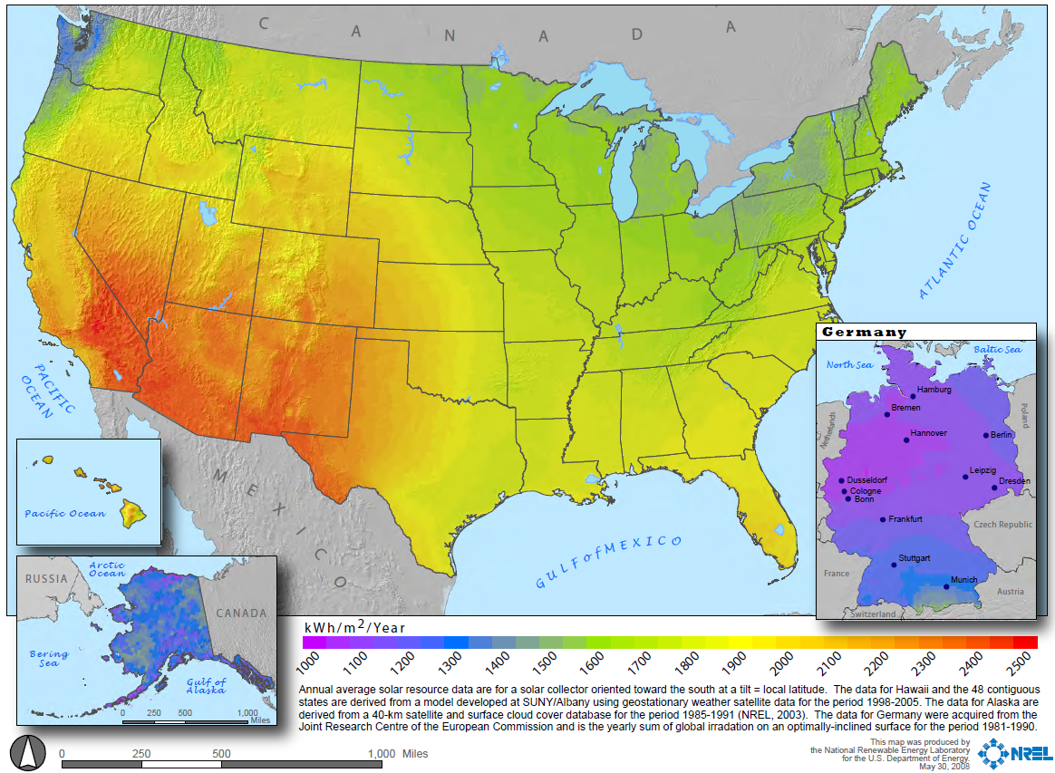
Most Famous Example is Germany
~83%
Of PV in Germany
is on rooftops
Source: National Renewable Energy Laboratory,
Statistics of the Federal Network Agency, BSW-Solar Estimates

Slide 13
First Steps in the US
17 different programs going back to 2008 totaling ~132 MW of installed capacity thus far.
Both state and municipal utility programs
Total existing programs would allow for over 1,200 MW of development
Majority of programs’ installed capacity is capped at 100 MW or fewer

Slide 14
What are the benefits?
Relatively straightforward for municipal utilities to implement
Local ownership keeps economic benefits local
Programs are relatively simple in design and execution
Can leverage private investment dollars rather than rebates or grants – lenders are familiar with long-term energy contracts
Cost of the program is known once the price is established
Helps the community meet clean energy goals
Additional benefits of Distributed Generation

Slide 15

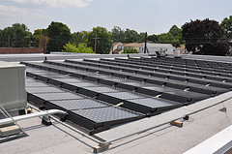
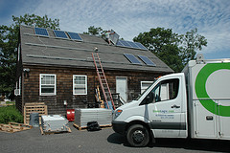
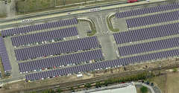

Investment in Solar Energy;
Benefitting Customers, Communities, & Businesses
Presented by
Michael Deering, V.P. of Environmental Affairs
April 10, 2013

Slide 16
LIPA Overview
LIPA is one of the largest public power utilities with a diverse and stable customer base
LIPA serves substantially all of Long Island’s electric service customers in Nassau County and Suffolk County (except for the villages of Freeport, Greenport and Rockville Center) and the Rockaway Peninsula in Queens
  2011 revenues $3.68 billion - second largest public power utility according to the American Public Power Association (“APPA”)
  1.1 million customers - third largest public power utility according to the APPA
  2011 sales totaled more than 20,000 GWh - seventh largest public power utility according to the APPA
  Record summer peak load of 5,771 MW set in August 2011
No significant single customer concentration
  Service area is largely residential (representing 54% of revenues), with a large portion of affluent households
  LIPA’s service territory has no concentrated industrial customer base
  LIPA’s largest customer, the Long Island Rail Road, accounts for less than 2% of total sales and revenue

Slide 17
2012 New York State of the State Address
“Investing in Solar While Protecting Ratepayers”
“Over the decades, we have aggressively developed our hydroelectric resources and are making great progress in tapping our land-based wind resources. Now it is time to focus more attention on exploiting our solar potential that is designed to meet both goals of expanding production of solar energy and protecting the ratepayer,” -Governor Andrew Cuomo
The Governor, in his State of the State Address called for:
Increased competitive procurement of large, commercial sized solar projects
Expand rebate programs for residential & commercial small-to-medium systems
The NY-Sun Initiative will be capable of doubling the customer-sited photovoltaic capacity that was installed in 2011
By 2013, it is estimated that the NY-Sun Initiative will quadruple 2011 capacity

Slide 18
LIPA’s Renewable Programs
Solar Pioneer and Solar Entrepreneur Programs - Since its inception in 2000, LIPA has rebated over 5,900 solar installations totaling over $141 million in rebates for Solar Pioneer and Solar Entrepreneur participants. In 2012, the ability for commercial renewable installations were able to remote net meter, and residential solar leasing was authorized in December
Backyard Wind - As of December 31, 2012, LIPA’s Backyard Wind Program has rebated $718,087 for 15 wind installations totaling 340 kW of installed capacity
Solar Carports and LI Solar Farm - During 2011 and 2012, solar carport projects, comprising a total of 12.8 MW capacity, were completed. These carports are in addition to the 37 MW solar installation at Brookhaven National Laboratory that was completed in 2011
CLEAN Solar Initiative Feed-In Tariff - In July 2012, LIPA launched New York State’s first feed-in tariff for solar at a price of $0.22 per kWh

Slide 19
LIPA’s Current Solar Photovoltaic (PV) Initiatives
Solar Pioneer & Solar Entrepreneur Programs (1% peak load) ~50 MW
  Rebates and net metering for residential systems
  Rebates and net metering and remote net metering for commercial customers
  More than 5,000 customers enrolled
  Projected to grow to 78 MW (AC nameplate) by the end of 2015
  Increased net metering limit by an additional 2.0% of peak demand adding 100 MW of potential capacity
Long Island Uniform Solar Code (LIUSPI)
Smart Grid Route 110 Solar Panel Project at LIPA Substations
Utility Scale Solar Projects ~50 MW
  Long Island Solar Farm (BP Solar) at Brookhaven National Laboratory
  Eastern Long Island Solar Project (enXco) carports on Suffolk County parking lots
CLEAN Solar Initiative (feed-in tariff aka standard offer) ~50 MW

Slide 20
LIPA’s Utility-Scale Solar Initiative
This is the Largest Solar Energy Project in New York State
  Through a Request for Proposals issued in 2008, LIPA, working with its public and private partners, has nearly completed a 50 MW utility-scale solar generation project
Long Island Solar Farm (developed by BP Solar)
  32 MW of solar energy located at Brookhaven National Laboratory
  Two large-scale arrays on approximately 165 acres
  Laboratory-dedicated Solar Research Facility
  Among the largest solar projects on Federal Land in the United States
Eastern Long Island Solar Project (developed by enXco)
  Up to 17 MW of solar energy on Suffolk County-owned properties
  Solar energy systems being installed on newly built carports within existing parking lots

Slide 21
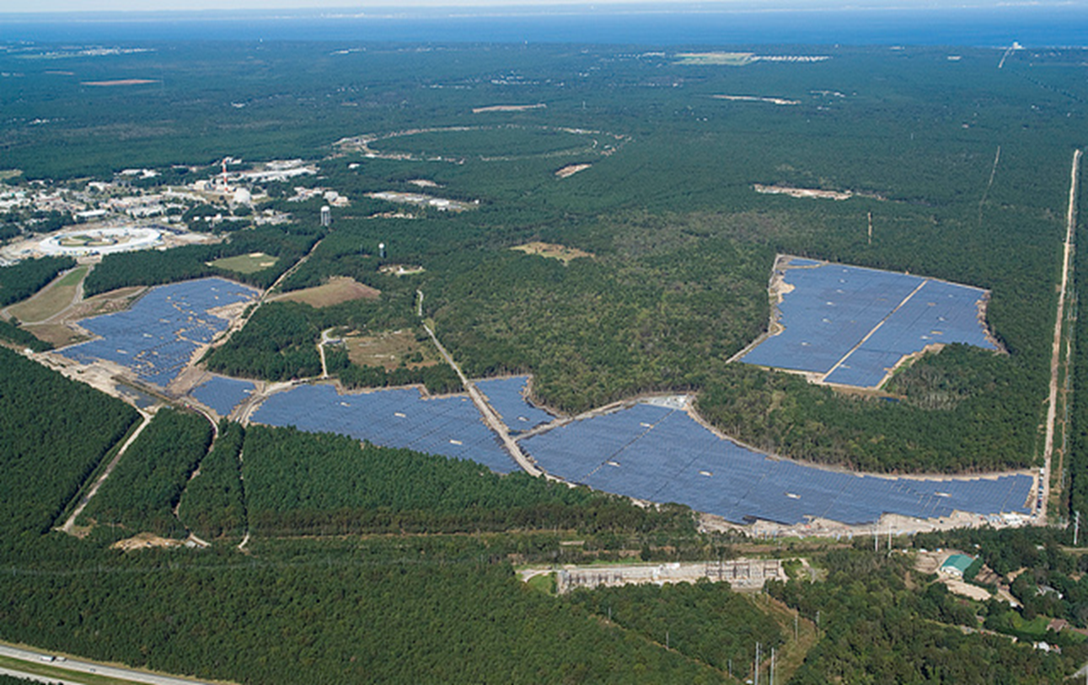
Long Island Solar Farm at Brookhaven National Laboratory (32 MW)
Arrays
Substation

Slide 22
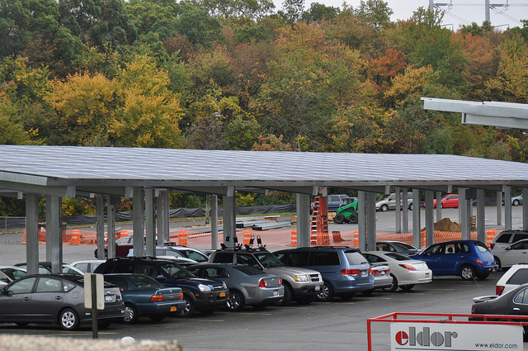
Solar Carport (portion) at H. Lee Dennison Parking Lot, Suffolk County (up-to 17 MW)

Slide 23
LIPA’s CLEAN Solar Initiative (feed-in tariff)
LIPA’s CLEAN Solar Initiative is a feed-in tariff program (aka, standard offer) in which the owner of an eligible solar photovoltaic (PV) electric system is paid a fixed rate for every solar kilowatt hour generated over the 20-year term of a Power Purchase Agreement between the owner and LIPA
LIPA’s CLEAN Solar Initiative is New York State’s first feed-in tariff program and consistent with Governor Cuomo’s call to expand solar energy in the State
All of the energy that is produced from solar arrays installed through LIPA’s CLEAN Solar Initiative will be fed into the grid and the customer will be paid only for the energy produced
The feed-in tariff or “standard offer” has been used successfully by other utilities in the United States, Canada, and Europe to encourage solar PV projects and increase the production of renewable energy

Slide 24
Why Use CLEAN Solar Initiative (feed-in tariff) to Invest in Solar Energy?
Help meet Governor’s goal of quadrupling customer-sited PV that was installed in 2011 by 2013
Expand development of larger solar systems on Long Island and diversify LIPA’s energy portfolio – current rebate program limits size to 10 kW for residential systems and 100kW for commercial and not-for-profit systems
Pay for the actual performance of the solar arrays over a 20-year term
Enable developer to get project financing through use of LIPA Power Purchase Agreement (PPA)
No lost revenue impact associated with net metering or remote net metering
Viewed favorably by Long Island solar contractors
Facilitates solar energy growth in manageable sized tranches

Slide 25
Overview of CLEAN Solar Initiative (feed-in tariff) Documents
LIPA’s Tariff for Electric Service
  Establishes the CLEAN Solar Initiative program
  Authorizes rates, terms, and conditions for participation
Interconnection Agreement
  Allows generator to attach to LIPA distribution system
  Requires generator to maintain equipment and operating standards
  Requires generator to pay the cost of interconnection
  Requires generator to pay for system upgrades (if any)
Power Purchase Agreement
  Provides certainty on revenue stream to developer/generator to support financing of the solar generation
  Specifies outer limit on commercial operation date or agreement expires
  Terms of Power Purchase Agreement are not negotiable

Slide 26
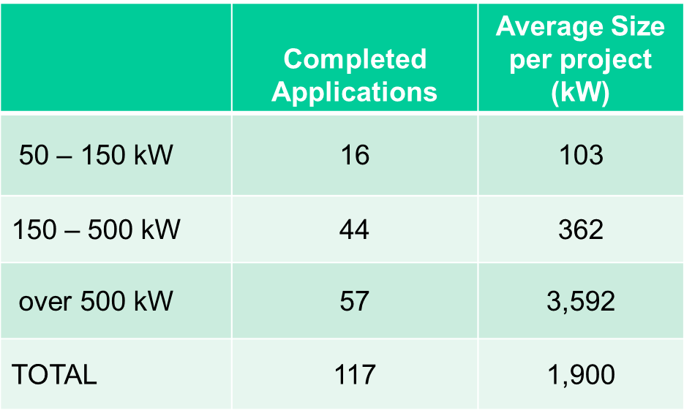
CLEAN Solar Applications Received
(July 16, 2012 – October 19, 2012)
Many of the category 2 projects and all of the category 3 projects will require detailed interconnection studies before being authorized and entering into a PPA

Slide 27
LIPA’s CLEAN Solar Initiative – Lessons Learned
Consider alternate pricing mechanism
  Price could vary by size of project, or geographic location
  Consider having applicants submit price bids
Consider better identifying those projects that are of “best value” to LIPA
  Target specific areas on the T&D system
Streamline the process with Small Generator Interconnection Procedure (SGIP)
Consider municipal timing and availability issues
  Municipal customers generally need more time to respond
Consider limiting the size of the projects
  Large projects over 2.0 MW require longer and more involved review of potential interconnection

Slide 28
LIPA’s CLEAN Solar Initiative II Goals & Objectives
Get best customer benefit from CSI-II
Provide availability for municipalities to participate
Streamline interconnection process
Focus on distribution of projects on Substation & Transmission constrained areas in service territory
Eliminate “land rush” application process

Slide 29
Differences Under Consideration Between CSI-I & CSI-II
CSI-II Policies Under Consideration….
Price reduced to reflect more favorable market conditions
Carve-out for municipal projects
Geographically targeted to load constrained areas
Size limited to 2MW per application
Application to FIT queue and then SGIP queue (FIT-I was opposite)
Potential limit to number of applications awarded per entity

Slide 30
Austin Energy’s
Residential Solar Rate
Leslie Libby
Austin Energy
Manager of Solar Incentive Programs

Slide 31
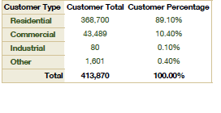
Austin Energy - Overview
Austin Energy Service Area
Austin Energy Customer Profile

Slide 32
Projected Overall Generation Portfolio

Slide 33
AE Solar Goal – 200 MW by 2020
2020 Utility Scale Solar Goal 175 MW
  30 MW PPA at Webberville
2020 Distributed Solar Goal 25 MW
  Residential – 7.0 MW
  Commercial – 1.4 MW
  Municipal and Schools – 1.0 MW
  TOTAL – 9.4 MW

Slide 34
Installed Cost of Distributed Solar

Slide 35
Residential Solar Programs
Residential Rebate $2.00/Watt
Average Installed Cost for March 2013 - $3.28/Watt
  SEIA Q2 2012 Report - Austin had the lowest installed cost in the nation ($3.88/W-DC)
FY04-FY12 Participation - 1918
FY13 Participation Goals - 660
Migrated all solar customers from Net Energy Metering to the Residential Solar Rate on October 1, 2012
Residential Solar Rate with a VOS of $0.128/kWh

Slide 36
Traditional Net Metering
Pros
  First step by utilities to recognize that the solar energy value is at least as much as a unit of energy delivered by the utility
  Easily administered
Cons
  Assigns retail value to solar energy – not representative of the true value of solar
  No provision to allow utilities to recover full cost of serving solar customers
  Excess generation is commonly undervalued at the “avoided cost” rate
  Tiered rate structures create variable solar values.

Slide 37
Application of the Residential Solar Rate
Customer pays for total consumption at applicable residential rate, plus applicable charges & adders as any other residential customer
Austin Energy credits customer for solar production at value calculated using “Value of Solar” (2012 VOS is $0.128/kWh)
Credits may be applied to all Austin Energy charges
Credits roll forward month to month until the end of the year at which time any carry over credit resets to zero
Value of Solar Algorithm is reassessed and applied to the Residential Solar Rate annually

Slide 38
Residential Solar Credit SOLAR VALUES
Energy: PV replaces energy produced by marginal unit in real time; PV value is based on cost of energy it replaces
Capacity: PV hourly kW contribution to system multiplied by the capital cost of installing a new gas turbine
T&D Deferral: Expense savings due to adding distributed PV which can defer future T&D capital investments; T&D deferral benefit is location-specific
Loss Savings: PV produces electricity at point of consumption eliminating need for supplemental energy to cover T&D losses
Environment: Based on customer willingness to pay premium prices for green power in Texas

Slide 39
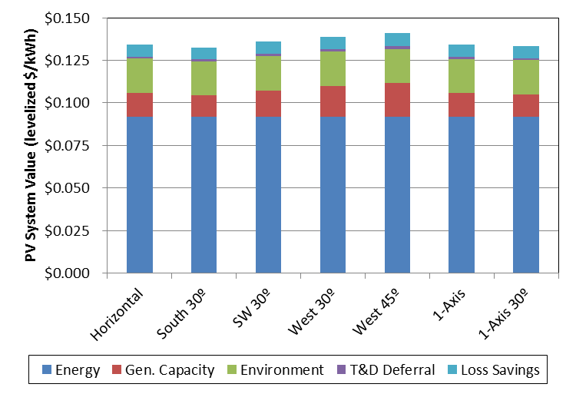
PV Value Results by Component and Configuration

Slide 40
Lessons Learned
Take time to educate stakeholders including:
  Customers
  Solar Advocates
  Local Solar Installers
Make sure the billing system can handle ALL aspects of the tariff
  Solar carry over credits were applied to other services such as water and resource recovery
    Two bills are now sent to solar customers
    We are considering converting $$ credits to kWh credits
Consider allowing credits to accrue indefinitely

Slide 41


Contact
Austin Energy– Solar Incentive Programs
811 Barton Spring Rd.
Austin, Texas 78704-1194
p. 512-482-5390
e. leslie.libby@austinenergy.com
Questions?
Twitter
@austinenergy
Facebook
facebook.com/austinenergy

Slide 42


Slide 43
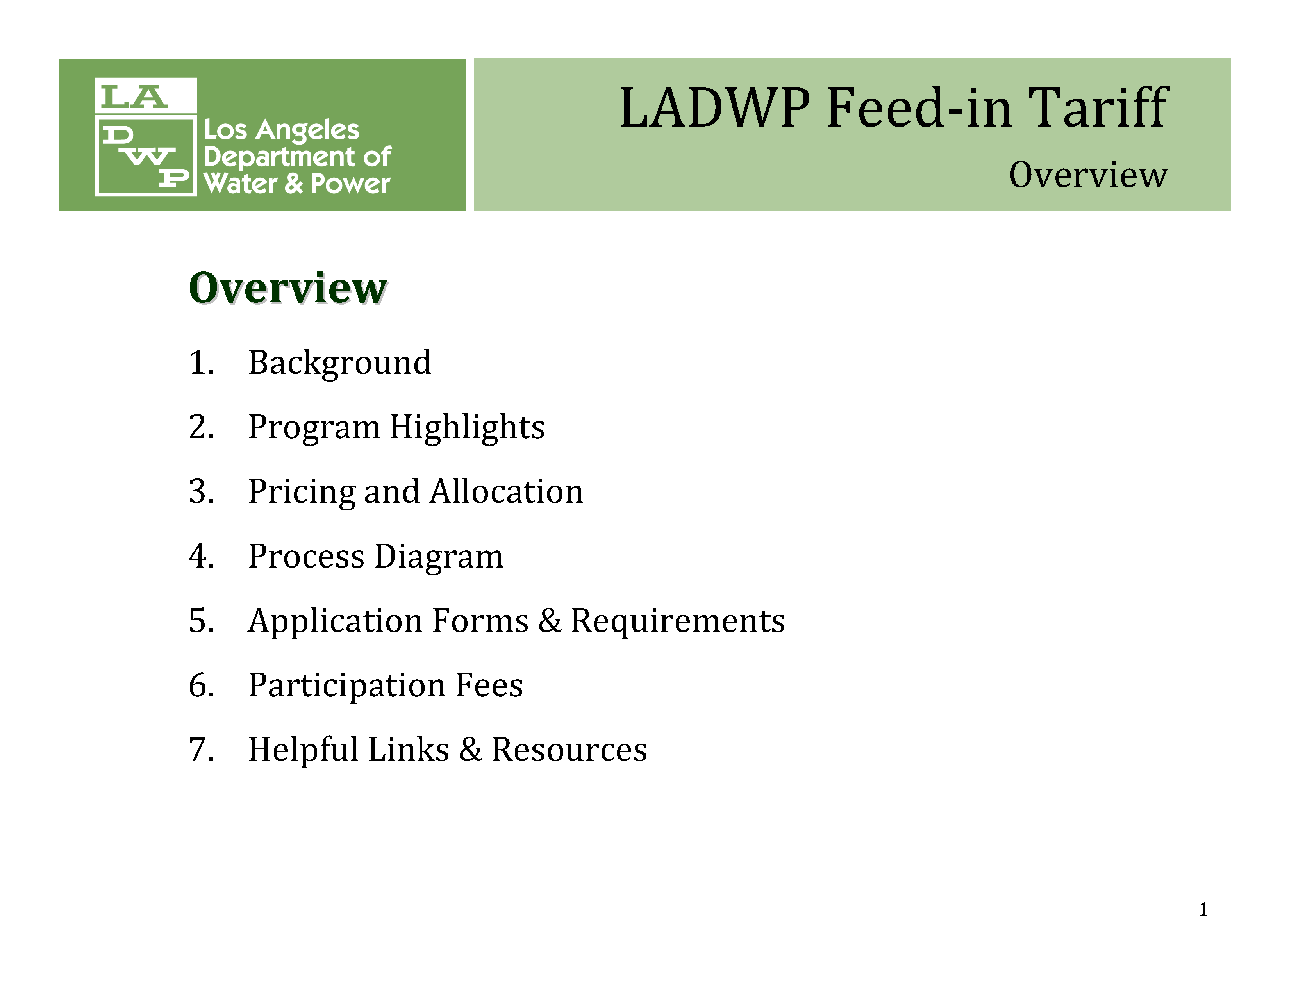

Slide 44
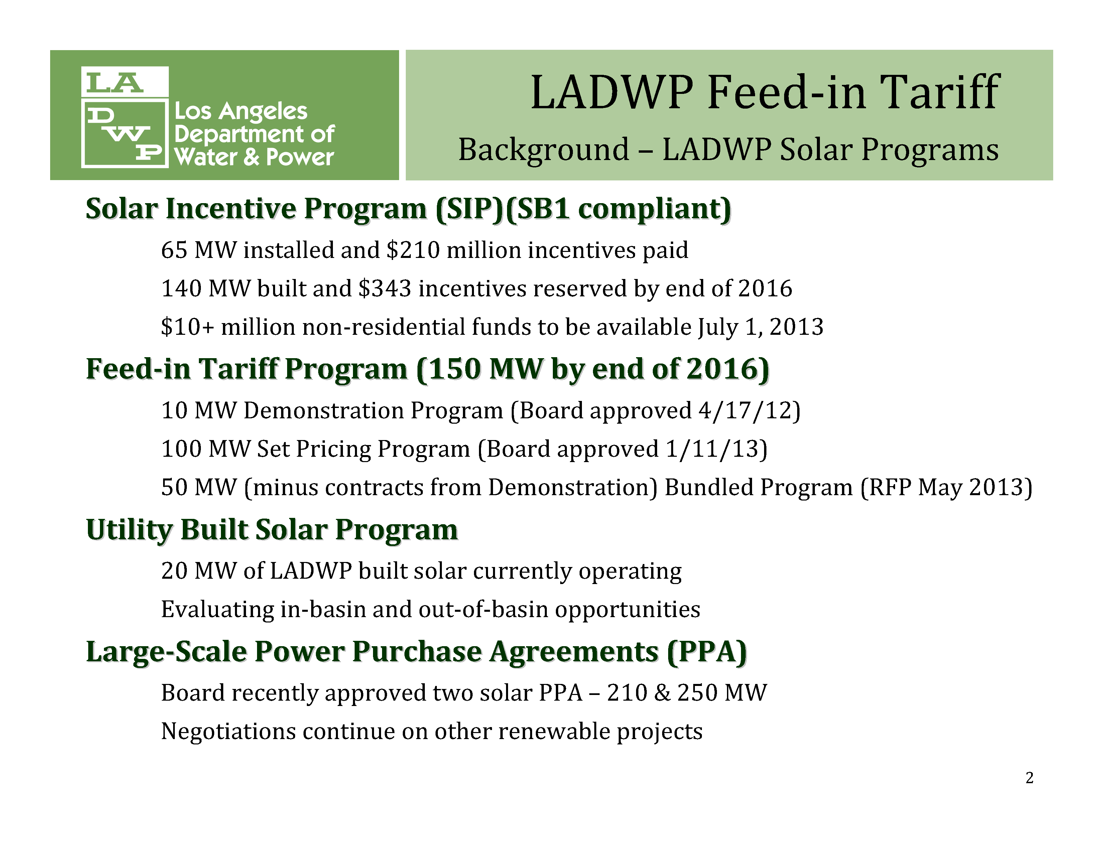

Slide 45
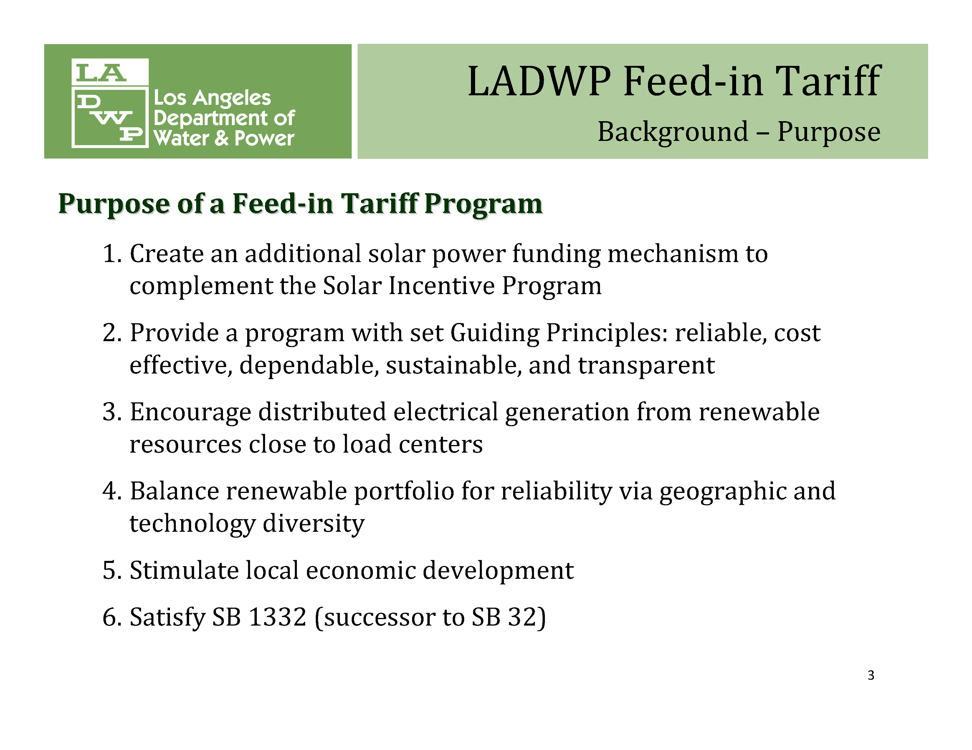

Slide 46
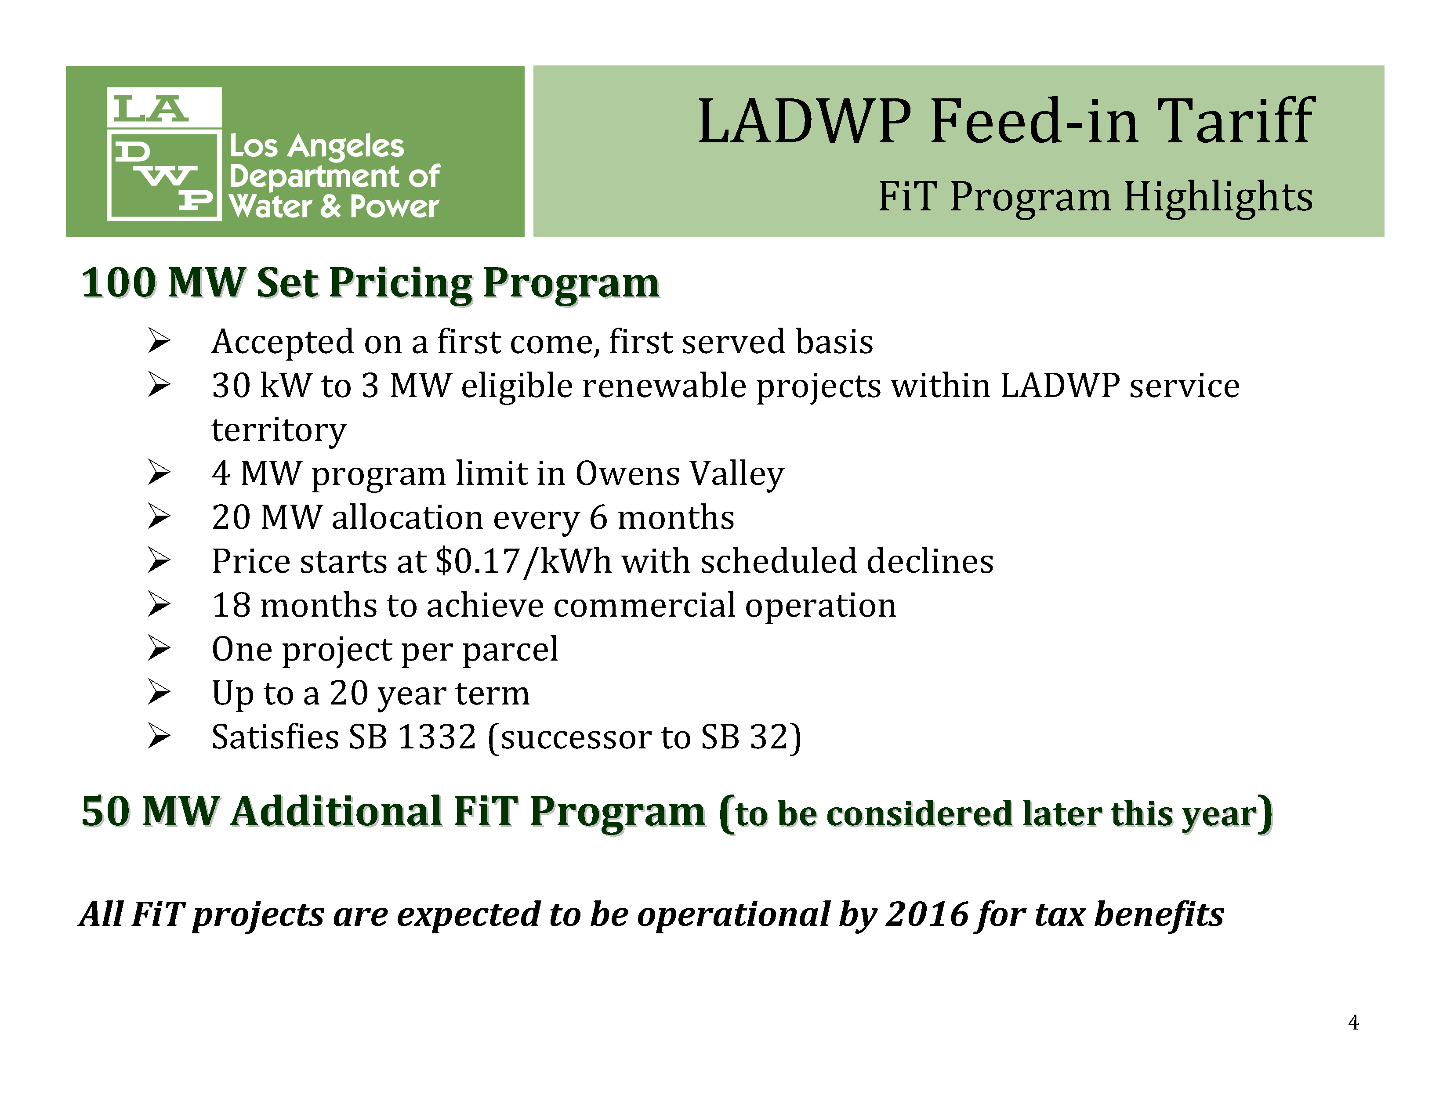

Slide 47
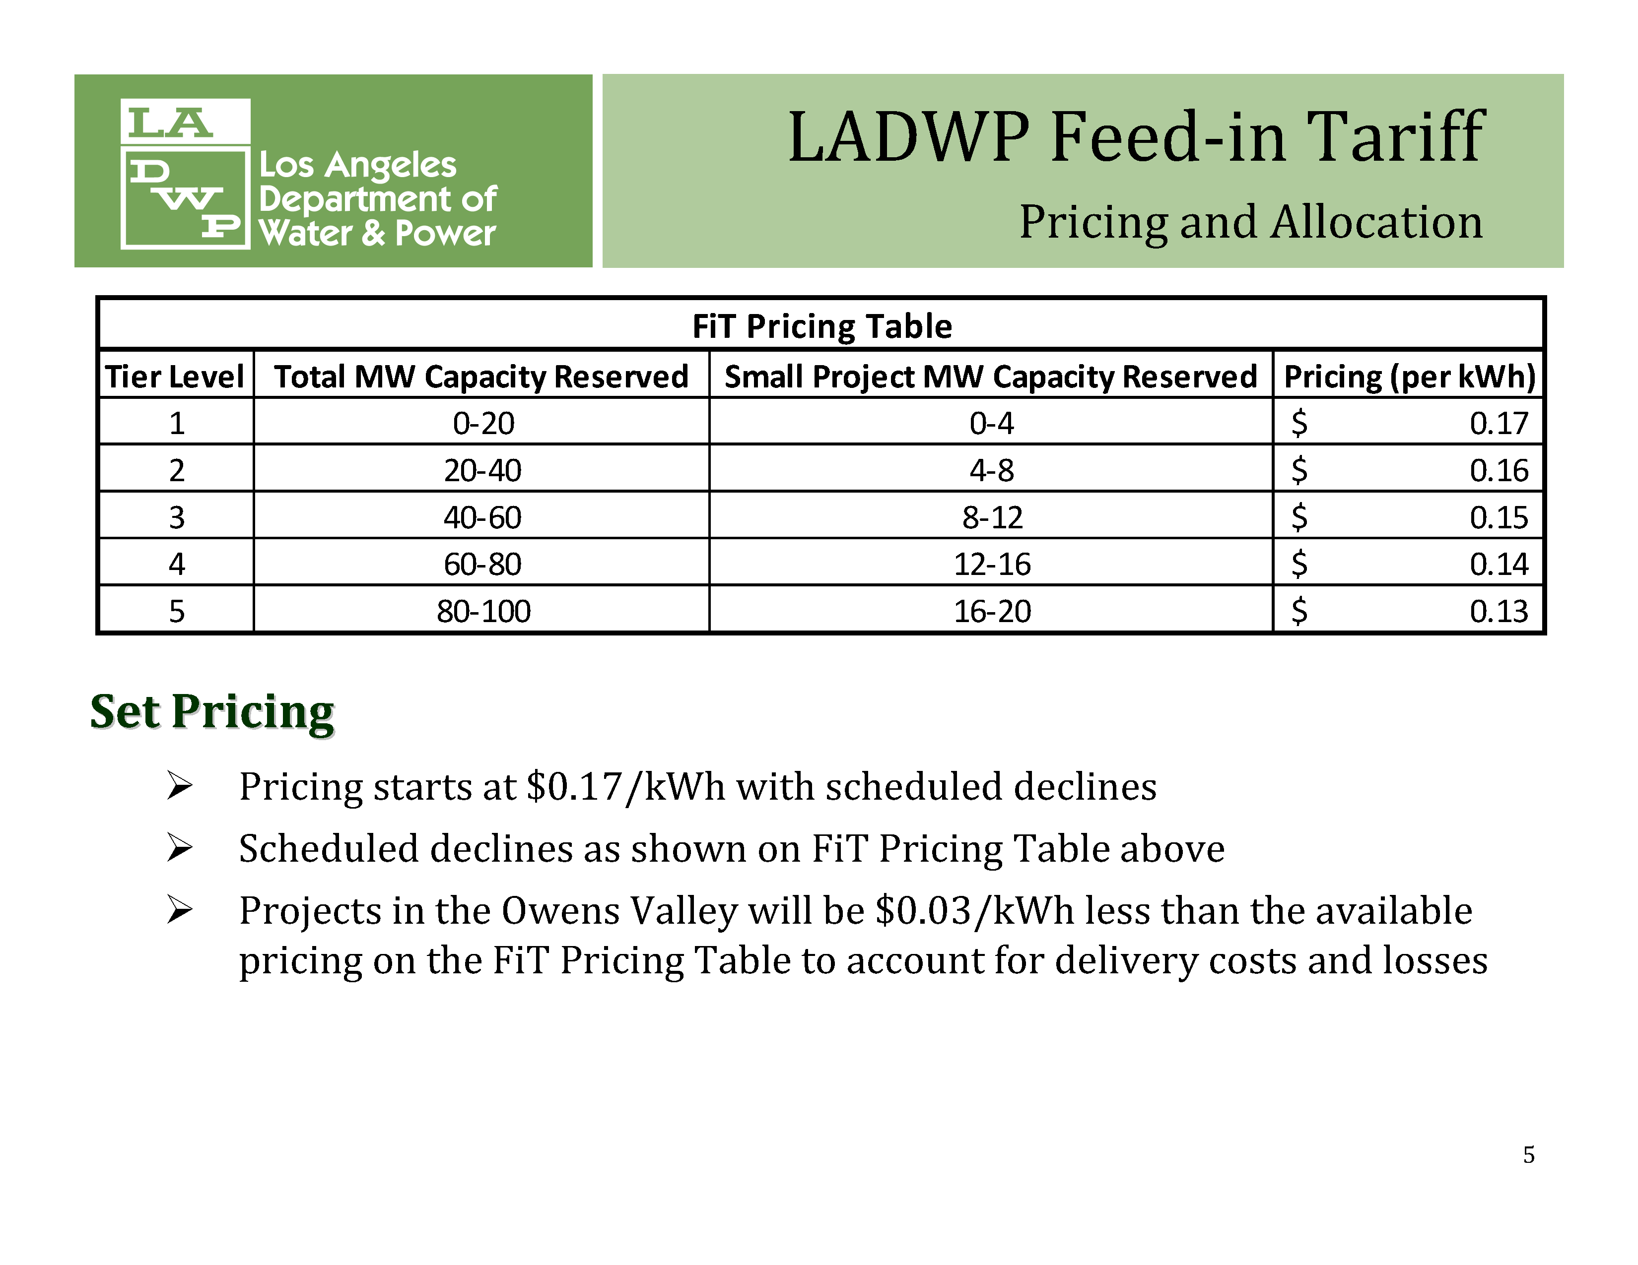

Slide 48
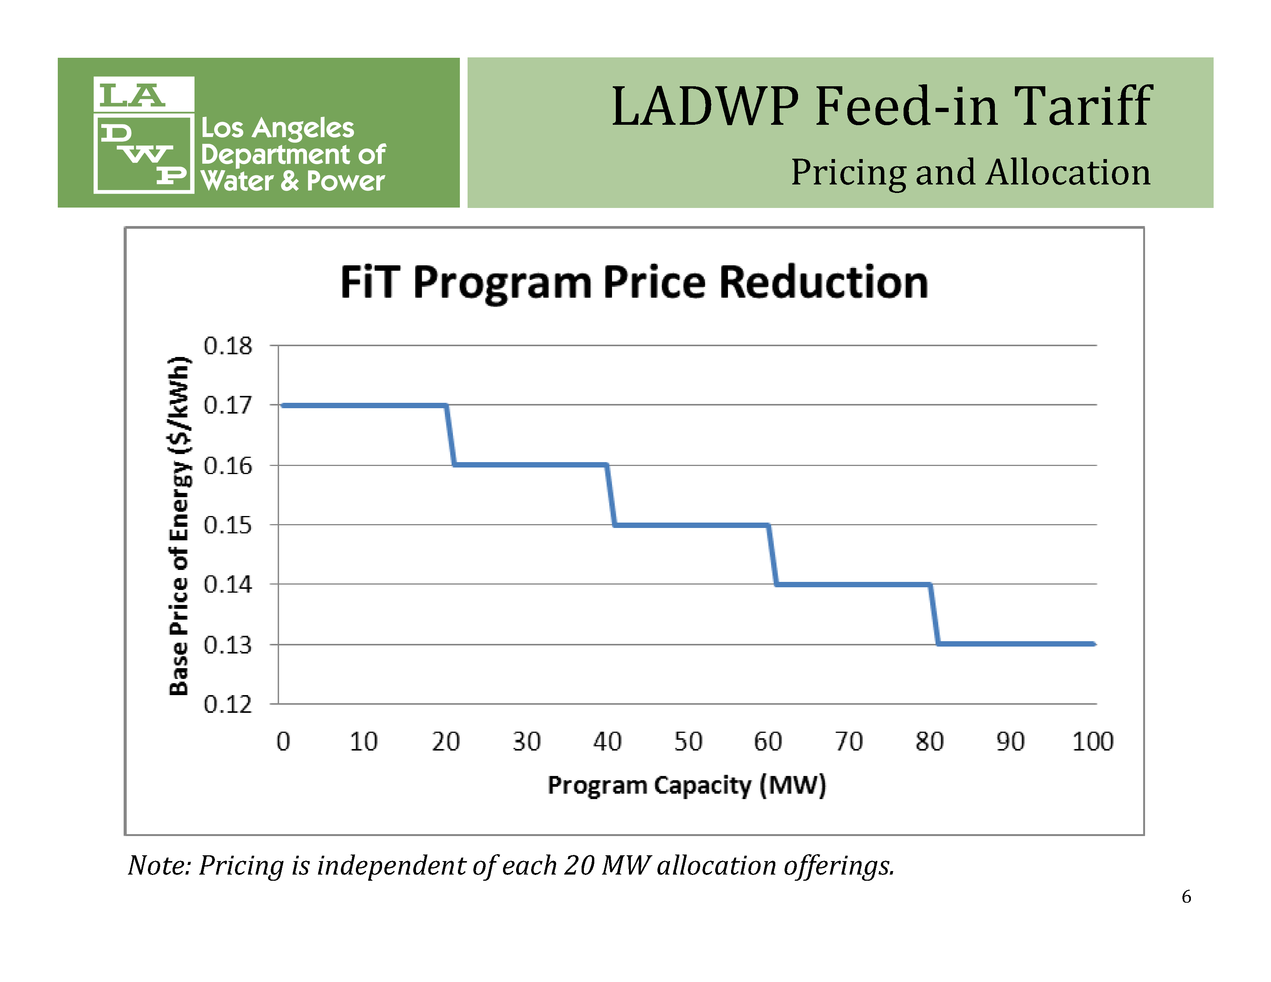

Slide 49
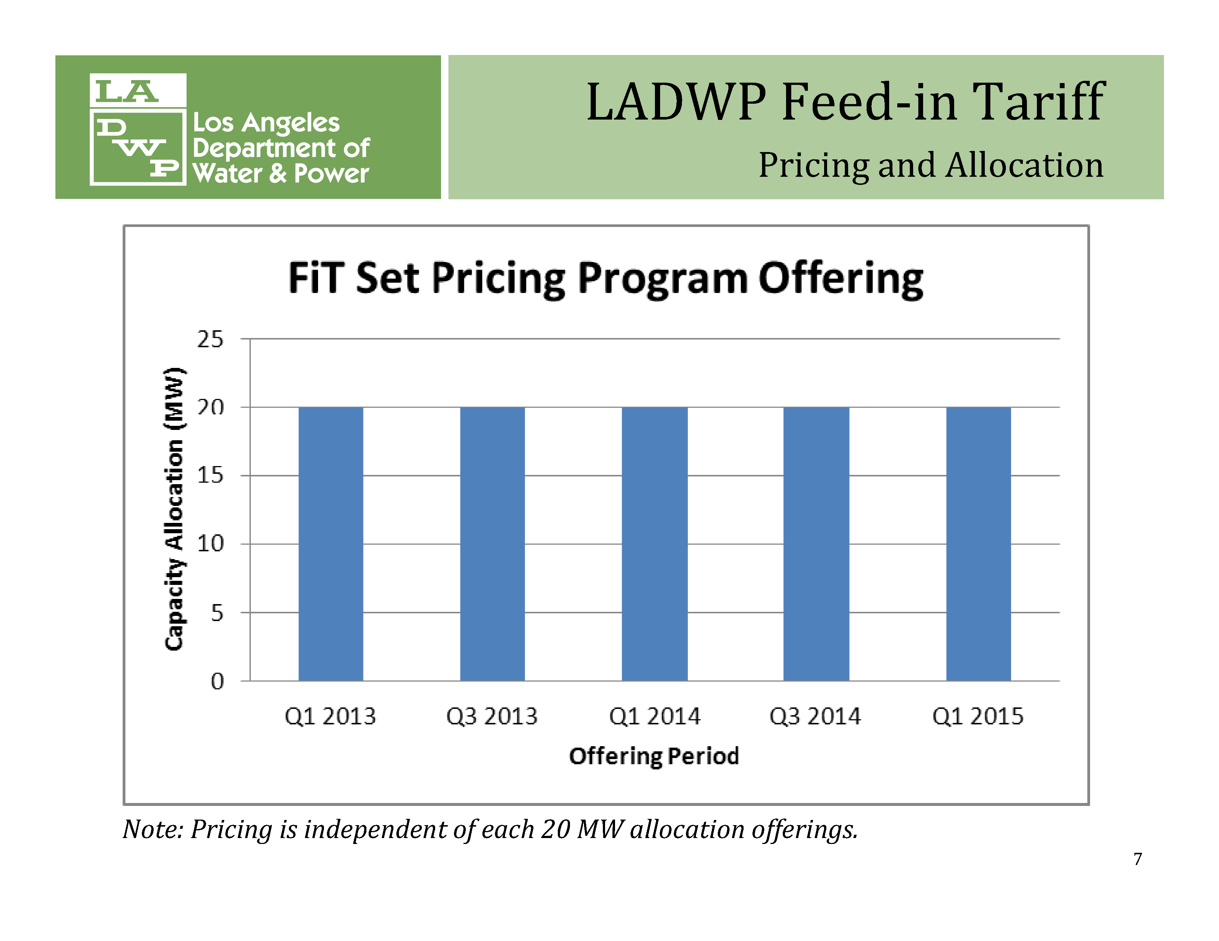

Slide 50
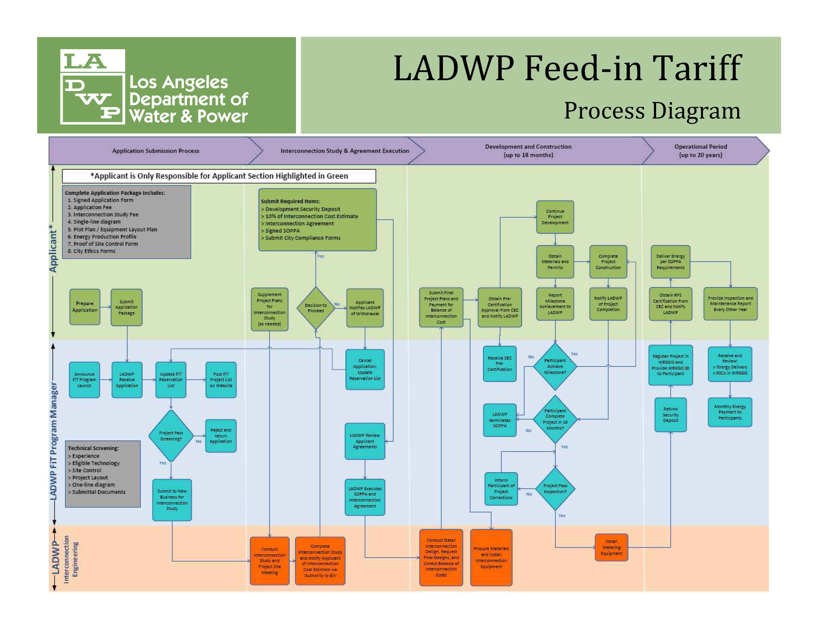

Slide 51
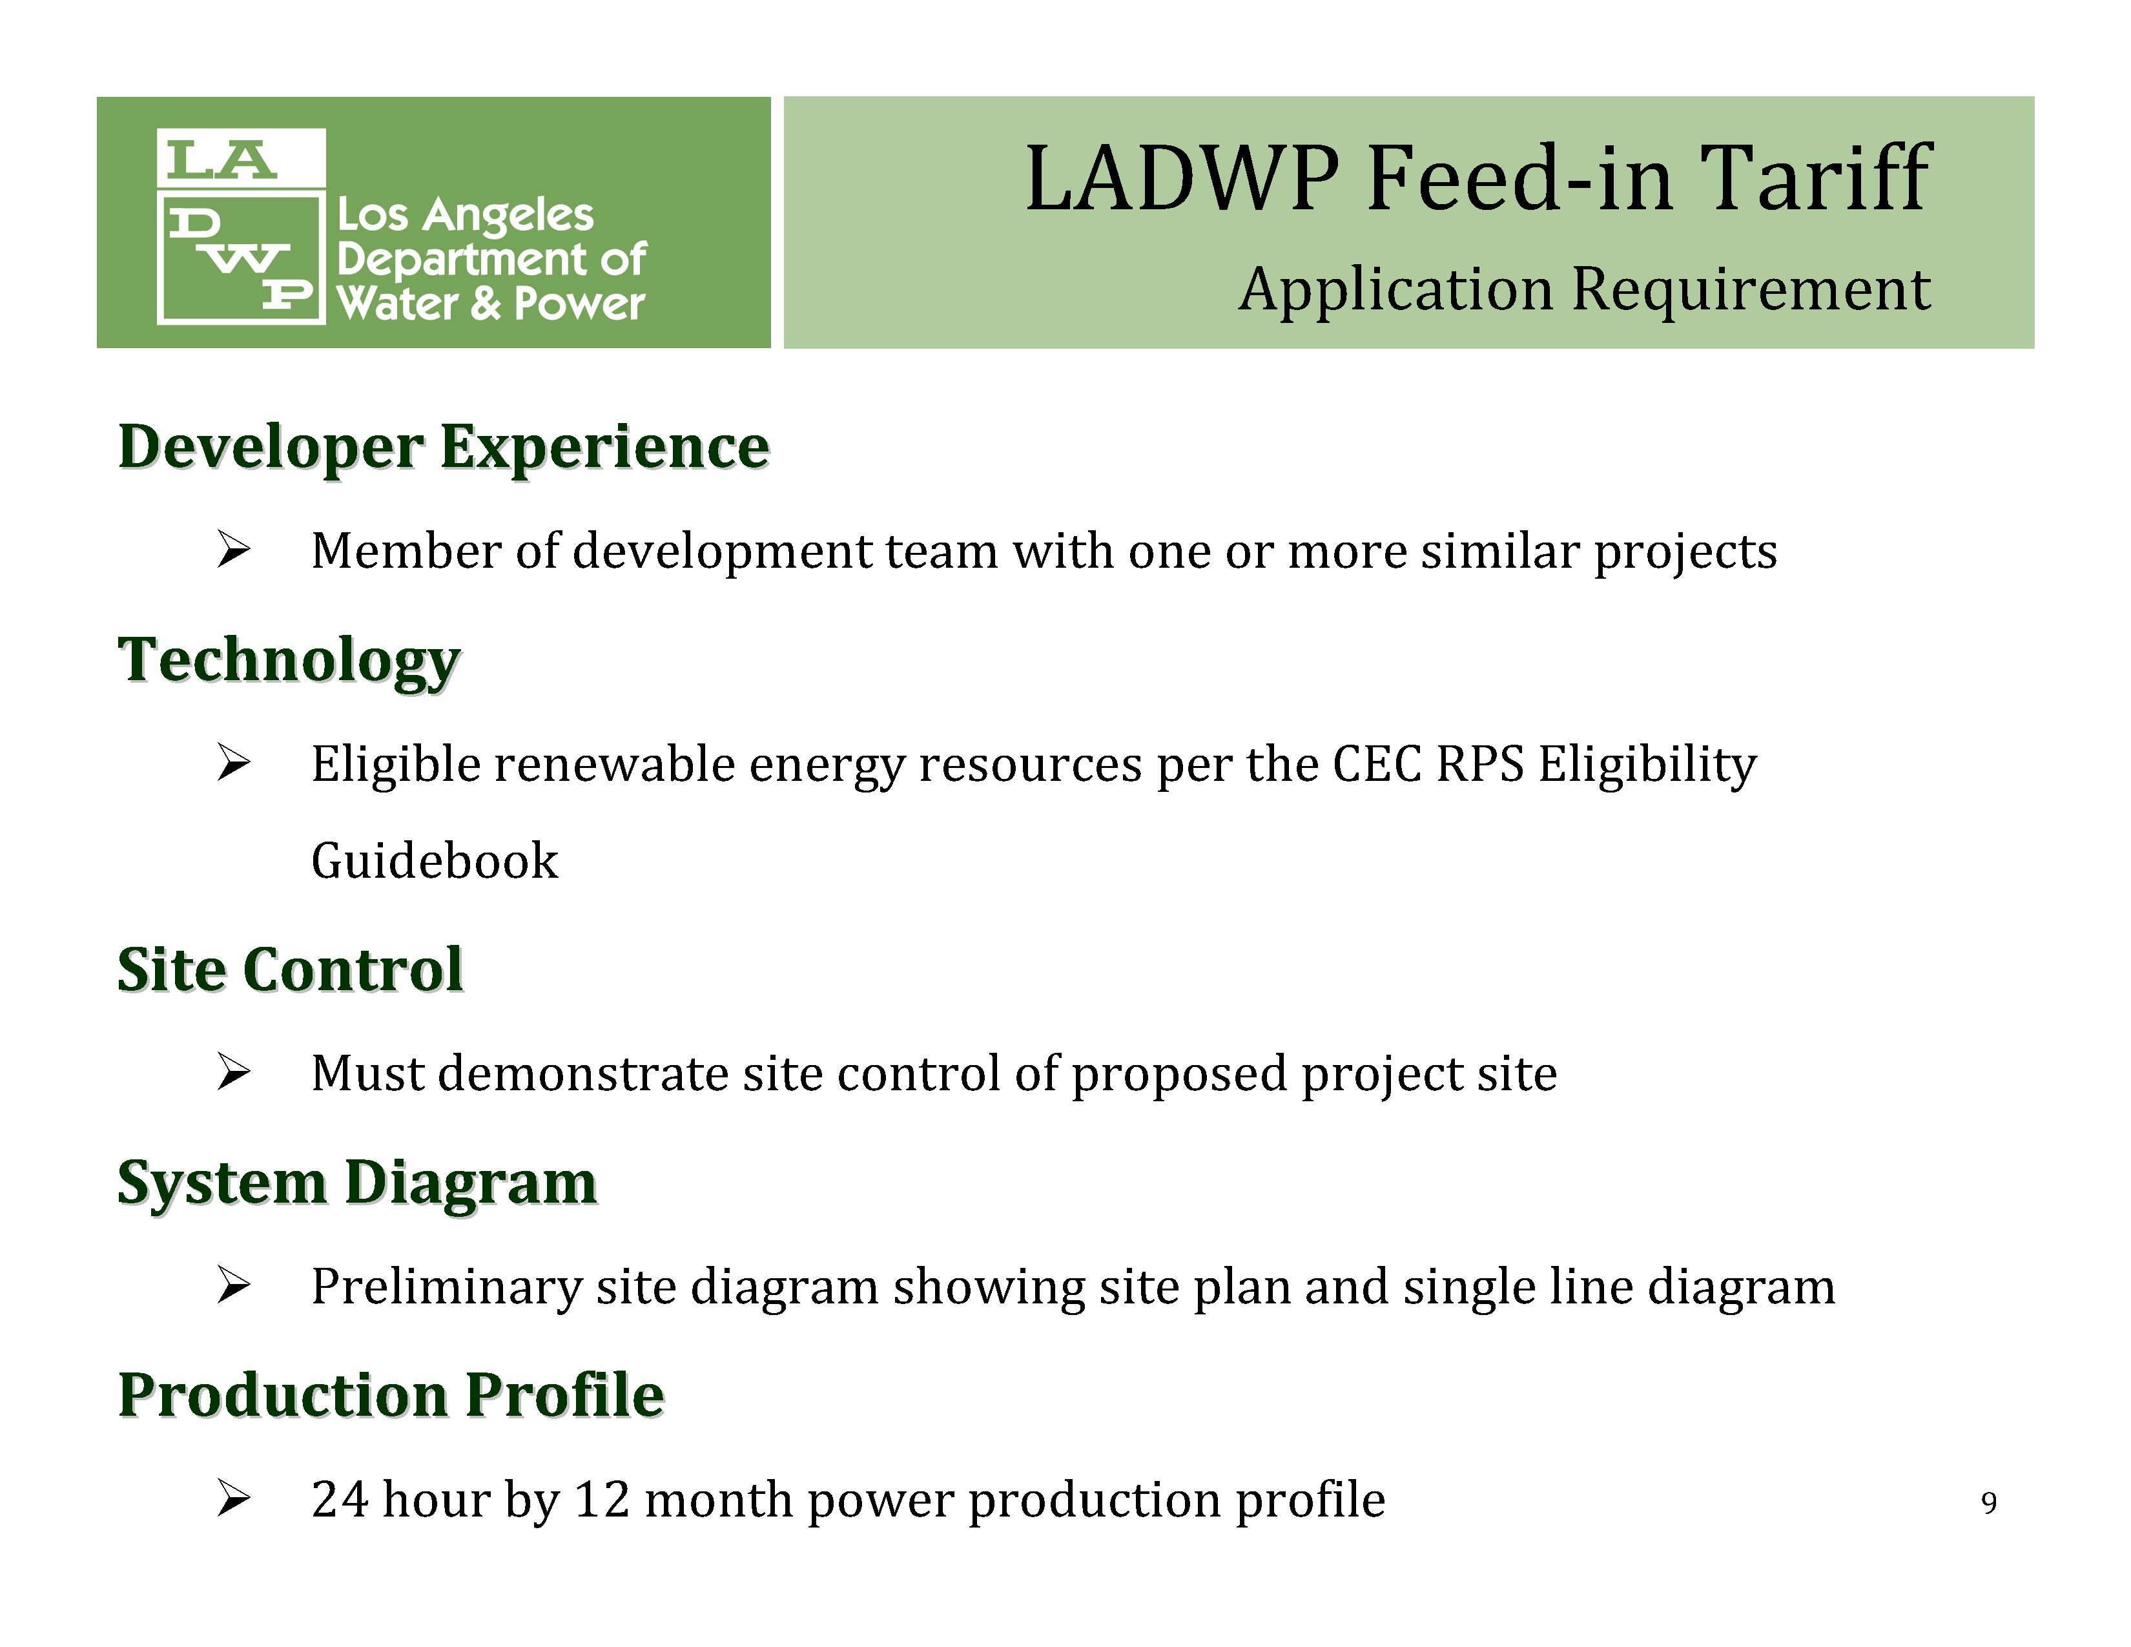

Slide 52
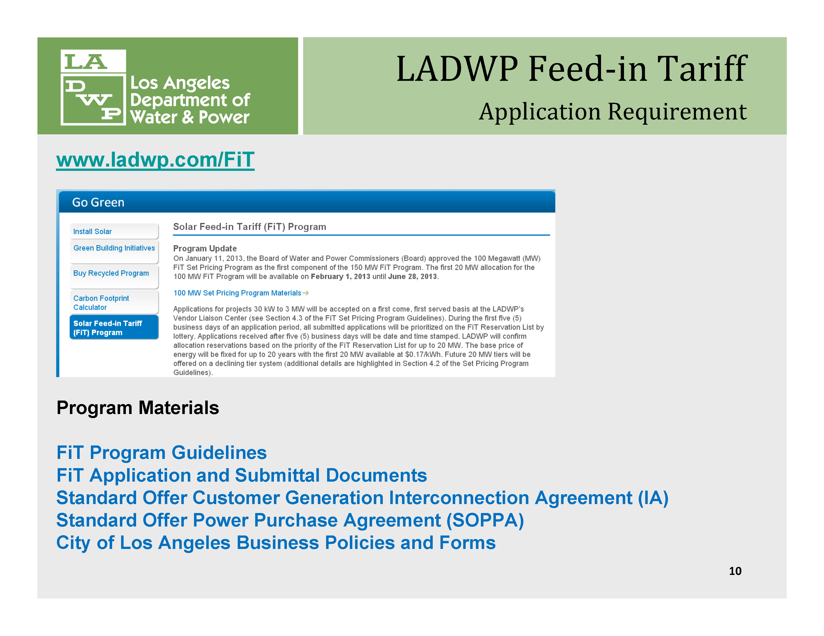

Slide 53
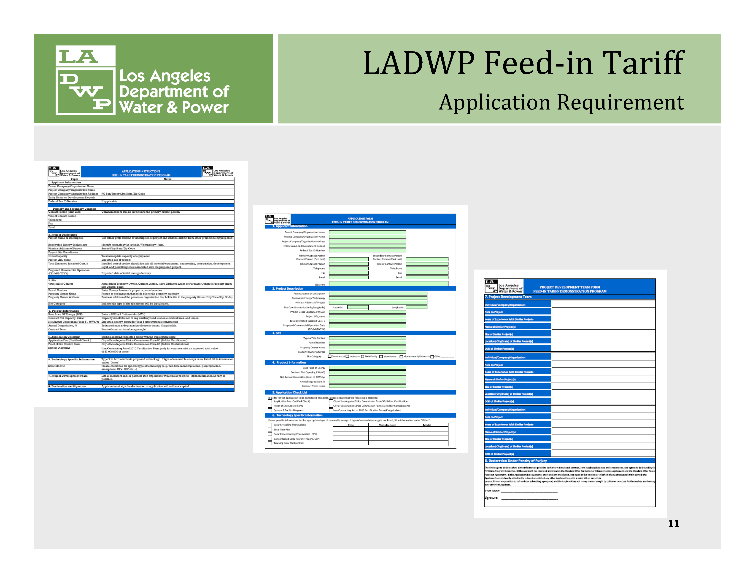

Slide 54
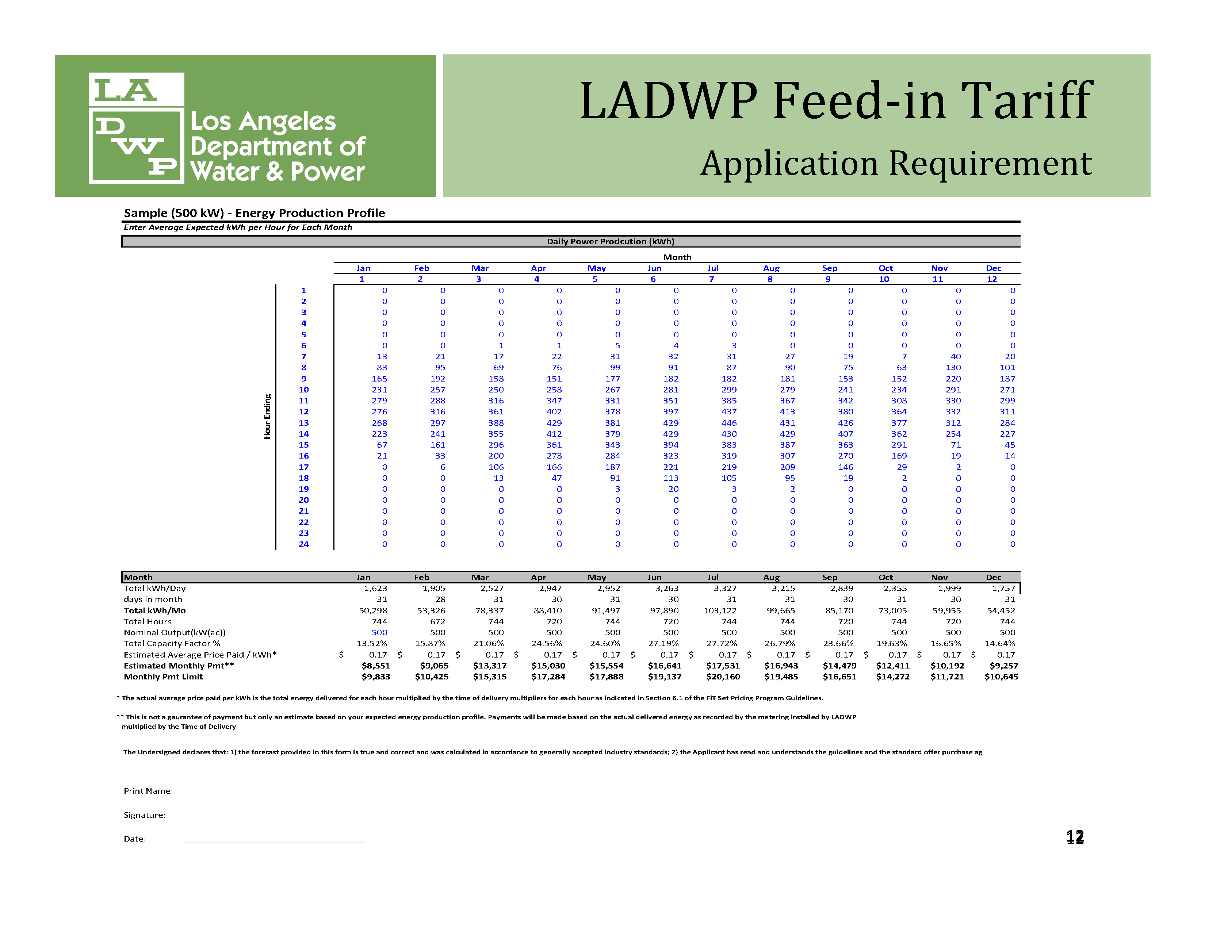

Slide 55


Slide 56
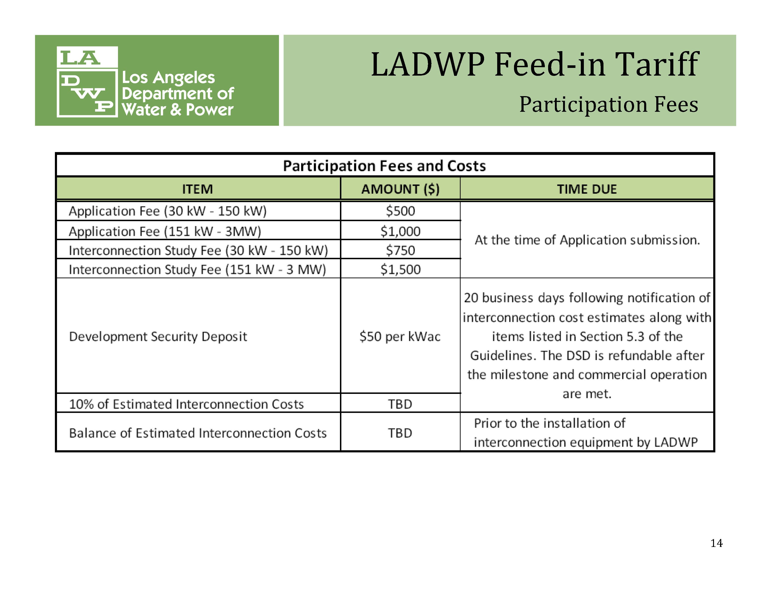

Slide 57


Slide 58
To learn more,
email solar-usa@iclei.org or
visit www.solaroutreach.org
Questions?
Notes:
Need to Apply Standard Formatting/Font

