Slide 1


Slide 2
What are Solar America Cities?
Started in 2007 by DOE
Develop model comprehensive approaches to urban solar energy use
25 designated cities – e.g. Philadelphia!
  Solar financing programs
  Updating zoning codes
  Streamlining permitting
  Training installers and code officials
  Outreach to residents and businesses
Best practices/lessons learned available at www.solaramericacommunities.energy.gov/resources/guide_for_local_governments
Success expanded into national outreach effort – Solar America Communities Outreach Partnership

Slide 3
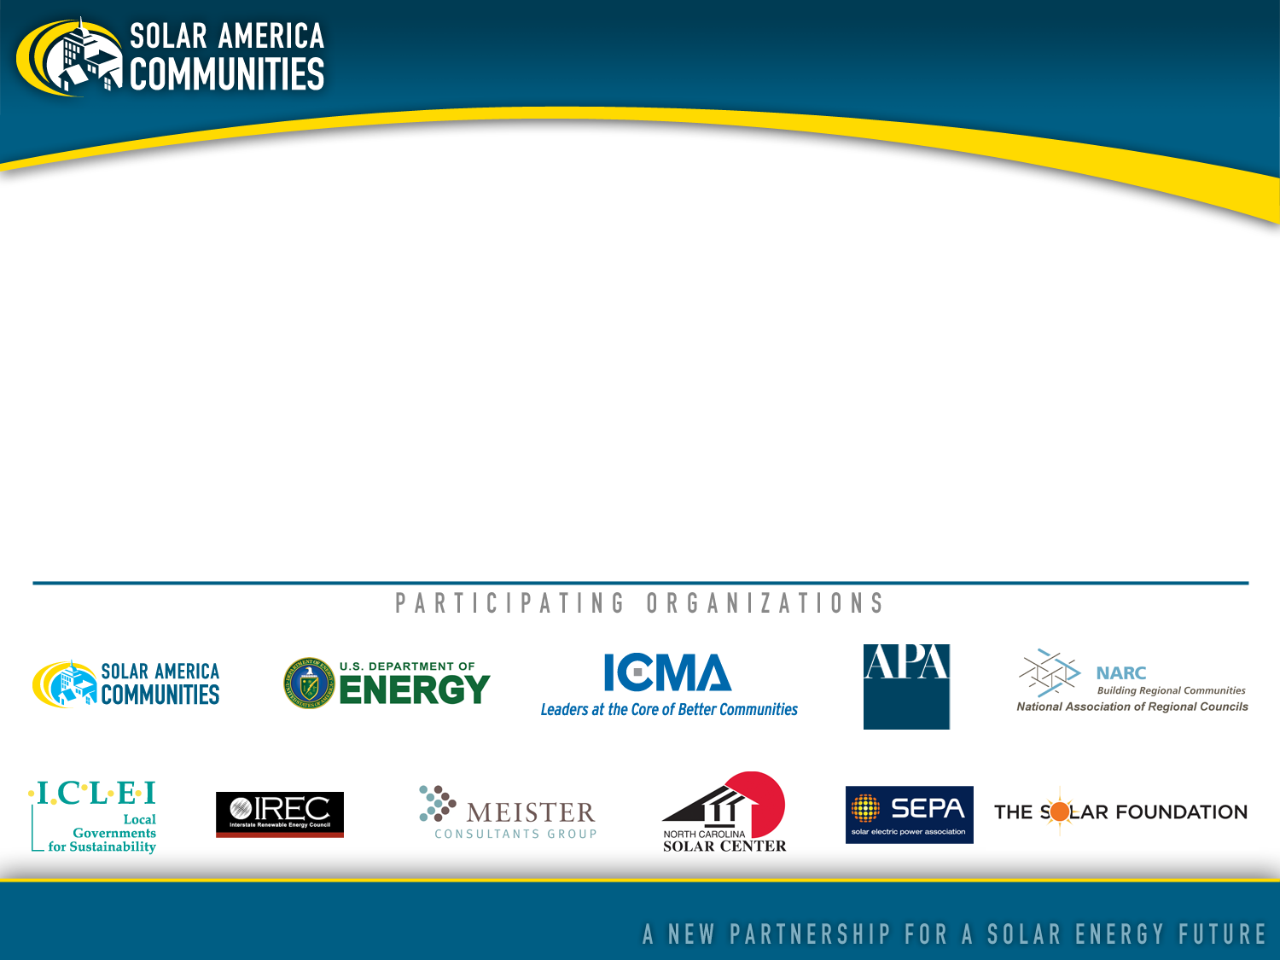
About Solar America Communities
Solar America Communities is a U.S. Department of Energy (DOE) program designed to increase the use and integration of solar energy in communities across the United States. The International City-County Management Association (ICMA) and ICLEI-Local Governments for Sustainability were competitively selected by DOE to conduct outreach to local governments across the United States, enabling them to replicate successful solar practices and quickly expand local adoption of solar energy. For more information visit www.solaramericacommunities.energy.gov.

Slide 4
Overall Project Goals
Increase domestic renewable energy generation
Create new green jobs
Spur economic growth
Reduce pollution

Slide 5
Outreach Project Efforts
Create best practices and strategies for local governments to increase solar adoption & use
  Educational workshops
  Peer-to-peer sharing
  Web-based resources

Slide 6
Outreach Project Focus
Three key areas:
Reducing permitting, interconnecting, inspection and incentive processing time
Improving building and zoning codes through updates
Increasing access to local solar financing options

Slide 7
Your Feedback is Important!
How receptive is the region/your community to solar? What level of support have elected officials demonstrated for solar?
What was the catalyst to work regionally through the AEOWG ?
What are the next steps after finalizing model ordinances?
What have been the challenges/successes in this process?
What are the region’s barriers to/success in solar adoption?
Has solar been incorporated into other work?
What are the solar financing options available?
What information/tools would be helpful in planning for solar?

Slide 8
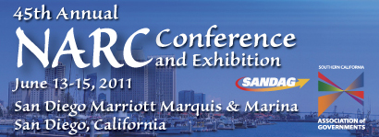
Upcoming Event
Sessions on the benefits, barriers and successful integration of regional solar development and best practices, as well as a solar tour of San Diego!

Slide 9
Thank you!
For more information, please contact:
Shannon Baxevanis
Deputy Director
National Association of Regional Councils
202.986.1032, x217 – shannon@narc.org
Kristin Heery
Program Analyst
National Association of Regional Councils
202.986.1032, x225 – kristin@narc.org

