Slide 1
Institutional Barriers
Net Metering, Interconnection
WCOG Solar Workshop
October 2011
Christopher Cook, Of Counsel, Keyes and Fox
IREC

Slide 2
Introduction
Keyes & Fox is a boutique law firm focused on distributed generation law. Our clients are predominantly renewable energy policy groups and solar energy companies.
IREC has worked for over 2 decades to accelerate the use of renewable energy through the development of programs and policies that reduce barriers to renewable energy deployment. IREC has participated in proceedings and rulemakings before over 20 state PUCs during the past year addressing net metering, interconnection, and third-party financing of renewable dg energy systems

Slide 3
Barriers: Interconnection & Net metering
Interconnection
  Technical rules for operating a solar system that is electrically connected to the utility grid
Net metering
  Economic and tariff arrangement for addressing utility customer on-site power production

Slide 4
Interconnection

Slide 5
Interconnection – policy considerations
Jurisdiction split between FERC and state commissions
FERC
  Wholesale transactions and high voltage interconnection point
States
  Retail and distribution interconnection point

Slide 6
State Rules
DC
  Good rules – NNEC Grade “B”
  Difficulties with downtown networks
MD
  Good rules – NNEC Grade “B”
VA
  Very Good rules – NNEC Grade “A”
Notes:
Discuss history of FERC – negotiated settlement of technical issues

Slide 7
IREC Model IC rules
Compendium of state best practices
  Continually updated; stakeholders included states; IEEE committee members; solar companies; others
Includes modified rules for solar
  Solar only technology limited to daylight production
  Can measure against utility criteria during day (e.g. peak DAYTIME load instead of all hours peak load)
  IN NJ – reaching grid saturation

Slide 8
NET METERING

Slide 9
Net Metering –What is it?
Tariff arrangement that simplifies the economic interaction between a customer-generator and the utility
Always ask the question: what would an old fashioned meter do with solar generation?
  Spins forwards – consuming
  Spins Backwards – producing excess
A Safe Harbor for customer generators
  No new fees
  No standby charges

Slide 10
Net Metering – states
  DC – NNEC Grade “B”
MD – NNEC Grade “A”
  Added in 2011 “CLOSED CONDUIT HYDRO” OWNED OR OPERATED BY A MUNICIPALITY, MUNICIPAL CORP OR PUBLIC WATER AUTHORITY
  Community solar for municipalities
VA– NNEC Grade “B”
  Net metering potentially under attack – cross subsidy issue

Slide 11
Utility and Regulator Concerns regarding NM
Are customers who swap an exported kWh from excess solar production being subsidized by other customers
Several studies have looked comprehensively at this problem and the results show only a very slight subsidy and can go either way
  NM customers subsidized or subsidizing
Most states start with a small peak cap
  ensures a subsidy, if any, is deminimis

Slide 12

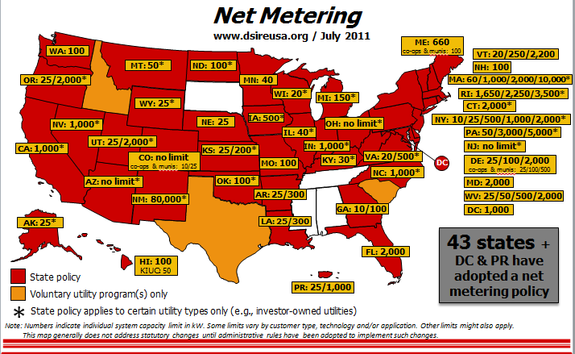

Slide 13
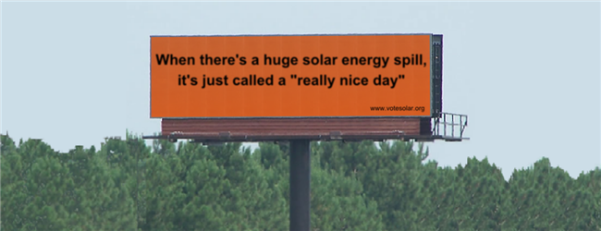

Slide 14
Contact info:
Christopher Cook
ccook@keyesandfox.com
IREC: www.irecusa.org

Slide 15

Solar Market Barriers; breaking down the walls
Mike Healy
guaranteed savings through green energy

Slide 16

The Permitting Process is a significant barrier to solar market growth
Notes:
Hi, my name is Zach Axelrod, I’m the CEO of Skyline Innovations – an Affinity Lab startup.

Slide 17

Permitting - What’s the problem?
Cost
Inefficiencies
Nebulous & ambiguous process
Notes:
Hi, my name is Zach Axelrod, I’m the CEO of Skyline Innovations – an Affinity Lab startup.

Slide 18
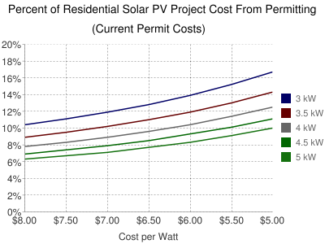
NEGATIVE IMPACTS OF EXCESS PERMITTING COSTS
Local Permitting and inspection add $0.50 per watt, or about $2500 per residential install
Permitting costs are equivalent to a $1 billion tax on solar over the next 5 years
Notes:
Hi, my name is Zach Axelrod, I’m the CEO of Skyline Innovations – an Affinity Lab startup.

Slide 19
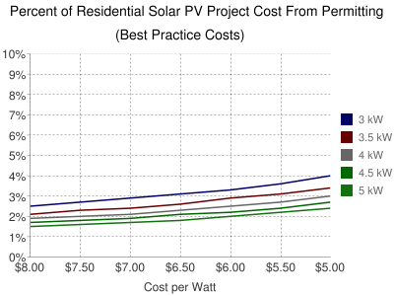
The costs of permitting
Countries like Germany and Japan have streamlined permitting giving them a price advantage over the U.S.
Germany has the lowest installed cost in the world, 40% lower than the U.S., even though total incentives are expected to be lower in Germany in 2011.4
Notes:
Hi, my name is Zach Axelrod, I’m the CEO of Skyline Innovations – an Affinity Lab startup.

Slide 20

Streamlining Process
Fair, flat fees
Over the counter issuance
Standardize permit requirements throughout the region
Make all material available online
Allow online permit application
submissions
Remove excess reviews
Reduce inspection appointment
windows
Train staff
Notes:
Hi, my name is Zach Axelrod, I’m the CEO of Skyline Innovations – an Affinity Lab startup.

Slide 21

Benefits to Jurisdictions
Save jurisdictions time and increase installations quality
No need to reinvent the wheel and/or expend excess budget dollars
Reduce re-submissions and failed inspection
Reduce customization leading to less errors
Streamlining permitting processes does not sacrifice safety, but simply eliminates inefficiencies
Notes:
Hi, my name is Zach Axelrod, I’m the CEO of Skyline Innovations – an Affinity Lab startup.

Slide 22
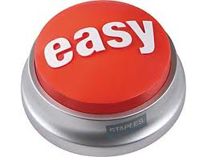
4 Next steps to streamlining permitting
Allow permitting applications to be submitted online
Reduce inspection appointment times
Form working group between industry stakeholders and government to specifically focus on streamlining permitting process
Make the permitting process completely transparent
Notes:
Hi, my name is Zach Axelrod, I’m the CEO of Skyline Innovations – an Affinity Lab startup.

Slide 23
Case Studies
Germany
  Streamlined, and in some cases eliminated, the permitting process
  Germany has the lowest installed cost in the world, 40% lower than the U.S., even though total incentives are expected to be lower in Germany in 2011
  Germany leads the world in installed solar capacity
Arizona
  High permitting costs were hindering solar development. City built strong coalition between council members and industry to tackle problem
  City streamlined, and expedited review process, and costs dropped as much as 80%
Colorado
Likely a new national model for lowering solar fees, the Fair Permit Act (CO)
Reduced inefficiencies in permitting process, capped fees at $500 for residential and $1000 for commercial projects, requires line-item costs for permitting agencies.
Prevent local governments from exceeding costs caps
Notes:
Hi, my name is Zach Axelrod, I’m the CEO of Skyline Innovations – an Affinity Lab startup.

Slide 24

Where can I get more information?
Solar American Board of Codes and Standards (Solar ABCs). http://www.solarabcs.org/
Vote Solar. Permitting Best Practices. http://votesolar.org/best-practices/
SunRun. The Impact of Local Permitting on the Cost of Solar Power. http://www.sunrunhome.com/cost-of-solar/solar-panels/local-permitting
Solar America Cities.
http://solaramericacommunities.energy.gov/
Notes:
Hi, my name is Zach Axelrod, I’m the CEO of Skyline Innovations – an Affinity Lab startup.

Slide 25
thank you.
Mike Healy
202.306.7900
mhealy@skylineinnovations.com
guaranteed savings through green energy

Slide 26




How do we own and pay for it?
Options for Solar Project Ownership and Financing
Amy Heinemann
Policy Analyst,
North Carolina
Solar Center
Francis Hodsoll
President, E&E Frontiers and
Executive Director, MDV Solar
Energy Industry Association
Stephen Pearlman
Partner,
Inglesino, Pearlman,
Wyciskala & Taylor LLC
Joseph Wiedman
Partner, Keyes & Fox LLP
and Interstate Renewable
Energy Council

Slide 27
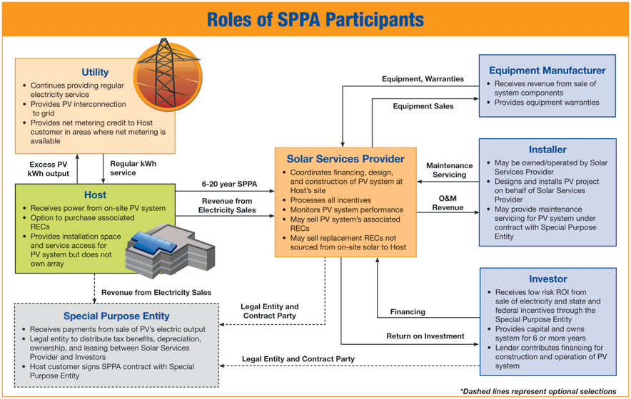

Slide 28
Solar PPA
  Advantages
    Turnkey, private solar developer
    Includes financing and O&M
    Developer tax incentives embedded in PPA price
  Disadvantages
    PPA pricing sub-optimal (most financial benefits to developer)
    Potential Risks in PPA (due to govt. action/inaction)
    FMV purchase at end of term, if term < useful life (not nominal)
  Risks
    Downtime (lost PPA price + SRECs + Profit, regardless of fault)
    Security obligation on government
    Performance guaranty from solar developer?
    Higher rated government payment guaranty?
    Limitation on real property options (mortgaging, lease, disposition)
    Early termination penalties (benefit of bargain)

Slide 29
Community Solar
Electricity and Renewable Energy Certificate Ownership: Who owns the energy and non-energy attributes (renewable energy certificates or RECs) generated by the project?
Virtual Net-Metering: How do participants get credited for the electricity produced by the project? Do they receive a credit on their utility bill for a calculated percentage of the project’s actual metered production, or a percentage of expected production, or other? Are the participants credited at the full retail rate for the power?
Financial Incentives: Do participants qualify for the tax credits or production incentives currently available for single-owner installations? Is participation tax deductible?
Financing: Is the system financed privately or uses public mechanisms?
Participation Fees: Do participants submit one payment, or do they pay over time?
Enrollment: Will the project accept additional participants after completion of construction, or do participants have just a single opportunity to enroll? Does pre-construction enrollment determine the project size, or can the project be built to meet future demand?

Slide 30
Solar Developer Procurement Criteria
PPA Price – economic benefit
Developer approach to comply with RFP requirements, including technical specs
Developer ability to deliver turnkey project, including O&M
Experience – contracts of similar size and scope
Management – key personnel and knowledge of applicable laws/regs
Logistics of implementing plan (1 year construction – multiple sites)
Financial strength (single purpose entity – guarantor)
Construction security (amount and strength)
Funding of deficiency (developer default, left w/ PPA and SREC – amount and strength)
Material changes to posted documents proposed?
Other economic benefits proposed?
Restoration security included? (option to guaranty roofs restored at end)

Slide 31
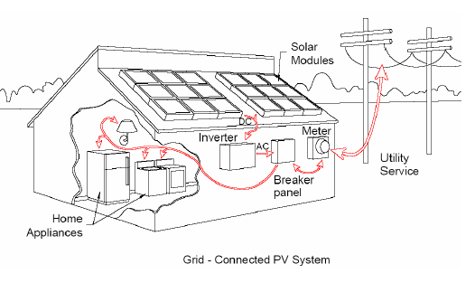
New Jersey Hybrid Model: How Does the Program Work ?
Option 1-Renewable Energy Program Company Financing
County IA
Competitive Contracting RFP
Site License & Power Purchase Agreement
Solar Company
Solar Energy
Potential Benefits
to Solar Company
County, Municipalities and School Districts
Reduced Energy Costs and Environmental Benefits
Accelerated Depreciation
SRECs - Revenues
Federal Tax Credits
Benefits to Taxpayers
PPA Revenue

Slide 32
New Jersey Model: How Does the Program Work ?
Options 2 and 3-Renewable Energy Program - Partial Authority/Authority Financing Structures (70 / 30% and 100%)
Security Package To County
(eg. cash, parent company guarantee, L/C)
or eliminate deficiency
County
Guarantee Bonds
Debt Service
less SRECS $
less PPA $
= Unsecured debt
(aka: County Security Amount)
County IA
Solar Energy
Bond Financing
Solar Company
Lease
Potential Benefits
to Solar Company
Power Purchase
License
County, Municipalities and School Districts
Reduced Energy Costs and Environmental Benefits
Accelerated Depreciation
SRECs - Revenues
Federal Tax Credits
Benefits to Taxpayers
PPA Revenue

Slide 33




Property Assessed Clean Energy (PACE)
City creates type of land-secured
financing district
or similar legal
mechanism (a special assessment district)
Property owners
voluntarily sign-up for financing and make energy improvements
Proceeds from
revenue bond or other financing provided to property owner
to pay for energy project
Property owner
pays assessment through property
tax bill
(up to 20 years)

Slide 34

What’s holding us back?
Or, if solar is so great, why isn’t it on my roof?
“Solar as Sustainability Approach in the Metropolitan Washington Region”
October 6, 2011
Washington, D.C.

Slide 35
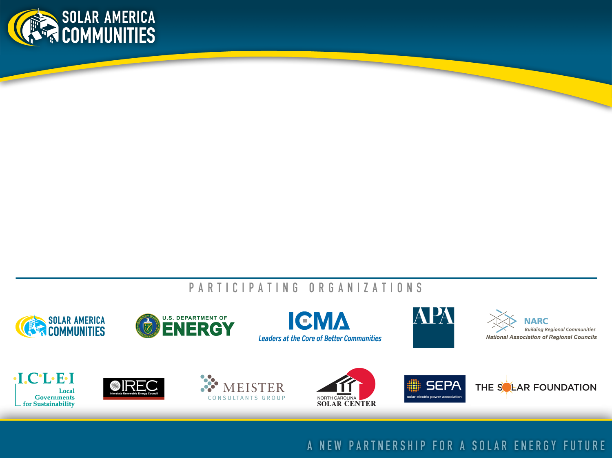
About Solar America Communities
Solar America Communities is a U.S. Department of Energy (DOE) program designed to increase the use and integration of solar energy in communities across the United States. The International City-County Management Association (ICMA) and ICLEI-Local Governments for Sustainability were competitively selected by DOE to conduct outreach to local governments across the United States, enabling them to replicate successful solar practices and quickly expand local adoption of solar energy. For more information visit www.solaramericacommunities.energy.gov.

Slide 36
Why Isn’t Solar More Widely Adopted?
Project permitting
Costs
Aesthetics - HOA
Utility policy
Public awareness

Slide 37
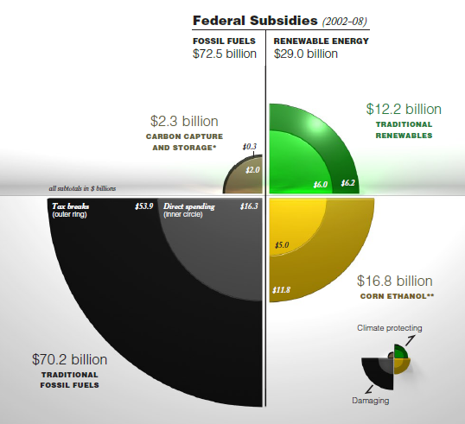
Source: Environmental Law Institute
Notes:
37

Slide 38
Myths and Misconceptions and lack of awareness.
Notes:
38

Slide 39
It’s not sunny enough where I live
It takes up too much land
I should wait because a better technology is around the corner
It causes too much glare
All of these are False!

Slide 40
What’s True?
Solar can be expensive
Notes:
40

Slide 41
People are not used to paying for 25 years of electricity up-front
Up-front cost for residential PV systems can be between $5,000-$15,000 after rebates and incentives.
I might not stay in my home long enough for the system to payback. 6-15 year payback might seem too long.

Slide 42
Is my home “solar ready?”
Notes:
42

Slide 43
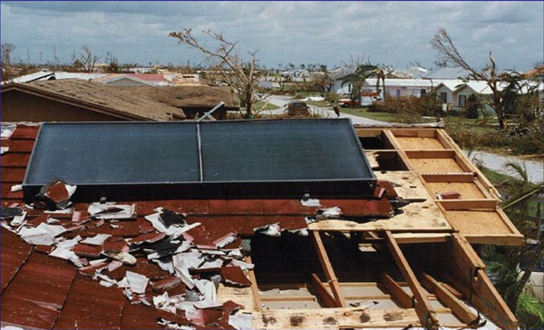
Can I even put solar on my roof?
Expensive roof repairs?
Electrical upgrade?
Getting everything up-to-code?
Panels on hurricane damaged roof in Florida. From One Block off the Grid:
http://1bog.org/yes-solar-panels-can-survive-a-hurricane/

Slide 44
Local utility is unfamiliar with the process
Notes:
44

Slide 45
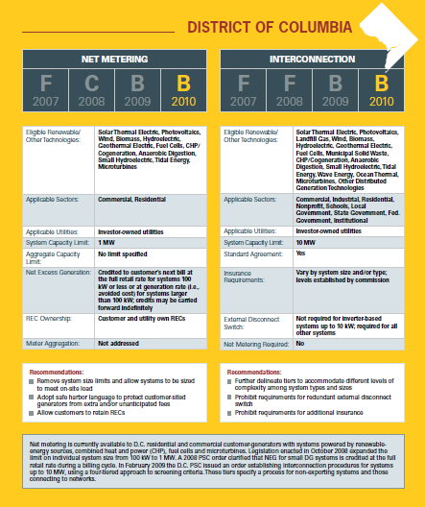
Can I connect to the grid?
Ground level disconnect?
Can I get net-metering?
Interconnection costs?

Slide 46
Local jurisdiction paperwork.
Notes:
46

Slide 47
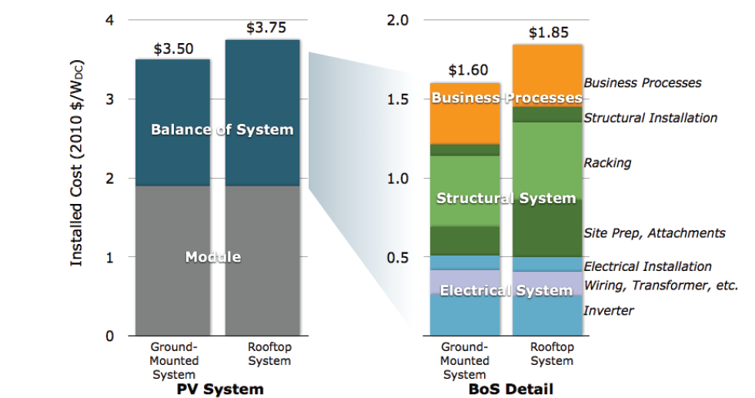

Red tape for Green energy
Special permit requirements?
Fire setbacks?
Multiple permits and inspections
Permitting delays
Local building officials unfamiliar with the technology or local installers

Slide 48
Not allowed in my neighborhood…
Notes:
48

Slide 49
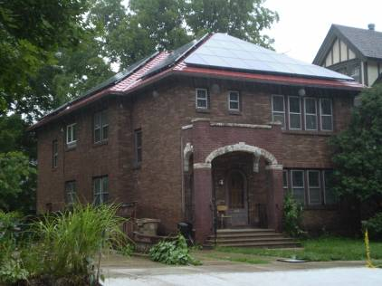
Homeowner’s Association restrictions
Historic district restrictions
Aesthetic complaints
Notes:
49

Slide 50
Additional Barriers…
Difficulty of coordinating efforts regionally
Territorialism/Competition between neighbors
Strong Anti-Regulation Sentiment
Neighborhood Association Pushback

Slide 51
Questions www.SolarAmericaCommunities.energy.gov

Slide 52

Solar as Sustainability Approach in the Metropolitan Washington Region
MWCOG Workshop
Washington, D.C.
October 6, 2011

Slide 53
Visioning and long-range goal setting
Plan making
Regulations and incentives
Development work
Public investment
Planning for Solar
Notes:
Starting with the big picture first
Let’s look at how solar can be incorporated in the planning process
The 5 Strategic Points of Intervention
(Refer to current issue of QuickNotes for more info on SPI)
Visioning and long-range goal setting
Plan making
Comprehensive, sub-area, functional
Regulations and incentives
Development work
Review, approval of projects
Public investment
Infrastructure, community facilities

Slide 54
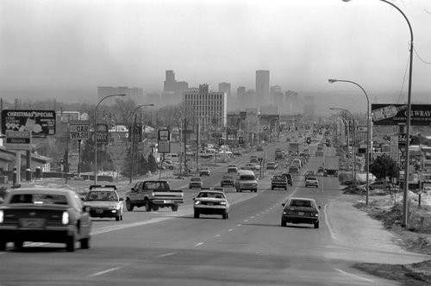
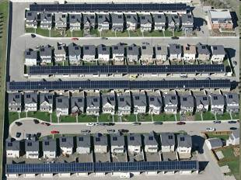
Visioning and long-range goal setting
Does solar play a role in the future vision for your community?
Photo: NREL
Photo: www.solar.calfinder.com
Notes:
Solar might not initially come up in a visioning process
But can use as an opportunity to make connections to concerns about climate change, wanting to become more sustainable
Ask questions, gage level of support in community
Incorporate in long-term goals

Slide 55
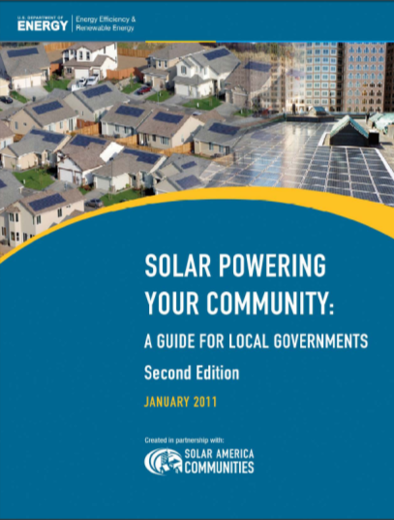
Plan Making
Comprehensive, general, or master planning
Sub-area plans
Functional plans
Notes:
Building solar into a plan
Comprehensive, general, or master planning
Sub-area plans
Neighborhood, downtown, corridors…
Functional plans
Water, open space, transportation/transit…
See Solar Powering Your Community guide for examples of plans that incorporate solar

Slide 56
Regulations and Incentives
Zoning ordinances
Subdivision ordinances or regulations
Form based codes
Planned unit development/ planned residential development ordinances
Transit oriented development regulations and guidelines
Historic district architectural or design guidelines
Transfer of development rights
Wetlands ordinances
Tree ordinances
Notes:
Think about current codes and how they affect solar implementation
More about codes shortly…

Slide 57
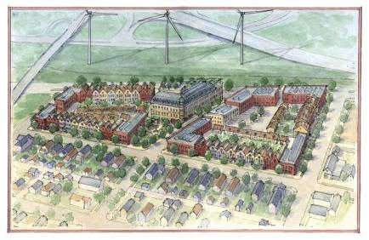
Review and approval of development projects
Public-private development and redevelopment projects
Development agreements
Development Work
Source: www.urbanmilwaukee.com

Slide 58
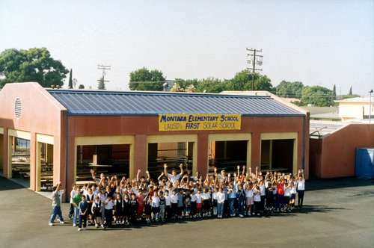
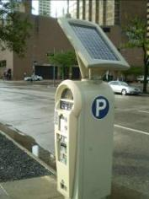
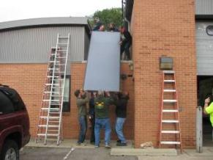
Source: NREL
Public Investment
Infrastructure
Streets
Community facilities
Schools
Bike paths
Water systems
Transit…
Libraries
Municipal buildings…
Source: solaramericacommunities.gov

Slide 59
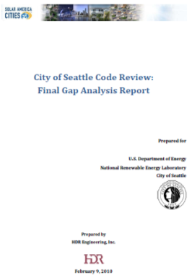
Seattle, Washington:
Review of City Codes and Practices
An example:
Increase/improve building energy standards
Require solar-ready construction
Add flexibility to height limits and roof coverage limits
Develop or refine definitions in the table of uses to ensure that solar energy projects are not unnecessarily prohibited
Implement a solar access ordinance
Increase focus on commercial and industrial land use/development
Notes:
An example to summarize…
Working with HDR (an architecture, engineering and consulting firm), Seattle conducted a gap analysis of Seattle’s codes relative to best management practices (BMPs) for solar energy development. The report is based on BMPs recognized in current literature by national subject matter experts. Planners and code specialists meticulously examined Seattle’s codes, focusing on those governing energy, land use and zoning, and other areas that affect solar energy development. They also evaluated processes in place at Seattle City Light (the municipal utility) and the Department of Planning and Development, and interviewed solar installers to learn where obstacles exist. The report identifies where Seattle meets or exceeds BMPs, where the city falls short of BMPs, or where code is silent on BMPs, and lists recommendations to bridge the gaps. Results of the gap analysis were presented to city staff from the Department of Planning and Development, the Office of Sustainability and the Environment, and Seattle City Light. Gaps that can be addressed in the Seattle Municipal Code include the following: increase/improve building energy standards; require solar-ready construction; add flexibility to height limits and roof coverage limits; develop or refine definitions in the table of uses to ensure that solar energy projects are not unnecessarily prohibited; implement a solar access ordinance; and increase focus on commercial and industrial land use/development. Gaps that can be addressed by policies, permitting, and review processes include the following: develop an interagency and stakeholder task force; require green power; expand training for contractors, inspectors, plan reviewers, and other city departments; address competing code requirements through planning processes; develop and implement a solar mapping and tracking program tied to the permitting process; and allow or streamline negotiation for downtown interconnection.

Slide 60
Making Zoning Codes
Solar-Friendly

Slide 61
Zoning Codes
Typically seen as barrier to solar implementation
Can be opportunity to easily, efficiently incorporate solar with clear provisions

Slide 62
Key Steps
Remove barriers
Create incentives
Enact standards
Notes:
Barriers…
Height? Only allowed in certain districts? Require a conditional use permit?
Standards…
Clear standards will help streamline the process for developers.
Consider standards for safety, etc.
Incentives…
Encourage solar implementation. Faster permitting process, for example, when solar included in development project.

Slide 63
Enabling solar installations
Encourage solar-oriented lots
Maximize solar access
Permitted use in zoning districts

Slide 64
Considerations when drafting provisions
Roof-mounted vs. ground-mounted
Urban vs. rural location
Grid-connected vs. off-grid
Zoning districts (residential, commercial, industrial)
Form-based code vs. traditional zoning code (focus on use)
Permitted use, accessory use, or conditional use
Notes:
May need different provisions in these different situations, depending on your community

Slide 65
Consider what standards may be needed
Height
Setback
Visibility
Coverage
Plan approval
Aesthetic conditions
Safety conditions
Notes:
Reduce complaints and outrage from poor installations that could stall future installations by incorporating acceptable standards that will encourage well-planned and designed solar installations acceptable to your community

Slide 66
Resources
Solar Powering Your Community: A Guide for Local Governments (2011)
http://solaramericacommunities.energy.gov/resources/guide_for_local_governments/
Planning and Zoning for Solar Energy Essential Info Packet
http://www.planning.org/pas/infopackets/open/eip30.htm
Solar Energy Standards in From Policy to Reality: Updated Model Ordinance for Sustainable Development
http://www.crplanning.com/pdfs/susdo6_09/solar.pdf
Site Design Strategies for Solar Access in the Sustainable Community Development Code Framework
http://law.du.edu/documents/rmlui/sustainable-development/SolarAccess.pdf

Slide 67

Contact APA
Ask APA’s Planning Advisory Service Inquiry Answer Service about Planning for Solar Energy!
Email pas@planning.org with subject line “Solar Energy Inquiry”

