Slide 1
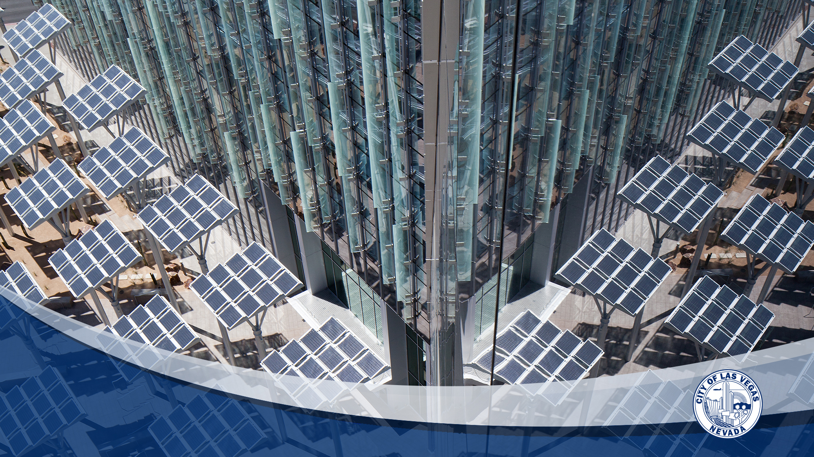
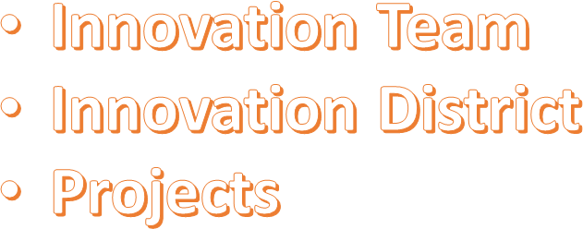
Fostering Innovation to
Build a Smart City Culture
WELCOME TO
LAS VEGAS

Slide 2

Innovation Team
Cross-departmental:
  IT; Public Works; Planning; Communications; Econ. Dev.
Team Leader
Organic (Bottom up - not top down)
Philosophy – Innovation is everyone's job, not just one person
May need Officer due to levels of activity requiring coordination
Need a next level strategy: Working off Smart City Application

Slide 3
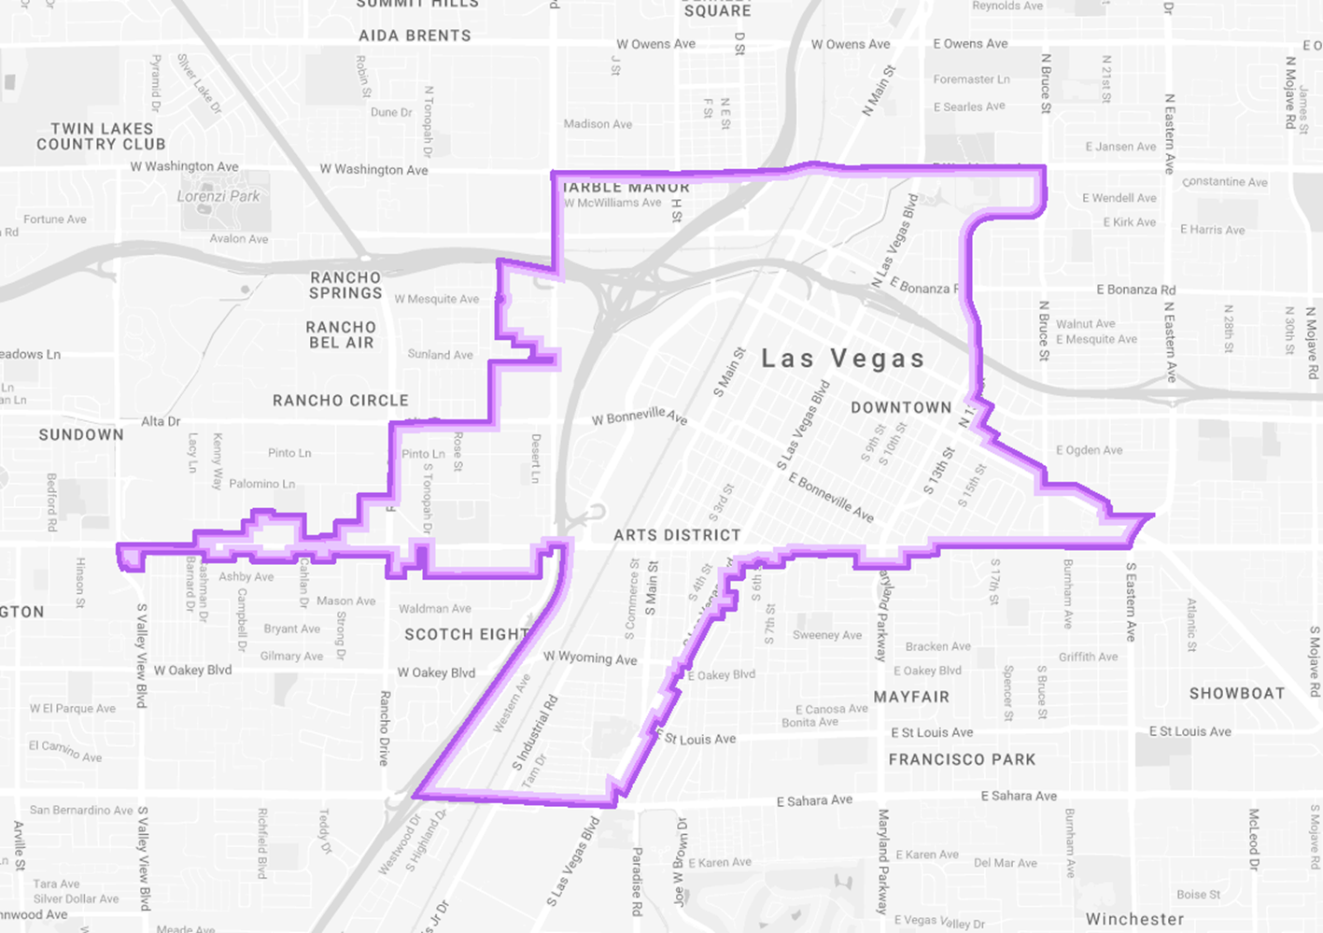
Innovation District
Downtown Las Vegas
Focus on traditional
city infrastructure
looking forward
www.innovate.vegas.com

Slide 4
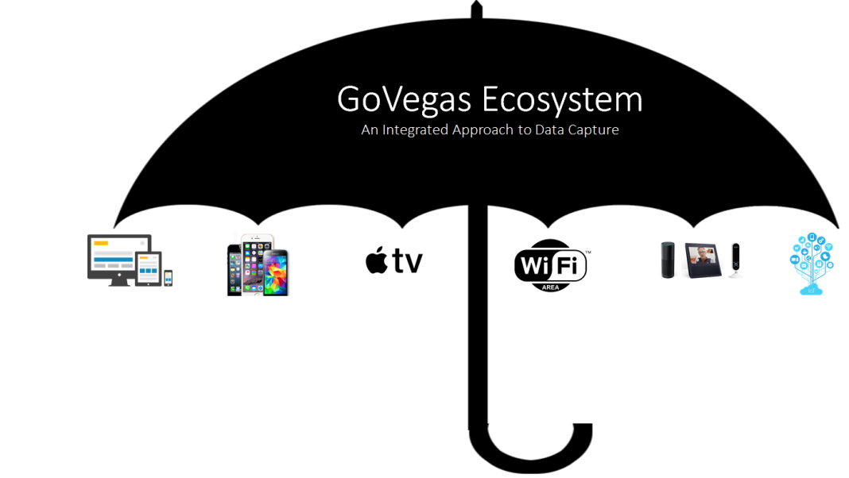
Select Projects – App Development
City LV Mobile – IPhone and Android ($30k)
Amazon Echo – Alexa (Staff time)
Apple TV Channel ($50k)
Single User ID
(GoVegas Ecosystem)

Slide 5
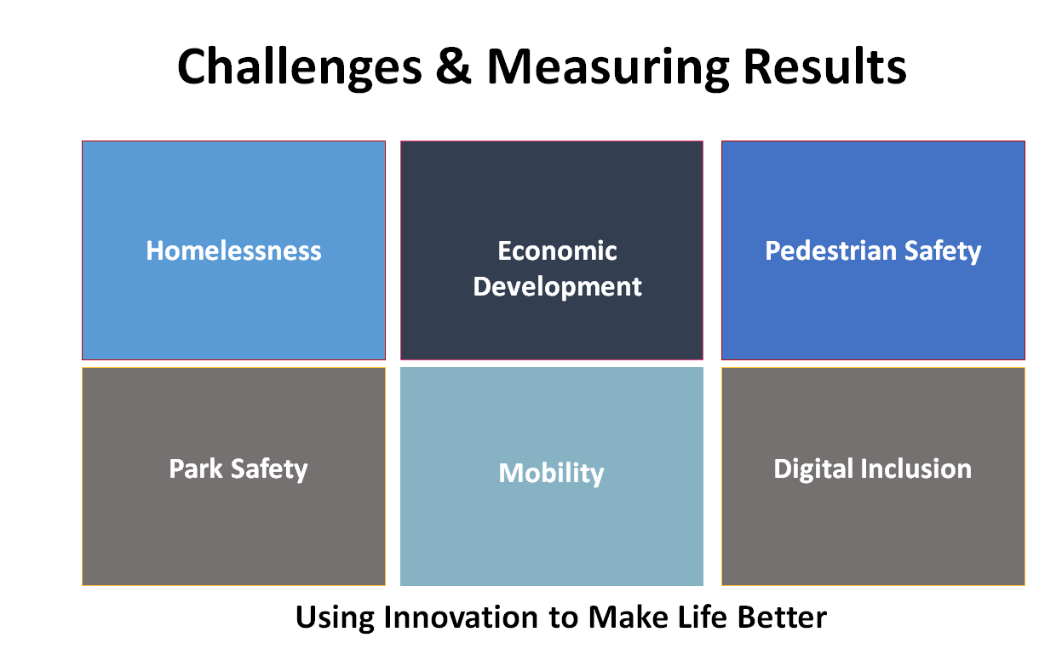
Select Projects - Infrastructure
WIFI in parks and downtown
Air quality monitoring ($2,000 per sensor, per year)
Smart street infrastructure – Motionloft
($2,500 per sensor, per year)

Slide 6
Appendix

Slide 7
Project Name | Description | Community Issues being Addressed
Driverless Shuttle Pilot | Developing pilot for 2nd on-street deployment. This second pilot will connect the vehicle to traffic signals. | Mobility Parking Safety Economic Development
Downtown Innovation District Infrastructure | Installation of conduit, fiber, and telecommunications equipment in support of communication network for Smart City deployments and providing Public WiFi | Infrastructure
Smart City Concept of Operations and Visioning Document | Develop an implementation roadmap for CLV to use as they continue deploying their Smart City infrastructure | Visioning
Downtown Connected Corridor Deployments | Deployment of DSRC for safety use cases such as pedestrian crash avoidance, wrong way entry crash avoidance, red light running avoidance. This will be the basis for communicating with connected cars. | MultiModal Safety Capacity/Mobility Data for Planning
GENIVI Connected Car Pilot (Should be noted no financial contribution was required for this project.) | Create connected, city-wide mobile resources and systems to help expedite ambulance response time, enable better triage, and standardize procedures for medical professionals. Involves emergency responders, public safety officials, application developers, GPS / GIS / location services, and citizens. | Pedestrian and Vehicle Safety Data for Planning

Slide 8
Project Name | Description | Community Issues being Addressed
Cisco Infrastructure | Deployment of network hardware to provide connectivity for sensors, interconnecting facilities and wireless infrastructure | Infrastructure
Cisco – Connected Digital Platform | Dashboard system where sensor data is displayed and where observers can review and make decisions | Public Safety Environmental – Air quality and trash Traffic Safety and Mobility Parking
Cisco Wireless | Provide WiFi in and around the downtown Las Vegas area for consumer use as well as internal use (sensors) | Infrastructure
Motionloft | Intersection analytics | Pedestrian Safety Data for Planning and Economic Development
Hitachi | Dashboard system where sensor data is displayed and where observers can review and make decisions | Public Safety Environmental Traffic Safety and Mobility Parking

Slide 9
Project Name | Description | Community Issues being Addressed
Apple TV Channel | Development of an Apple TV channel to distribute city council meetings and other city video content | Social
Amazon Echo | Conversational computing | Social
ShotSpotter | Sound detection system | Public Safety
Cisco – LIDAR | Pedestrian and vehicle alerting system | Pedestrian Safety Public Safety
Numima | Intersection analytics | Traffic Safety and Mobility

Slide 10
Project Name | Description | Community Issues being Addressed
www.innovate.vegas | Website dedicated to promoting the city of Las Vegas and its innovation efforts. | Social Economic Development
Camera System | Camera system for monitoring intersections and deriving analytics Medical District and Corridor of Hope | Public Safety
WiFi in Parks | Establish WiFi service in city parks | Public Safety Environmental (Air quality and trash) Social
Environmental Analysis (T-Mobile) | Air quality monitoring on 3rd street | Environmental Social – Quality of Life
Living Technology Lab | Incubator location where city staff, vendors and upstarts can work together on social and technical innovations. | Social Economic Development

Slide 11
Project Name | Description | Community Issues being Addressed
US Ignite \ Gigabit Community | Application to become a Gigabit community | Economic Development
CES Challenge and Outreach | Consumer Electronics Show (CES) attracts innovators from around the world and is increasingly focused on Smart Cities applications. In collaboration with CES, we plan to reach out to industry and solicit their best, deployable, smart cities applications so they can be evaluated and the winners announced at CES. | Social Economic Development

