Slide 1
Managing Crisis Communications During the COVID-19 Pandemic
April 22, 2020

Slide 2
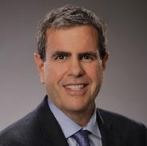
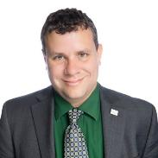
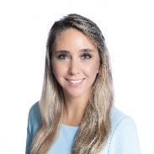
Speakers
Thomas Bakaly
CEO
Beach Cities Health District
Thomas Bryer
Professor
University of Central Florida
Sarah Stoeckel
City Council Member
City of Titusville, Florida

Slide 3
Critical Communications Amidst COVID-19
Beach Cities Health District
Tom Bakaly, CEO

Slide 4
Agenda
About Beach Cities Health District
Critical Situations Plan
COVID-19 Plan
Integrated Health Promotions & Communications
Based on Public Feedback

Slide 5
About Beach Cities Health District
California Healthcare District (special service district)
Five-member elected board
Mission: To enhance community health through partnerships, programs and services for people who live and work in Hermosa Beach, Manhattan Beach and Redondo Beach
Vision: A health beach community

Slide 6
65 Years of Improving Health
1955 Community votes to fund South Bay Hospital
1960 South Bay Hospital opened
1984 Building leased to outside management (Tenet)
1998 Tenet leaves and BCHD focuses on preventive health
2010 The Beach Cities are chosen for the Blue Zones Project
2017 Announces proposed plans for the Healthy Living Campus
TODAY BCHD delivers 40+ programs and services in the community

Slide 7
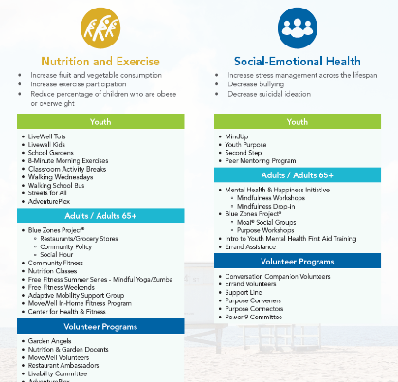
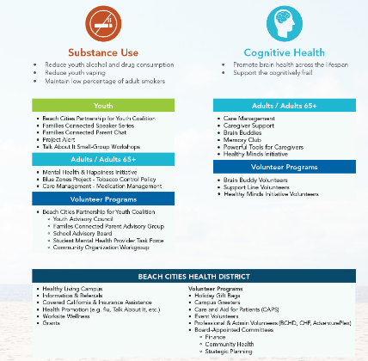
2019-2021 Health Priorities

Slide 8
BCHD Communications
Professional Communications Team
Aligned with Organizational Goals

Slide 9
Critical Situations Plan
Step-by-step reference guide
One-Voice (clear message)
Daily Updates – aligned with Joint Information Center (JIC)
Shift from grassroots (in-person) to calls and online tactics

Slide 10
BCHD COVID-19 Plan
Level 1
Inform the Community
Level 2
Practice Preventive Measures
Level 3
Regional Closures & Cancellations
Level 4
Level 5
DOC Plan
Recovery
- Provide accurate updates from the Los Angeles County Department of Public Health and Centers for Disease Control and Prevention - Flyers, posters, newsletters, social media, website, etc.
- Encourage self-decision Making
Limit Public Exposure (events) for Vulnerable Populations
- Testing
- Strategic Plan
- Phased
- Coordinated
- Messaging
- Pregnant Women - Individuals w/underlying health conditions - Older Adults (60+)
- Events specifically for vulnerable populations
- Community-wide closures
- Identify at-risk individuals
- Provide volunteer opportunities
- Timely and accurate info
- Health and well-being tips/tools
- Recovery planning

Slide 11
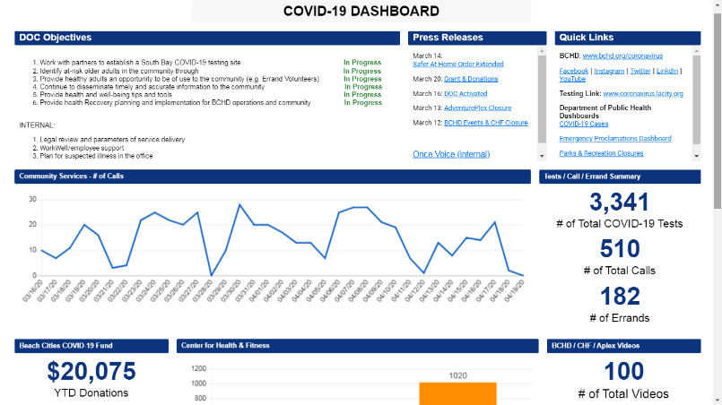

Slide 12
COVID-19 Communications Objectives
Continue to disseminate timely and accurate information to the community
Provide health and well-being tips and tools

Slide 13
BCHD Communications
Pre COVID-19 Digital & Print BCHD E-newsletters – 2x/month and as needed Social Media – 1-2x/daily and as needed Website – daily updates and as needed Video – < 30 year Newspaper - 2-3x/month Posters/flyers – updated 2x/month and as needed Direct Mail – 3x/year Other Press Releases – as needed Tri-City Partner Communication (cities, schools, chambers) Community Events (non BCHD) – 2-4x/month | During COVID-19 Digital & Print COVID-19 E-newsletters – 1x/week and as needed Social Media – 5x/daily and as needed Website – daily updates and as needed Video – 100+ posted Newspaper – 3-4x/month Posters/flyers – none post L.A. County Safer At Home Order Direct Mail – 3x/year Other Press Releases – as needed Tri-City Partner Communication (cities, schools, chambers) JIC participation / survey results

Slide 14
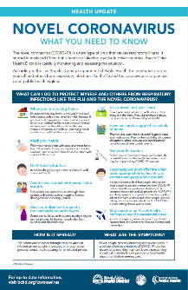
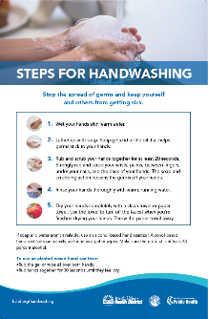
Posters / Flyers

Slide 15
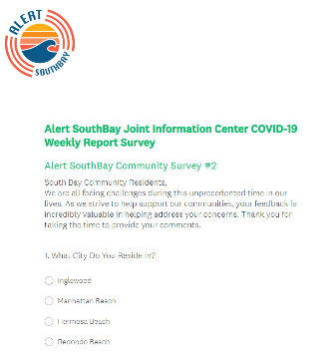
JIC Survey
3,512 Responses from Beach Cities
57% extremely or very worried
Top three biggest challenges:
64% general anxiety
50% social isolation/places to go
49% purchasing supplies (e.g. toilet paper)
43% Daily communication
Email and text messaging preferred

Slide 16
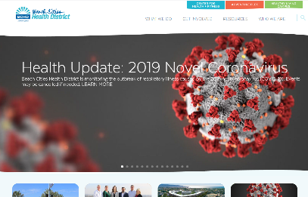
COVID-19 Communications
bchd.org/coronavirus

Slide 17
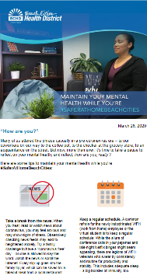
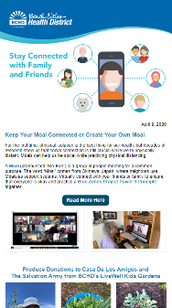
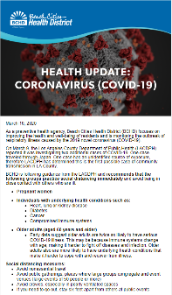
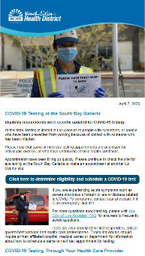
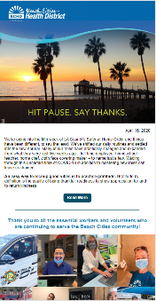
E-Newsletters

Slide 18
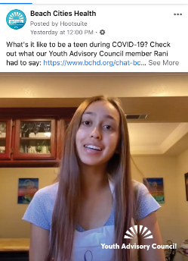
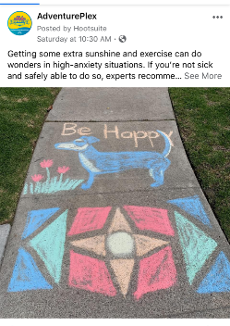
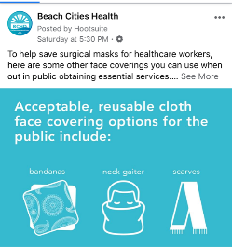
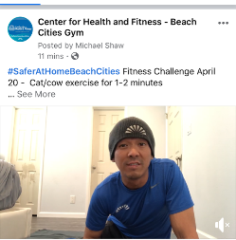
Social Media

Slide 19
Summary
Have a plan
Clear message
Daily updates
Shift from grassroots (in person) to calls and online tactics
Align message with what public wants to hear about

Slide 20
Managing Crisis Communications During the COVID-19 Pandemic
Thomas Bryer, PhD (University of Central Florida) and Sarah Stoeckel, PhD (City of Titusville, Florida)

Slide 21
Agenda
Social Media vs. Online Engagement Tools
Approaches to Social Media and Online Engagement
Communication Content Strategies During Crisis
Public Meetings
Questions and Discussion

Slide 22
Social Media vs. Online Engagement Tools
Social Media | Online Engagement Tools
Tools that allow for rapid dissemination of ideas and information, strategic viral dissemination, and largely unfacilitated and unmoderated interaction between government and stakeholders. | Tools that allow for government’s stakeholders to engage in idea and information development, preference setting, and/or solution creation in a facilitated and moderated space.
Examples: Facebook, Twitter, Instagram, Snapchat, Blog, YouTube | Examples: Wiki, Bang The Table ($), IdeaScale ($), Zoom ($)

Slide 23
Approaches to Social Media and Online Engagement
Spectrum of Public Participation
Elements of an Effective Social Media Policy
Elements of an Effective Social Media and Online Engagement Operation

Slide 24
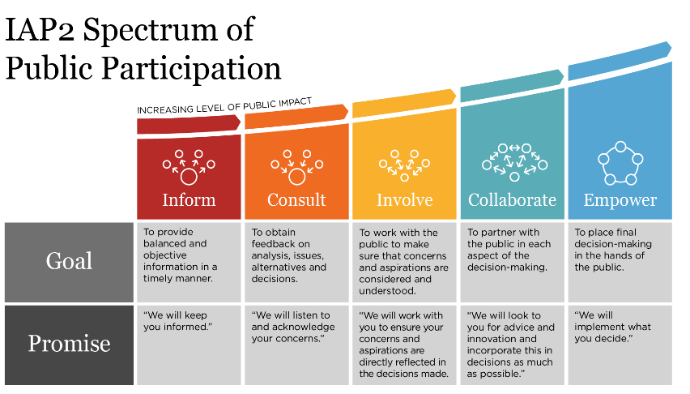

Slide 25
Elements of an Effective Social Media Policy
Citizen Conduct
Employee
Access
Legal Issues
Account
Management
Security
Acceptable Use
Content
Employee
Conduct
Adapted from the Center for Technology in Government

Slide 26
Ongoing and Future Legal Issues
Free speech
Public Records
Blocking and Deleting
“Public Forum”
Monitoring and Discipline
ADA

Slide 27
Elements of an Effective Social Media and Online Engagement Operation
Expectation
Management
Rapid
Response
Plan
Defined
Objectives
Relevant
Content

Slide 28
Social Media in Normal vs. Crisis Times
Social Media Strategies During Normal Times
Social Media Strategies During Crisis
Public Health
Weather
Mass Casualty Event

Slide 29
Social Media Strategies During Normal Times
Expect misinformation, rumor, and conspiracy theories.
Multiple voices for the local government, customized across agencies, functions, and users.
Monitor other social media in your community, sharing information when appropriate.
Bring the people to you; strive for engagement, including consultation and deliberation.
You are maintaining an audience. Keep them engaged through meaningful interactions, including with online engagement tools.

Slide 30
Social Media Strategies During Crisis
Expect misinformation, rumor, and conspiracy theories.
One voice for the local government, spread as shared post or copy/paste across all government operated social media platforms.
Identify other local social media sites that can share your information, including media, citizen groups, nonprofits, council members, businesses—this is a good opportunity to assemble a directory of social media sites and site manager information for local groups and organizations.
Go where the people are; do not assume they know where to look and strive for information sharing.
You are gaining and audience. Plan for keeping them engaged post-crisis.

Slide 31
Social Media Strategy Considerations
Normal Time | Crisis Time
Expect misinformation. Unchecked, trust in government can plummet. | Expect misinformation. Unchecked, consequences can be deadly.
Multiple voices matched to constituency for each agency and office. Experiment and track. | One voice across local government. Stick to what you know without experimentation and track.
Monitor other social media accounts, sharing information with them as appropriate. Keep the networks active but not burdened for next crisis. | Identify and leverage other local social media accounts within the community.
Bring the people to you. Create new platforms. | Go to where the people are. Use existing platforms.
You are maintaining an audience. | You are gaining an audience.
Strive for active engagement, including consultation and deliberating using online engagement tools. | Strive for information sharing, including question & answer.

Slide 32
Communication Content Strategies During Crisis
Know Your Audience
Message Content
Calming Fear
Moving from Fear to Growth
Facilitating Community

Slide 33
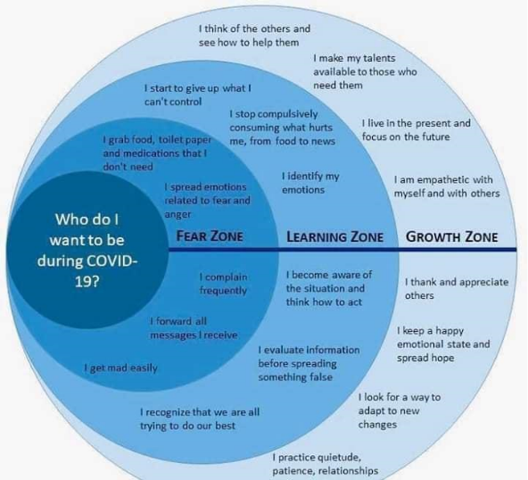
Know Your Audience and Content Development
Calming Fear
Moving from Fear to Growth
Facilitating Community

Slide 34
Calming Fear
Use all available communication tools already in the tool chest, including the “traditional” tools of static website, email list, and postal mail
Post daily information sharing updates on social media channels (remember, one voice!) and static websites, even if there is nothing new to report
Maintain a single online landing page for resources for each core stakeholder group, specifically individuals & families, businesses, and nonprofit organizations
Share videos of public service professionals describing their job and what role they have in the response (e.g. police, bus driver, teacher, et cetera)

Slide 35
Moving from Fear to Growth
Post and share opportunities to be part of the support network (note, this can be coordinated through nonprofit partners in the community)
Share videos of community volunteers introducing themselves and sharing what they are doing
Be firm and encouraging simultaneously (Maintain social distance and stop the spread of the virus; help us help each other by volunteering)
Bullet-proof hashtags

Slide 36
Facilitating Community
Using Online Engagement Tools….
Ask for feedback on the government’s communications
Ask for identification of problems/challenges that are not being addressed in the community (e.g. unsupervised youth, stray animals, rental assistance, crime)
Ask for solution ideas to known problems/challenges (note, this an act of consultation, but you can go beyond asking for ideas to co-develop solutions)
NOTE, for each of these, creating a feedback loop is imperative. For example, report weekly or bi-weekly on the discussions and ask for further ideas, or evolve to a higher level of the IAP2 spectrum.

Slide 37
Facilitating Community
Using Social Media Tools….
Link to and tag other online spaces in the community offering support or unique opportunities
Recipe exchange
Virtual museum tours
Educational resources
Library services
“Toilet Paper Finders” (e.g. shopping guides)
Et cetera

Slide 38
Choose the Path for Your Citizen
Citizen Progression
Fear
Learning
Growth
Citizen Regression
Fear
Anger
Protest

Slide 39
Public Meetings
100% Virtual
Physical government + Virtual citizens
Small group physical + Virtual citizens

Slide 40
ICMA 2020 Pre-Conference Workshop
Workshop Title: Local Government Run Social Media and Online Technologies: Tools for Proactively Building Strategic and Creative Citizen Engagement
Date/Time: Tuesday, September 22, 8:30am-12pm

Slide 41
Questions and Discussion
Thomas Bakaly Tom.Bakaly@bchd.org
Thomas Bryer, PhD thomas.bryer@ucf.edu
Sarah Stoeckel, PhD Stoeckel.sarah@yahoo.com

