Slide 1



COVID-19 Teleconference
Emotional Health

Slide 2
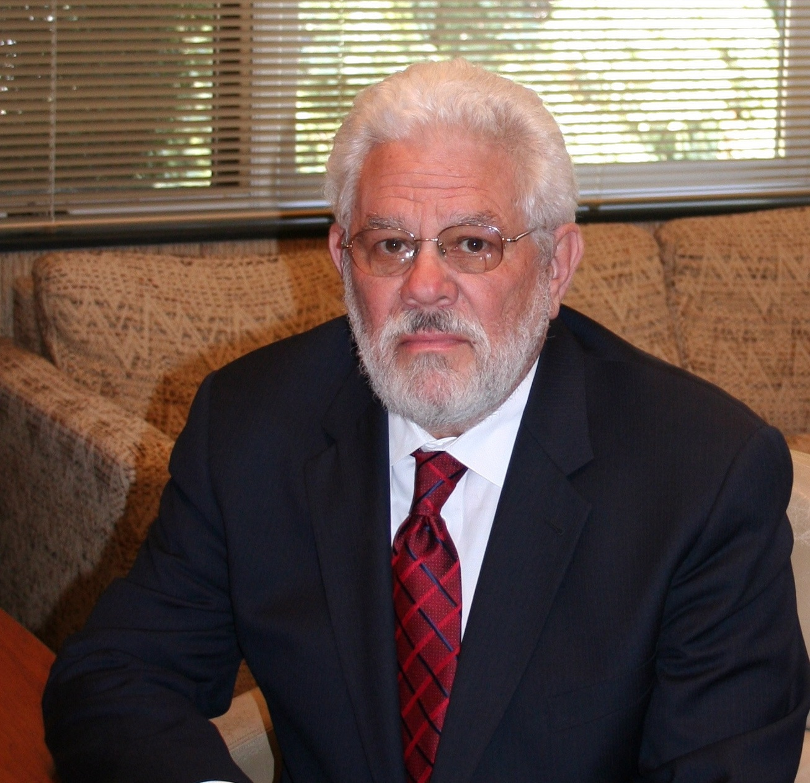
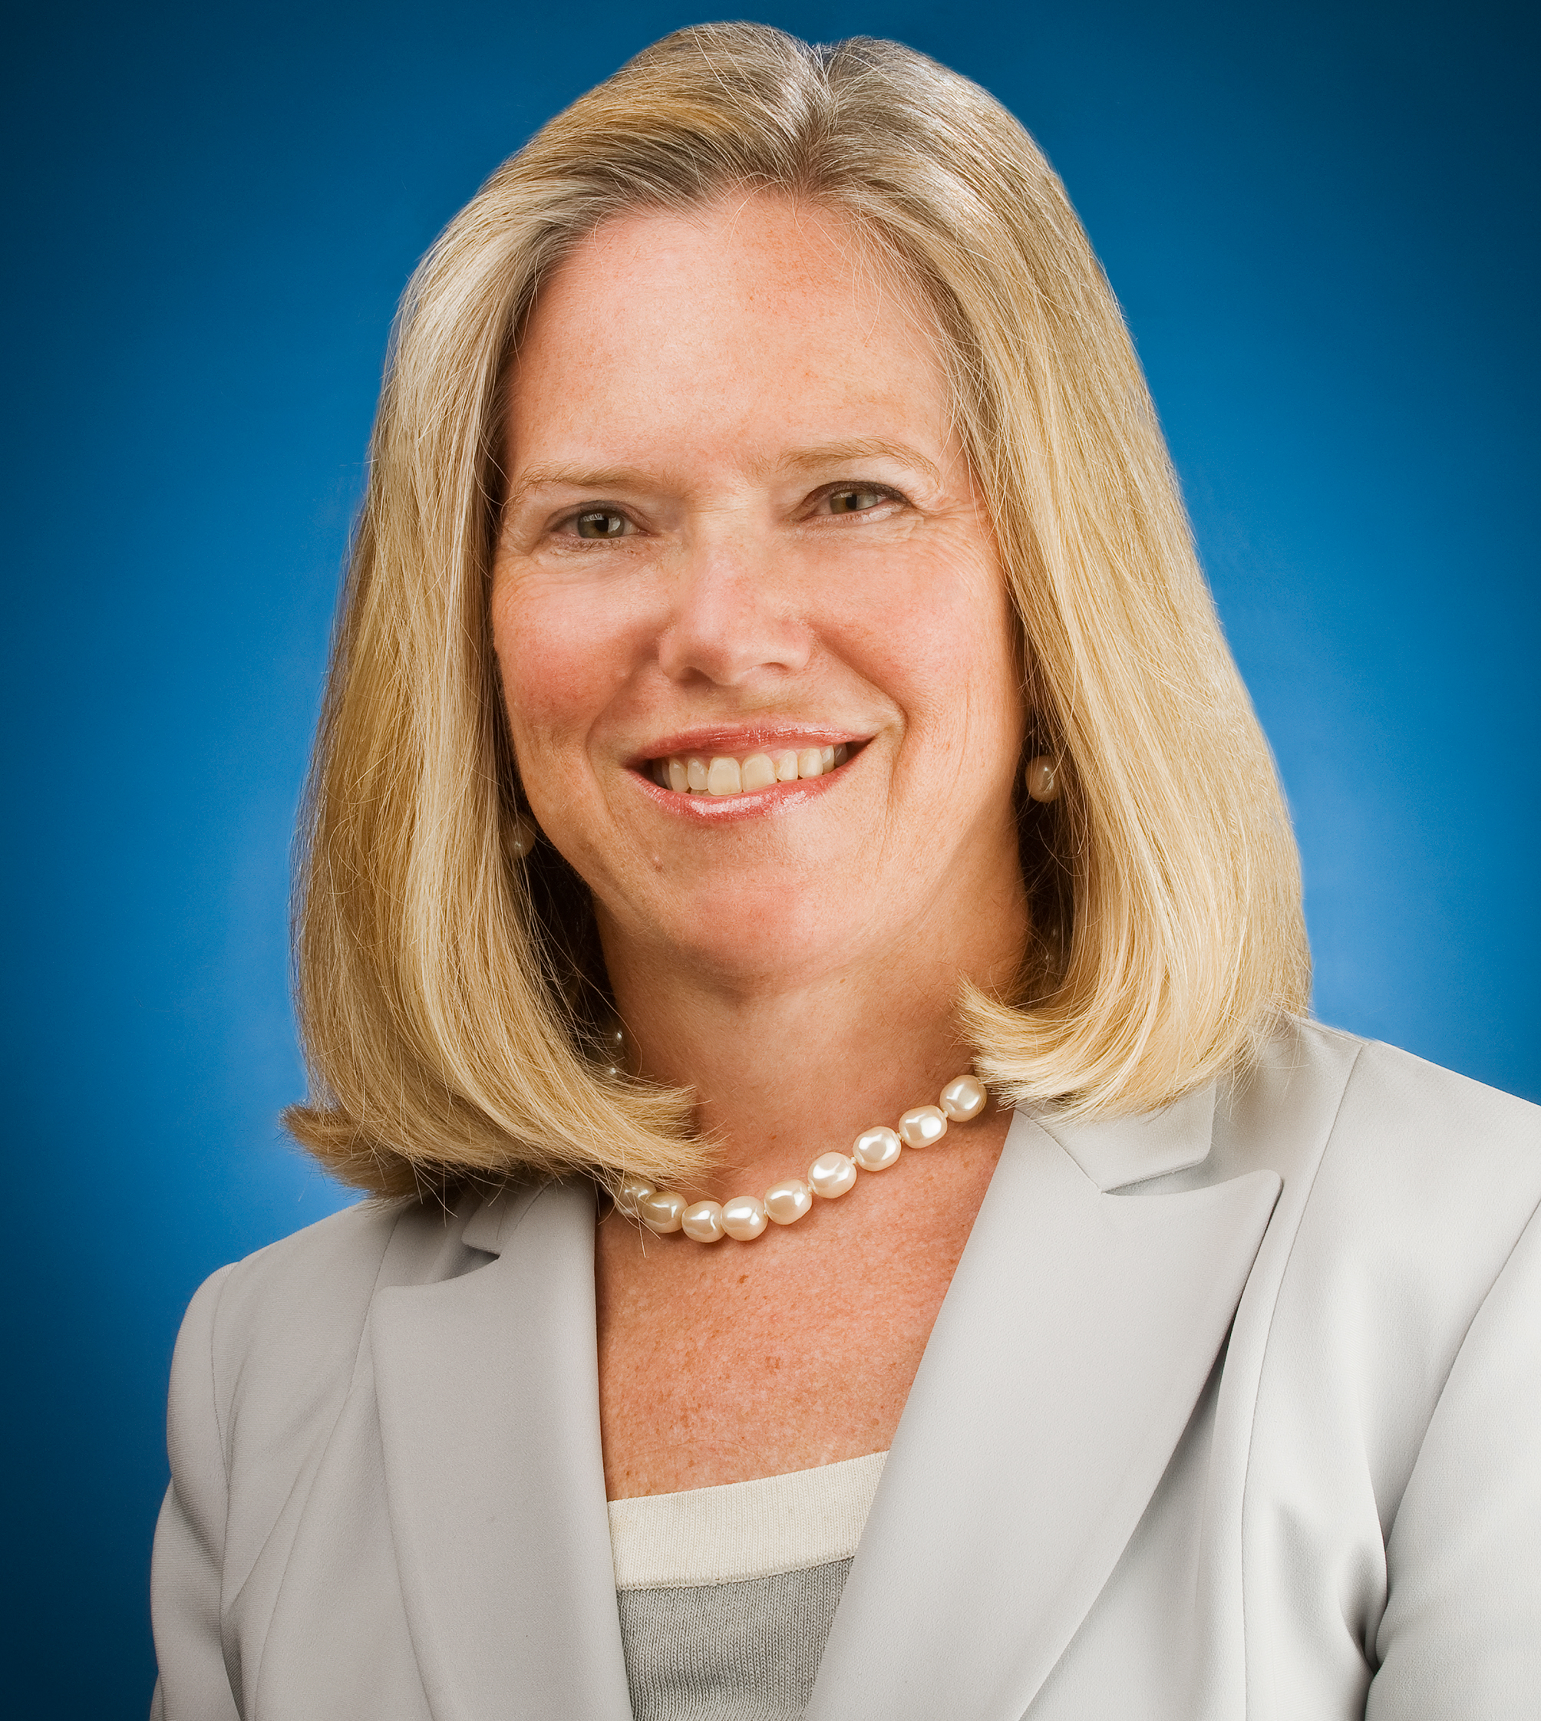
Today’s Presenters
David E. Morrison, M.D.
Morrison Associates, Ltd.
dmmd@morrisonltd.com
Elizabeth Kellar
ICMA
ekellar@icma.org

Slide 3
Emotional Health & Resilience During a Crisis
ICMA
David Morrison, M.D.
April 3, 2020
© David Morrison, M.D., March 31, 2020
Notes:
Covid-19 not just spilling over into the economy, a major issue for leadership.
CMGS Trust and dealing with crisis.
Had to cancel our CM groups at the very time they are needed.
Much good advice: NYT, NPR, TV.
Also some simplistic wrong advice.
In our short time we are only going to hit the surface of four basic actions

Slide 4
FOUR BASIC THINGS TO DO
Be Realistic
Maintain Structure
Tend to your Self
Build & Maintain Supportive Relationships
Notes:
5√ Using heroin to feel better is not realistic
Going to Mardi Gras or crowded beach for spring break.
Stress affects decisions.
Scientific, reliable sources of information.
Do what is realistic, not comfortable.
Realistically manage your time. √

Slide 5
MAINTAIN STRUCTURE
Structure is support
  Routines
Sleep schedule
Planning
Be Problem Focused
Notes:
√√√ Wake up at the same time.
√ Layout a schedule for the day at breakfast.
√ We’ll do a study of pruning
I am a problem solver and this is a problem.

Slide 6
TEND TO YOUR SELF
Exercise
Healthy Coping Mechanisms (George Vaillant)
  Sublimation
  Altruism
  Anticipation
  Humor
  Suppression
Be Playful
Keep your sense of responsibility realistic
Personal Reflection
Emotional awareness
Notes:
√ Yoga
Playful: Have to feel safe
Personal Reflection
Mindfulness
Meditation Dali Lama: Practicing
Relaxation techniques

Slide 7
WORKING WITH EMOTIONS
Get Curious About Emotions
Put feelings in perspective
  Emotional responses are normal
  They inform us about ourselves and our environment
Be aware of feelings
  Use them as data
  Work to understand them
  Know your own feelings

Slide 8
MANAGING EMOTIONS
Minimize Inhibition of Emotions
Minimize Negative Emotions
Maximize Positive Emotions
Perceive → Name → Meaning
Notes:
4 Actions
Minimizing negative and maximizing positive affects are the key to emotional resilience.

Slide 9
MINIMIZE NEGATIVE EMOTIONS
Perceive  Name  Meaning
  Curious About Why
  What It Is Signaling
Turn Loose Intellectually
Act To Solve Problem
Notes:
√√ When you get curious you have moved to positive affect.
√√√
Give an example of anger:
Anger is response to a frustrated goal.
Turning lose intellectually

Slide 10
MAXIMIZE POSITIVE EMOTIONS
Perceive  Name  Meaning
Address your Mood
Put Positive Meaning Into Ordinary Events
Notes:
When you get curious you have moved to positive affect.
√√ Mood: What is it? How is affecting my relationship to others and myself. Affects are contagious.
√
The sun came up
The rain will help the plants.
The dog that welcomes you home.
Grace and Gratitude.

Slide 11
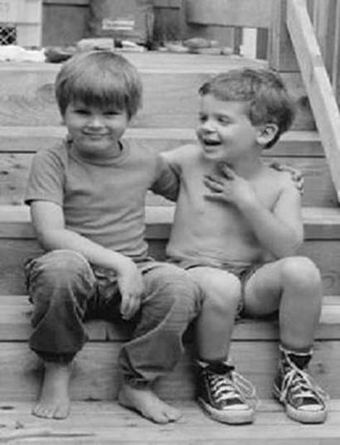
MAXIMIZE POSITIVE EMOTIONS
Perceive  Name  Meaning
Address your Mood
Put Positive Meaning Into Ordinary Events
Be Grateful
Notes:
They have 1 shirt, pair pants, shoes between them—happy
Gratitude: Oxford don, John Wesley
The porter: The evening was cold, and he was poorly clad, Wesley urged him to go home for a coat.
“I thank God for this the one coat I possess,” indicating his threadbare garment. “And I thank Him for water, my only drink during the day.”
“What else is there for which you are thankful?”
“I will thank Him I have the dry stones to lie upon.”
“Please, continue.” “I thank Him that He has given me my life and being, a heart to love Him, and a desire to serve Him.”

Slide 12
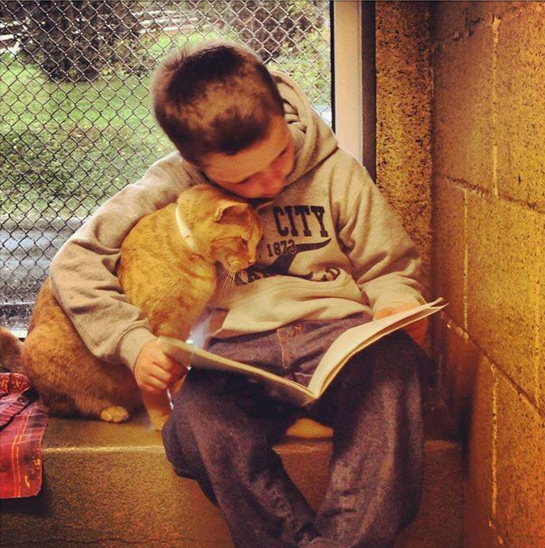
RELATIONSHIPS
Notes:
What does the holding do?
Oxycitocin

Slide 13
Build Supportive Relationships
Emotionally close—Attunement
Altruism & Gratitude
Build Support Structures
  Sacred Times
Notes:
√ Attunement—no multiple tasking.
Dog, if you can’t be close to people.
Think of the people you love and vice versa.
NSCM
√ Wound liken place
Time can count on being with each other.
No distractions, Sacred
Dinner, breakfast, church
Calls: Larry, Kelly, Taylor—They knew me when…

Slide 14
Questions?
Please use THE Q/A FUNCTION TO SUBMIT YOUR QUESTION
Content

Slide 15


