Slide 1



COVID-19 Mass Vaccination
Preliminary Guidance for Local Government Leaders and Managers

Slide 2


Today’s Presenters
Tad McGalliard
Director, Research and Technical Assistance
ICMA
Claire Hannan, MPH
Executive Director
Association for Immunization Managers

Slide 3

ICMA and COVID-19 www.icma.org/coronavirus

Slide 4
Moving with the Crisis
Planning/
Preparation
Initial Response
Response + Initial Recovery
Future Recovery/ Restoration

Slide 5
Areas of Action
Research and Content
Events and Learning
Policy and Advocacy
Member Outreach & Engagement
www.icma.org/coronavirus

Slide 6
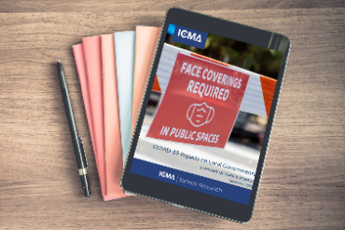
Research & Content
140 blog posts and articles since early March
Additional fact sheets, documents, templates
Two COVID impacts surveys
Notes:
125 blog posts and articles since early March
Additional fact sheets, documents, templates
Two financial impacts survey
Sample topics
Two Places at One Time: Coronavirus Presents Challenges for Working Families
Arts, Culture, and Entertainment: Vital Sectors to Restarting Your Economy
Coronavirus: Restroom Guidance for Local Leaders
Lessons Learned: The City of Cedar Park and COVID-19 Response

Slide 7

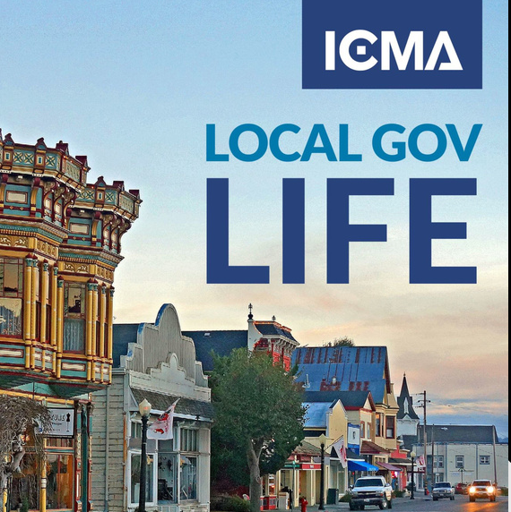
Events & Learning Opportunities
Notes:
Several dozen sessions at UNITE
Leadership During Crisis
Bergamo city manager discusses the challenges of leadership in the jurisdiction at the epicenter of the Italian peak in March 2020.
Going back to the platform on November 13 for a one-day event that will include new sessions on COVID
COVID-19 ocal Gov Life Webinars
20 free webinars since March
Cares Act
Small Business Support

Slide 8
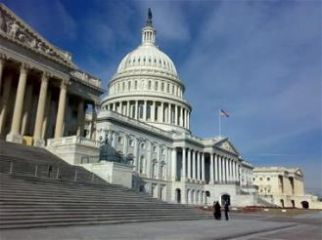
Policy & Advocacy
Big 7 coordination
Letters to White House & Congress
Legislative updates, guidance from federal agencies

Slide 9


Member Outreach & Engagement
Notes:
Newsletters, social media, messages from Marc
ICMA Connect relaunch
Global Perspectives series; International Teams Channel
We encourage our members to post their questions, responses and needs to these channels so that we can better respond to your needs

Slide 10
2020: The Year of What Could Possibly Be Next www.icma.org/coronavirus
Notes:
2020 Election
Heightened cyber security worries
Compounding crises
Mass Vaccination Preparation
Introduce Claire Hannan

Slide 11


ICMA: COVID-19 Vaccine Preparation
Claire Hannan, MPH
Executive Director, Assoc of IZ Managers
October 14, 2020

Slide 12

Agenda
Introduction to AIM
COVID-19 vaccine development
COVID-19 vaccine distribution plan
CDC’s Interim Playbook for Jurisdictional Operations and state COVID-19 vaccine planning

Slide 13
Association of Immunization Managers (AIM)
AIM represents the 64 immunization programs who receive funding from CDC’s National Center for Immunization and Respiratory Diseases (NCIRD). These 64 immunization programs are in 50 states, 5 major cities + DC, the territories, and Pacific Islands
These 64 immunization programs are tasked with COVID-19 vaccine planning: distribution, administration, and tracking.

Slide 14
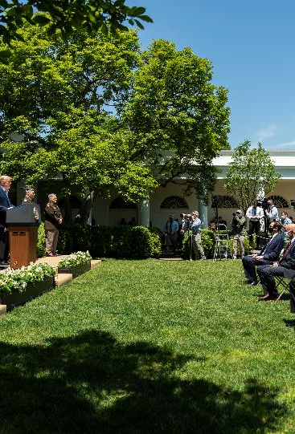

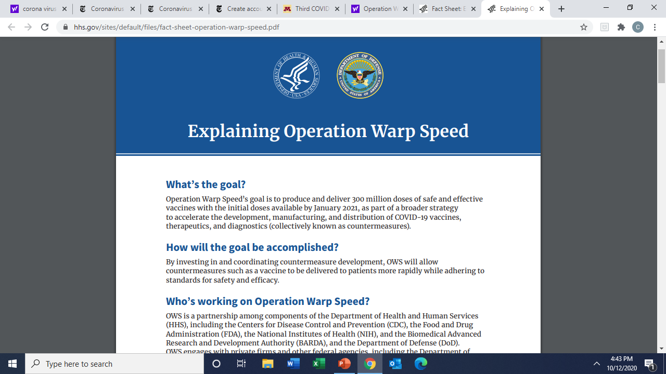
Operation Warp Speed
May 15, 2020
Notes:
The advent of Operation Warp Speed introduced a number of uncertainties into this process and in some ways has put planning into a holding pattern.
The President has said on multiple occasions that the military will handle logistics and the Department of Defense will lead vaccine distribution efforts. DOD and Operation Warp Speed have not provided any details on how vaccine will be distributed, and we have some concern that DOD may use a different delivery model such as the Strategic National Stockpile model that is used for other countermeasures which don’t require special storage and handling. Vaccine is fragile and most states no longer have vaccine depots, so using the CDC distributor to deliver vaccine directly to the provider is a best practice for cold chain management reducing the number of touches in transport. We also want to make sure that allocation of vaccine and tracking of doses administered goes through existing channels so that states can manage inventory and assure vaccine is targeted to prioritized groups.

Slide 15
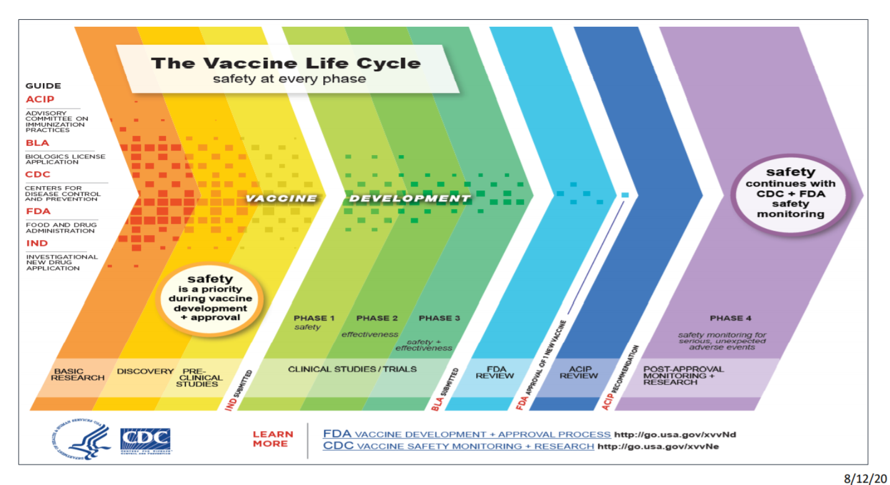
Notes:
Before I talk in more detail about Operation Warp Speed and their investment in COVID-19 vaccine development, I want to quickly review how a vaccine is developed and tested. It is important to note that safety is a priority during all phases of vaccine development and continues to be a priority after the vaccine is approved and in use.

Slide 16
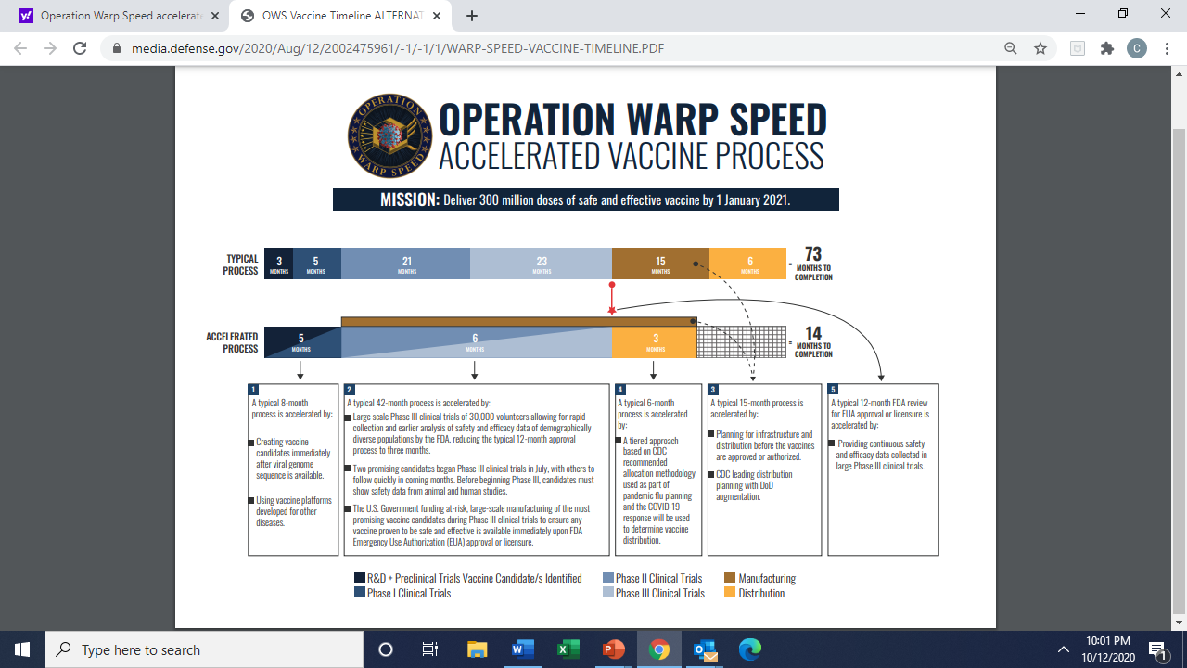
Notes:
Operation Warp Speed has accelerated the vaccine development process in this time of emergency. Research is accelerated by sharing vaccine platforms. Preclinical trials are occurring in parallel with research, phase 1 and 2 clinical trials occurre in parallel, and actual manufacturing of the vaccine is occurring simultaneously to phase 3 trials. The same safety and effectiveness protocols are in place in the phase 1, 2, and 3 trials but manufacturing is occurring at the same time at financial risk
Operation Warp Speed or OWS has spent about $10 billion to help vaccine makers develop their candidates and build out production capacity to make vaccines at commercial scale. An innovation to speed vaccine development: the vaccine makers are already producing doses, before they even know if vaccines work. If the vaccine is shown to be safe and effective, use of it can start immediately.

Slide 17
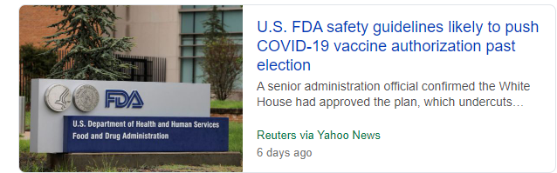
FDA COVID-19 Vaccine Guidance for Industry
Development and Licensure of Vaccines to Prevent COVID-19, June 2020
  Demonstrate 50% effectiveness
Emergency Use Authorization for Vaccines to Prevent COVID-19, October 2020
  Follow-up duration of at least two months after completion of the full vaccination regimen to help provide adequate information to assess a vaccine’s benefit-risk profile
EUA:
  Declared HHS emergency
  Evidence of effectiveness
  Known and potential benefits outweigh
  known and potential risk
  No adequate, approved and available alternative
Notes:
Today, the U.S. Food and Drug Administration issued guidance with recommendations for vaccine sponsors regarding the scientific data and information that would support the issuance of an emergency use authorization (EUA) for an investigational vaccine intended to prevent COVID-19.
The recommendations in the guidance describe key information and data that would support issuance of an EUA, including chemistry, manufacturing and controls information, nonclinical and clinical data, and regulatory and administrative information.
This guidance provides further information on the EUA process for investigational vaccines and provides additional context to the information provided in the agency’s June guidance regarding the development and licensure of COVID-19 vaccines.
An EUA is a different standard than an approval, as noted in the June guidance, however, in the case of an investigational vaccine developed for the prevention of COVID-19, both pathways require the submission of data demonstrating any vaccine’s safety and effectiveness.
This guidance reiterates that any assessment regarding an EUA will be made on a case-by-case basis considering the target population, the characteristics of the product, the preclinical and human clinical study data on the product, and the totality of the available scientific evidence relevant to the product.
The FDA plans to convene an open session of its Vaccines and Related Biological Products Advisory Committee (VRBPAC) prior to issuance of any EUA for a COVID-19 vaccine to discuss the EUA request and whether the available safety and effectiveness data support the authorization. The VRBPAC is currently scheduled to meet on Oct. 22 to discuss the general development, authorization and/or licensure of COVID-19 vaccines. While this meeting is not intended to discuss any particular vaccine candidate, the agency is prepared to rapidly schedule additional future meetings of this committee after submission of any BLA or request for EUA to further ensure transparency.
To ensure that a widely deployed COVID-19 vaccine is effective, the primary efficacy endpoint point estimate for a placebo-controlled efficacy trial should be at least 50%, and the statistical success criterion should be that the lower bound of the appropriately alpha-adjusted confidence interval around the primary efficacy endpoint point estimate is >30%.
FDA acknowledges the potential to request an EUA for a COVID-19 vaccine based on an interim analysis of a clinical endpoint from a Phase 3 efficacy study. Issuance of an EUA requires a determination that the known and potential benefits of the vaccine outweigh the known and potential risks. For a preventive COVID19 vaccine to be potentially administered to millions of individuals, including healthy individuals, data adequate to inform an assessment of the vaccine’s benefits and risks and support issuance of an EUA would include not only meeting the prespecified success criteria for the study’s primary efficacy endpoint as described in the guidance for industry entitled “Development and Licensure of Vaccines to Prevent COVID-19” (Ref. 1) (i.e. a point estimate for a placebocontrolled efficacy trial of at least 50%, with a lower bound of the appropriately alpha-adjusted confidence interval around the primary efficacy endpoint point estimate of >30%) but also additional safety and effectiveness data as described below. The timing of interim analyses planned for a Phase 3 study would thus ideally be aligned with the ability of the analyses to meet these criteria. Contains Nonbinding Recommendations 10 b. An EUA request for a COVID-19 vaccine should include all safety data accumulated from phase 1 and 2 studies conducted with the vaccine, with focus on serious adverse events, adverse events of special interest, and cases of severe COVID-19 among study subjects. We recognize that the phase 1 and 2 safety data likely will be of a longer duration than the available safety data from the Phase 3 trial at the time of submission of an EUA request. The phase 1 and 2 data are intended to complement the available data from safety follow-up from ongoing Phase 3 studies. c. Data from Phase 3 studies should include a median follow-up duration of at least two months after completion of the full vaccination regimen to help provide adequate information to assess a vaccine’s benefit-risk profile, including: adverse events; cases of severe COVID-19 disease among study subjects; and cases of COVID-19 occurring during the timeframe when adaptive (rather than innate) and memory immune responses to the vaccine would be responsible for a protective effect. In addition, FDA does not expect to be able to make a favorable benefit-risk determination that would support an EUA without Phase 3 data that include the following, which will help the Agency to assess the safety of the vaccine: i. Local and systemic solicited adverse reactions collected for the protocoldefined duration of follow-up in an adequate number of subjects to characterize reactogenicity in each protocol-defined age cohort participating in the trial; ii. All safety data collected up to the point at which the database is locked to prepare the submission of the EUA request, including a high proportion of enrolled subjects (numbering well over 3,000 vaccine recipients) followed for serious adverse events (SAEs) and adverse events of special interest for at least one month after completion of the full vaccination regimen;5 and iii. Sufficient cases of severe COVID-19 among study subjects to support low risk for vaccine-induced ERD (a total of 5 or more severe COVID-19 cases in the placebo group would generally be sufficient to assess whether the severe COVID-19 case split between vaccine vs. placebo groups supports a favorable benefit-risk profile or conversely raises a concern about ERD). d. Vaccine safety and COVID-19 outcomes in individuals with prior SARS-CoV-2 infection, who might have been asymptomatic, are important to examine because screening for prior infection is unlikely to occur prior to administration of 5 As noted in FDA’s guidance for industry entitled “Development and Licensure of Vaccines to Prevent COVID-19” (Ref. 1), the pre-licensure safety database for preventive vaccines for infectious diseases typically consists of at least 3,000 study participants vaccinated with the dosing regimen intended for licensure. FDA anticipates that adequately powered efficacy trials for COVID-19 vaccines will be of sufficient size to provide an acceptable safety database for each of younger adult and elderly populations, provided that no significant safety concerns arise during clinical development that would warrant further evaluation. Contains Nonbinding Recommendations 11 COVID-19 vaccines under EUA. An EUA request should therefore include subgroup analyses of safety and efficacy endpoints stratified by prior infection status at study entry, as determined by pre-vaccination serology or medical history. e. The EUA request should include a plan for active follow-up for safety (including deaths and hospitalizations, and other serious or clinically significant adverse events) among individuals administered the vaccine under an EUA in order to inform ongoing benefit-risk determinations to support continuation of the EUA

Slide 18
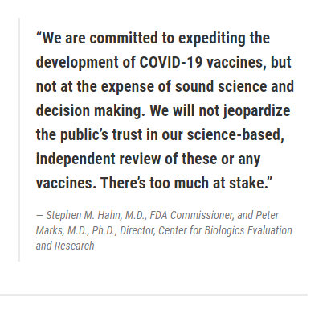
COVID-19 Vaccine Approval and Recommendation Process
FDA approves vaccine licensure request or authorizes its use under Emergency Use Authorization (regulatory authority)
CDC makes recommendations on the use of vaccine once it is authorized or licensed (CDC/ACIP recommendations are covered by health insurance)
Two independent advisory committees: Vaccines and Related Biological Products Advisory Committee (VRBPAC) advises FDA; Advisory Committee on Immunization Practices (ACIP) advises CDC
Notes:
Today, the U.S. Food and Drug Administration issued guidance with recommendations for vaccine sponsors regarding the scientific data and information that would support the issuance of an emergency use authorization (EUA) for an investigational vaccine intended to prevent COVID-19.
The recommendations in the guidance describe key information and data that would support issuance of an EUA, including chemistry, manufacturing and controls information, nonclinical and clinical data, and regulatory and administrative information.
This guidance provides further information on the EUA process for investigational vaccines and provides additional context to the information provided in the agency’s June guidance regarding the development and licensure of COVID-19 vaccines.
An EUA is a different standard than an approval, as noted in the June guidance, however, in the case of an investigational vaccine developed for the prevention of COVID-19, both pathways require the submission of data demonstrating any vaccine’s safety and effectiveness.
This guidance reiterates that any assessment regarding an EUA will be made on a case-by-case basis considering the target population, the characteristics of the product, the preclinical and human clinical study data on the product, and the totality of the available scientific evidence relevant to the product.
The FDA plans to convene an open session of its Vaccines and Related Biological Products Advisory Committee (VRBPAC) prior to issuance of any EUA for a COVID-19 vaccine to discuss the EUA request and whether the available safety and effectiveness data support the authorization. The VRBPAC is currently scheduled to meet on Oct. 22 to discuss the general development, authorization and/or licensure of COVID-19 vaccines. While this meeting is not intended to discuss any particular vaccine candidate, the agency is prepared to rapidly schedule additional future meetings of this committee after submission of any BLA or request for EUA to further ensure transparency.
To ensure that a widely deployed COVID-19 vaccine is effective, the primary efficacy endpoint point estimate for a placebo-controlled efficacy trial should be at least 50%, and the statistical success criterion should be that the lower bound of the appropriately alpha-adjusted confidence interval around the primary efficacy endpoint point estimate is >30%.
FDA acknowledges the potential to request an EUA for a COVID-19 vaccine based on an interim analysis of a clinical endpoint from a Phase 3 efficacy study. Issuance of an EUA requires a determination that the known and potential benefits of the vaccine outweigh the known and potential risks. For a preventive COVID19 vaccine to be potentially administered to millions of individuals, including healthy individuals, data adequate to inform an assessment of the vaccine’s benefits and risks and support issuance of an EUA would include not only meeting the prespecified success criteria for the study’s primary efficacy endpoint as described in the guidance for industry entitled “Development and Licensure of Vaccines to Prevent COVID-19” (Ref. 1) (i.e. a point estimate for a placebo controlled efficacy trial of at least 50%, with a lower bound of the appropriately alpha-adjusted confidence interval around the primary efficacy endpoint point estimate of >30%) but also additional safety and effectiveness data as described below. The timing of interim analyses planned for a Phase 3 study would thus ideally be aligned with the ability of the analyses to meet these criteria. Contains Nonbinding Recommendations 10 b. An EUA request for a COVID-19 vaccine should include all safety data accumulated from phase 1 and 2 studies conducted with the vaccine, with focus on serious adverse events, adverse events of special interest, and cases of severe COVID-19 among study subjects. We recognize that the phase 1 and 2 safety data likely will be of a longer duration than the available safety data from the Phase 3 trial at the time of submission of an EUA request. The phase 1 and 2 data are intended to complement the available data from safety follow-up from ongoing Phase 3 studies. c. Data from Phase 3 studies should include a median follow-up duration of at least two months after completion of the full vaccination regimen to help provide adequate information to assess a vaccine’s benefit-risk profile, including: adverse events; cases of severe COVID-19 disease among study subjects; and cases of COVID-19 occurring during the timeframe when adaptive (rather than innate) and memory immune responses to the vaccine would be responsible for a protective effect. In addition, FDA does not expect to be able to make a favorable benefit-risk determination that would support an EUA without Phase 3 data that include the following, which will help the Agency to assess the safety of the vaccine: i. Local and systemic solicited adverse reactions collected for the protocol defined duration of follow-up in an adequate number of subjects to characterize reactogenicity in each protocol-defined age cohort participating in the trial; ii. All safety data collected up to the point at which the database is locked to prepare the submission of the EUA request, including a high proportion of enrolled subjects (numbering well over 3,000 vaccine recipients) followed for serious adverse events (SAEs) and adverse events of special interest for at least one month after completion of the full vaccination regimen;5 and iii. Sufficient cases of severe COVID-19 among study subjects to support low risk for vaccine-induced ERD (a total of 5 or more severe COVID-19 cases in the placebo group would generally be sufficient to assess whether the severe COVID-19 case split between vaccine vs. placebo groups supports a favorable benefit-risk profile or conversely raises a concern about ERD). d. Vaccine safety and COVID-19 outcomes in individuals with prior SARS-CoV-2 infection, who might have been asymptomatic, are important to examine because screening for prior infection is unlikely to occur prior to administration of 5 As noted in FDA’s guidance for industry entitled “Development and Licensure of Vaccines to Prevent COVID-19” (Ref. 1), the pre-licensure safety database for preventive vaccines for infectious diseases typically consists of at least 3,000 study participants vaccinated with the dosing regimen intended for licensure. FDA anticipates that adequately powered efficacy trials for COVID-19 vaccines will be of sufficient size to provide an acceptable safety database for each of younger adult and elderly populations, provided that no significant safety concerns arise during clinical development that would warrant further evaluation. Contains Nonbinding Recommendations 11 COVID-19 vaccines under EUA. An EUA request should therefore include subgroup analyses of safety and efficacy endpoints stratified by prior infection status at study entry, as determined by pre-vaccination serology or medical history. e. The EUA request should include a plan for active follow-up for safety (including deaths and hospitalizations, and other serious or clinically significant adverse events) among individuals administered the vaccine under an EUA in order to inform ongoing benefit-risk determinations to support continuation of the EUA

Slide 19
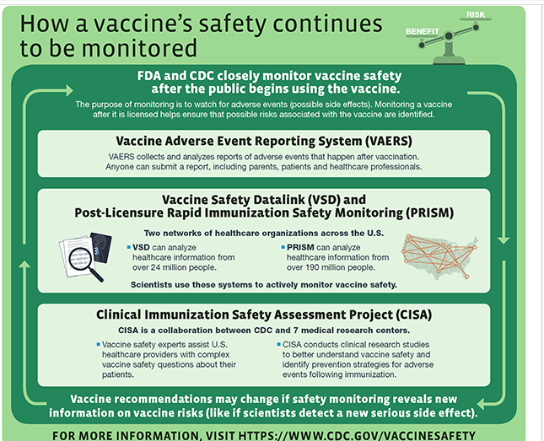
FDA and CDC continue to monitor vaccine safety after it is licensed or approved for use
Multiple surveillance systems are used to track adverse events following vaccination
Any adverse events occurring more frequently in vaccinated persons than in non-vaccinated persons will be investigated as a potential safety signal

Slide 20
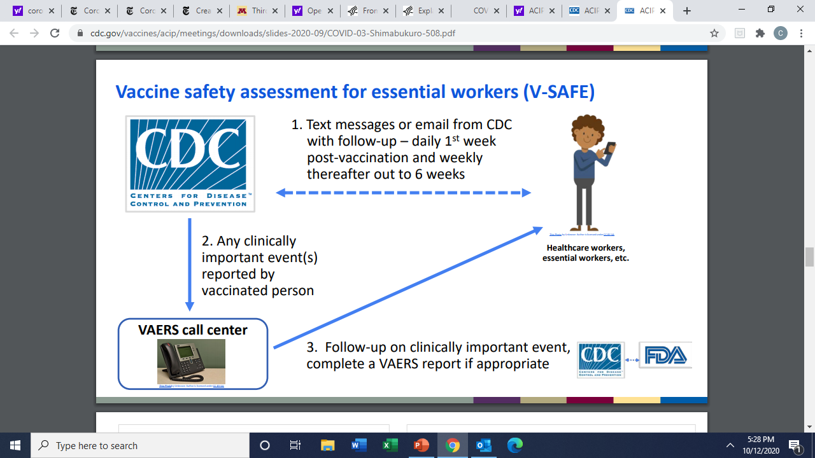
V-SAFE Safety Surveillance

Slide 21
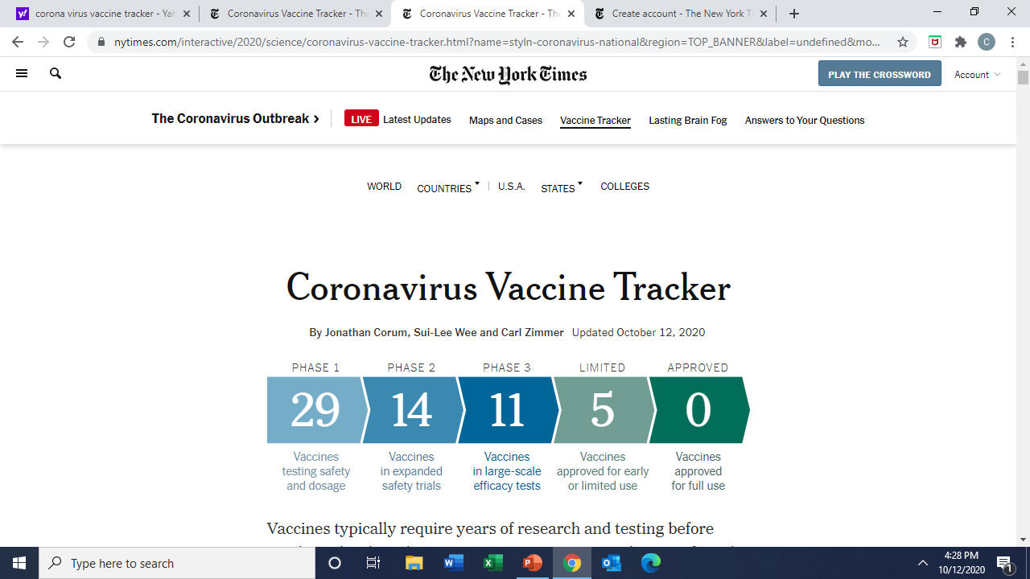
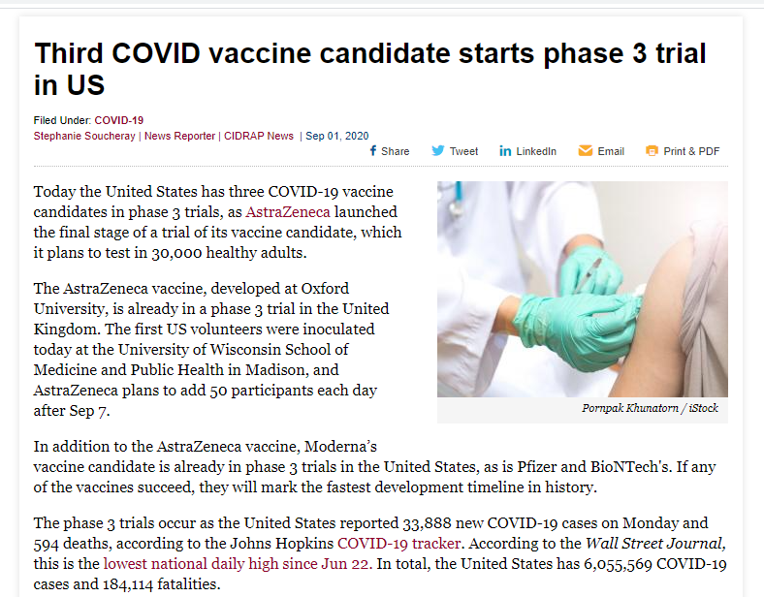
COVID-19 Vaccine Development

Slide 22

Promising Vaccine Candidates
Operation Warp Speed has invested in research and development of 14 promising vaccine candidates and contracted for manufacture of 6 vaccine candidates:
1. Pfizer (100 million doses, late 2020/early 2021) [2 dose series, 21 days apart, ultra cold, pkg in 975 dose increments, requires diluent]
2. Moderna (100 million doses, early 2021) [2 dose series, 28 days apart, frozen, 100 dose pkg]
3. Johnson & Johnson (100 million doses, Spring 2021) [1 dose, refrigerator stable, 100 dose pkg]
4. Astra Zeneca (300 million doses)
5. GSK/Sanofi (100 million doses)
6. Novavax (100 million doses)
Notes:
The US has committed to purchase upwards of 800 million initial doses, with options for another 1.6 billion doses

Slide 23
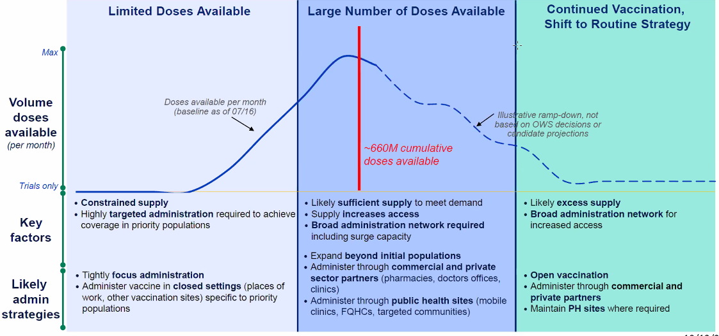
COVID-19 Vaccine Phased Approach

Slide 24
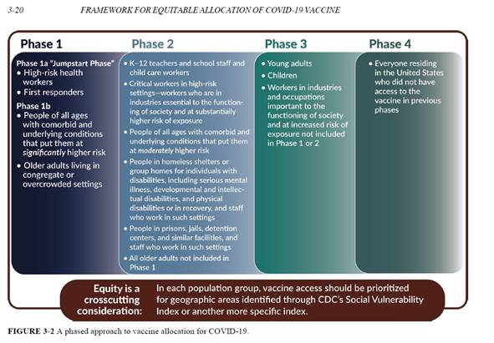
National Academy of Science
Framework for Equitable Distribution

Slide 25
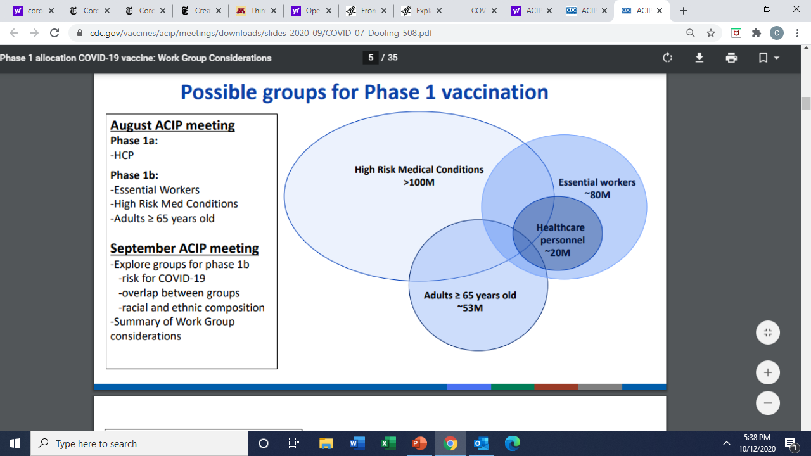
Possible Groups for Phase 1 Vaccination
Phase 1a
-health care personnel
Phase 1b
- essential workers
- high risk medical conditions
- adults > 65 years old

Slide 26
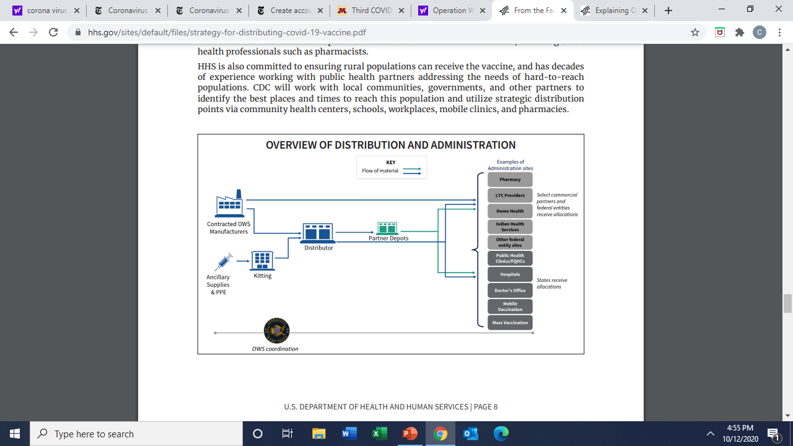
COVID-19 Distribution Plan

Slide 27
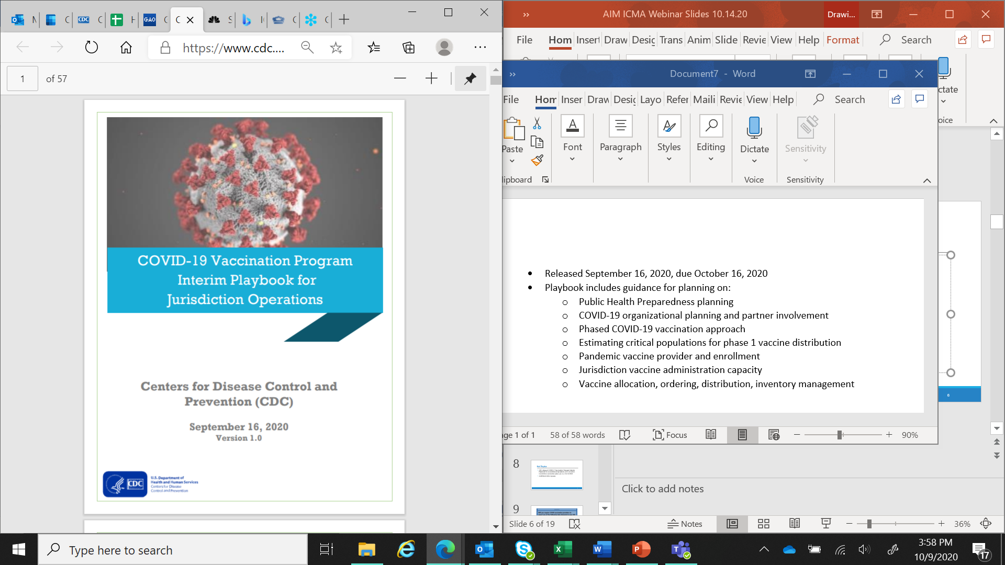
COVID-19 Interim Playbook for Jurisdictional Operations
Guidance released September 16, 2020; State written plans due October 16, 2020
Guidance for planning in 15 sections, including:
Provider enrollment and training
Vaccine allocation, ordering and distribution
Defining and estimating critical populations
Vaccine storage and handling (preliminary)
Communications
Required data collection and reporting

Slide 28

State Planning Activities
Identifying and enrolling providers
Estimating priority populations
Determining allocation/prioritization process
Establishing data expectations and IT capacity
Identifying ultra cold storage capacity and high throughput clinic capacity
Preparing communication plans

Slide 29
Vaccine Distribution: Planning Assumptions
          Limited doses may be available Nov/Dec 2020
          Phase 1: Critical workforce, health care personnel, high-risk
          Multiple presentations with different protocols; some requiring 2 doses
Notes:
There are some basic assumptions driving the current planning for vaccine distribution. We’ve been told to plan for doses in limited numbers as early as Fall of this year, with larger quantities coming in early 2021.
It is likely that critical workforce, health care personnel, and those at highest risk for developing complications from COVID-19 will be prioritized to receive the vaccine first.
Given the number of different vaccine candidates progressing through clinical trials, it is likely there will be multiple vaccines coming to market around the same time. These vaccines may have different age indications, different storage protocols… some may require 2 doses,, some may use an adjuvant.

Slide 30
Vaccine Distribution: Planning Assumptions
          Cold chain storage and handling requirements for vaccine presentations will vary from refrigerator stable to frozen to ultra cold
          Early vaccine logistical challenges (ultra cold storage, 975 dose minimum, dry ice pkg)
          Vaccine will be provided at no cost to providers; no out-of-pocket costs for consumers
Notes:
- ultra Cold Storage (-70 C )
- ships on dry ice; 975 doses per box
- must use within 5 days after thawing
- mix with diluent at administration site
- two doses 21 days apart

Slide 31
Vaccine Distribution: Planning Assumptions
          Supply kits containing needles, syringes, alcohol prep pads, vaccination record cards, and personal protective equipment (PPE) will be provided (not including gloves, sharps containers and band aids)
          Redistribution will be allowed but with the challenge of maintaining cold chain redistribution is not a best practice
Notes:
There are some basic assumptions driving the current planning for vaccine distribution. We’ve been told to plan for doses in limited numbers as early as Fall of this year, with larger quantities coming in early 2021.
It is likely that critical workforce, health care personnel, and those at highest risk for developing complications from COVID-19 will be prioritized to receive the vaccine first.
Given the number of different vaccine candidates progressing through clinical trials, it is likely there will be multiple vaccines coming to market around the same time. These vaccines may have different age indications, different storage protocols… some may require 2 doses,, some may use an adjuvant.

Slide 32
Communication
          Training for providers on proper storage and handling, dose reporting, and vaccine administration
          Educational materials for consumers and providers, tailored to each audience
          Vaccine confidence and trust, particularly among groups anticipated to receive early vaccination and groups at highest risk
          Dispelling misinformation
Notes:
There are some basic assumptions driving the current planning for vaccine distribution. We’ve been told to plan for doses in limited numbers as early as Fall of this year, with larger quantities coming in early 2021.
It is likely that critical workforce, health care personnel, and those at highest risk for developing complications from COVID-19 will be prioritized to receive the vaccine first.
Given the number of different vaccine candidates progressing through clinical trials, it is likely there will be multiple vaccines coming to market around the same time. These vaccines may have different age indications, different storage protocols… some may require 2 doses,, some may use an adjuvant.

Slide 33
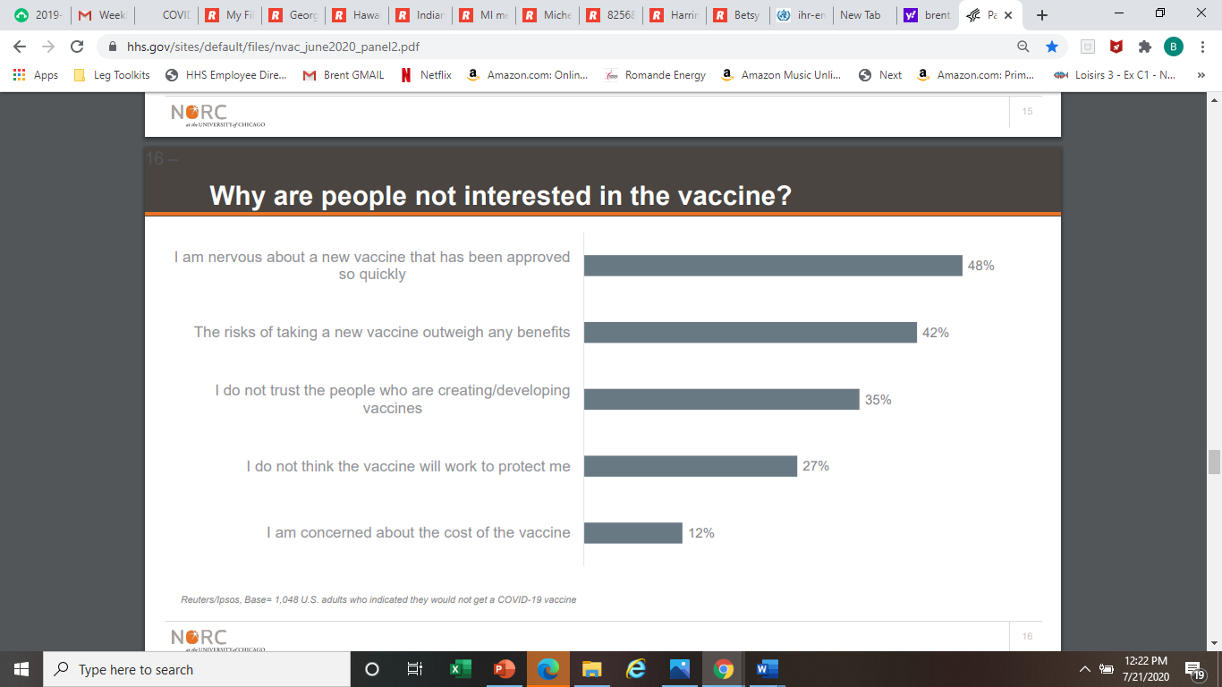
Notes:
It is also critically important for the public to accept the vaccine. Some polls have shown that more than 50% of Americans are unsure or not planning to get COVID-19 vaccine.
This is from a poll conducted by Reuters in mid-May showed that Americans are nervous about a new vaccine that has been approved so quickly.
So we need to engage the public, understand their concerns, and provide transparency in all aspects of vaccine development and distribution.

Slide 34

VYF Has Responses to Common Concerns https://www.vaccinateyourfamily.org/vaccine-safety/
Who monitors the safety of vaccines in the United States?
Aren't vaccines just a way for pharmaceutical companies (Big Pharma) to make money?
If I'm breastfeeding my baby, why do I need to vaccinate him or her?
How can I be confident that vaccines don’t cause autism?
If some vaccines are grown in human fetal cells, is it against Christian religions to be vaccinated?

Slide 35
Funding
          Supplemental funding $200 million for immunization program awardees (Sept 2020)
          Must be spent by June 30, 2021
          No specific funding appropriated by Congress for COVID-19 vaccine planning or implementation
          State and local health departments need additional funding
Notes:
There are some basic assumptions driving the current planning for vaccine distribution. We’ve been told to plan for doses in limited numbers as early as Fall of this year, with larger quantities coming in early 2021.
It is likely that critical workforce, health care personnel, and those at highest risk for developing complications from COVID-19 will be prioritized to receive the vaccine first.
Given the number of different vaccine candidates progressing through clinical trials, it is likely there will be multiple vaccines coming to market around the same time. These vaccines may have different age indications, different storage protocols… some may require 2 doses,, some may use an adjuvant.

Slide 36
Key Considerations
          Familiarize yourself with your state plan
          Build relationships with local and state health department immunization and preparedness staff
          Pay special attention to communications planning. Where will you direct providers who want to enroll? Employers who want to provide vaccine for employees? Consumers with questions about vaccine safety?
          What is expected of local government? Volunteers? Large clinic locations? Security? Traffic flow?
Notes:
There has been a lot of focus on the possibility of a very difficult fall when flu and coronavirus could be circulating concurrently, so I want to quick flag some of the strategies that immunization programs are planning:
Conducting school-located vaccination clinics and mass vaccination clinics (using schools, parking lots, testing sites, and other locations)
Purchasing additional flu vaccine to assure a safety net
Targeting healthcare workers, staff in long-term care facilities, and adults at higher risk for complications such as those with underlying health conditions. Also looking at those populations hardest hit by COVID-19 and trying to reduce their risk of flu through vaccination.
Working with Federally Qualified Health Centers, Community Health Centers, and Rural Health Clinics
Partnering with Pharmacies, doctors, insurers, hospitals, medical societies, schools, businesses

Slide 37
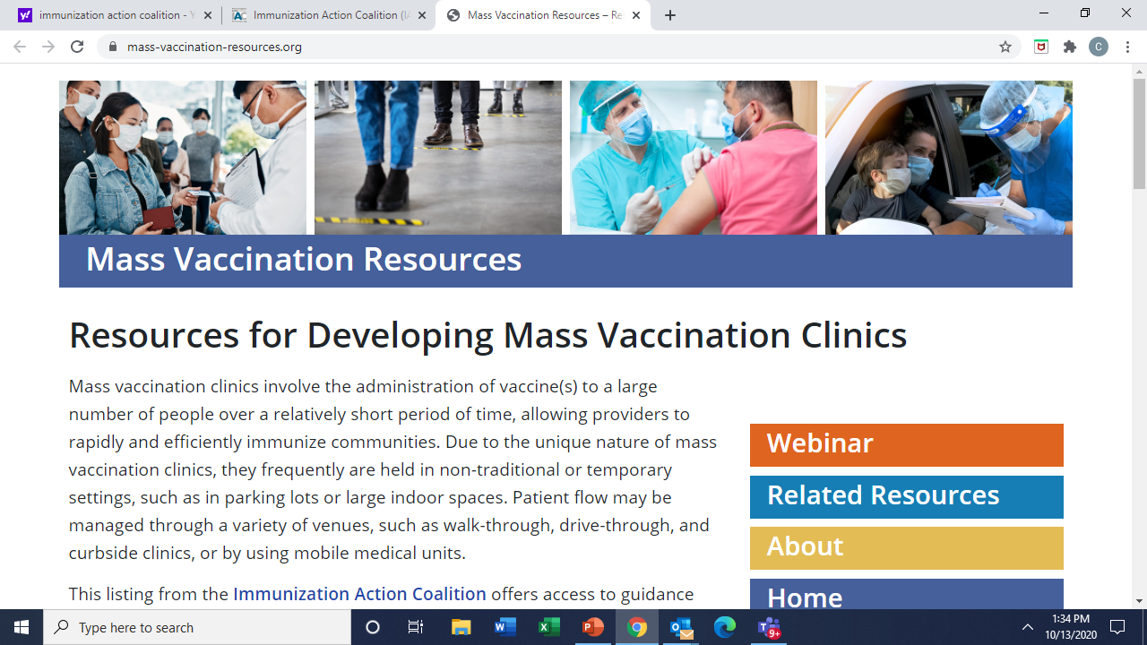
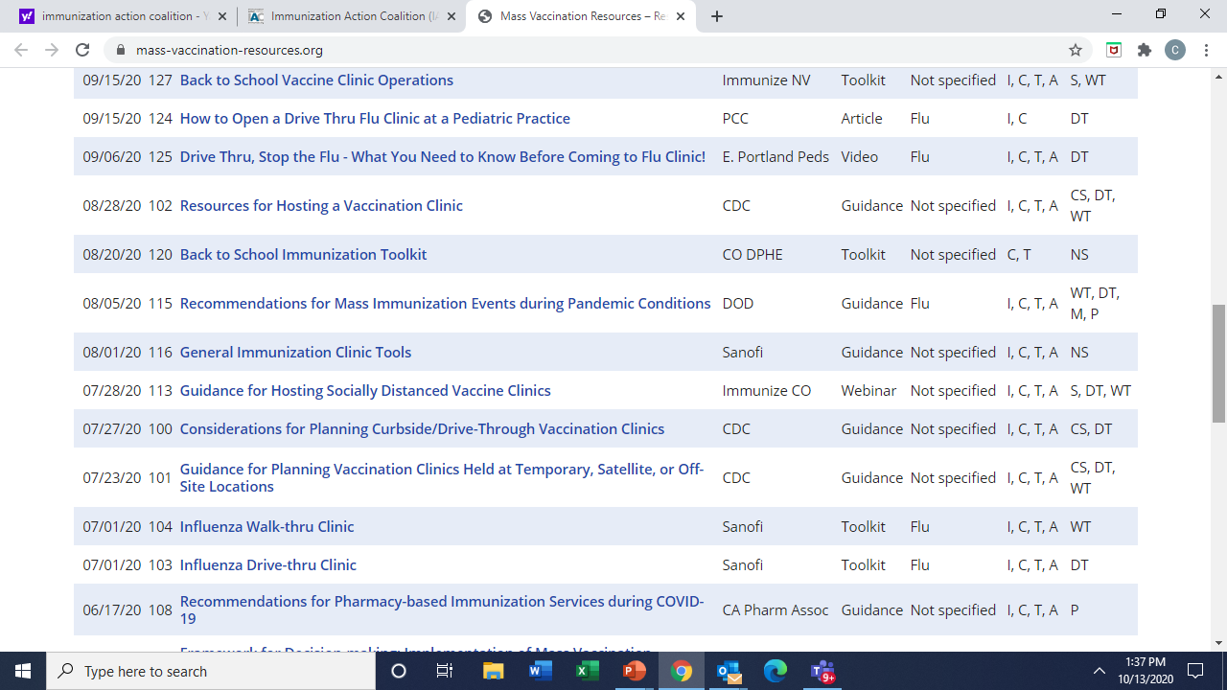
Mass Vaccination Clinics
Mass-vaccination-resources.org
Notes:
Mass vaccination clinics involve the administration of vaccine to a large number of people over a relatively short period of time, allowing providers to rapidly and efficiently immunize communities. Due to the unique nature of mass vaccination clinics, they frequently are held in non-traditional or temporary settings, such as in parking lots or large indoor spaces. Patient flow may be managed through a variety of venues, such as walk-through, drive-through, and curbside clinics, or by using mobile medical units.
The Immunization Action Coalition has developed this webpage offering access to guidance documents, toolkits, and other helpful resources, produced over a span of many years, and to information that can be adapted to meet current program needs. Most of the resources will need to be modified to account for social distancing and wearing PPE, but there is current guidance included on mass vaccination during a pandemic.
Mass-vaccination-resources.org

Slide 38
Flu Vaccination Activities
          Communication and outreach campaigns
          School located and mass vaccination clinics
          Late-season flu vaccine
          Involvement with FQHCs, CHCs
          Partnerships with pharmacies, doctors, insurers, hospitals, community leaders…
          More effort and involvement by public health than ever before!
Notes:
There has been a lot of focus on the possibility of a very difficult fall when flu and coronavirus could be circulating concurrently, so I want to quick flag some of the strategies that immunization programs are planning:
Conducting school-located vaccination clinics and mass vaccination clinics (using schools, parking lots, testing sites, and other locations)
Purchasing additional flu vaccine to assure a safety net
Targeting healthcare workers, staff in long-term care facilities, and adults at higher risk for complications such as those with underlying health conditions. Also looking at those populations hardest hit by COVID-19 and trying to reduce their risk of flu through vaccination.
Working with Federally Qualified Health Centers, Community Health Centers, and Rural Health Clinics
Partnering with Pharmacies, doctors, insurers, hospitals, medical societies, schools, businesses

Slide 39
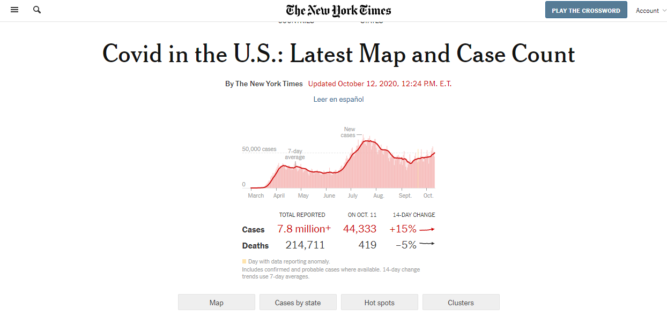

Slide 40
Key COVID Vaccine Planning Resources
CDC COVID-19 Vaccination Program Interim Playbook for Jurisdiction Operations
IAC’s Mass Vaccination Resources
AIM’s COVID-19 Vaccination Preparation Tips for Immunization Program Managers
AIM / ASTHO / NACCHO / AIRA Recommendations to OWS Leaders
ASTHO – AIM Immunization Campaign Policy Principles
HHS Operation Warp Speed Fact Sheet
ASTHO Report Assessing Policy Barriers To Effective Public Health Response In The H1N1 Influenza Pandemic
GAO Report INFLUENZA PANDEMIC Lessons from the H1N1 Pandemic Should Be Incorporated into Future Planning
CDC Pandemic Vaccine Program Distribution, Tracking, and Monitoring
CDC Interim Updated Planning Guidance on Allocating and Targeting Pandemic Influenza Vaccine during an Influenza Pandemic
CDC Pandemic Influenza Vaccine Targeting Checklist
CDC Roadmap to Implementing Pandemic Influenza Vaccination of Critical Workforce
CDC Checklist of Best Practices for Vaccination Clinics Held at Temporary, or Off-site, Satellite Clinics
CDC Guideline for Large-Scale Influenza Vaccination Clinic Planning

Slide 41
Questions?
Notes:
Questions??

