Slide 1



COVID-19 Teleconference
Public Health

Slide 2
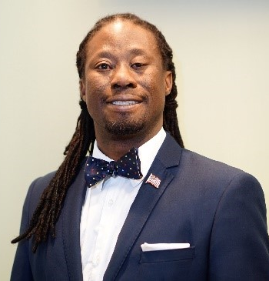
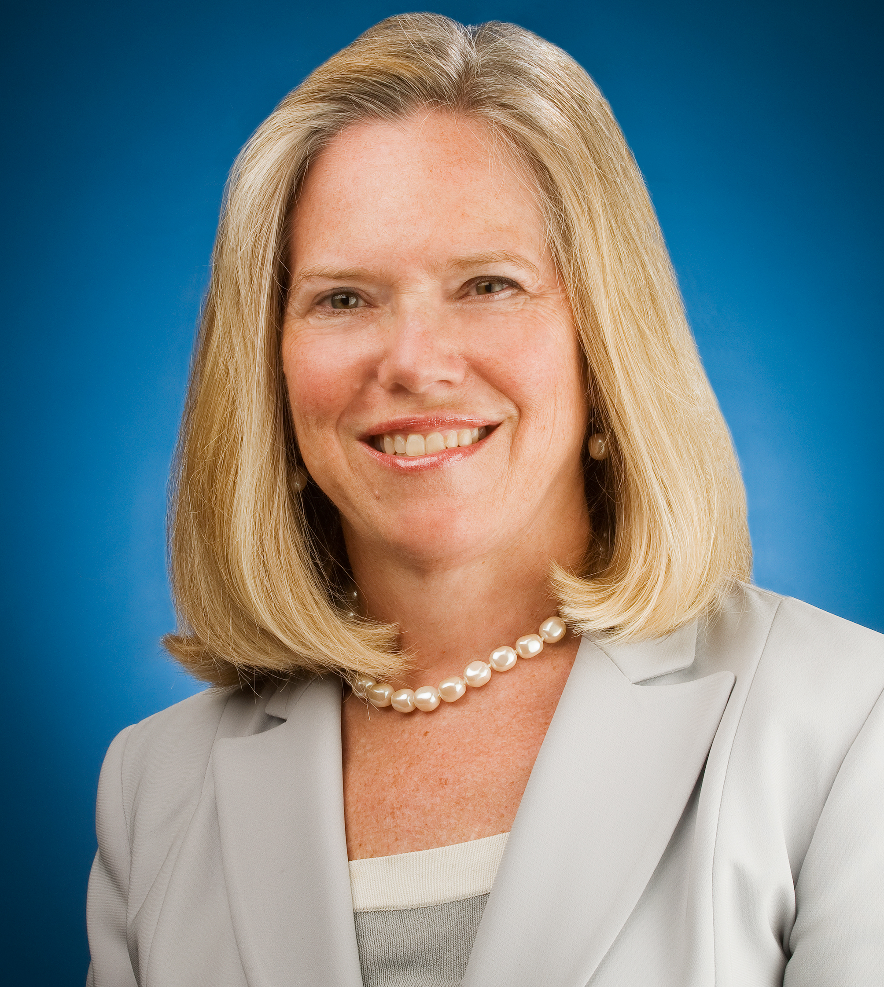
Today’s Presenters
E. Oscar Alleyne, DrPH, MPH
NACCHO
oallyene@naccho.org
Elizabeth Kellar
ICMA
ekellar@icma.org

Slide 3
Situational Report on the 2019 Coronavirus Outbreak
Dr. Oscar Alleyne
Chief Program Officer
Natl Assoc. of County and City Health Officials

Slide 4
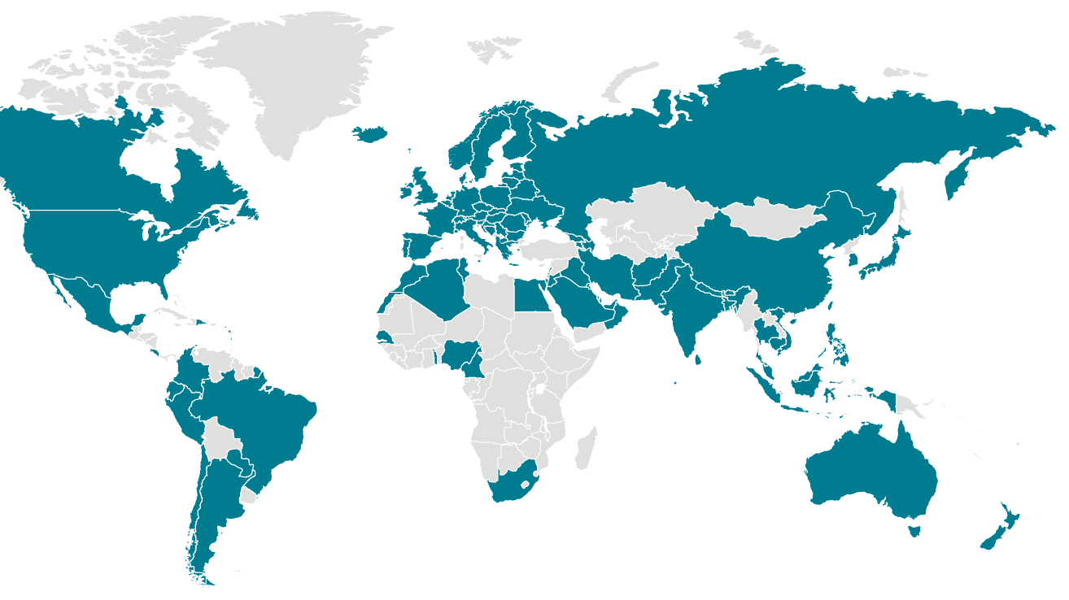
Global Summary
Total 255 300 confirmed
10 400 deaths

Slide 5
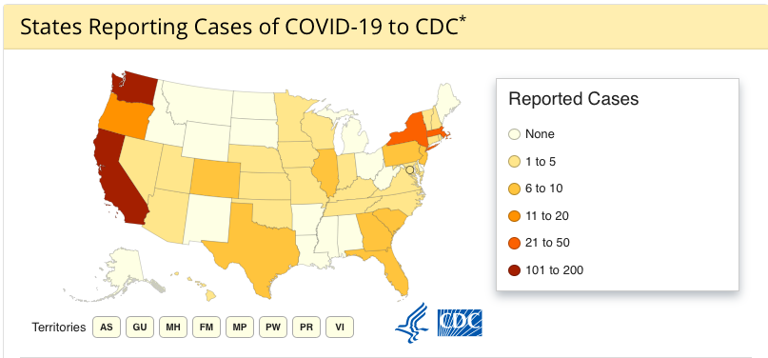

Slide 6
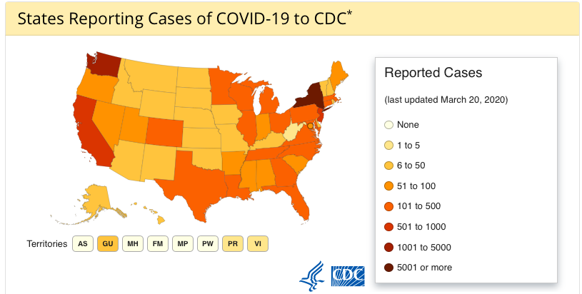

Slide 7
Summary in the USA
10 442 cases in 50 States & Washington, DC Puerto Rico, Guam, and the US Virgin Island
150 deaths
travel related cases
cases of person-to-person spread
under investigation

Slide 8
COVID19
CORONAVIRUS
Illness Severity
Symptom
Reported illnesses have ranged from mild to severe, including illness resulting in death.
Fever
Cough
Shortness of Breath

Slide 9
Risk Status
People in places where ongoing community spread of the virus that causes COVID-19 has been reported are at elevated risk of exposure, with increase in risk dependent on the location.
Healthcare workers caring for patients with COVID-19 are at elevated risk of exposure.
Community Spread
1
2
Healthcare Workers
3
4
Close contacts
Travelers
Close contacts of persons with COVID-19 also are at elevated risk of exposure.
Travelers returning from affected international locations where community spread is occurring also are at elevated risk of exposure.

Slide 10
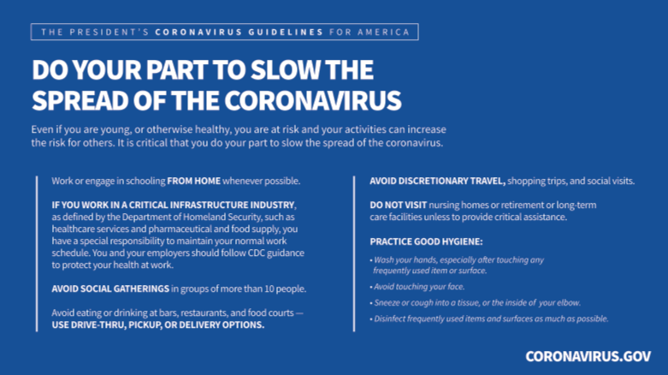

Slide 11
Actions in place
Community-based testing sites are being established in many cities, screening and quarantine, vaccine and treatment development, providing updated guidance, operationalizing pandemic preparedness plans, and interagency situational awareness.

Slide 12
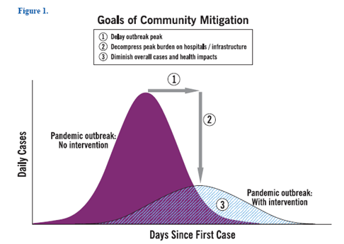
Impact of Community Mitigation

Slide 13
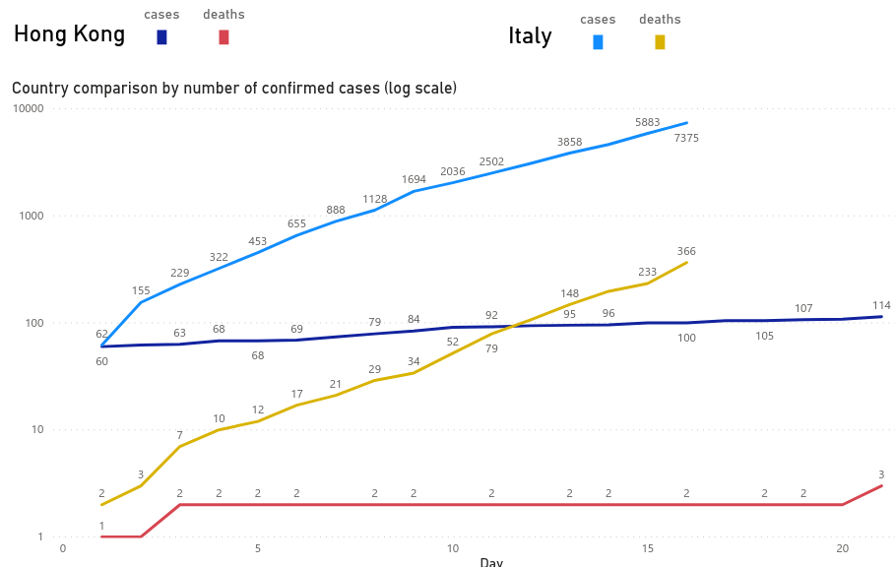

Slide 14
$8.3Bn Emergency Funding for Coronavirus
Advocacy by NACCHO and Public Health Partners
$950 million for localities and states to carry out surveillance, epidemiology, laboratory capacity, infection control, mitigation, communications, and other preparedness and response activities.
  Half of the total amount is required to be sent out within 30 days. The bill also reimburses costs incurred since January 2020.
$826 million for the National Institute of Allergy and Infectious Diseases to help develop vaccines, cures and tests.
$300 million to help buy vaccines and treatments once they're approved.
$136 million to reimburse dollars from Health and Human Services (HHS) programs that were temporarily transferred to support emergency preparedness and response activities at the Centers for Disease Control and Prevention (CDC) and the Office of the Assistant Secretary for Preparedness and Response (ASPR).
Notes:
nCoV gives an opportunity to explain important role of LHDs in preparedness, as well as what goes into planning an effective and professional response.
Perspective: The emergency funding request is much smaller than the Obama administration's $6.2 billion request in 2014 to fight the Ebola outbreak.
Trump's emergency funding request also falls far short from what some public health experts — and former administration appointees — had deemed necessary to fight coronavirus. Chris Meekins, a Raymond James analyst and former Trump administration HHS official, had called for $15 billion in emergency spending, arguing that $3 billion was needed for vaccine development alone.

Slide 15
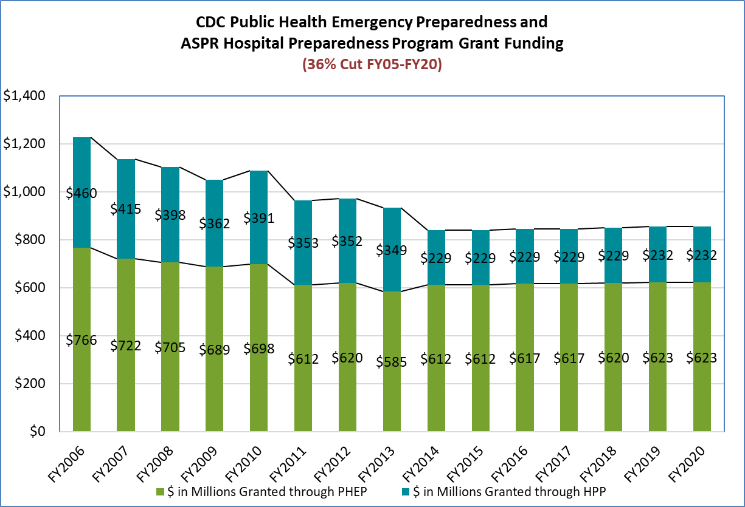

Slide 16
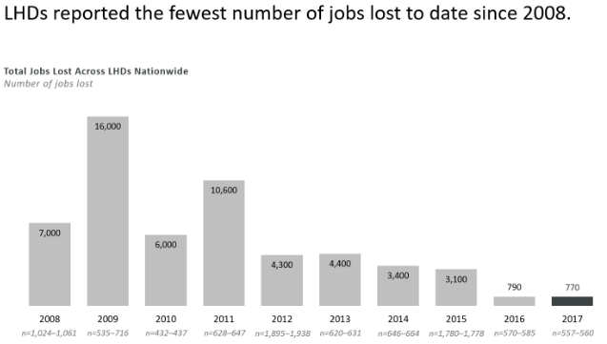

Local and state health departments have lost nearly a quarter (23%) of their workforce since 2008, shedding over 50,000 jobs across the country.
55% of local public health professionals are over age 45, and almost a quarter of health department staff are eligible for retirement.
Between those who plan to retire or pursue jobs in the private sector, projections suggest that nearly half of the local and state health department workforce might leave in coming years.

Slide 17
Laboratory
89 public-health labs are now running the CDC assay (50 states plus Washington DC).
As of March 17, CDC has tested over 4,691 samples that equate to over 1,554 patients
Public Health Labs (PHL) tested over 27,623 samples.
Data reported to CDC from selected large commercial labs:
  95,524 samples
  Cumulative number # with results: 20,917; positive:1609

Slide 18
Media Analysis
Conversation about hospital staff lacking personal protective equipment throughout the U.S. has spiked in volume as more are posting pictures of the gear they’re reusing and reports of shortages in hospitals where they or loved ones work.
There is equally large worry over shortages of ventilators.

Slide 19
Public Sentiment Analysis
Open media reports are critical of federal response:
  Misallocation of limited resources
  Not effectively ramping up mitigation efforts during containment
  Federal messaging diminishing sense of urgency
  Federal gov’t struggling to gather and disseminate info
  Likely missing million weekly test capacity goal

Slide 20

Travel Restrictions

Slide 21
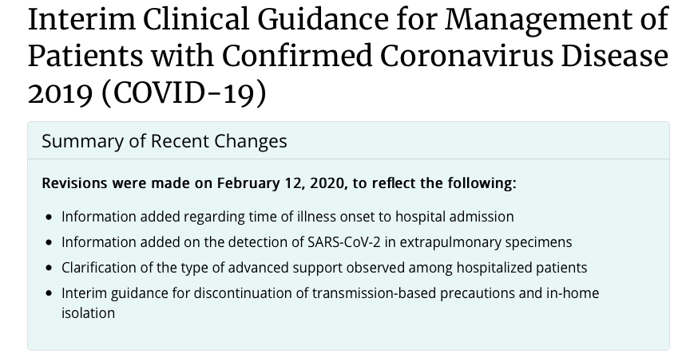
Clinical Guidance

Slide 22
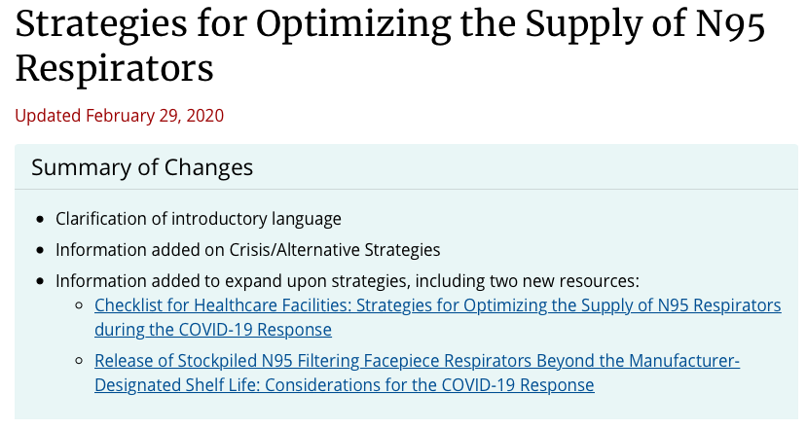

Slide 23
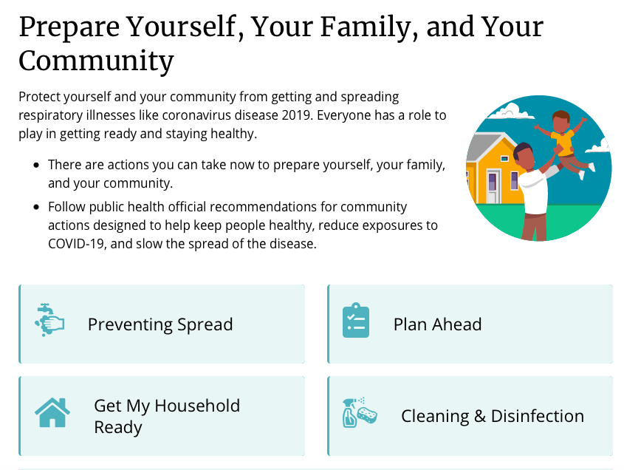

Slide 24
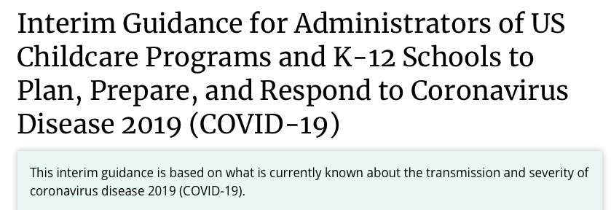
School Guidance

Slide 25
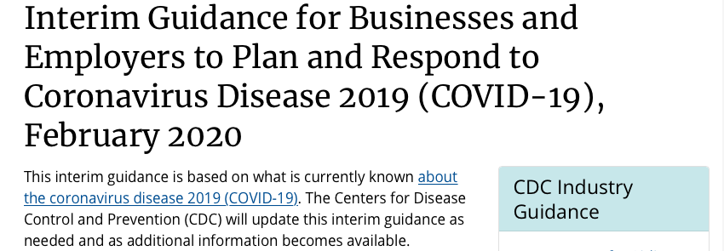
Business Guidance

Slide 26
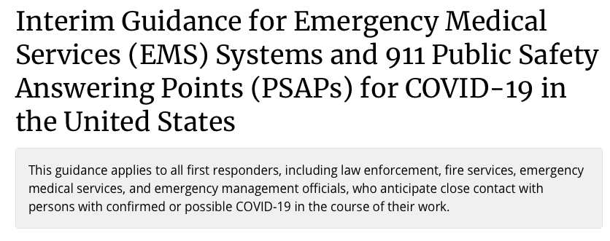
EMS Guidance

Slide 27
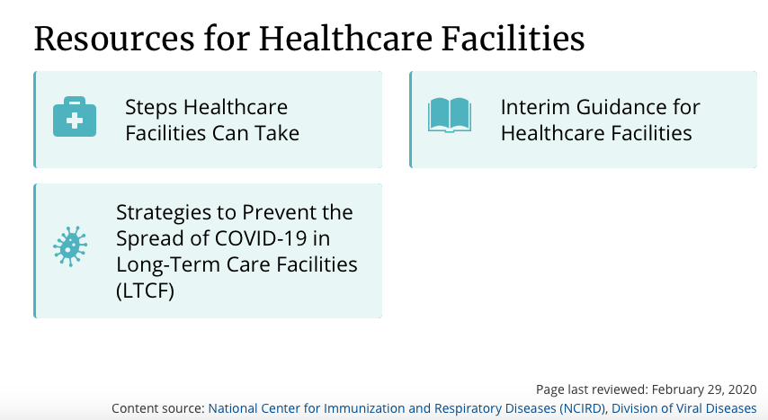

Slide 28
Thank you
oalleyne@naccho.org

Slide 29
Questions?
Please use the “raise Hand” icon to join the queue. When your line is opened, please introduce yourself and state your question
Content

Slide 30


